Slide 1
Ways of the World:
A Brief Global History
First Edition
Robert W. Strayer
CHAPTER XXI
The Collapse and Recovery of Europe
1914–1970s
Versailles, The Great Depression
and The Rise of Dictators

Slide 2
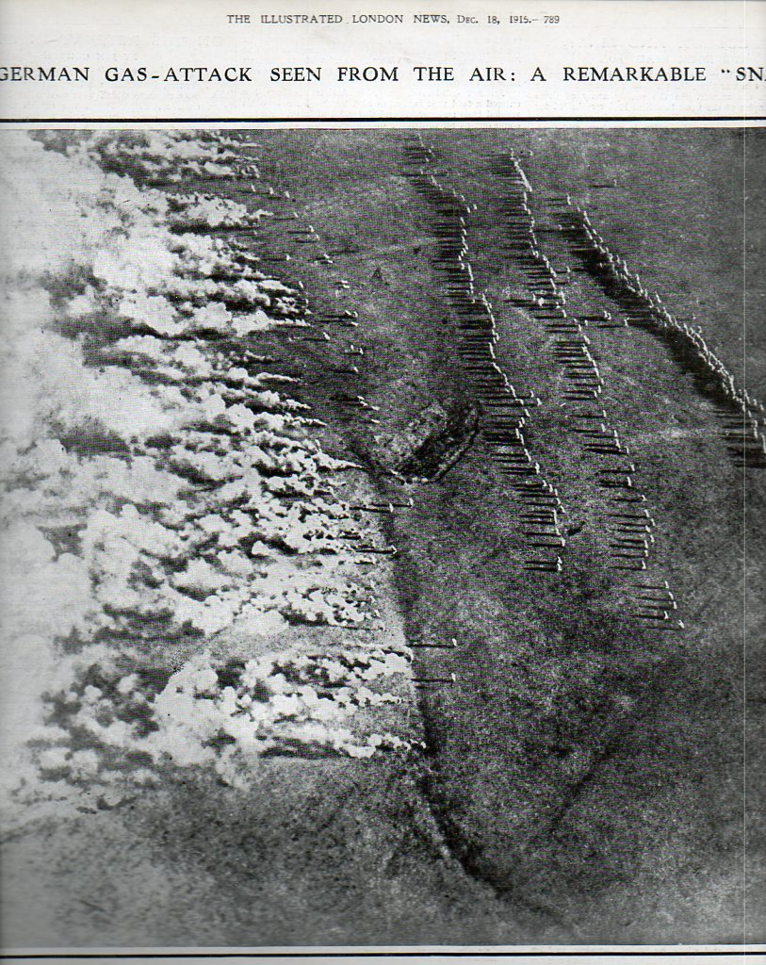
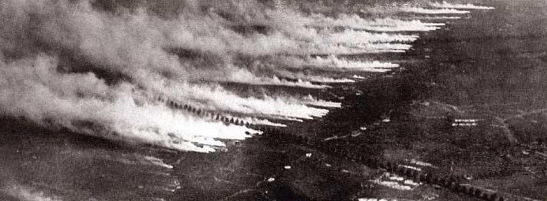
Legacies of the Great War

Slide 3
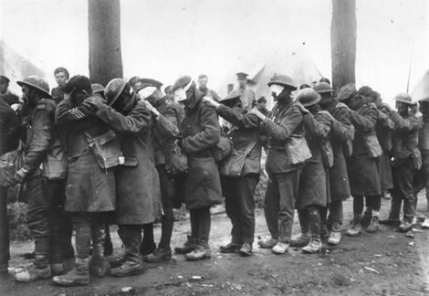
Legacies of the Great War

Slide 4
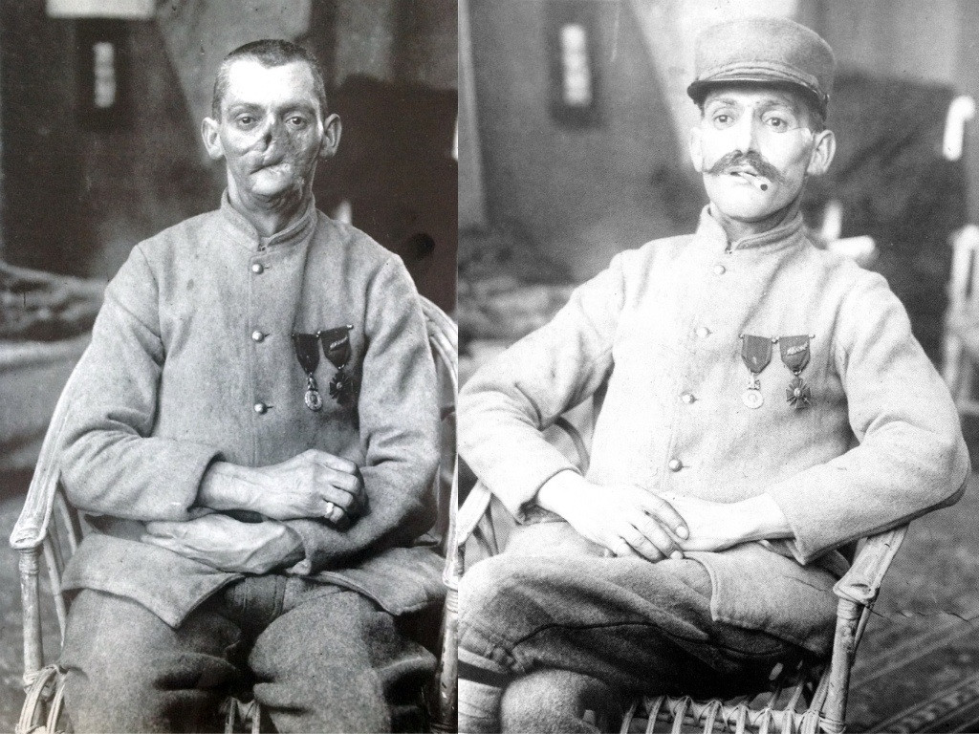
Legacies of the Great War

Slide 5
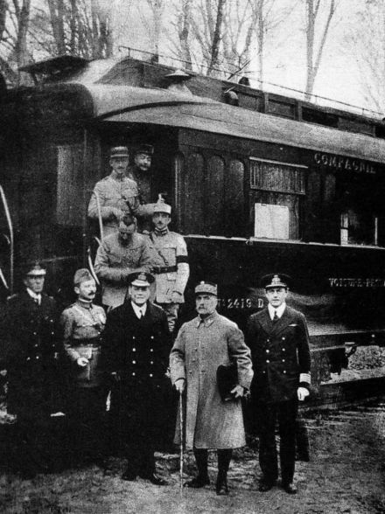
Legacies of the Great War

Slide 6
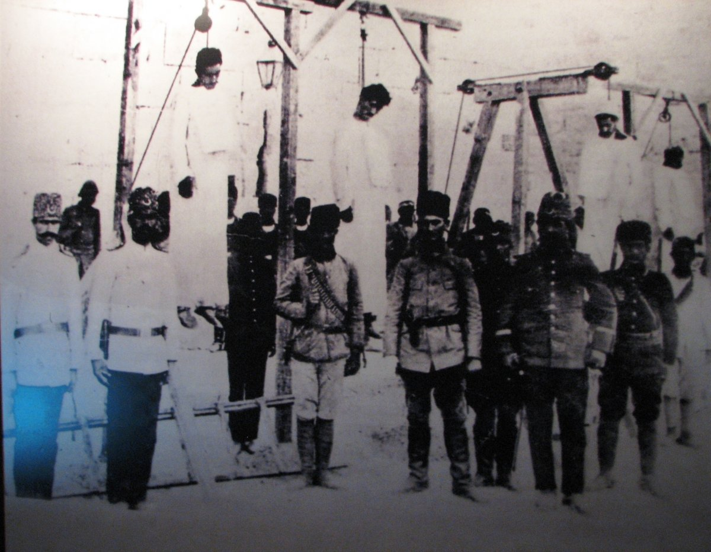
Legacies of the Great War
1. Dissolution of the Ottoman Empire
a. The Armenian genocide
Notes:
1. Dissolution of the Ottoman Empire
a. The Armenian genocide
2. Creation of new Arab states
3. British promises to both Arabs and Jews created a new problem in Palestine
4. Britain promised to start the process of creating self-government in India

Slide 7
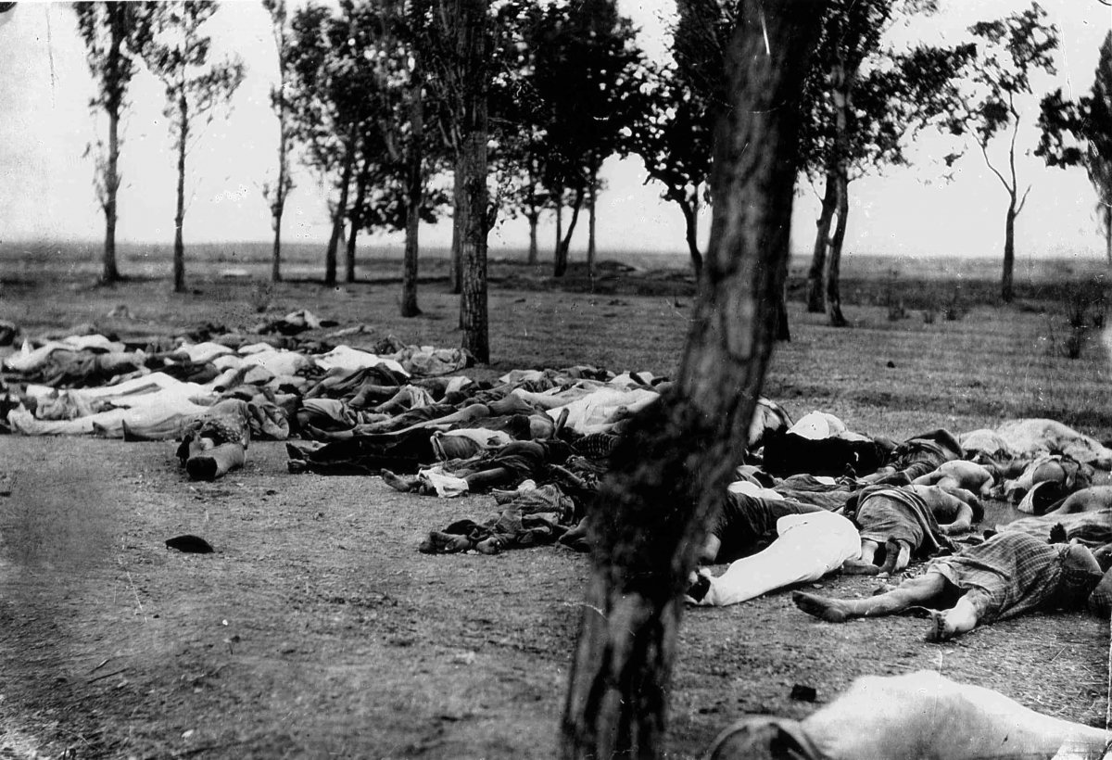
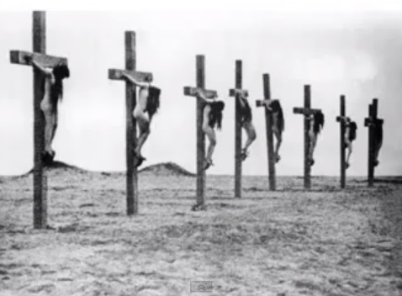
Legacies of the Great War

Slide 8
Legacies of the Great War
1. Rearrangement of the map of Central Europe
a. Creation of independent Poland Czechoslovakia,
Yugoslavia
b. Created new problems of ethnic minorities
c. Triggered the Russian Bolshevik revolution (1917)
Notes:
1. Rearrangement of the map of Central Europe
a. Creation of independent Poland Czechoslovakia, Yugoslavia
b. Created new problems of ethnic minorities
c. Triggered the Russian Bolshevik revolution (1917)

Slide 9
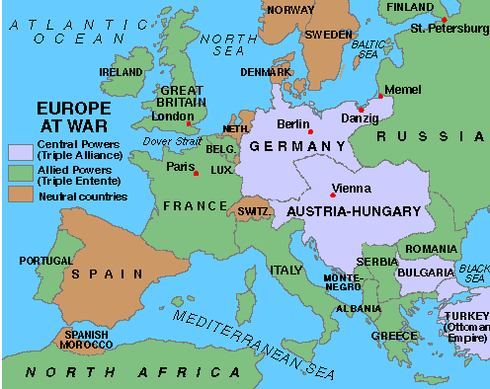
Pre-WWI

Slide 10
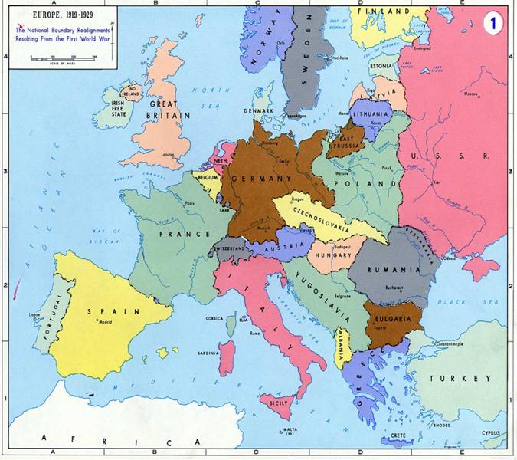
Post-WWI

Slide 11
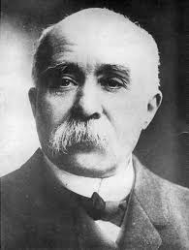
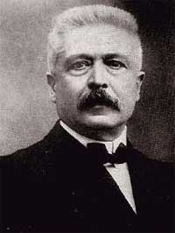
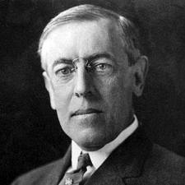
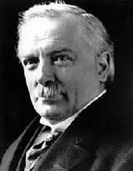
Paris Peace Conference
(The Big Four)
Georges Clemenceau
(France)
Woodrow Wilson
(United States)
Vittorio Orlando
(Italy)
David Lloyd George
(Great Britain)

Slide 12
The Treaty of Versailles
          ARTICLE 231
          ‘WAR GUILT CLAUSE’
Held Germany completely responsible for the war and thus responsible for its damages.

Slide 13
The Treaty of Versailles
2. The Treaty of Versailles (1919) made the conditions that
caused World War II
a. Germany had to accept sole responsibility for the
outbreak of the war
b. Germany lost its colonial empire and 15% of its
European territory
c. Germany was required to pay heavy reparations
Notes:
2. the Treaty of Versailles (1919) made the conditions that caused World War II
a. Germany lost its colonial empire and 15 percent of its European territory
b. Germany was required to pay heavy reparations
c. Germany suffered restriction of its military forces
d. Germany had to accept sole responsibility for the outbreak of the war
e. Germans resented the treaty immensely

Slide 14
Legacies of the Great War
d. Germany suffered restriction of its military forces
e. Germans resented the treaty immensely
Notes:
2. the Treaty of Versailles (1919) made the conditions that caused World War II
a. Germany lost its colonial empire and 15 percent of its European territory
b. Germany was required to pay heavy reparations
c. Germany suffered restriction of its military forces
d. Germany had to accept sole responsibility for the outbreak of the war
e. Germans resented the treaty immensely

Slide 15
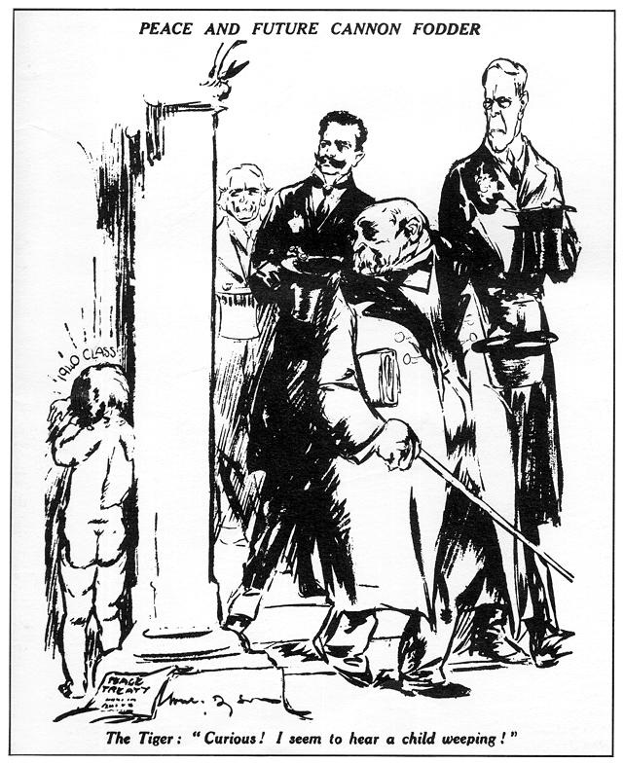
Legacies of the Great War

Slide 16
Today in the Hall of Mirrors of Versailles the disgraceful Treaty is being signed.
Do not forget it. The German people will press forward to reconquer the place among nations to which we deserve. Then will come revenge for the shame of 1919.
From a German Newspaper on the day the treaty was signed.

Slide 17
The Treaty of Versailles
Terms of the Treaty were to be enforced by the League of Nations.
The Weimar Republic was associated with the humiliation of the Treaty of Versailles
The Germans believed that the German Revolution of 1918-1919 was orchestrated by the “November Criminals” who later assumed office in the new Weimer Republic.
French security was a real concern
  Population 60 Million to Germany’s 80 Million
  Germans/Prussians have invaded France 1813, 1815, 1870 and 1914.
Notes:
Made last Reparations payment October 3, 2010.

Slide 18
HYPERINFLATION
The German Mark v. the U.S. Dollar
1914: $1 = 4 Marks
1921: $1 = 75 Marks
02/1923: $1 = 48,000 Marks
10/1923: $1 = 440,000,000 Marks (440 million)
11/1923: $1 = 4,200,000,000,000 Marks (4.2 trillion)

Slide 19
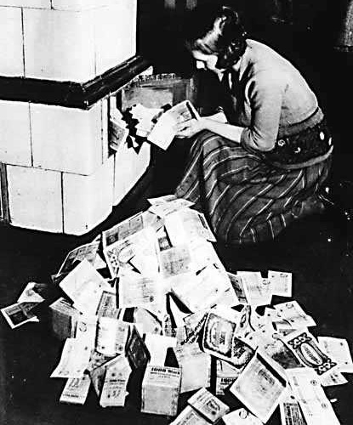
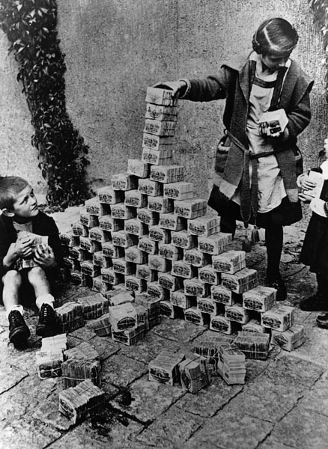
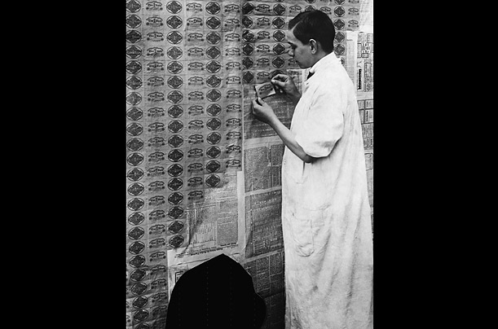

Slide 20
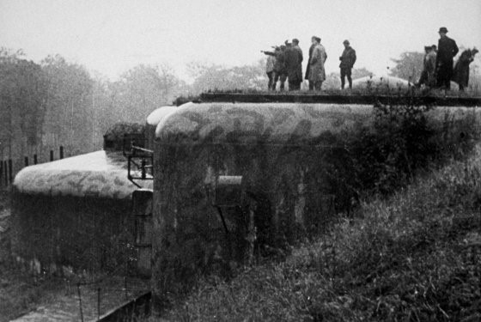
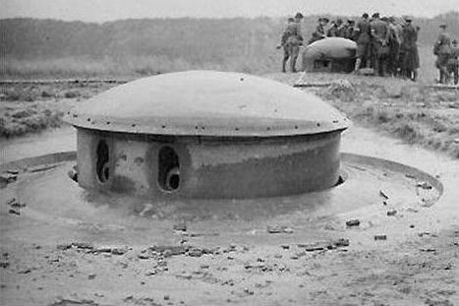

Slide 21
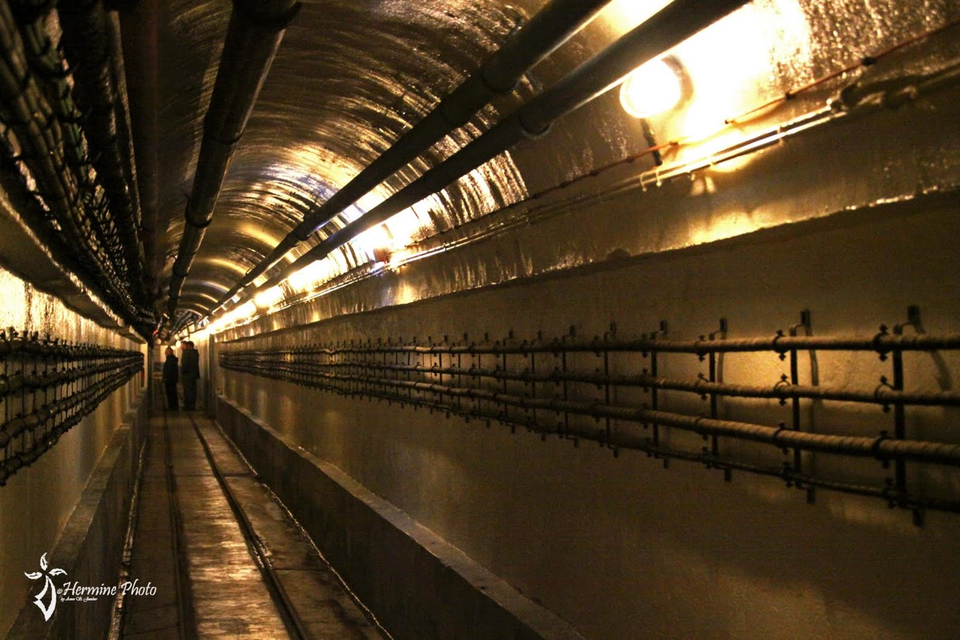
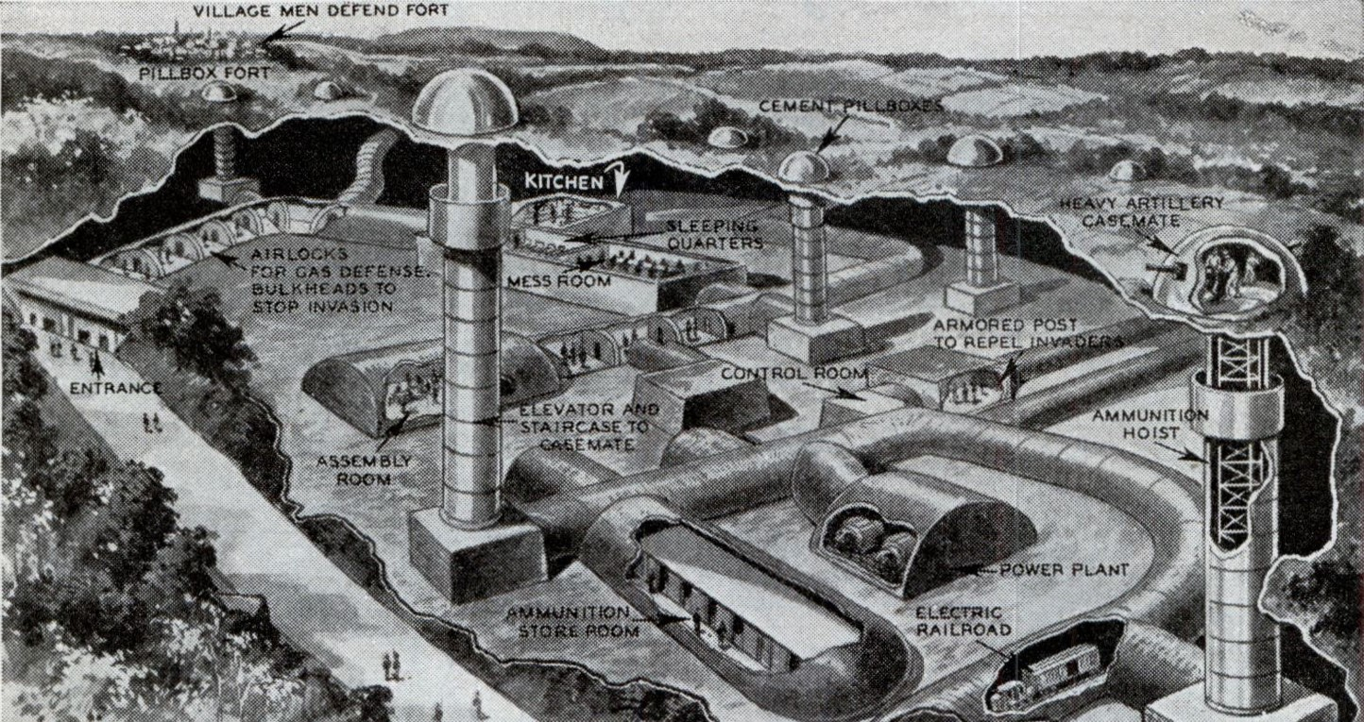

Slide 22
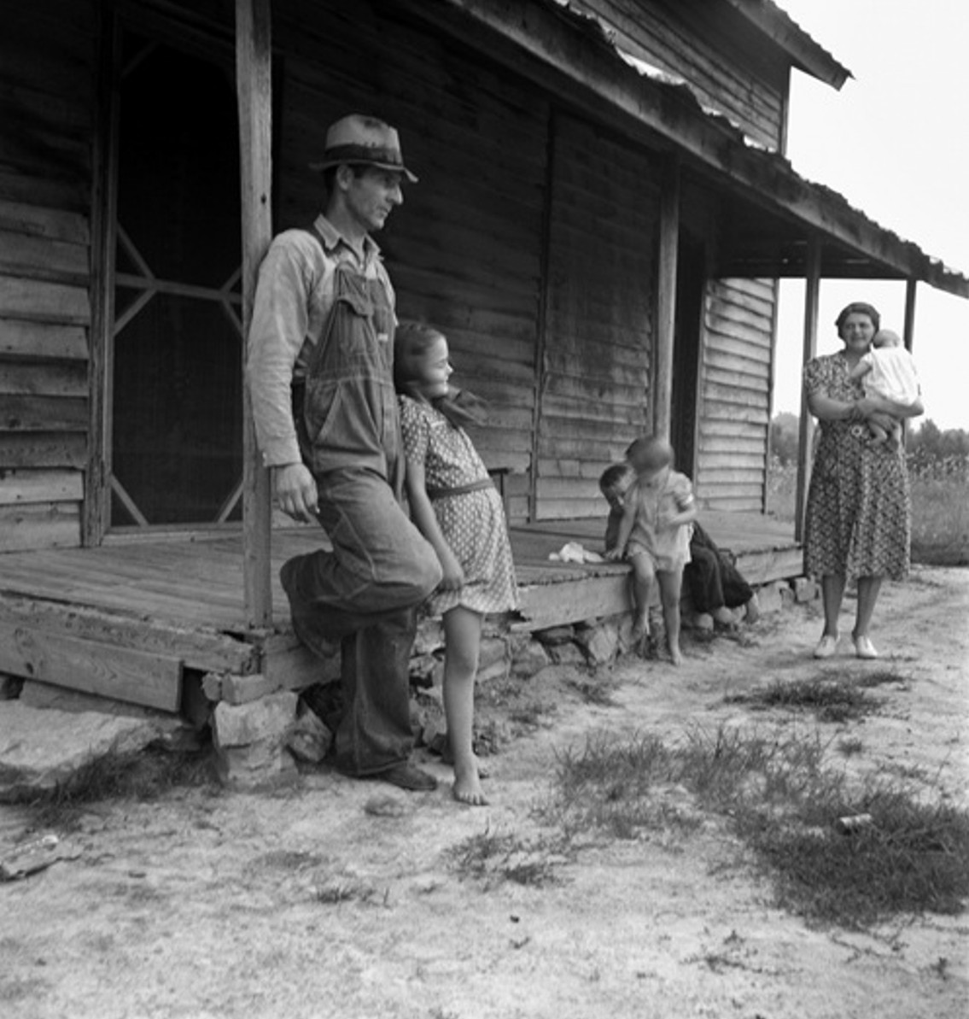
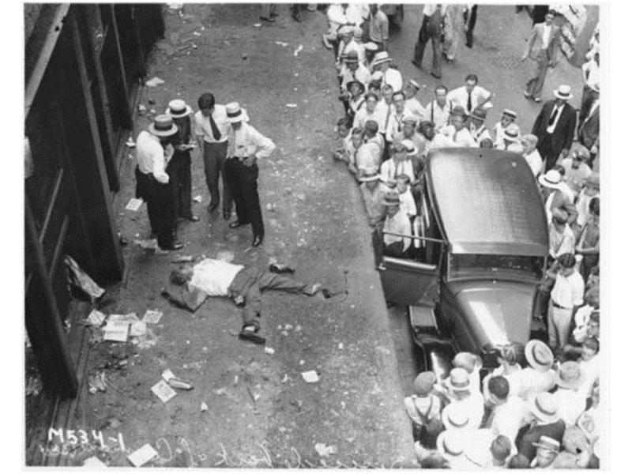

Slide 23
