Slide 1
Ways of the World: A Brief Global History First Edition
Robert W. Strayer
CHAPTER XV
Global Commerce
1450–1750
European and Asian Commerce

Slide 2
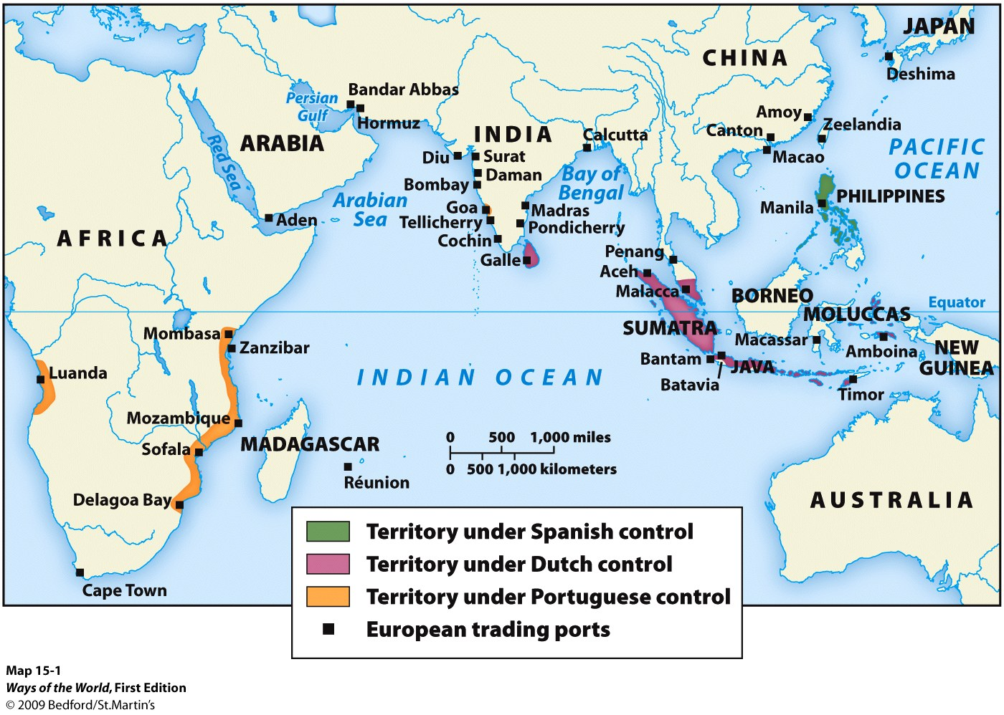

Slide 3
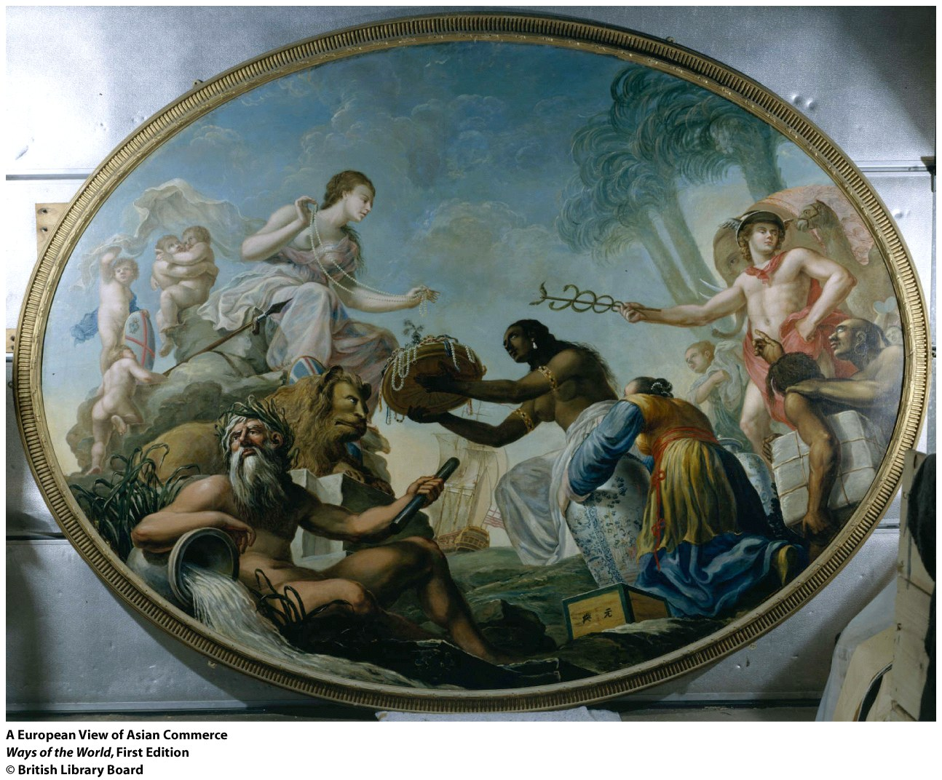

Slide 4
Europeans and Asian Commerce
A. Europeans wanted commercial connections with Asia
1. Columbus and Vasco da Gama both sought a route to Asia
2. Motivation above all was the desire for spices (though
other Eastern products were also sought)
3. European civilization had recovered from the Black Death

Slide 5
Europeans and Asian Commerce
4. National monarchies were learning to govern more
effectively
5. Some cities were becoming international trade
centers
6. The problems of old trade systems from the Indian
Ocean network
Notes:
6. The problems of old trade systems from the Indian Ocean network
a. Muslims controlled supply
b. Venice was chief intermediary for trade with Alexandria; other states resented it
c. desire to find Prester John and enlist his support in the Crusades
d. constant trade deficit with Asia

Slide 6
A Portuguese Empire of Commerce
1. Indian Ocean commerce was highly rich and diverse
2. Portuguese did not have goods of a quality for
effective competition
3. Portuguese took to piracy on the sea lanes
Notes:
3. Portuguese took to piracy on the sea lanes
a. Portuguese ships were more maneuverable, carried cannons
b. established fortified bases at key locations ( Mombasa , Hormuz, Goa, Malacca, Macao )

Slide 7
A Portuguese Empire of Commerce
4. Portuguese created a “trading post empire”
5. Portuguese gradually assimilated to Indian
Ocean trade patterns
Notes:
4. Portuguese created a “trading post empire”
a. goal was to control commerce, not territories or populations
b. operated by force of arms, not economic competition
c. at height, controlled about half of the spice trade to Europe
5. Portuguese gradually assimilated to Indian Ocean trade patterns
a. carried Asian goods to Asian ports
b. many Portuguese settled in Asian or African ports
c. their trading post empire was in steep decline by 1600

Slide 8
Spain and the Philippines
1. Spain was the first to challenge Portugal ’s control of
Asian trade
2. Establishment of a Spanish base in the Philippines
3. Major missionary campaign made Filipino society the
only major Christian outpost in Asia
Notes:
2. establishment of a Spanish base in the Philippines
a. first encountered when Ferdinand Magellan circumnavigated the globe (1519–1521)
b. Philippines were organized in small, competitive chiefdoms
c. Spaniards established full colonial rule there (takeover occurred 1565–1650)
d. the Philippines remained a Spanish colonial territory until 1898, when the United States assumed control

Slide 9
Spain and the Philippines
4. Spaniards introduced forced relocation, tribute, taxes,
unpaid labor
5. Manila became a major center with a diverse population
6. Periodic revolts by the Chinese population; Spaniards
expelled or massacred them several times
Notes:
4. Spaniards introduced forced relocation, tribute, taxes, unpaid labor
a. large estates for Spanish settlers, religious orders, and Filipino elite
b. women’s ritual and healing roles were attacked

Slide 10
The East India Companies
1. Dutch and English both entered Indian Ocean commerce
in the early seventeenth century
2. ca. 1600: both the Dutch and the English organized
private trading companies to handle Indian Ocean
trade
3. Established their own trading post empires
Notes:
1. Dutch and English both entered Indian Ocean commerce in the early seventeenth century
a. soon displaced the Portuguese
b. competed with each other
2. ca. 1600: both the Dutch and the English organized private trading companies to handle Indian Ocean trade
a. merchants invested, shared the risks
b. Dutch and British East India companies were chartered by their respective governments
c. had power to make war and govern conquered peoples
3. established their own trading post empires
a. Dutch empire was focused on Indonesia
b. English empire was focused on India
c. French company was also established

Slide 11
The East India Companies
4. Dutch East India Company
5. British East India Company
6. Dutch and English also became involved in
“carrying trade” within Asia
7. both gradually evolved into typical colonial
domination
Notes:
4. Dutch East India Company
a. controlled both shipping and production of cloves, cinnamon, nutmeg, and mace
b. seized small spice-producing islands and forced people to sell only to the Dutch
c. destroyed the local economy of the Spice Islands ; made the Dutch rich
5. British East India Company
a. was not as well financed or as commercially sophisticated as the Dutch; couldn’t break into the Spice Islands
b. established three major trade settlements in India during the seventeenth century: Bombay , Calcutta , and Madras
c. British navy gained control of Arabian Sea and Persian Gulf
d. could not compete with the Mughal Empire on land
e. negotiated with local rulers for peaceful establishment of trade bases
f. Britons traded pepper and other spices, but cotton textiles became more important
6. Dutch and English also became involved in “carrying trade” within Asia
7. both gradually evolved into typical colonial domination

Slide 12
Dutch | British
Notes:
Handout

Slide 13
Asian Commerce
1. European presence was much less significant in Asia than in Americas or Africa
2. Europeans were no real military threat to Asia
3. The case of Japan
4. Asian merchants continued to operate, despite European
presence
Notes:
1. European presence was much less significant in Asia than in Americas or Africa
2. Europeans were no real military threat to Asia
3. the case of Japan
a. Portuguese reached Japan in the mid-sixteenth century
b. Japan at the time was divided by constant conflict among feudal lords (daimyo) supported by samurai
c. at first, Europeans were welcome
d. but Japan unified politically under the Tokugawa shogun in the early seventeenth century
i. increasingly regarded Europeans as a threat to unity
ii. expulsion of missionaries, massive persecution of Christians
iii. Japanese were barred from travel abroad
iv. Europeans were banned, except the Dutch at a single site
e. Japan was closed off from Europe from 1650 to 1850
4. Asian merchants continued to operate, despite European presence
a. overland trade within Asia remained in Asian hands
b. tens of thousands of Indian merchants lived throughout Central Asia, Persia , and Russia

Slide 14
Silver and Global Commerce
Silver was the first commodity to be exchanged on a global scale sustaining a direct link between the Americas and Asia, and it initiated a web of Pacific commerce that grew steadily over the centuries.

Slide 15
Silver and Global Commerce
A. The silver trade was even more important than the spice trade in creating a global exchange network.
1.
2.
B. China’s economy was huge and had a growing demand for silver.
1.
a.
b.
Notes:
A. The silver trade was even more important than the spice trade in creating a global exchange network.
1. enormous silver deposits were discovered in Bolivia and Japan in the mid-sixteenth century
2. in the early modern period, Spanish America produced around 85 percent of the world’s silver
B. China’s economy was huge and had a growing demand for silver.
1. 1570s: the Chinese government consolidated taxes into a single tax to be paid in silver
a. value of silver skyrocketed
b. foreigners with silver could purchase more Chinese products than before

Slide 16
Silver and Global Commerce
C. Silver was central to world trade.
1.
2.
3.
4.
5.
a.
b.
Notes:
C. Silver was central to world trade.
1. “silver drain” to Asia: bulk of the world’s silver supply ended up in China (most of the rest reached other parts of Asia )
2. Spanish silver brought to Europe was used to buy Asian goods
3. silver bought African slaves and Asian spices
4. the Spanish “piece of eight” was widely used for international exchange
5. Potosí , Bolivia , became the largest city in the Americas (population: 160,000) because it was at the world’s largest silver mine
a. the city’s wealthy European elite lived in luxury
b. Native American miners lived in horrid conditions

Slide 17
Silver and Global Commerce
D. Silver vastly enriched the Spanish monarchy.
1.
a.
b.
2.
E. The Japanese government profited more from silver production than
did Spain.
1.
2.
3.
4.
Notes:
D. Silver vastly enriched the Spanish monarchy.
1. caused inflation, not real economic growth in Spain
a. Spanish economy was too rigid
b. Spanish aristocrats were against economic enterprise
2. Spain lost its dominance when the value of silver fell ca. 1600
E. The Japanese government profited more from silver production than did Spain .
1. Tokugawa shoguns used silver revenues to defeat rivals and unify the country
2. worked with the merchant class to develop a market-based economy
3. heavy investment in agriculture and industry
4. averted ecological crisis, limited population growth

Slide 18
Silver and Global Commerce
F. In China , silver further commercialized the country’s economy.
1.
2.
3.
G. Europeans were essentially middlemen in world trade.
1.
2.
Notes:
F. In China , silver further commercialized the country’s economy.
1. people needed to sell something to obtain silver to pay their taxes
2. economy became more regionally specialized
3. deforestation was a growing problem; wasn’t addressed as it was in Japan
G. Europeans were essentially middlemen in world trade.
1. funneled American silver to Asia
2. Asian commodities took market share from European products

Slide 19
Japan | China
Notes:
Handout

Slide 20
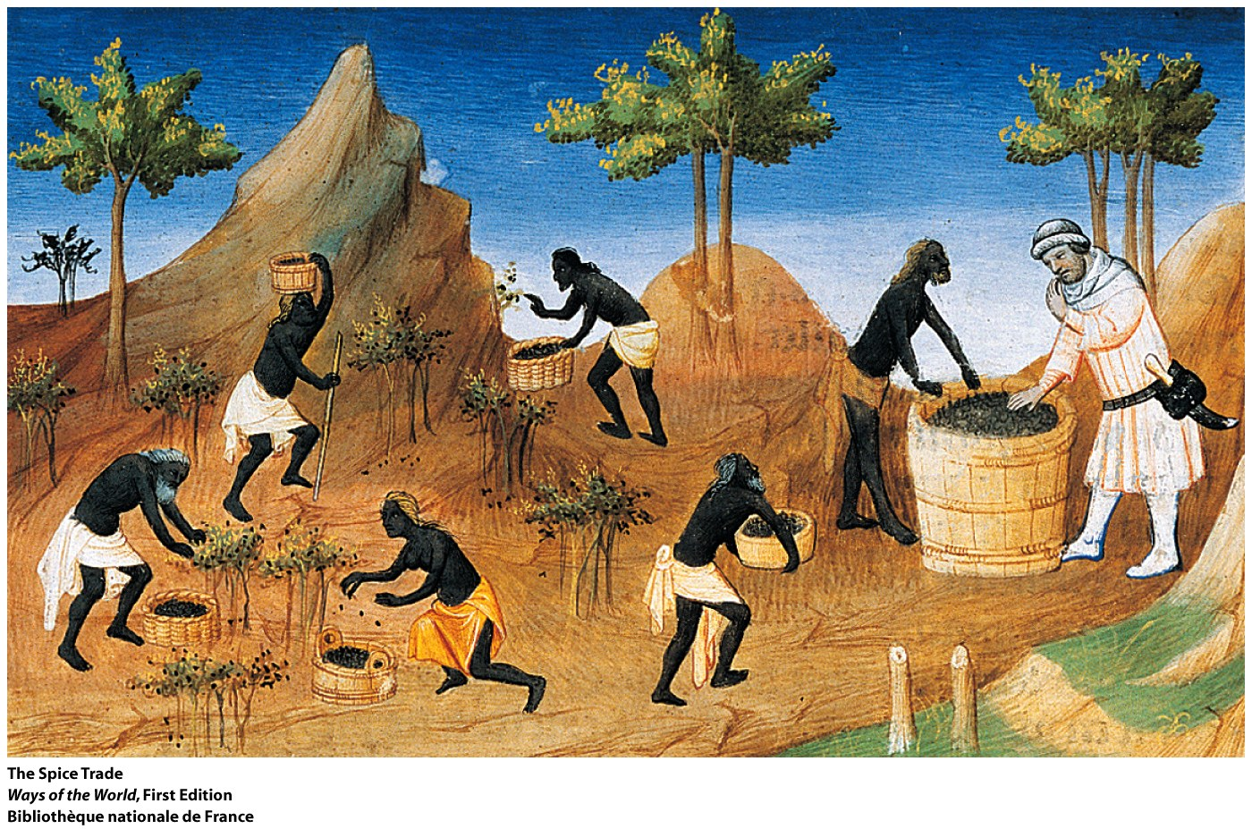

Slide 21
The arrival of Western European ships in the Indian Ocean during the early modern era resulted in
Connection
The emergence of European powers as important carriers of goods along the Indian Ocean trading network.
b. Greater availability in India and China of highly sought-after European manufactured goods.
c. The collapse of trade in the region.
d. Rapid political conquest of the region by European powers.

Slide 22
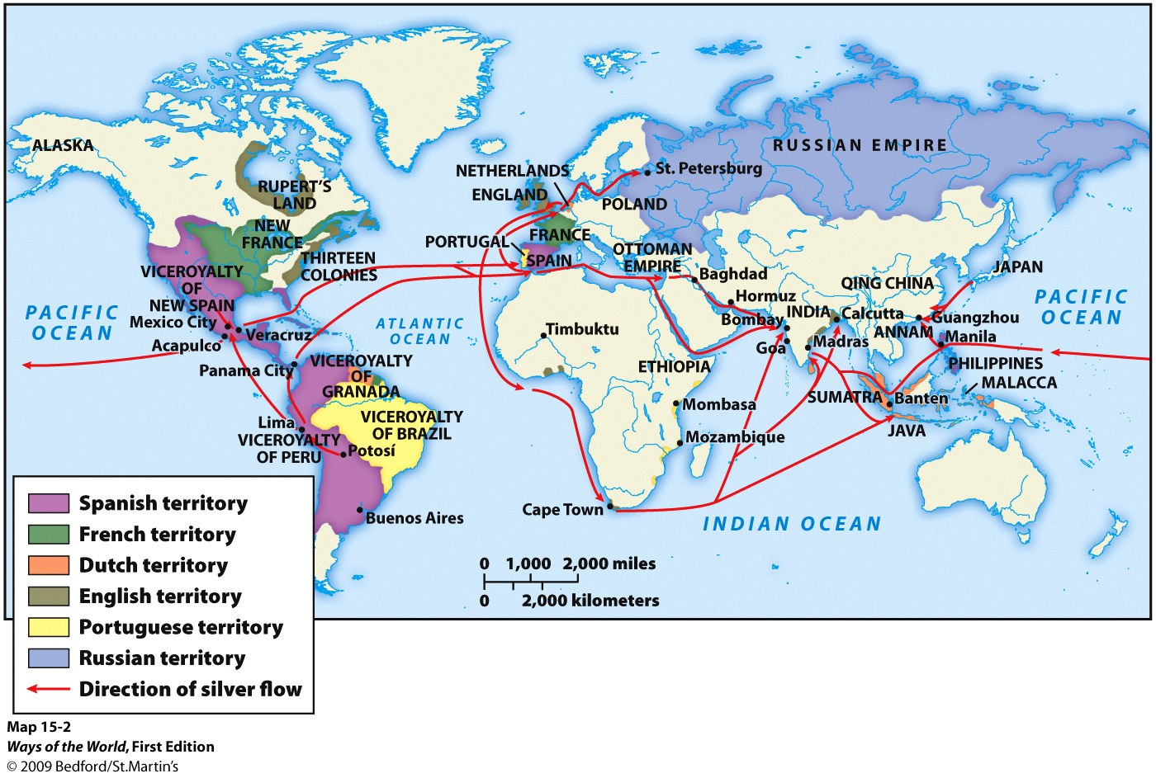

Slide 23
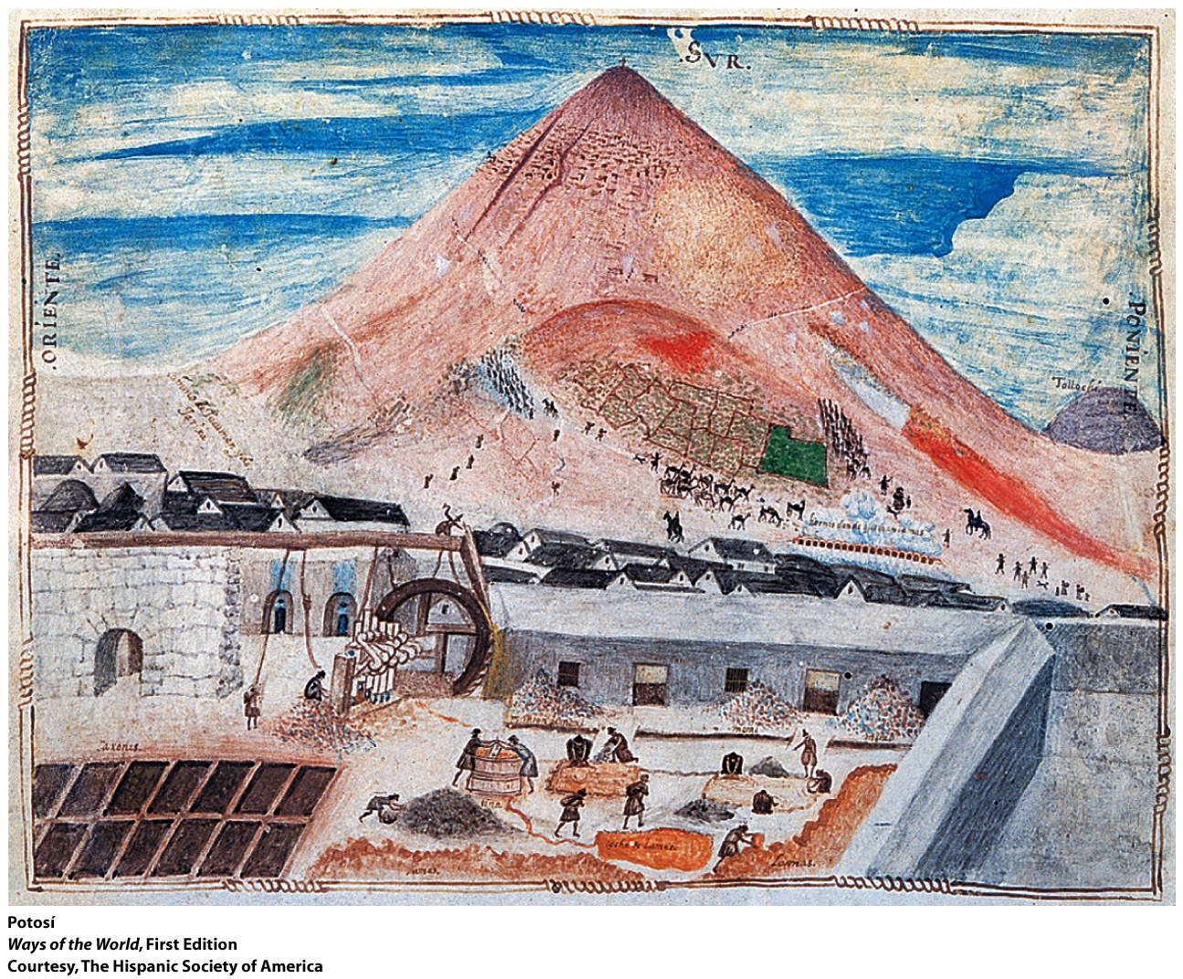

Slide 25
The mining of large amounts of silver in Spanish colonies in the Americas resulted in all EXCEPT which of the following?
Change
a. Growing political power for the Spanish king
b. Further commercialization of the Chinese economy
c. A vibrant low-inflation economy in Spain
d. Growth of trade from the across the Pacific Ocean

Slide 26
Dutch | British
▪The Dutch acted to control—not only the shipping but also the production of cloves, cinnamon, nutmeg, and mace. With much bloodshed, the Dutch seized control of a number of small spice-producing islands, forcing their people to sell only to the Dutch. ▪ On the Banda Islands—the Dutch killed, enslaved, or left to starve virtually the entire population and then replaced them with Dutch planters, using a slave labor force to produce the nutmeg crop. ▪ Ultimately, the local economy of the Spice Islands was shattered by Dutch policies, and the people there were impoverished. | ▪ They established—three major trading settlements in India during the 17th century: Bombay, Calcutta, and Madras. They secured their trading bases with the permission of Mughal authorities or local rulers. ▪ British traders focused on—Indian cotton textiles, and hundreds of villages in the interior of southern India became specialized producers for the British market.
Notes:
Handout-KEY

Slide 27
Japan | China
The shoguns allied with the merchant class to develop a market-based economy and to invest heavily in agricultural and industrial enterprises. Local and state authorities acted to protect and renew forests. Families practiced late marriages, contraception, abortion, and infanticide. The outcome was the dramatic slowing of Japan’s population growth, the easing of an impending ecological crisis, and a flourishing, highly commercialized economy. | In order to obtain silver needed to pay their taxes, more and more people had to sell something—either labor or their products. Areas that devoted themselves to growing mulberry trees, on which silkworms fed, had to buy their rice from other regions. The Chinese economy became more regionally specialized. In southern China, this surging economic growth resulted in the loss of about half the area’s forest cover as more and more land was devoted to cash crops.
Notes:
Handout-KEY

