Slide 1
Ways of the World: A Brief Global History First Edition
Robert W. Strayer
CHAPTER XV
Global Commerce
1450–1750
Commerce in People
The Atlantic Slave Trade

Slide 2
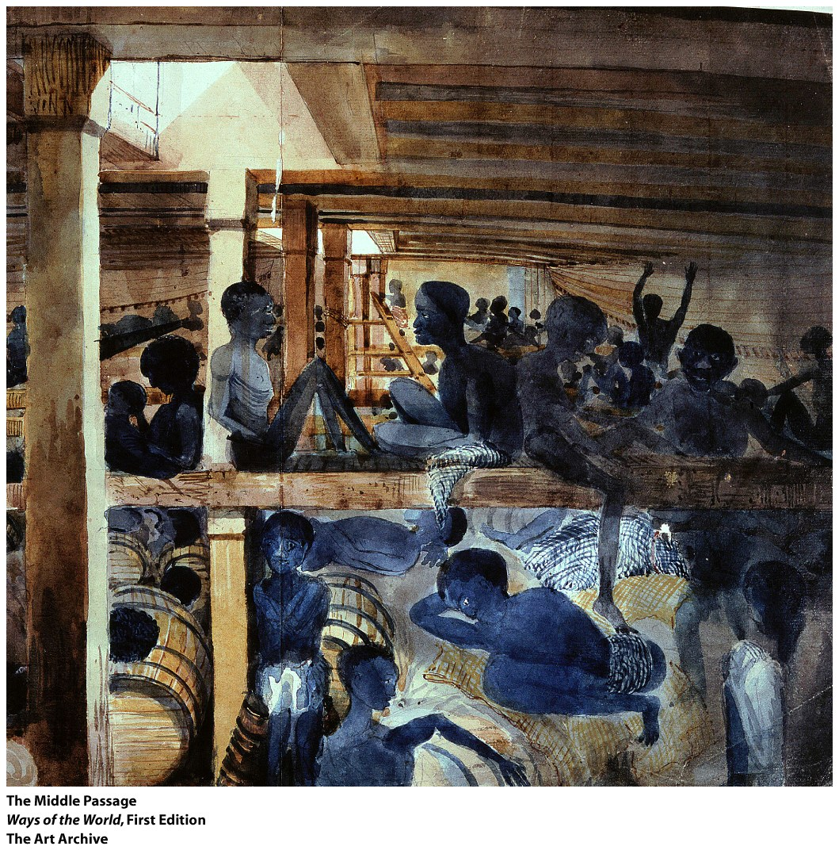
Commerce in People:
The Atlantic Slave Trade

Slide 3
A. Between 1500 and 1866, the Atlantic slave
trade took an estimated 12.5 million people
from Africa and deposited some 10.7 million of them in the Americas.
1.
2.
3.
Notes:
1. Around 1.8 million died during the transatlantic crossing
2. Millions more died in the process of capture and transport to the African coast
3. Vast human tragedy

Slide 4
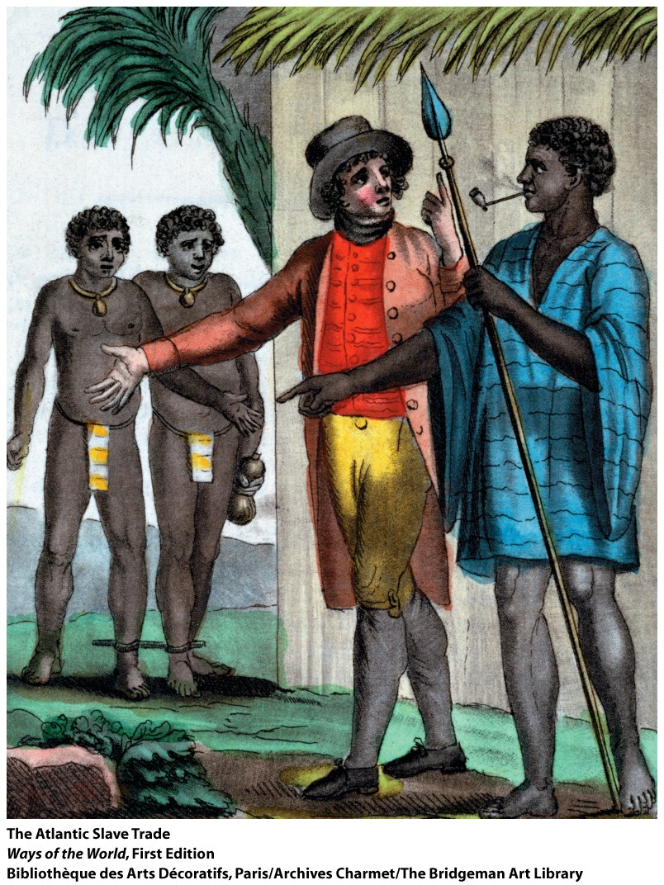
4. African slave trade transformed the
societies of all participants
a. The African diaspora
b.
c.
Notes:
a. The African diaspora
b. Slave trade and slavery enriched many
c. Slavery became a metaphor for many types of social oppression

Slide 5
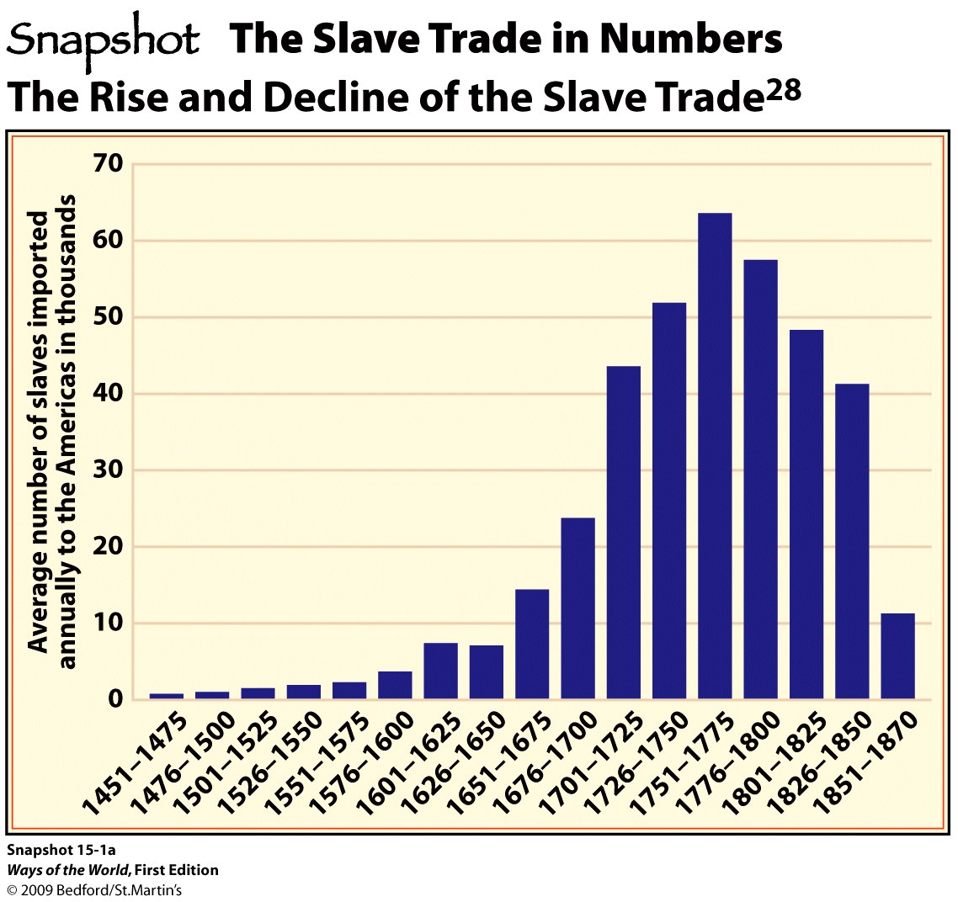

Slide 6
The Slave Trade in Context
1. Most human societies have had slaves
2. Africans had practiced slavery and sold slaves
for centuries
a.
b.
Notes:
2. Africans had practiced slavery and sold slaves for centuries
a. trans-Saharan trade took slaves to the Mediterranean world
b. East African slave trade

Slide 7
The Slave Trade in Context
3. Slavery took many forms, depending on the
region and time period
a.
b.
c.
d.
e.
Notes:
2. Africans had practiced slavery and sold slaves for centuries
a. trans-Saharan trade took slaves to the Mediterranean world
b. East African slave trade
3. slavery took many forms, depending on the region and time period
a. Slaves were often assimilated into their owners’ households
b. Children of slaves were sometimes free, sometimes slaves
c. Islamic world preferred female slaves; Atlantic slave trade favored males
d. Not all slaves had lowly positions (in Islamic world, many slaves had military or political status)
e. Most premodern slaves worked in households, farms, or shops

Slide 8
The Slave Trade in Context
4. Distinctiveness of slavery in the Americas
a.
b.
c.
Notes:
a. The scale and importance of the slave trade in the Americas was enormous
b. Largely based on plantation agriculture, with slaves denied any rights at all
c. Slave status was inherited

Slide 9
The Slave Trade in Context
d. Little hope of manumission
e.
f. Slavery was wholly identified with Africa and
with “blackness”
Notes:
d. The act of freeing or the state of being freed from slavery, servitude, etc
e. Widespread slavery in society that valued human freedom and equality—unlike anywhere else except maybe ancient Greece
f. Slavery was wholly identified with Africa and with “blackness”

Slide 10
The Slave Trade in Context
5. Origins of Atlantic slavery lay in the Mediterranean
and with sugar production
a. sugar production was the first “modern”
industry (major capital investment, technology,
disciplined workers, mass market)
b. The work was very difficult and dangerous—
slaves were ideal

Slide 11
The Slave Trade in Context
c. At first, Slavs from the Black Sea region
provided most slaves for Mediterranean sugar
plantations
d. Portuguese found an alternative slave source in
West Africa
Notes:
c. At first, Slavs from the Black Sea region provided most slaves for Mediterranean sugar plantations
d. Portuguese found an alternative slave source in West Africa

Slide 12
The Slave Trade in Context
6. Africans became the primary source of slave labor
for the Americas
a.
b.
Notes:
a. Slavs weren’t available
b. Indians died of European diseases

Slide 13
The Slave Trade in Context
c. Europeans were a bad alternative: Christians
from marginal lands couldn’t be enslaved; indentured servants were expensive
d. Africans were farmers, had some immunity to
diseases, were not Christian, and were readily available
e. Much debate over how much racism was involved

Slide 14
The Slave Trade in Practice
1. Slave trade was driven by European demand
2. Europeans didn’t raid Africa for slaves; they
traded freely with African merchants and elites
a.
b.
Notes:
a. From capture to sale on the coast, trade was in African hands
b. Africans received trade goods in return, often bought with American silver

Slide 15
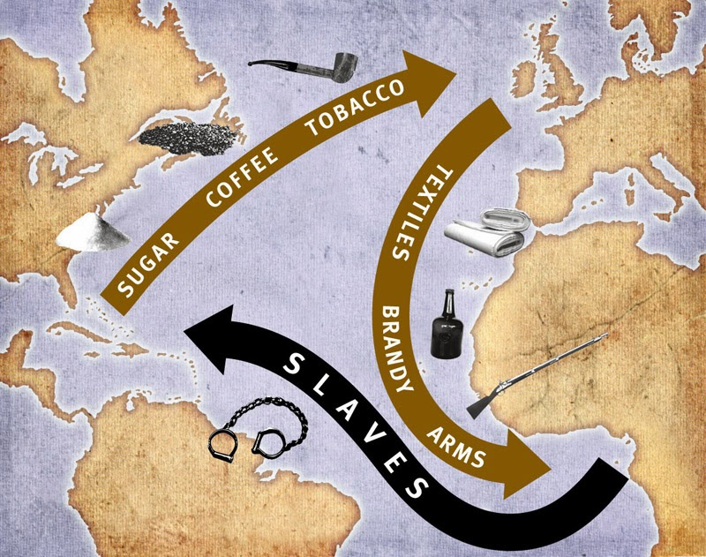

Slide 16
The Slave Trade in Practice
3. Destabilization of African societies
a.
b.
c. Some African slave traders were themselves enslaved by unscrupulous Europeans
Notes:
a. Many smaller societies were completely disrupted by slave raids from their neighbors
b. Even larger states were affected (e.g., kingdom of Kongo)

Slide 17
The Slave Trade in Practice
4. Increasing pace of Atlantic slave trade
a.
b.
Notes:
1700’ number of slaves shipped peaked
a. During the sixteenth century, annual slave exports from Africa averaged under 3,000 annually
b. In the seventeenth century, average of 10,000 slaves per year taken to the Americas

Slide 18
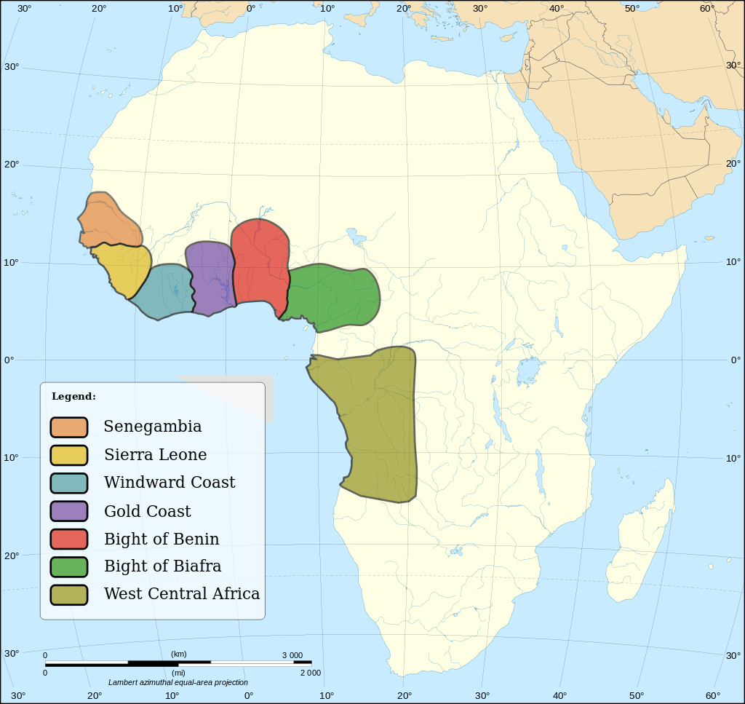
The Slave Trade in Practice
5. Who was enslaved?
a. People from West Africa
(present-day Mauritania to Angola)
b. Mostly people from marginal
groups (prisoners of war, debtors, criminals)
c. Africans generally did not
sell their own peoples

Slide 19
The Slave Trade in Practice
6. 80 percent of slaves ended up in Brazil and the
Caribbean
a. 5–6% in North America
b. The rest in mainland Spanish America or in
Europe

Slide 20
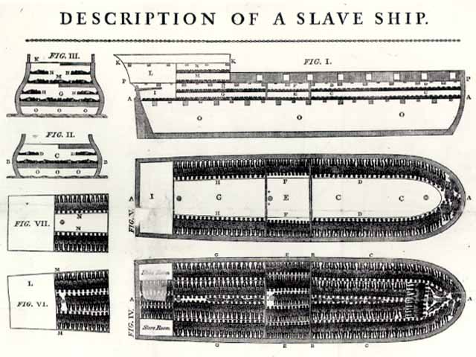
The Slave Trade in Practice
c. About 15% of enslaved died during the Middle Passage

Slide 21
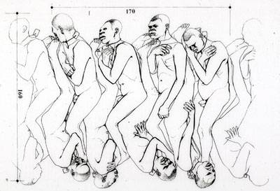
“Coffin” Position Below Deck

Slide 22
Comparing Consequences: The Impact of the Slave Trade in Africa
1. Created new transregional linkages
2. Slowed Africa’s growth, while Europe and China
expanded in population
a.
Notes:
1. Created new transregional linkages
2. Slowed Africa’s growth, while Europe and China expanded in population
a. sub-Saharan Africa had about 18 percent of the world’s population in 1600 but only 6 percent in 1900

Slide 23
Comparing Consequences: The Impact of the Slave Trade in Africa
b. Slave trade generated economic stagnation and
political disruption in Africa
i. Those who profited in the trade did not invest in production
ii. Did not generate breakthroughs in agriculture
or industry—since Europeans didn’t increase
demand for Africa ’s products, just for its people
Notes:
b. slave trade generated economic stagnation and political disruption in Africa
i. those who profited in the trade did not invest in production
ii. did not generate breakthroughs in agriculture or industry—
since Europeans didn’t increase demand for Africa ’s products, just for its people

Slide 24
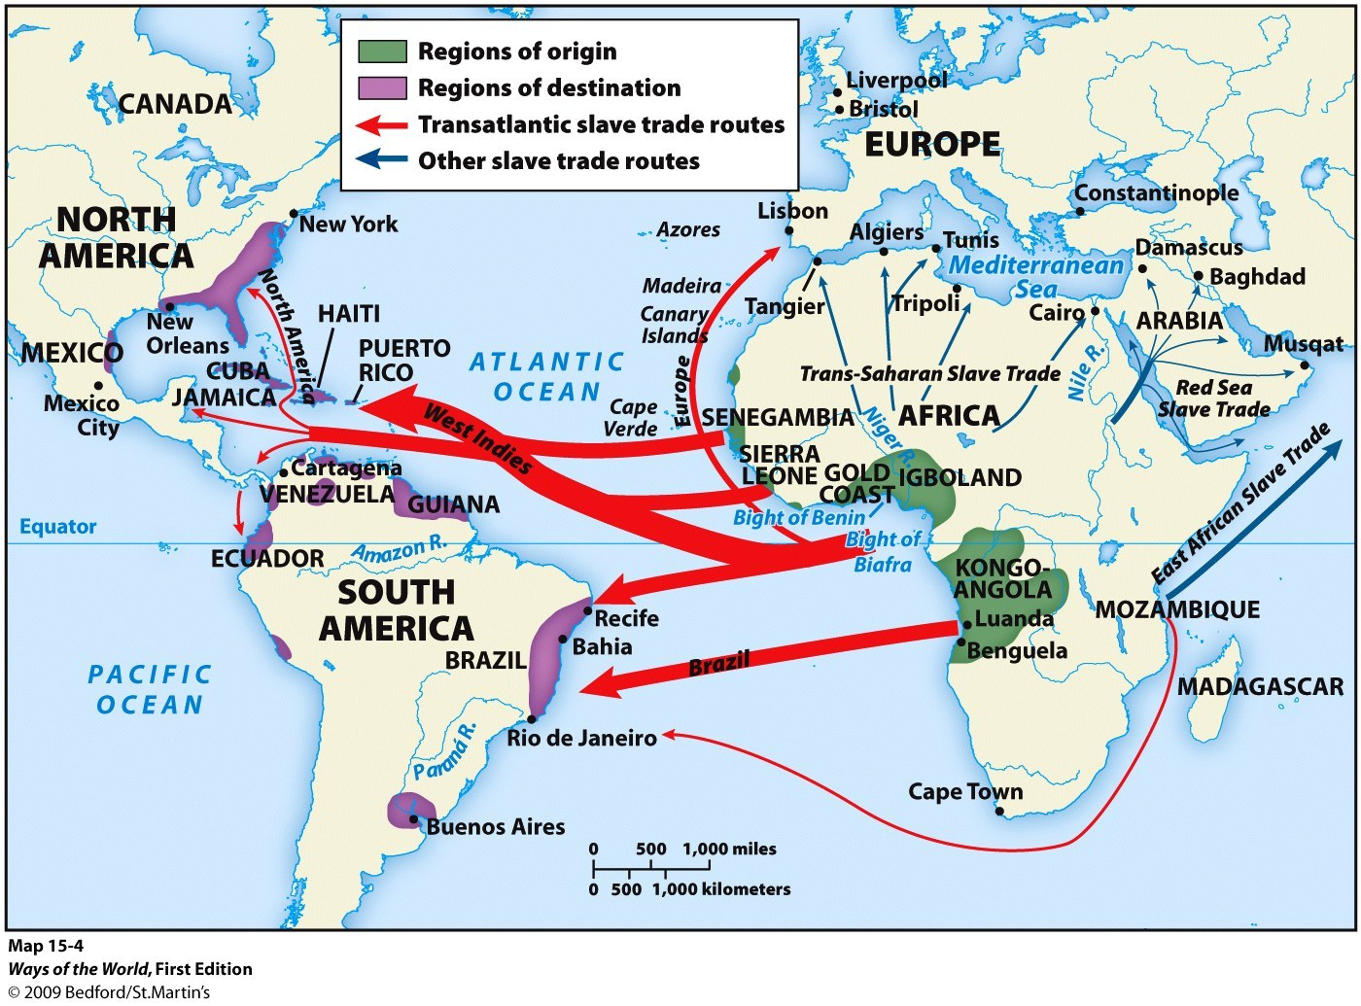

Slide 26
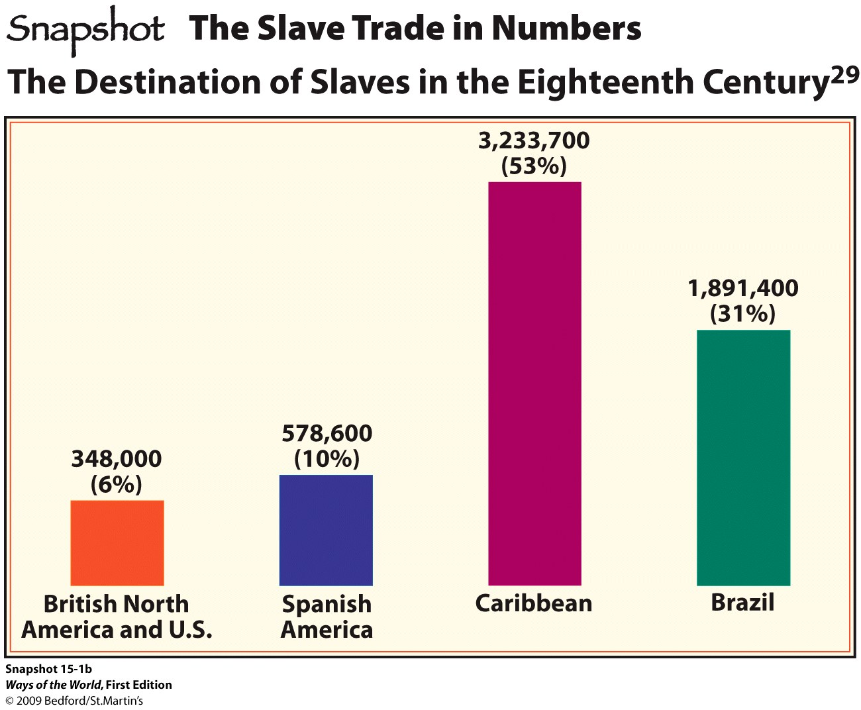

Slide 27
Slavery in the Americas was distinctive from other slave-holding systems in history because in the Americas
Comparison
Slaves were treated more as human beings than as mere property.
b. Slavery was identified with “blackness.”
Slaves were used as a primary labor force in
agricultural enterprises.
Female slaves were more highly valued than
male slaves.

Slide 28
Reflections: Economic Globalization—Then and Now
A. A study of global commerce in the early modern
period shows both how different from and how
similar we are to people of the past.
B. Globalization isn’t just a twentieth-century
phenomenon.
1. But early modern globalization was much
slower and on a smaller scale

Slide 29
Reflections: Economic Globalization—Then and Now
2. Early modern globalization was not yet
centered on Western civilizations
3. Early modern economic life was mostly
preindustrial
4. Early modern globalization was tied to empire
building and slavery

