Slide 1
Ways of the World: A Brief Global History First Edition
Robert W. Strayer
CHAPTER XIV
Empires and Encounters
1450–1750
Colonies of Sugar

Slide 2
Colonies of Sugar V. Settler Colonies in North America
Brazil/Caribbean | British North America
Notes:
Handout-Students to complete

Slide 3
Colonies of Sugar
Lowland Brazil and the Caribbean developed a different society
a. Regions had not been home to great civilizations
and didn’t have great mineral wealth until
the 1690s
b.
c.
Notes:
but sugar was in high demand in Europe
these colonies produced almost solely for export

Slide 4
2. Arabs introduced large-scale sugar production to the Mediterranean
a. Europeans transferred it to Atlantic islands and Americas
b. Portuguese on Brazilian coast dominated the world sugar market 1570–1670
c. Then British, French, and Dutch in the Caribbean broke the Portuguese monopoly

Slide 5
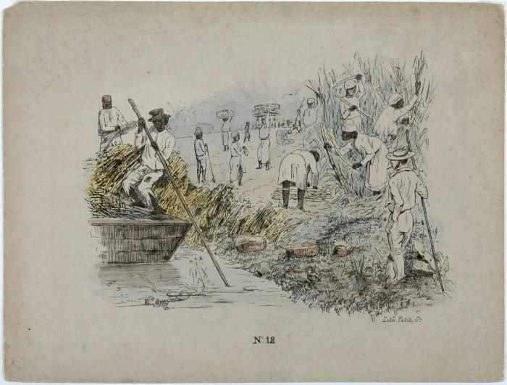
3. Sugar transformed Brazil and the Caribbean
a. Production was labor intensive, worked best on
large scale
b. Can be called the first modern industry
c. Had always been produced with massive use of
slave labor
Notes:
Cost effective on a large scale

Slide 6
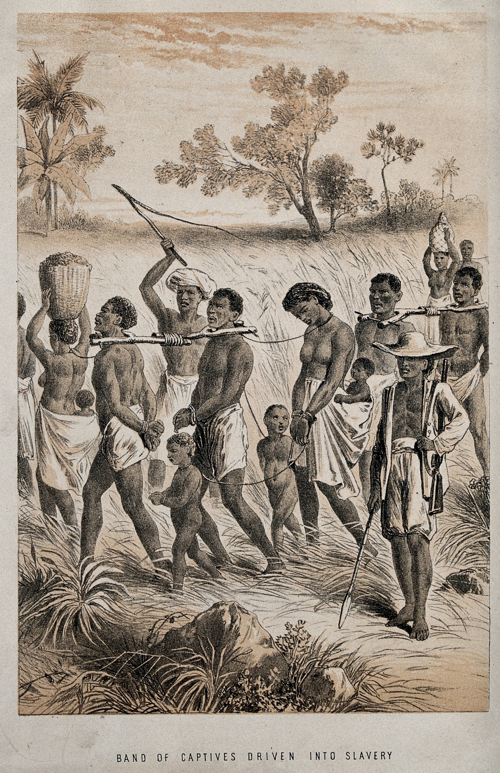
d. Indians of the area were
almost totally wiped out
or fled
e. Planters turned to African
slaves
Notes:
at least 80 percent of all African captives enslaved in the Americas ended up in Brazil and the Caribbean

Slide 7
4. Much more of Brazilian and Caribbean society
was of African descent
5. Large mixed-race population provided much of
urban skilled workforce and supervisors in
sugar industry

Slide 8
6. Plantation complex based on African slavery
spread to southern parts of North America
a. But in North America, European women came
earlier
b. Result was less racial mixing, less tolerance
toward mixed blood
c. Sharply defined racial system evolved
d. Slavery was less harsh

Slide 9
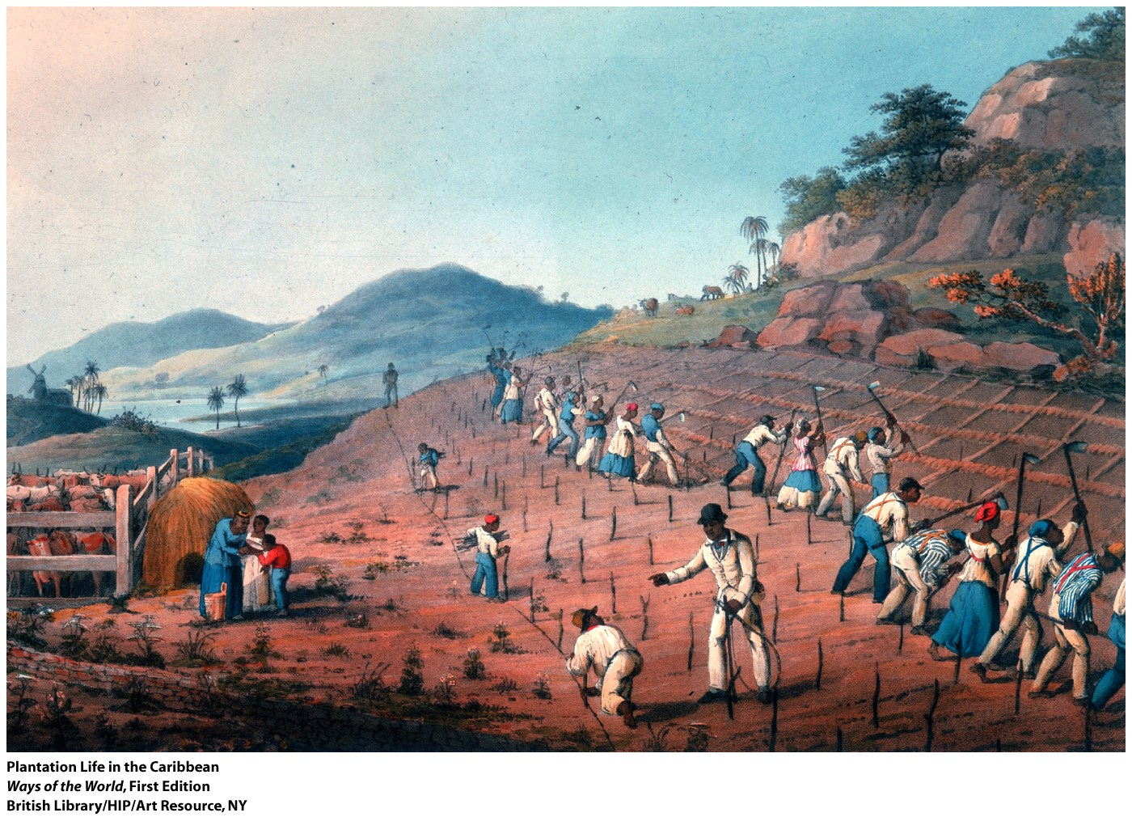

Slide 10
The European conquest of the Americas increased global connections in all EXCEPT which of the following ways?
Connection
It brought new crops and technologies to the Americas.
b. Although no American crops spread beyond Europe to the rest of Eurasia and Africa, the European conquest did result in the adoption of several American crops in Western Europe.
c. It resulted in the extensive mixing of indigenous American, African, and European peoples.
d. It reshaped the world economy by providing Europeans with access to large amounts of silver.

Slide 12
Settler Colonies in North America
Because the British were the last of the European
powers to establish a colonial presence in the
Americas, they found that “only the dregs were
left.” Lands they acquired were regarded as the
unpromising leftovers of the New World.

Slide 13
Settler Colonies in North America
British society was changing more rapidly than
Catholic Spain
British colonist were trying to escape European
society
British colonist were more numerous and by 1750
outnumbered the Spanish by 5 to 1.

Slide 14
Settler Colonies in North America
British colonies developed traditions of local
government.
British Civil War (17th Century)
Literacy rates
Seeds of Independence?
Notes:
By 1776 90% of North American colonies were European
Indians were killed off by disease and military policy.
Small scale farming did not need slaves..
Literacy Rates:
The Protestant emphasis on reading the Bible for oneself led to a much greater mass literacy than in Latin America whereas the Catholic Church was far more focused on converting the natives to Christianity.
British colonies developed traditions of local self government.
Britain didn’t impose an elaborate bureaucracy like Spain.
British civil war (seventeenth century) distracted government from involved colonies.
The English Civil War (1642–1651) was a series of armed conflicts and political machinations between Parliamentarians ("Roundheads") and Royalists ("Cavaliers") in the Kingdom of England over, principally, the manner of its government. The first (1642–46) and second (1648–49) wars pitted the supporters of King Charles I against the supporters of the Long Parliament, while the third (1649–51) saw fighting between supporters of King Charles II and supporters of the Rump Parliament. The war ended with the Parliamentarian victory at the Battle of Worcester on 3 September 1651.
North America gradually became dominant, more developed than South America.

Slide 15
The racial system of which of the following regions was characterized by less racial mixing and less willingness to recognize the offspring of interracial unions than occurred in the other regions?
(A) Brazil
(B) British North America
(C) The Caribbean
(D) Mexico
(E) Peru

Slide 16
Which of the following was true only of the Western European empires among all the early modern empires?
(A) They were the largest empires in the world.
(B) They spread diseases to which conquered
peoples had little immunity.
(C) They were initiated by maritime expansion.
(D) They were created by merchants rather than governments.
(E) They included possessions in Africa.

Slide 17
Why did some Native Americans aid the Spanish
in their initial invasion of the New World?
(A) Payment in gold and jewels
(B) A desire to learn about European culture
(C) A shared Christian faith
(D) No Native Americans helped the Spanish.
(E) To gain an advantage against their own enemies

Slide 18
What happened to Native Americans’ religious beliefs in
Mesoamerica and Peru when confronted with Catholicism?
(A) They rejected Catholicism completely.
(B) They blended their old customs easily into Catholic practices.
(C) They only pretended to be Catholic when Europeans were
around.
(D) They completely abandoned their old religions, and
embraced Catholicism entirely.
(E) They ultimately rejected both their old religions and
Catholicism in favor of the Protestant

Slide 19
The differences among colonial societies that emerged in the Americas after European conquest can be accounted for through all EXCEPT which of the following factors?
Change
The number of Europeans who settled in a region
b. The type of economy that took shape in the region
c. The rejection of slave holding in the early 1600s by Portuguese and Dutch rulers
d. Whether a Protestant or Catholic power settled a region

