Slide 1
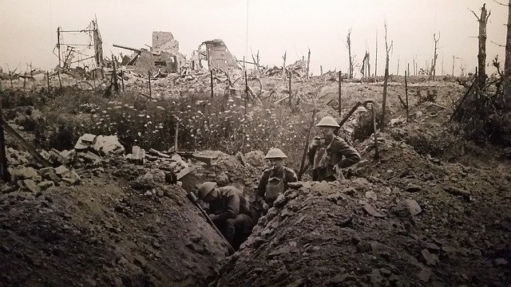
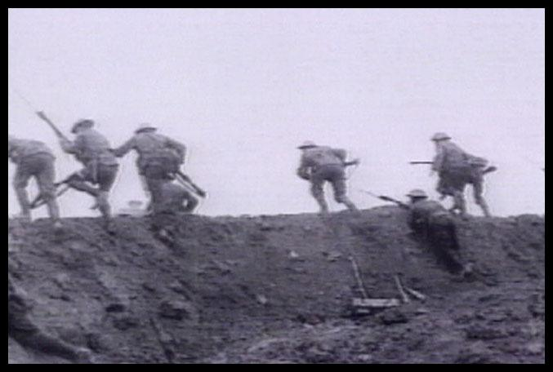
World War I Vocabulary

Slide 2
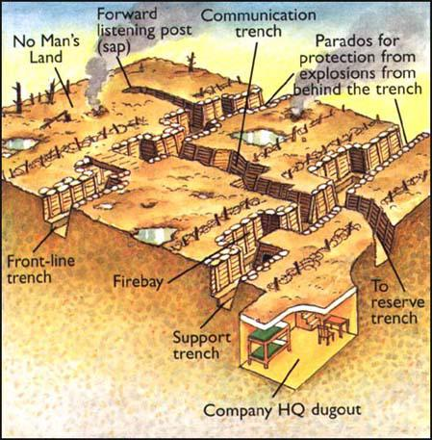
Trench Warfare The Allies and Central Powers were locked in a stalemate, neither would give up.
This Photo by Unknown Author is licensed under CC BY-SA
Troops hid in trenches across from each other in the battlefield
“No man’s land”, extremely dangerous

Slide 3
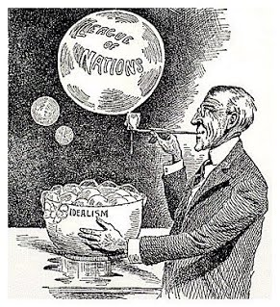
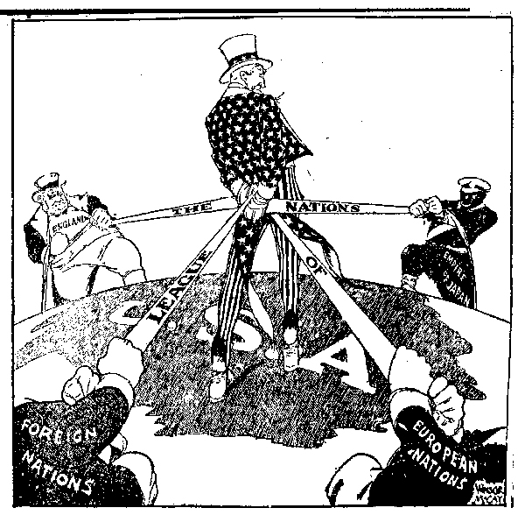
League of Nations
International organization created after the First World War to provide a forum for resolving international disputes.

Slide 4
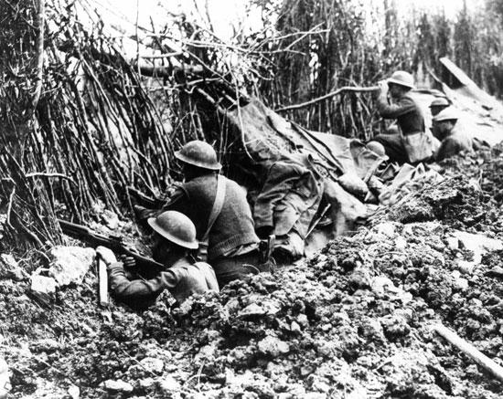
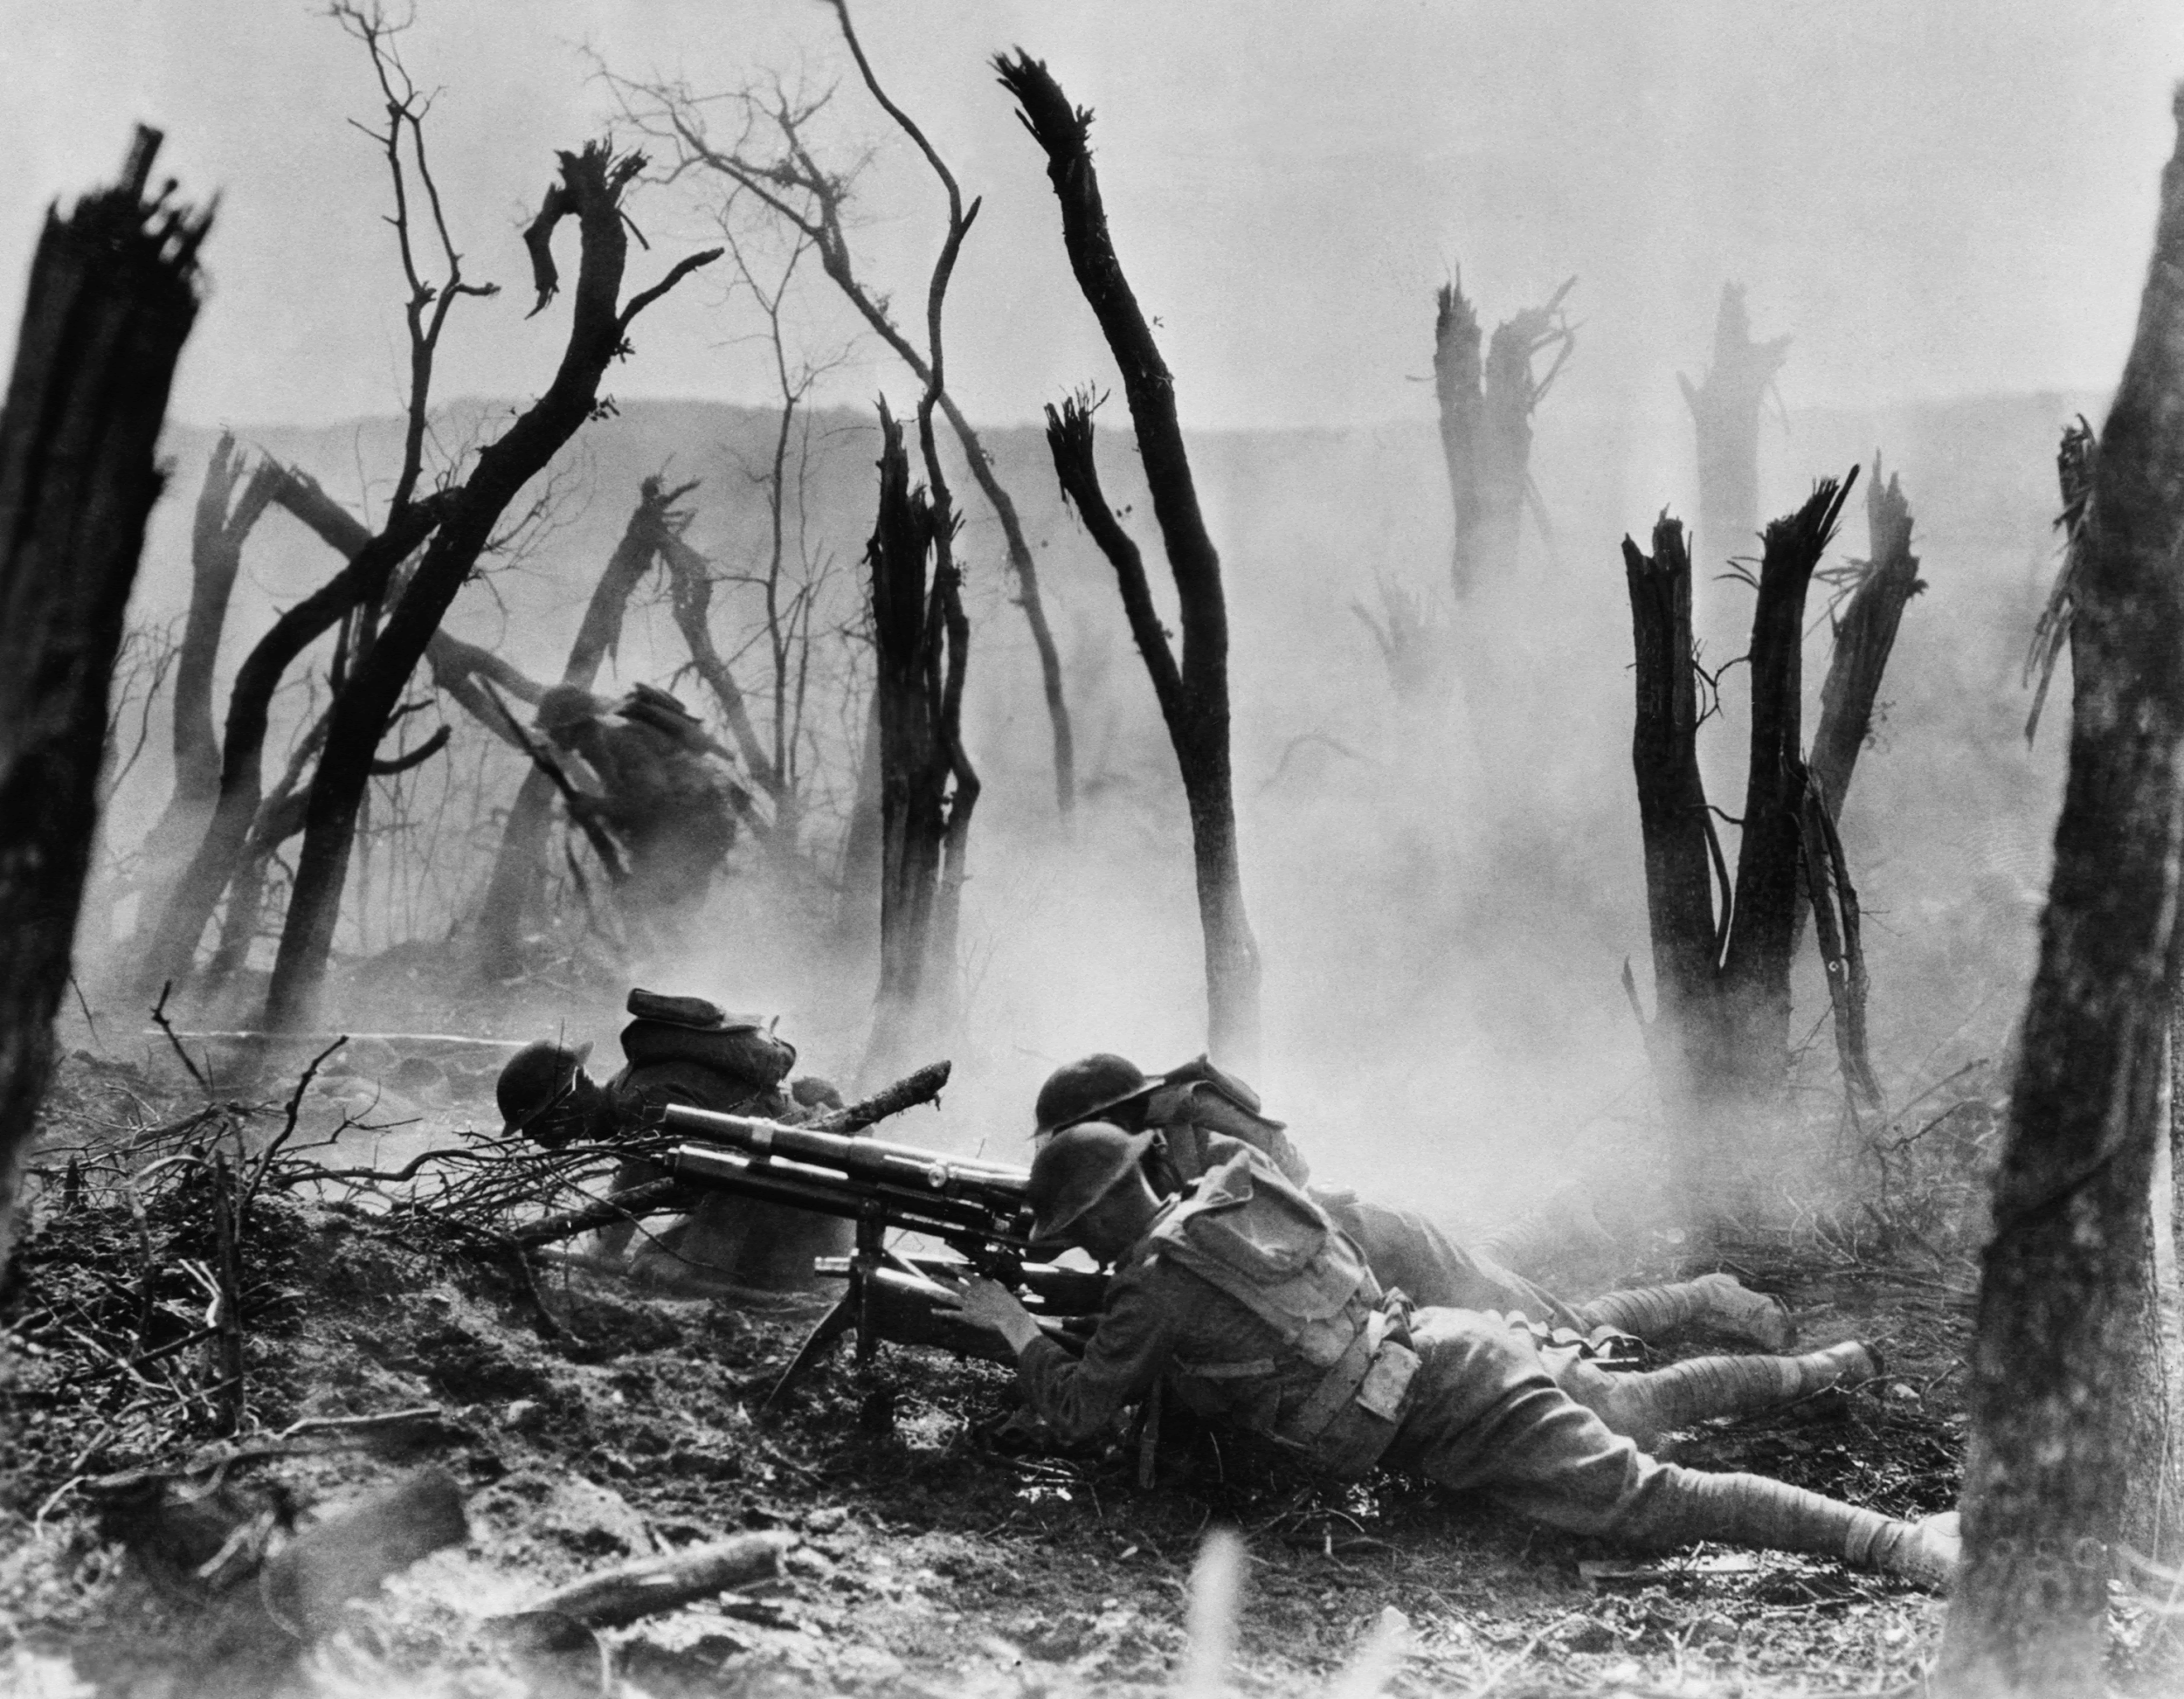
Battle of Argonne Forest
Turning point battle in WW1; American troops were able to cut off German supply lines

Slide 5
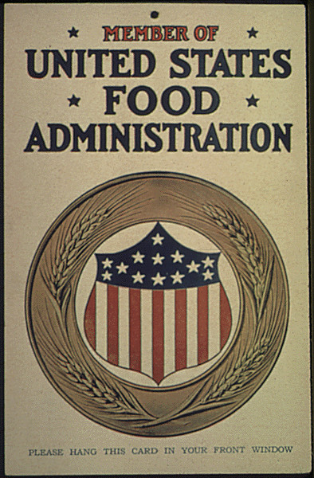
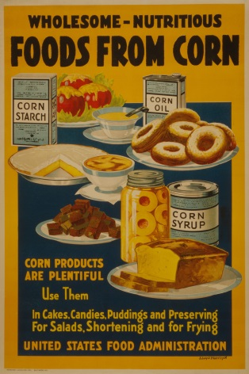
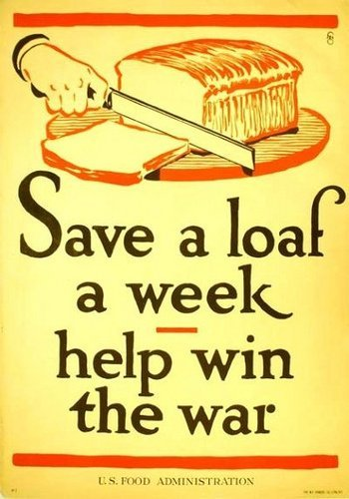
Food Administration
Food production and civilian consumption; rationing

Slide 6
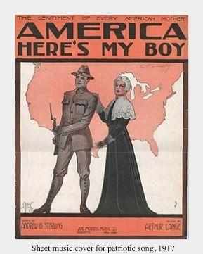
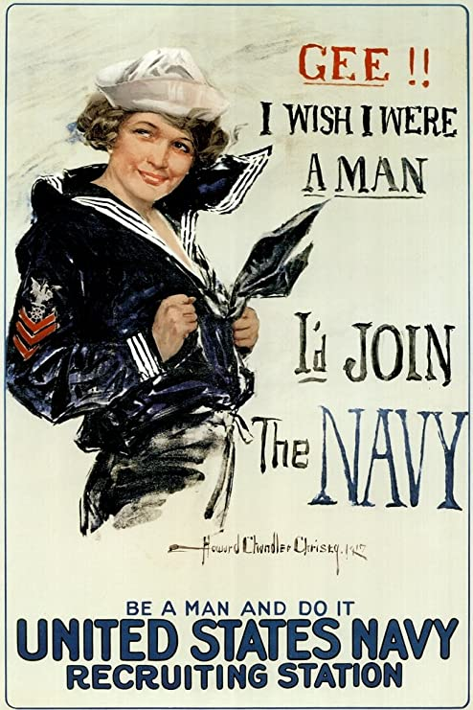
Selective Service Act
This authorized the United States federal government to raise a national army for service in World War I through forced service
The creation of a mandatory draft (compulsory service)

Slide 7
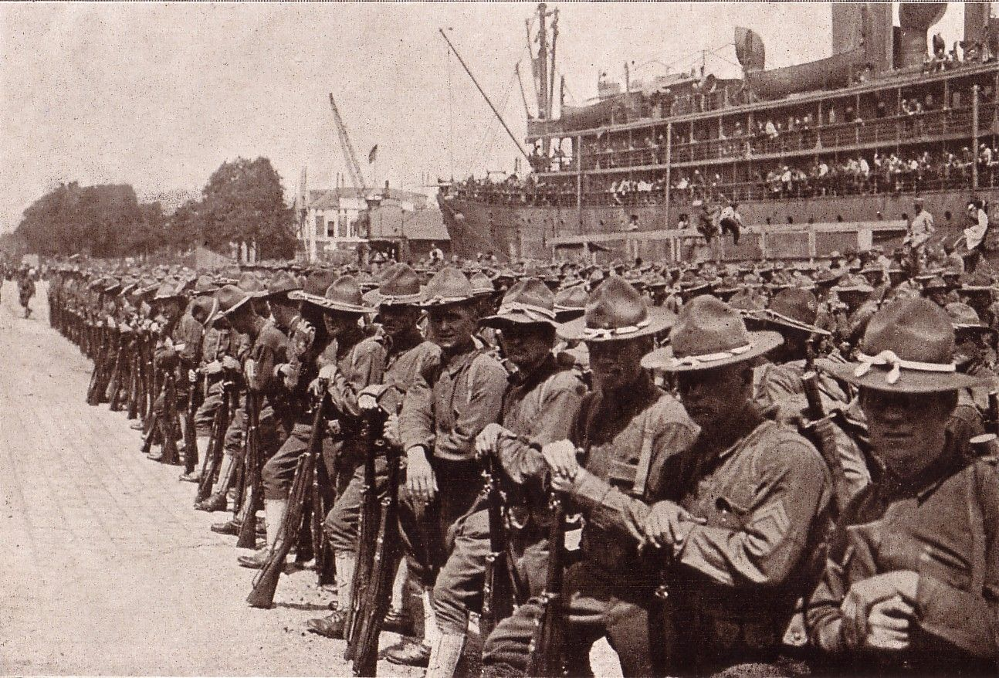
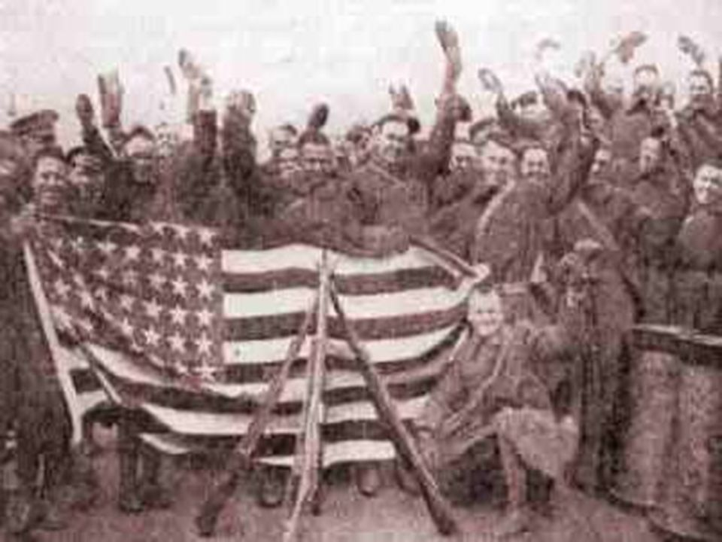
American Expeditionary Forces
The name of the American troops fighting in Europe; came to “save the day” under the leadership of John J. Pershing; were able to break the stalemate

Slide 8
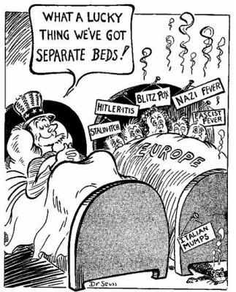
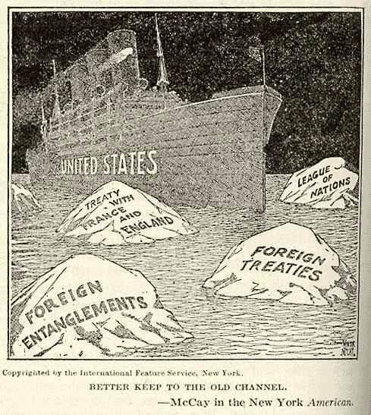
Isolationism
The policy or doctrine of isolating one's country from the affairs of other nations by declining to enter into alliances, foreign economic commitments, international agreements, etc.

Slide 9
Central Powers
Germany
Austria-Hungary
Bulgaria
Ottoman Empire

Slide 10
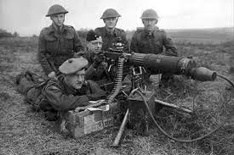
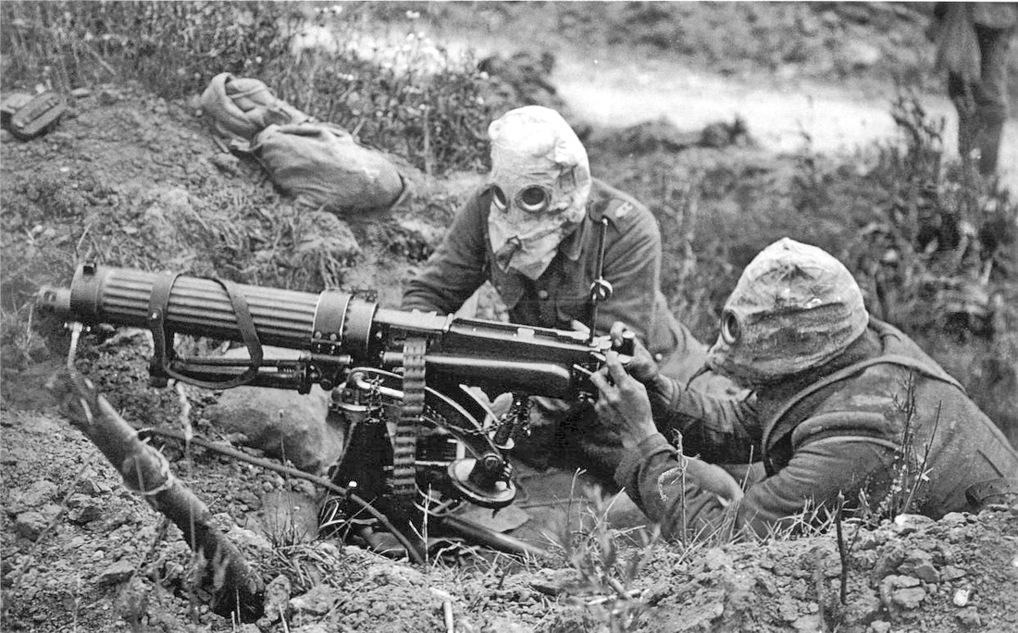
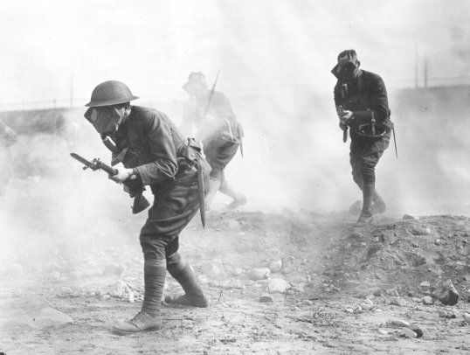
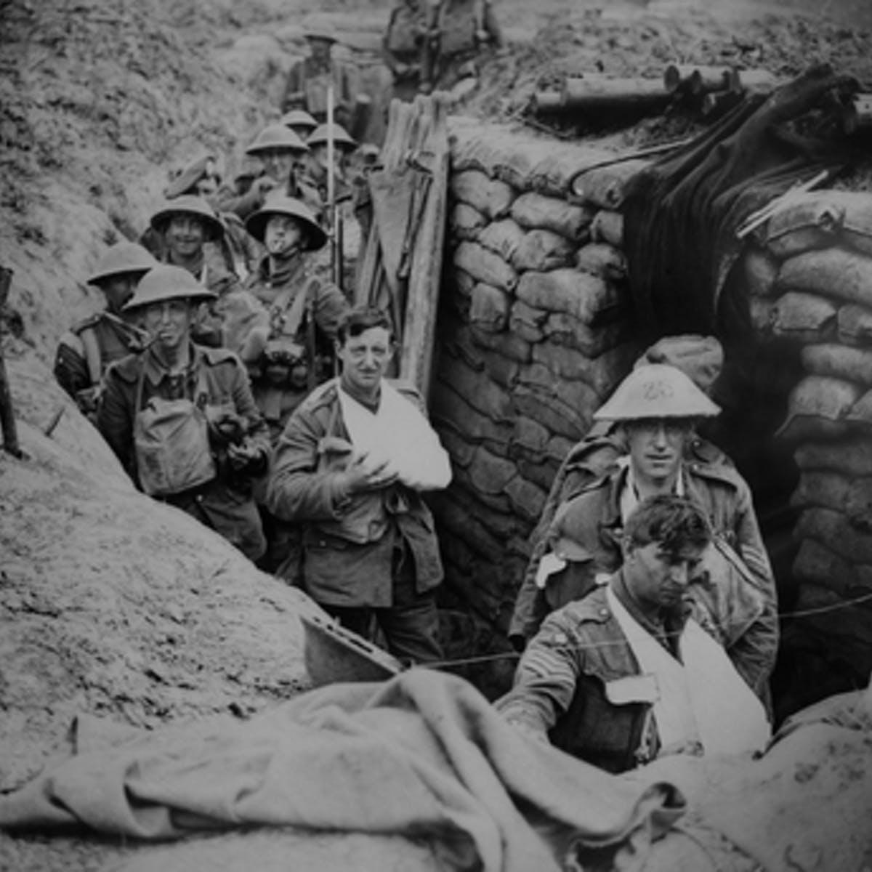
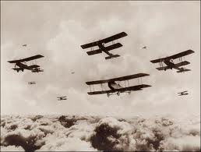
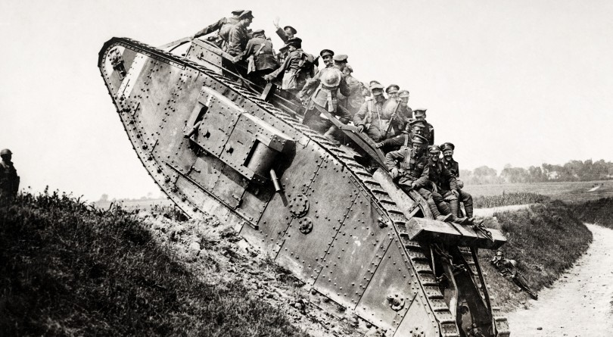
New Technologies for War
Machine guns
airplanes
tanks
poison gas
trench warfare

Slide 11
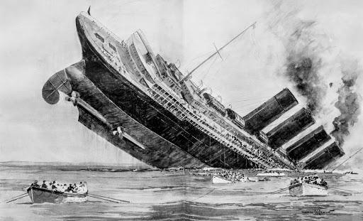
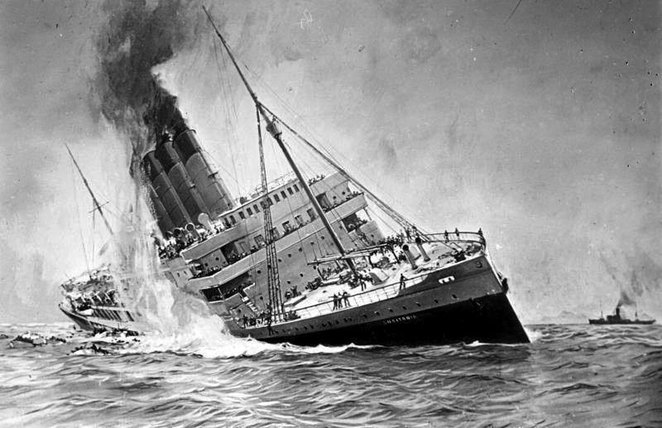
Lusitania
A British luxury liner sunk by a German submarine in the North Atlantic on May 7, 1915: one of the events leading to U.S. entry into World War I

Slide 12
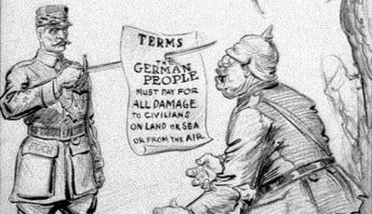
Reparations
The making of amends for a wrong one has done, by paying money to or helping those who have been wronged.

Slide 13
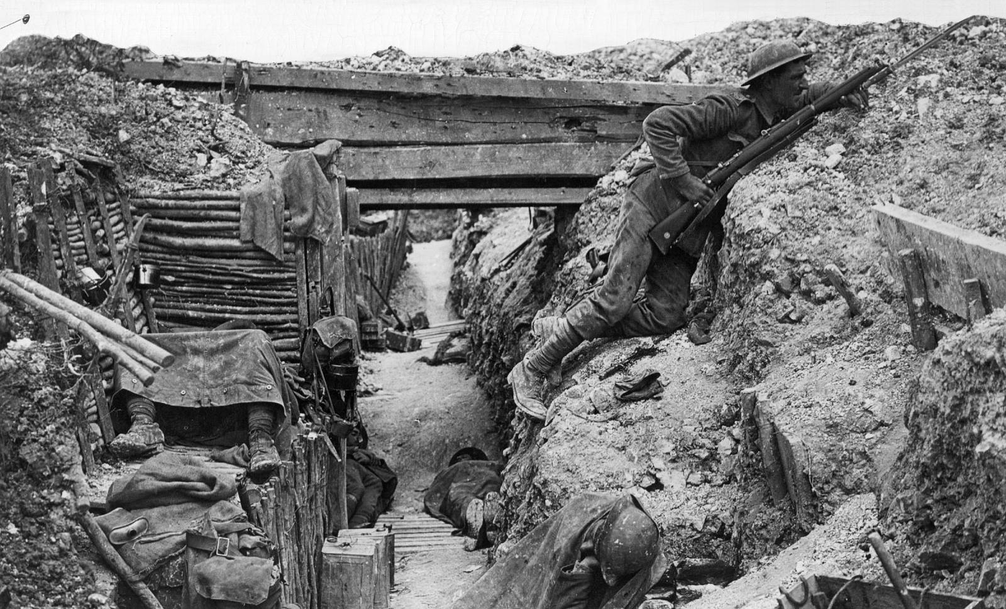
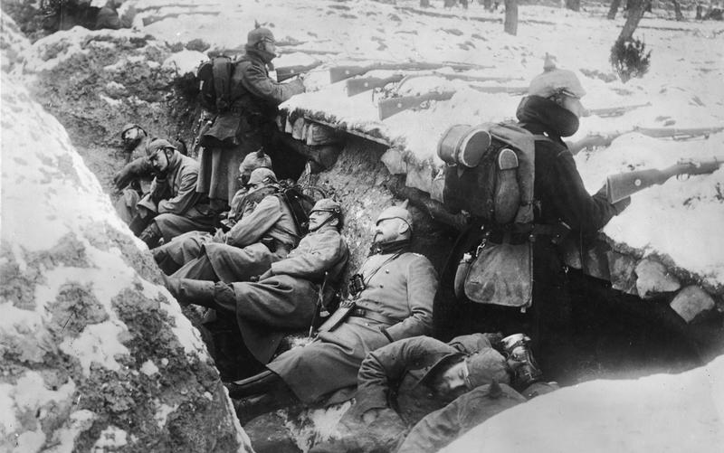
Stalemate
A situation in which neither side can win a clear victory; the war becomes very long and slow.
The armies had to begin to be creative with war tactics since neither side would leave their trenches

Slide 14
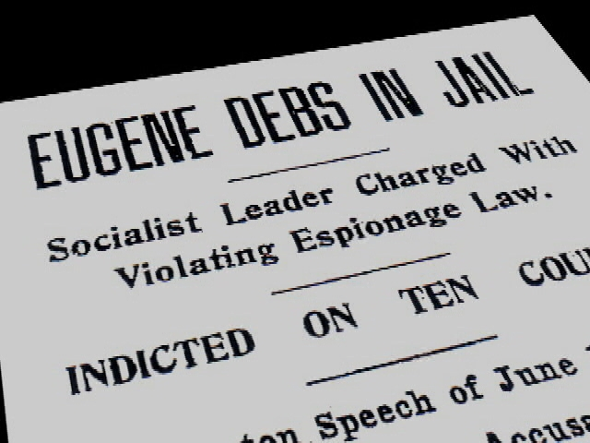
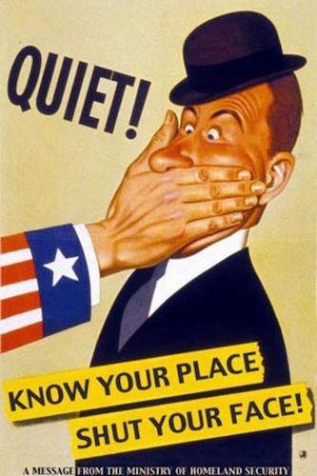
Espionage Act
Made it a crime for any person to convey information intended to interfere with the U.S. armed forces prosecution of the war effort or to promote the success of the country's enemies

Slide 15
RUN – reasons US joined the war
⬧Relationship with Great Britain and Russia exits the war
⬧Unrestricted submarine warfare
⬧Note (Zimmerman)

Slide 16
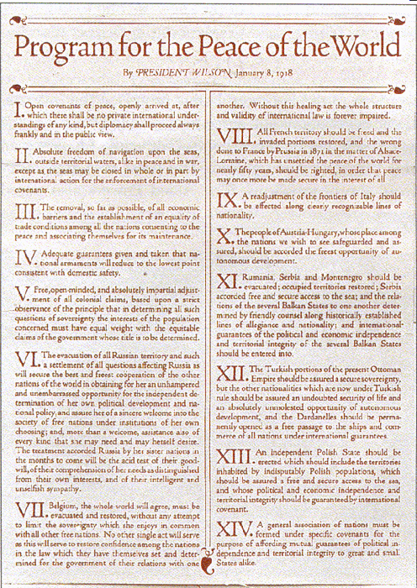
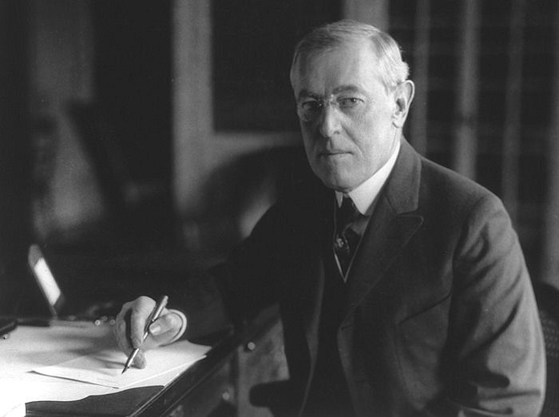
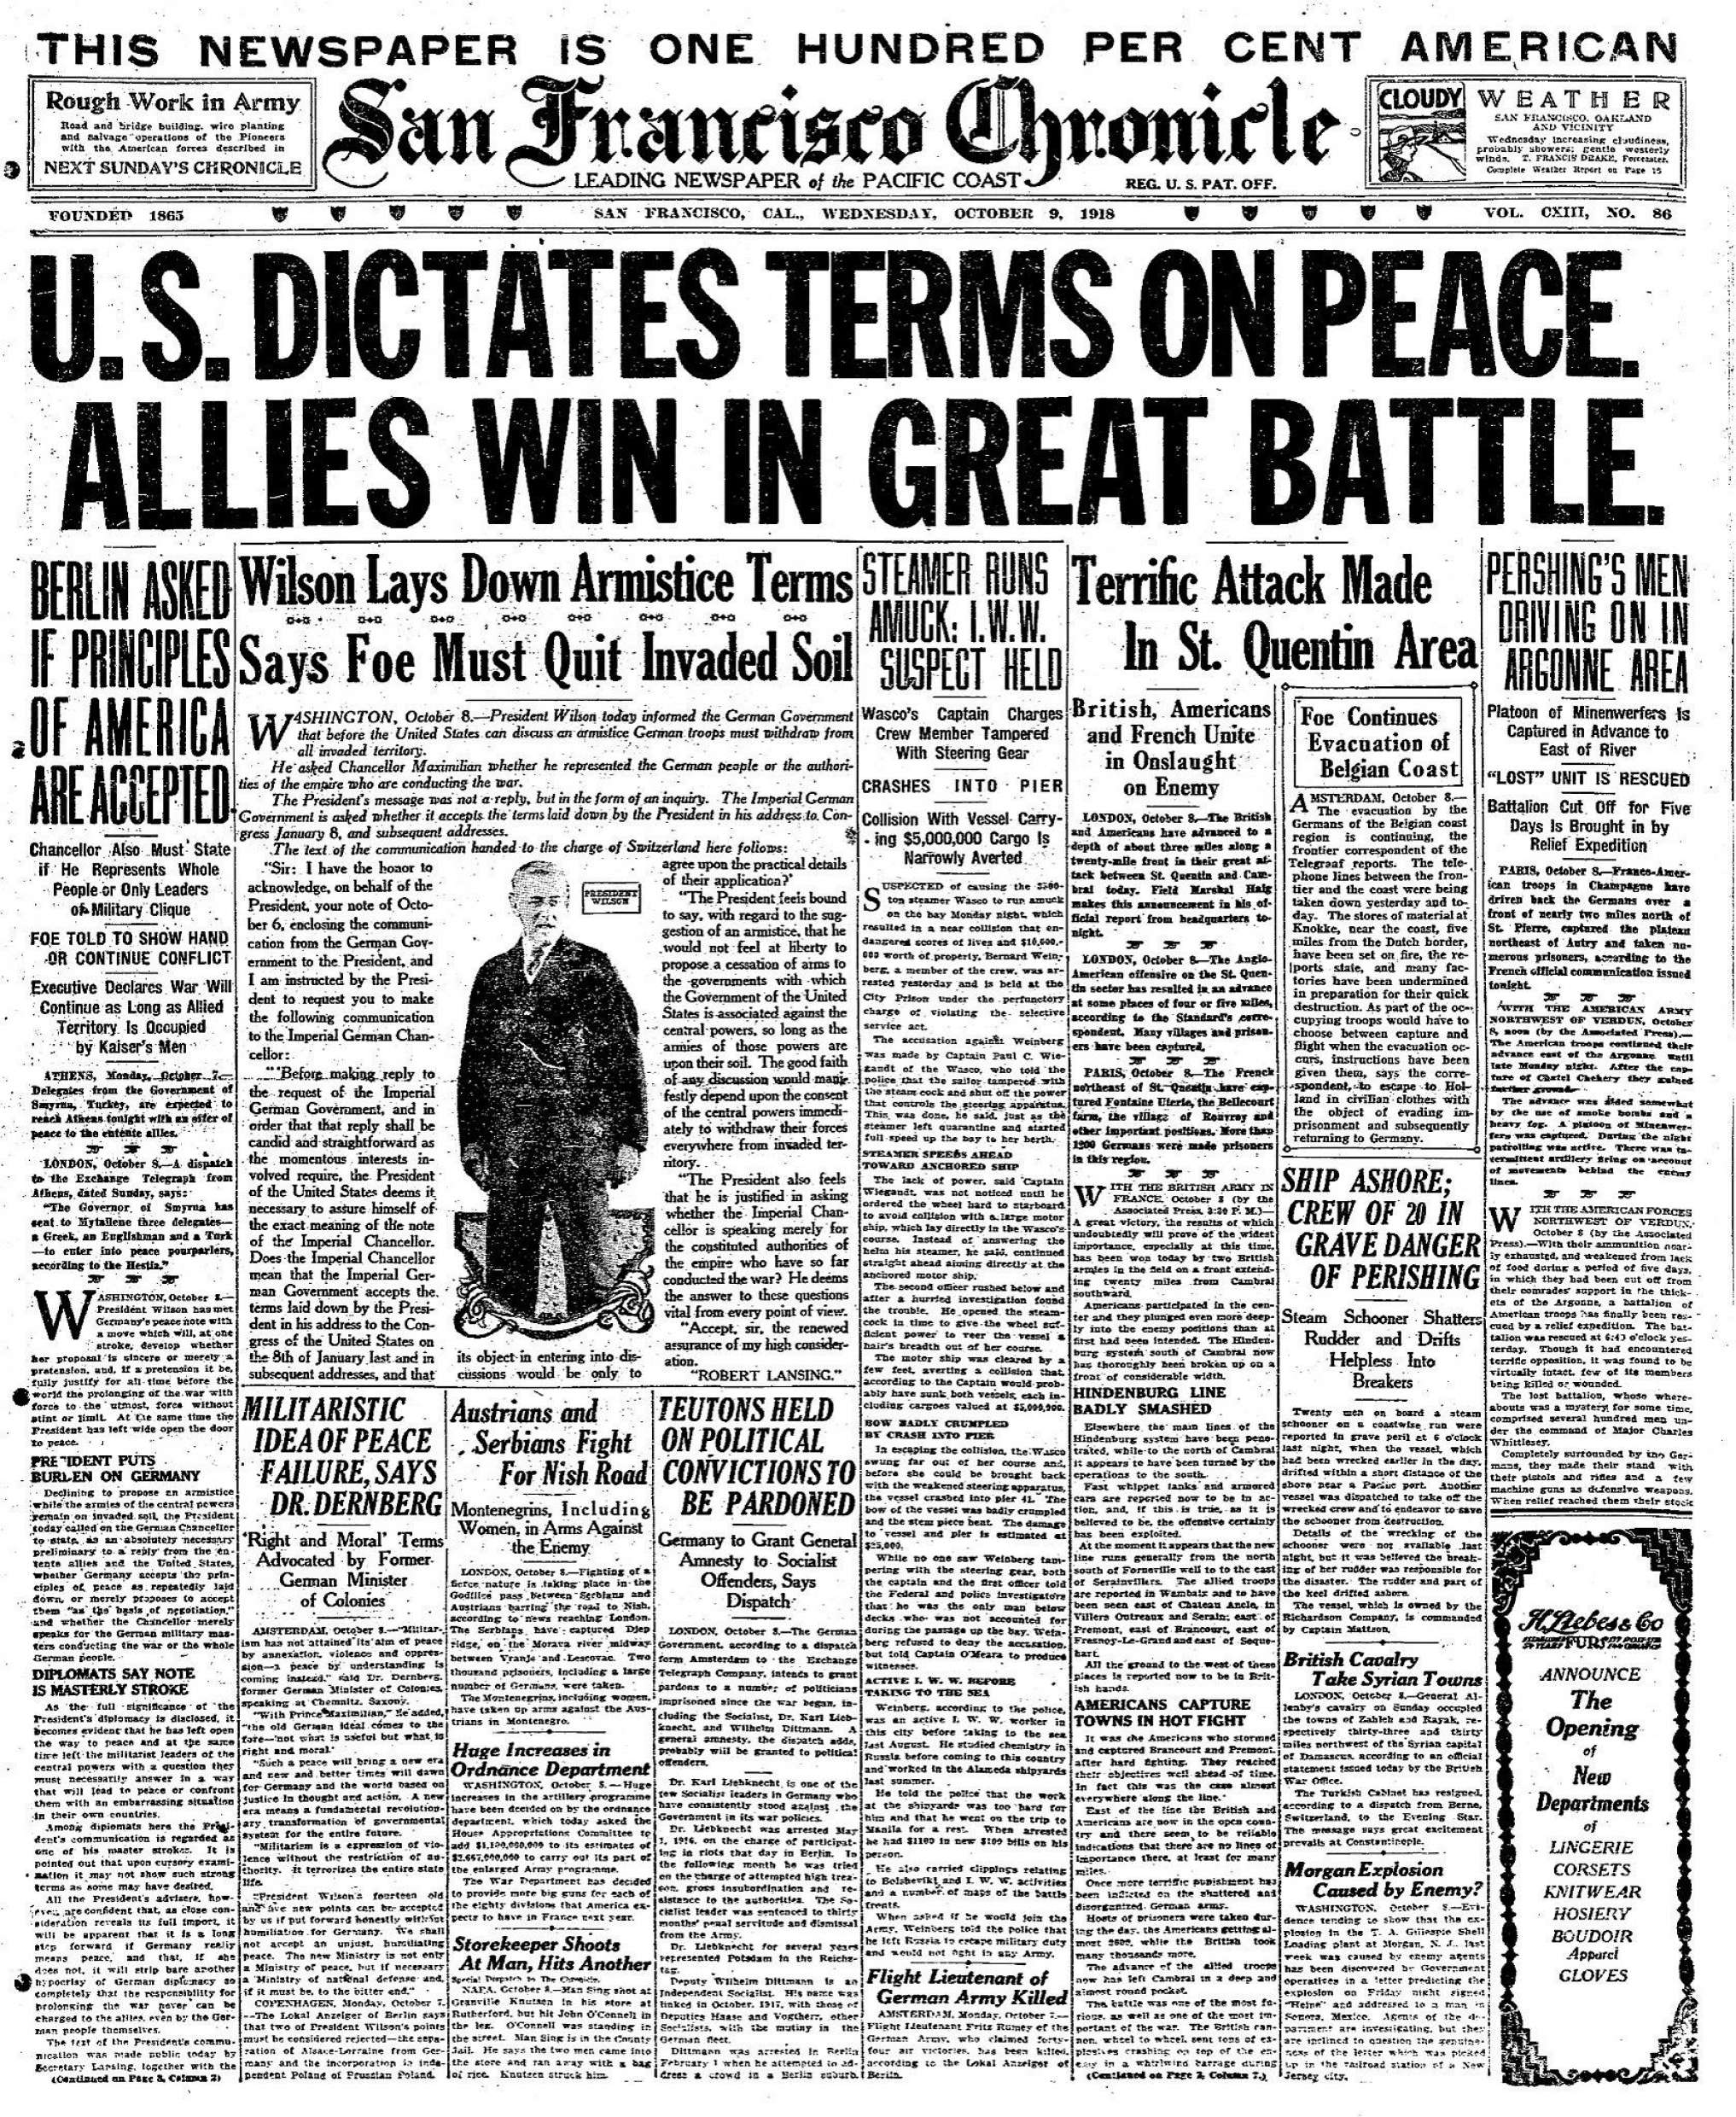
14 Point Speech
Woodrow Wilson’s idealistic plan for peace at the end of the war; included the creation of League of Nations

Slide 17
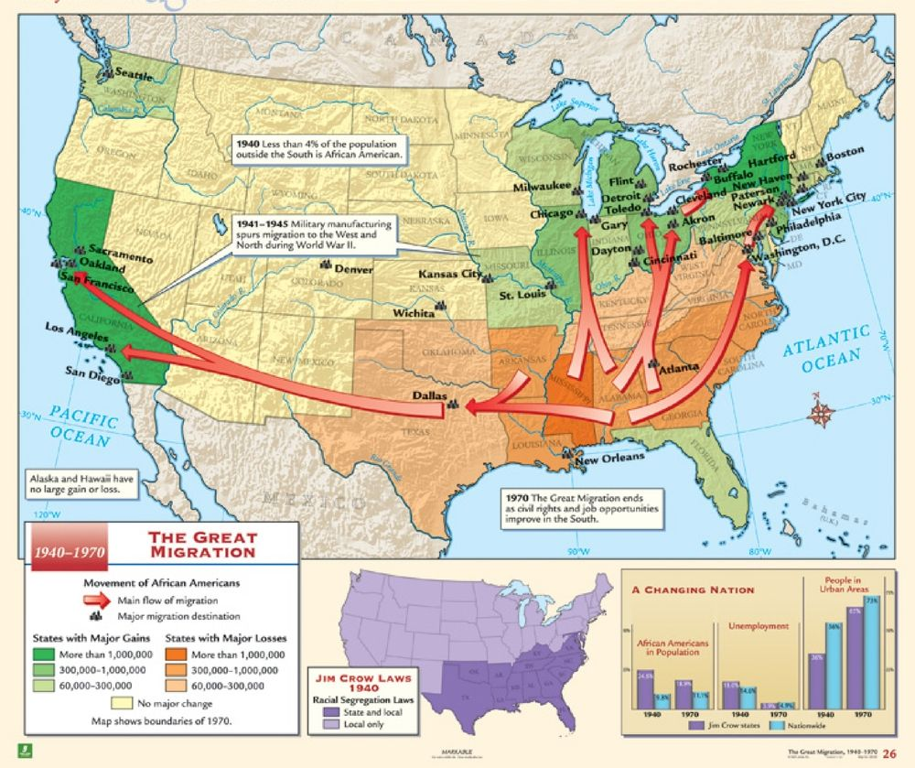
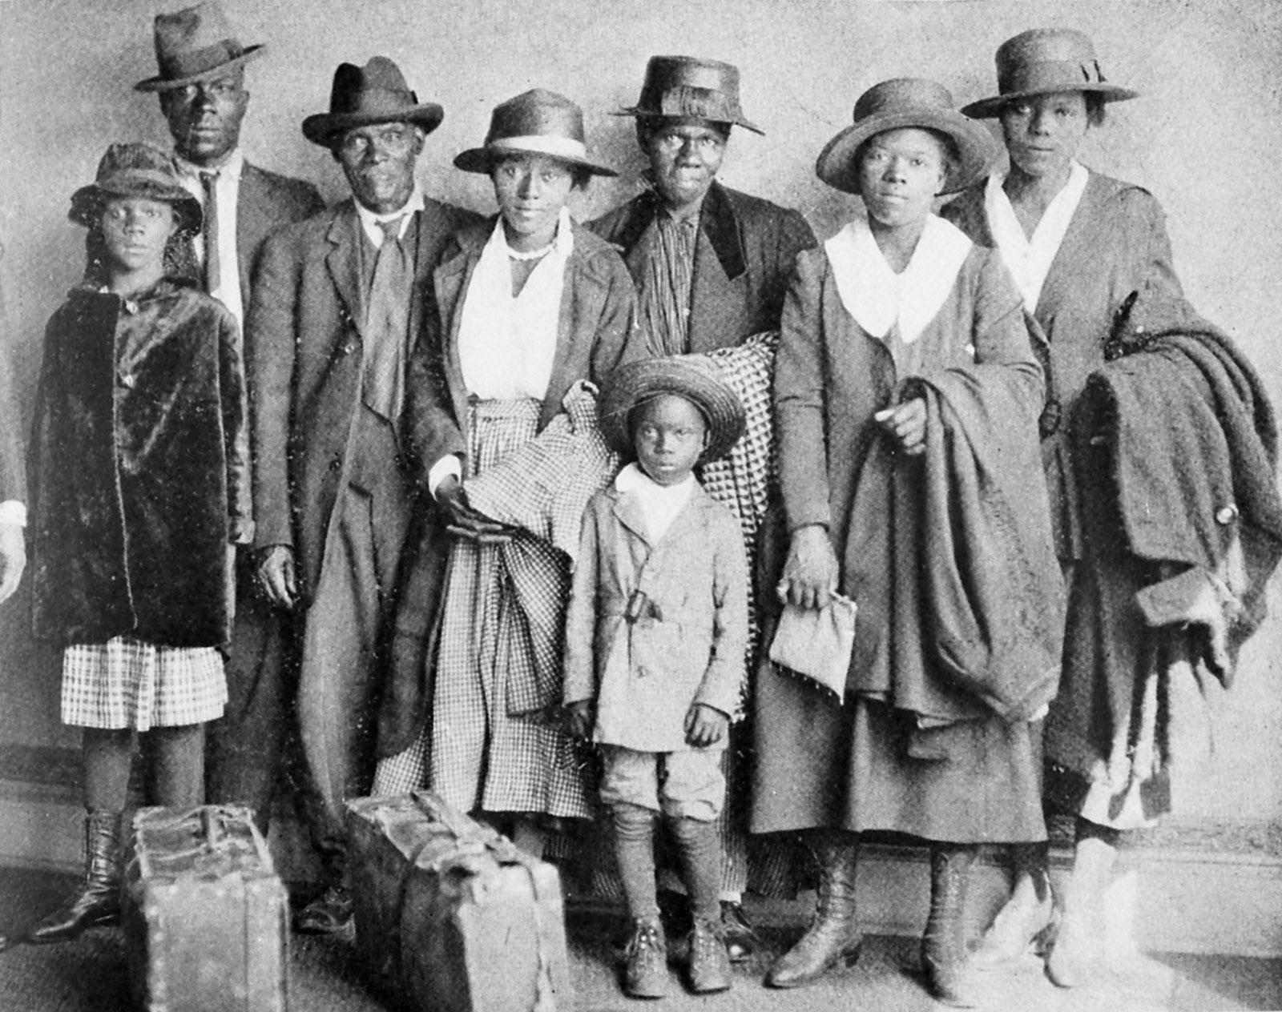
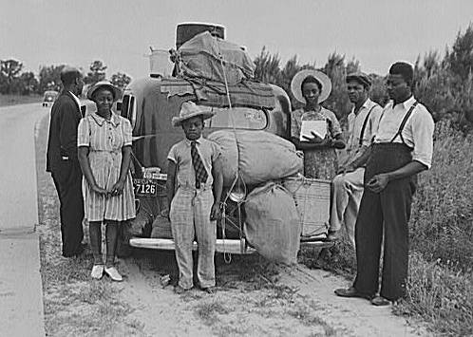
Great Migration
Movement of around 300,000-500,000 African Americans to the North due to unsatisfactory economic opportunities and harsh segregation laws in the South

Slide 18
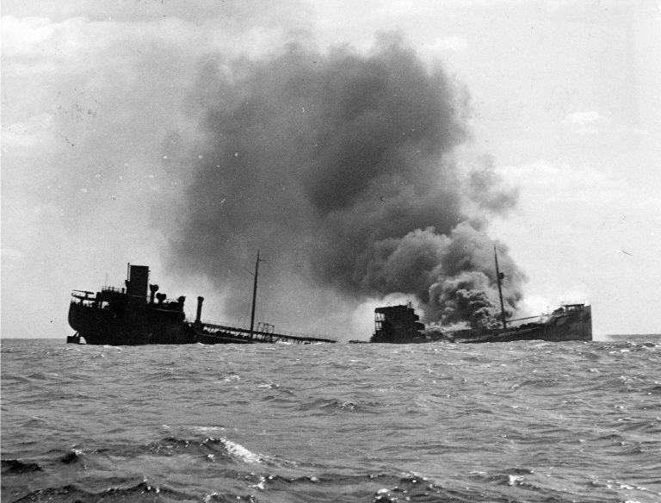
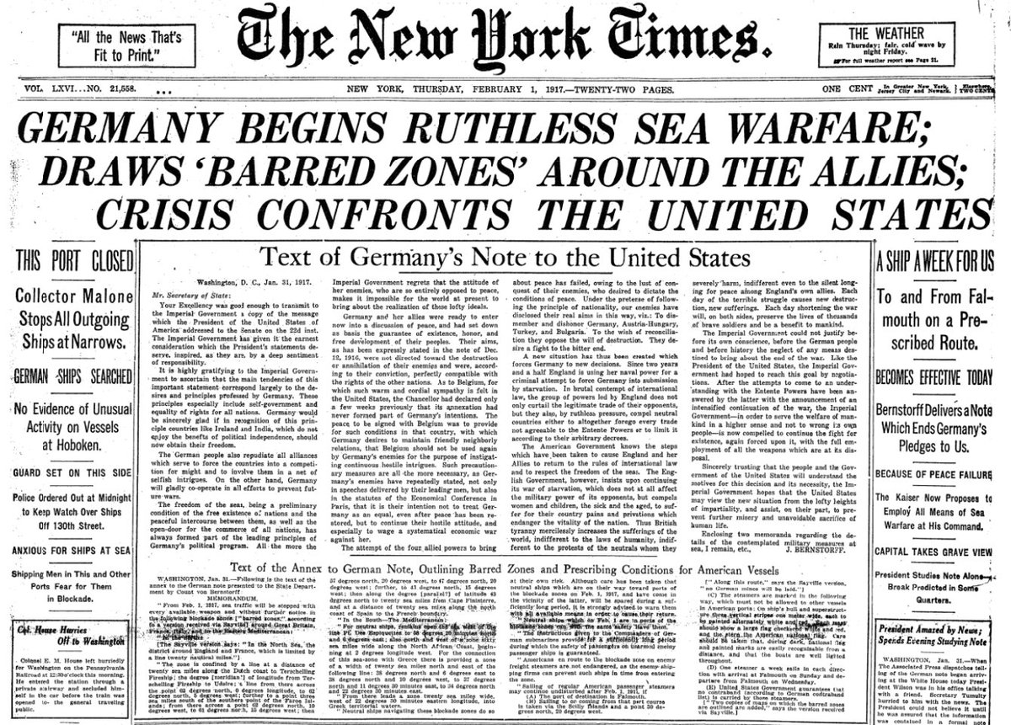
Unrestricted Submarine Warfare
A type of naval warfare in which submarines sink vessels such as freighters and tankers without warning; used by the Germans

Slide 19
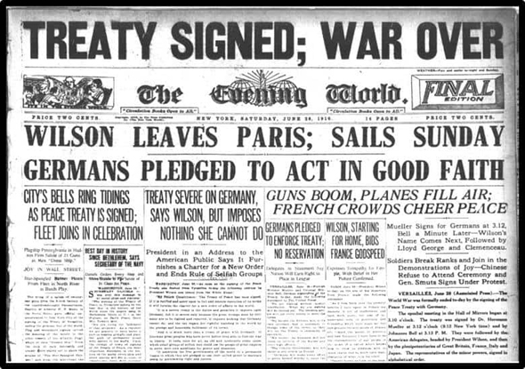
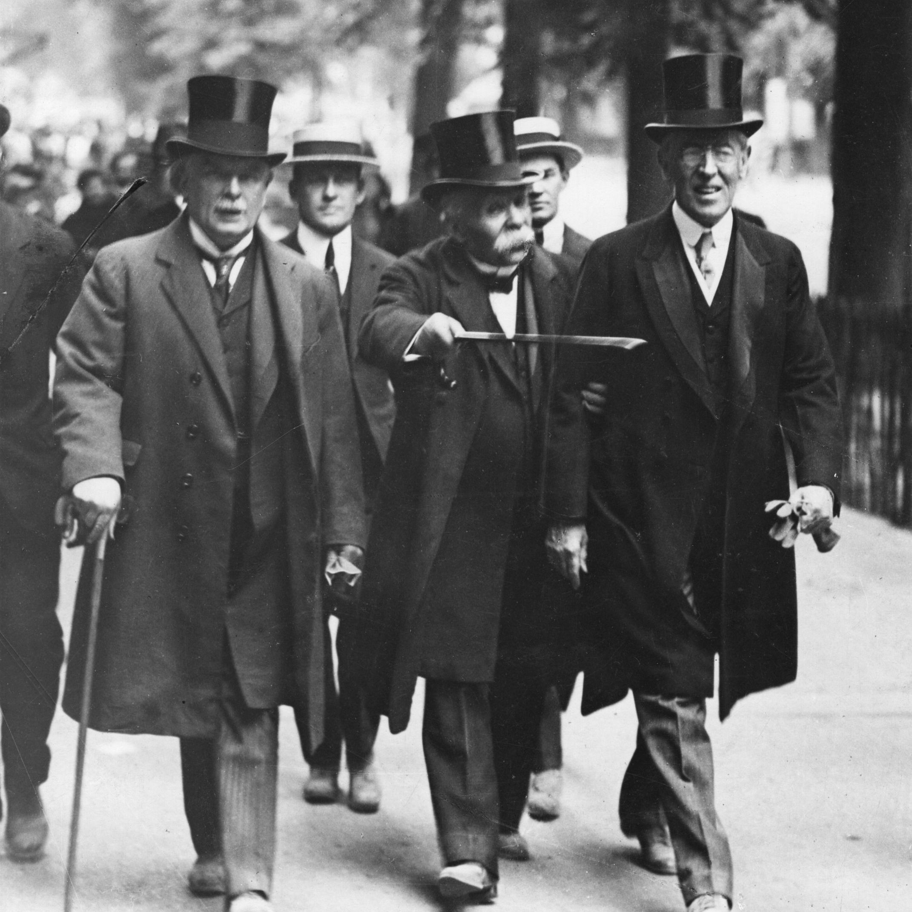
Treaty of Versailles
Attempted peace treaty at the end of the war; major cause of WW2 with German reparations and War Guilt clause; created border changes; adopted League of Nations and German sanctions

Slide 20
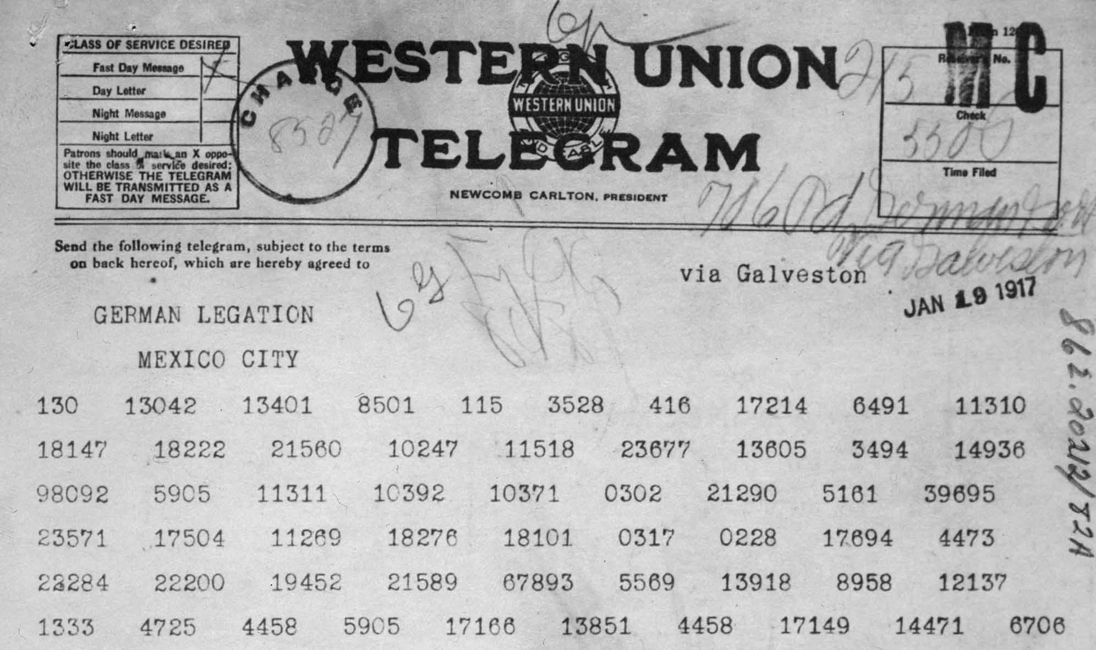
Zimmerman Note (Telegram)
A secret diplomatic communication issued from Germany in January 1917 that proposed a military alliance between Germany and Mexico. If the United States entered World War I against Germany, Mexico would recover Texas, Arizona, and New Mexico.

Slide 21
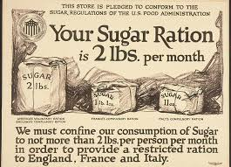
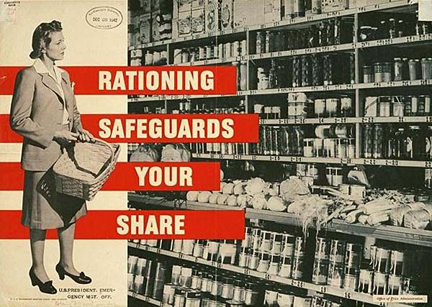
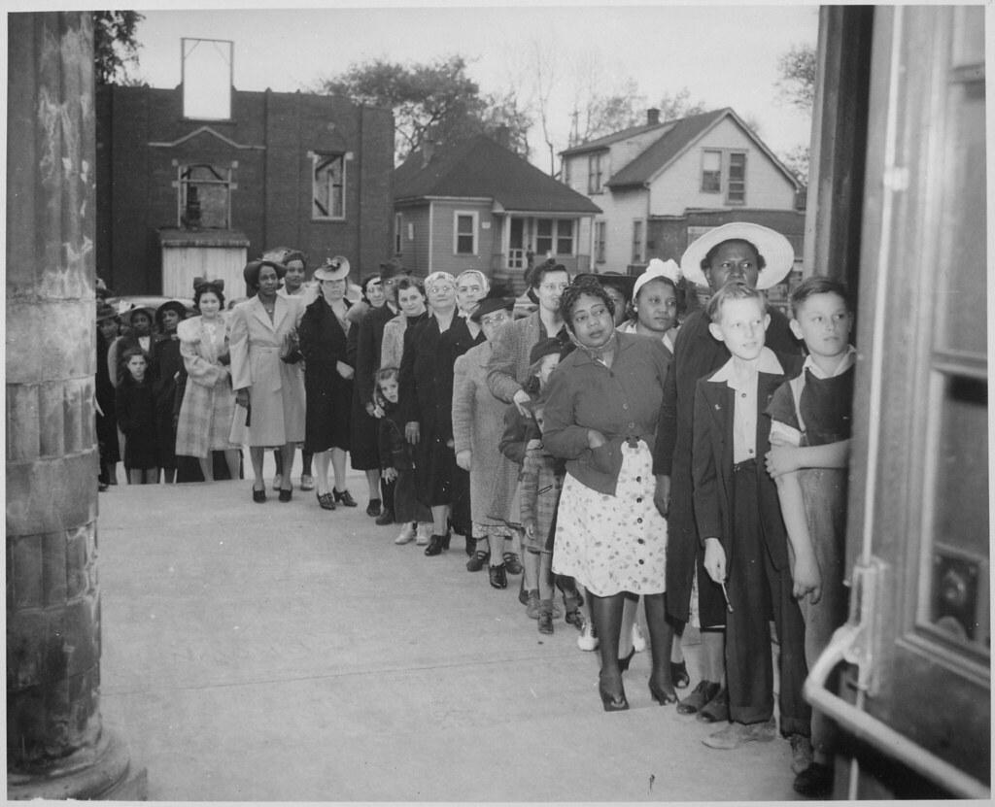
Rationing
A way of sharing food fairly; used special books to allow you to purchase certain items in certain quantities

Slide 22
Allied Powers
Russia,
France
Great Britain
Italy
U.S.

Slide 23
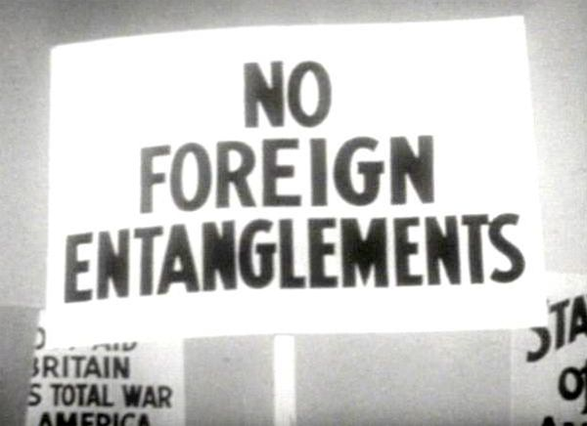
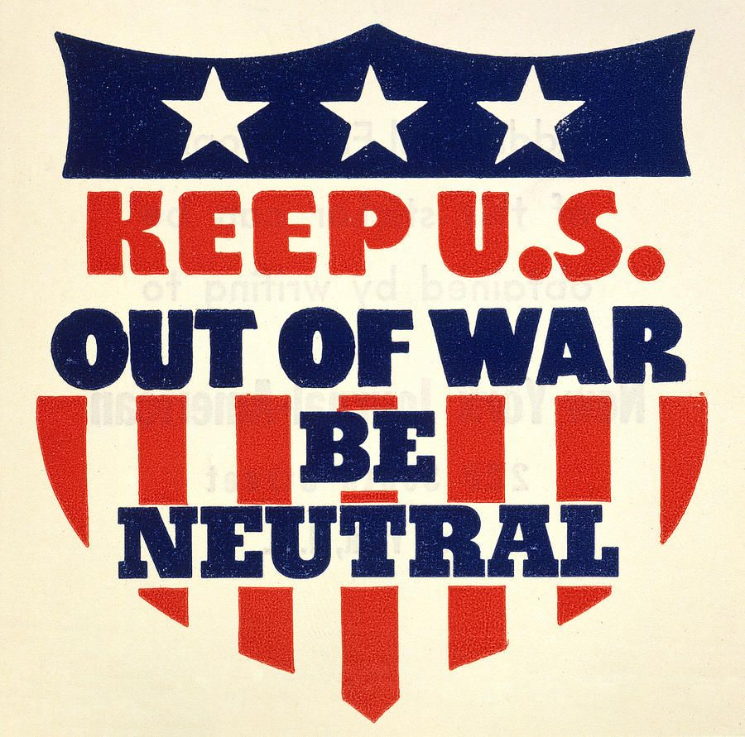
Neutrality
Not supporting or helping either side in a conflict, disagreement; impartiality

Slide 24
Victory Gardens
Americans were encouraged to produce their own food, planting vegetable gardens in their backyards, churchyards, city parks, and playgrounds; provided American citizens an opportunity to assist with the war effort

Slide 25
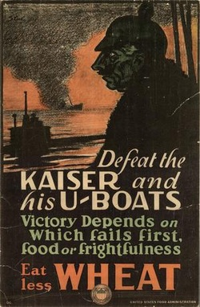
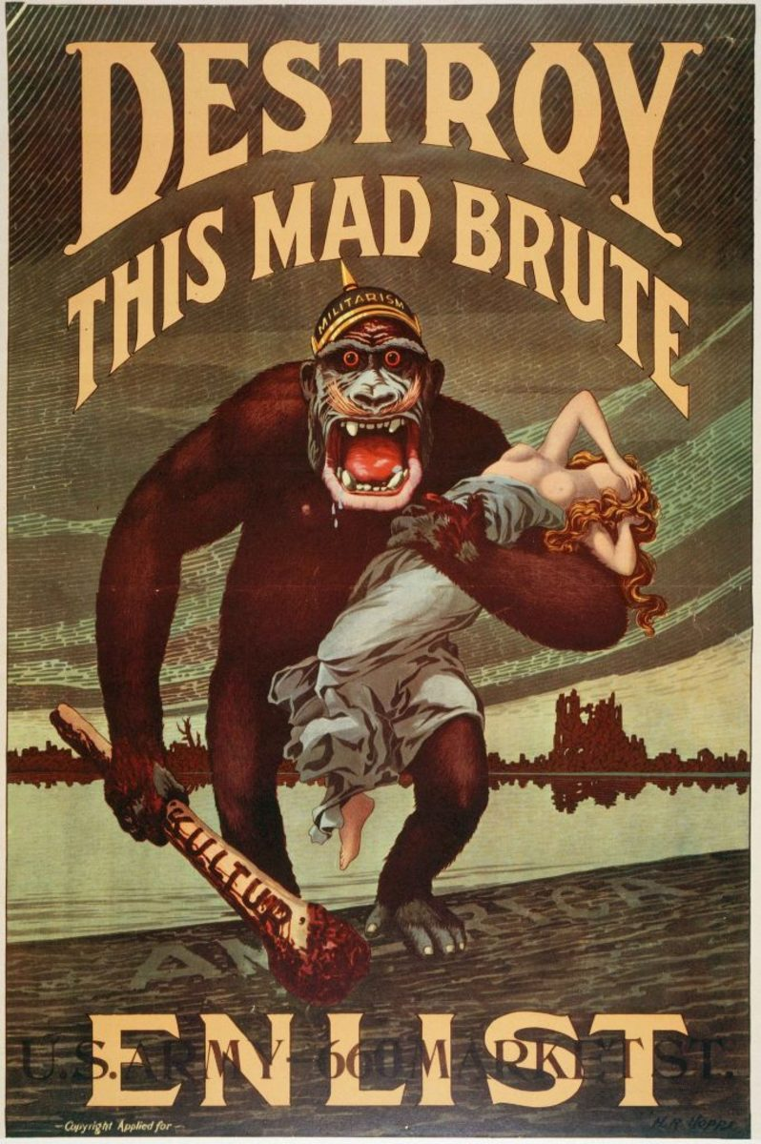
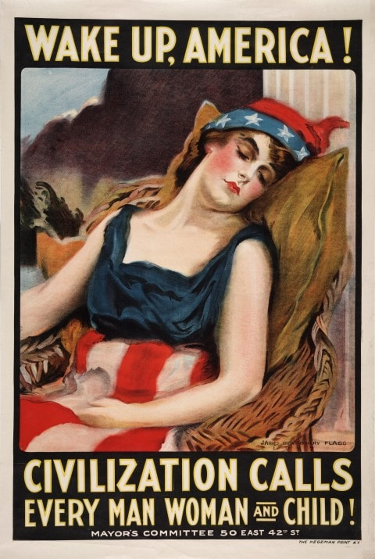
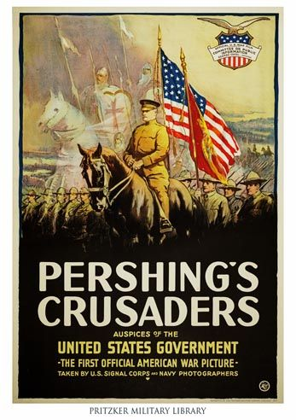
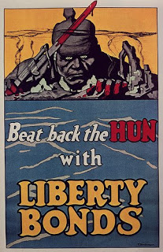
Committee on Public Information
An independent agency of the government of the United States created to influence public opinion to support US participation in World War I.

Slide 26
Fuel Administration
Use of coal and oil; introduction of Daylight Savings Time

Slide 27
Propaganda
information, especially of a biased or misleading nature, used to promote or publicize a particular political cause or point of view.

Slide 28
Mobilization of the Workforce
Women,African Americans, and other minority groups find job opportunities

Slide 29
Liberty and Victory Bonds
American citizens purchase bonds to help fund the war

Slide 30
Sedition Acts
This made it a crime to "willfully utter, print, write, or publish any disloyal, profane, scurrilous, or abusive language about the form of the Government of the United States" or to "willfully urge, incite, or advocate any curtailment of the production" of the things " – took away 1st amendment rights of free speech

Slide 31
War Industries Board
Created for the production of war materials; coordinated efforts to purchase war supplies between the Army and Navy

Slide 32
Army Corporal Alvin York
He was one of the most decorated United States Army soldiers of World War I.
He received the Medal of Honor for leading an attack on a German machine gun nest, taking at least one machine gun, killing at least 25 enemy soldiers and capturing 132

Slide 33
General John J. Pershing
American leader of the American Expeditionary Forces in Europe

