Slide 1
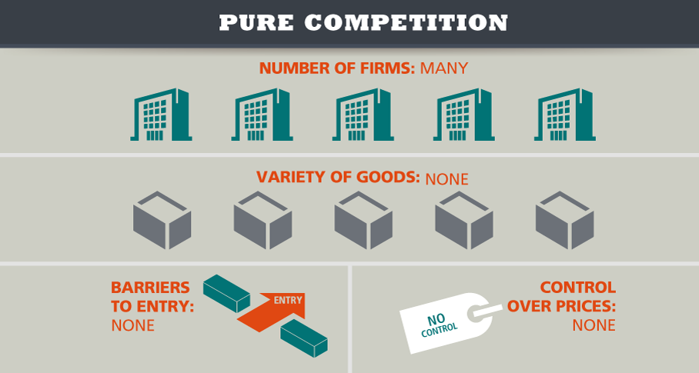
Pure Competition
Many firms all produce the same product and no single seller controls supply or price

Slide 2
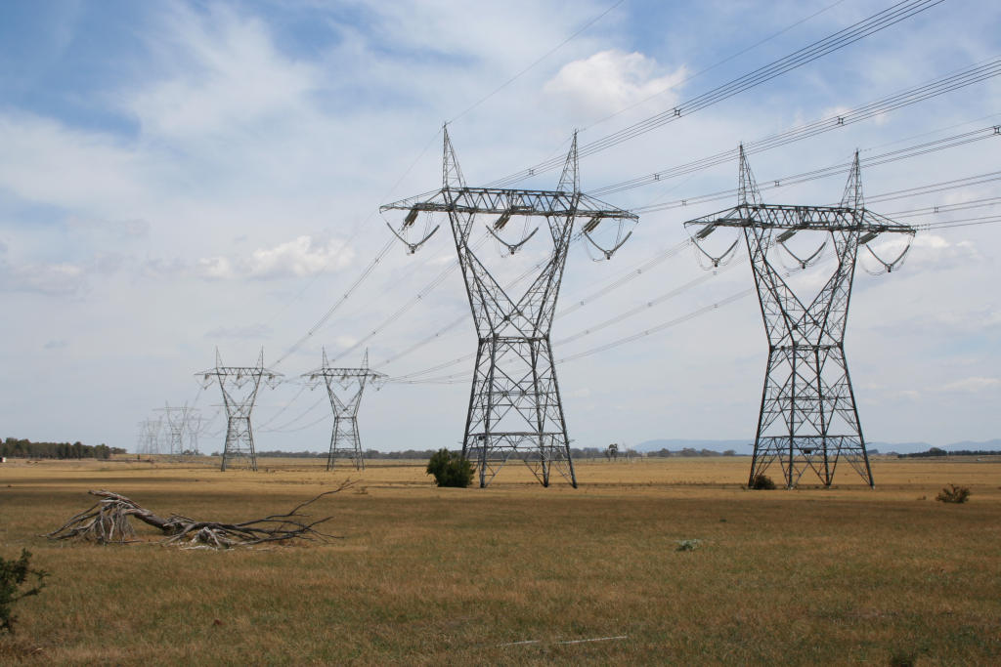
Monopoly
a market in which a single seller dominates

Slide 3
Oligopoly
a few large firms dominate the market

Slide 4
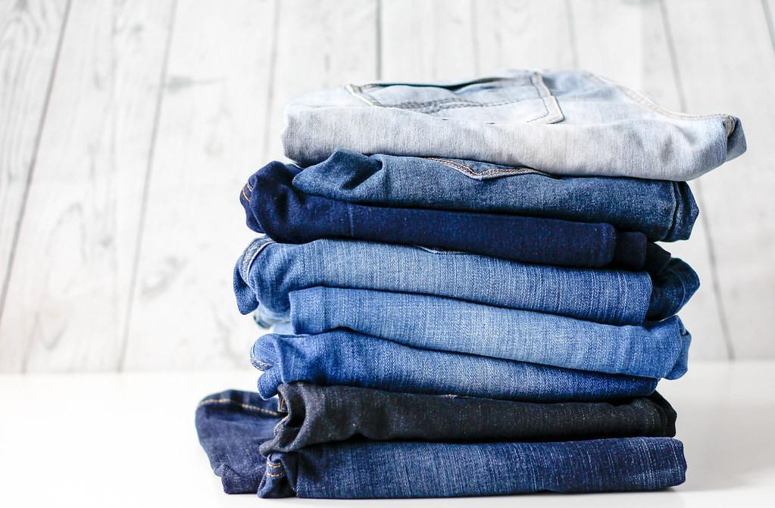
Monopolistic Competition
Many companies sell products that are similar but not identical

Slide 5
Corporation
Owned by stockholders who have limited liability for the firm’s debts

Slide 6
Partnership
Business owned by 2 or more people who divide the responsibilities and profits

Slide 7
Sole Proprietorship
Business owned and managed by single individual

Slide 8
Private Property
Ownership of property by anyone other than the government

Slide 9
Mergers
An agreement that unites two existing companies into one new company

