Slide 1
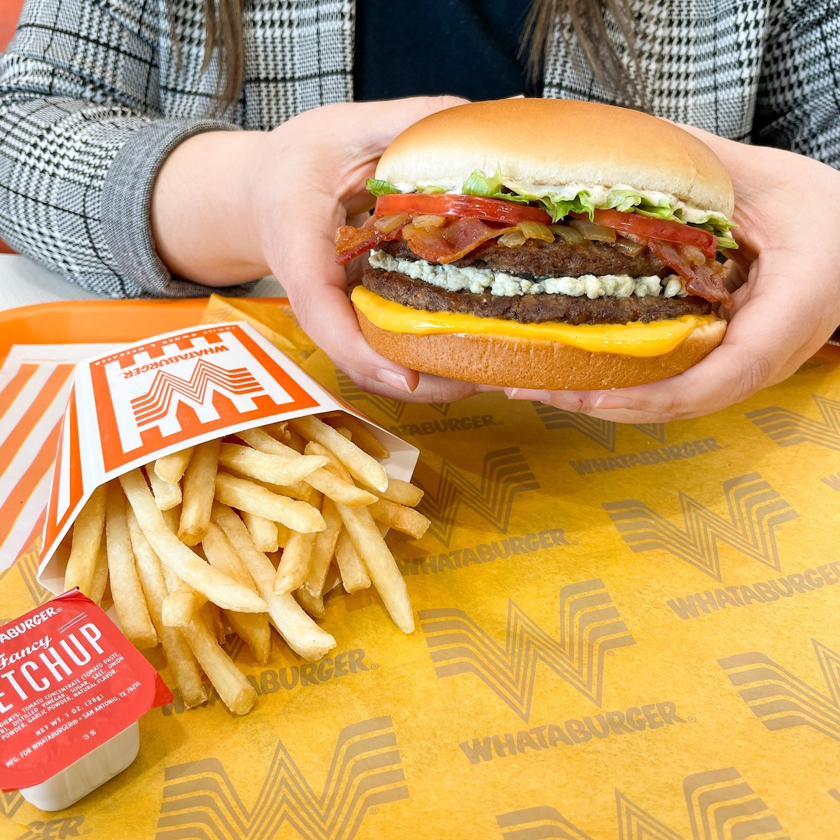
Absolute Advantage
Ability to produce more of a given product using a given amount of resources

Slide 2
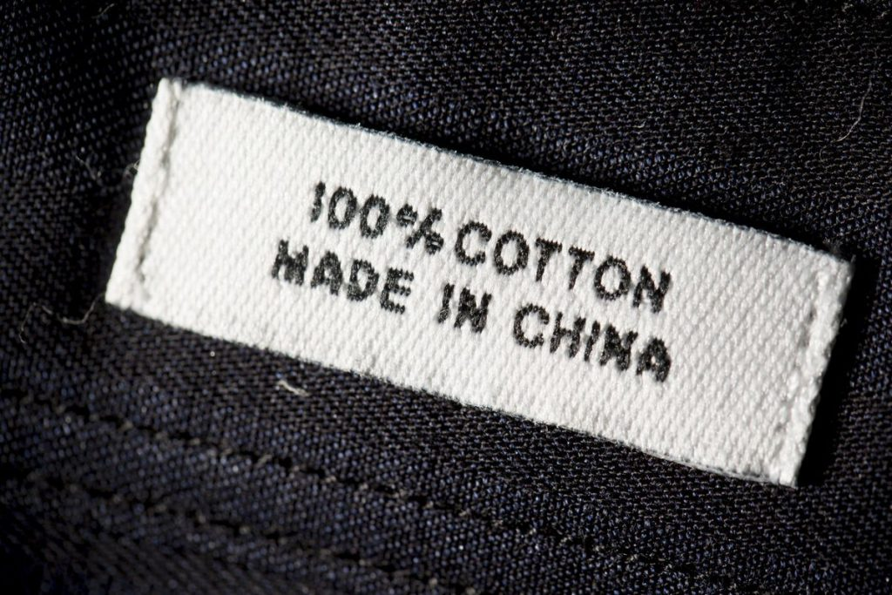
Comparative Advantage
Ability to produce a product most efficiently given all the other products that could be produced

Slide 3
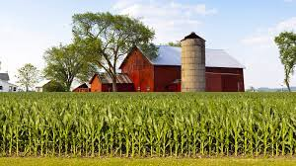
Factors of Production
the resources that are used to make goods and services
land, labor, capital, entrepreneurship

Slide 4
Scarcity
Unlimited wants but limited resources

Slide 5
Communism
the government owns and controls the resources and means of production, and makes all the economic decisions

Slide 6
Socialism
the belief that wealth should be evenly distributed throughout society

Slide 7
Free Enterprise
what is produced is usually determined by consumer demand and how its produced is based on supply of resources, with little to no government control

Slide 8
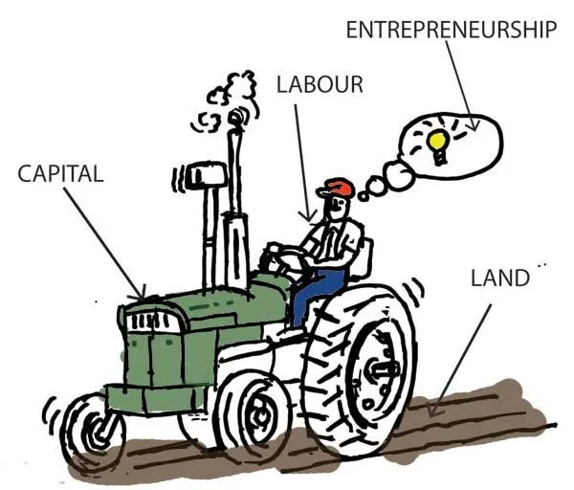
Factor Market
where businesses purchase the factors of production from households

Slide 9
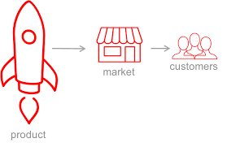
Product Market
where households purchase goods and services from businesses

Slide 10
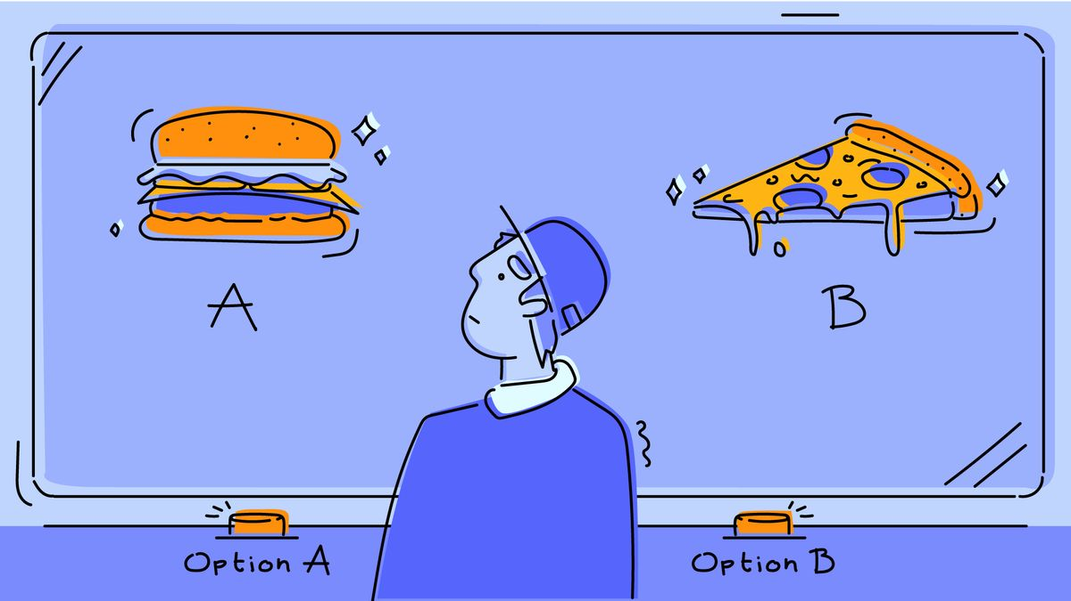
Opportunity Cost
the most desirable alternative given up as a result of a decision
*what you lose when you chose

Slide 11
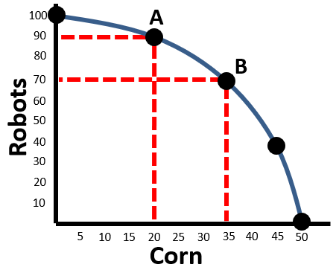
Production Possibility Curve
a graph that shows all the different combinations of output that can be produced given current resources and technology

Slide 12
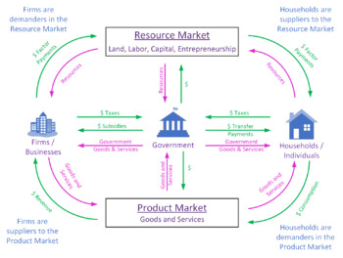
Circular Flow Model
demonstrates how money moves through society

