Slide 1
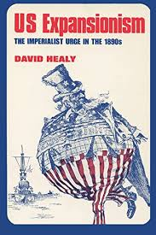
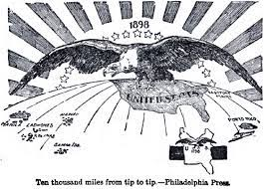
U.S. Imperialism & Expansionism
Unit 4: American Expansionism #1

Slide 2
Eras of Time we’ve discussed:
1783-1900: The West
1865-1901: Gilded Age
1890-1920: Progressive Era
1890-1920: Imperialism

Slide 3
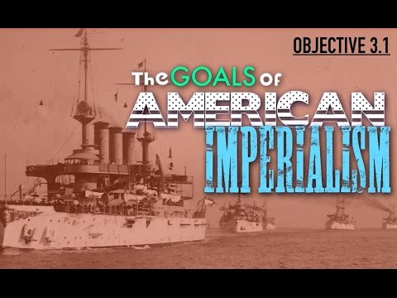

Slide 4
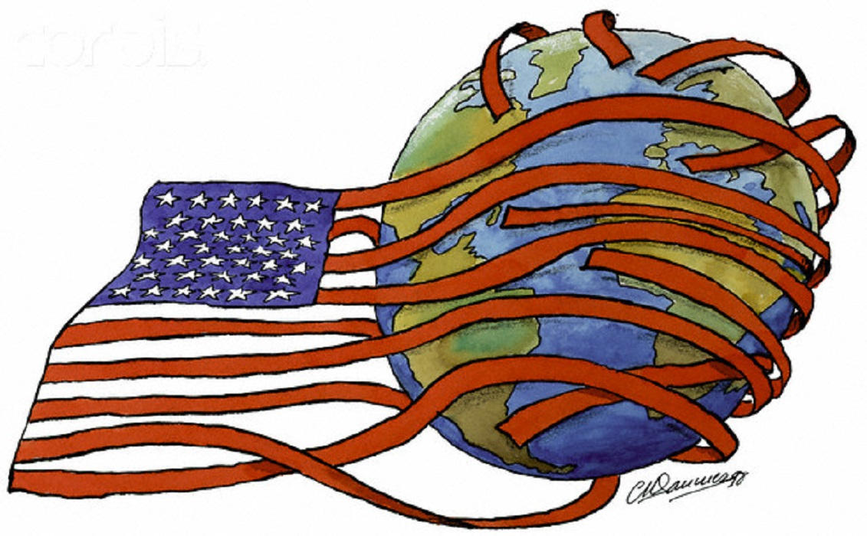
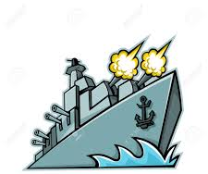
What is imperialism/expansionism? How is it accomplished?
Imperialism: stronger nations (countries) try to expand (get bigger) & create empires
Goal: extend their borders (America has been expanding its size for many years - Manifest Destiny)
For the first time, we will look beyond the American continent
Accomplished by dominating or controlling weaker nations:
Economically (money)
Militarily (war)
Politically (politics & laws)

Slide 5
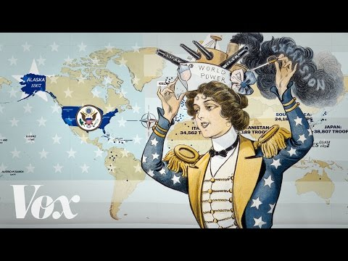

Slide 6
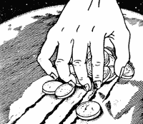
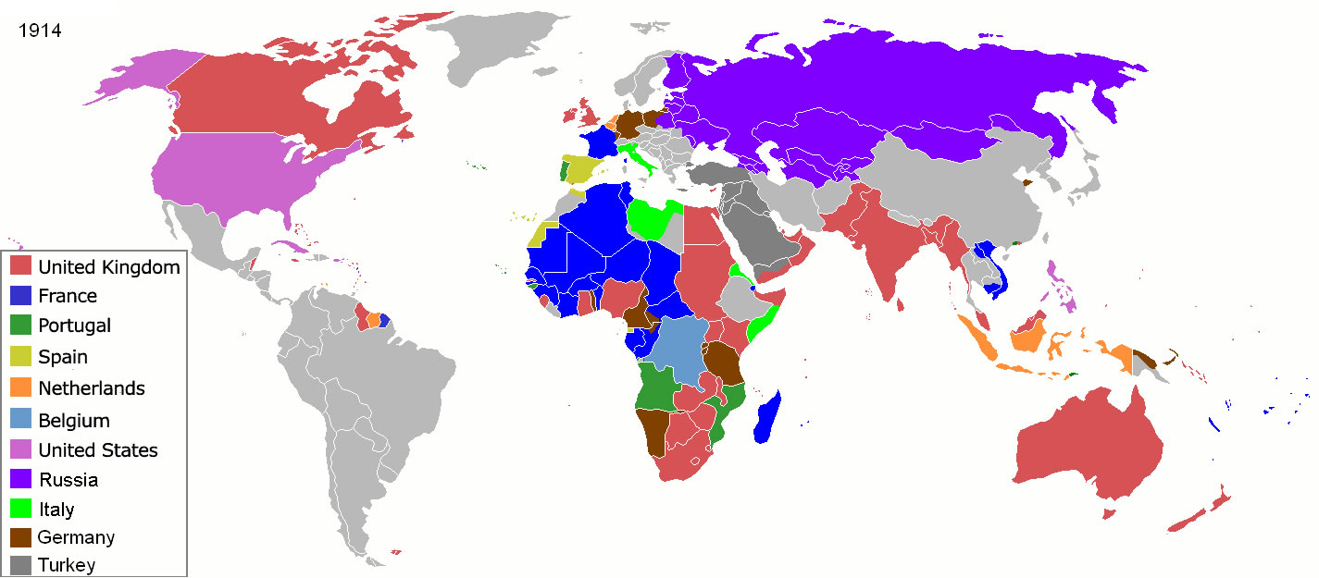
Why did the U.S. engage in expansionism?
European Imperialism
U.S. believed they were going to get left behind
Colonies would provide raw materials to export (sell):
Crops (coffee, bananas, pineapples)
Resources (oil, gold)

Slide 7
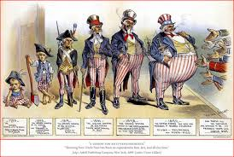
Mastery Check:
What is imperialism/expansionism?
Gaining territory through war
Growing through trade
Voting for control
Growing territory borders

Slide 8
Annexation - New Territories | Military Conquest - Increase the navy
Economic Domination | Spheres of Influence - Latin America
What are the characteristics of imperialism?

Slide 9
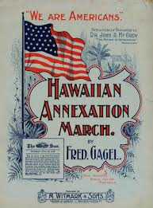
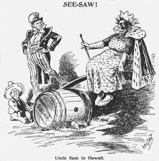
Annexation
To add a territory or an area into the U.S.
What two major areas does the U.S. annex add during this time?
Hawaii
Alaska

Slide 10
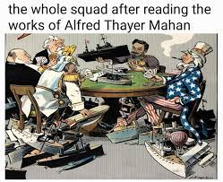
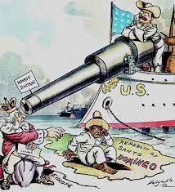
Military Conquest
Alfred Thayer Mahan wrote “The Influence of Sea Power Upon History”
Wanted to become a world power (strong country) and develop a strong navy (ships & boats)
Roosevelt will be greatly influenced by Alfred Mahan

Slide 11
What did Mahan want Americans to do to become a world power?
“England’s naval bases have been in all parts of the world and her fleets have at once protected them… Colonies attached to the mother-country afford, therefore, the surest means of support abroad the sea power of a country…”

Slide 12
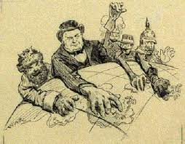
Economic Domination
The U.S. wanted to secure new markets (places to trade) and export (sell) products
$$$$

Slide 13
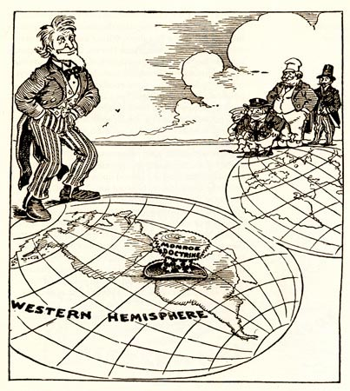
Spheres of Influence
Political and economic influence (power) over a smaller/weaker nation
Sphere = area/nation
Influence = power
In the 1850s, European powers had already established spheres of influence in China
U.S. did not have it in China, but had active trade with them
Secretary of State John Hay wanted to protect American businessmen and investors there
He feared trade would be shut out of China by European powers

Slide 14
Mastery Check
Who does the man on the left represent?
What is he doing to the lands/nations?

Slide 15
Does everyone agree with the U.S. expanding??

Slide 16
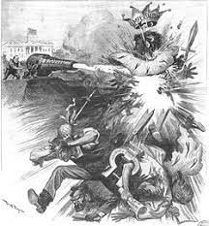
Anti-Imperialists
Anti = Against
American Anti-Imperialist League
Thought the U.S. should NOT take control of areas outside of the U.S.

Slide 17
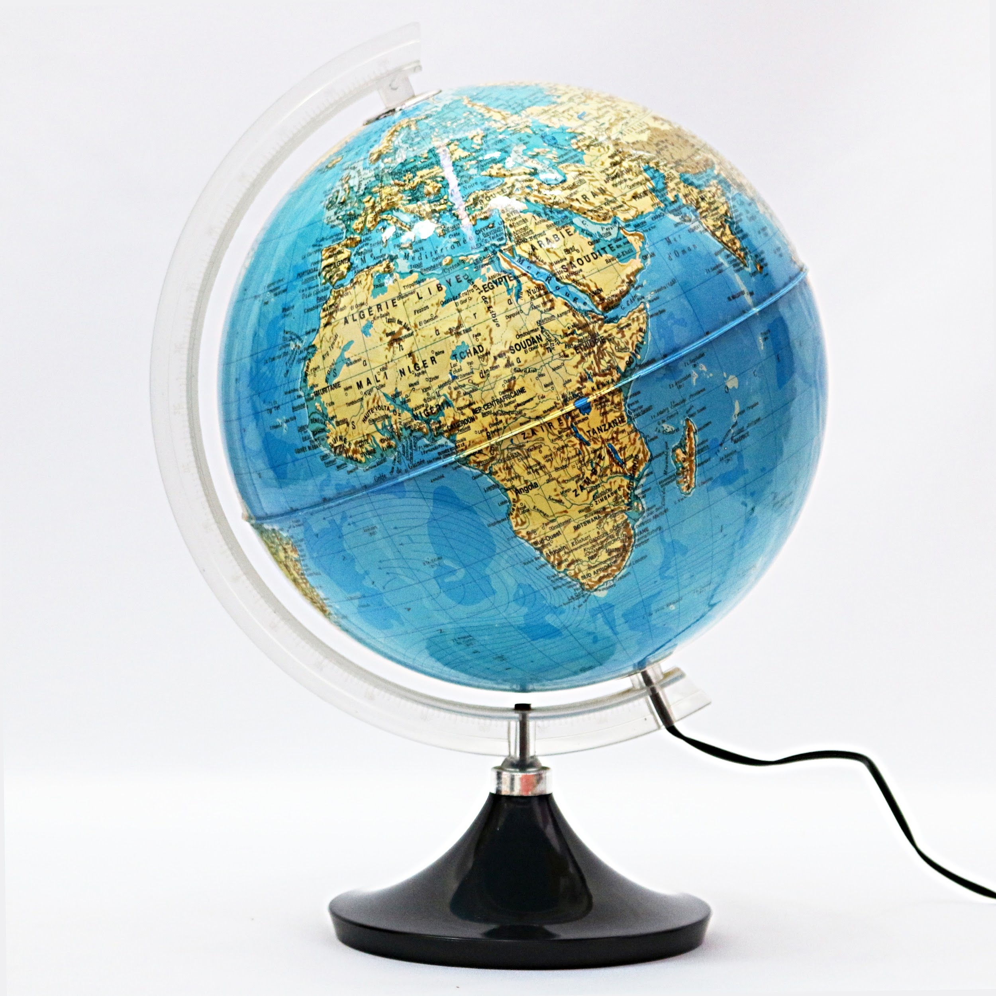
What is foreign policy?
Every nation has two types of policies:
Domestic policy: how the country deals with the people and issues in its own country
Foreign policy: how the country interacts with other countries and their issues

Slide 18
America’s Foreign Policy changes…
In the 1800s and early 1900s, America’s foreign policy will change dramatically…
For the first time it involved:
Imperialism
Expansionism
*Looking outside our borders for territory*

Slide 19
Mastery Check: Foreign or Domestic?
Contemplating bombing Syria
Immigration
National Budget
Civil Rights
War in Afghanistan
Trade with China

Slide 21
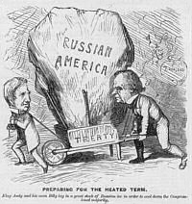
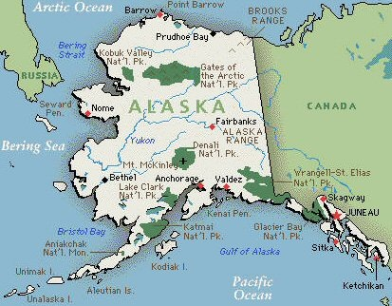
Alaska: “Seward’s Folly”
1867 - Secretary of State William Seward bought Alaska from Russia ($7.2 million or 2 cents an acre)
Called “Seward’s Folly”
‘Folly’ - foolish/act stupid
*Alaska’s geography: a vast tundra (empty/lifeless area) of snow and ice
Benefits: Klondike Gold Rush (1896); oil, (1967)

Slide 22
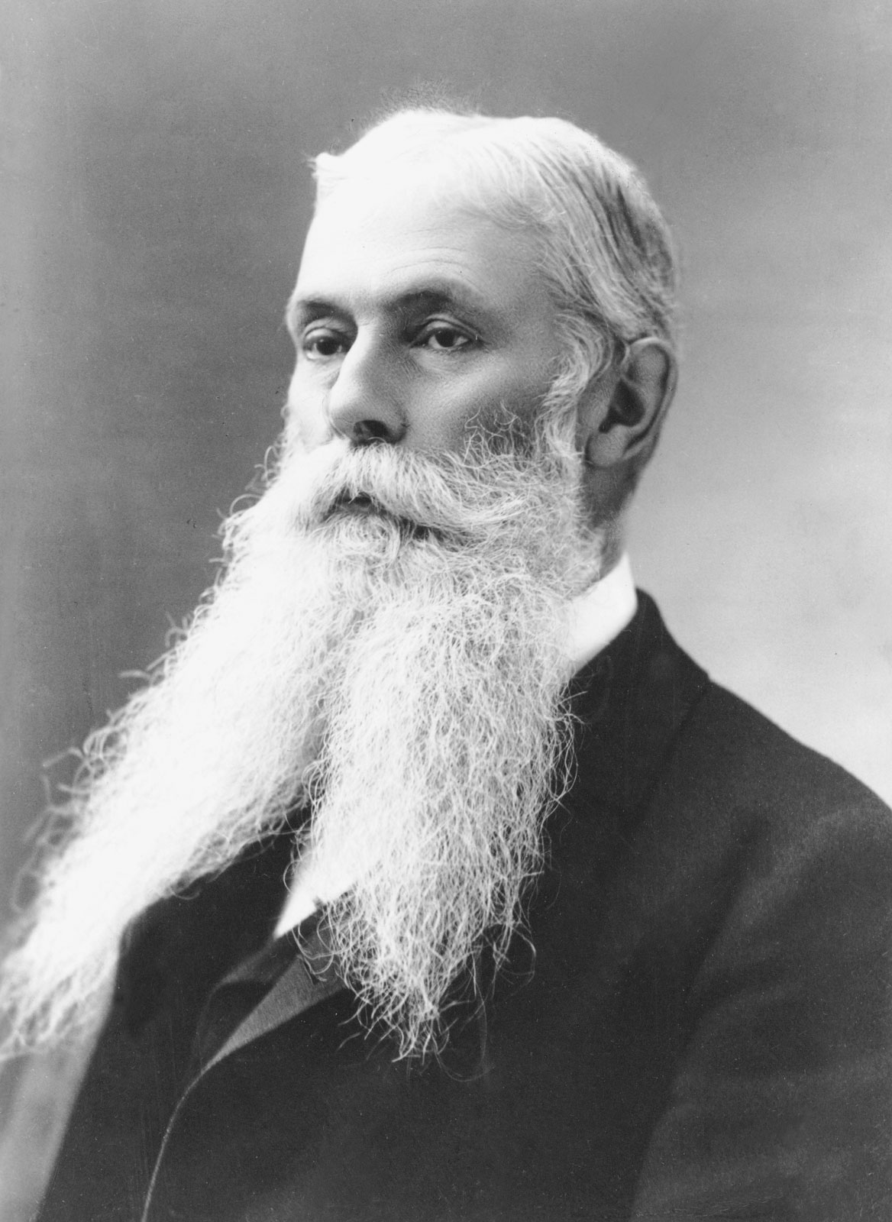
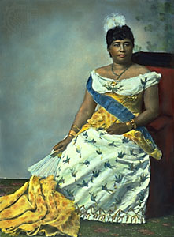
Annexation of Hawaii (1898)
Sanford B. Dole helped overthrow (replace) Hawaii’s Queen Liliuokalani
Wanted to annex (add/take over) Hawaii
Hawaii (Dole) and Midway Islands (Seward) gave the U.S. more power in the Pacific Ocean
Repair & refuel ships & build navy bases
Example: Pearl Harbor
President McKinley supports annexation

Slide 23
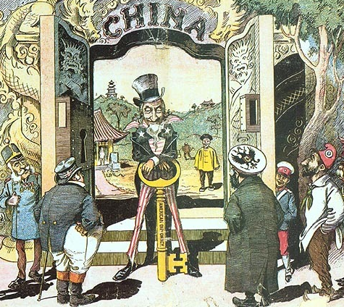
Open Door Policy
Favored American interests over foreigners (other countries)
Secretary of State John Hay saw China as a vital market for America’s new industrial economy
In 1899, he announced the Open Door Policy, giving equal trading rights to all foreign nations in China
He sent notes to the other major powers and declared his policy to be in effect
Boxer Rebellion: The ‘boxers’ were a group of Chinese who did not like the foreign presence in their country
*Anti-Imperialists

Slide 24
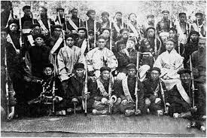
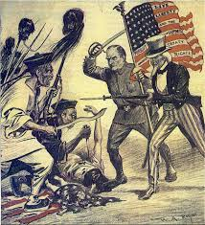
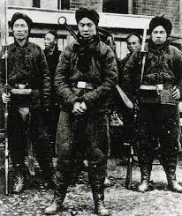
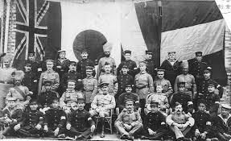
Boxer Rebellion
Secret societies formed in China that spoke about driving out all foreigners
Rebellion led by “boxers” because they practiced martial arts
1900: Chinese Boxers began killing foreigners
August 14, 1900: 2500 American soldiers were joined by British, French, German, and Japanese soldiers
September 7, 1900: Rebellion ended

Slide 25
