Slide 1
Donald Trump & Joe Biden
(& Modern Technology)
Unit 13:Modern Era #3

Slide 2
2016 Presidential Election

Slide 3
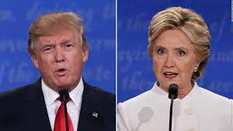
Donald Trump vs. Hillary Clinton
Donald Trump (R) vs. Hillary Clinton (D)
Trump will win the 2016 election based on the electoral votes, NOT the popular vote
He will become the 45th President of the U.S.

Slide 4
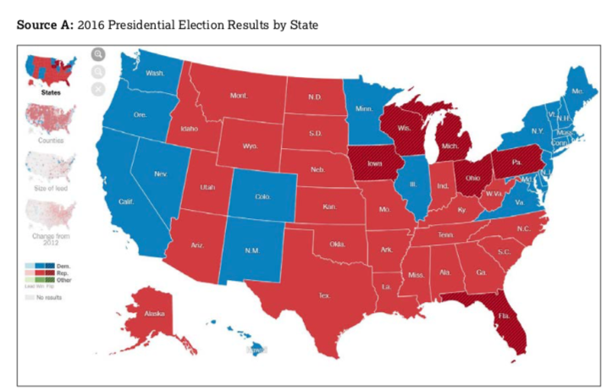

Slide 5
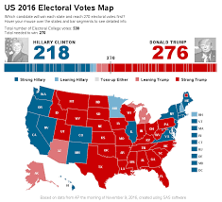

Slide 6
Can you name another modern era president who won the electoral votes?

Slide 7
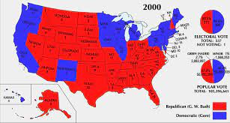
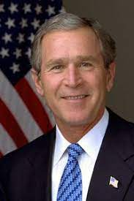

Slide 8
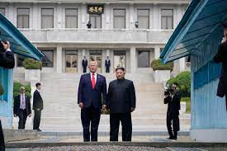
Trump’s Foreign Policies
USMCA (United States Mexico Canada Agreement) replaced NAFTA
{Slowly} reduce the number of troops in Afghanistan
Taliban & ISIS less of a threat
Met with Kim Jong-Un (North Korea)

Slide 9
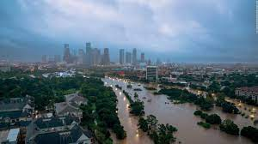
Trump’s Domestic Policies
Attempted to repeal Obamacare
Nationwide women’s protest
Border control controversy (“The Wall”)
Russian collusion
Hurricane Harvey
COVID (Stimulus checks)
Impeached twice

Slide 10
2020 Presidential Election

Slide 11
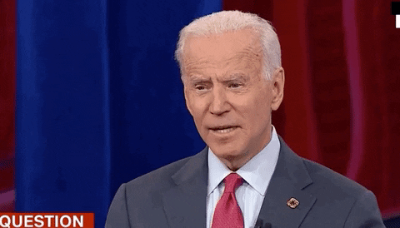
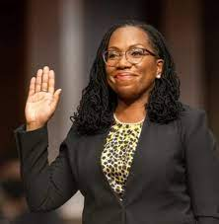
Donald Trump vs. Joe Biden
Biden wins (former VP under Obama)
Kamala Harris VP (first female & female of color as VP)
Election results questioned
Oldest elected president (currently 81 years old)
Excessive executive orders
Massive border issues (migrant children)
COVID continues
Ketanji Brown Jackson
First African-American female Supreme Court Justice

Slide 12
Modern Technology
(Innovators & Innovations)

Slide 13
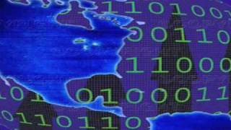

Slide 14
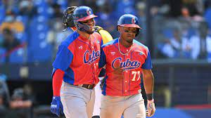
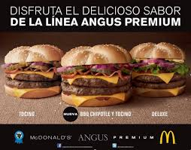
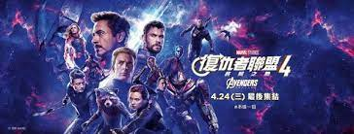
Diffusion of American Culture
Things from American culture that are also used, bought & sold, or consumed in other countries
Multinational corporations are corporations that has set up local companies in several countries
McDonald’s is a franchise with over 30,000 restaurants in 113 countries
Starbucks sells coffee in 40 overseas markets, operating 12,00 stores
Baseball is a major sport in Cuba & Puerto Rico
“Avengers” is the most popular movie in China

Slide 15
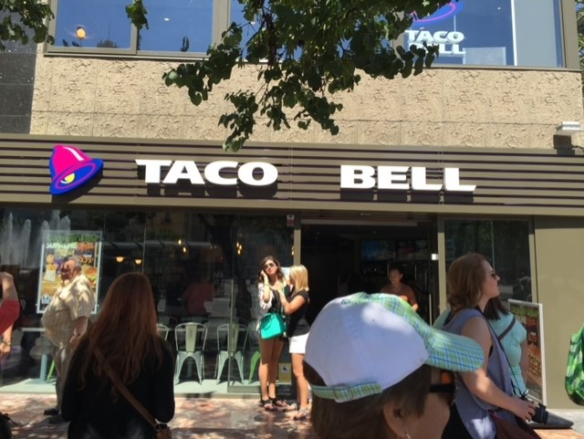
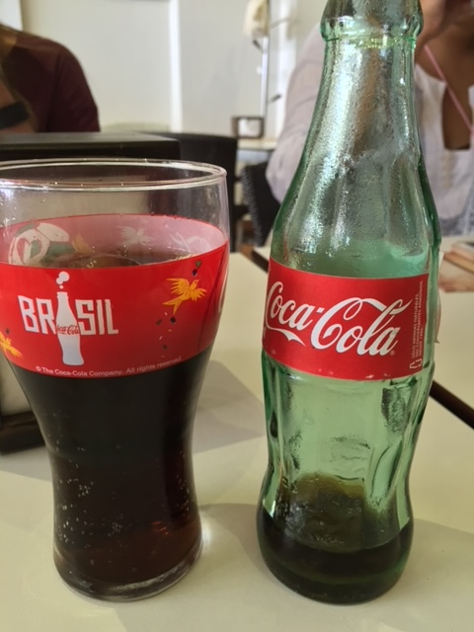
Taco Bell & Coca-Cola in Valencia, Spain

Slide 16
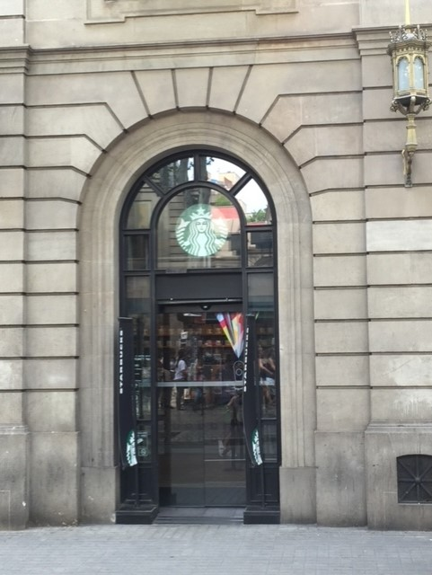
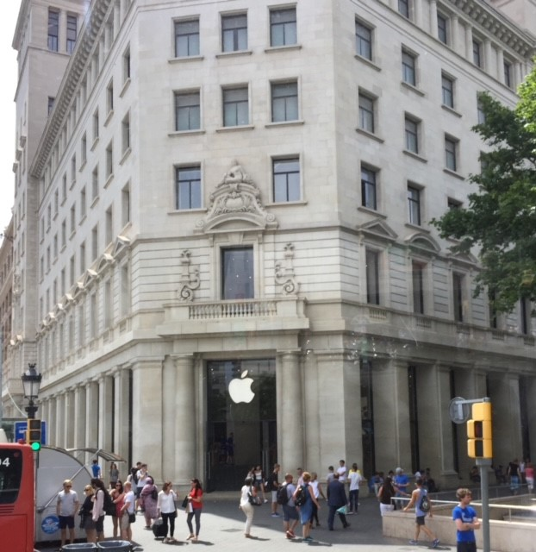
Starbucks & Apple Store in Barcelona, Spain

Slide 17
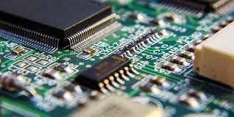
The Internet & The Information Age
Instant communication across the globe
Developed in the mid-90s
Work from home instead of office
Silicon Chips:
Manufactured many devices like smartphones, automobile electronics, home appliances, and drone technology
Started “e-commerce” marketplace
Greatly increased access to information
Creation of Google in 1998

Slide 18
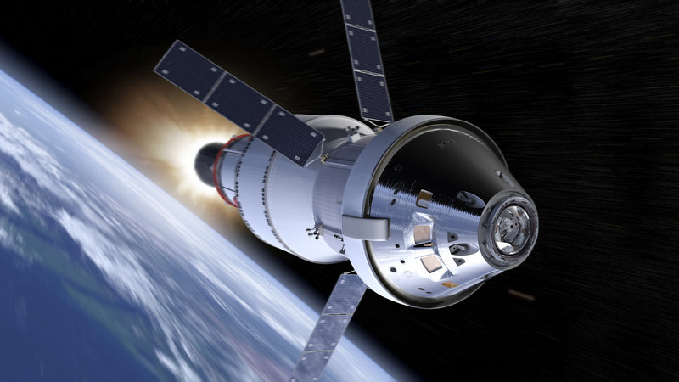
Technology from Space Exploration
Heat resistant technology - used originally to protect space shuttles on re-entry
Scratch resistant technology
Satellites:
Increase efficiency in telecommunications & GPS systems for navigation
More accurate weather forecasts
UV filtering lenses

Slide 19
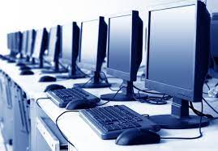
Age of Computers
Data entry systems improve productivity
Bill Gates made a uniform operating system
Steve Jobs founded Apple
Home systems came in the 1990s (personal computers)
Free market boost competition between computer/cell phone producers
Wifi printers

Slide 20
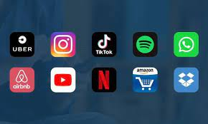
Age of Computers Con’t
Applications (“Apps”):
“The app industry has taken the world by storm, creating a micro-economy in its own right and creating jobs for hundreds of thousands of talented professionals worldwide. A successful app can now be the different between complete anonymity and global digital fame.”
Photomath
Life360
YouTube
QR Codes:
“Quick response,” a machine-scannable image that can instantly be read using a Smartphone camera

Slide 21
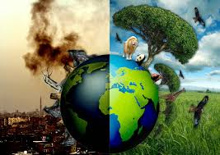
Environmentalism & Renewable Energy
Hybrid & electric cars
Reduces $ spent on gas
Global warming
Solar and wind power
Reducing emissions to cut greenhouse gasses

Slide 22
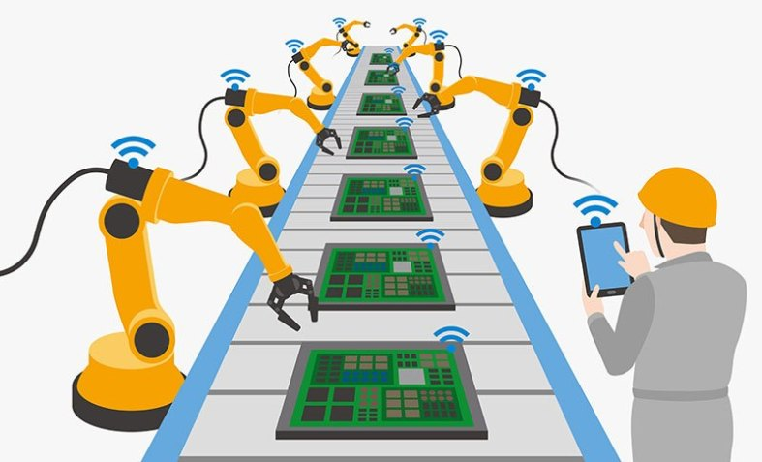
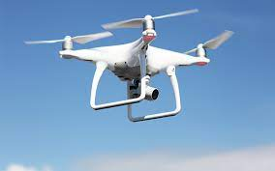
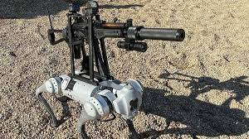
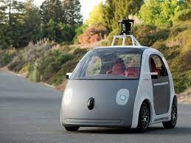
Robotics & Animation
Replacing human workers in factories:
Automated tracking system for inventory
Assembly lines
Cuts costs of labor
Increases manufacturing productivity
Driverless cars
Drones & drone technology
Robotics
Medical capabilities & advancement

Slide 23
