Slide 1
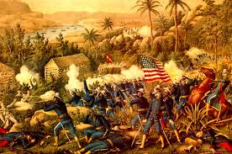
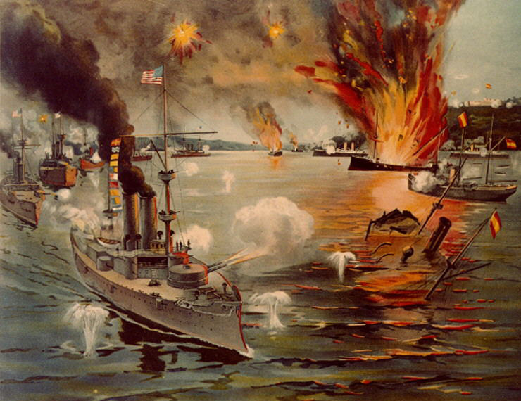
THE SPANISH AMERICAN WAR
April – August, 1898
Unit 4: American Expansionism #2

Slide 2
TIMELINE OF U.S. IMPERIALISM
1867
Purchase of Alaska (Seward)
1898
Spanish-American War
1908
Panama Canal under construction

Slide 3
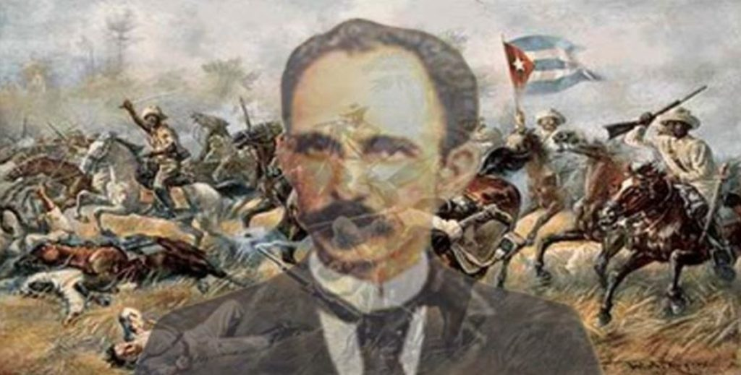
CUBAN REVOLUTION
Cuba was one of Spain’s New World colonies
Rebelling against Spain since 1860
1895 – Rebel leader Jose Marti led an invasion against Spain
The Spanish response: put villagers in concentration camps to stop the rebels

Slide 4
CAUSES OF THE SPANISH-AMERICAN WAR
Yellow Journalism
The Spanish-American War
U.S.S. Maine exploded
De Lome letter
Nationalism

Slide 5
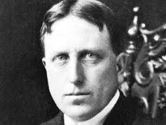
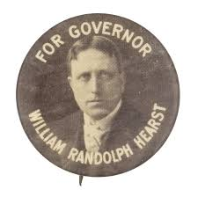
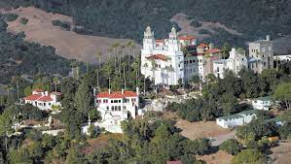
YELLOW JOURNALISM
Competing papers sensationalized or exaggerated news, even lied
Huge influence on the public
Newspapers depicted the Spaniards as murderous brutes
Increased their circulations, but gave Americans the wrong picture of events in Cuba
Two biggest newspaper owners behind this:
William Randolph Hearst
Joseph Pulitzer

Slide 6
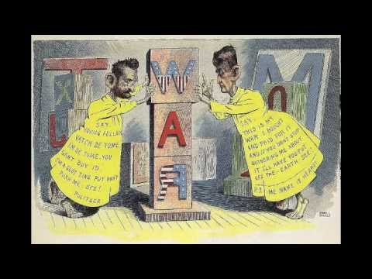

Slide 7
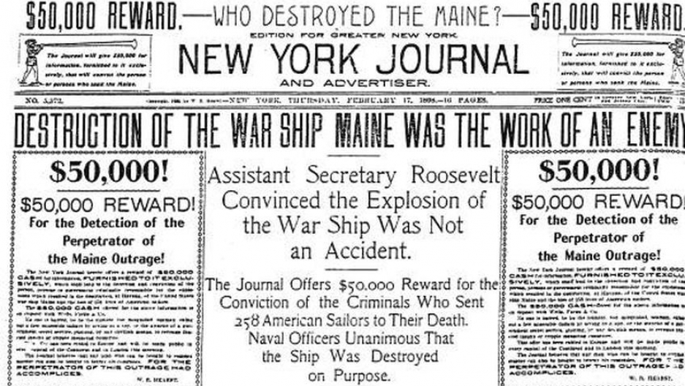
EXAMPLE OF YELLOW JOURNALISM
“Destruction” =
dramatic
“$50,000” = eye -catching
“Outrage” = emotional

Slide 8
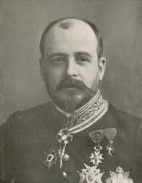
DE LOME LETTER
Spanish minister Dupuy de Lôme wrote a letter criticizing President McKinley calling him “weak”
Leaked and printed in the NY Journal
Americans were outraged
Published shortly before the U.S.S. Maine was sent to Cuba to protect lives and properties of Americans

Slide 9
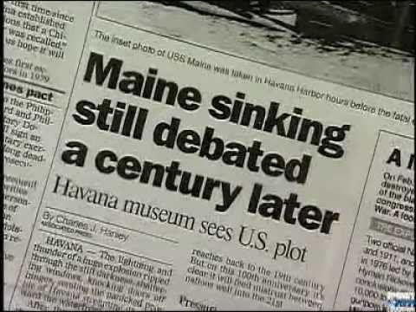

Slide 10
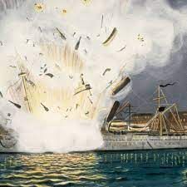
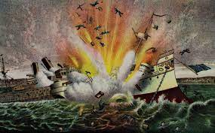
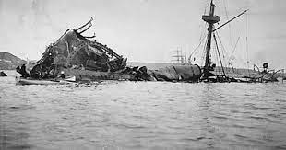
U.S.S. MAINE
The U.S. sent the battleship U.S.S. Maine to the Havana Harbor
This was to make sure Americans living in Havana were safe
February 15, 1898, the U.S.S. Maine suddenly exploded in Havana Harbor
260 Americans were killed
Yellow journalists declared Spain responsible; explosion was probably an accident
“Remember the Maine!”

Slide 11
WAR!
Pressure from Congress & the public forced President McKinley to issue a message calling for war
Depended on army volunteers, especially the Rough Riders

Slide 12
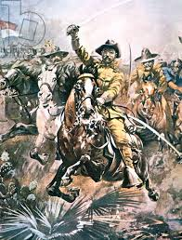
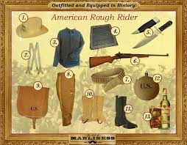
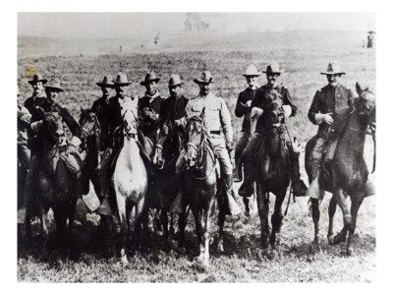
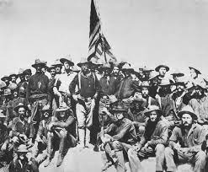
TEDDY ROOSEVELT & THE ROUGH RIDERS
As Assistant Secretary of the Navy, at the time, Theodore Roosevelt organized & commanded the volunteer cavalry unit The Rough Riders
Rough Riders are the most famous unit from the war
Acted with other army regiments, defeated Spanish forces at San Juan Hill, Cuba
Roosevelt earned the Medal of Honor

Slide 14
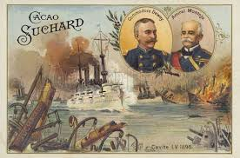
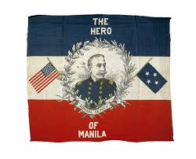
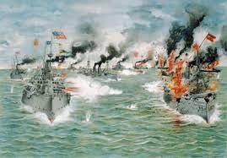
FIGHTING THE WAR
First shots fired at Manila Bay, Philippines
Admiral George Dewey destroyed the Spanish fleet demonstrating the power of the U.S. Navy
By August, America had “liberated” (freed) the Philippines

Slide 15
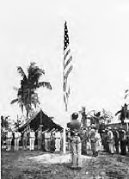
VICTORY!
August 1898, Spain surrendered to the U.S.
Treaty of Paris (December 10, 1898)
Cuba was independent
U.S. would acquire Puerto Rico, Guam, & The Philippines ($20 million)
U.S. becomes a WORLD POWER

Slide 16
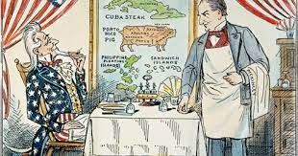
THE PLATT AMENDMENT
Cuba 1902: U.S. withdraws; honoring Teller Amendment
Before U.S. withdrew, Cuba was forced to add the Platt Amendment to their Constitution:
Cuba cannot make treaties that would compromise their independence without U.S. approval
Cannot take on debt that could not be repaid
U.S. could intervene with troops when it saw fit
U.S. could leave naval stations (Guantanamo)
Platt Amendment provisions ended in 1934, except for Guantanamo Base leasing

Slide 17
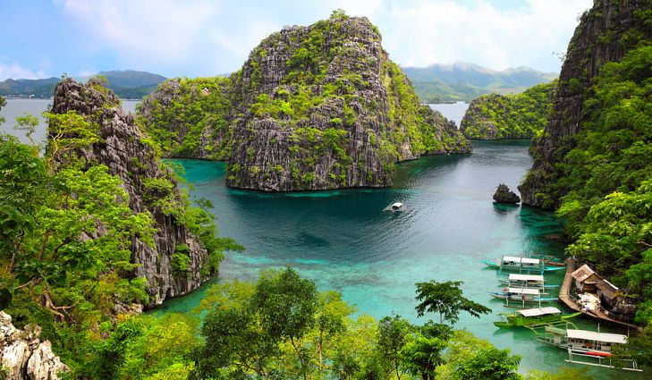
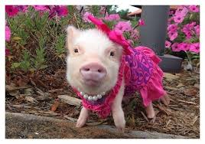
U.S. ACQUISITIONS (GAINS) AFTER THE SPANISH AMERICAN WAR
1. Puerto Rico
2. Philippine Islands
3. Guam
PRETTY PIG

Slide 18
How do you think Anti-Imperialists will feel about the gain of the Philippine Islands?

Slide 19
EFFECTS OF THE SPANISH AMERICAN WAR
Ended Spanish colonial empire
in the Americas
THE SPANISH AMERICAN WAR
Supported Mahan’s
two ocean Navy
U.S. becomes a world power

Slide 20
ECONOMIC ($) EFFECT OF THE WAR
1890-1920 =
U.S. Imperialism
Exports = goods (things)
we sell, TRADE
YEARS | VALUES OF AMERICAN EXPORTS
1865 - 1897 | $1,000,000
1897 - 1900 | $3,000,000
1900-1917 | $1,600,000,000

