Slide 1
The Cold War At Home
Unit 9 - The Cold War #3

Slide 2
The Space Race
At the end of WWII, the U.S. and the Soviets both recruits German scientists who had worked in the Nazi rocket program
Both countries began competing for dominance of spaceflight technology
This competition came to be called “The Space Race”
Why race to space?
The rocket technology needed to go to space would also have military uses (such as nuclear bombs)
It was a morale thing - to prove who was the best

Slide 4
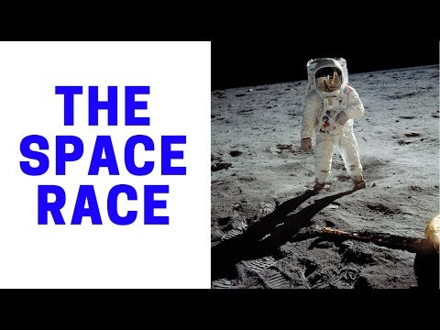

Slide 5
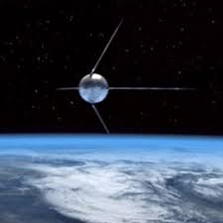
Sputnik
In 1957, the Soviets surprised the world by launching Sputnik I
They won the first round of the Space Race
Sputnik was the first artificial satellite ever
Sputnik made Americans nervous because:
It showed that the Soviets were more scientifically advanced
If they could launch a missile into space, they could try to launch a missile to America

Slide 6
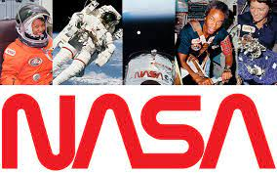
The U.S. Response
In response to Sputnik, the U.S. government began to emphasize on math and science education
The National Defense Education Act (1958) gave billions of dollars to public schools and universities to increase their math and science programs and to help students attend college
U.S. formed the National Aeronautics And Space Administration (NASA) in 1958
Afraid that Soviet technology was superior
NASA was dedicated to space exploration

Slide 7
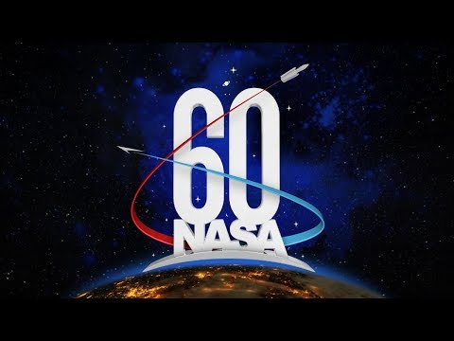

Slide 8
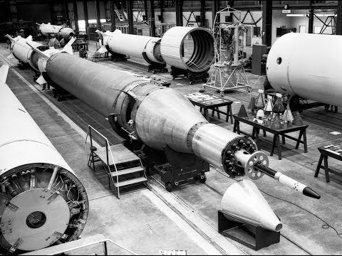

Slide 9
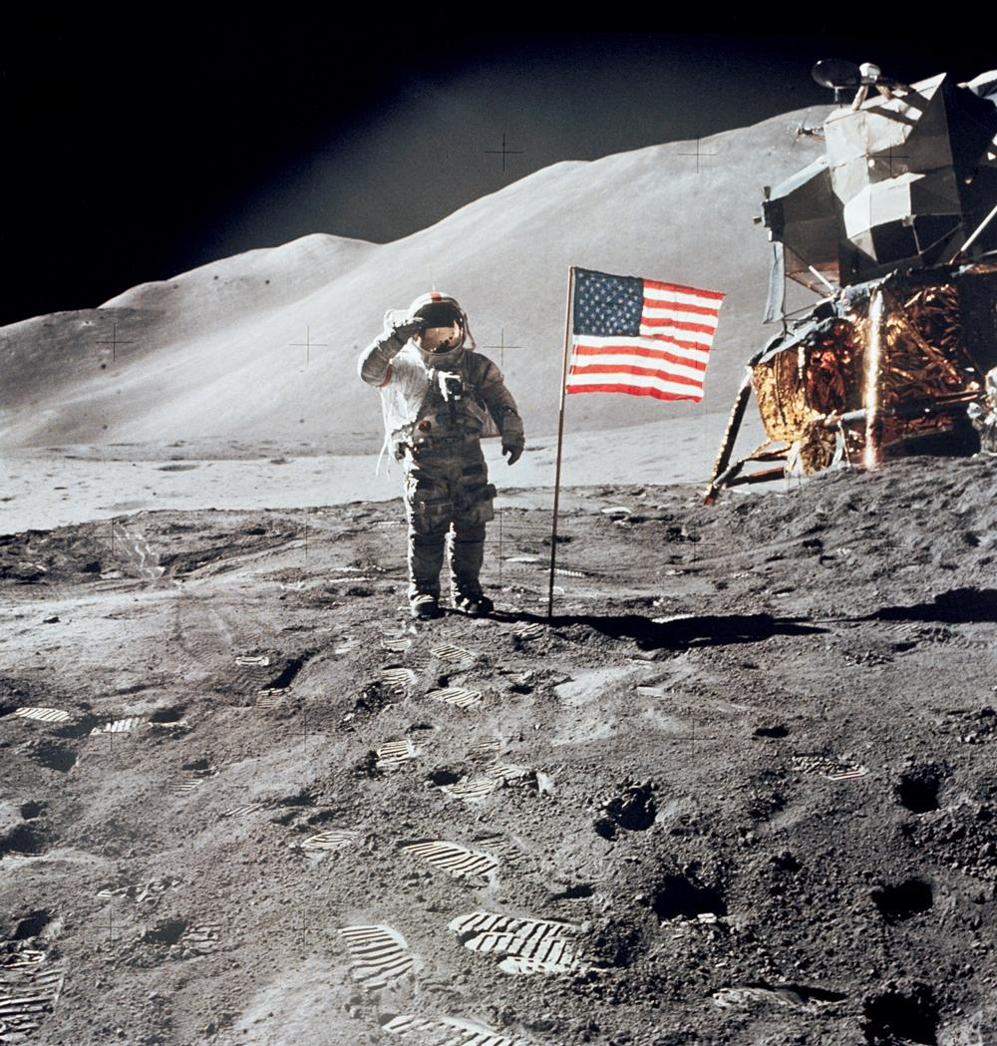
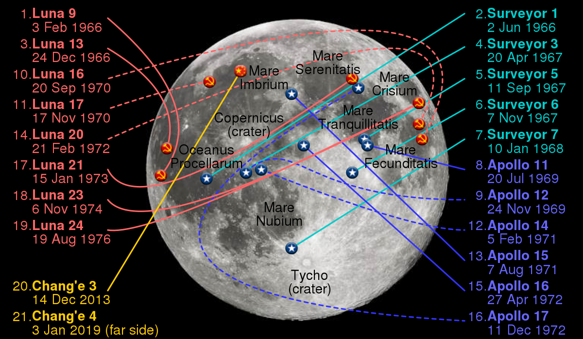
U.S. Wins!
On July 20, 1969, the U.S. “won” the Space Race by successfully landing a man (actually 2) on the moon
The U.S. would go on to land 5 more manned missions on the moon and is to date the only country to ever send a manned mission there

Slide 10
One Small Step…

Slide 11
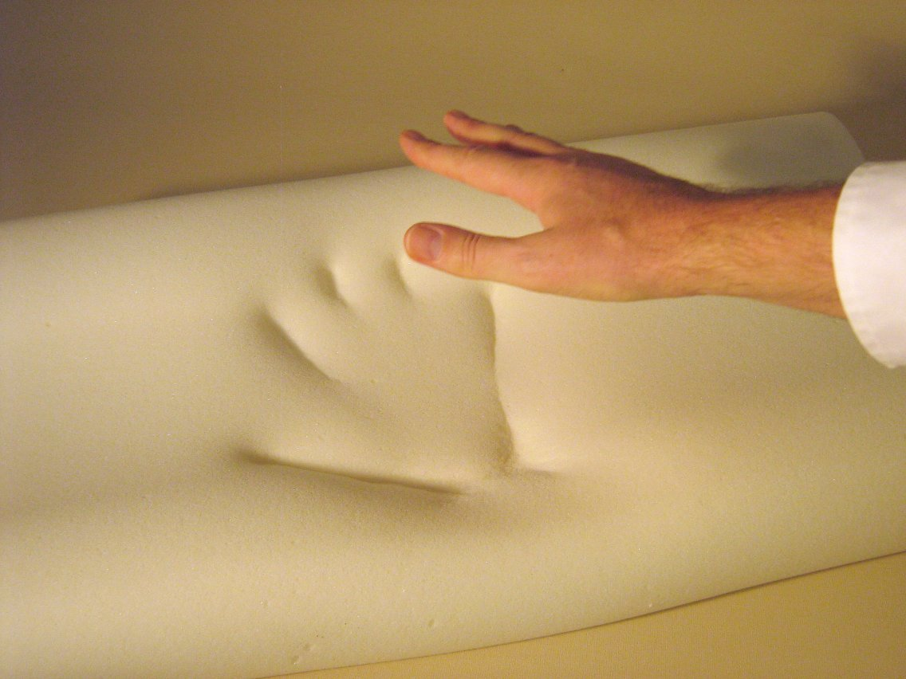
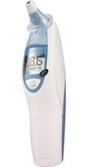
Every Day Inventions Brought to You By The Space Race
**Velcro, cordless power tools and Tang did not result from the Space Race - they are myths

Slide 12
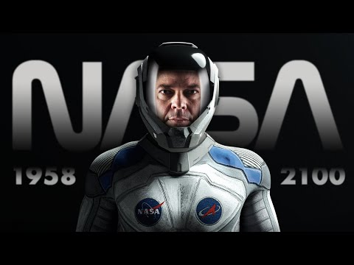

Slide 13
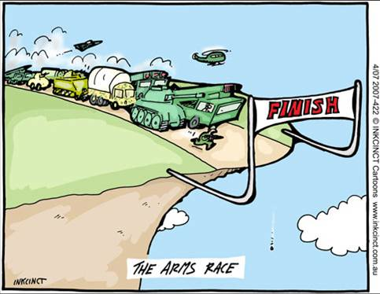
Arm’s Race
Alongside the Space Race, the U.S. and the Soviet Union competed to have more nuclear weapons than the other
America believed that if Russia were to have more nuclear warheads than the U.S. then they would be less afraid to use them, and so the U.S. should have striven to maintain, at a minimum, nuclear equality with USSR
Also, nuclear rivalry led to the invention of a long line of increasingly deadlier weapons

Slide 14
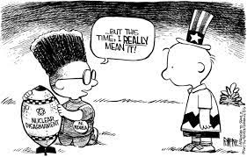
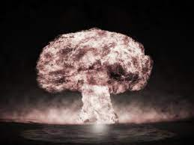
What is ‘Mutually Assured Destruction?’

Slide 15
Nuclear Arms Race
1949: Soviet Union exploded its first atomic bomb
Soon the U.S. and the Soviet Union will be in a race to create and deliver nuclear weapons, satellites, biological weapons and digital computing
American and Soviet leaders realize these weapons should never be used and instead use them as deterrents against each other in a Balance of Terror

Slide 16
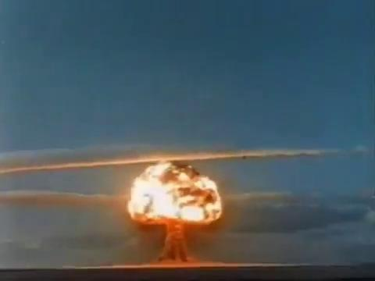
Soviet Nuclear Bomb Test (1953)

Slide 17
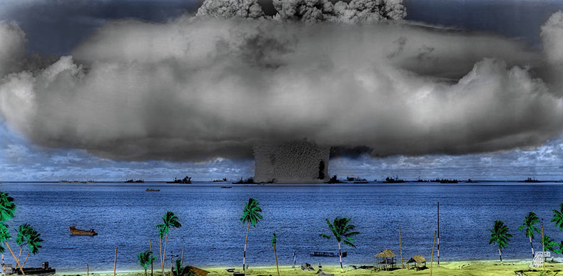
Nuclear Bomb Testing
America tests its nuclear bombs on an area of the Marshall Islands in the Pacific called Bikini Island
We removed the 167 residents on the island and tested the bombs underwater
This could be observed on the islands 3.5 miles away from the blast
July 25, 1946

Slide 18
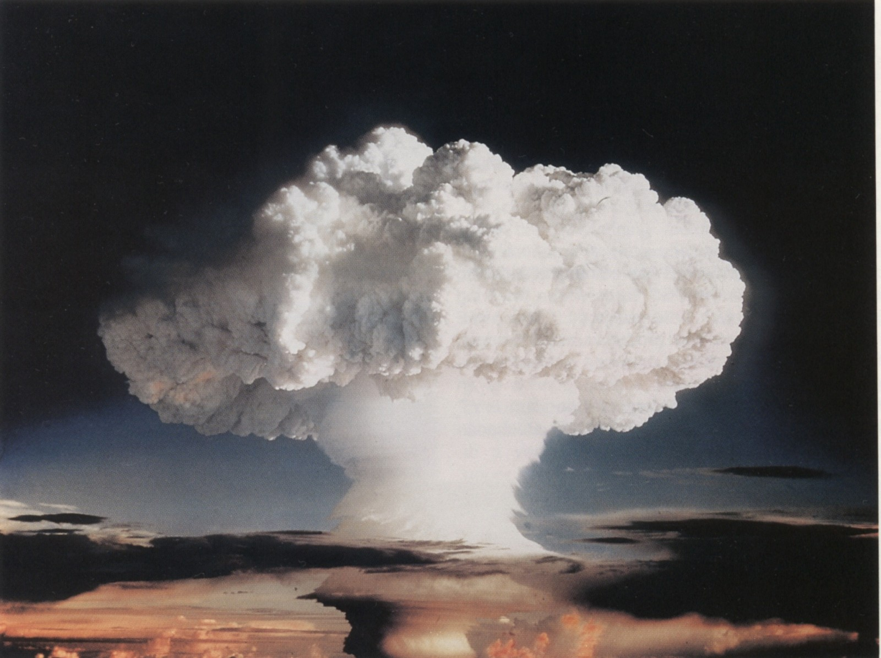
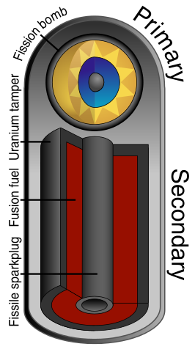
The H-Bomb
In 1950, the U.S. developed the hydrogen bomb
Relied on the fission of hydrogen atoms to create the energy for nuclear fusion reaction
Hydrogen bombs can be 1000X more powerful than atomic bombs
“Ivy Mike” the first hydrogen bomb ever tested

Slide 19
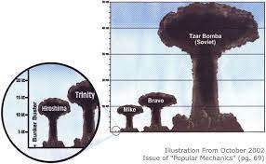
NUKEMAP by Alex Wellerstein

Slide 20
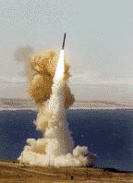
The Arms Race
Deterrence: maintaining a military arsenal so strong that no enemy will attack, resulting in the escalating development of powerful nuclear weapons
The policy of brinkmanship: bringing the U.S. to the brink

Slide 21
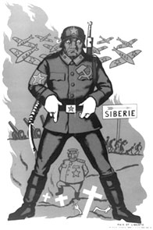
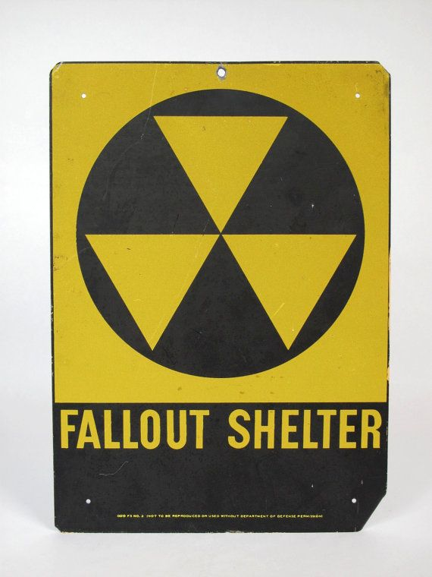
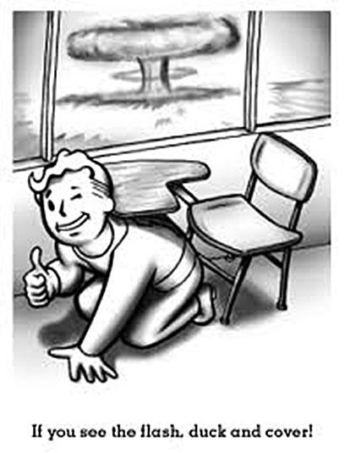
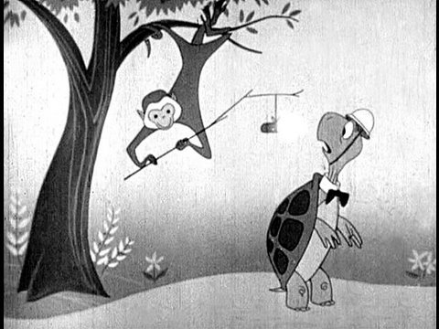
The Cold War At Home
Americans feared Communist ideology, a world revolution, and Soviet expansion
Duck & Cover:
Americans were very nervous about the threat of nuclear war
School safety drills required students to hide under their desks in case of nuclear attack
Local governments, businesses, & individuals bought or constructed bomb shelters and fall out shelters
Homeowners could even buy bomb shelter kits from magazines to install themselves
Anti-Soviet cartoon

Slide 22
How To Spot A Communist…

Slide 23
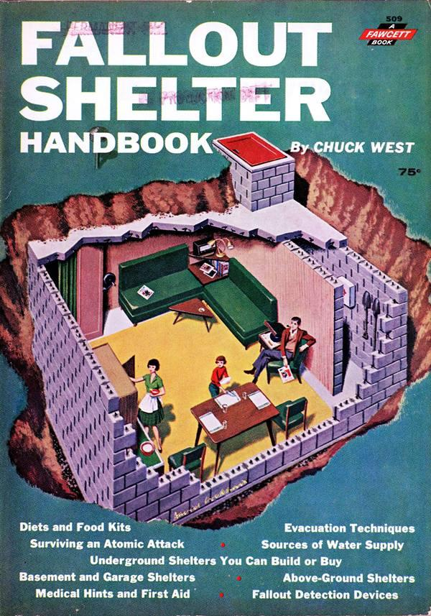
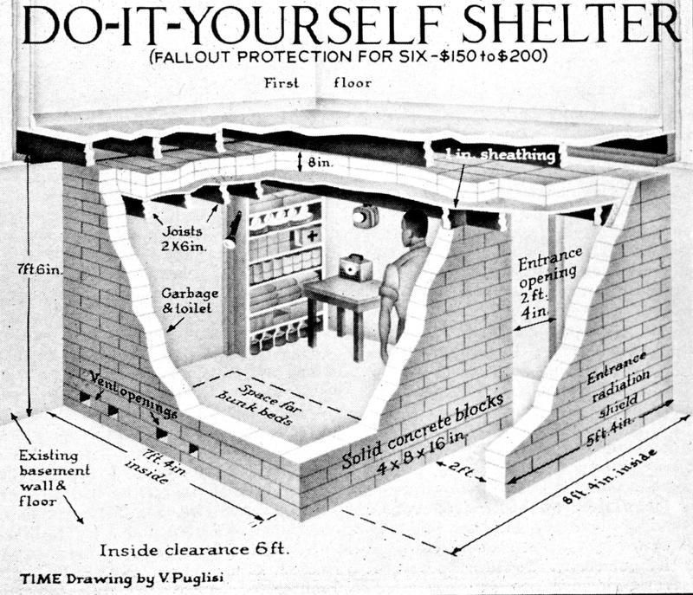
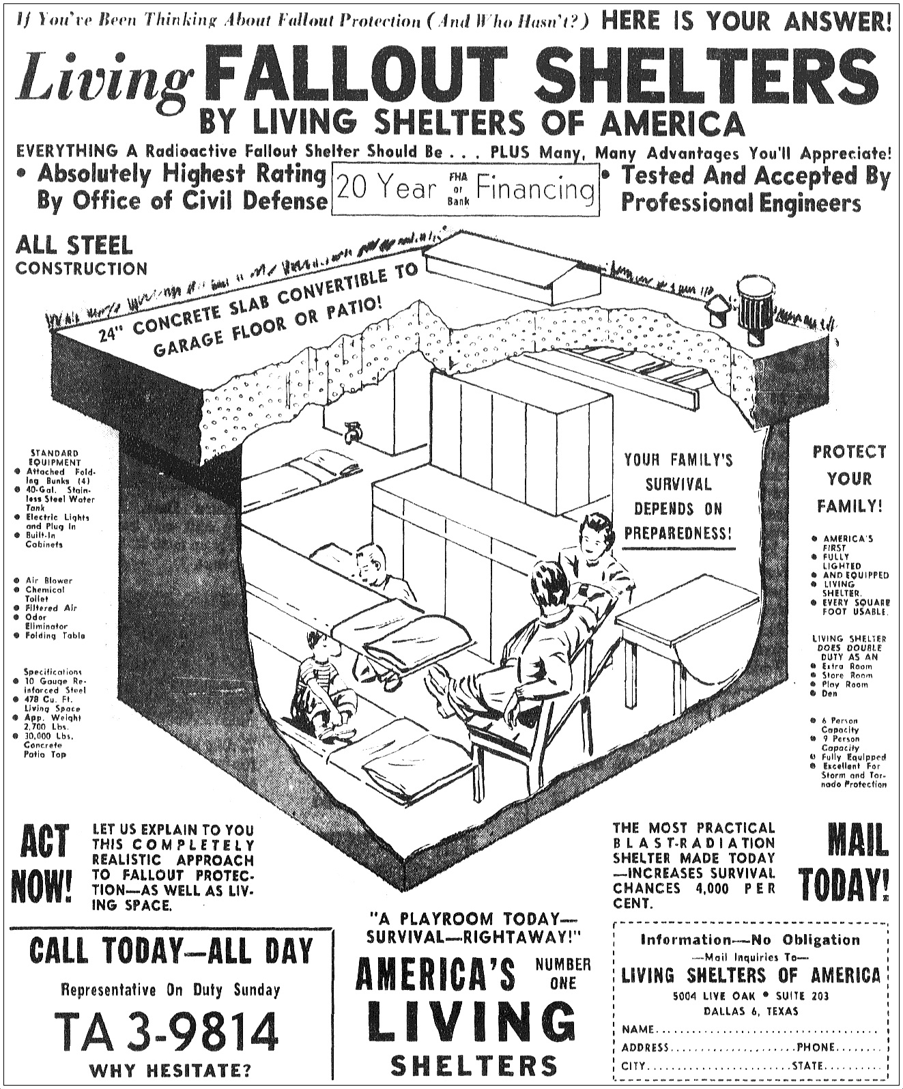

Slide 24
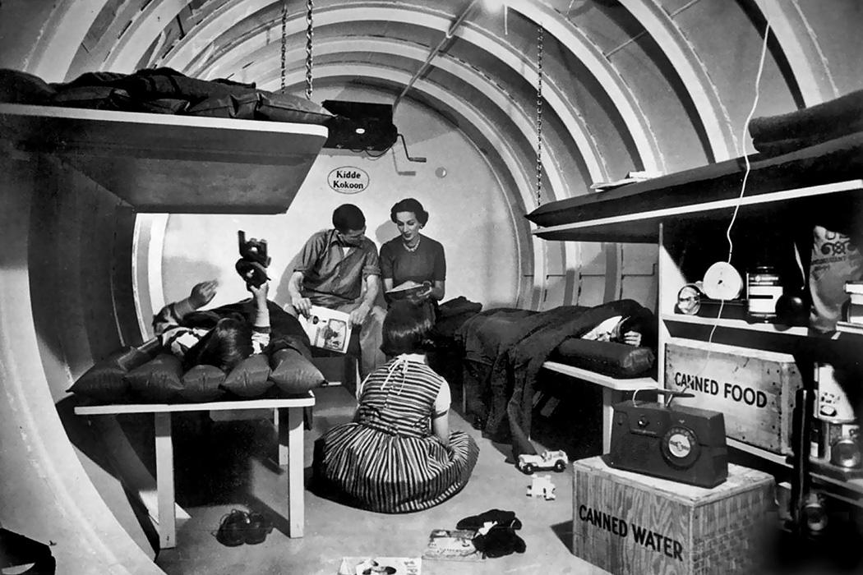

Slide 25
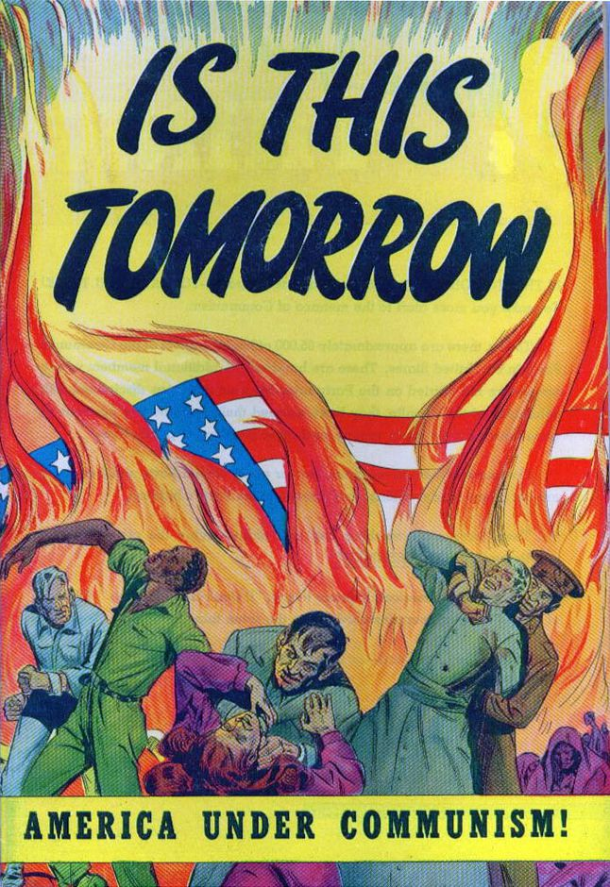
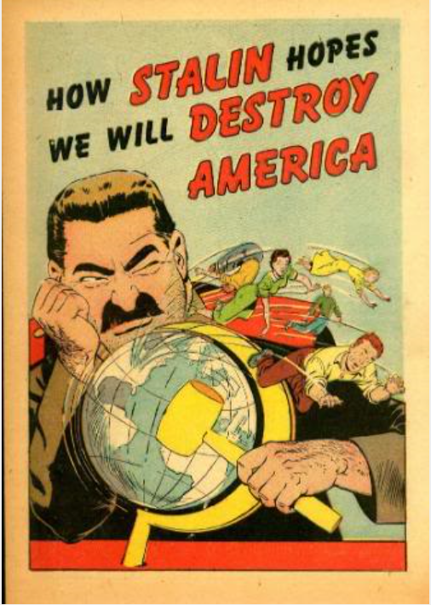
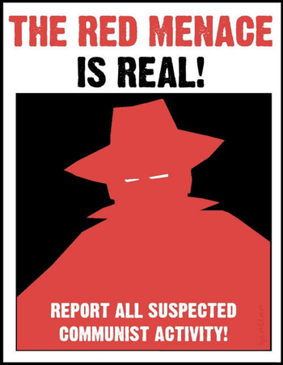
The Second Red Scare
Many Americans felt threatened by the rise of Communist governments in Europe & Asia
Some even felt that Communists could threaten the U.S. government from within

Slide 26
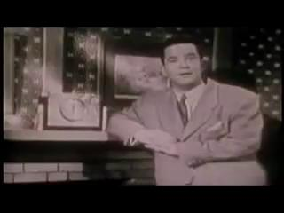
Better Dead than Red

Slide 27
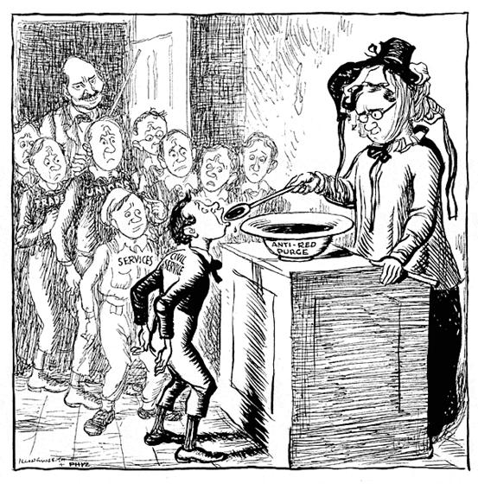
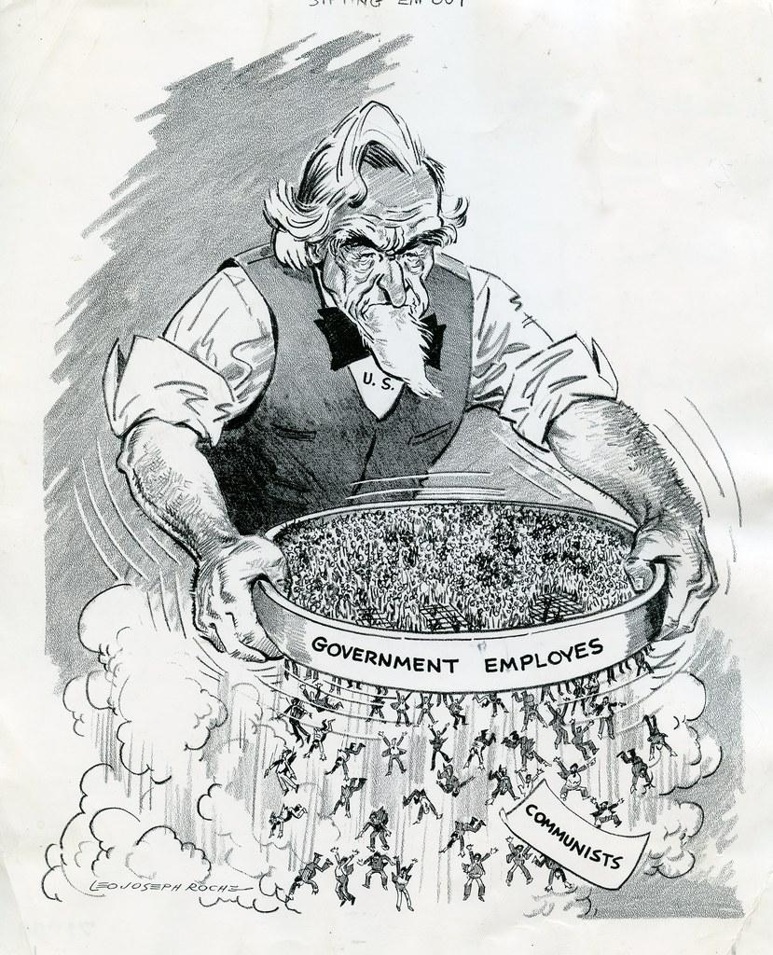
Loyalty Review Boards
Pressured by his Republic critics President Truman set up Loyalty Review Boards to investigate government employees
These boards questions more than 3 million government employees and removed about 200 from their jobs
The reasons for their firing ranged from actually having Communist sympathies to being an alcoholic to being in debt to being gay

Slide 28
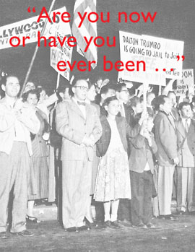
The House Un-American Activities Committee
1947: a Congressional committee called the HUAC began an investigation of Communist influence in the movie and film industry
Most brought before the committee cooperated but 10 men will refuse, they will be known as the Hollywood Ten
They felt the committee’s questions were unconstitutional
They will go to prison for refusing to answer and their careers will be ruined
Subsequently, the committee blacklisted 500 actors, directors, writers, and producers whom they believed had communist connections

Slide 29
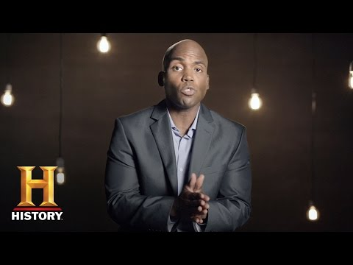

Slide 30
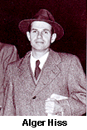
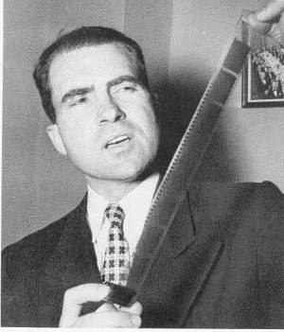
Spy Cases Stun the Nation
Two spy cases added to the fear gripping the nation
The first case involved government official Alger Hiss who worked for the State Department
Accused of spying for the Soviet Union
Found guilty of 2 counts of perjury relating to espionage
Sentenced to 2 five year sentences to be served concurrently, actually served less than 4 years
Nixon examines microfilm in Hiss case

Slide 31
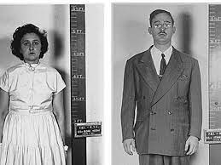
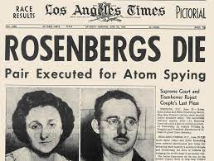
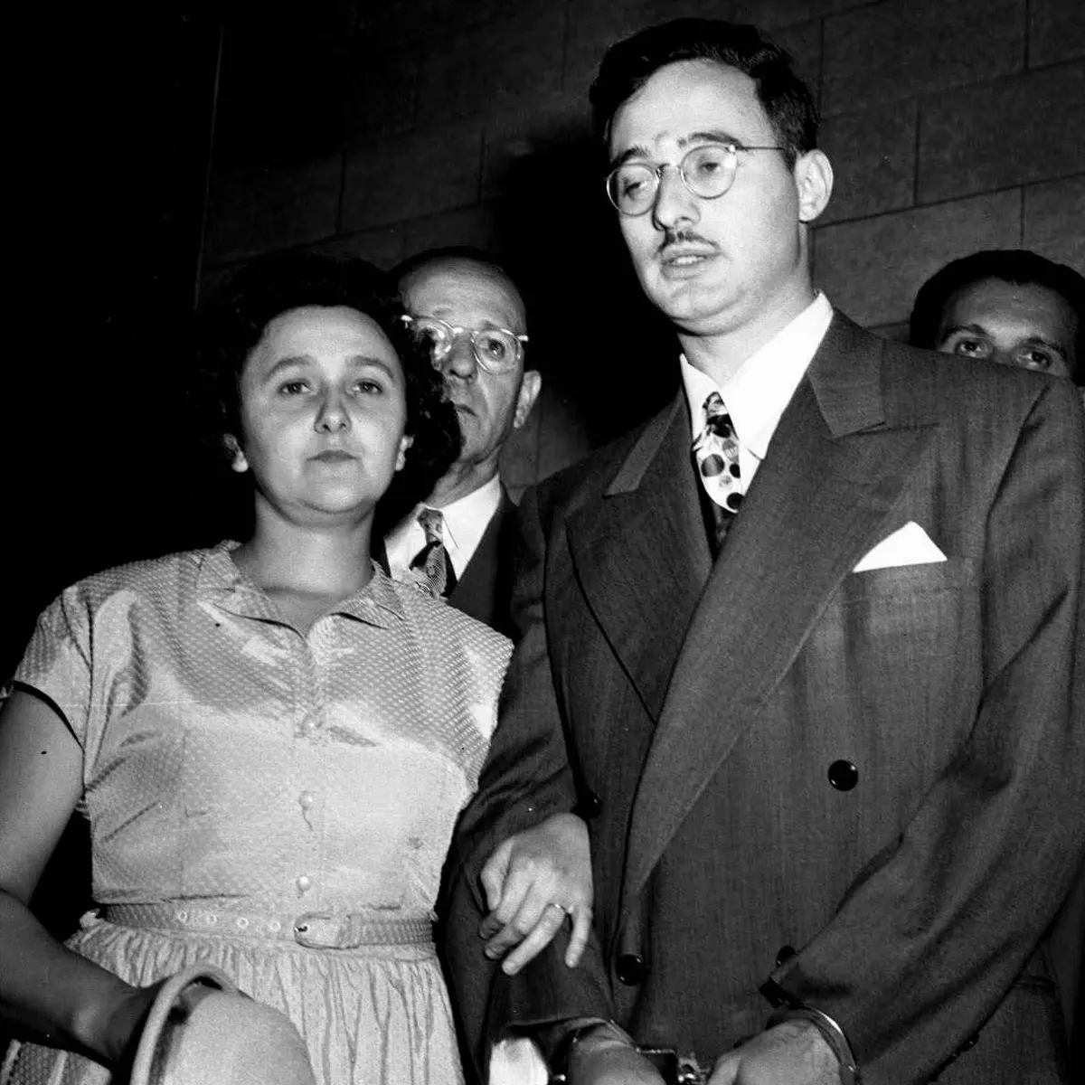
The Rosenbergs
The second case involved members of the American Communist Party: Ethel and Julius Rosenberg
Accused of providing information to Soviets which enabled them to produce an atomic bomb in 1949
Ethel & Julius Rosenberg were found guilty & executed

Slide 32
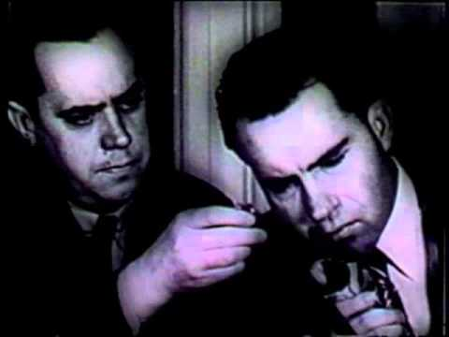

Slide 33
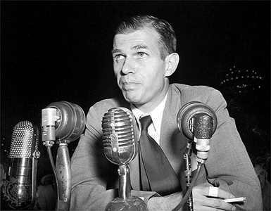
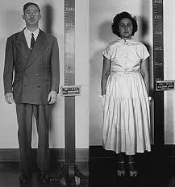
But Were They Really Spies?
Alger Hiss maintained his innocence until his death (he died in prison serving a sentence for perjury)
No one has ever been able to prove that he was a spy…or that he wasn’t
In 1997, the Venona Papers were released proving that a secret government investigation
It revealed the names of Soviet spies in America, including the name of Julius Rosenberg
Much like the Sacco & Vanzetti trial, many Americans feared that the Rosenbergs might have been innocent

Slide 34
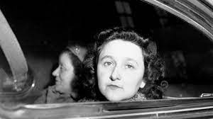
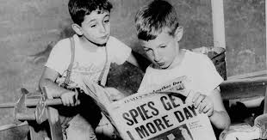
Notes:
https://www.usatoday.com/videos/news/nation/2016/12/01/sons-ethel-rosenberg-make-white-house-appeal/94754004/

Slide 35
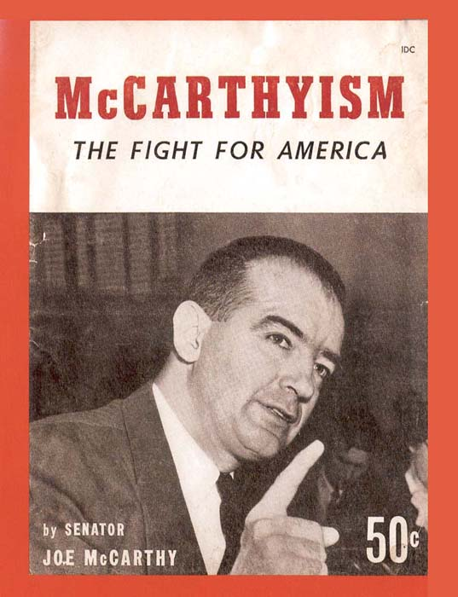
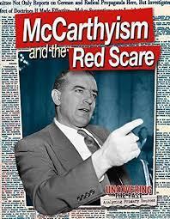
McCarthy Launches “Witch Hunt”
The most famous anti-Communist activist was Republican Senator Joseph McCarthy
In the early 1950s there were hundred of Communists taking over the government
He never produced any actual evidence of these accusations but did inspire fear and mistrust
His colleagues in the Senate encouraged his bullying tactics known as McCarthyism

Slide 36
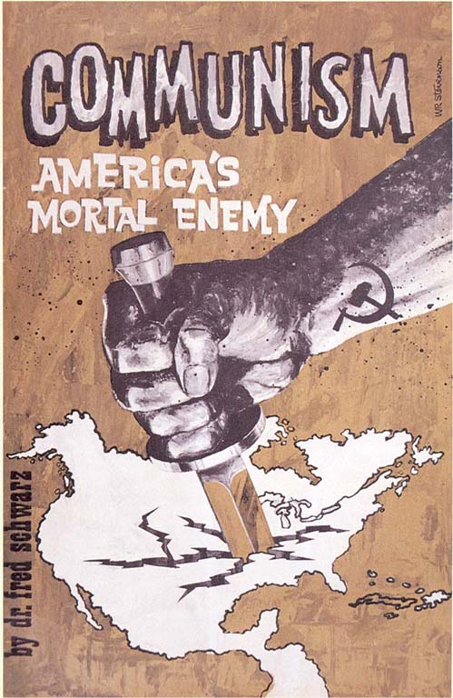
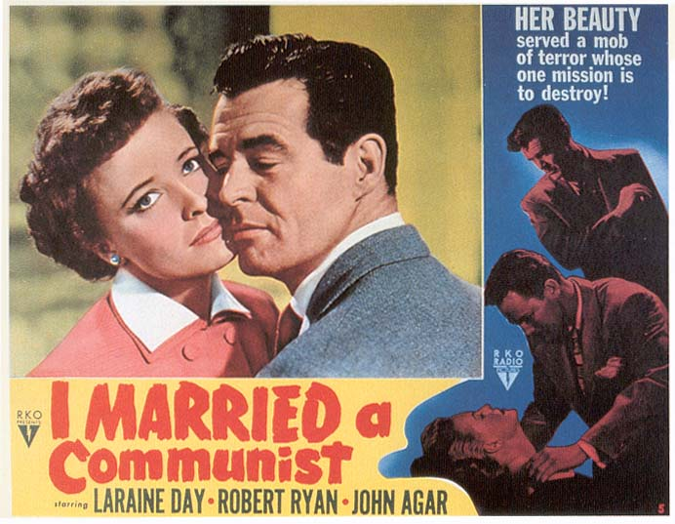
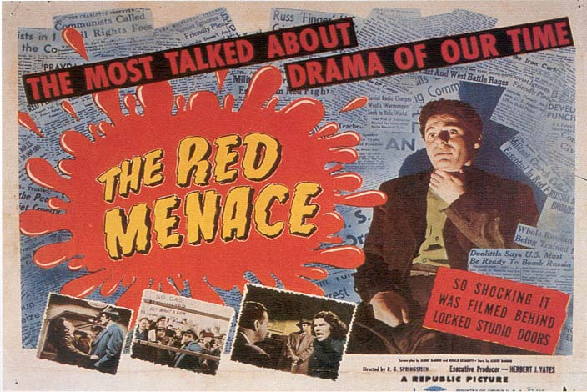
Anti-Communist Propaganda During McCarthy Era

Slide 37
McCarthy’s Downfall
McCarthy’s unsupported charges violated the constitutional rights of those he accused and often ruined their careers
In 1954, during televised hearings into the U.S. Army, his vindictive and bullying behavior was revealed to the American people
As a result, he lost the support of the public and the Senate voted to condemn him for improper conduct
McCarthy’s attacking style and utter lack of evidence led to his downfall

