Slide 1
TEDDY ROOSEVELT & THE ELECTION OF 1912
PROGRESSIVE ERA #3

Slide 2
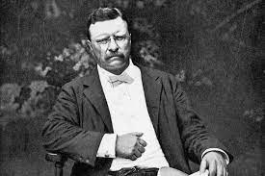
TEDDY ROOSEVELT
26th President of the U.S.
He was a progressive president – meaning he sought changes to improve American life
Known to be a rugged outdoorsman and warrior who went to Yale, spoke several languages, and won the Nobel Peace Prize
Champion of Reform

Slide 3
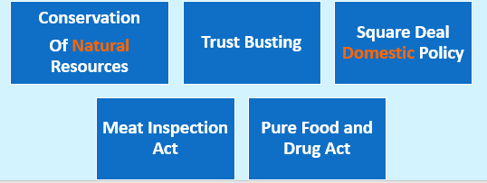

Slide 4
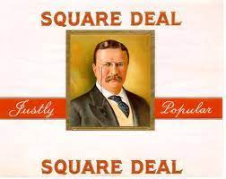
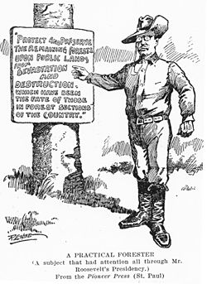
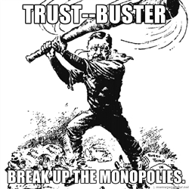
THE SQUARE DEAL
Reformed businesses, supported progressive reforms
Square Deal: Roosevelt’s domestic (within the U.S.) policy
Focused on conservation of natural resources
230 million acres of public lands were established by Roosevelt to become national parks (to conserve/protect forest & environment)
Controlling corporations
Nicknamed “Trust Buster”
Government activities or regulations designed to break up trusts (monopolies)
Protecting consumers

Slide 5
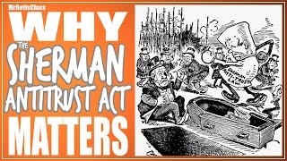

Slide 6
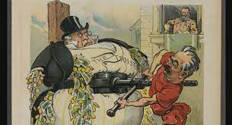
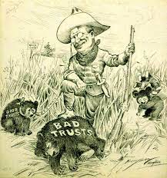
SHERMAN ANTITRUST ACT
The President’s(Teddy Roosevelt) weapon was the Sherman Antitrust Act
The act was enacted in 1890
To reduce combinations of power that interfere with trade and reduce economic competition
It outlaws both formal cartels and attempts to monopolize any part of commerce in the U.S.

Slide 7
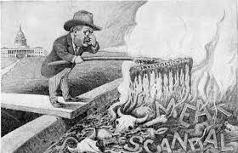
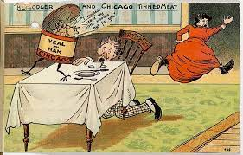
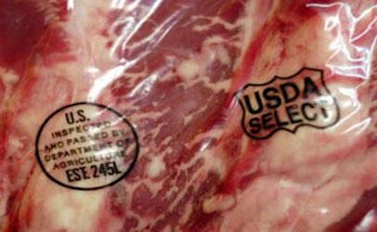
MEAT INSPECTION ACT
Forced meat processors to follow strict cleanliness guidelines
Protected consumers from buying bad meat

Slide 8
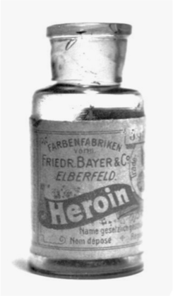
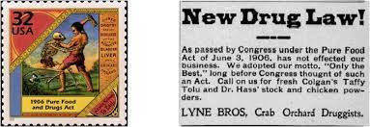
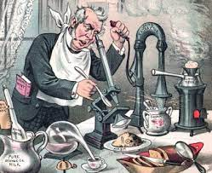
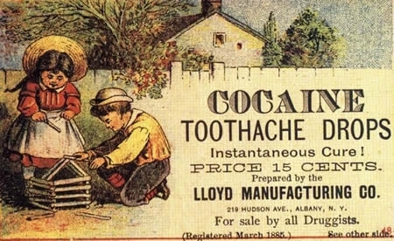
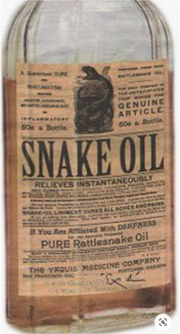
PURE FOOD AND DRUG ACT
Allowed the government to inspect all foods
Also made it illegal to sell dangerous or fake medicines

Slide 9
ELECTION OF 1912

Slide 10
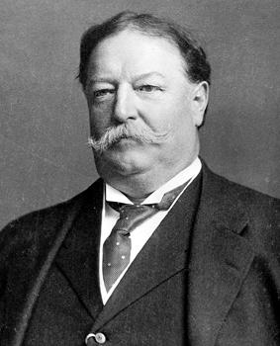
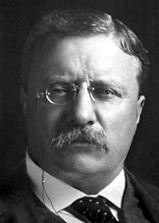
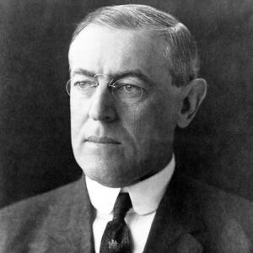
THE ELECTION OF 1912
William Taft
(Republican)
Theodore Roosevelt
(Bull Moose Party)
Woodrow Wilson
(Democrat)
Republican vote gets split between these two

Slide 11
WILLIAM HOWARD TAFT
In 1908, Teddy Roosevelt decided NOT to run for president (already served 2 terms)
Roosevelt endorsed (supported) William Howard Taft (fellow Republican)
People trusted Teddy’s recommendation, so Taft WON!
Taft would become the 27th President

Slide 12
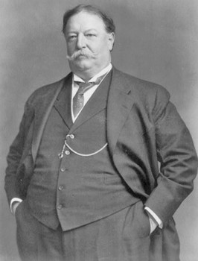
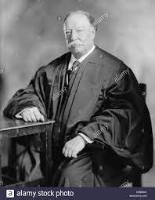
TAFT IN OFFICE
As President, Taft broke up MORE trusts than Roosevelt
But, NOT as supportive of Teddy’s other “progressive ideas”
Did not really want to be President
He was NOT very energetic or “charismatic”
Didn’t have the “Teddy Factor” → not very popular
Also claims title as only president to get stuck in the White House bathtub (myth)
Became a Chief Justice on Supreme Court in 1921

Slide 13
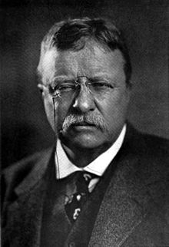
TEDDY COMES BACK…
Teddy was not happy with what happened to his legacy
Decided to run for President in 1912
Taft won the Republican nomination
Teddy couldn’t run as a Republican because he did not win the nomination
So, he made his own political party - The Progressive or Bull Moose Party

Slide 14
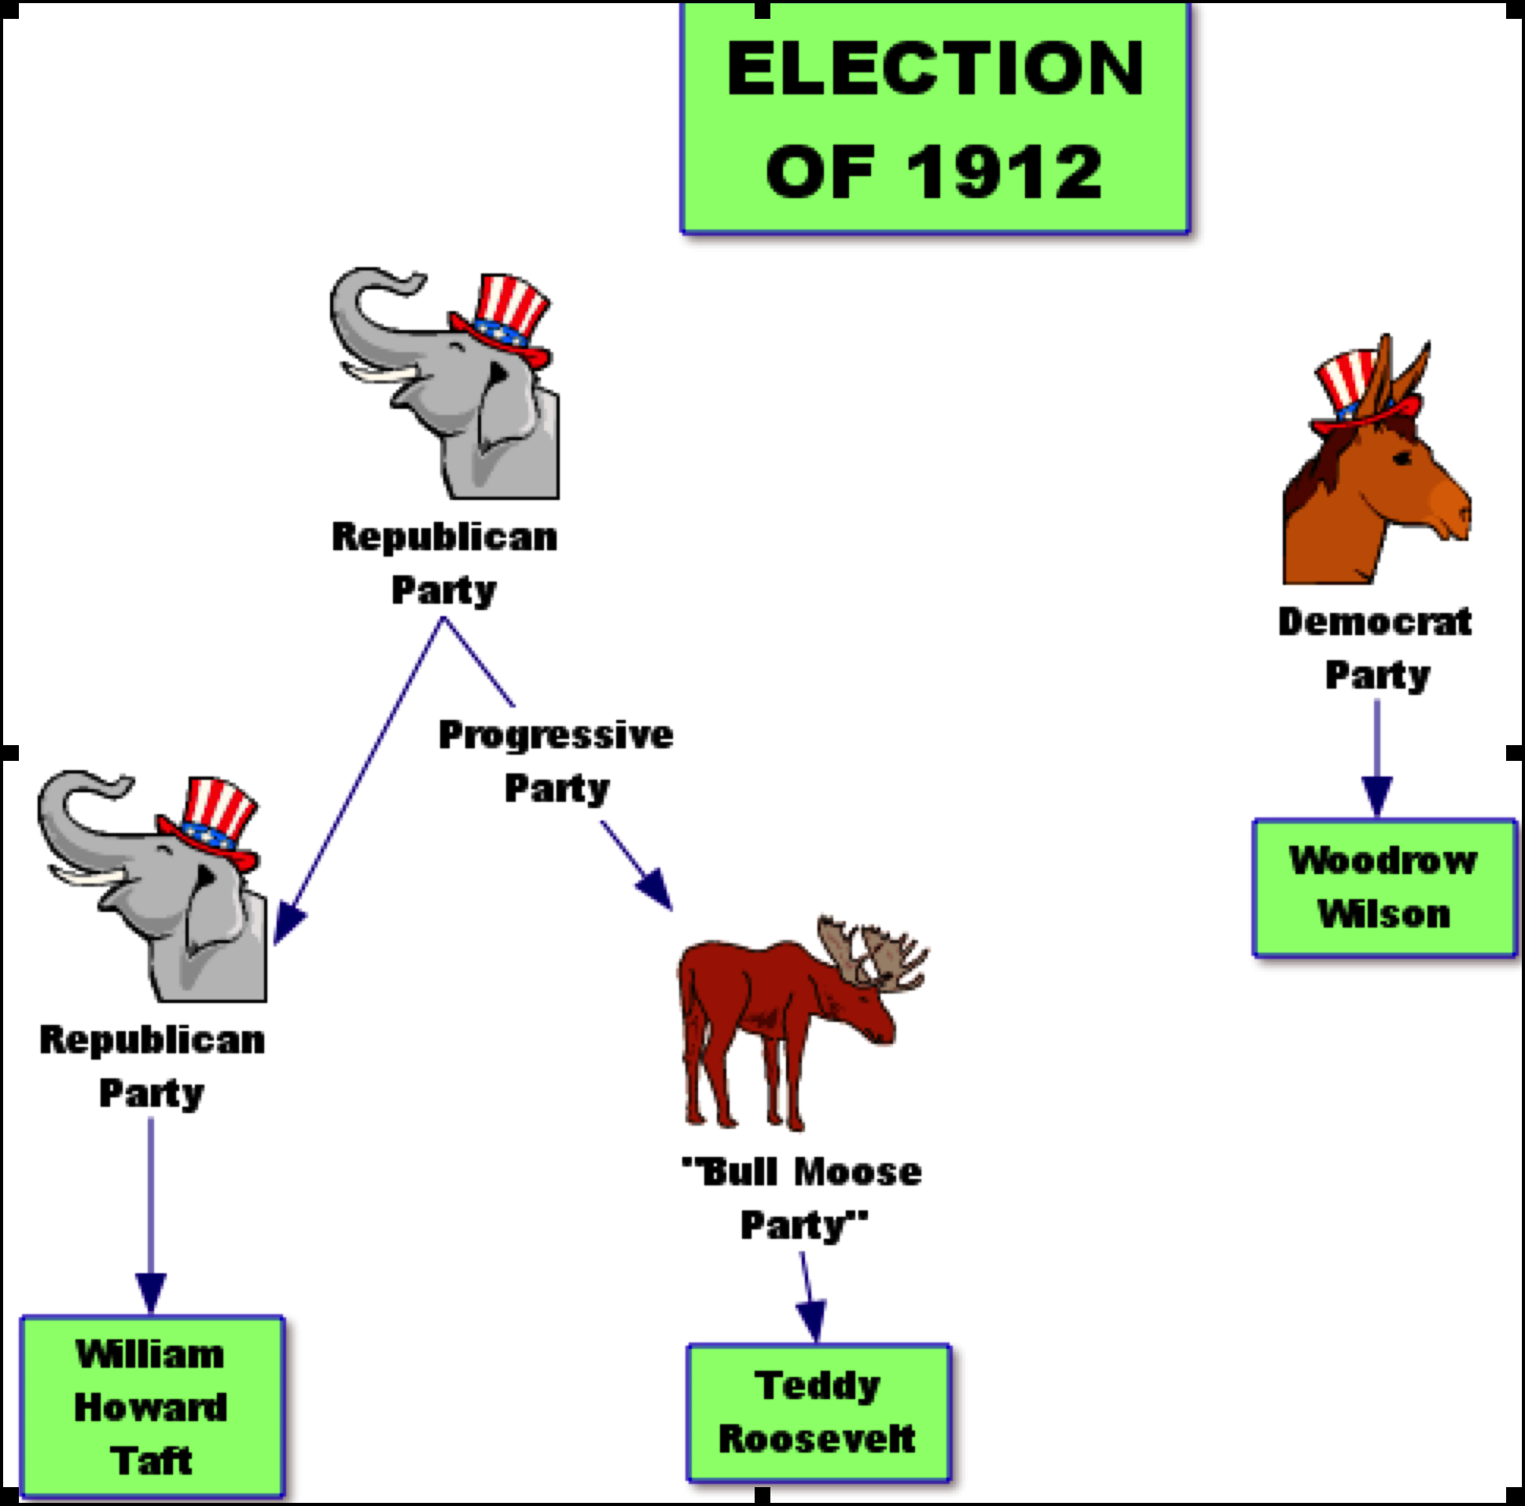
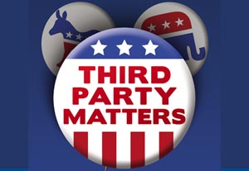
ELECTION OF 1912
3rd parties always split the vote from the party they split with - results in the other party winning!

Slide 15
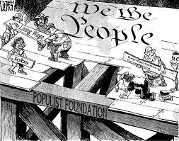
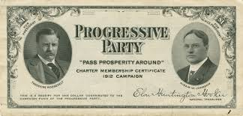
THIRD PARTIES
Why do they matter?
Progressives & Populists
They bring up reforms and ideas that are eventually adopted by the main parties
Many reforms during the Progressive Era began with ideas from the Populist Party

Slide 16
THE ELECTION OF 1912
William Taft
(Republican)
Theodore Roosevelt
(Bull Moose Party)
Woodrow Wilson
(Democrat)
Republican vote gets split between these two

Slide 17
WILSON AS PRESIDENT
Quite the progressive, although quiet on some issues
Women’s suffrage: silently supported, but didn’t think during WWI was the right time
Would later pass the 19th Amendment
Against U.S. involvement in WWI, but eventually supported the U.S. joining

Slide 18
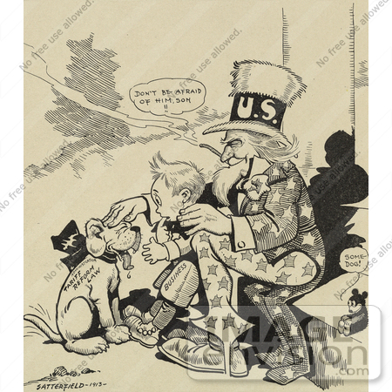
WILSON’S BIG PROGRESSIVE ISSUES
16th Amendment: federal income tax
More money = higher tax paid
Provided revenue (money) to government to pay for social reforms
Populist idea - income inequality
Wilson supports it because we had removed tariffs (taxes on imports) and the government needed money

Slide 19
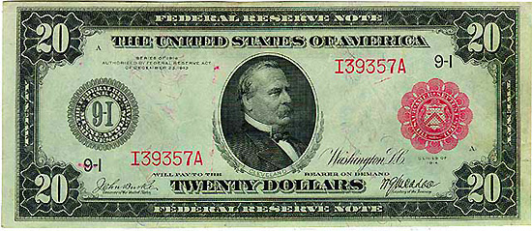
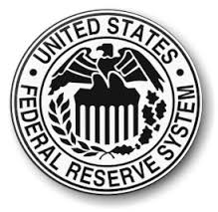
THE FEDERAL RESERVE ACT (1913)
Reformed corrupt banking industry
Set interest rates
Established 12 regional Federal Reserve Banks to serve as “banker’s banks”
Regulated the money in circulation by controlling the amount of money that banks could lend

Slide 20
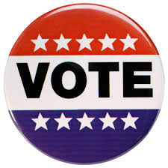
DIRECT DEMOCRACY
The Progressive Era led to more direct democracy
People have more say in the government, more changes to vote (initiative, referendum, recall, and 17th Amendment)

Slide 21
CONSUMER PROTECTION
All the Progressive presidents believed that the government should use its power to regulate unfair business practices

