Slide 2
Individual and Corporate Income Taxes
The United States has a government “of the people, by the people, for the people.” For that government to function, it needs the economic backing of the American people.
If you work and pay income taxes, you are helping to support the work the government does. Taxes are of great economic importance to the nation.

Slide 5
Individual and Corporate Income Taxes
Federal Individual Income taxes paid by the person who works.
Texas does not have a State Income tax!
Our tax system is progressive, the more you make the more you will pay.
Flat tax???

Slide 6
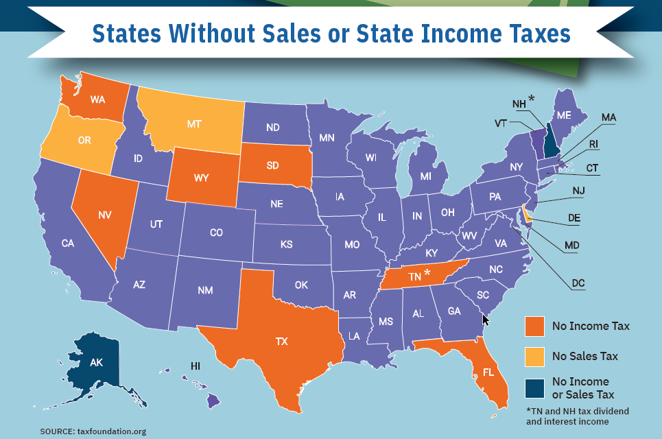

Slide 7
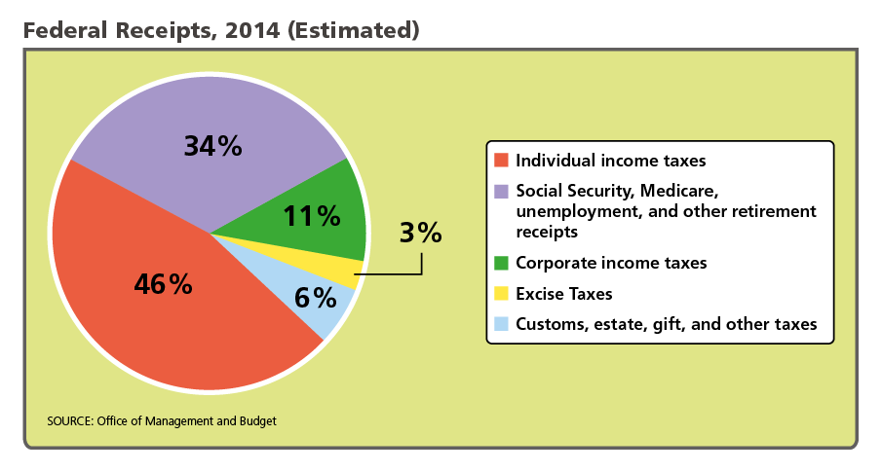
Individual and Corporate Income Taxes
Analyze Graphs Based on this graph, what effect would an economic downturn, with lower corporate and individual earnings, have on government receipts? Explain.

Slide 8
Social Security, Medicare, and Unemployment Taxes
In addition to withholding money for income taxes, employers withhold money for taxes authorized under the Federal Insurance Contributions Act, or FICA.
FICA taxes fund two large government social-insurance programs, Social Security and Medicare. Employees and employers share FICA payments. Most employers pay both state and federal Unemployment Taxes.

Slide 9
Social Security, Medicare, and Unemployment Taxes
In addition to helping older people, Social Security offers benefits to people with certain disabilities, such as Down Syndrome.

Slide 10
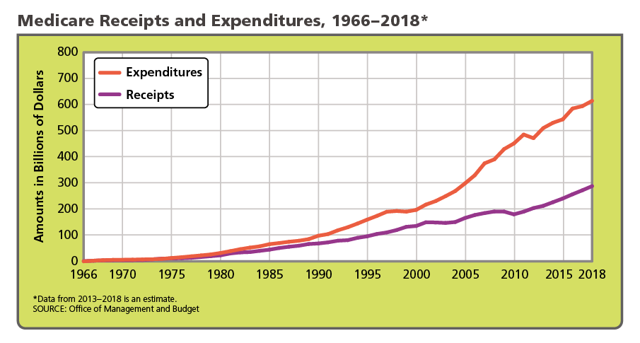
Social Security, Medicare, and Unemployment Taxes
The gap between what Medicare takes in and what it spends has been widening. Analyze Graphs What are two possible solutions to the problem presented by this graph?

Slide 11
Corporate Income Taxes
The corporate income tax is levied on business profits of incorporated businesses.
Forty-four states and the District of Columbia levy a corporate income tax.
Ohio, Nevada, and Washington tax corporations' gross receipts instead of income. Texas levies a franchise tax on a business's income or "margin", but the tax otherwise operates like a gross receipts tax

Slide 12
Sales Tax and Property Tax
State taxes includes sales tax. We pay a percentage on every purchase we make in Texas.
There is no state property tax in Texas.
Local Property taxes in Texas is the 7th highest in the nation
Texas average is 1.69% of the value of the property.
National average is 1.07%
Montgomery County property tax rate 1.820%

Slide 14
Quiz: Individual and Corporate Income Taxes
What is a person’s taxable income?
the income subject to the highest tax rate
the income subject to the lowest tax rate
gross income minus exemptions and deductions
D. all the money a person earns in a given year

Slide 15
Quiz: The Importance of National Taxes
According to the Constitution, for what purpose can government collect taxes?
to pay the nation’s debts and provide for its defense and welfare
to discourage exports and promote imports
to ensure religious freedom for all citizens
D. to establish the nation’s gross domestic product

Slide 16
Quiz: Key Characteristics of a Tax
Economists generally agree that taxes ought to be
simple, efficient, certain, and fair.
universal, progressive, fair, and low.
simple, proportional, low, and infrequent.
D. high, regressive, simple, and universal.

Slide 17
Graphic Organizer
Illustrate the five types of taxes (40%)
Individual Income taxes
Corporate Income Tax
Social Security Tax
Property Tax
Sales Tax
Explain each type of tax (40%)
Neatness (readable); Use color (20%)

