Slide 1
South America Physical Geography
1
Notes:
1

Slide 2
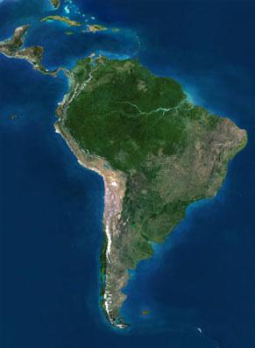
Satellite View
2

Slide 3
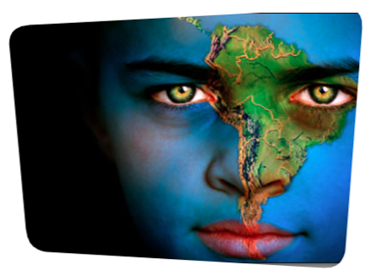
History
Prior to European colonization, the Incan Civilization was a dominant force in South America.
In the 1500's, Spain and Portugal colonized much of South America.
3

Slide 4
Nations Today
It is politically divided into twelve sovereign states: Argentina, Bolivia, Brazil, Chile, Colombia, Ecuador, Guyana, Paraguay, Peru, Suriname, Uruguay and Venezuela, plus the overseas administration of French Guiana.
4

Slide 5
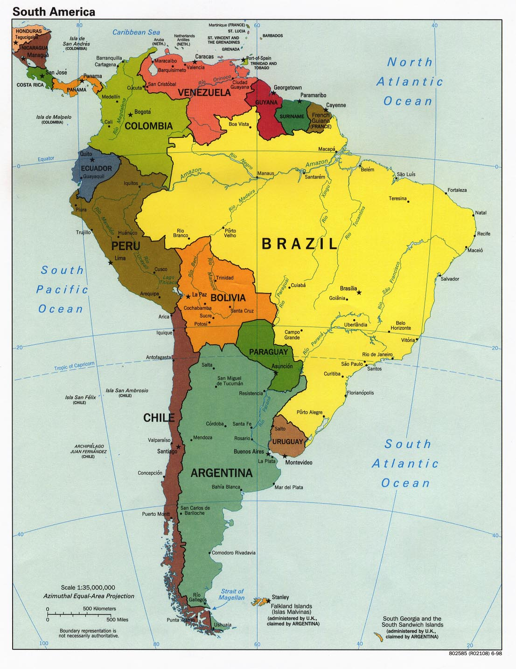
South America’s Size
▄4th largest continent
▄ 6,879,000 sq miles
▄ 12% of the earth’s land
5
Notes:
5

Slide 6
South America’s Size
422 million people live in South America
Over 200 million live in Brazil, South America’s most populous nation
6
Notes:
6

Slide 7
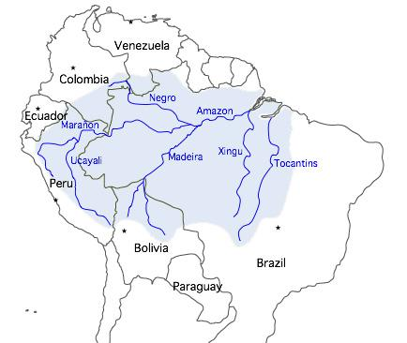
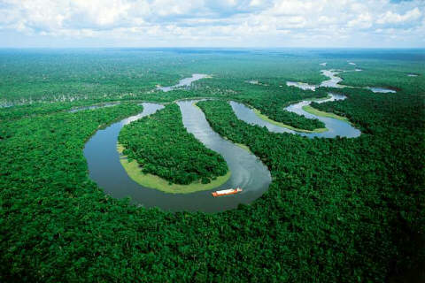
Amazon River
At least 4,000 miles long and runs through 7 counties
World 2nd longest river
Accounts for about 20% of the total water carried to the oceans by rivers
7
Notes:
7

Slide 8
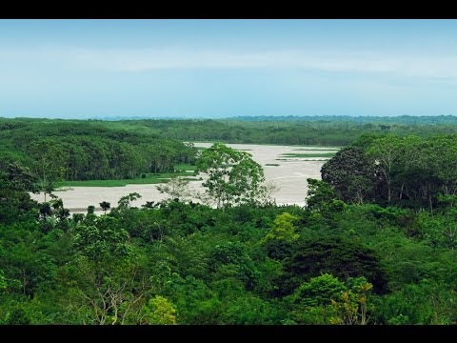
Amazon River Cruise

Slide 9
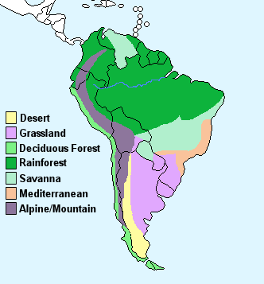
Climate Zones
Desert
Grasslands
Temperate Deciduous Forest
Rainforest
Savanna
Mediterranean
Alpine/Mountain
9
Notes:
9

Slide 10
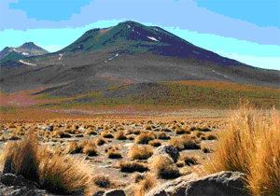
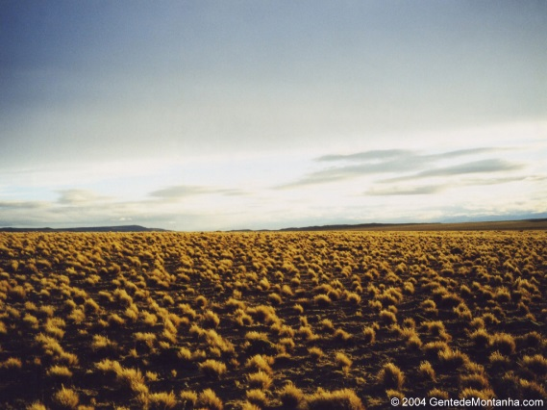
Deserts
▄ Atacama Desert is the world's’ driest
▄ Patagonian Desert►
Largest in Americas/5th in the world
10

Slide 11
Atacama Desert
Where is the Atacama Desert Located?
What did NASA test here?
What bird can be found here?
What unique geological feature is found in this desert?
If you visited here what activity would you most like to do?

Slide 12
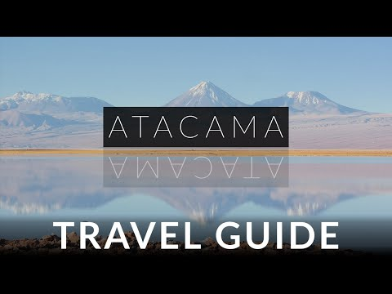
Atacama Desert

Slide 13
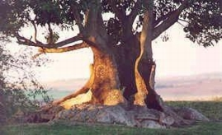
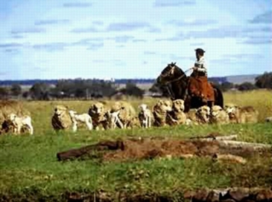
Pampas - Grassland
▄ Just below Buenos Aires
▄ Average temperature is 64°f
▄ Dry season is summer (December)
13
Notes:
13

Slide 14
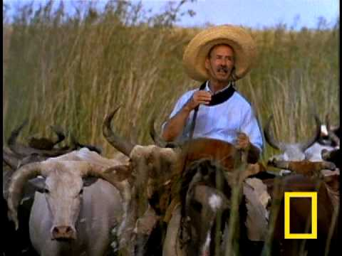
Gauchos
What is a Gaucho?
Where do they live? (What county)
How many Gauchos are still working?

Slide 15
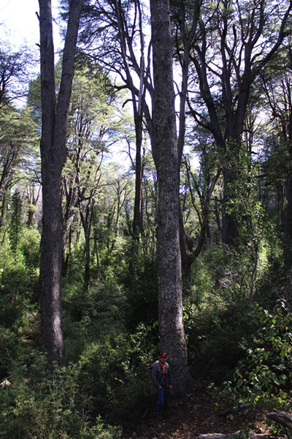
Temperate Deciduous Forest
Southern Chile
Middle East coast of Paraguay
Broad-leaf forests
Dominated by trees that lose their leaves each year
15

Slide 16
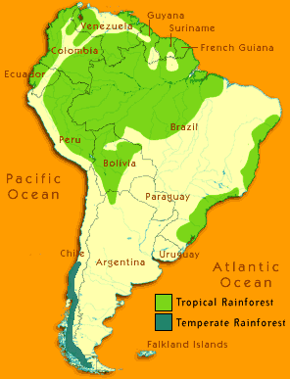
Rainforest
Half of the rainforest in the world is in the Amazon region
The Amazon Rainforest covers over 2 million square miles land
60% of the amazon Rainforest is located in Brazil
16

Slide 17
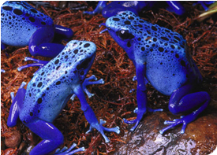
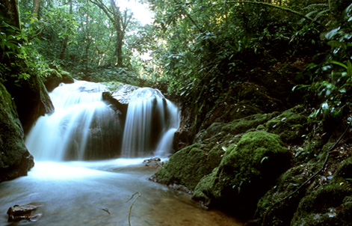
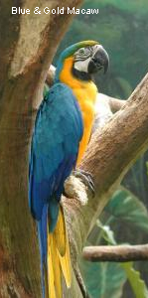
Rainforest
◄Blue Poison Dart Frog
◄Blue/Gold
Macaw
17
Notes:
17

Slide 18
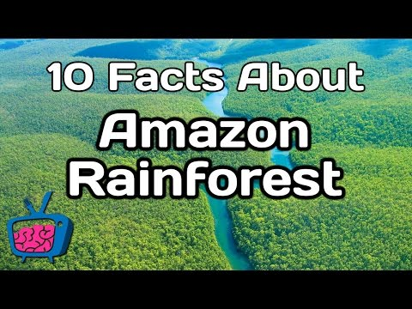
Amazon Rainforest

Slide 19
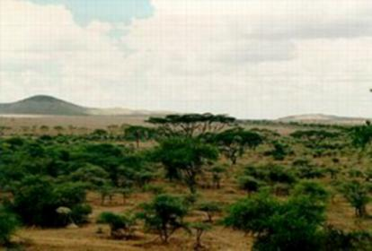
Savannah
The area between a rainforest and desert.
Grassland region with scattered trees
Rainfall is seasonal
19
Notes:
19

Slide 20
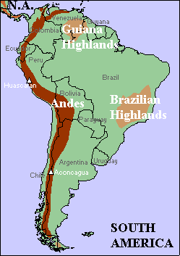
Alpine Mountains
The world's longest above-water mountain range (4,350 miles long)
Runs through 7 countries
Many different climatic conditions ranging from very cold to warm, tropical climate
Includes several active volcanos
.
20
Notes:
20

Slide 21
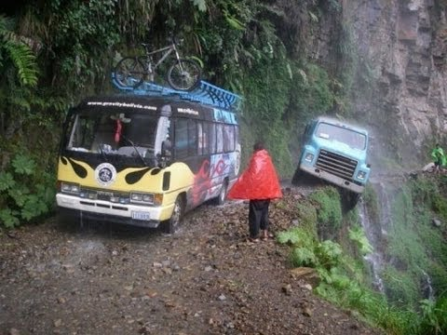
Death Road

Slide 22
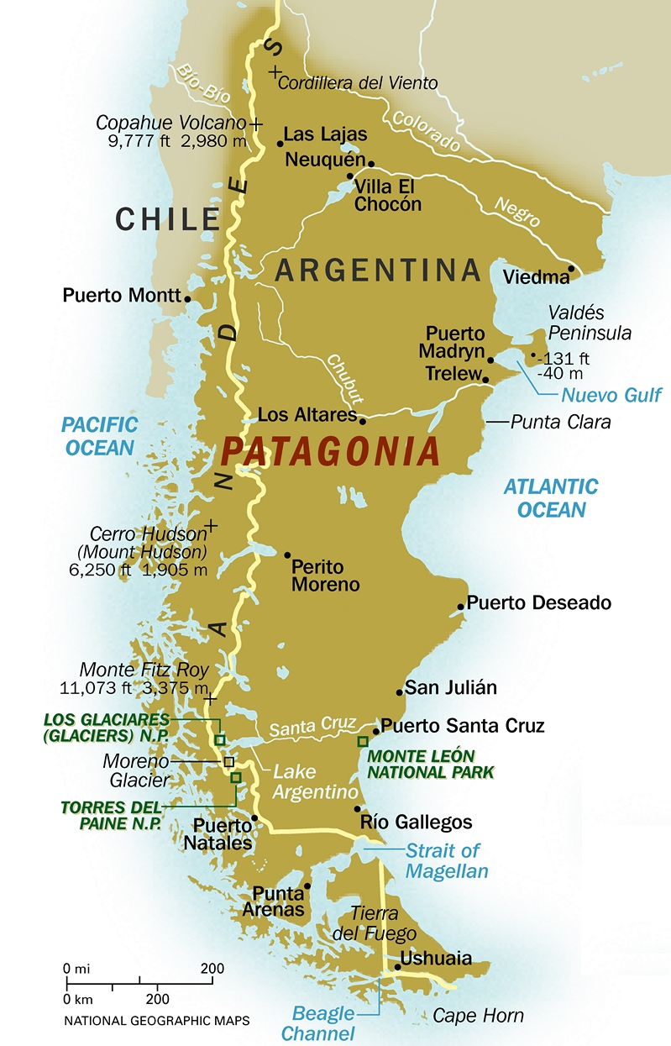
Patagonia Region

Slide 23
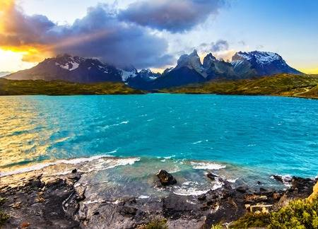
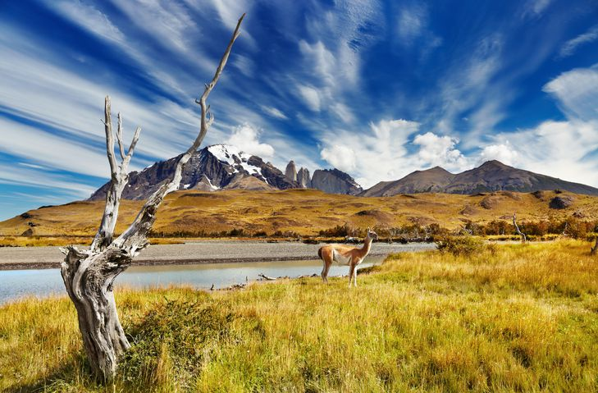
Patagonia Region
A sparsely populated region at the southern end of South America, shared by Argentina and Chile
Made up of mountains and the deserts, pampas and grasslands
Patagonia is one of the few regions with coasts on three oceans (Atlantic, Pacific and Southern Oceans)
Its stunning landscape makes it a popular tourist destination

Slide 24
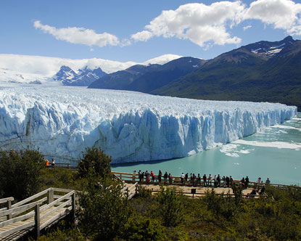
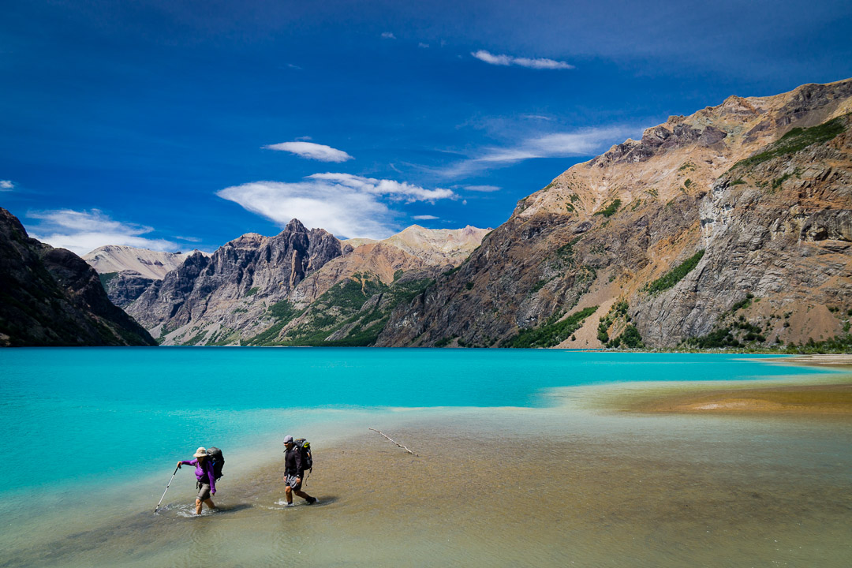
Patagonia Region

Slide 25
Patagonia Region

Slide 26
Summary
South America has Earth’s longest mountain range, driest desert, biggest rainforest, and river with the most water
26

