Slide 1
Please pick a seat and we will get started soon!!
U.S. History 23-24
Greg Scott Room 158

Slide 2
Agenda: Friday, August 11th
Welcome-Get to know Mr Scott
Complete Notecard
Canvas Page/Web Page
Questions you have about the year

Slide 3
Heads Up:
Supplies needed for Class (please have these items by Tuesday)
1 ½-2 inch 3 ring binder-just for this class
Loose leaf notebook paper
Pens (blue or black ink)-colored pens for your personal note taking only.
Pencils for test-taking and if this is your preferred way to take notes.
Classroom items needed:
I got this but you may use your own.

Slide 4
Questions?

Slide 5
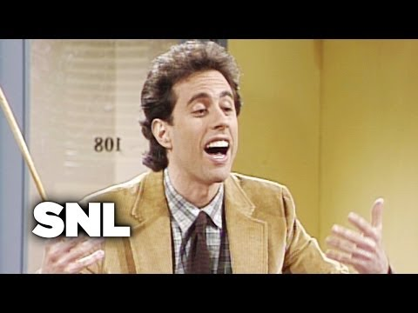
US History Humor:

Slide 6
U.S. History
Mr. Scott
Room 158
U.S History:1877-Present
Tutorials-after school; upon request. The Social studies team will have after school tutorials and those details will be made available to you once those days and times have been decided.

Slide 7
Who Am I Really?
Married to Mary (2nd) 4 kids 2 from first mistake 2 from her previous marriage.
From Houston joined the Army after High School!
Army Ranger
Graduated from Texas A&M Corpus Christi (BBA)
Graduated from SFA w/Masters in Teaching
Coached soccer since 1995
I was an accountant and CFO at a Hospital in C.C. prior to teaching
Moved to Nacogdoches became a teacher
I enjoy history and collect military items. 1870 Franco-Prussian War
WWI and WWII
10. I am a Star Wars fan!
11. This is my tenthg year to teach. I previously taught World
Geography, World H?istory, AP World History and Pre-AP World
History as well as Economics.
12. My favorite quote: Carpe Diem

Slide 8
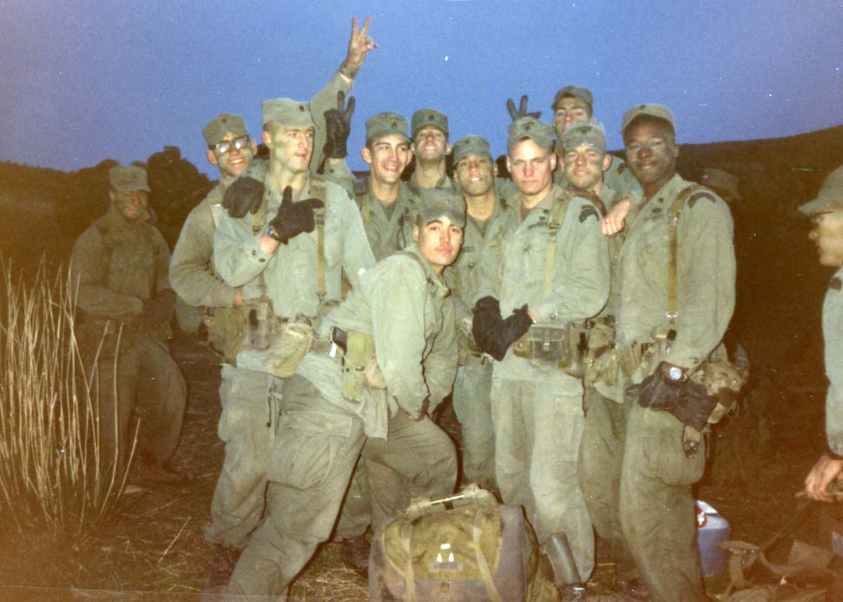
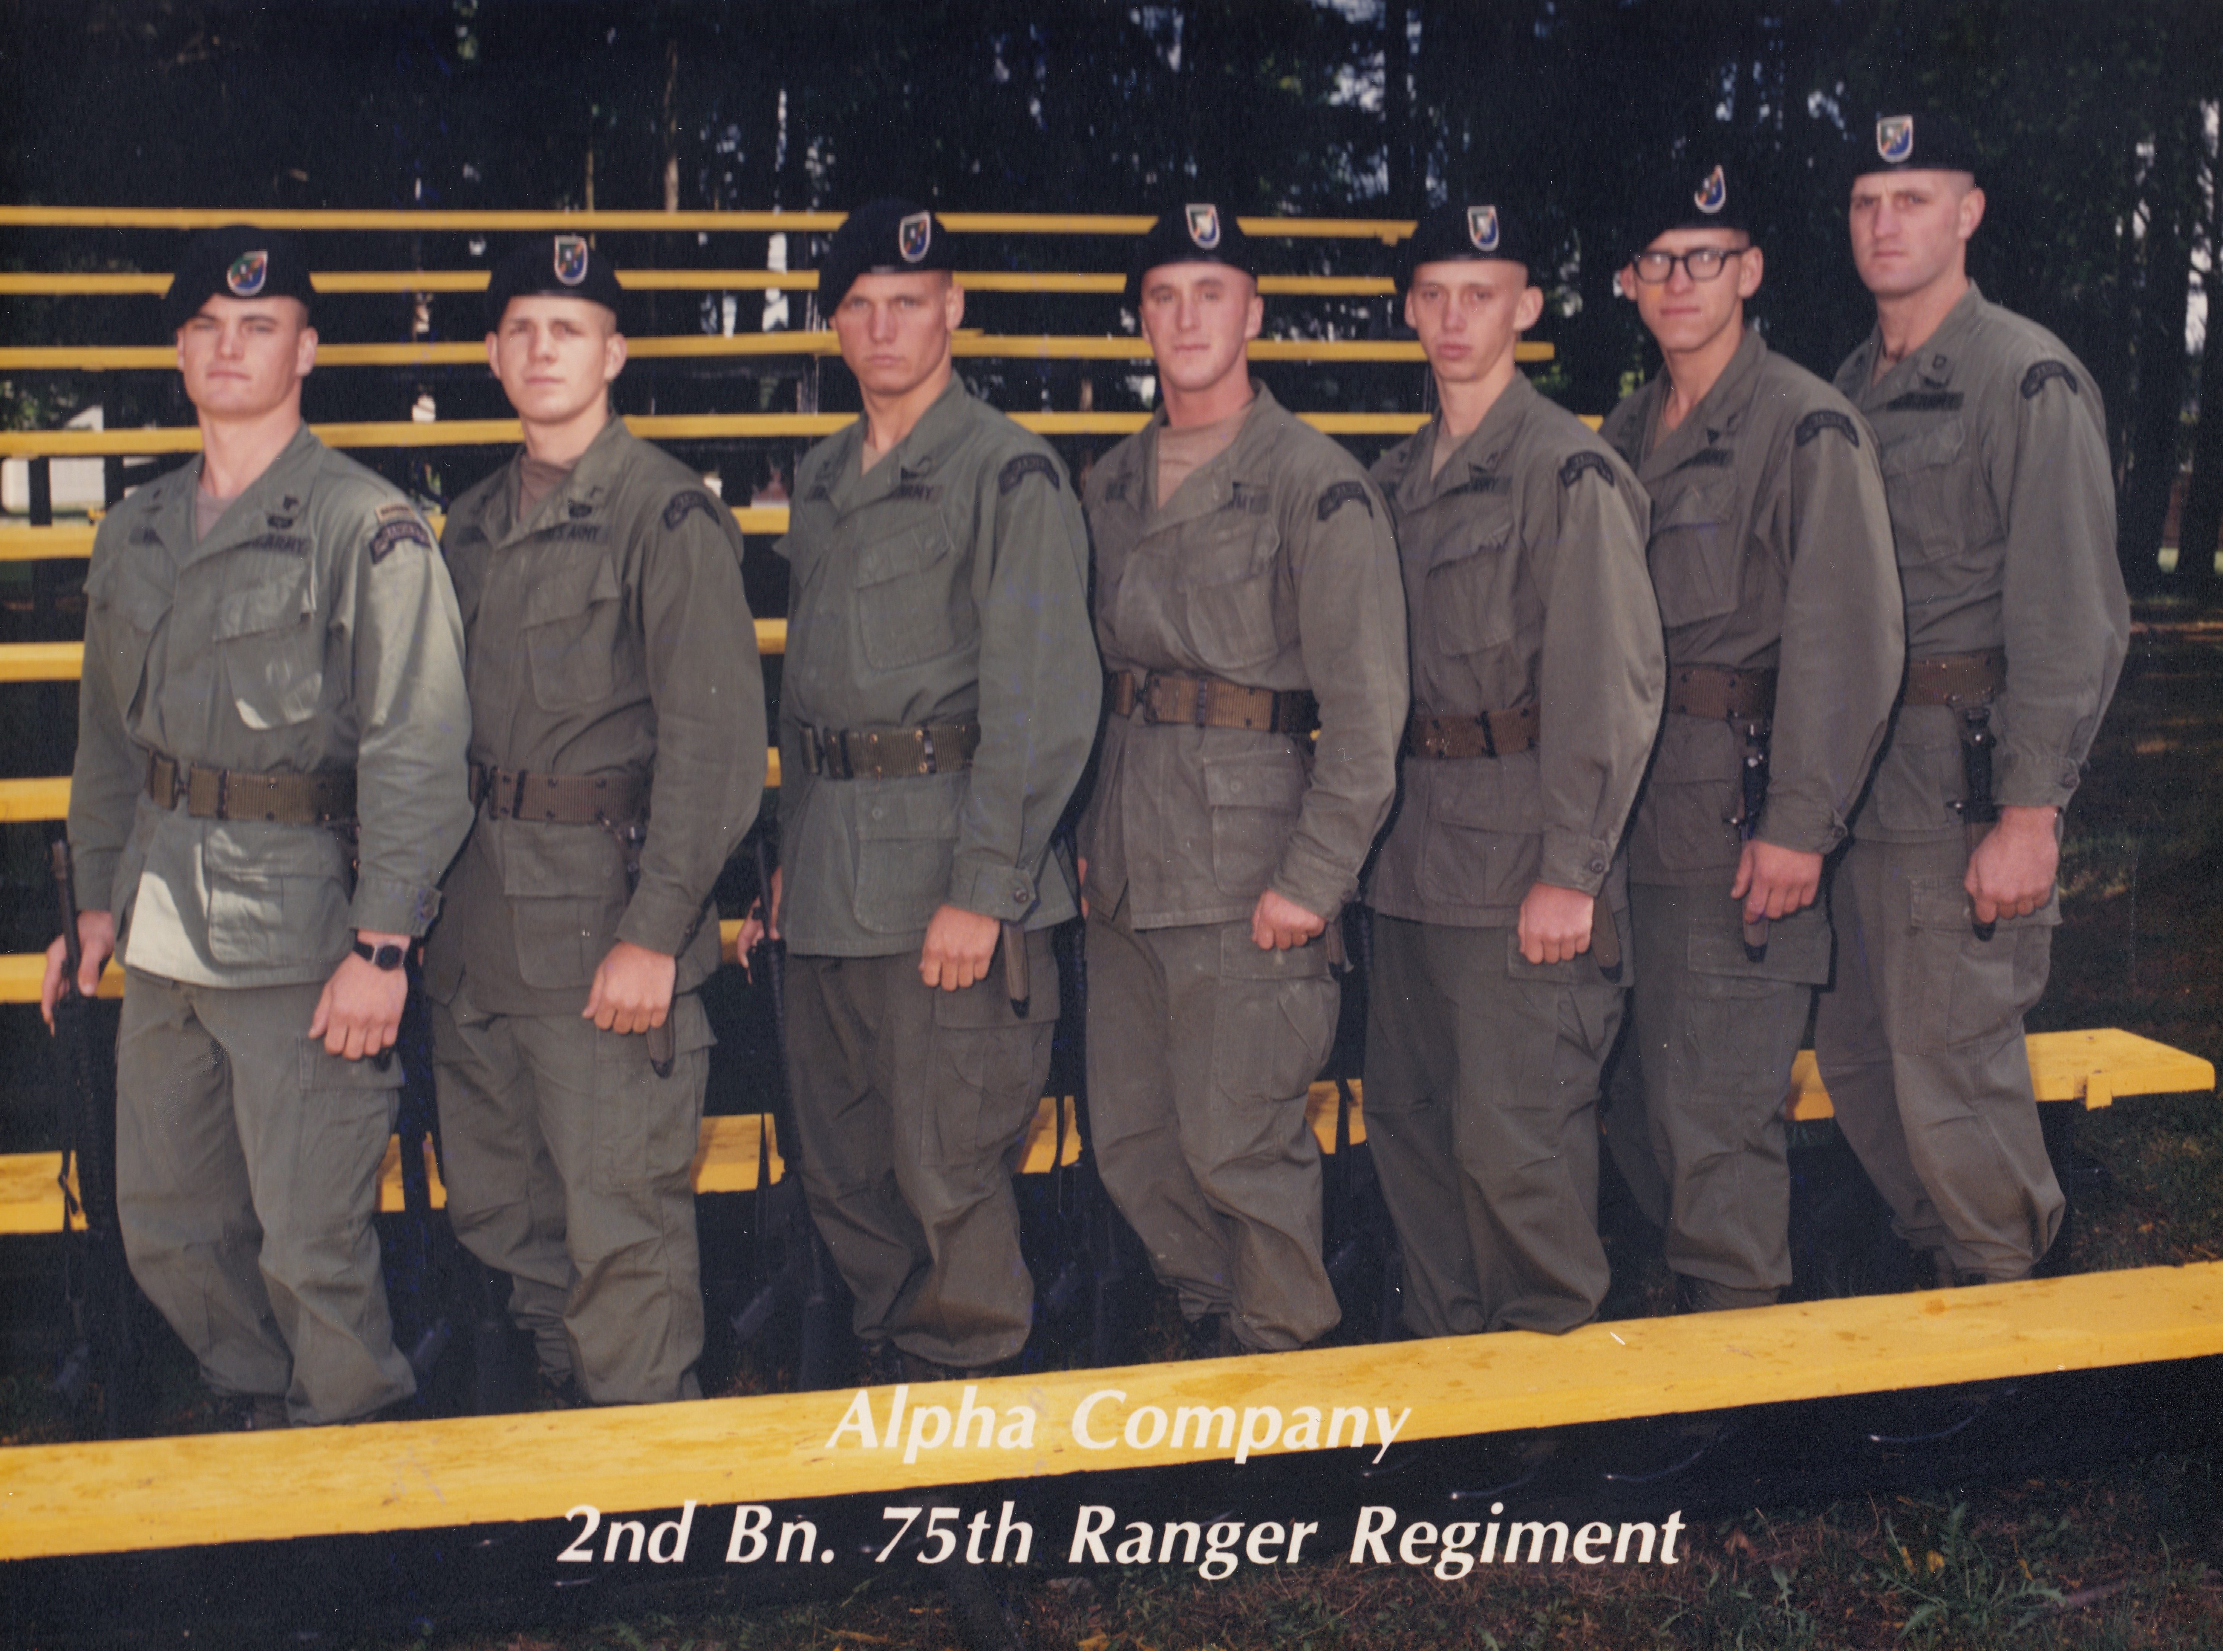
My History!!!

Slide 9
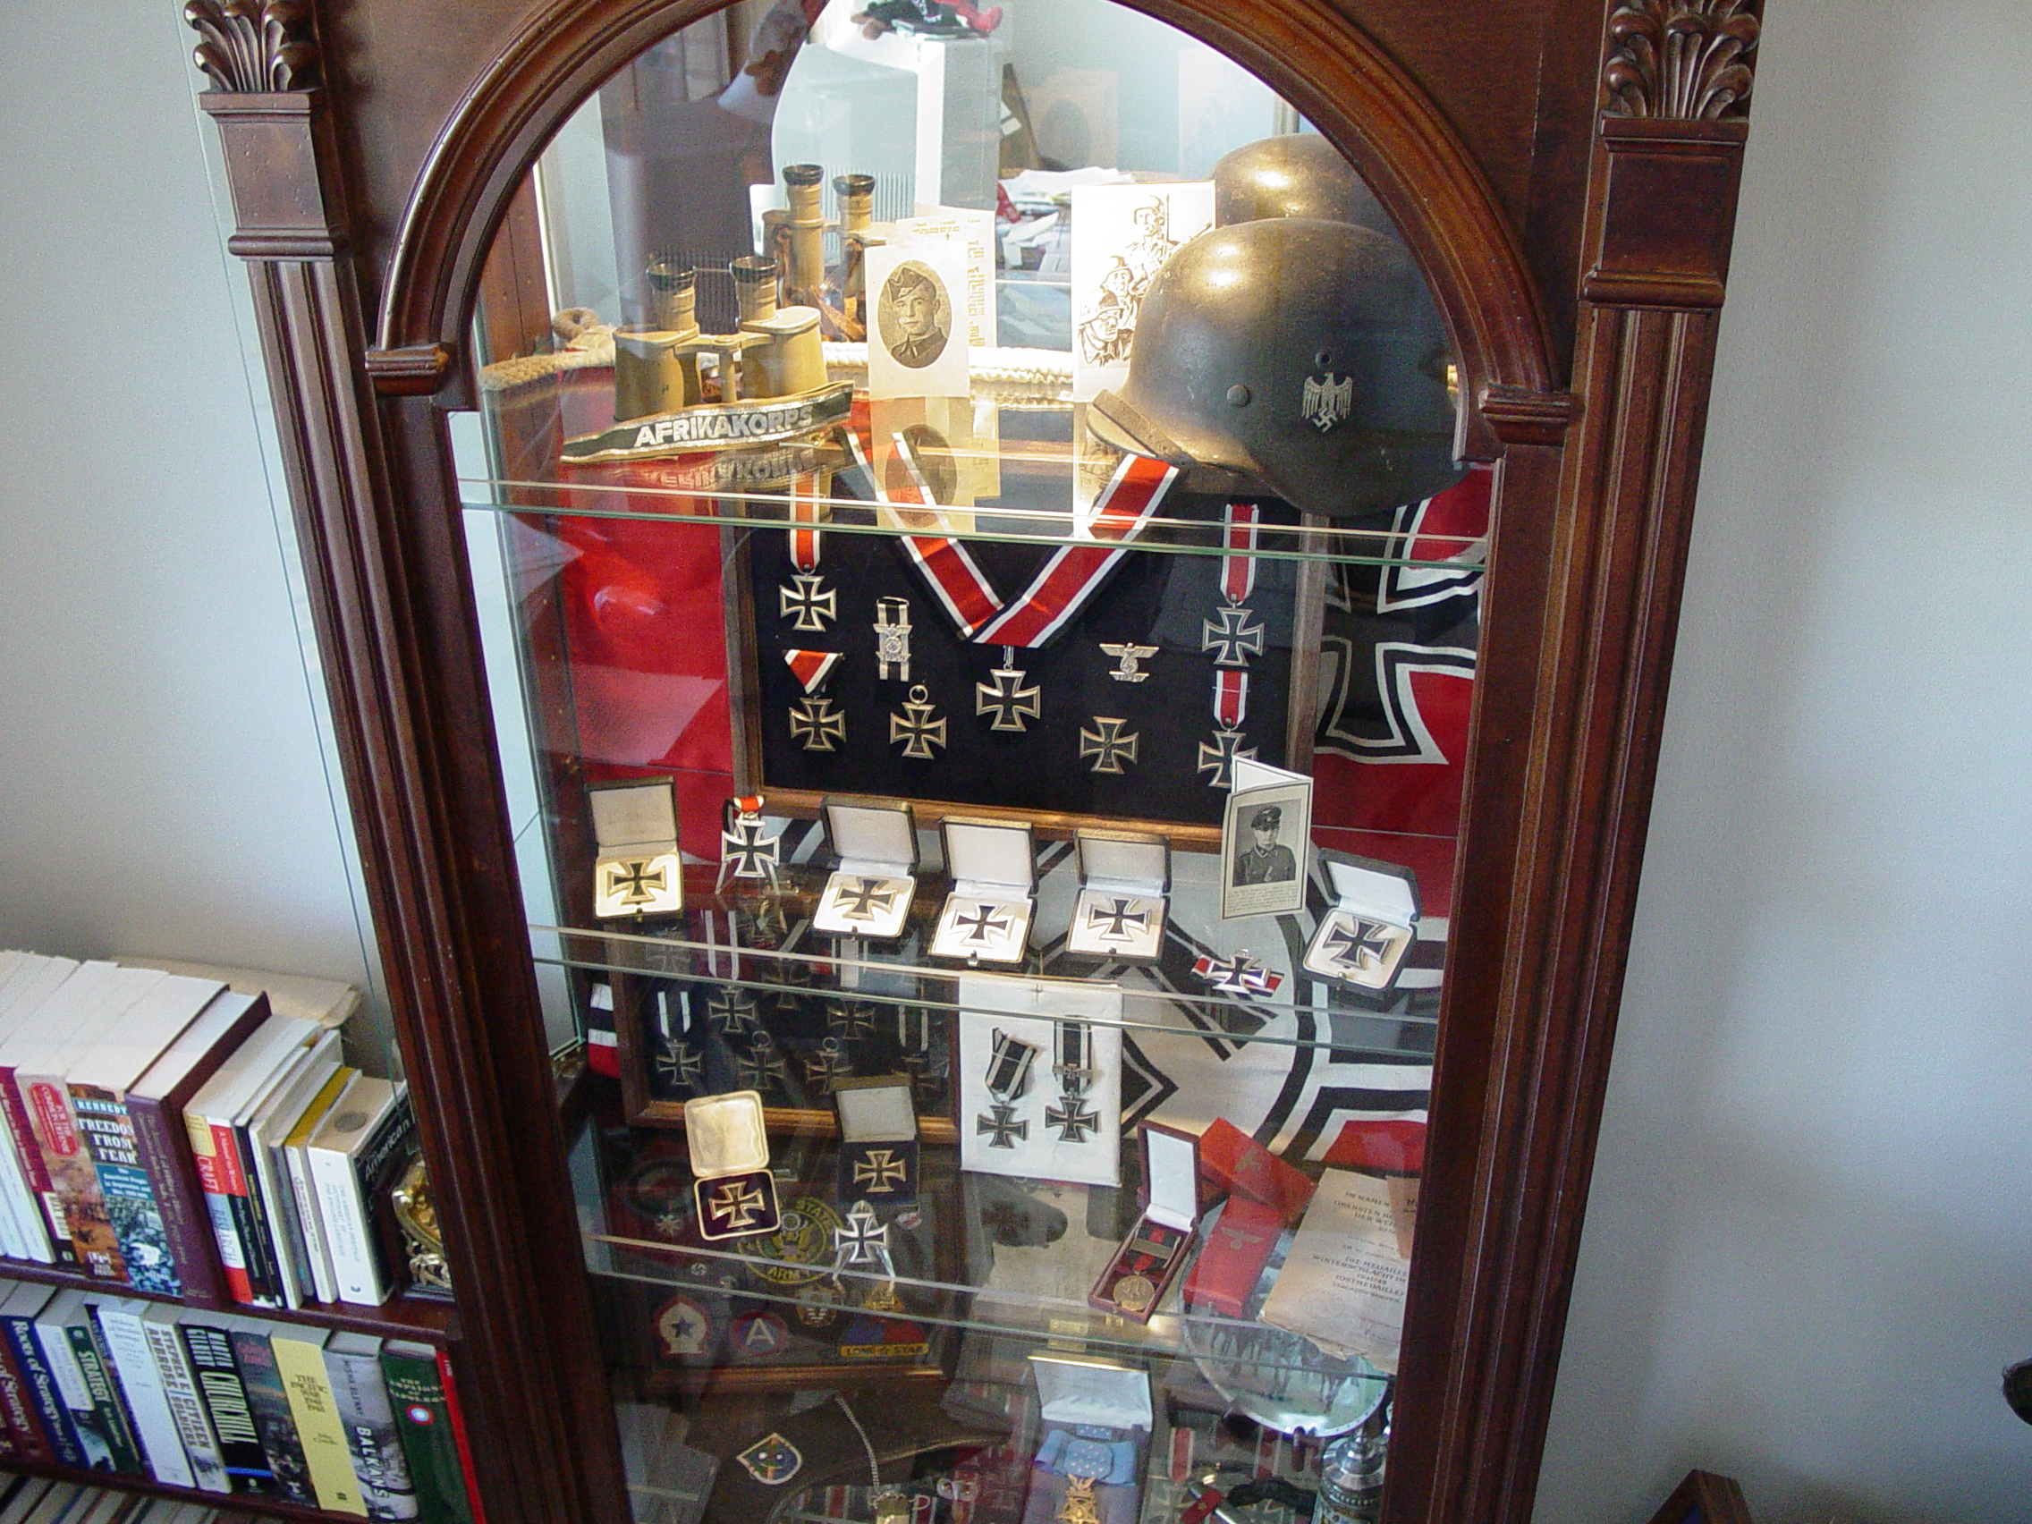

Slide 10
A little bit about this course:
We will explore the history of the United States from 1877 to present day (this is the second half of the class that most of you took in 8th grade).
We will look at major themes that seem to repeat and give you a better understanding of the events that shaped our country.
I will do my best to help you understand not only WHAT happened but WHY it happened with relevant ties to present day situations.

Slide 11
Carpe Diem

