Slide 1
POLITICAL REFORMS
Unit 3: Progressive Era #2

Slide 2
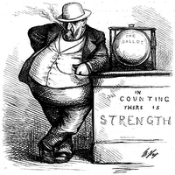
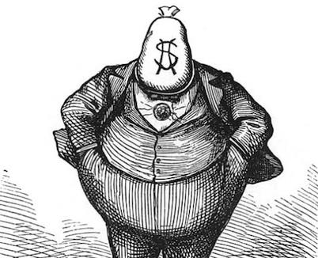
POLITICAL REFORMS IN THE PROGRESSIVE ERA
During the Progressive Era, many reforms were made to address the issues of corrupt politics from the Gilded Age

Slide 3
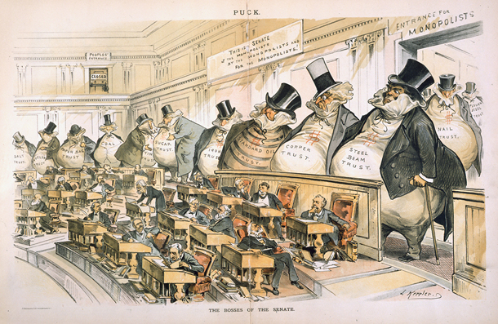
2. GILDED AGE PROBLEM: POLITICAL MACHINES
Political machines and corrupt officials were not passing laws that benefited the people
Laws were passed that helped political machines and monopolies who influenced the government

Slide 4
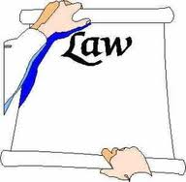
2.REFORM (SOLUTION): REFERENDUM
Allows voters to put a bill on the ballot so voters can vote on it

Slide 5
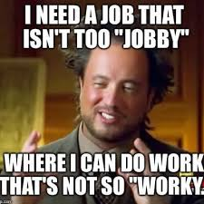
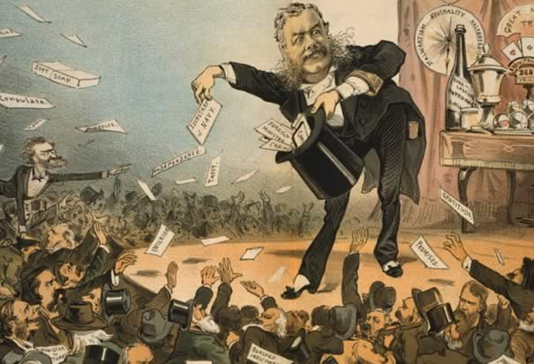
3. GILDED AGE PROBLEM: PATRONAGE
Patronage and political machines helped corrupt people become mayors and other elected officials

Slide 6
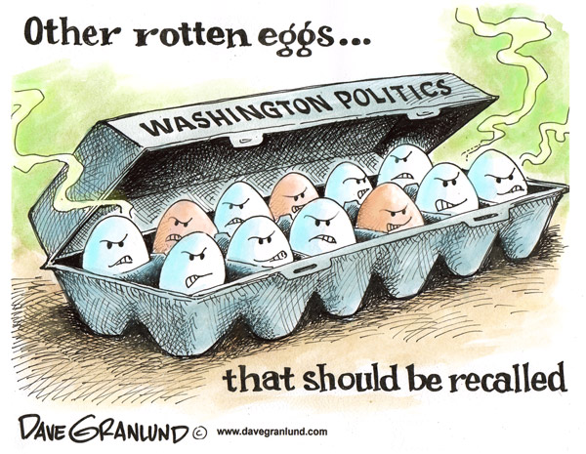
3. REFORM (SOLUTION): RECALL
Allows voters to remove an elected official from office

Slide 7
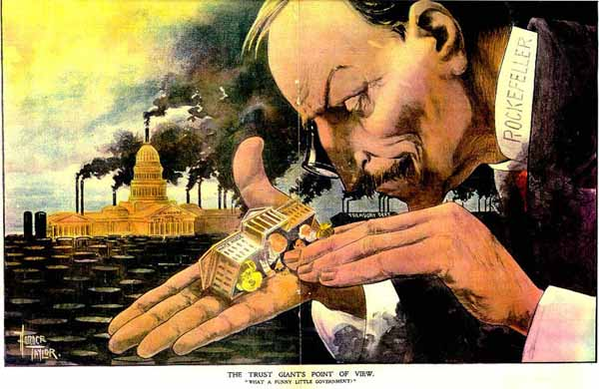
4. GILDED AGE PROBLEM: LAWMAKERS
Lawmakers would not even discuss some of the issues that people thought were most important because of the influence of political machines and monopolies

Slide 8
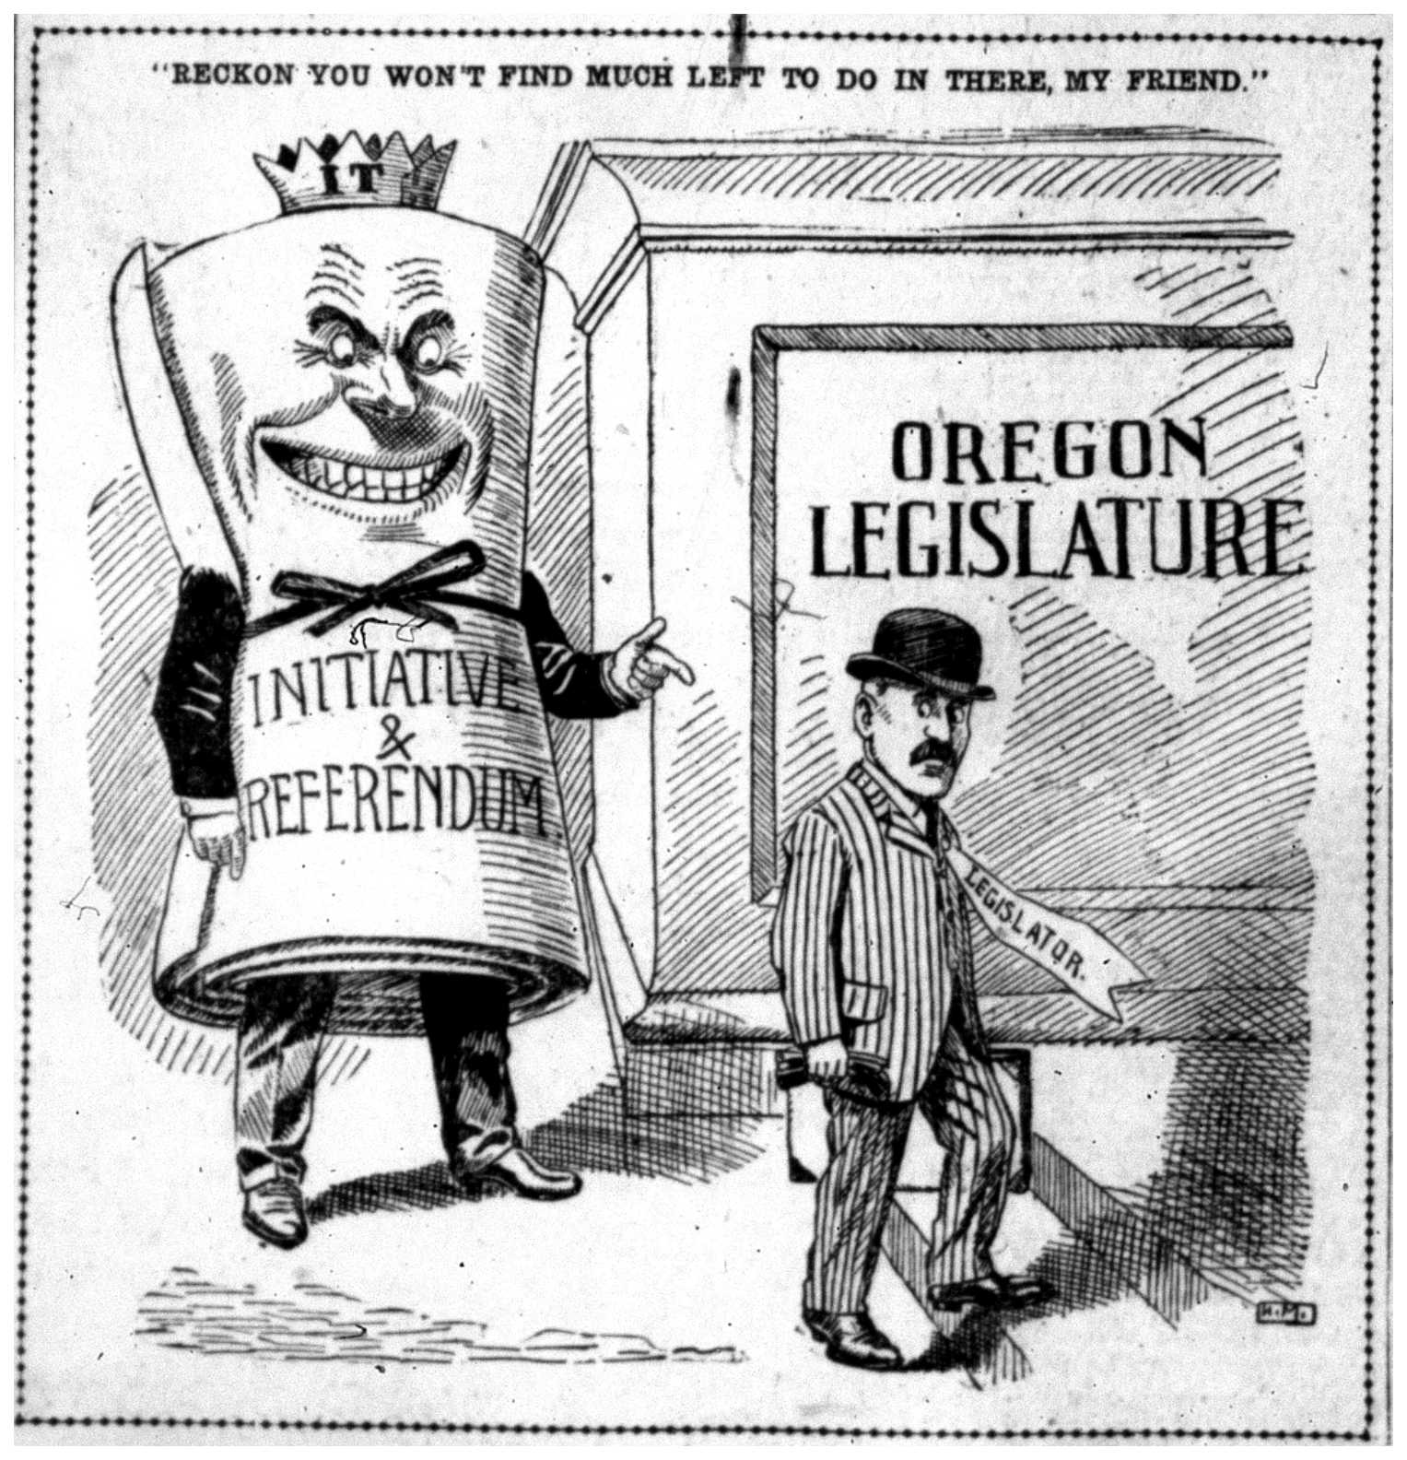
4. REFORM (SOLUTION): INITIATIVE
Allows the people to create new laws rather than lawmakers

Slide 9
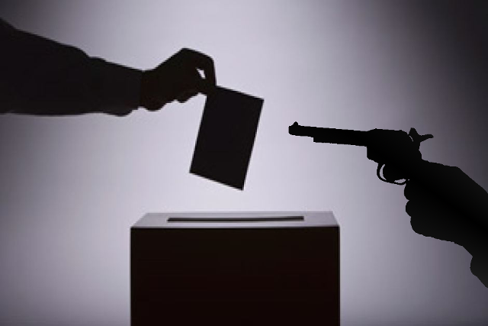
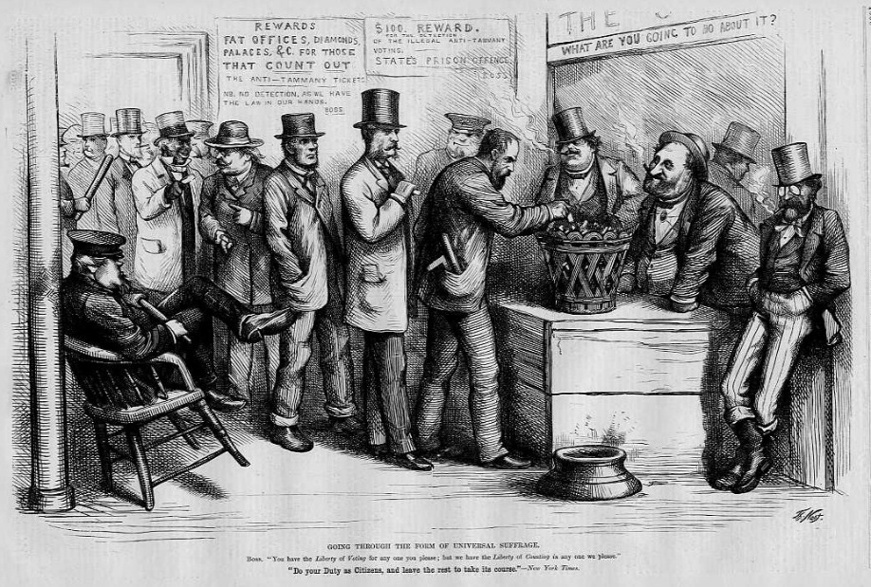
5. GILDED AGE PROBLEM: OPEN BALLOT
Voters were intimidated and coerced (forced) to vote a certain way because people could see who they voted for

Slide 10
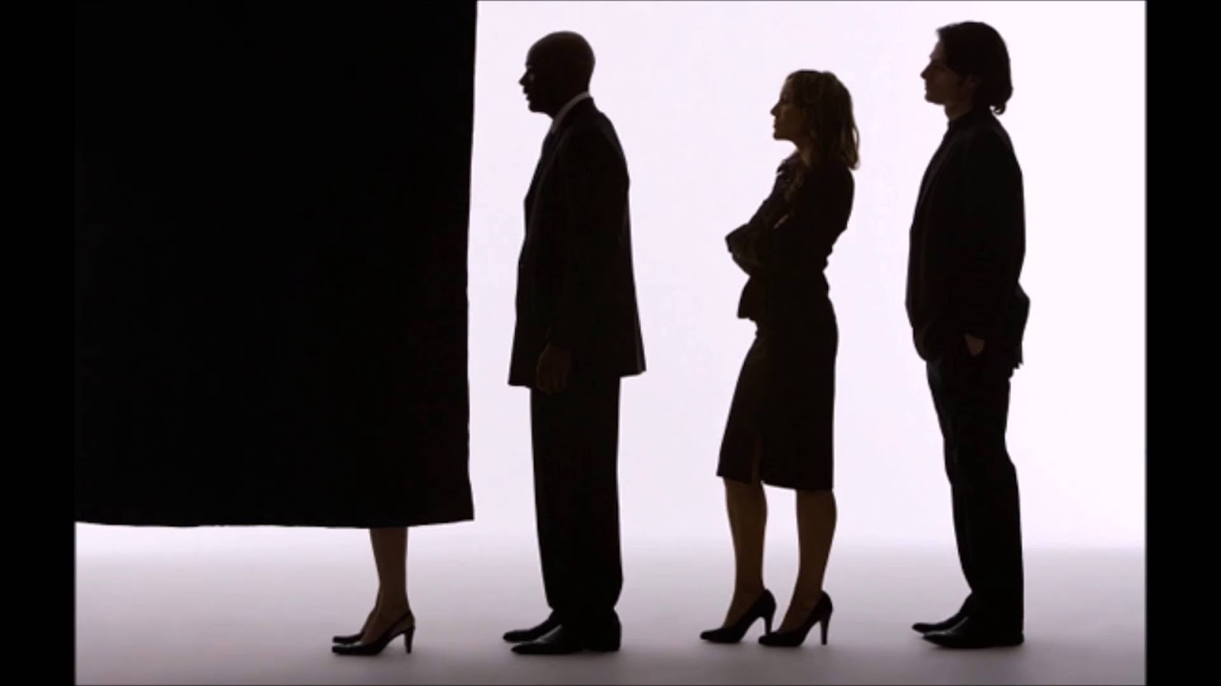
5. REFORM (SOLUTION): SECRET BALLOT
Gave voters privacy at the ballot box – they were less subjective to pressure and intimidation

Slide 11
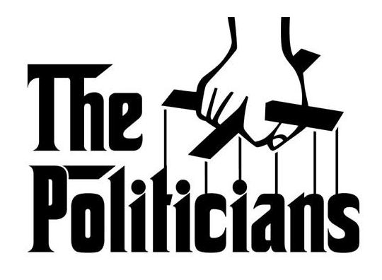
6. GILDED AGE PROBLEM: POLITICAL CANDIDATES
Candidates for political parties were chosen by the political machines – people didn’t get to have a say in who represented their political parties in elections

Slide 12
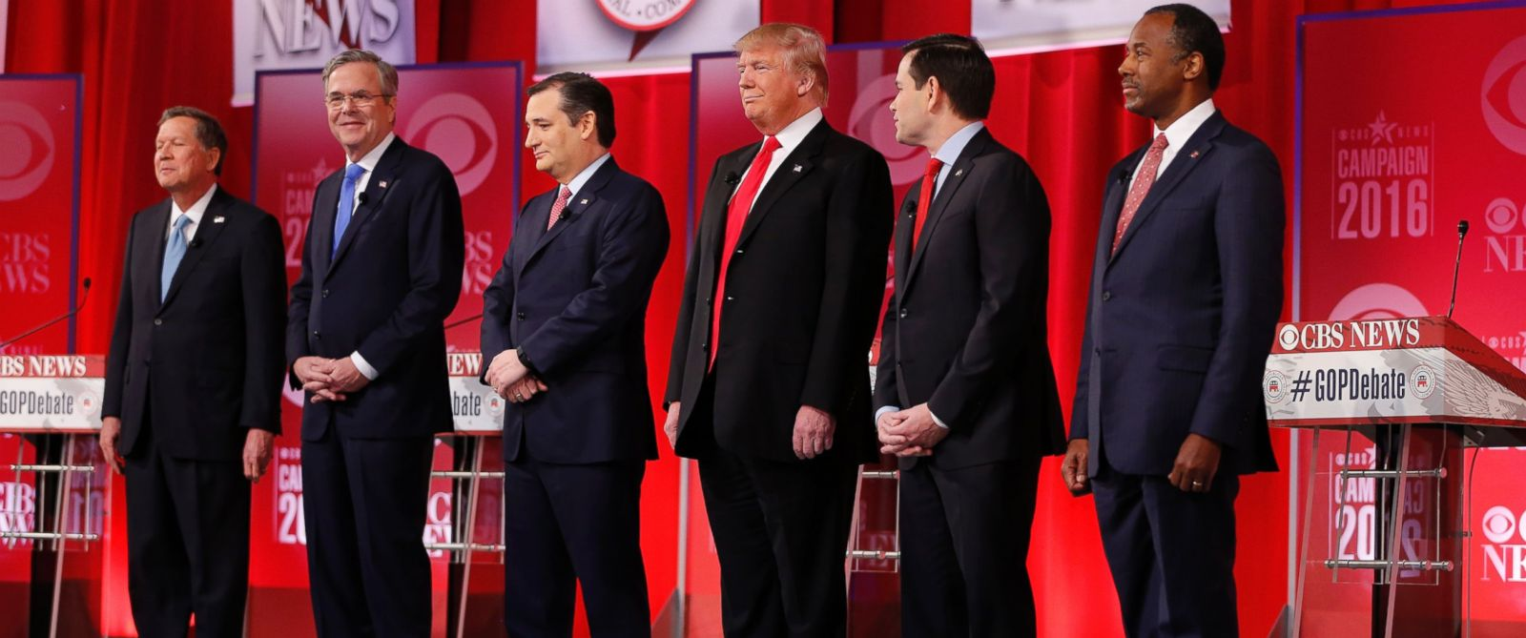
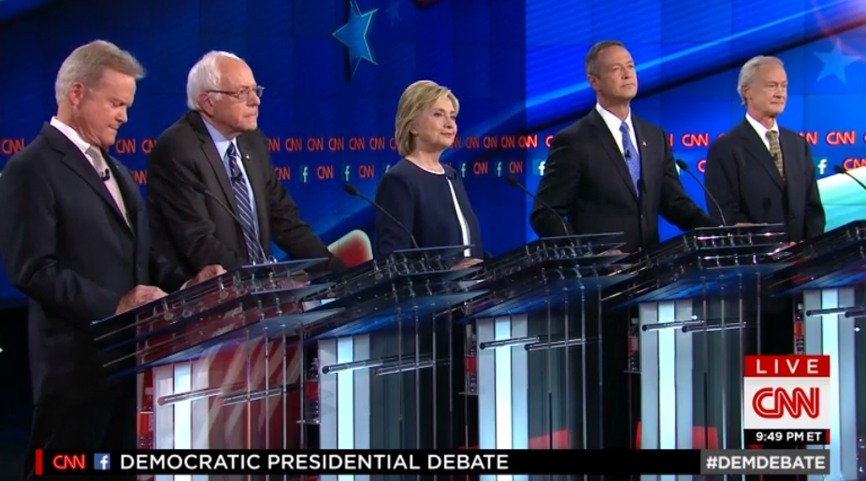
6. REFORM (SOLUTION): DIRECT PRIMARY
Candidates for each political party are now determined by a preliminary vote

Slide 13
7. DIRECT PRIMARY EXPLAINED
Each political party has a number of candidates who would like to run for office
After the primary vote, the winners from each party go head to head
Gave citizens a way to participate in the selection of a presidential candidate
Republican
Primary vote
Democrat
Primary vote
VS

Slide 14
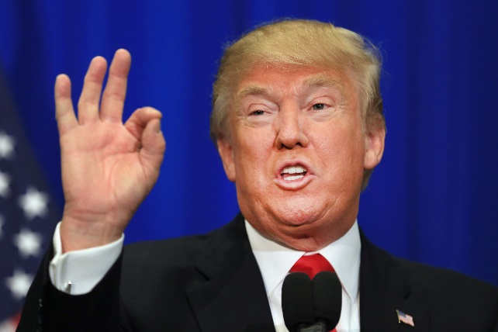
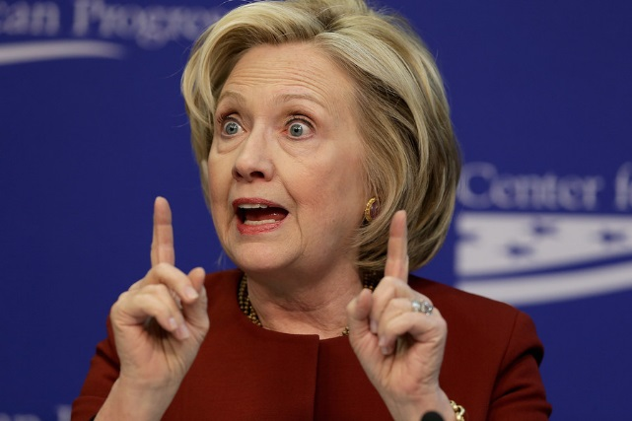
EXAMPLE: 2016 PRESIDENTIAL ELECTION
VS.

Slide 15
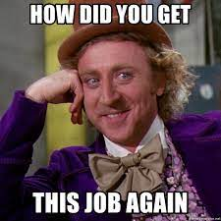
8. GILDED AGE PROBLEM: PATRONAGE 2.0
Political machines would put people in power in government who were NOT qualified for the responsibilities

Slide 16
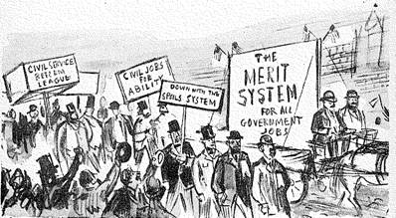
8. REFORM (SOLUTION): PENDLETON ACT
Created The Civil Service Commission – it required exams and specific criteria to get government jobs
Took out the spoils systems (corrupt office appointing) and put in a merit system

Slide 17
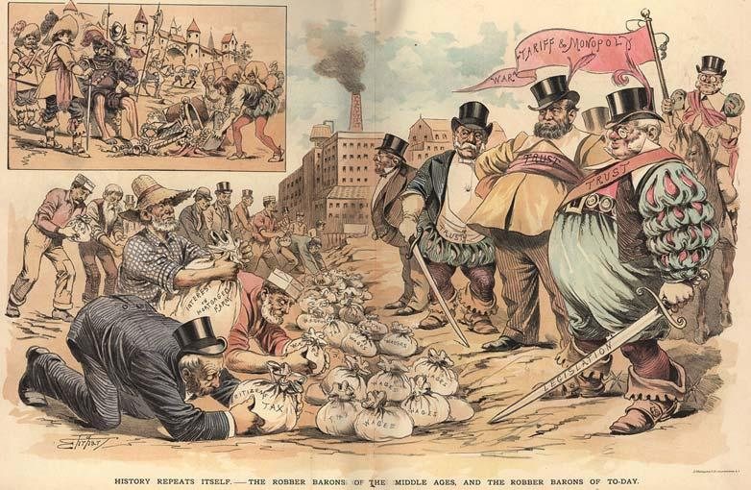
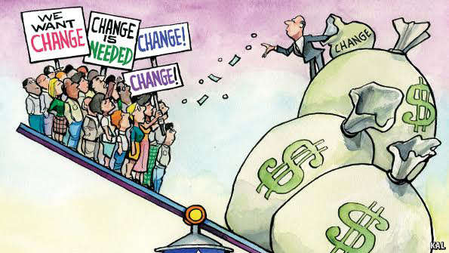
9. GILDED AGE PROBLEM: INCOME INEQUALITY
- The rich were extremely rich and the poor were extremely poor; no inbetween

Slide 18
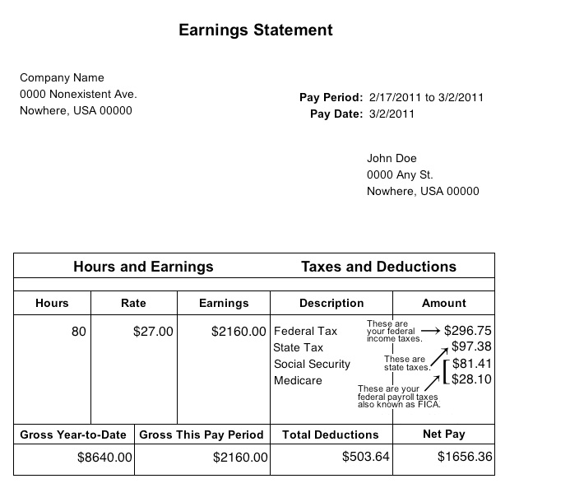
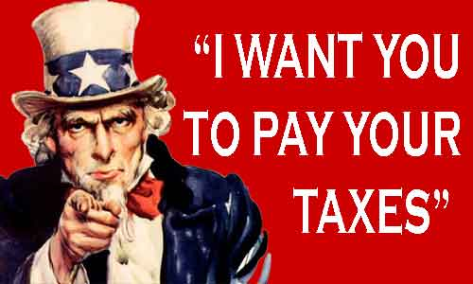
9. REFORM (SOLUTION): 16TH AMENDMENT
Granted Congress the power to create an income tax
Idea is that money of the wealthy can be used by the government to do public works that can help the poor (roads, streets, libraries, schools etc.)

Slide 19
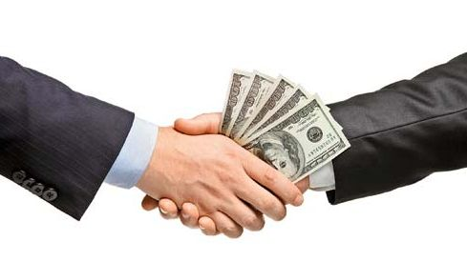
10. GILDED AGE PROBLEM: SELECTED GOV’T OFFICIALS
Senators were chosen by state government officials
Often times they would bribe people to select them

Slide 20
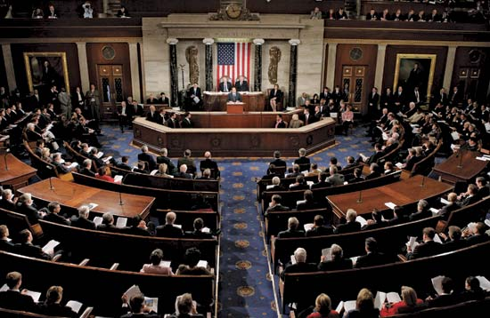
10. REFORM (SOLUTION): 17TH AMENDMENT
Established the direct election (people choose by voting) of U.S. Senators

Slide 21
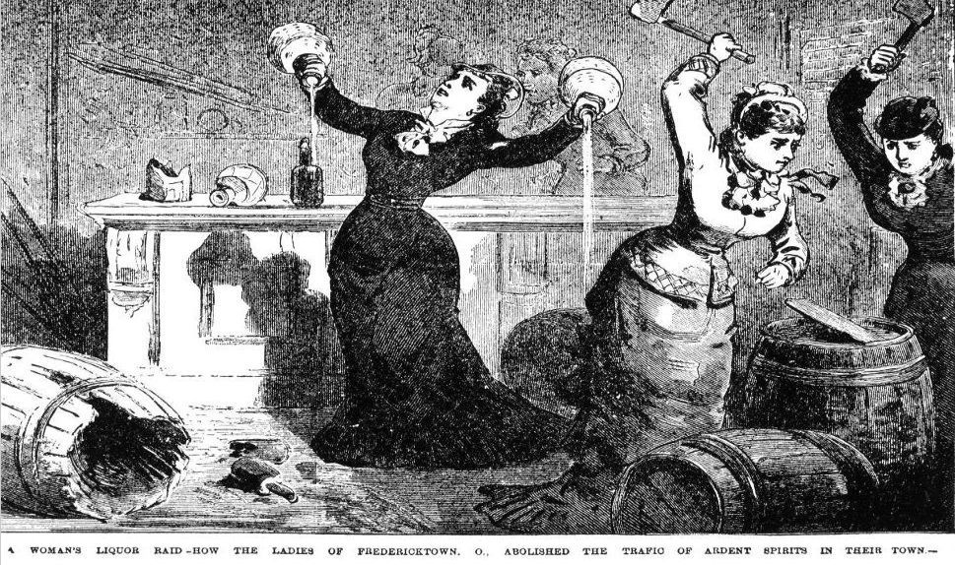
11. GILDED AGE PROBLEM: ALCOHOL
Women thought many of America’s social problems seemed to be linked to alcohol

Slide 22
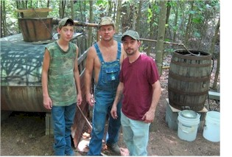
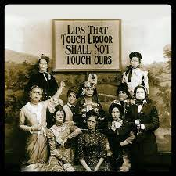
11. REFORM (SOLUTION): 18TH AMENDMENT
Made making, selling, or transporting alcohol illegal

Slide 23
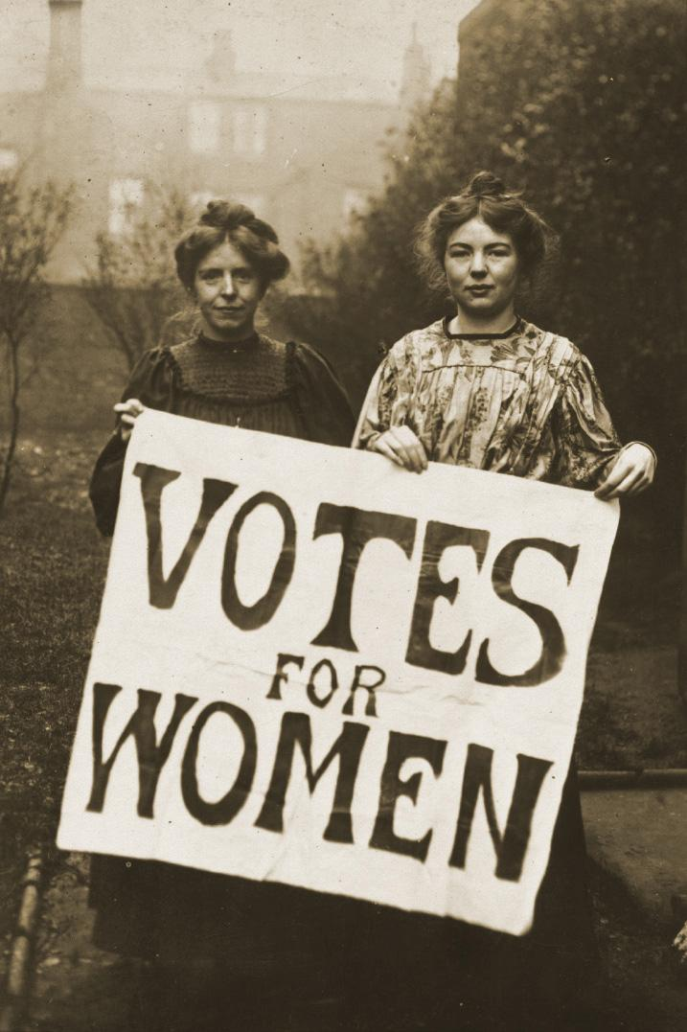
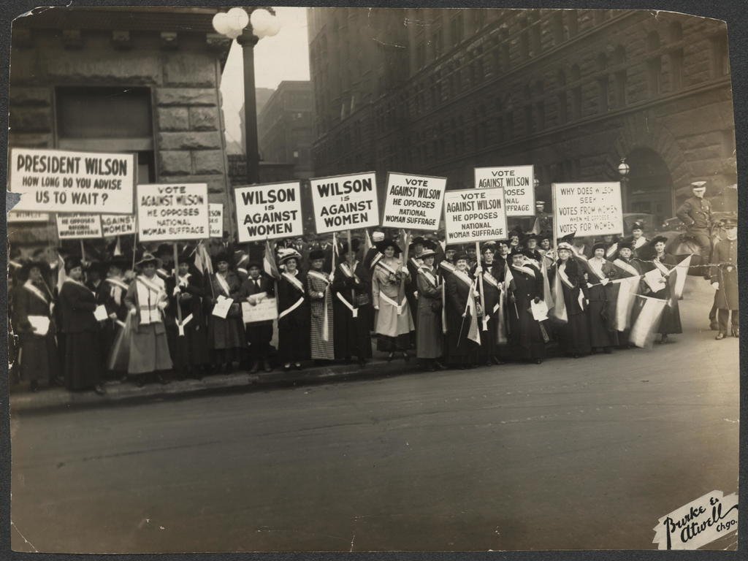
12. GILDED AGE PROBLEM: VOTING
Women could not vote
They had no voice or say in their government

Slide 24
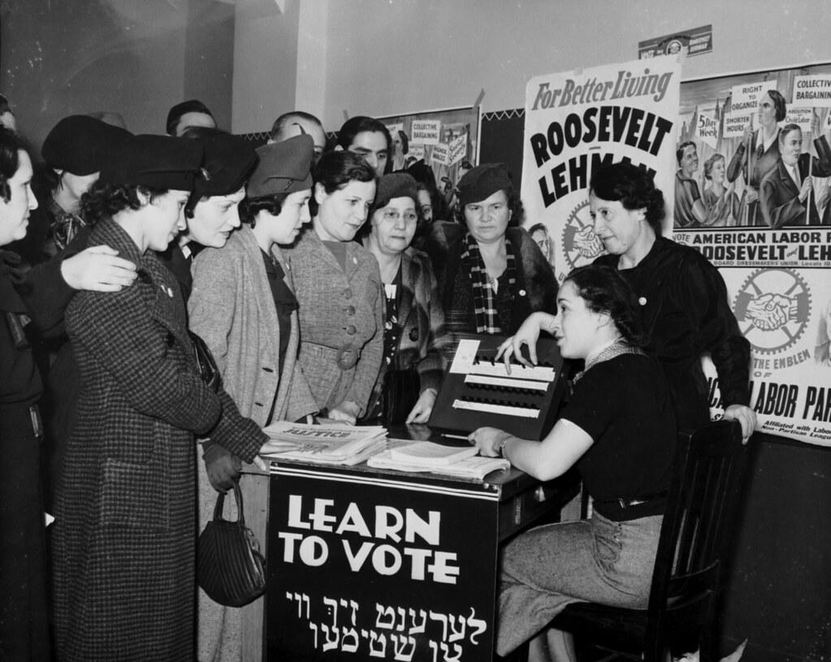
12. REFORM (SOLUTION): 19TH AMENDMENT
Granted women’s suffrage (the right to vote)

