Slide 1
Partnerships

Slide 2
The Unique Characteristics of Partnerships
General Partnership
Limited Partnership
Limited Liability Partnerships

Slide 3
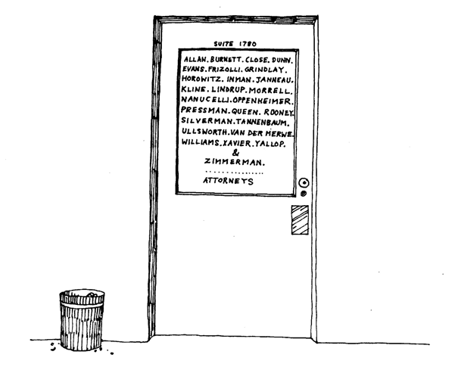
The Characteristics of Partnerships
Law partnerships are common, and law practices can have many partners. Analyze Political Cartoons What advantages and disadvantages might having many partners offer a business?

Slide 4
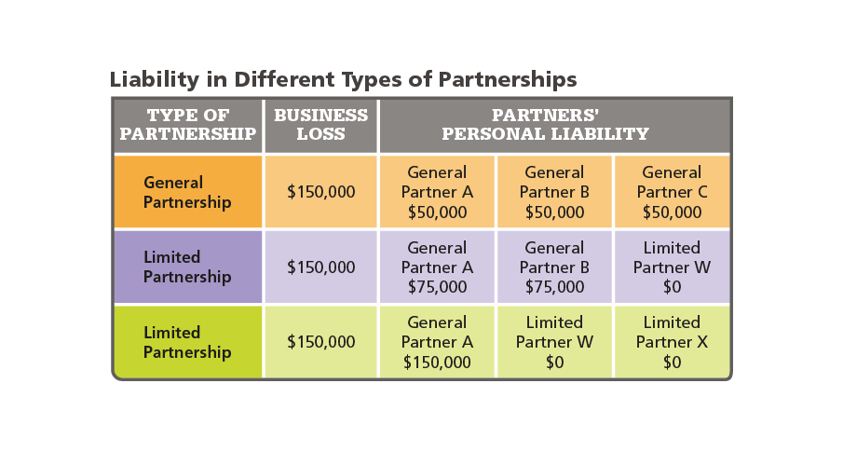
The Characteristics of Partnerships
The table shows how the same business loss might be shared by partners in three different partnerships. Synthesize Why does the personal liability of the partners differ in these scenarios?

Slide 5
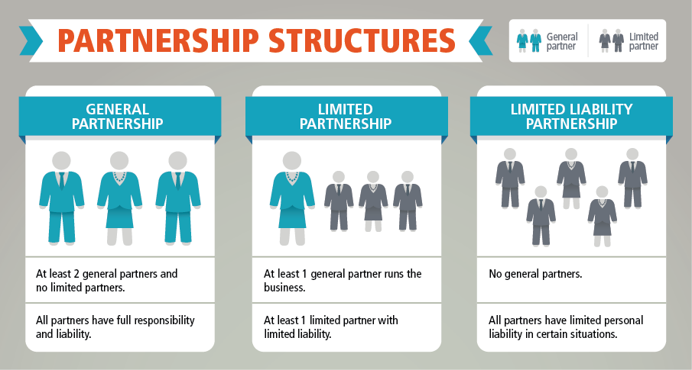
The Characteristics of Partnerships
Compare and Contrast How do limited liability partnerships differ from the other two types of partnerships?

Slide 6
Advantages of Partnerships
Ease of Start-Up
Financial Impact shared losses
Shared Decision Making
Requires small amounts of capital

Slide 7
Disadvantages of Partnerships
Unlimited Liability
Potential for Conflict
Lack of Permanence
Shared profit

Slide 8
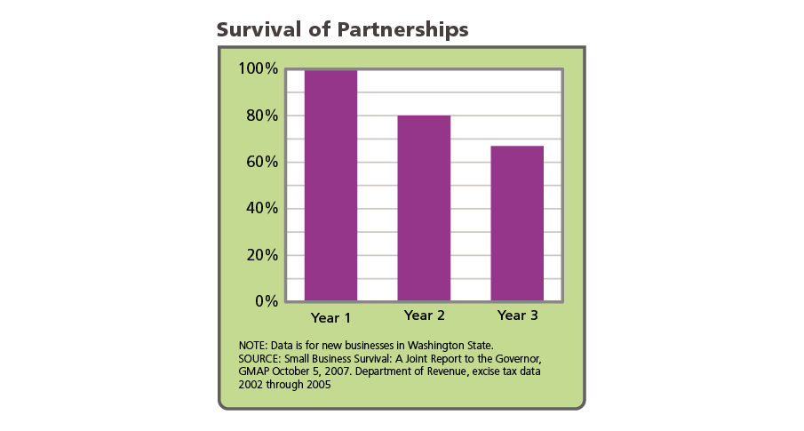
Disadvantages of Partnerships
Analyze Graphs If the trend suggested by the graph continues, about what percentage of partnerships do you predict would survive by the end of Year 4? Explain.

Slide 9
Quiz: The Characteristics of Partnerships
Which of these is an advantage that general partners alone enjoy in a limited partnership?
A. control of business operations
B. limited liability
C. share of investment
D. share of profits

Slide 10
Quiz: Advantages of Partnerships
What is an advantage that the general partners who own a partnership have that the owner of a sole proprietorship may not have?
A. no need to follow government regulations
B. better access to capital
C. ease of start-up
D. no need to hire employees

Slide 11
Quiz: Disadvantages of Partnerships
Suppose a business is owned by two partners. What skill does each partner need that a sole proprietor would not necessarily need?
A. decision-making ability
B. management expertise
C. ability to collaborate with an equal
D. advertising expertise

