Slide 1
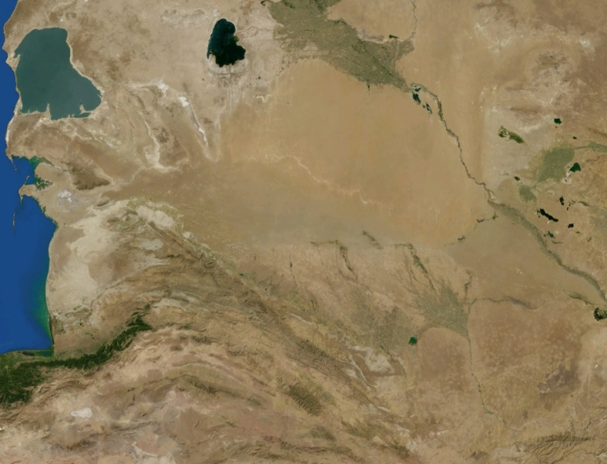
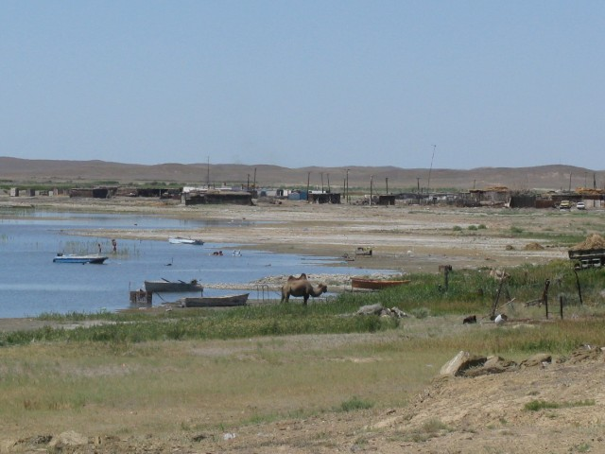
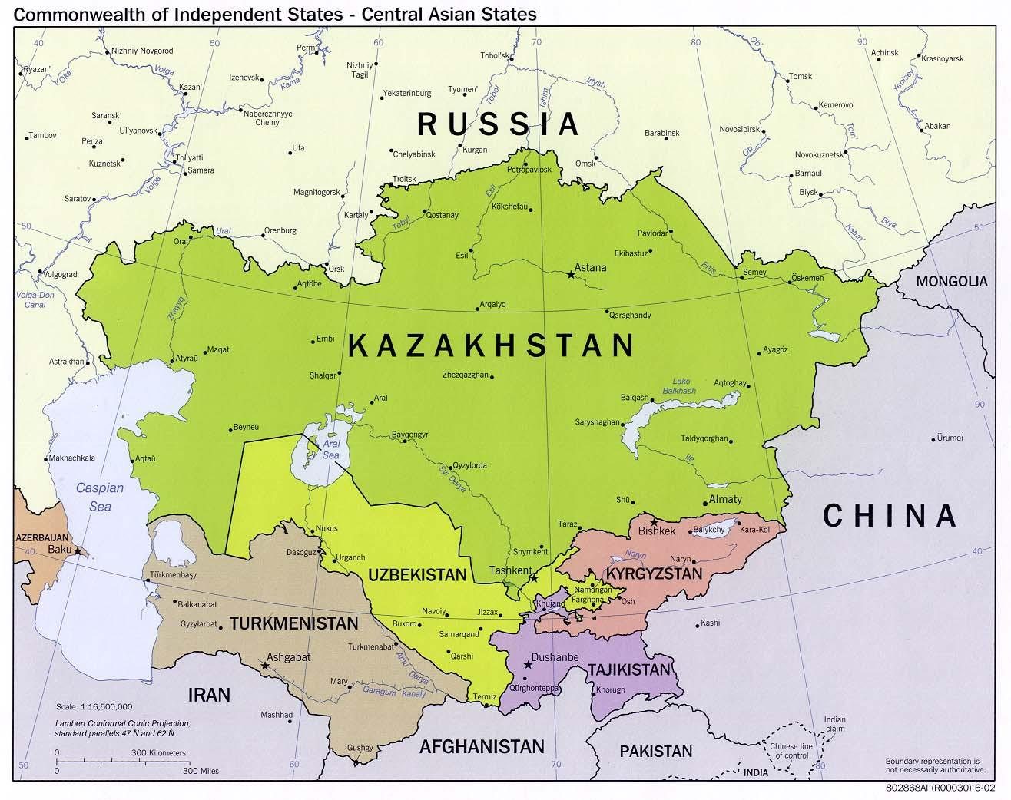
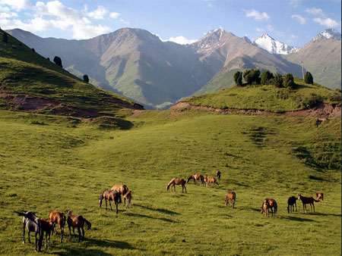
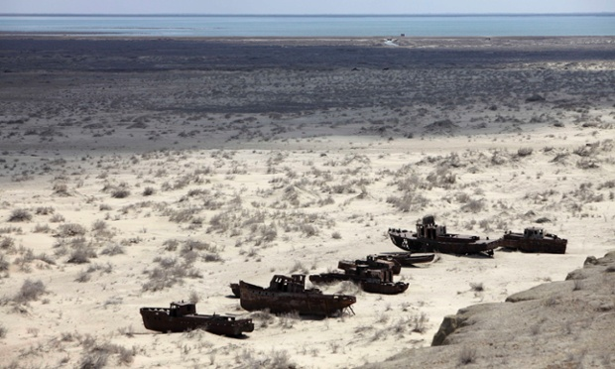
PHYSICAL GEOGRAPHY OF CENTRAL ASIA

Slide 2
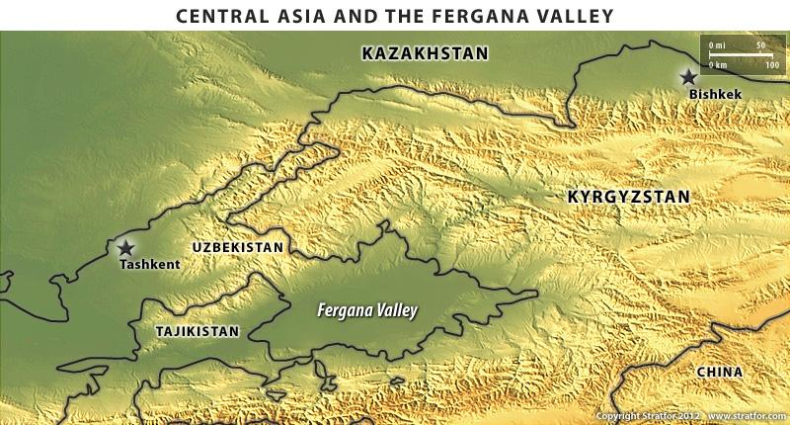
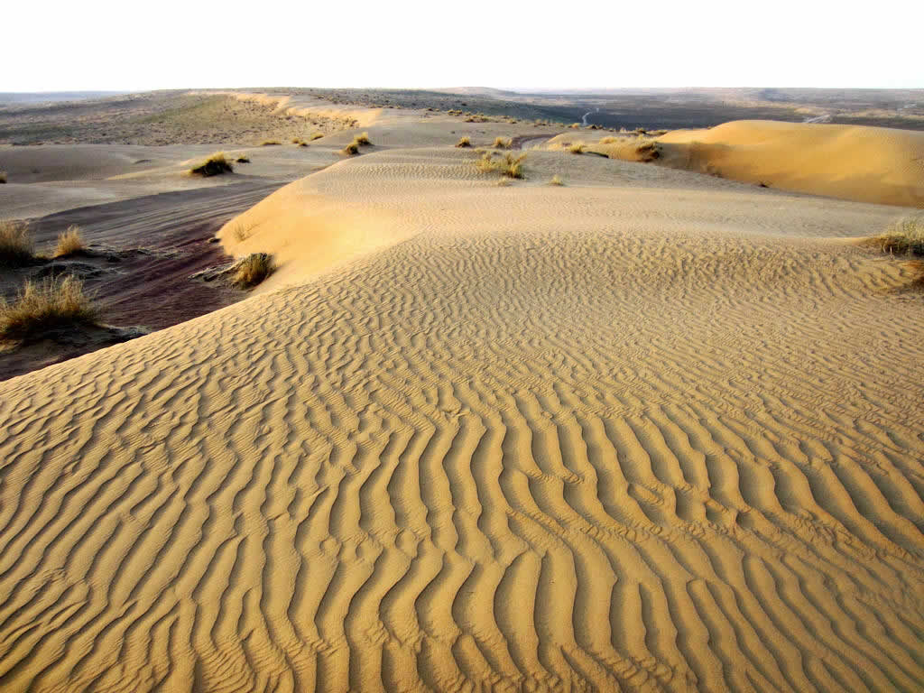
PHYSICAL GEOGRAPHY OF CENTRAL ASIA
Landforms
Central Asia is marked by a rugged landscape, highlands, a dry climate, and vast expanses of desert.
All the countries are landlocked, except Georgia, with no direct access to the sea.

Slide 3
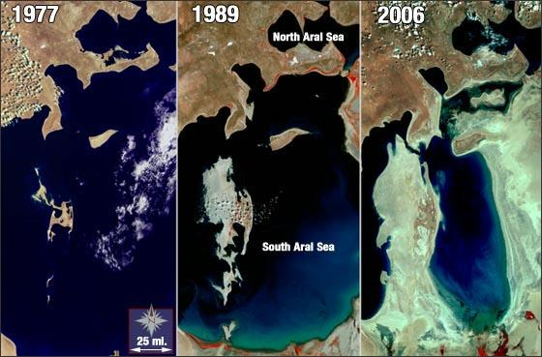
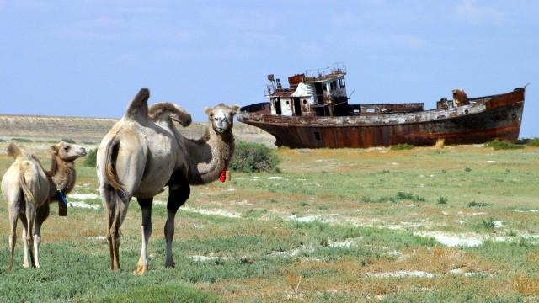
PHYSICAL GEOGRAPHY OF CENTRAL ASIA
Water Systems
When the weather is warm and there is little precipitation, the Caspian Sea, the world’s largest inland sea, loses more water from evaporation than it gains from the rivers emptying into it.
Human activity has harmed bodies of water in the subregion.

Slide 4
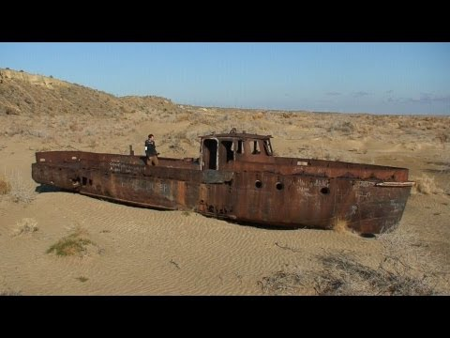
Aral Sea
What caused the sea to dry up?

Slide 5
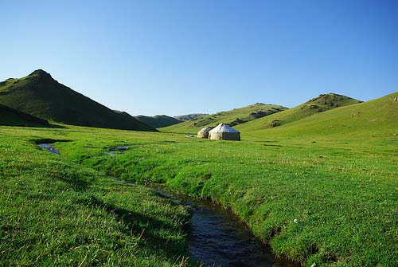
PHYSICAL GEOGRAPHY OF CENTRAL ASIA
Climate, Biomes, and Resources
Far from any oceans, Central Asia has mainly dry climates with sparse vegetation..
Major crops of the region are cereals, or grains grown for food.
Major resources in the area are oil, natural gas, and mining.

Slide 6
Dubai - Copy Questions to your notes
How tall is the Burj Khalifa?
What resource allowed Dubai to become so rich?
About 25% of _______ are in Dubai.
Burj Al Arab Suite Cost/Night: ________
Cost to Build Palms Islands: _________
What type of cars do the police drive?
What is the major sport in Dubai?
What is the income tax rate in Dubai?

Slide 7
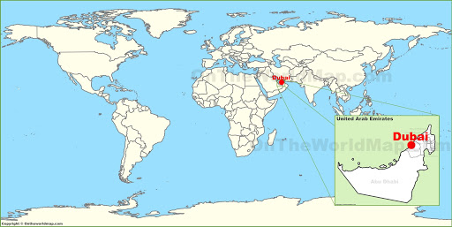
Dubia

Slide 8
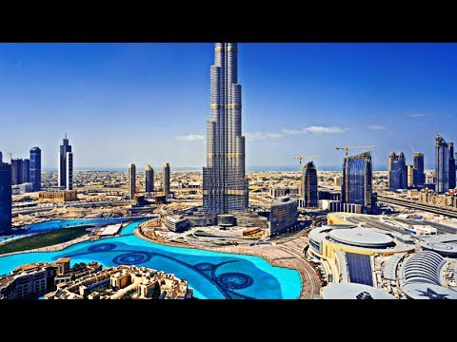
Dubia Film

