Slide 1
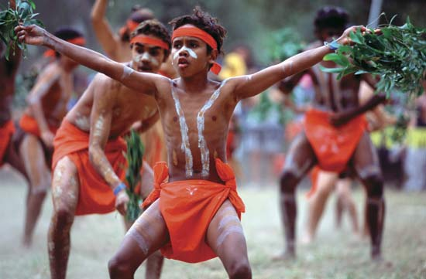
Human Geography of Australia and New Zealand
History and Government
The Aborigines are the earliest inhabitants of Australia, and the Māori are New Zealand’s indigenous population.
Both countries were settled by Britain, which had a disastrous impact on the indigenous peoples.
Today, dominions, or largely self-governing countries within the British Empire, are constitutional monarchies with parliamentary systems.

Slide 2
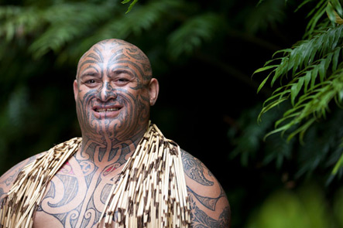
Human Geography of Australia and New Zealand
Population Patterns
Both countries have multicultural communities.
About 2 percent of Australia’s population is Aboriginal, and about 7 percent of New Zealand is Māori.
Most Australians live along the mild and fertile southern, eastern, and southwestern coasts.
New Zealand’s urban populace lives mostly on the North Island.
Australia’s aging population is a concern.

Slide 3
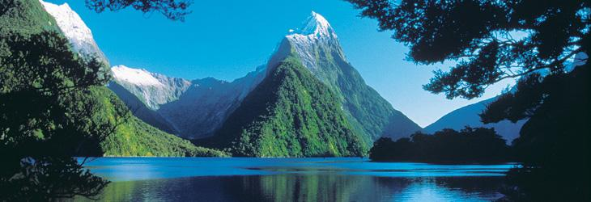
Human Geography of Australia and New Zealand
Society and Culture Today
Both countries blend European, indigenous, and Asian elements into their cultures.
English is the major language, and both countries offer high-quality education and health care.
Relations between indigenous populations and European descendants have improved with increased integration and better understanding.
Roles for women are evolving as more women participate in the workforce.

Slide 4
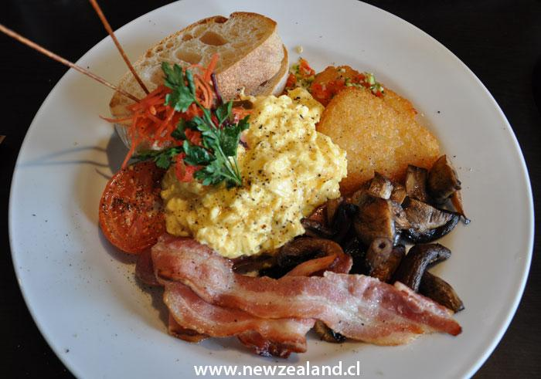
Human Geography of Australia and New Zealand
Economic Activities
Australia and New Zealand have a close economic relationship.
Both countries have well developed service sectors.
Australia’s diverse economy includes agriculture, mining, and industrial equipment, and is home to many natural resources that invite significant foreign investment.
New Zealand’s main industries include food processing and textiles, and the country benefits from many natural resources.

Slide 5
