Slide 1
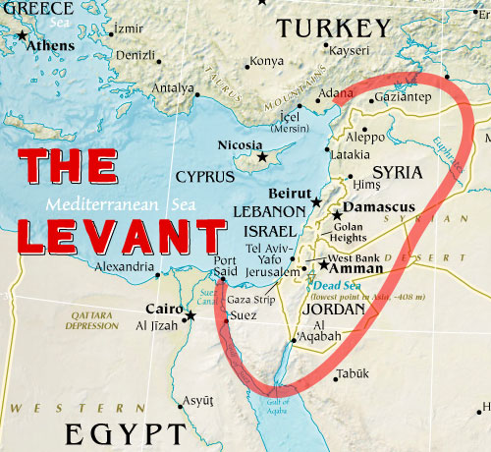
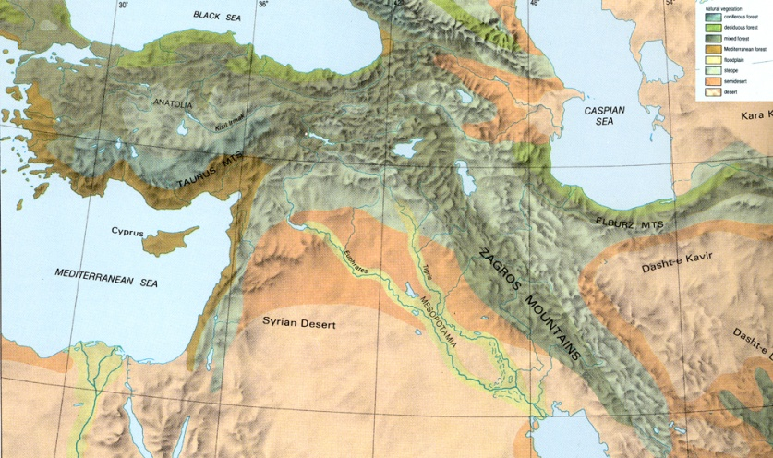
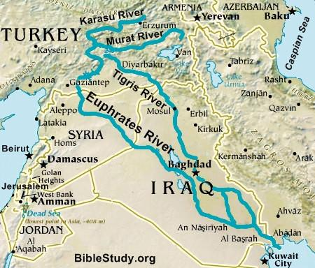
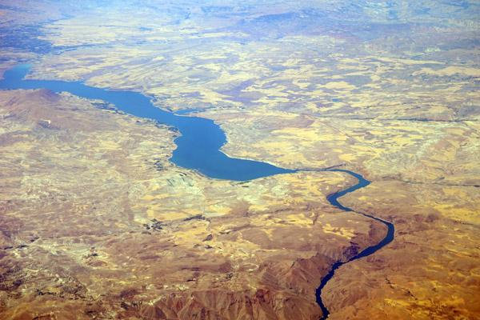
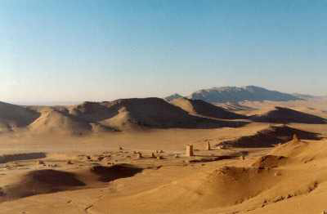
PHYSICAL GEOGRAPHY OF THE EASTERN MEDITERRANEAN

Slide 2
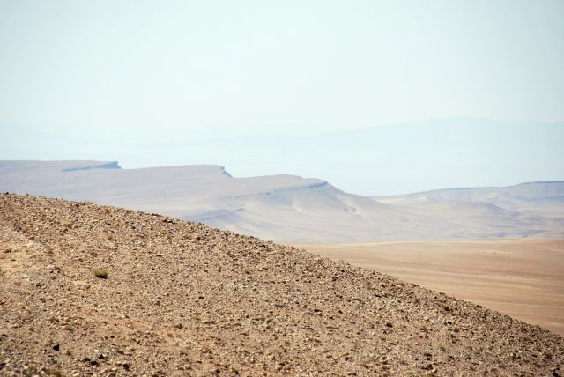
PHYSICAL GEOGRAPHY OF THE EASTERN MEDITERRANEAN
Landforms
This area is known as the Levant and includes Syria, Jordan, Lebanon, Israel, and the Palestinian territories.
The area is marked by mountains and deserts and has a generally temperate climate.
The sparsely populated Anti-Lebanon mountain range runs along the border between Syria and Lebanon.
The Syrian Desert is composed of gravel and used as a roadway.

Slide 3
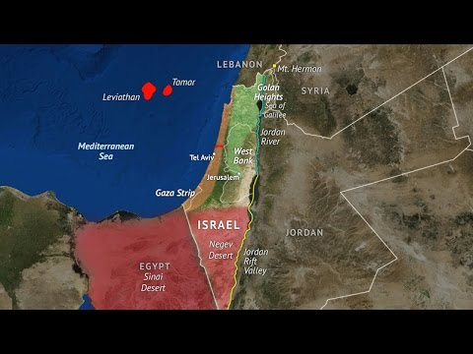
Israel Geo
What major body of water borders Israel?
What nations border Israel?
List the geographic regions of Israel:

Slide 4
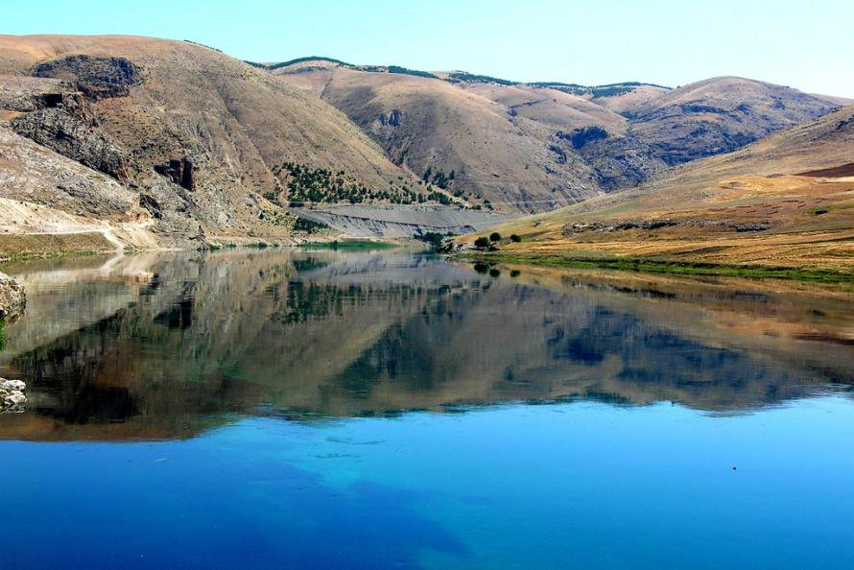
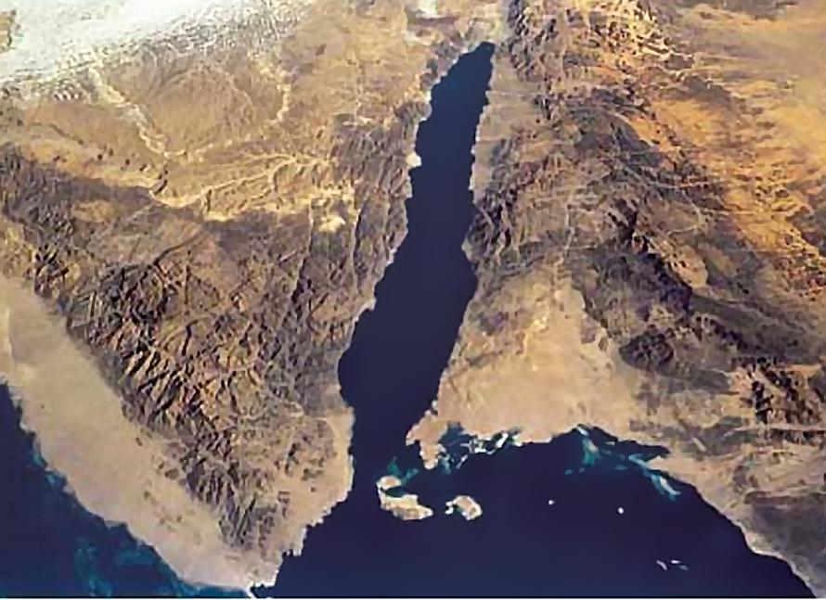
PHYSICAL GEOGRAPHY OF THE EASTERN MEDITERRANEAN
Water Systems
The Euphrates River is the most important river in the Eastern Mediterranean

Slide 5
PHYSICAL GEOGRAPHY OF THE EASTERN MEDITERRANEAN
Climate, Biomes, and Resources
Rainfall is limited in the subregion, which consists of mostly semi-arid and arid climates.
The coastal regions have a Mediterranean climate that supports agriculture, and a wide array of vegetation and wildlife.
As one moves inland, the climate becomes humid subtropical, and arid desert.
Lumber and minerals are important natural resources in the subregion.

Slide 6
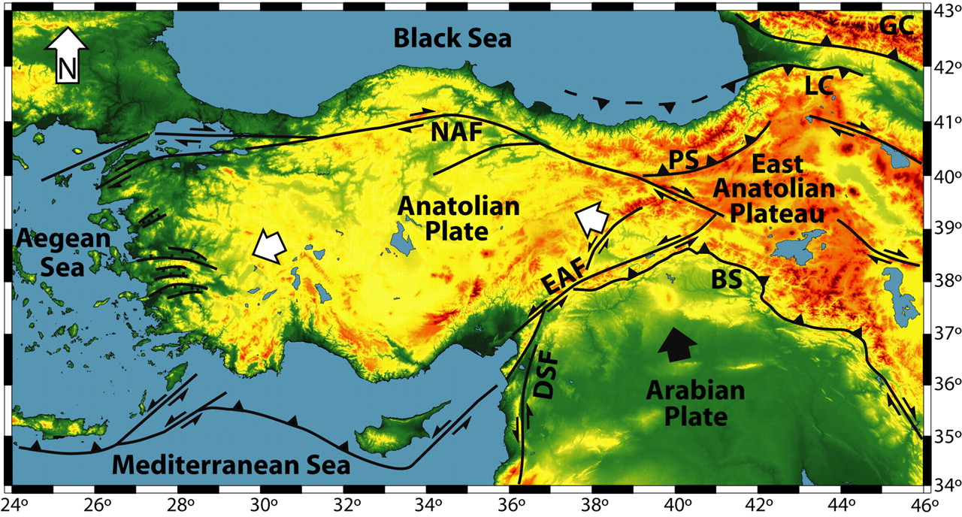
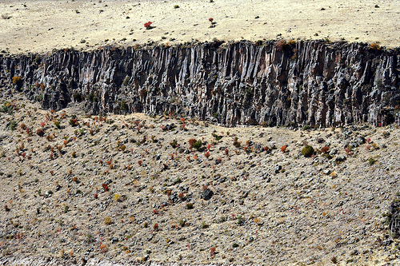
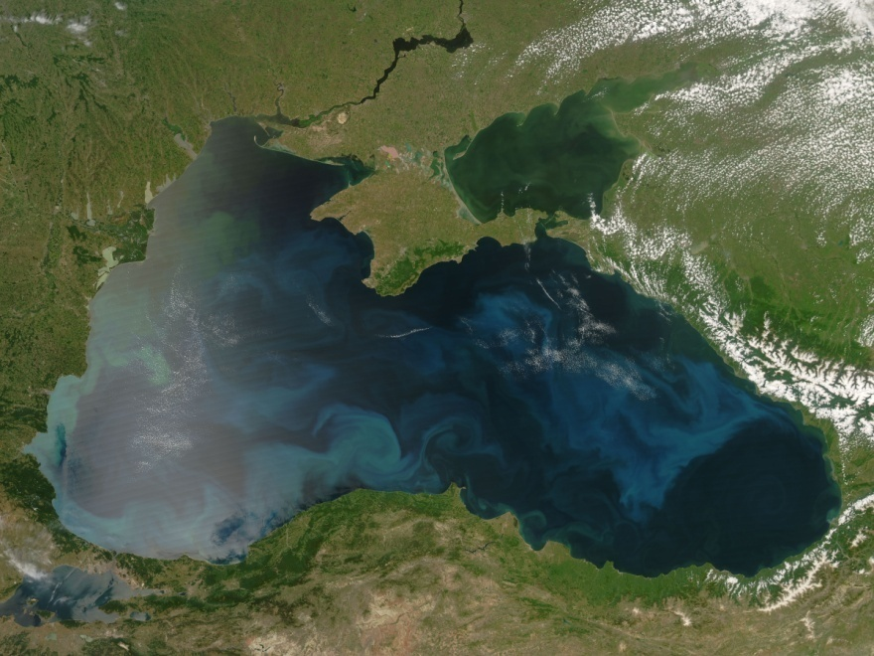
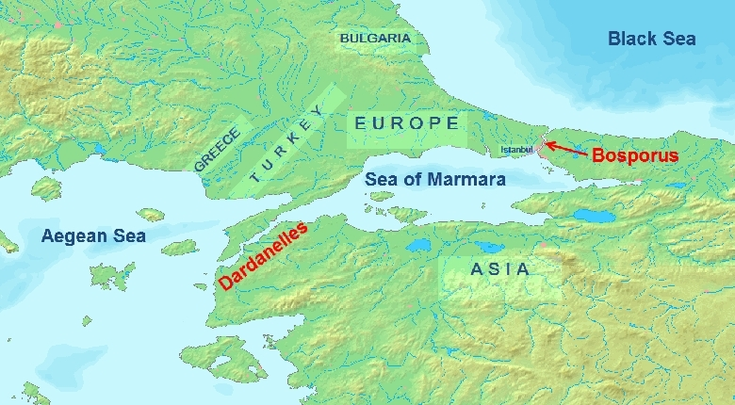
PHYSICAL GEOGRAPHY OF THE NORTHEAST

Slide 7
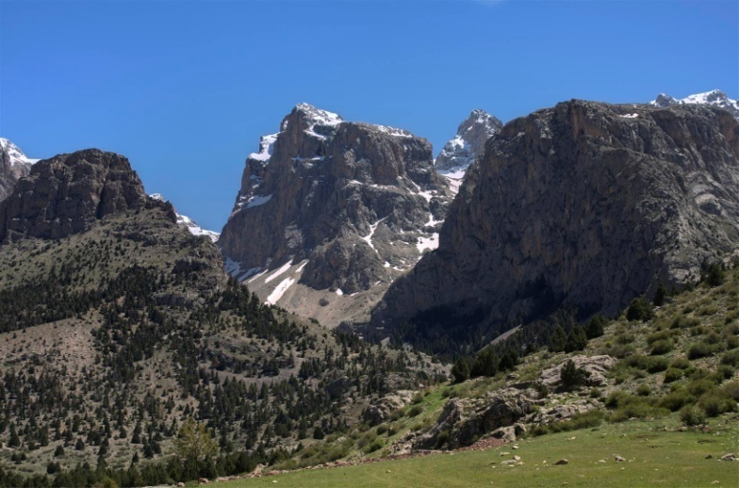
PHYSICAL GEOGRAPHY OF THE NORTHEAST
Landforms
The Northeast is a mountainous area where several tectonic plates converge.
Many fault lines run through the subregion, including the North Anatolian Fault, one of the most active producers of earthquakes in the world.

Slide 8
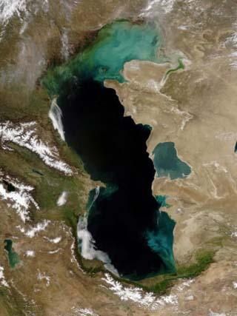
PHYSICAL GEOGRAPHY OF THE NORTHEAST
Water Systems
Mesopotamia, the land between the Tigris and Euphrates Rivers in present-day Iraq, is the site of the world’s earliest civilizations.
The Caspian Sea in Iran serves as a key transportation link to Asia.

Slide 9
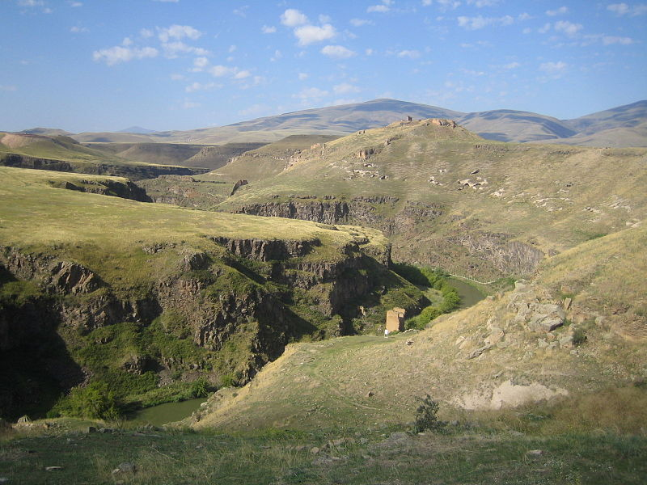
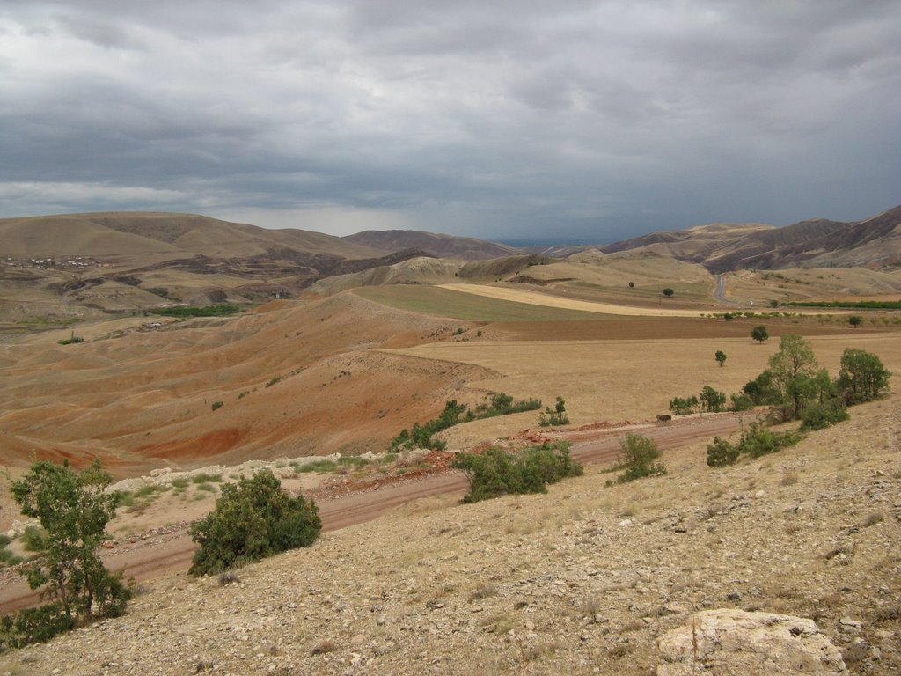
PHYSICAL GEOGRAPHY OF THE NORTHEAST
Climate, Biomes, and Resources
Apart from the coasts, deserts cover much of the Northeast.
Fossil fuels are among the most significant resources in the area.

Slide 10
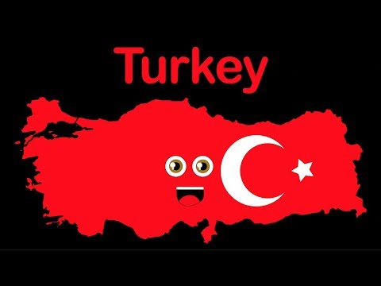
Geography of Turkey
List any 4 facts

Slide 11
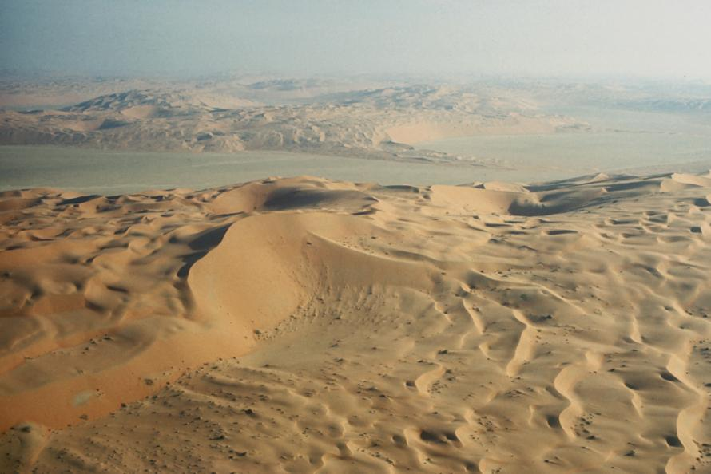
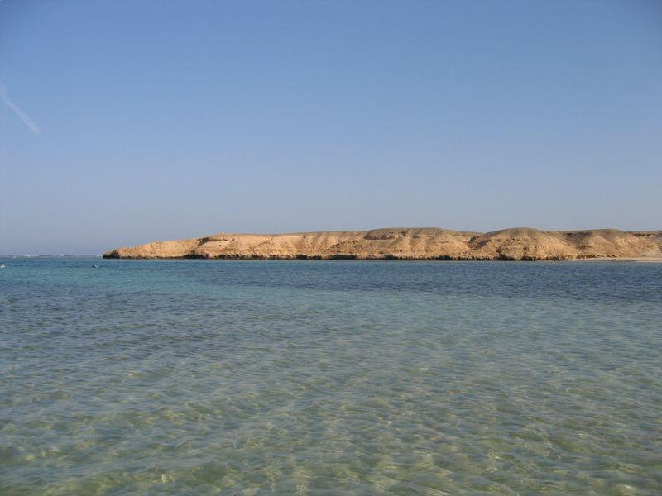
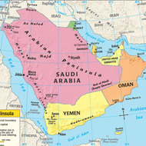
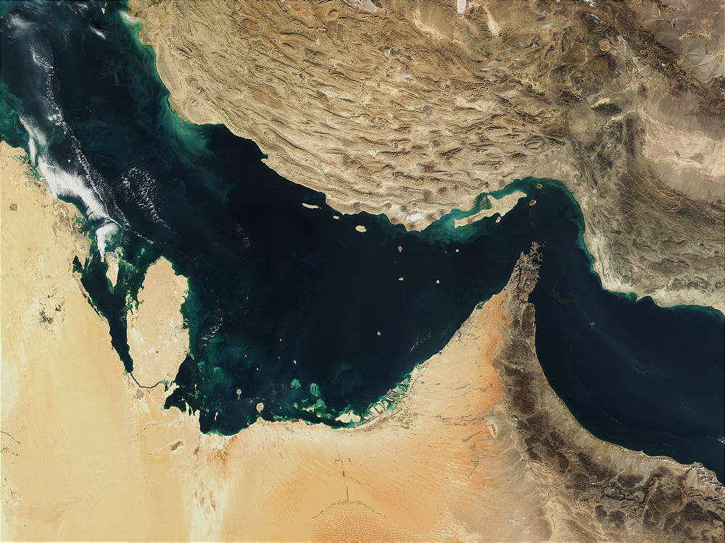
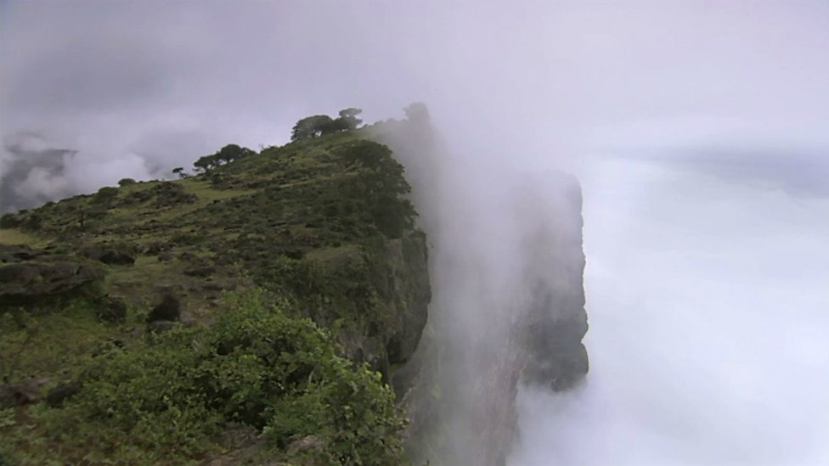
PHYSICAL GEOGRAPHY OF THE ARABIAN PENINSULA

Slide 12
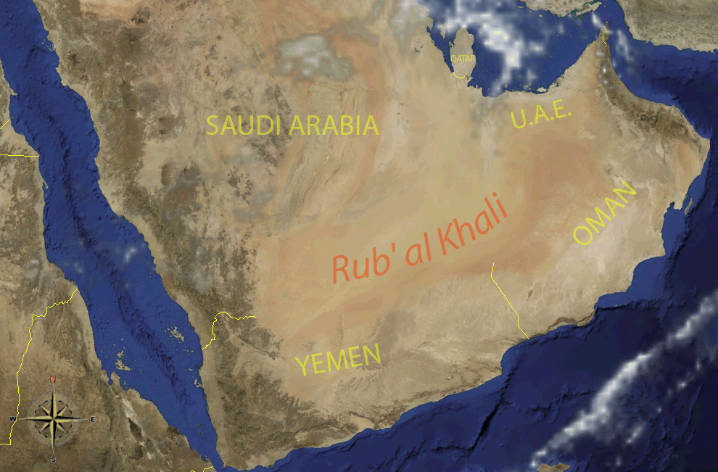
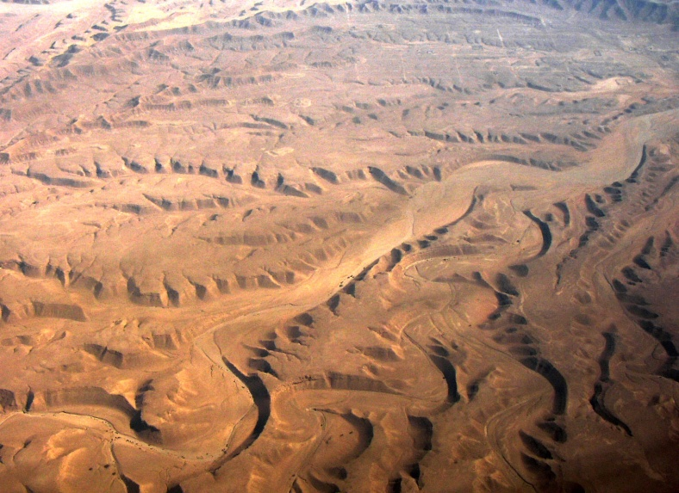
PHYSICAL GEOGRAPHY OF THE ARABIAN PENINSULA
Landforms
The Arabian Peninsula is surrounded almost entirely by water.
The climate of the interior is arid, or very dry, and is unsuitable for agriculture or human settlement.

Slide 13
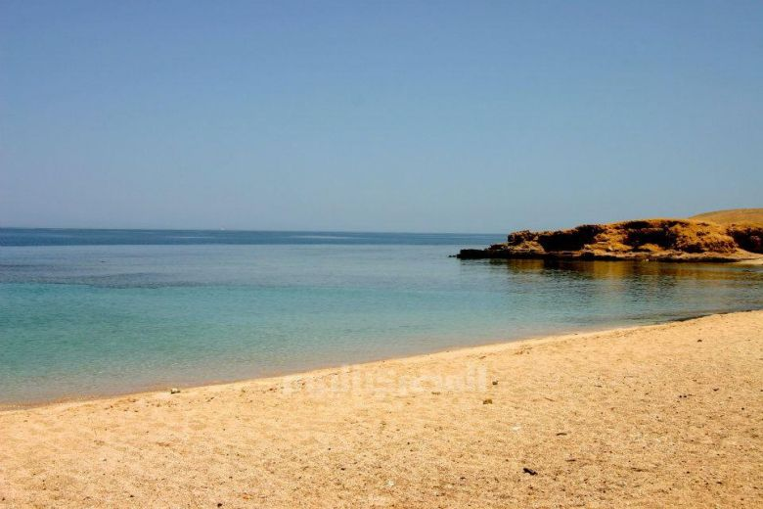
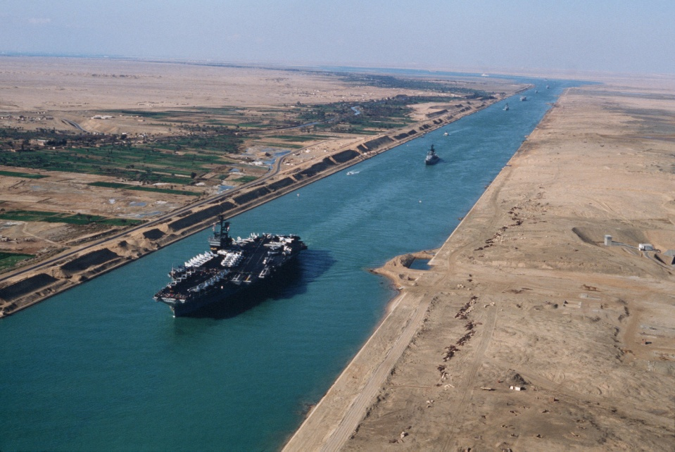
PHYSICAL GEOGRAPHY OF THE ARABIAN PENINSULA
Water Systems
The waters that surround the peninsula are vital to the economy.
The Red Sea links the Suez Canal to the Gulf of Aden, allowing the transportation of goods between Europe and Asia.
Rapidly growing populations are using up the already scarce sources of freshwater.

Slide 14
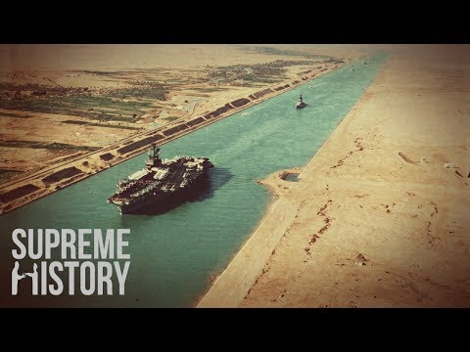
Suez Canal
How long is it?
When did it open?
What nation built the canal?
When did Egypt take over the Canal?
Who can use it?

Slide 15
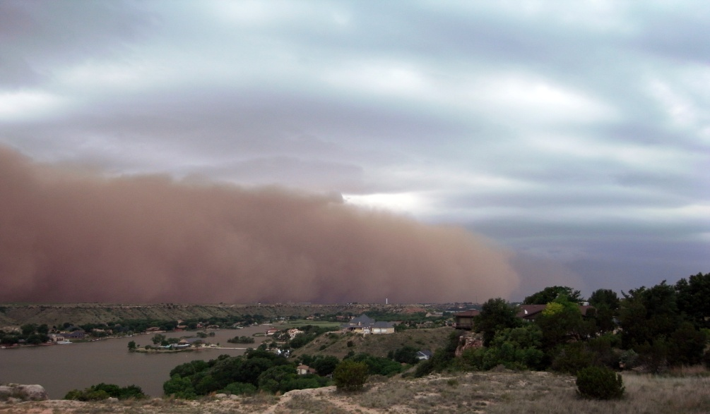
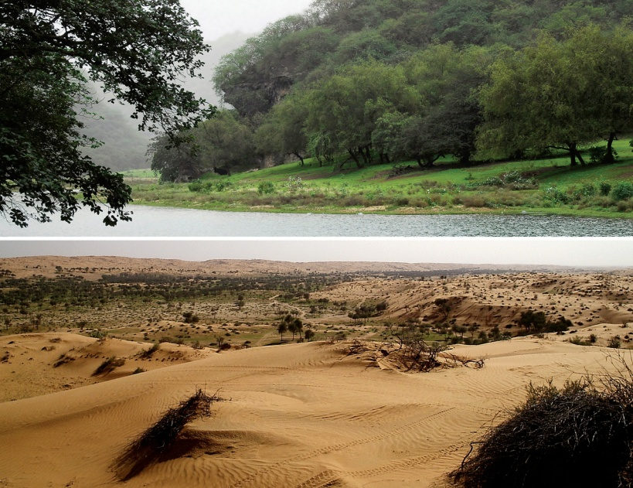
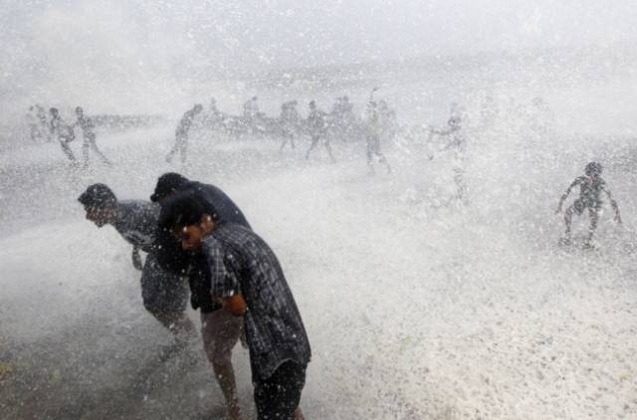
PHYSICAL GEOGRAPHY OF THE ARABIAN PENINSULA
Climate, Biomes, and Resources
The dry heat of the desert areas contrasts with extreme humidity of the coastal regions.
The Arabian deserts are estimated to contain at least 25 percent of the world’s oil reserves.

Slide 16
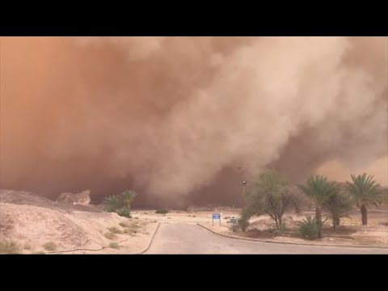
Sandstorms in 2018
Explain what is causing the increase in Sandstorms in the Middle East

