Slide 1
Nations of Western Europe

Slide 2
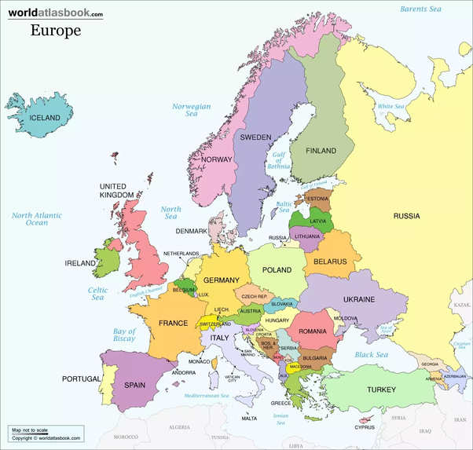

Slide 3
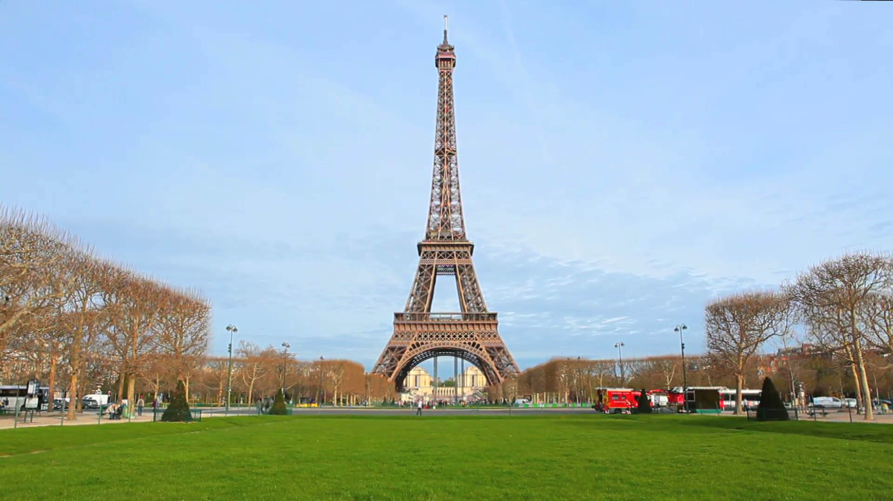
France
Population: 65,630,692
Capital: Paris
Language: French
Government: Republic
Economy: machinery, chemicals, automobiles, tourism
Religion: 80% Roman Catholic
Climate: generally cool winters and mild summers
Geographic Features: French Alps

Slide 4
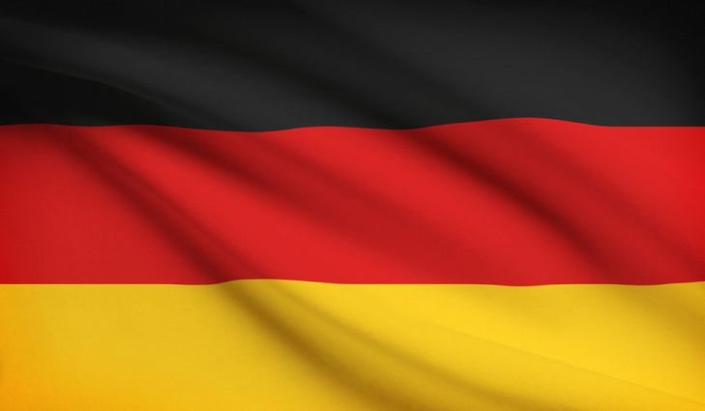
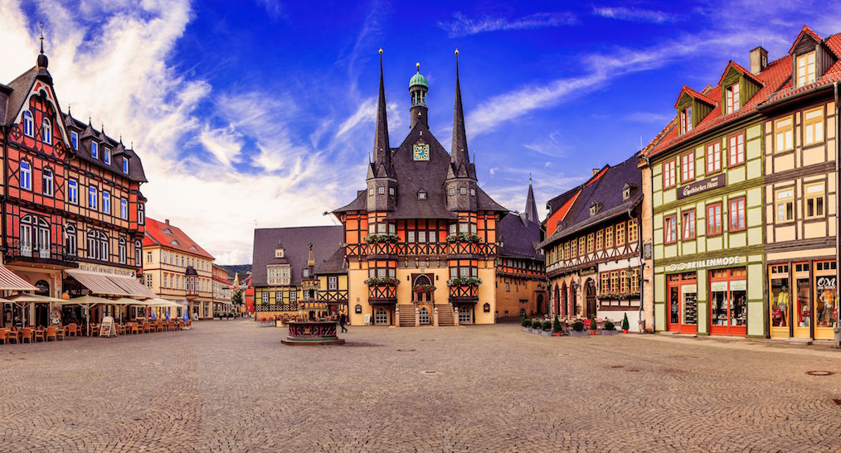
Germany
Population: 81,305,856
Capital: Berlin
Language: German
Government: Republic
Economy: iron, steel, coal, automotive
Religion: Protestant 34%, Roman Catholic 34%
Climate: temperate and marine
Geographic Features: Alps, North European Plain

Slide 5
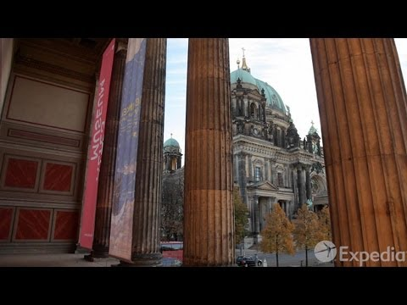
Berlin
Population:
What is the perfect way to explore the city?
The ____________ gate was built in the 18th century.
How many species of animal call the Berlin Zoo home?
What separated the city during the cold war?
What was the most famous border crossing?

Slide 6
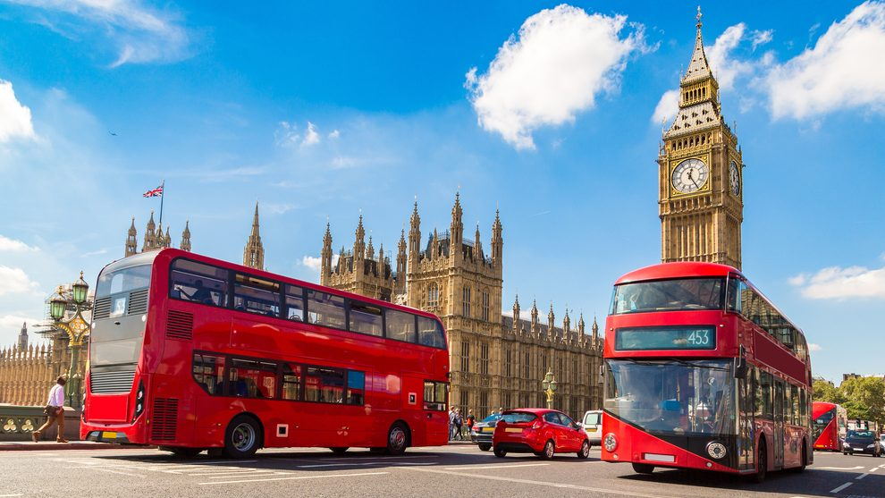
United Kingdom
Population: 63,047,162
Capital: London
Language: English
Government: constitutional monarchy
Economy: Consumer goods, machine tools, shipbuilding
Religion: 70% Christian
Climate: temperate
Geographic Features: English Channel, Scottish Highlands

Slide 7
Scotland, UK
List 5 things to do in Scotland:

Slide 8
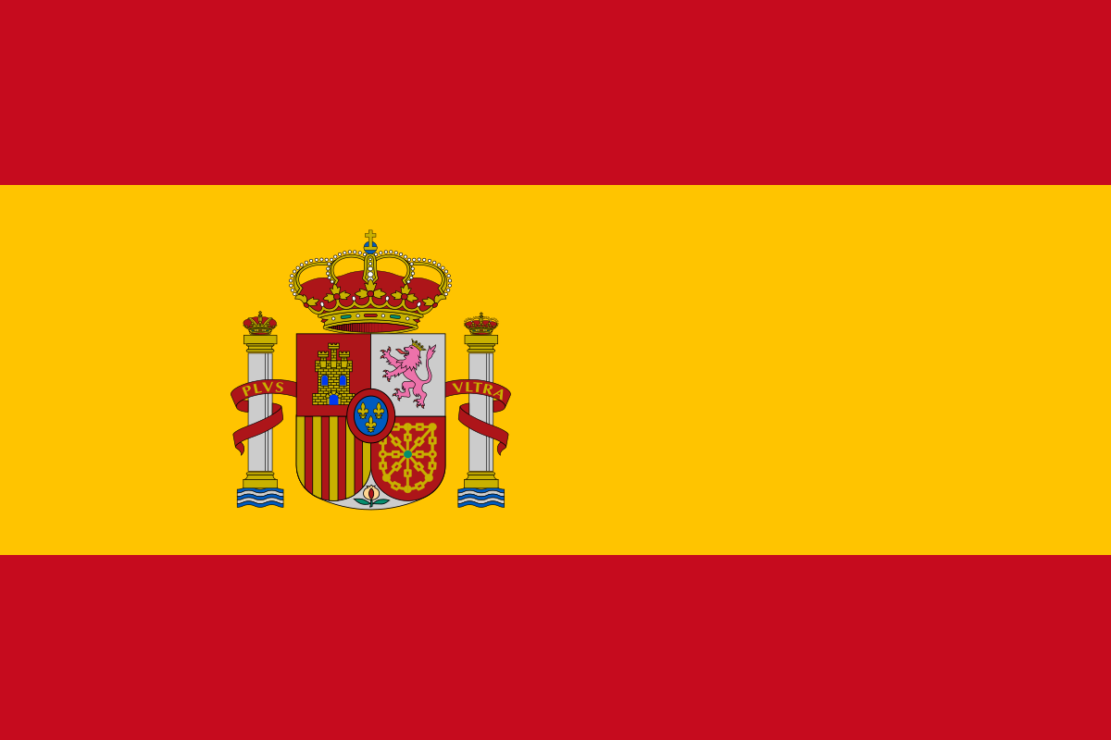
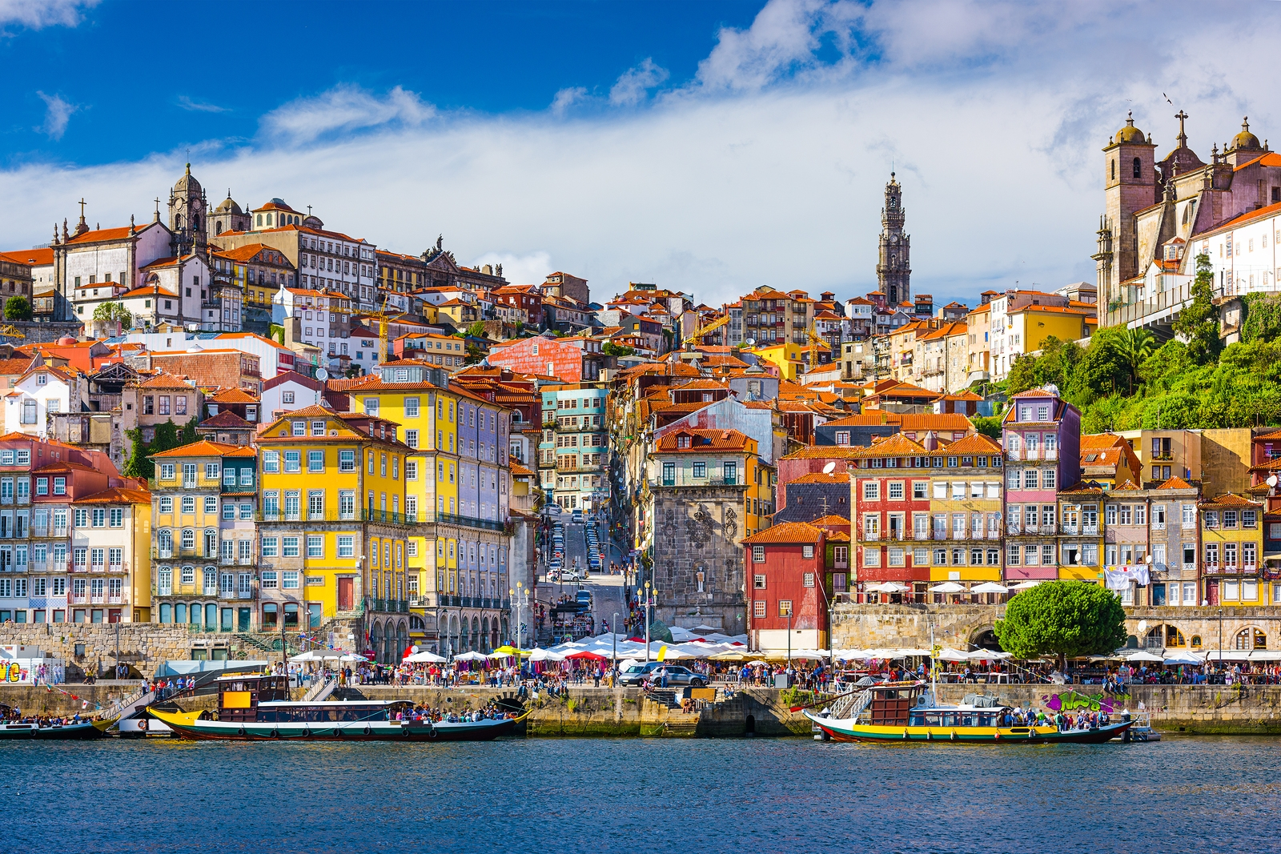
Spain
Population: 47,042,984
Capital: Madrid
Language: Spanish
Government: parliamentary monarchy
Economy: textiles and apparel, tourism, food and beverages
Religion: Roman Catholic 94%
Climate: temperate; clear, hot summers in interior
Geographic Features: Iberian Peninsula, Mediterranean Sea

Slide 9
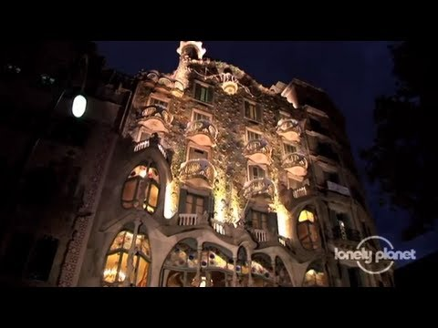
Barcelona
Barcelona is the capital of what region in Spain?
The city is located on the __________________ sea.
What famous explorer has a statue here?

Slide 10
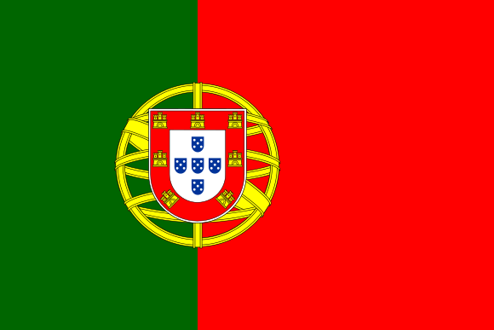
Portugal
Population: 10,781,459
Capital: Lisbon
Language: Portuguese
Government: parliamentary democracy
Economy: textiles, wine, tourism
Religion: Roman Catholic 94%
Climate: maritime temperate
Geographic Features: Atlantic Ocean

Slide 11
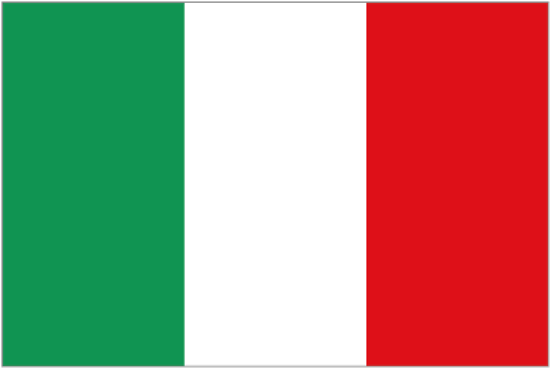
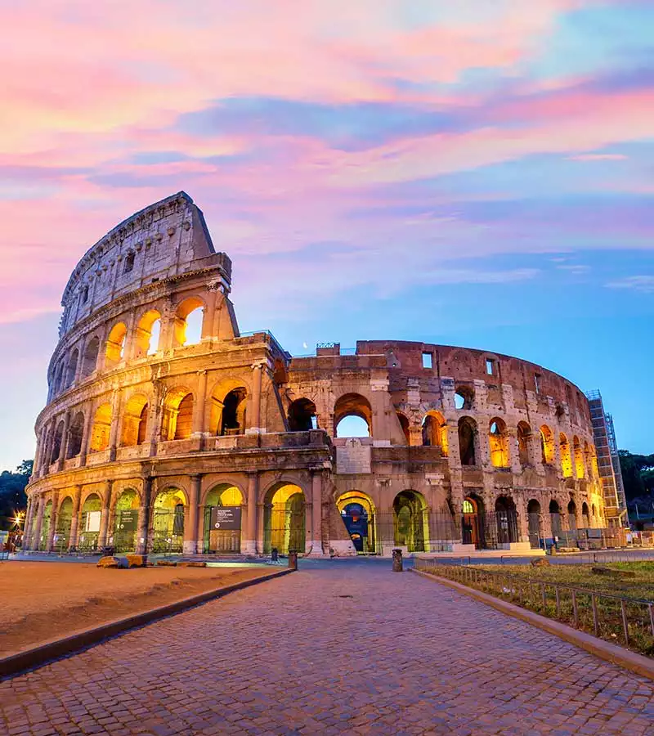
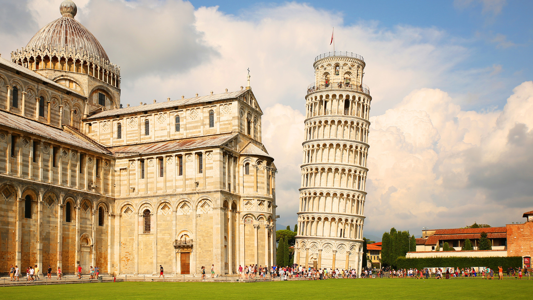
Italy
Population: 61,261,254
Capital: Rome
Language: Italian
Government: republic
Economy: tourism, machinery, vehicles
Religion: 90% Roman Catholic
Climate: Alpine in far north; hot, dry in south
Geographic Features: Alps, Sicily Island

Slide 12
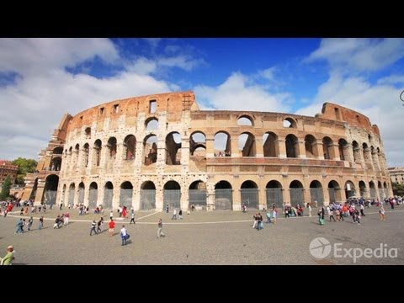
Rome
What is the population?
What two brother founded Rome?
The Roman ____________ was the center of public life in ancient Rome.
What is the most enduring symbol of ancient Rome?
Rome is the center/capital of what major religion?
What is the largest church in the world?

Slide 13
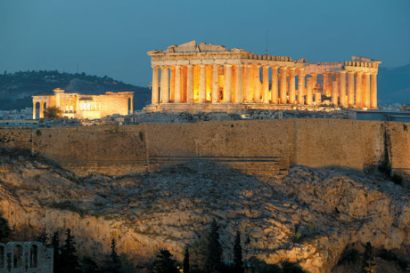
Greece
Population: 10,767,827
Capital: Athens
Language: Greek
Government: parliamentary republic
Economy: tourism, food, textiles
Religion: Greek Orthodox 98%
Climate: mild, wet winters; hot, dry summers
Geographic Features: Over 200 inhabited islands

Slide 14
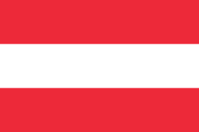
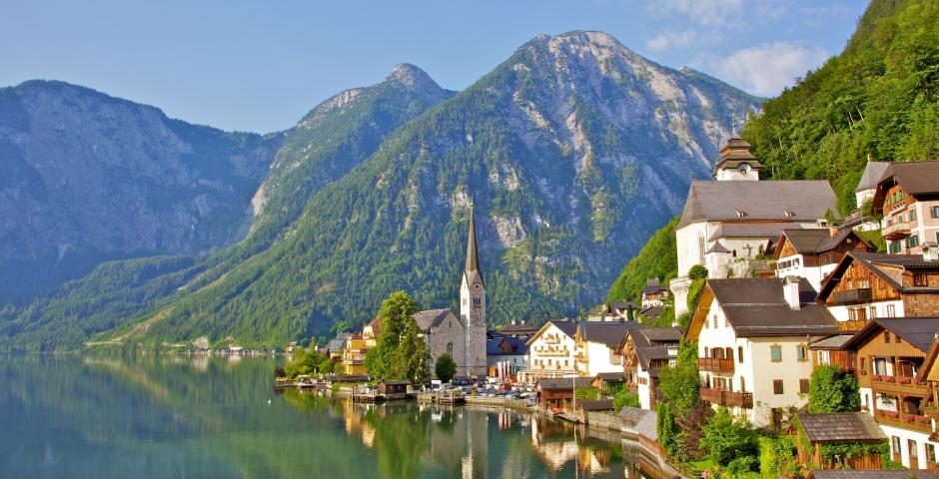
Austria
Population: 8,219,743
Capital: Vienna
Language: German
Government: federal republic
Economy: machinery, vehicles and parts, paper
Religion: Roman Catholic 73.6%
Climate: cold winters, moderate summers
Geographic Features: Alps

Slide 15
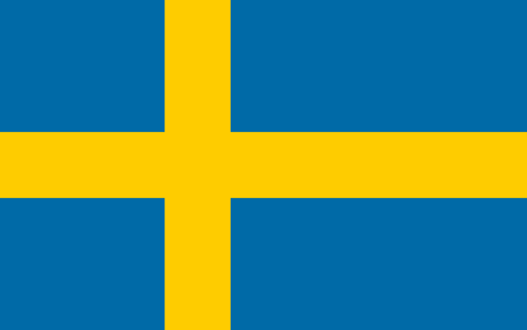
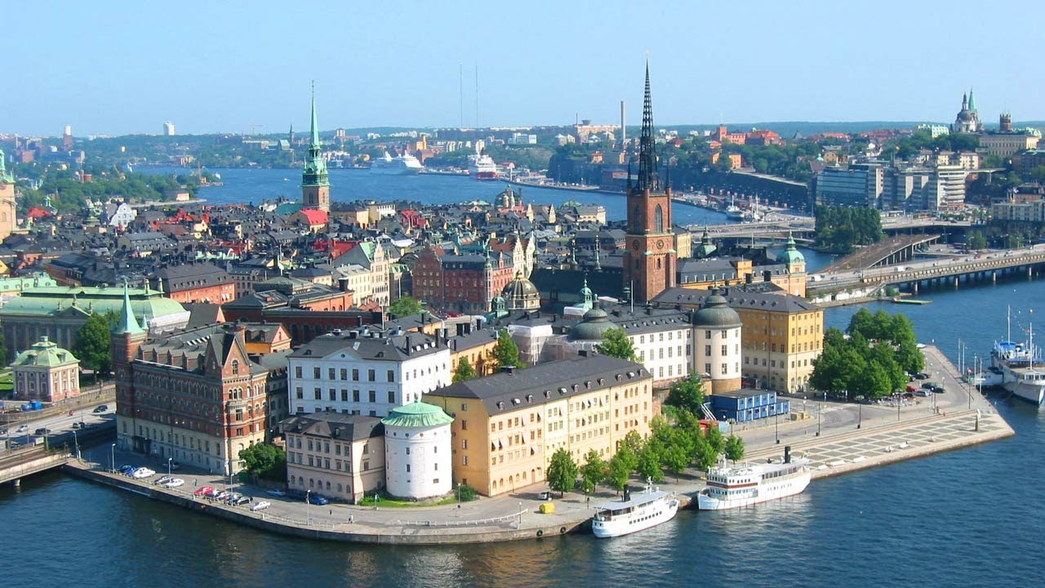
Sweden
Population: 9,103,788
Capital: Stockholm
Language: Swedish
Government: constitutional monarchy
Economy: iron and steel, precision equipment
Religion: Lutheran 87%
Climate: temperate in south, subartic in north
Geographic Features: Scandinavian Mountains

Slide 16
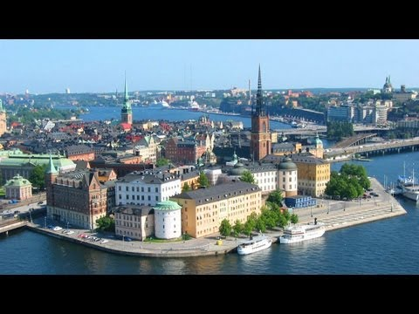
Stockholm
The city is surrounded by the _______
What is in the Vasa Museum?
What famous prize is awarded here?
What is the cities “coolest” attraction?

Slide 17
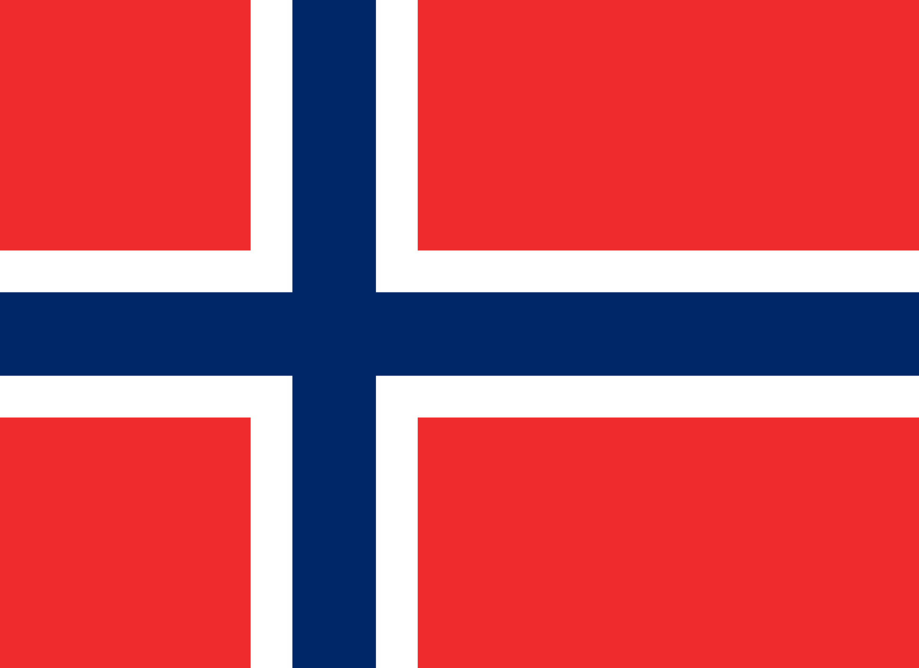
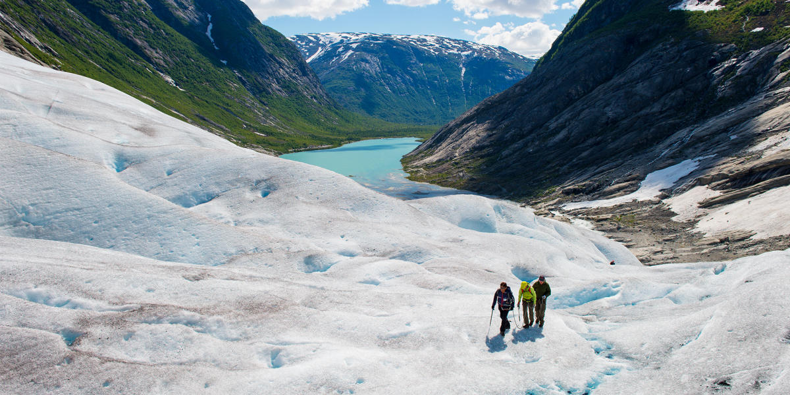
Norway
Population: 4,707,270
Capital: Oslo
Language: Norwegian
Government: constitutional monarchy
Economy: petroleum and gas, paper, shipbuilding
Religion: Church of Norway 85.7%
Climate: temperate along coast, colder interior
Geographic Features: glaciers

Slide 18
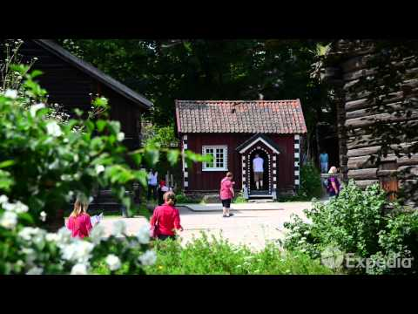
Oslo

Slide 19
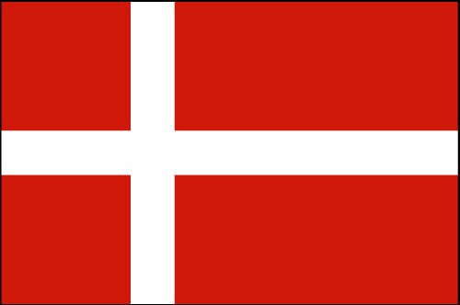
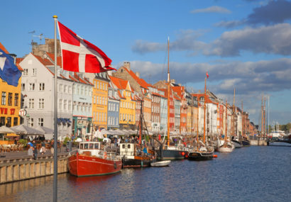
Denmark
Population: 5,543,453
Capital: Copenhagen
Language: Danish
Government: constitutional monarchy
Economy: iron, steel, furniture and other wood products
Religion: Evangelical Lutheran 95%
Climate: mild, windy winters and cool summers
Geographic Features: flat to gently rolling plains

Slide 20
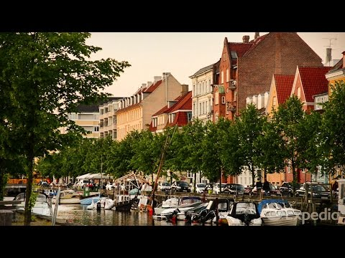
Copenhagen

Slide 21
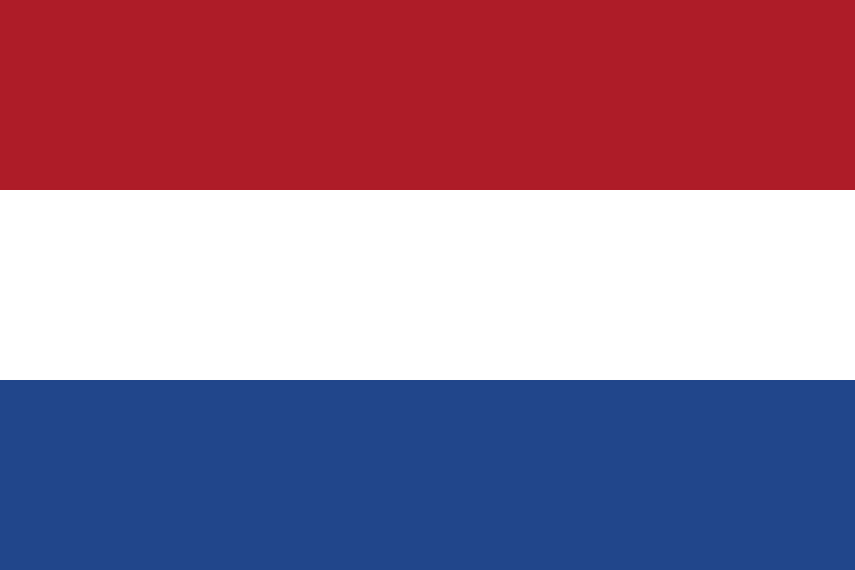
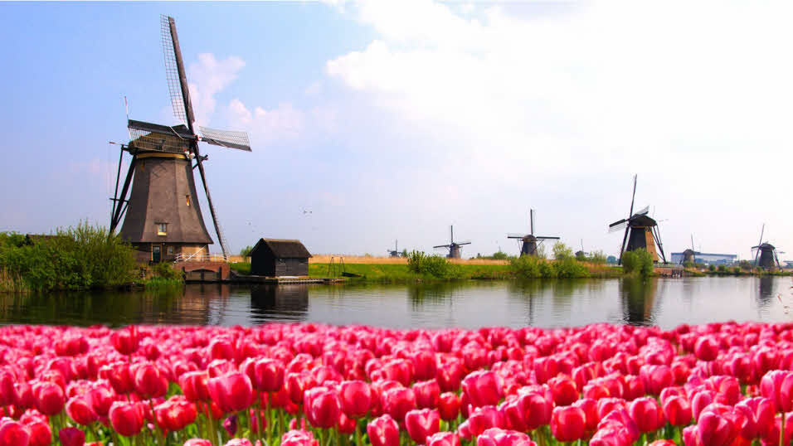
Netherlands
Population: 16,730,632
Capital: Amsterdam
Language: Dutch
Government: constitutional monarchy
Economy: machinery and equipment, fishing
Religion: Roman Catholic 31%, Dutch Reformed 13%
Climate: cool summers and mild winters
Geographic Features: 20 percent of the Netherlands is located below sea level

Slide 22
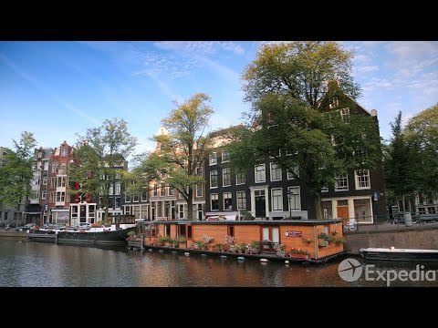
Amsterdam

Slide 23
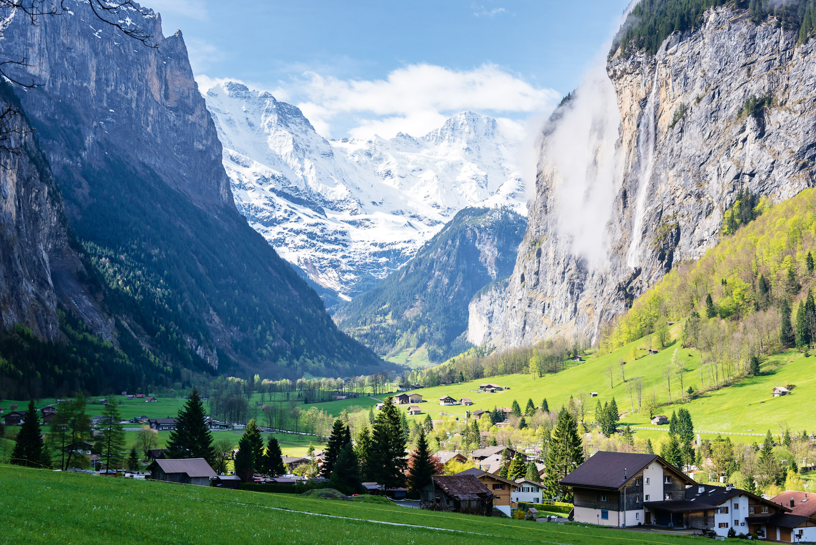
Switzerland
Population: 7,925,517
Capital: Bern
Language: German and French
Government: confederation
Economy: machinery, watches, textiles
Religion: Roman Catholic 41.8%, Protestant 35.3%
Climate: temperate/mild
Geographic Features: Alps

Slide 24
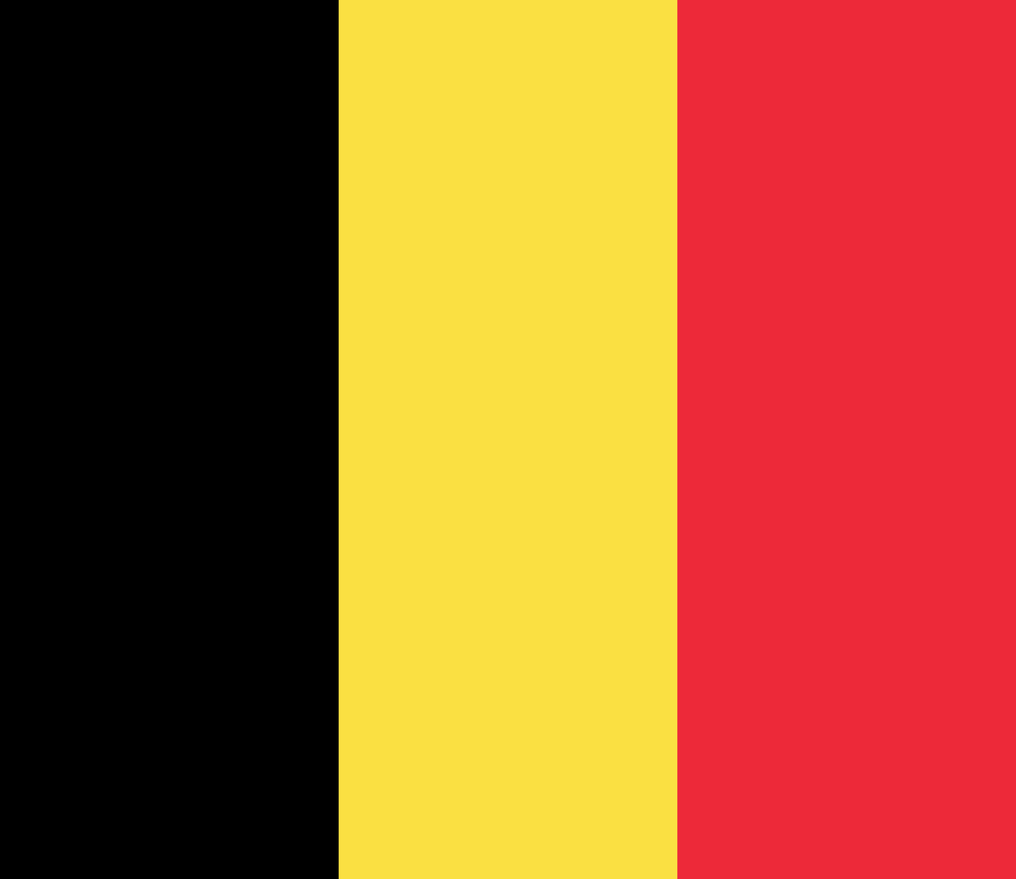
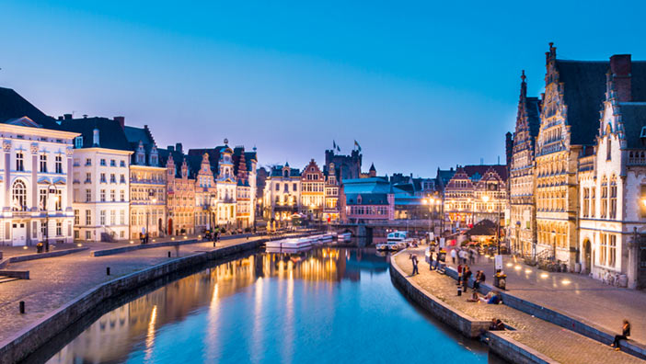
Belgium
Population: 10,438,353
Capital: Brussels
Language: Dutch 60%, French 40%
Government: parliamentary democracy under a constitutional monarchy
Economy: metal products, motor vehicle assembly
Religion: Roman Catholic 75%
Climate: mild winters, cool summers
Geographic Features: coastal plains

Slide 25
Population:
Capital:
Language:
Government:
Economy:
Religion:
Climate:
Geographic Features:

