Slide 1
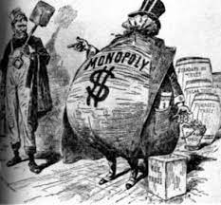
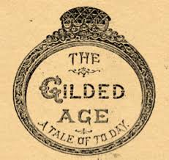
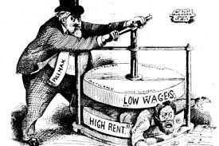
GILDED AGE
(1865-1901)
DEVELOPMENT OF MODERN BUSINESS

Slide 2
WHAT IS THE GILDED AGE?
Gilded = to cover with a thin layer of gold
Covered in gold is not solid gold things seemed good, but weren’t always good
Characteristics:
Extreme differences between upper and lower classes
Industrial progress Booming Economy
Political Corruption
Child Labor

Slide 3
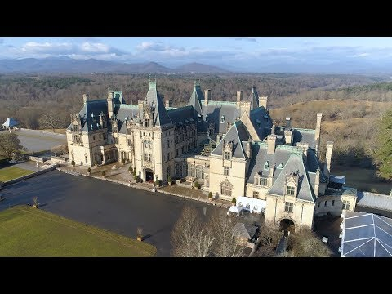

Slide 4
U.S. INDUSTRIALIZATION
1860 U.S. is a second rate industrial power
1890 U.S. has become a world production power
So, what changed in 30 years?
Manifest Destiny?

Slide 5
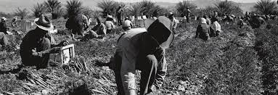
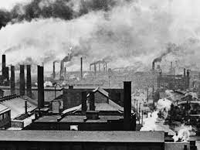
WHAT IS INDUSTRIALIZATION?
A time period when a country transforms primarily from an agricultural society to a manufacturing of goods and services
Using machines and new technology to do jobs previously done by people
New technologies made production much faster and cheaper
Agriculture (farming) Manufacturing (factories)

Slide 6
POPULATION GROWTH
U.S. population in 1800 5.3 million
U.S. population in 1900 76 million
Today’s population 334 million
Population was becoming more urban due to industrialization and immigration
People were taking jobs in factories in the cities
Less man power was needed on farm

Slide 7
INVENTIONS & TECHNOLOGY
Technology had the greatest impact on the Gilded Age (late 1800s)
New inventions and technologies helped fuel economic expansion
Steam and electricity replaced human and animal strength
Iron replaced wood; steel replaced iron
Areas of greatest need:
Transportation
Communication

Slide 8
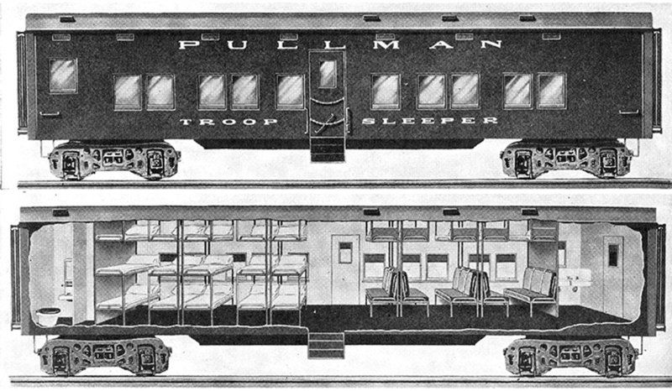
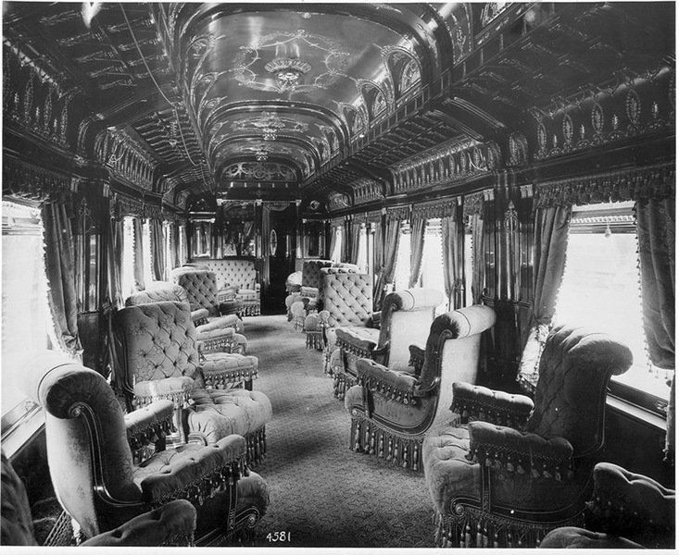
RAILROADS
Convenience:
Pullman car - 1st class sleeping and eating car
Most luxurious and fastest way to get across country

Slide 9
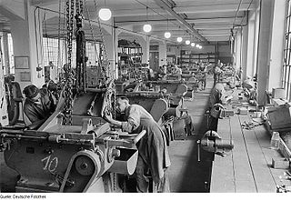
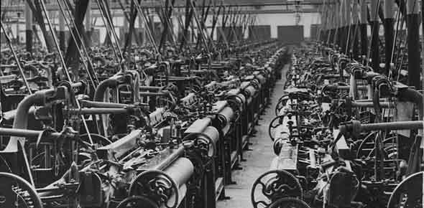
ELECTRICITY
Transformed cities and factories with lighting
With electricity factories could extend work schedules and the number of shifts (overnight if needed)

Slide 10
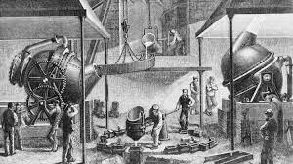
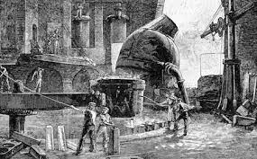
BESSEMER PROCESS
Henry Bessemer creates a cheaper and efficient process for making steel
Steel was important to the growth of industry
Improved: skyscrapers, suspension bridges, stronger engines for trains, rails improved & farm equipment
Steel is now lighter, harder, and more durable than iron

Slide 11
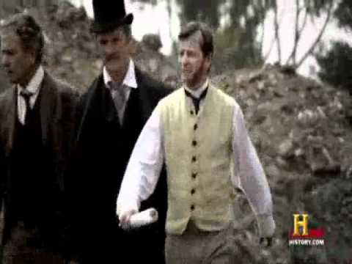

Slide 12
KNOWLEDGE CHECK
What effect did the Bessemer process have on the growth of cities?
It end the political corruption in cities by destroying the political machine
It developed a system to fairly distribute electricity throughout the city
It forced cities to expand to large areas due to a lack of space
It allowed cities to build skyscrapers and span bodies of water with suspension bridges

Slide 13
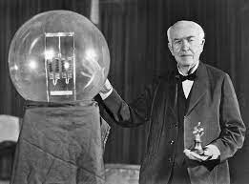
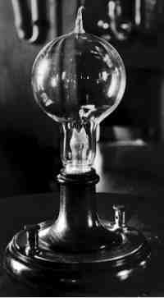
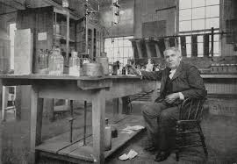
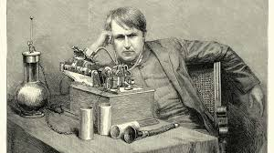
LIGHT BULB
Invented in 1879 by Thomas Edison
He tried 9,000 times to create a bulb
Used in factories and homes, and cheap to make

Slide 14
Answer the following:
Factory Shifts Prior to Electricity: | Factory Hours After Electricity:
7 AM - 7 PM 7:30 AM - 7:30 PM 8 AM - 8 PM | 4 AM - 6 PM 6 PM - 2 AM 8 AM - 11 PM
What is the effect of electrical lights on factories according to the chart above?
Sentence starter:
The effect of electric lights on factories is…

Slide 15
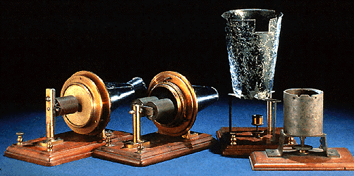
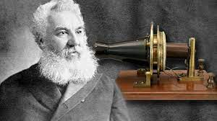
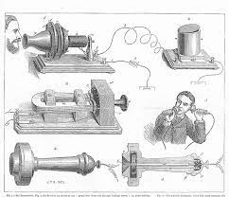
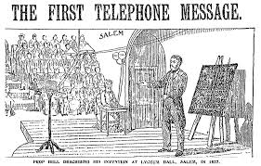
TELEPHONE
Invented in 1876 by Alexander Graham Bell
By 1900, 1.5 million telephones in use
Increased speed and efficiency of communication

Slide 16
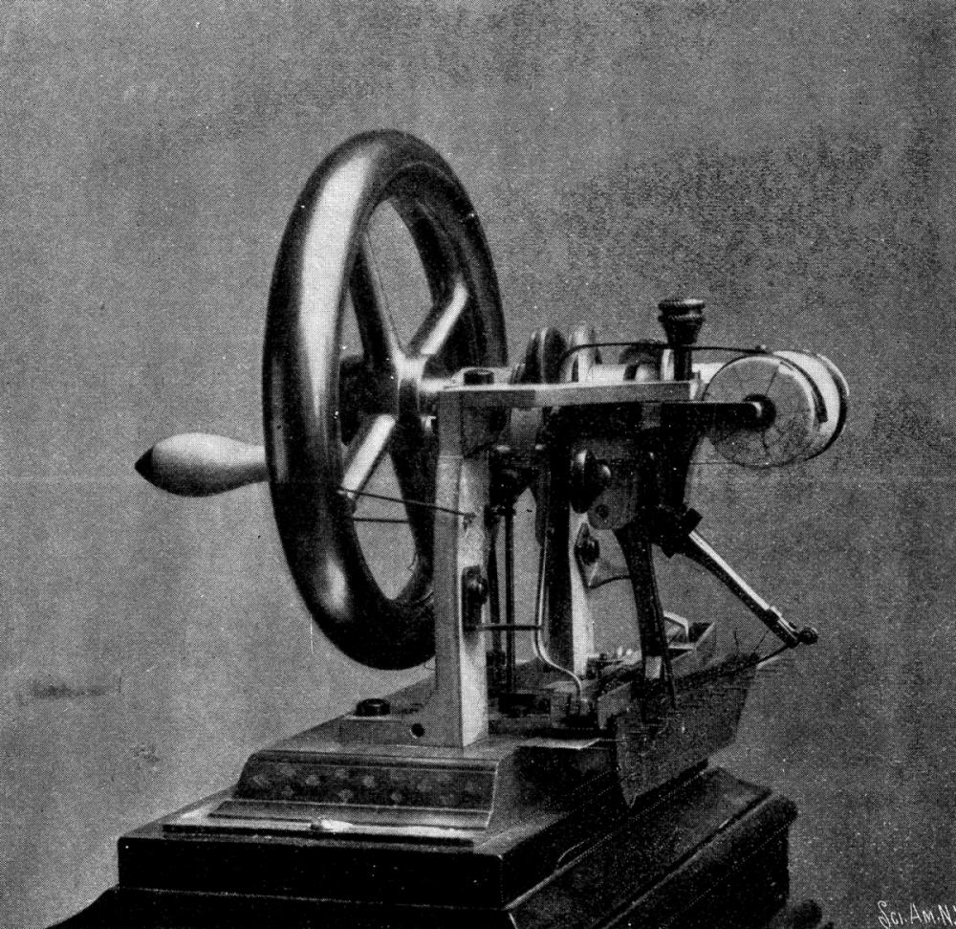
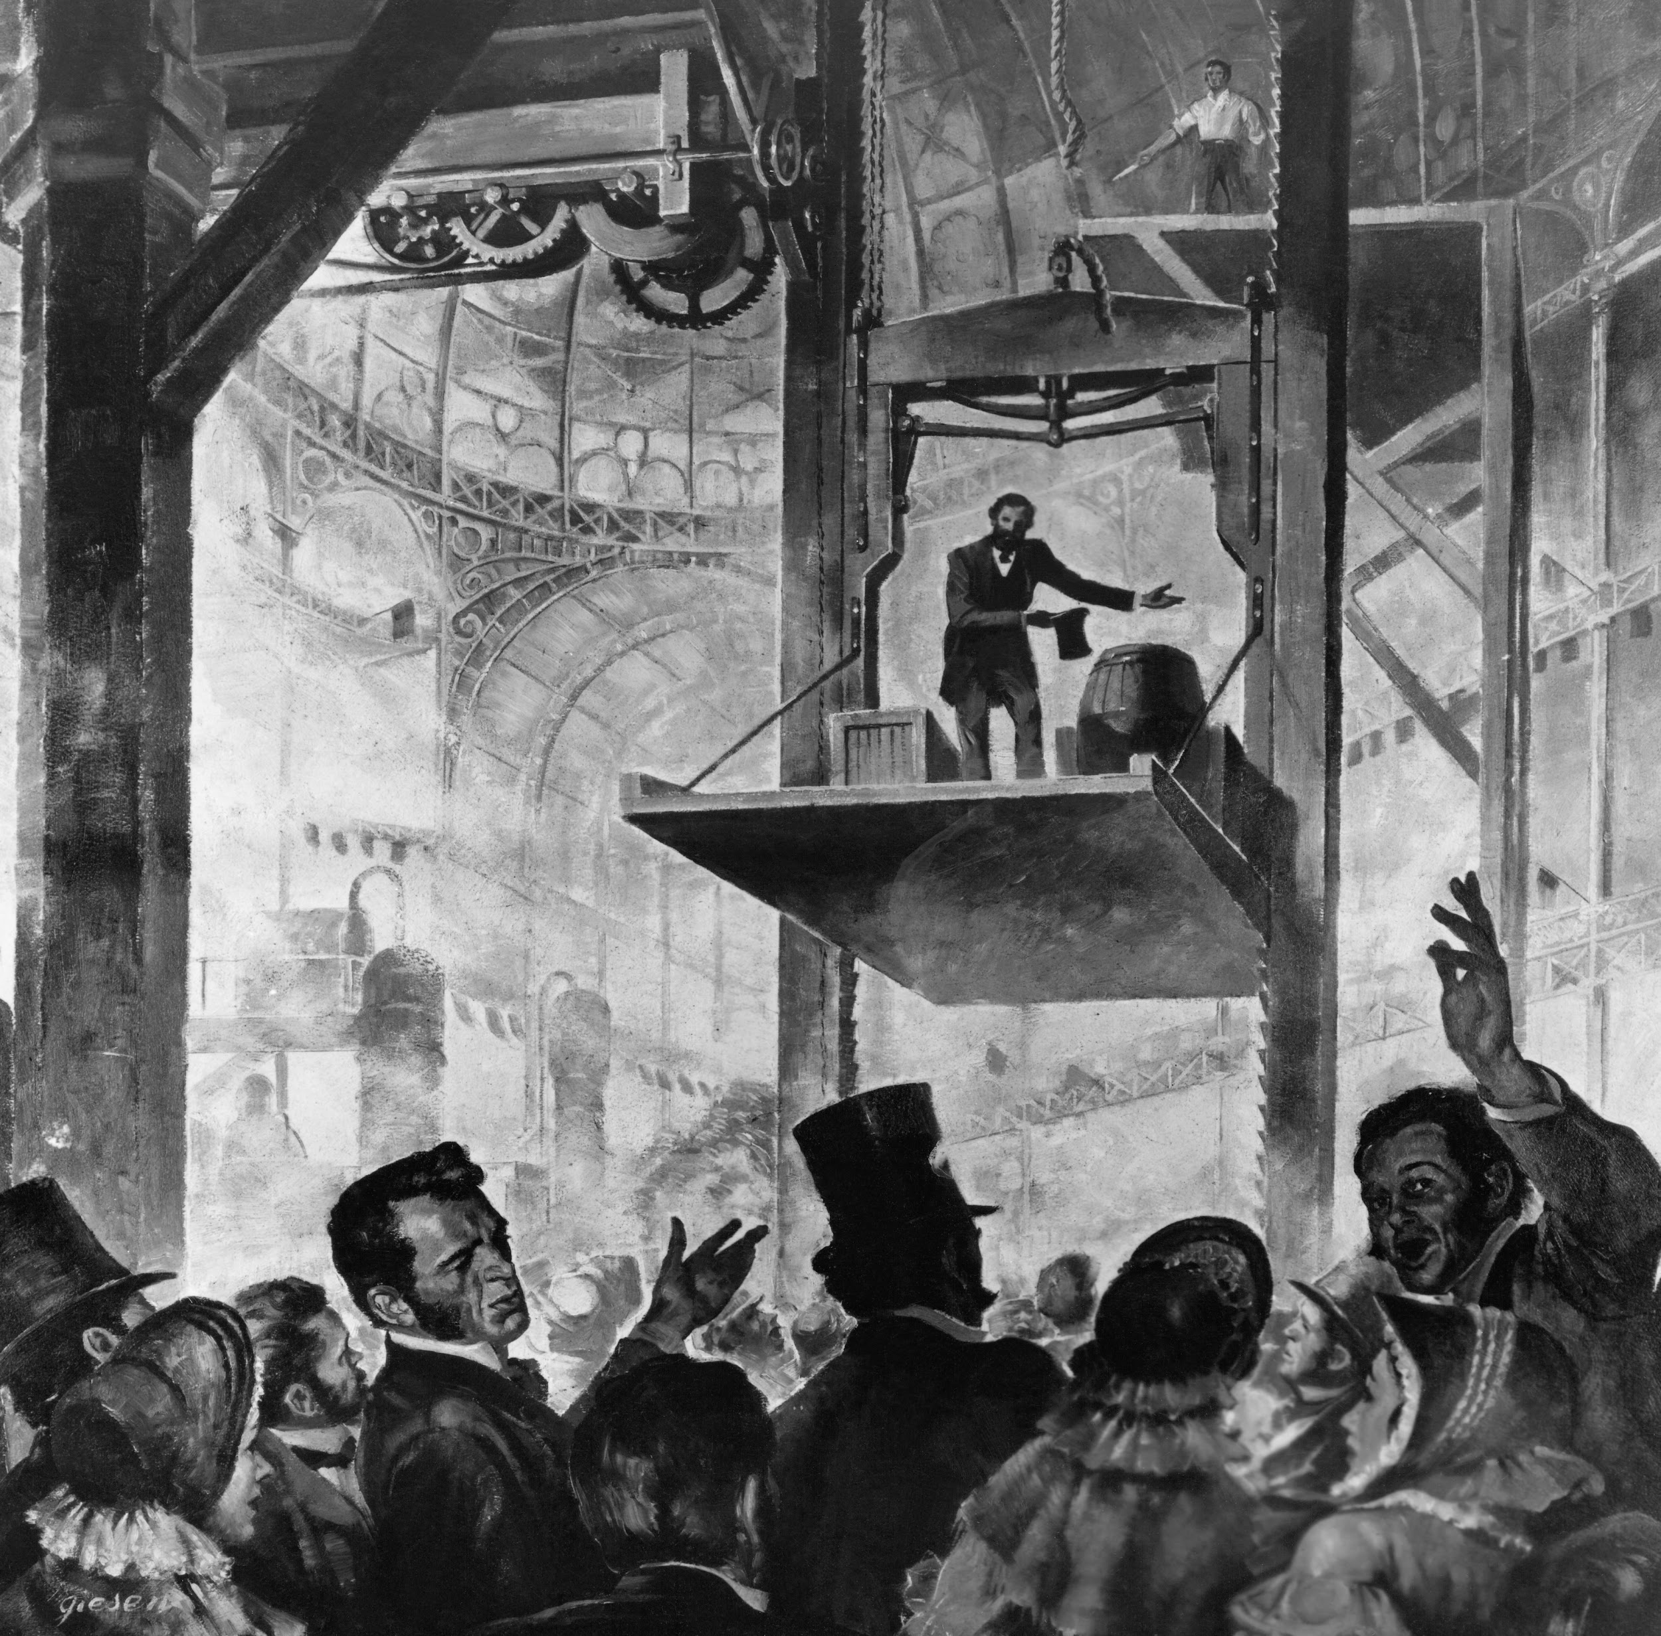
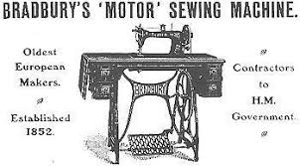
OTHER INVENTIONS
Typewriter: Christopher Sholes
Elevator: Elisha Otis
Sewing Machine: Elias Howe

Slide 17
CORPORATION
During industrialization a new type of business emerged
Corporation: sells shares (or stocks) to investors
This makes each investor a shareholder, or partial owner, in the company
Shareholders: get a portion of the profits that the company earns
Corporations made it possible for people to raise large amounts of money to form businesses
Led to the creation of large numbers of industrial companies resulting in the American Industrial Revolution

Slide 18
Entrepreneur
Entrepreneur: a person or group who starts their own business
During the Industrial Revolution, entrepreneurs used industrial power to lower the price of goods and improve their quality to make huge profits

Slide 20
