Slide 1
Teddy Roosevelt & Latin America
Unit 4: U.S. Expansionism & World Power #3

Slide 2
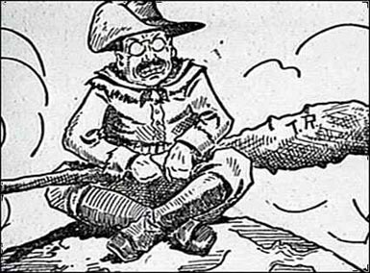
Teddy Roosevelt’s Foreign Policy:
“Speak softly and carry a big stick”

Slide 3
Timeline of U.S. Imperialism
Panama Canal under construction
Purchase of Alaska (Seward)
Spanish-American War
1867
1898
1908

Slide 4
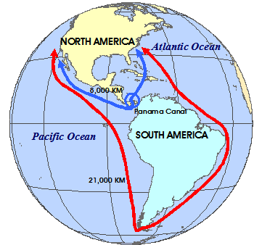
U.S. Interests in Latin America & The Panama Canal
U.S. interests turned toward Central America and a quicker way of moving ships between the east & west coasts of North America
Canal: man-made waterway for ships to pass through
Why?
U.S. wanted a faster and easier way to trade
Think: Which route is faster?

Slide 5
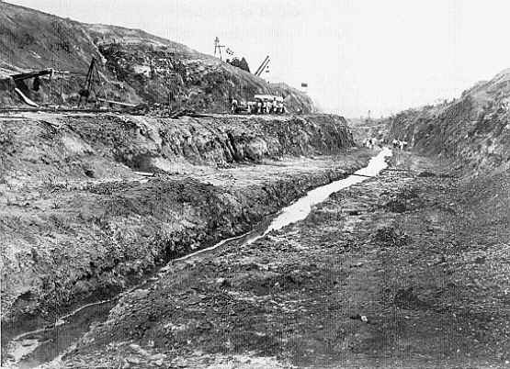
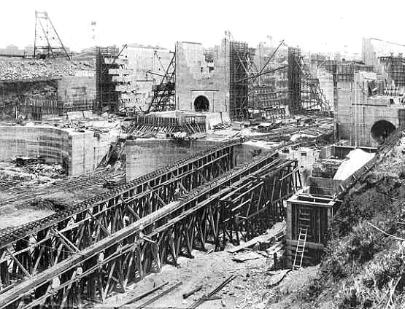
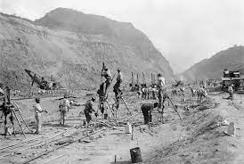
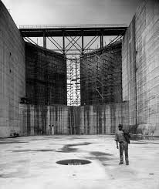

Slide 6
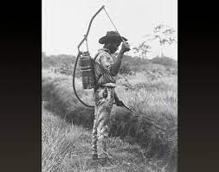
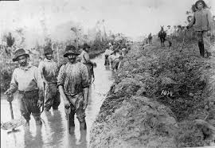
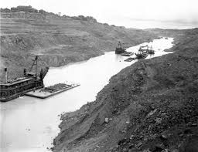
Dangers Working on the Canal
Yellow Fever: swampy ditches & standing water attract mosquitoes that carried diseases
Poor sanitation (cleanliness)
Landslides
Results: Many canal workers died

Slide 7
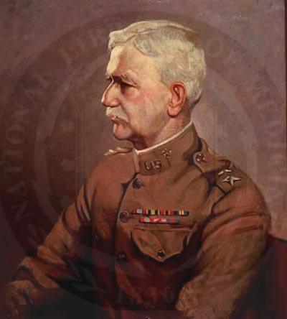
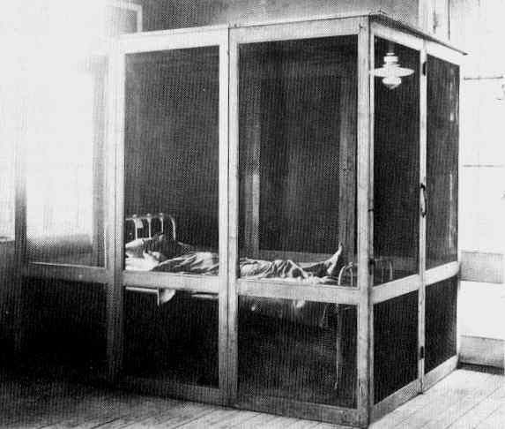
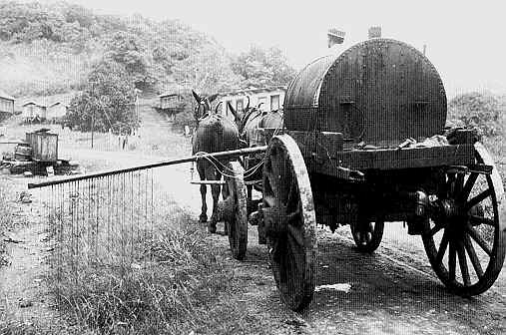
William C. Gorgas & Yellow Fever
Dr. Gorgas learned that yellow fever was transmitted through mosquitoes
His discovery allowed the canal to be built
1905: fumigation car eradicating the mosquitoes
Yellow fever quarantine station

Slide 8
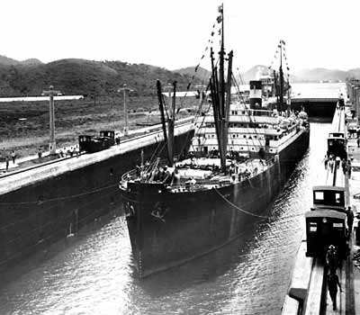
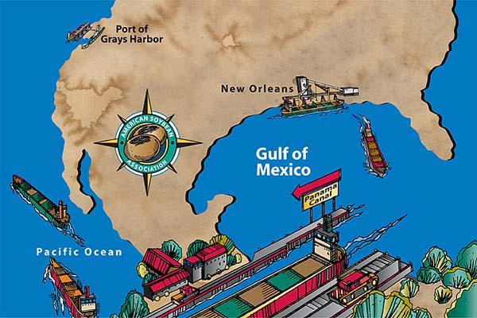
Roosevelt & The Panama Canal
Roosevelt’s major action was to ensure the building of the canal
The canal was wanted to link the Atlantic & Pacific Oceans
Panama then was a province of Colombia, but won its independence in a U.S. support revolt
President Roosevelt & the U.S. wanted to prove their power & increase trade
Think: How could the Panama Canal benefit the navy?

Slide 9
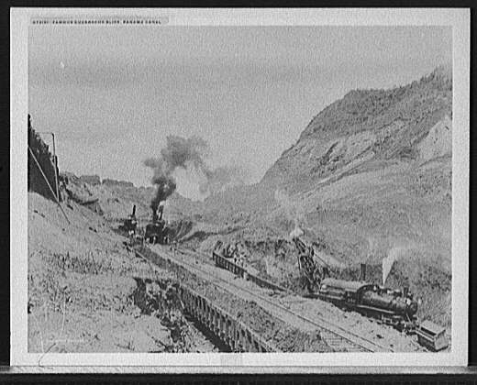
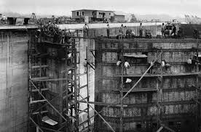
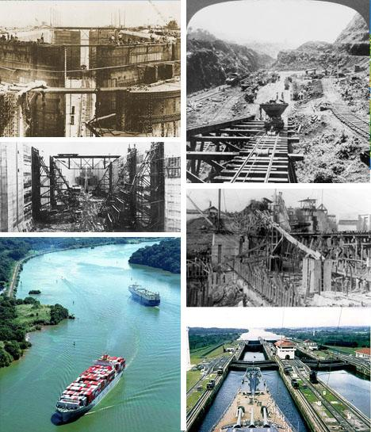
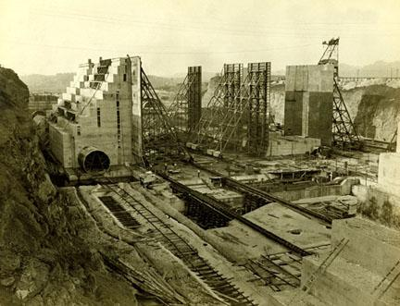
Panama Canal - 10 years to complete 50 miles

Slide 11
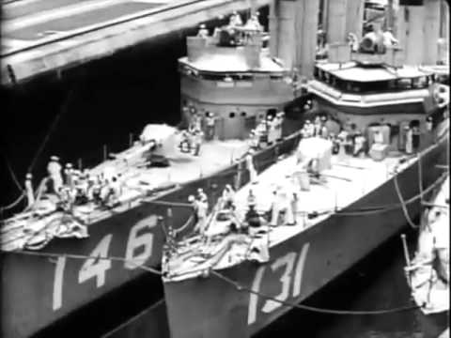

Slide 12
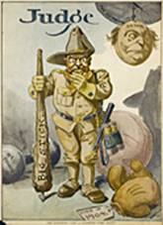
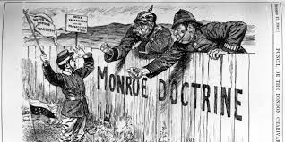
The Monroe Doctrine & “Big Stick Diplomacy
Roosevelt reminded European powers of the Monroe Doctrine
Issued in 1823 by President James Monroe
Demanded that European countries stay out of the affairs of Latin America
“Speak softly and carry a big stick”
Roosevelt’s Corollary: added to the Monroe Doctrine in December 1904
Stated: the U.S. would now use force to protect its interests in Latin America
Translation: Be gentle, but be prepared to use power & force if needed
U.S. = “international police force”

Slide 13
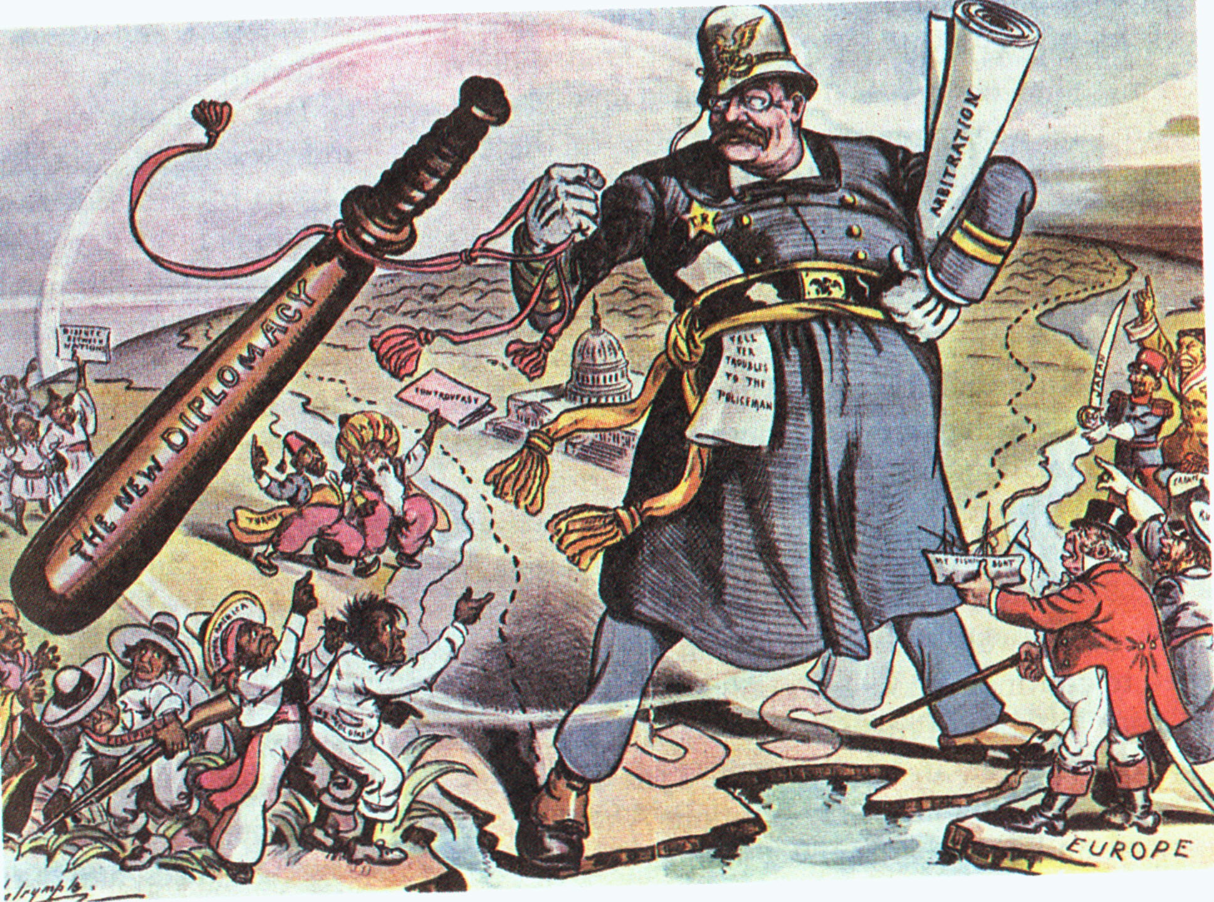

Slide 14
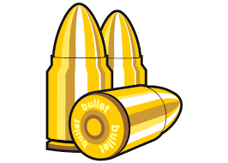
Dollar Diplomacy
Using the U.S. government to guarantee loans made to foreign countries by American businesspeople
Keeping European powers out of the Caribbean
Wanted to control foreign countries through economic investments
NOT the military

Slide 15
U.S. Foreign Policy in the Early 20th Century
First, it expanded its access to foreign markets in order to ensure the continued growth of the domestic economy
Second, the U.S. built a modern navy to protect its interests abroad (overseas; outside of the U.S. territory)
Third, the U.S. exercised its international police power to ensure dominance in Latin America

Slide 16
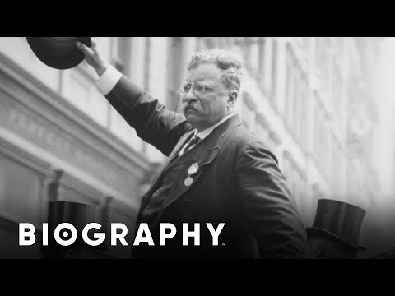

Slide 17
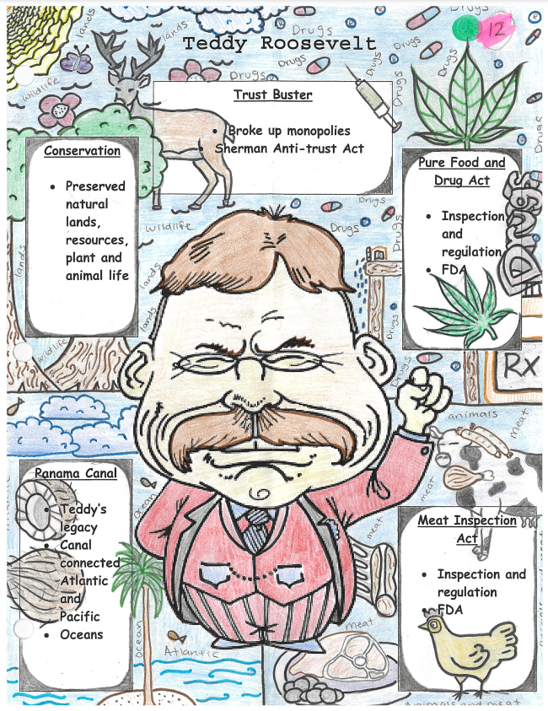
Teddy Roosevelt Cartoon

