Slide 1
8/31
Why did Unions form during the period of industrialization?
Answer:
To give the individual workers a voice. Low wages and working conditions.

Slide 2
8/31
Notes over Immigration –Turned in (Daily)
Funko POP – Robber Barons

Slide 3
GILDED AGE (1865-1901): IMMIGRATION AND CHANGING DEMOGRAPHICS
U.S. History: Gilded Age #3

Slide 4
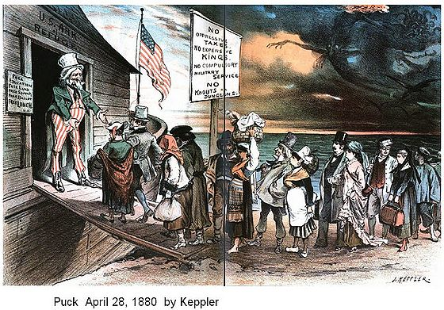

Slide 5
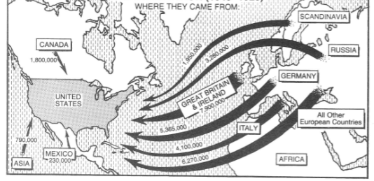
What do you notice about this map?

Slide 6
THINK ABOUT IT…
List 3 reasons why people move to new areas.
1.
2.
3.
Choose a place you would want to move to, list 3 descriptive reasons why.

Slide 7
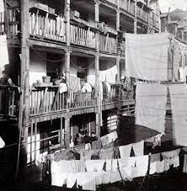
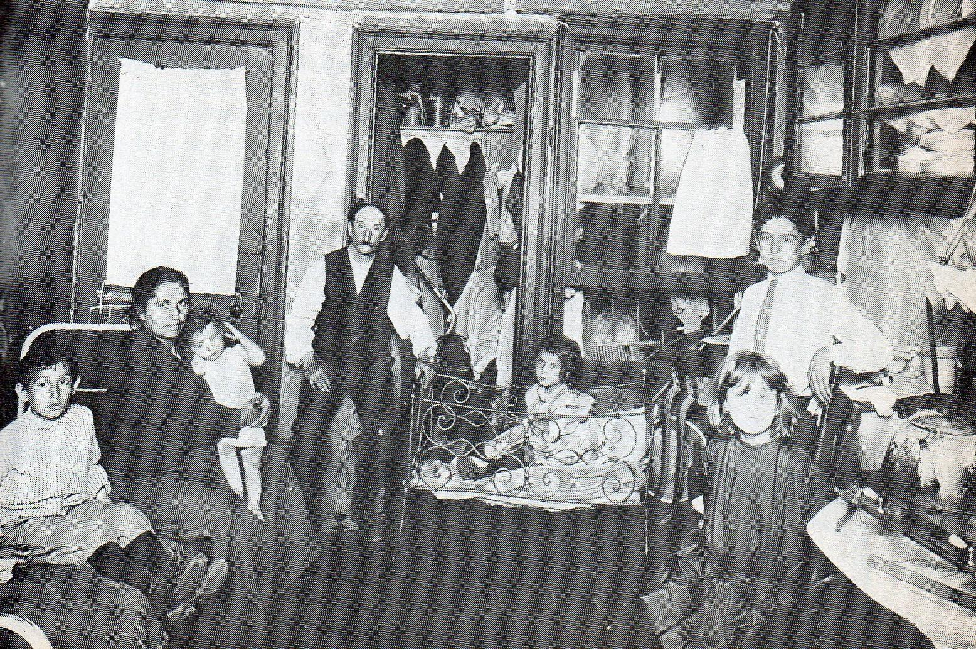
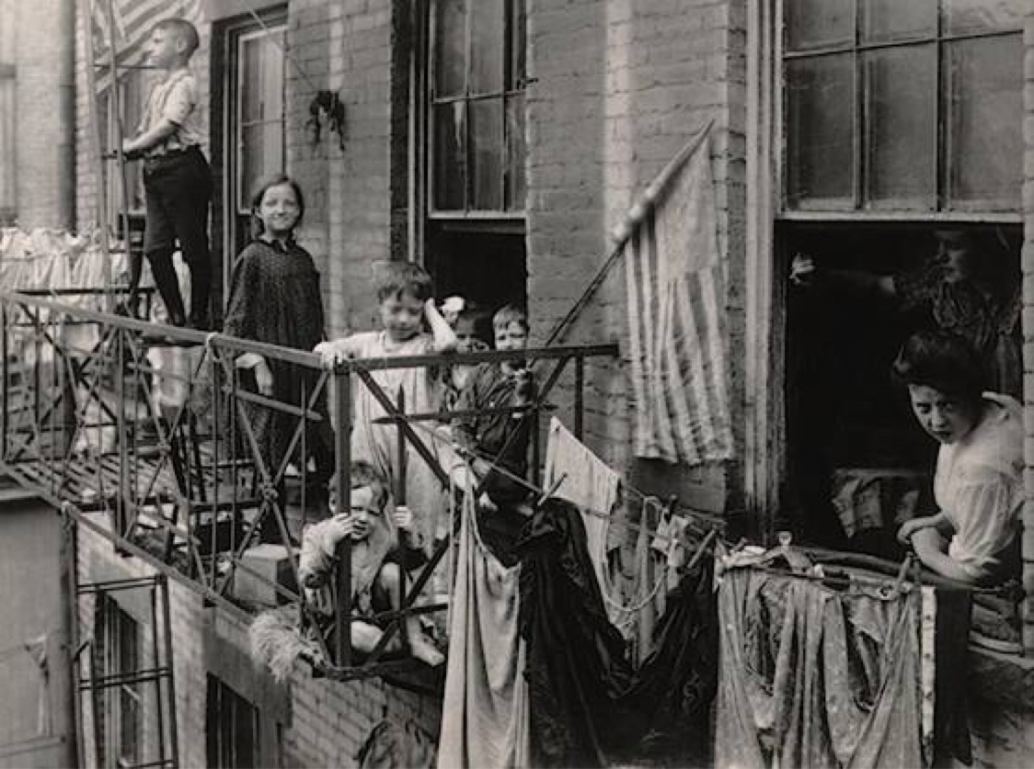
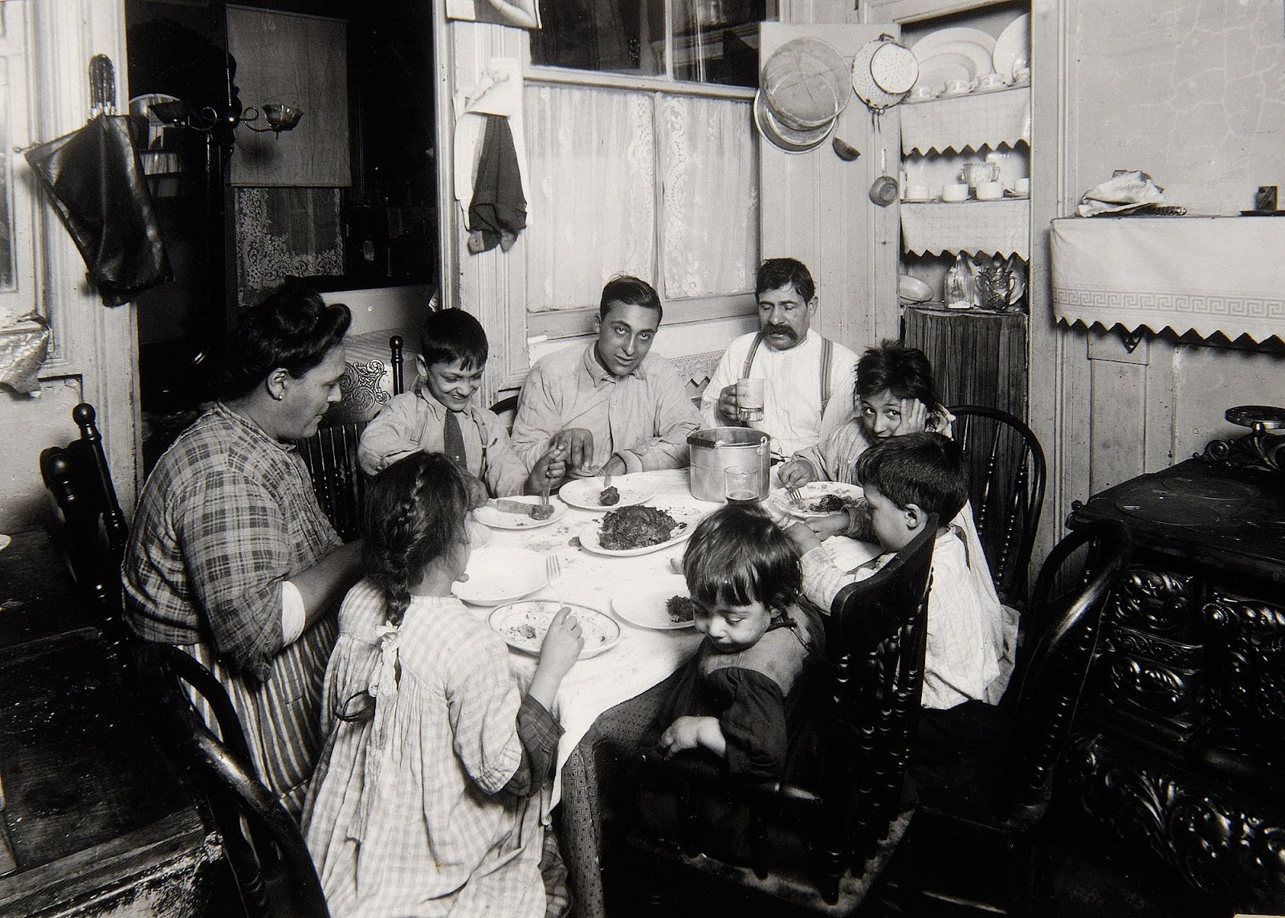

Slide 8
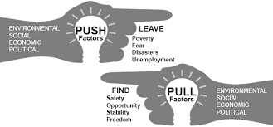
IMMIGRATION
Talk with your table, which of the following below would be push factors and which would be pull factors?
PUSH = Bad, PULL = Good
A. job opportunities in factories and cities ___________
B. to escape violence in Europe _______
C. social mobility _____________
D. religious discrimination __________
Why did immigrants move to the U.S.?
- A combo of push (bad) and pull (good) factors

Slide 10
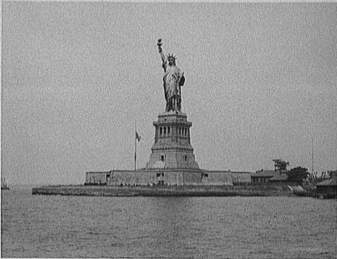
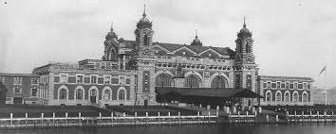
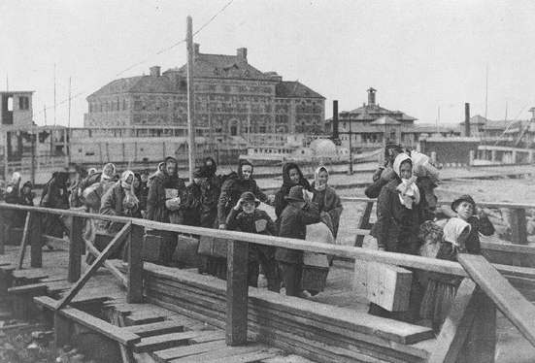
COMING TO AMERICA
First thing many immigrants saw coming from the east was the Statue of Liberty near Ellis Island
First arrived at Ellis Island
Depot included:
Quarantine areas
Customs
Registration

Slide 11
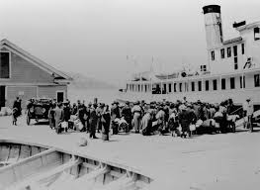
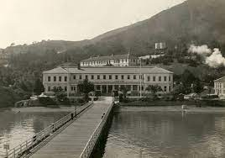
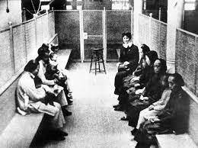
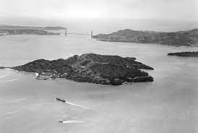
ANGEL ISLAND
Asian immigrants came to Angel Island in San Francisco

Slide 12
EUROPEAN IMMIGRANTS
“Old Immigrants”
“New Immigrants”
1800
1880
1910
“Old Immigrants”: from North and Western Europe
“New Immigrants”: from Southern and Eastern Europe

Slide 13
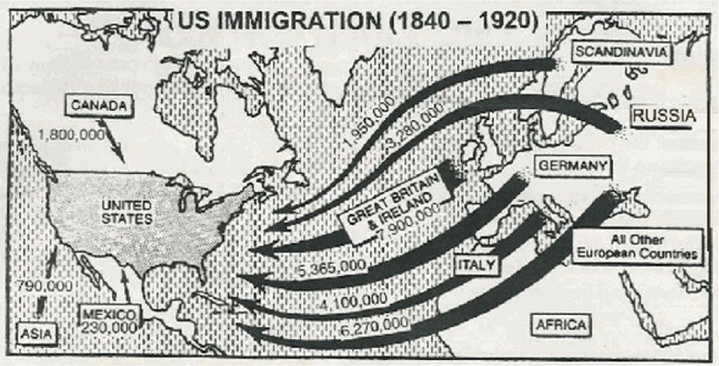
EFFECTS OF IMMIGRANTS
Immigrants brought:
New ethnic foods
Different languages
Foreign customs
New traditions
Different sects of religions

Slide 14
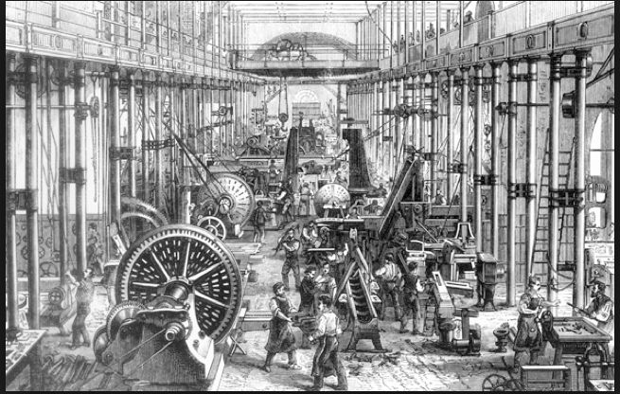
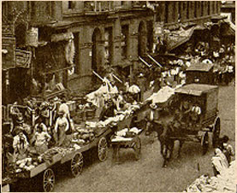
NEW COMMUNITIES
Immigrants settled in cities in Northeastern U.S. to find jobs in the growing industrial factories
Low wages
Large availability of jobs
Unskilled jobs

Slide 15
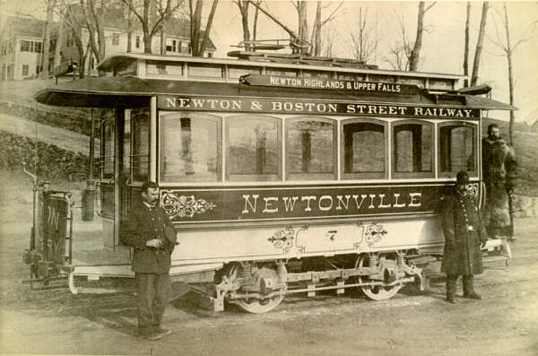
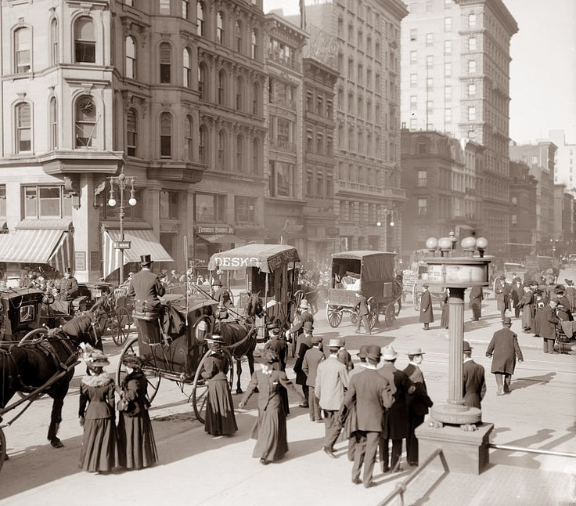
BIG CITIES
Industrialism + Immigration = Rapid Urbanization
Urbanization – the growth of cities
New York
Boston
Chicago
San Francisco

Slide 16
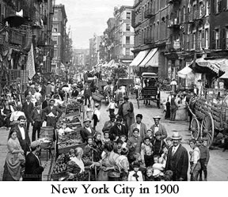

Slide 17
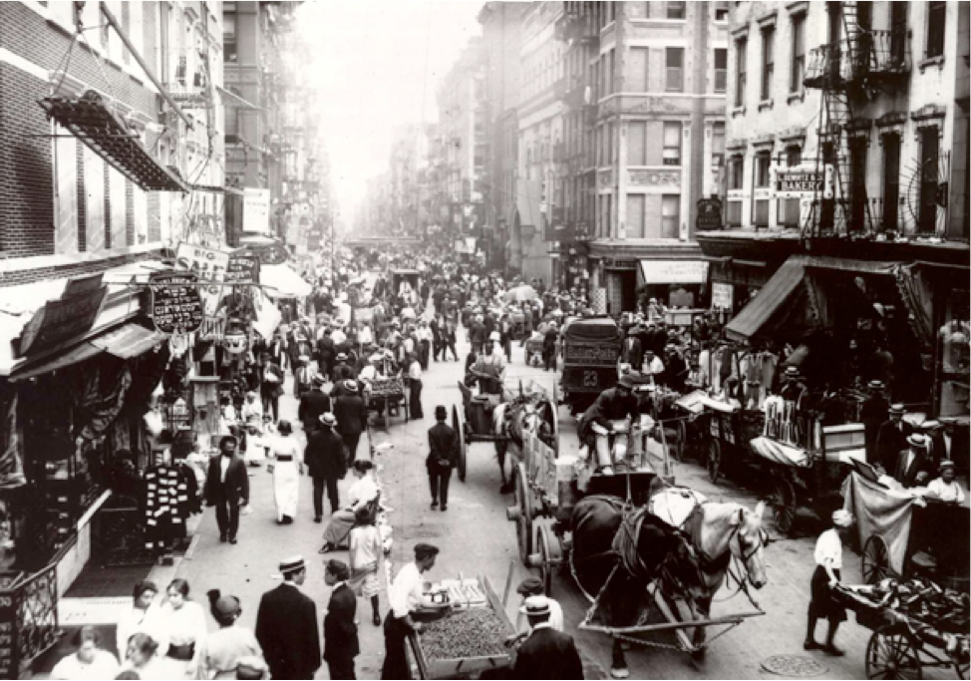
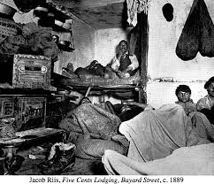
SETTLING INTO AMERICA
Majority of immigrants settled into ghettos or slums:
Lived in unofficially segregated neighborhoods with the same ethnic groups (ethnic enclaves)
Tenements: cramped unclean apartments
City Populations:
Cities became crowded, dirty, & dangerous

Slide 18
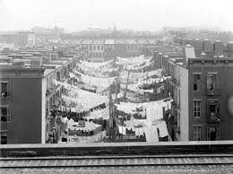
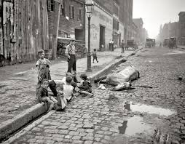

Slide 19
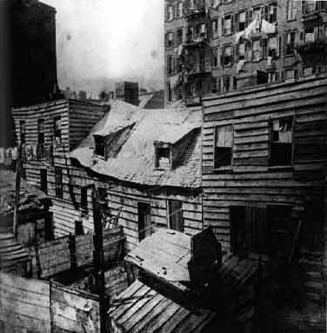
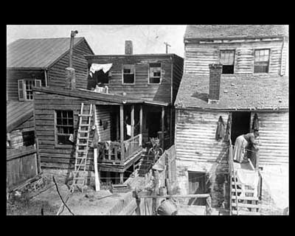

Slide 20
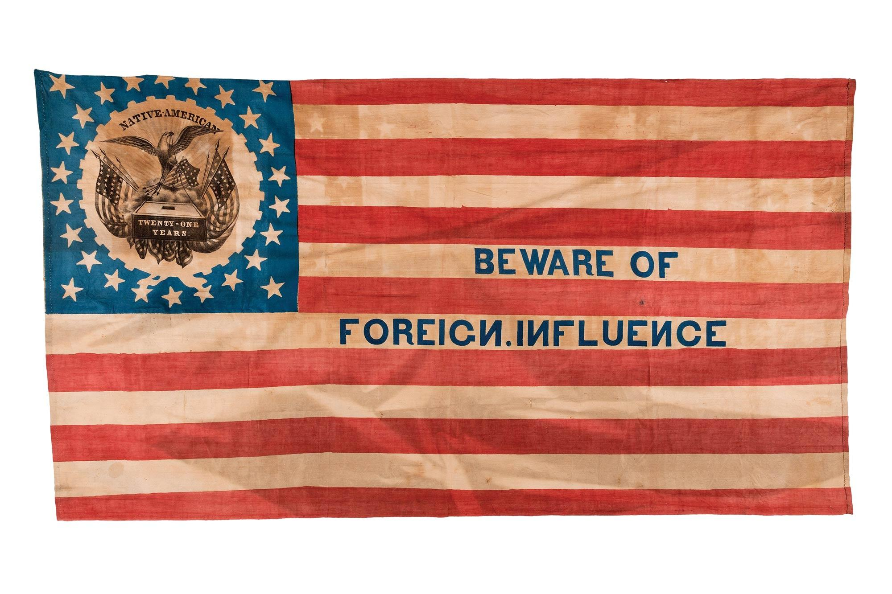
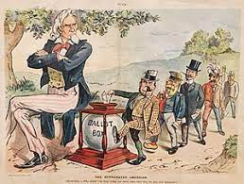
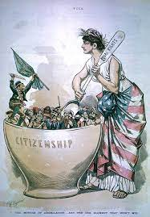
HOW DID AMERICANS REACT TO IMMIGRATION?

Slide 21
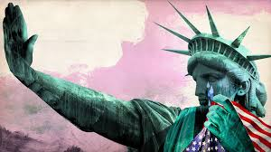
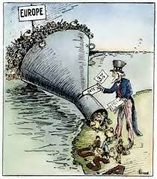
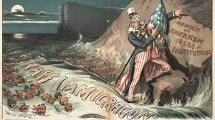
NATIVISM IN AMERICA
Belief that new immigrants were inferior (less)
Those born in the U.S. were hostile towards immigrants

Slide 22
WHY WERE AMERICANS SO AFRAID?
They feared:
New culture
Often did not speak English
Would work for less (took jobs)

Slide 23
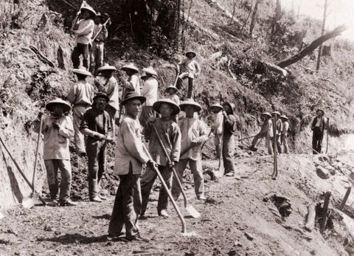
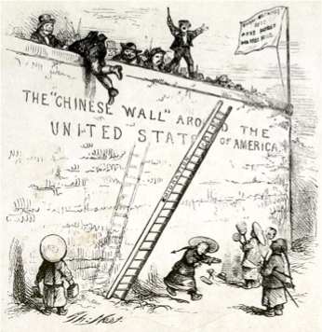
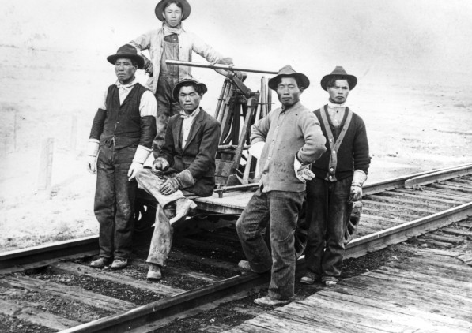
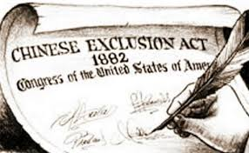
OTHER IMMIGRANTS
Chinese – most became railroad workers
They were treated worse than European immigrants (discrimination)
Chinese Exclusion Act:
Prohibited Chinese from entering the country for 10 years
Law passed to satisfy nativist prejudices in California and to reduce competition for jobs

Slide 24
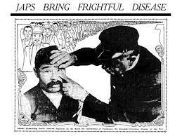
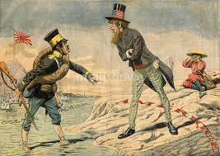
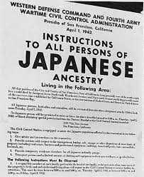
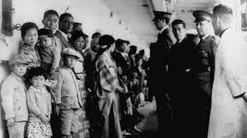
THE GENTLEMEN’S AGREEMENT
The President and Japanese leaders reached an agreement called the Gentlemen’s Agreement
Two parts:
San Francisco agreed to not segregate Japanese students
Japan agreed to not allow people to emigrate (move) to the U.S. unless they had family there

Slide 25
MASTERY CHECK
Why was the Chinese Exclusion Act passed?
A. to give the Chinese more jobs
B. to help the Chinese assimilate
C. to reduce competition for jobs

Slide 26
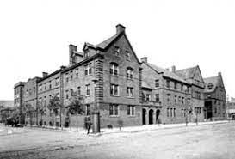
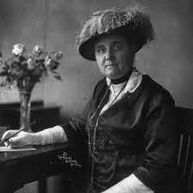
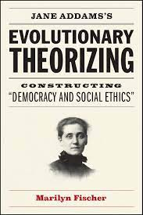
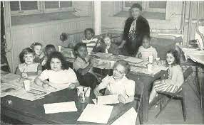
SETTLEMENT HOUSES
Founded by social reformers
In 1889, Jane Addams established Hull House, a place where immigrants could:
Learn English
Basic education
Learn about America
Job skills
Help with legal problems

Slide 27
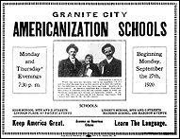
MOVEMENT TO ASSIMILATE IMMIGRANTS
Immigrants and children encouraged to attend public schools to learn English, American history, and government
Adult immigrants attend night school
Public school was crucial to success of immigrant children
Largely failed

