Slide 1
Objective: I will be able to interpret the rate of inflation.
What makes something valuable? Why do the value of things (like candy bars or cars) change over time?
Inflation

Slide 2
What is INFLATION?
= is when the buying power of money goes down and prices go up.

Slide 3
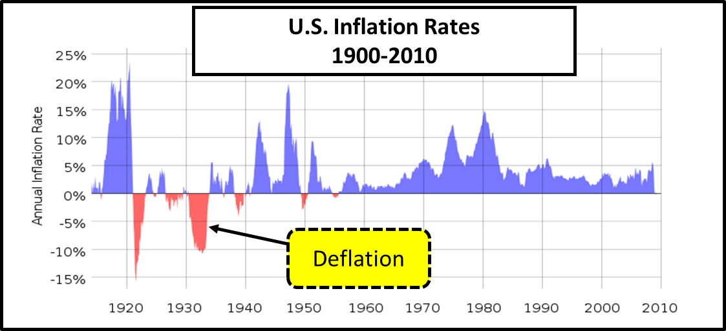
What is DEFLATION?
= is when prices fall and the value of money increases.
Dramatic periods of deflation in the U.S. are rare. The last major period of deflation was from 1930 to 1933, which was during the Great Depression.

Slide 4
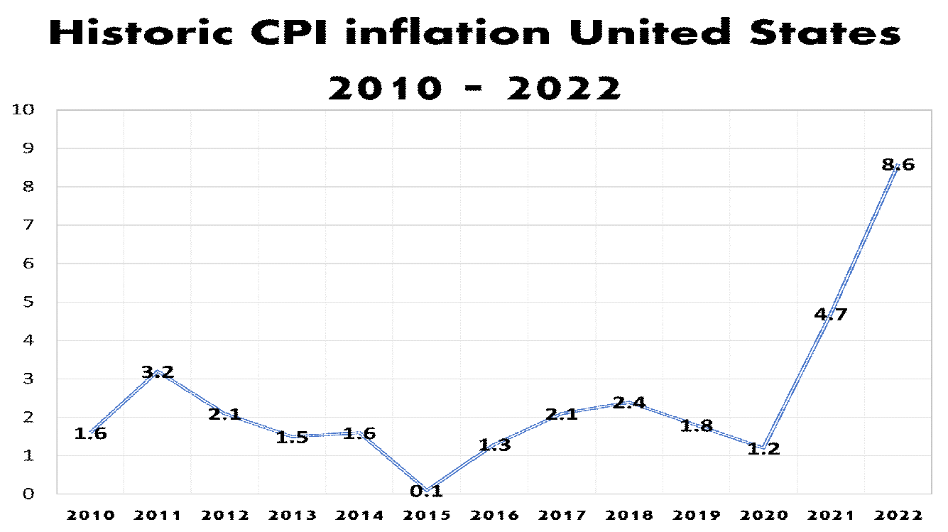
How is inflation measured?
The Bureau of Labor Statistics measures inflation by using what is called the Consumer Price Index (CPI).

Slide 5
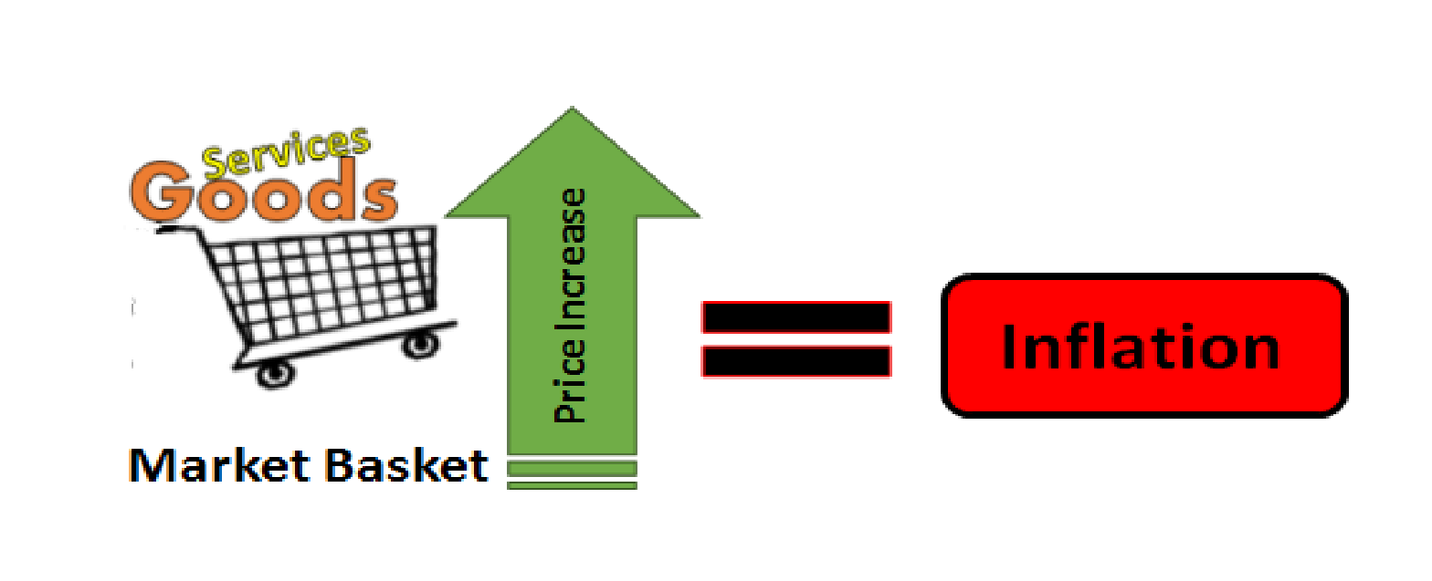
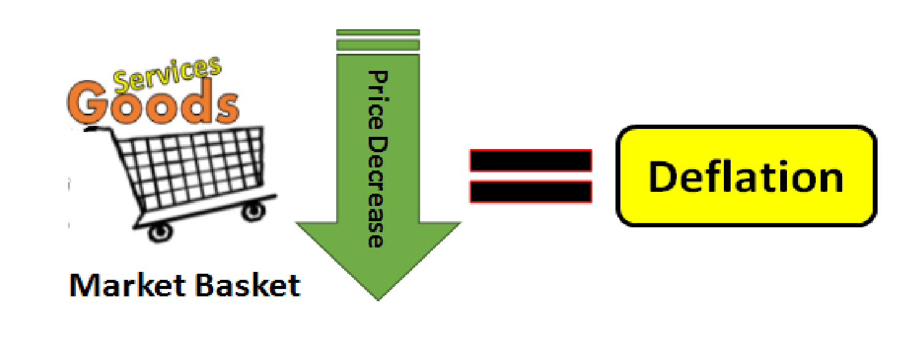
How does the Consumer Price Index (CPI) measure inflation?
CPI measures the price change of a selected group of consumer goods and services overtime.
Thousands of goods and services are selected and placed in what is called a “market basket.”
Each month the “market basket” is checked to see if the overall price of the basket has increased or decreased.

Slide 6
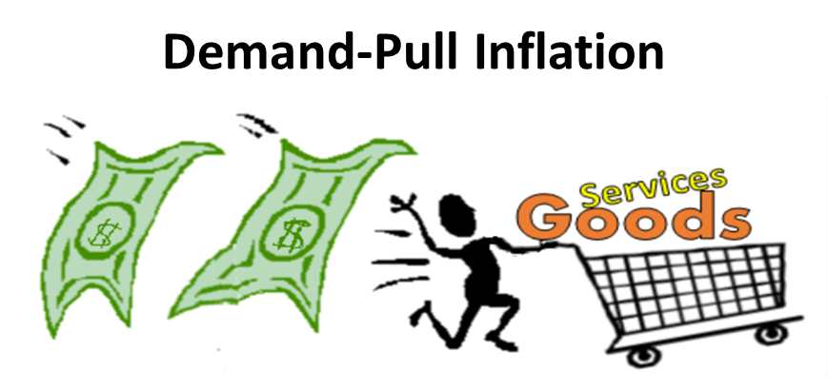
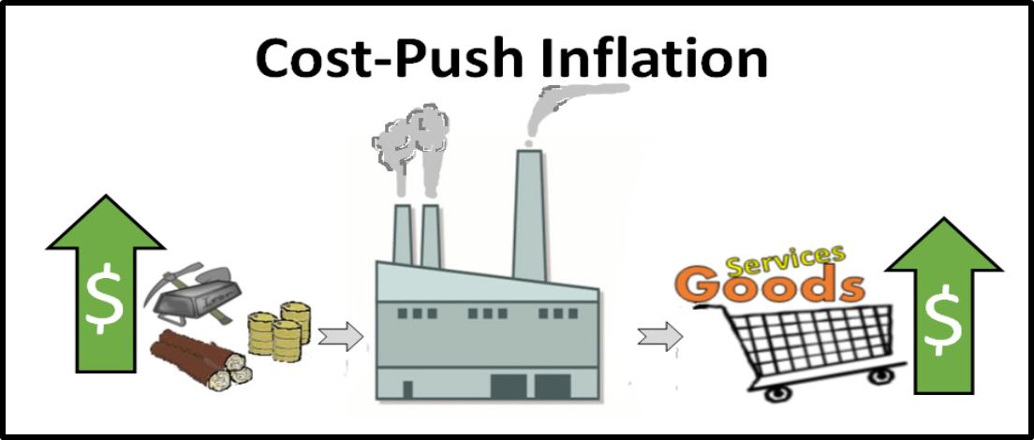
What are two common types of inflation?
1) Cost-push inflation
2) Demand-pull inflation

Slide 7
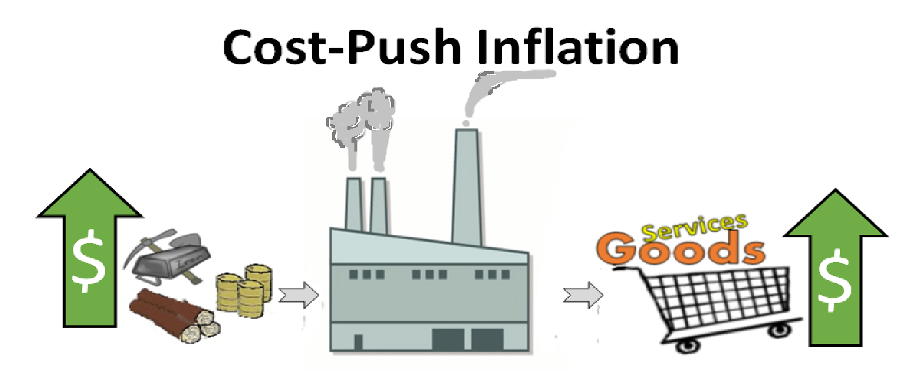
What is COST-PUSH INFLATION?
= is when price raises (are pushed-up) because the cost of resources and labor increases.
If companies have to pay more for raw materials or labor to make products then they will need to increase their prices. Higher prices of resources that are needed to produce goods or services PUSHES prices up causing inflation.

Slide 8
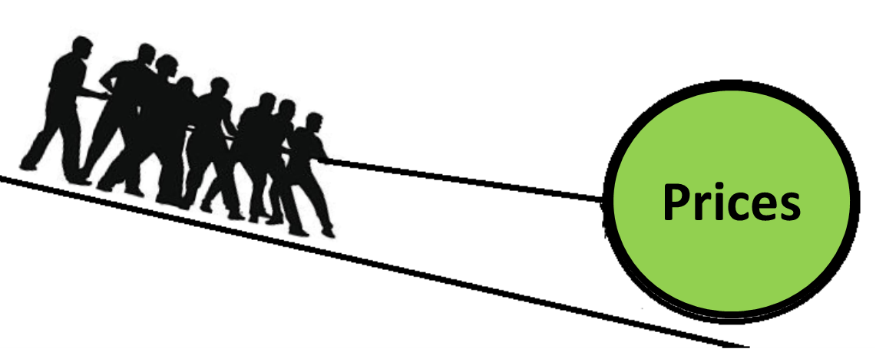
What is DEMAND-PULL INFLATION?
= is when prices are PULLED up because demand is greater than supply.
When demand is greater than supply, people are trying to buy more stuff than is currently available leading to the bidding up of prices. In this case, demand is pulling up prices.

Slide 9
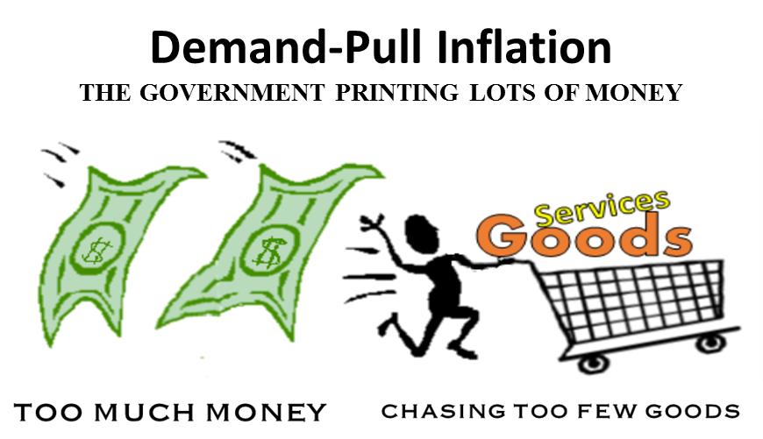
Why does Demand-Pull Inflation Occur?
Demand-pull inflation often occurs because governments print too much money.
When a government prints lots of money, people have more money to bid up prices.
Economists refer this as “too much money chasing too few goods”

Slide 10
What are some effects of inflation?
1) When inflation occurs, we all lose buying power.
2) The loss of buying power, especially hurts those on fixed incomes.
A fixed income is income that doesn’t change. People that are retired or on disability are on fixed incomes. Overtime, during periods of inflation, these individuals may begin to struggle to buy the things they need, unless their income becomes adjusted for inflation.

Slide 11
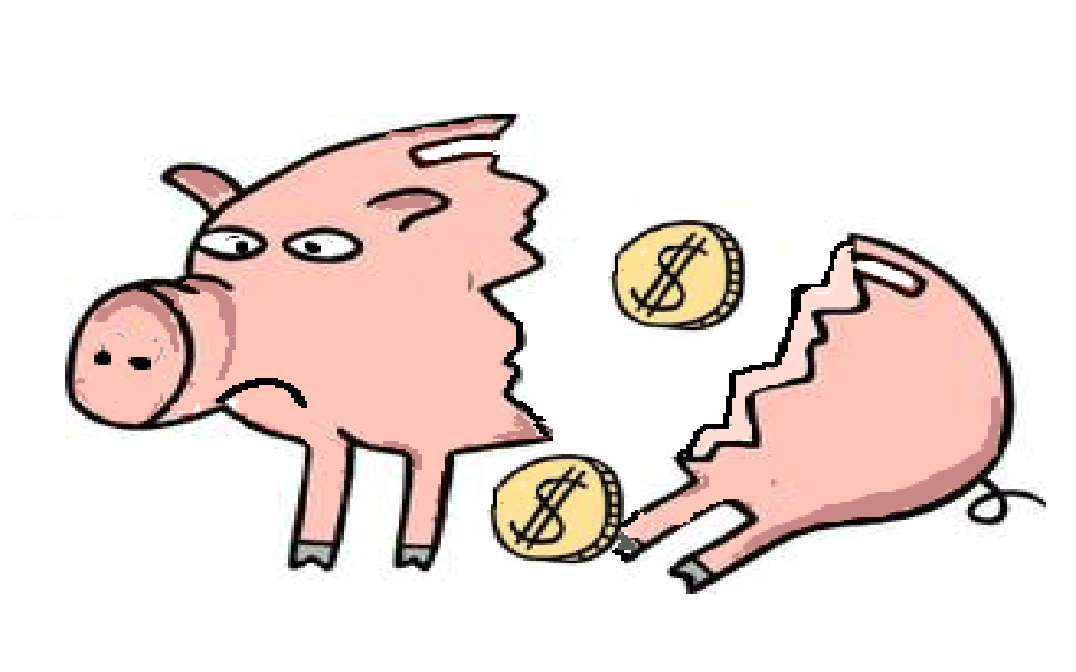
Other effects of inflation
3) Increases the cost of borrowing.
Inflation pushes interest rates higher. As interest rates raise, it can make it more expensive and harder for many to borrow. High interest rates may discourage consumers from buying goods that are often bought with credit such as cars, houses, and other expensive items. Higher interest rates will also affect credit card holders; consumers with credit card balances will find it more expensive to have a balance month to month.
4) Savers are negatively impacted with inflation.
Inflation leads to a fall in the value of money which lowers the value of savings and investments. Inflation can be especially hurtful to savers if inflation is higher than interest rates given to savers. High inflation can be an incentive for people to spend money and a disincentive to invest money. There is no or little benefit to save money if you know that it is going to lose value and be worth less in the future.

Slide 12
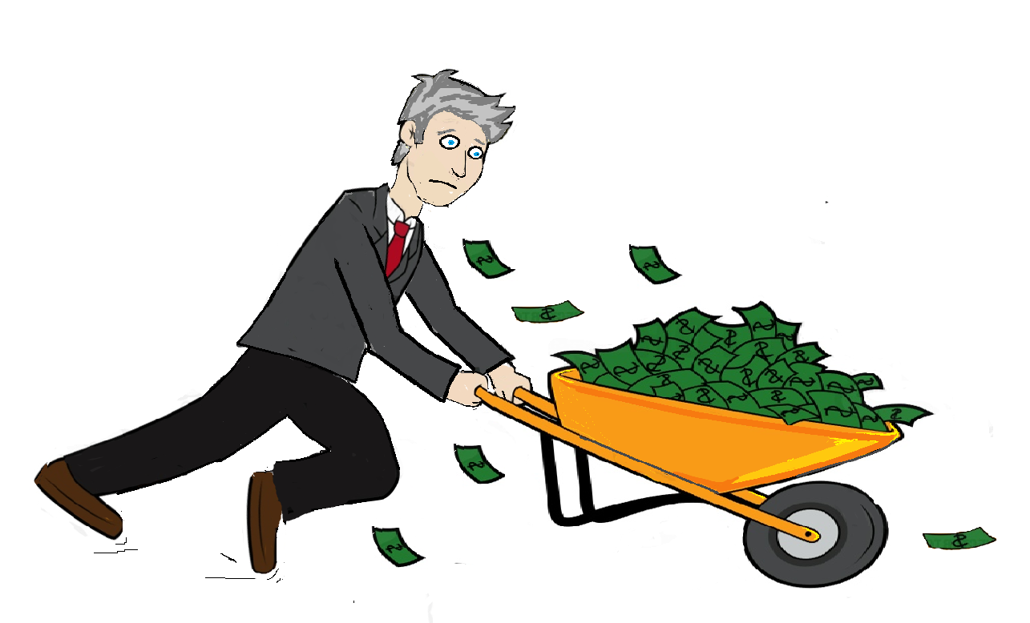
Inflation Activities: Work in your table groups on activities. Please place completed activities into the black bin on the grey table.
Price Changes Analysis
Comparison 1950’s to Present day.
Find the average cost of items listed and the average annual salary.
Using the price chart answer the questions about inflation.

Slide 13
The House Hunters
Money Supply Simulation
A fun, engaging, and memorable simulation
to demonstrate how inflation works
H
H
Notes:
700k
800k
900k
1 million
1.1 million

Slide 14
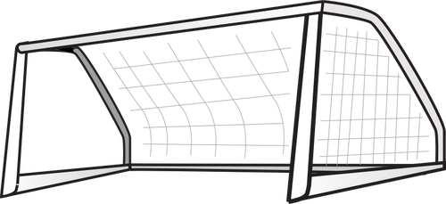
Today’s Goal
I can explain the relationship between the money supply and inflation

Slide 15
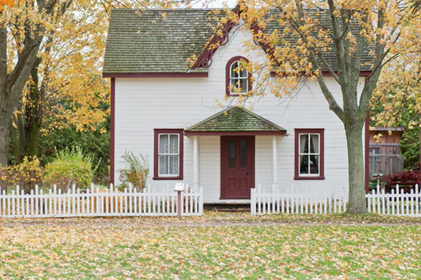
House Hunters
In a minute we will use a randomly determine your max budget
You will use this budget to bid on houses- the highest bid wins the house.
There are no rules on the number of houses you can buy, but you may not exceed your budget
The goal of the game is to get SOMEWHERE to live- and the best possible place for your money
Notes:
700k
800k
900k
1 million
1.1 million

Slide 16
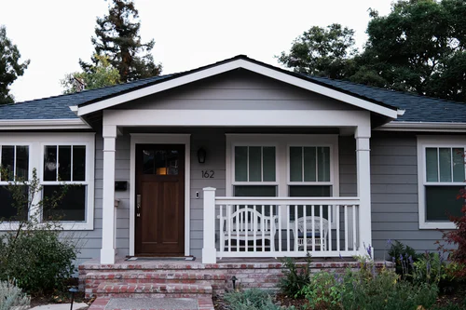
Auction 1: The Porch House
Location
Columbus, OH
Bedrooms
2
Bathrooms
1
Year built
1990
Minimum bid
$150k

Slide 17
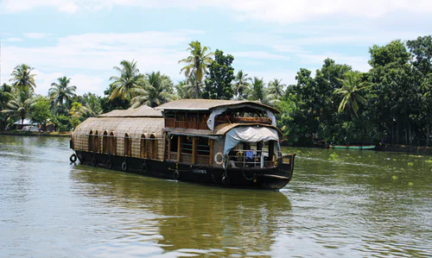
Auction 2: The Houseboat
Location
Bar Harbor, Maine
Bedrooms
3
Bathrooms
1
Year built
2000
Minimum bid
$100k

Slide 18
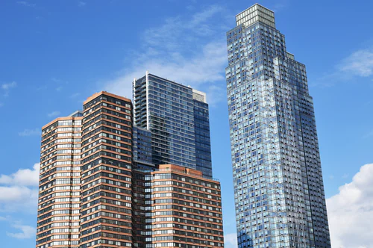
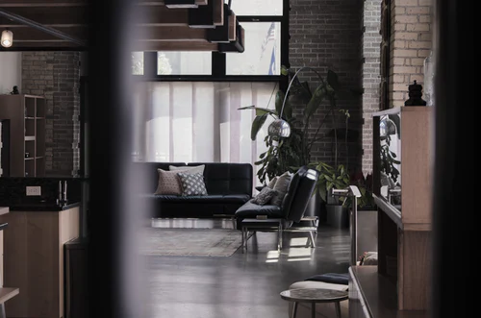
Auction 3: Penthouse Apartment
Location
New York City (73rd floor)
Bedrooms
2
Bathrooms
1.5
Year built
2006
Minimum bid
$400k

Slide 19
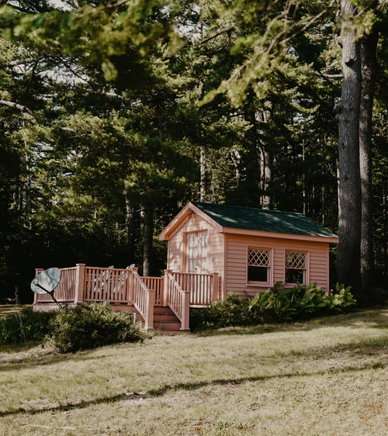
Auction 4: Peach State Mini-House
Location
Savannah, Georgia
Bedrooms
1
Bathrooms
1
Year built
2003
Minimum bid
$125k

Slide 20
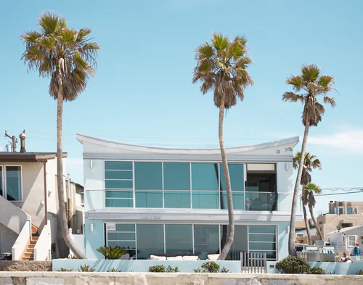
Auction 5: Miami Beach Mansion
Location
Miami, FL
Bedrooms
8
Bathrooms
4.5
Year built
2013
Minimum bid
$500k

Slide 21
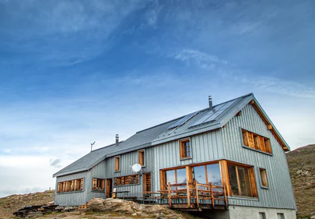
Auction 6: Converted Farmhouse
Location
Billings, Montana
Bedrooms
4
Bathrooms
2
Year built
1996
Minimum bid
$350k

Slide 22
Auction 7: Peace and Quiet Lake House
Location
Rural Michigan
Bedrooms
4
Bathrooms
2
Year built
2003
Minimum bid
$300k

Slide 23
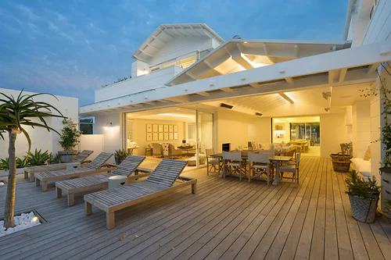
Auction 8: Malibu Mansion
Location
Malibu, CA
Bedrooms
4
Bathrooms
6
Year built
2019
Minimum bid
$500k

Slide 24
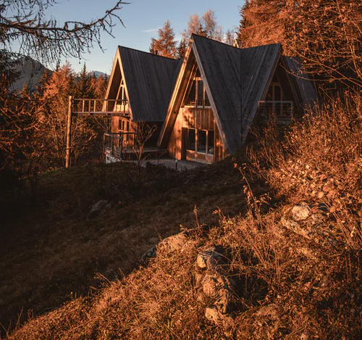
Auction 9: Ski Outpost
Location
Outside Denver, CO
Bedrooms
3
Bathrooms
1.5
Year built
1988
Minimum bid
$200k

Slide 25
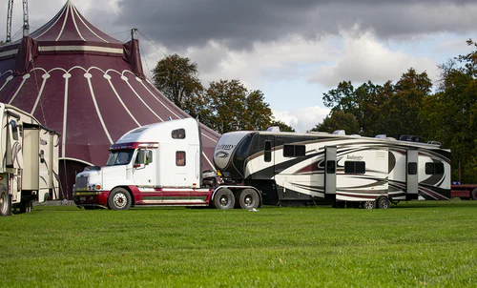
Auction 10: Jumbo RV
Location
Depends!
Bedrooms
2
Bathrooms
1
Year built
2014
Rig is a 2012
Minimum bid
$100k

Slide 26
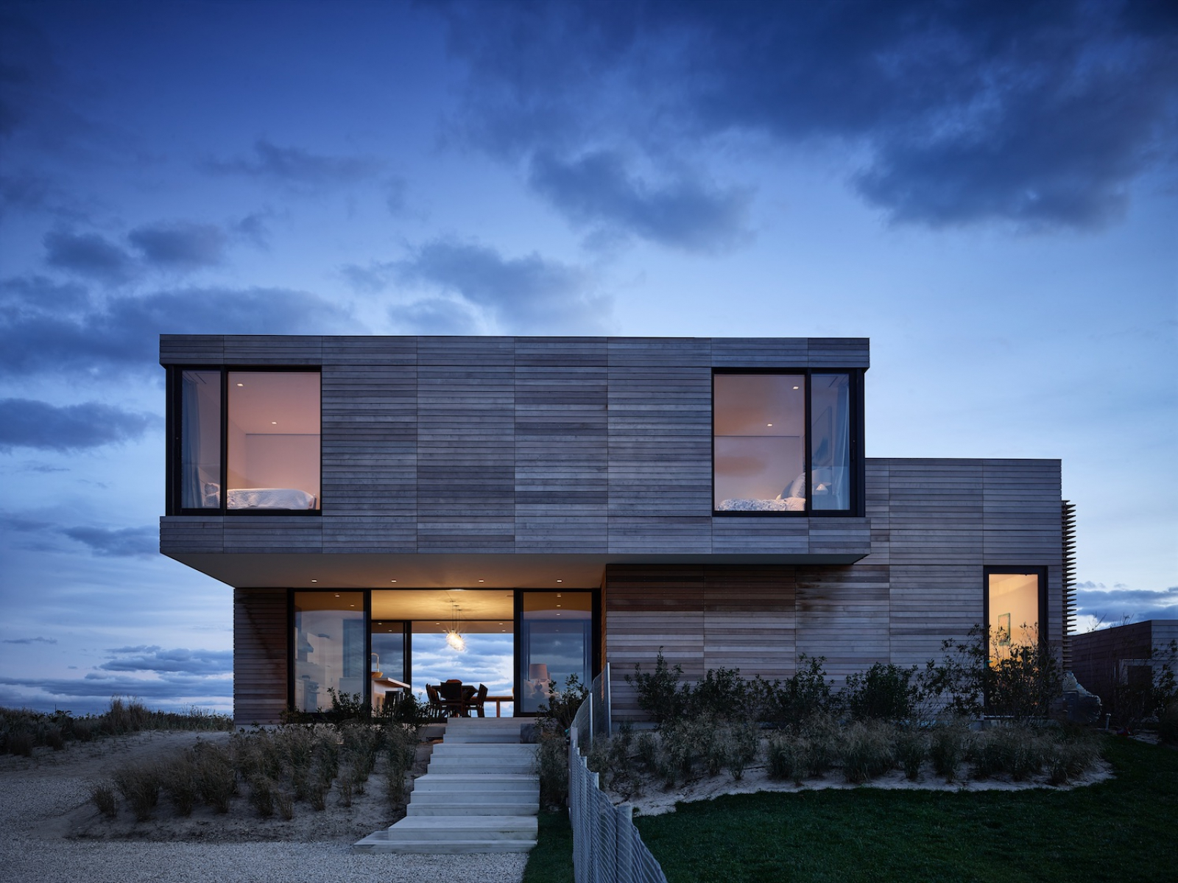
Auction 11: Modern Mansion
Location
Phoenix, AZ
Bedrooms
4
Bathrooms
3
Year built
2018
Minimum bid
$500k

Slide 27
Auction 12: Lighthouse Home
Location
Gloucester, MA
Bedrooms
5
Bathrooms
2.5
Year built
1977
Minimum bid
$400k

Slide 28
Auction 13: Ranch and Horse Stables
Location
Phoenix, AZ
Bedrooms
4
Bathrooms
3
Year built
2018
Minimum bid
$250k

Slide 29
Round 2: The Real Deal!
A major adjustment for round 2:
Everybody’s budget is doubled for this last round

Slide 30
Auction 1: The Porch House
Location
Columbus, OH
Bedrooms
2
Bathrooms
1
Year built
1990
Minimum bid
$300k

Slide 31
Auction 2: The Houseboat
Location
Bar Harbor, Maine
Bedrooms
3
Bathrooms
1
Year built
2000
Minimum bid
$200k

Slide 32
Auction 3: Penthouse Apartment
Location
New York City (73rd floor)
Bedrooms
2
Bathrooms
1.5
Year built
2006
Minimum bid
$800k

Slide 33
Auction 4: Peach State Mini-House
Location
Savannah, Georgia
Bedrooms
1
Bathrooms
1
Year built
2003
Minimum bid
$250k

Slide 34
Auction 5: Miami Beach Mansion
Location
Miami, FL
Bedrooms
8
Bathrooms
4.5
Year built
2013
Minimum bid
$1.0 Million

Slide 35
Auction 6: Converted Farmhouse
Location
Billings, Montana
Bedrooms
4
Bathrooms
2
Year built
1996
Minimum bid
$700k

Slide 36
Auction 7: Peace and Quiet Lake House
Location
Rural Michigan
Bedrooms
4
Bathrooms
2
Year built
2003
Minimum bid
$600k

Slide 37
Auction 8: Malibu Mansion
Location
Malibu, CA
Bedrooms
4
Bathrooms
6
Year built
2019
Minimum bid
$1.0 Million

Slide 38
Auction 9: Ski Outpost
Location
Outside Denver, CO
Bedrooms
3
Bathrooms
1.5
Year built
1988
Minimum bid
$400k

Slide 39
Auction 10: Jumbo RV
Location
Depends!
Bedrooms
2
Bathrooms
1
Year built
2014
Rig is a 2012
Minimum bid
$200k

Slide 40
Auction 11: Modern Mansion
Location
Phoenix, AZ
Bedrooms
4
Bathrooms
3
Year built
2018
Minimum bid
$1.0 Million

Slide 41
Auction 12: Lighthouse Home
Location
Gloucester, MA
Bedrooms
5
Bathrooms
2.5
Year built
1977
Minimum bid
$800k

Slide 42
Auction 13: Ranch and Horse Stables
Location
Phoenix, AZ
Bedrooms
4
Bathrooms
3
Year built
2018
Minimum bid
$500k

Slide 43
Reflection Questions
Initial thoughts?
Was it easier to get the house you wanted in the second round, once you had twice the money?
The same exact houses went for different prices in the second round. What did you think of that?

Slide 44
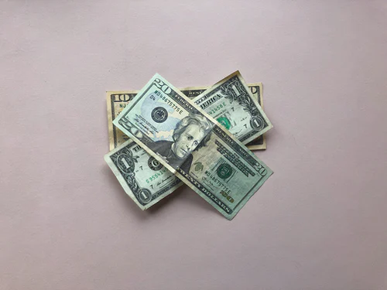
So why did the same houses go for more money the second round?
Inflation!
The simple relationship between the money supply and its buying power
For the second round the “money supply” in our classroom doubled, and as a result prices skyrocketed, too.

Slide 45
Related to this idea of “Money Supply”, why can’t the government just print more money when it needs it?

Slide 46
What is the relationship between the money supply and the value of money?

