Slide 2
Herbert Hoover & The Dust Bowl
Unit 7: The Great Depression #2

Slide 3
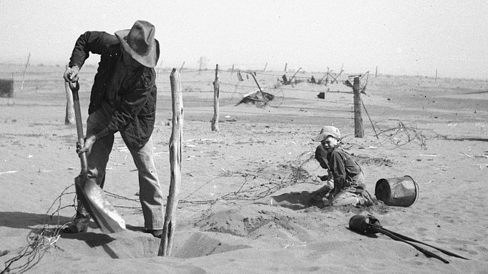
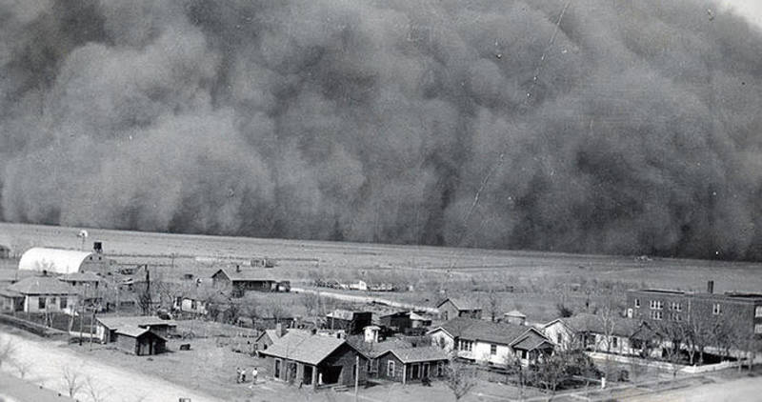
Causes of the Dust Bowl
Overfarming & overproduction
Sustained drought (no rain)
Land dried up → DUST CLOUDS

Slide 4
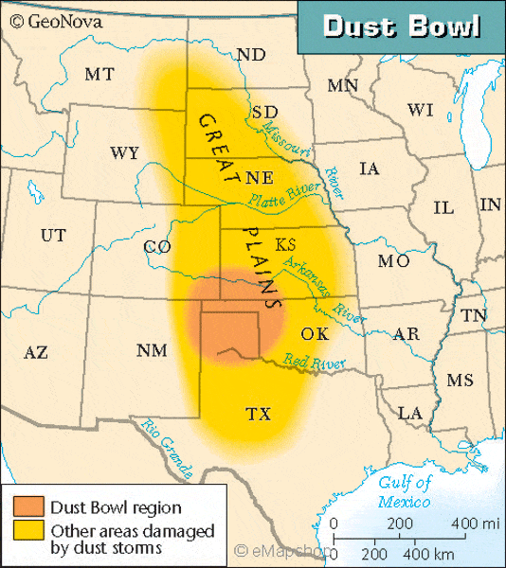

Slide 5
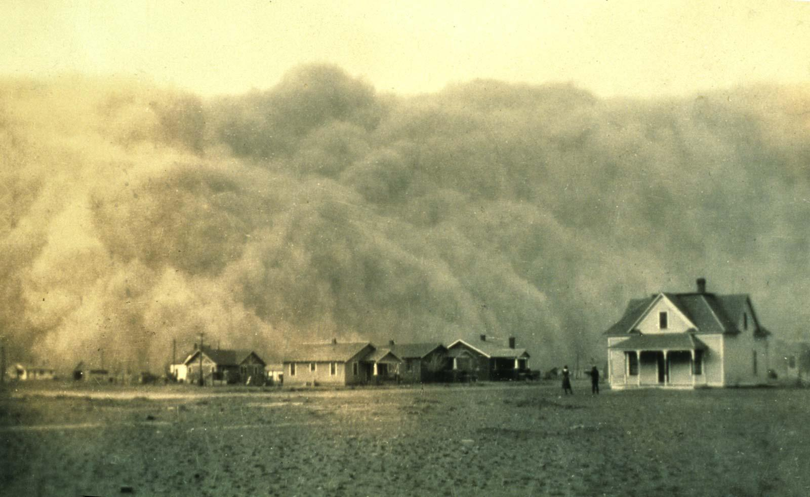
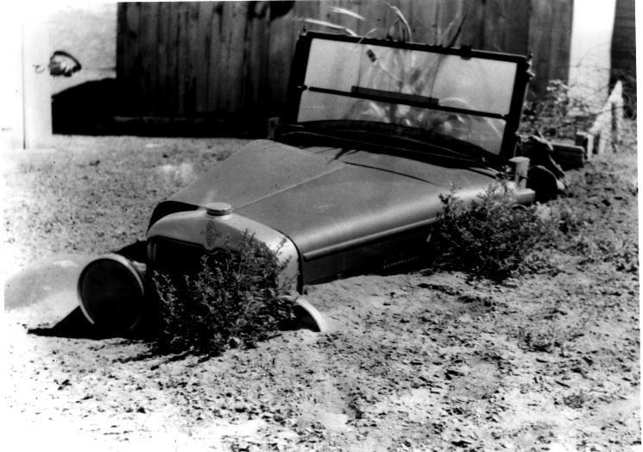
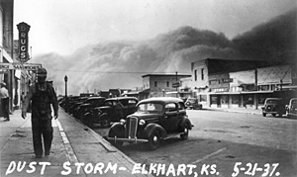
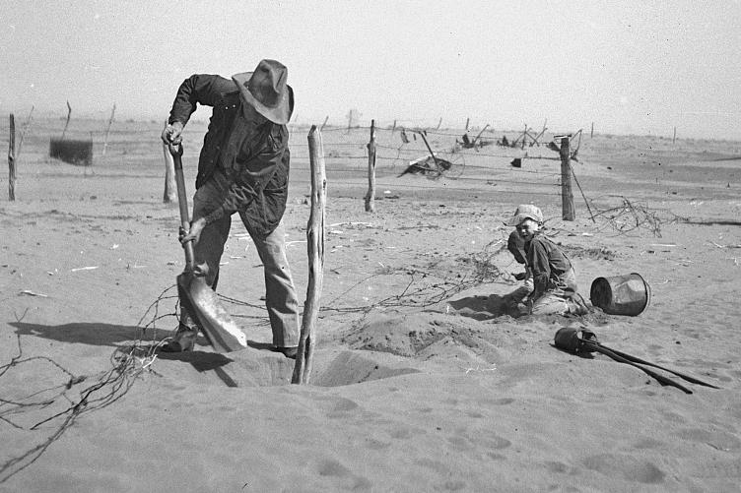

Slide 6
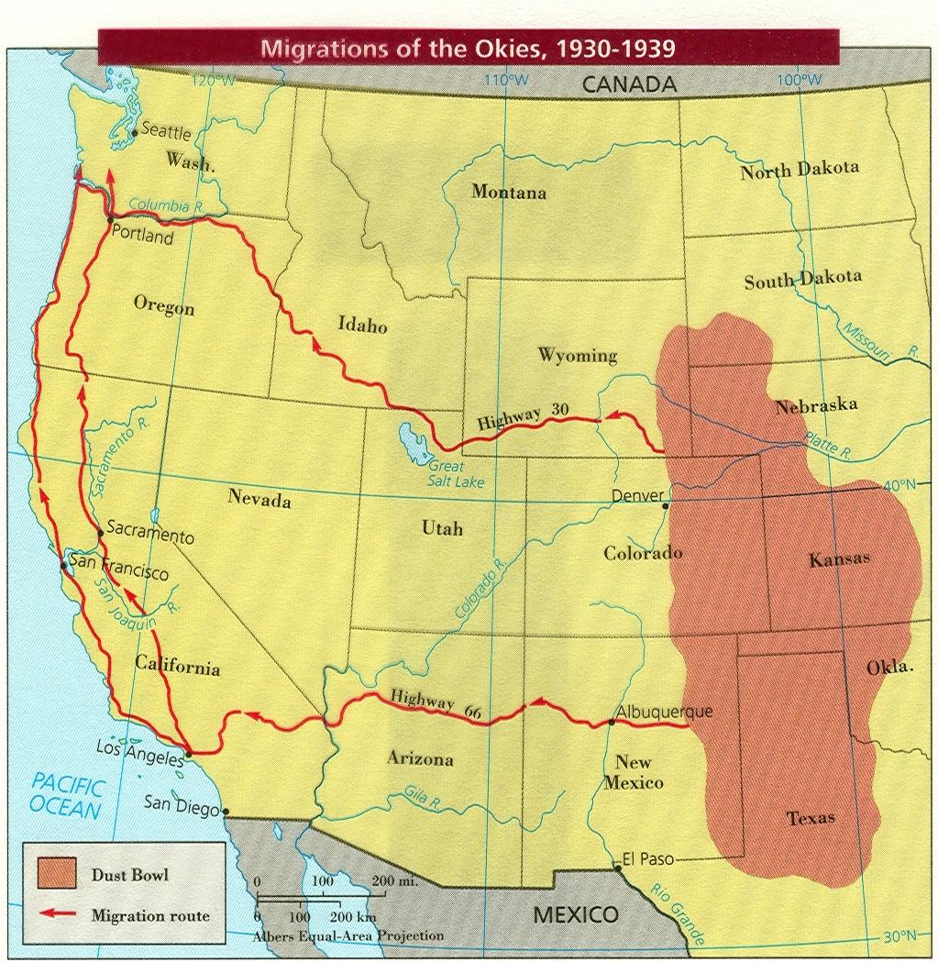
Impact of the Dust Bowl
Farmers lost land (foreclosure)
Forced migrants called “Oakies” to leave the Great Plains → moved west to California, Oregon, and Washington

Slide 7
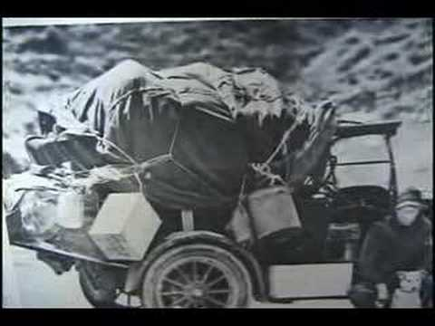

Slide 8
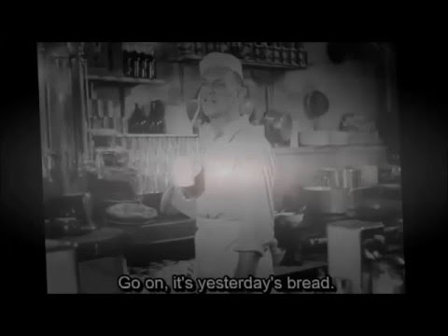

Slide 9
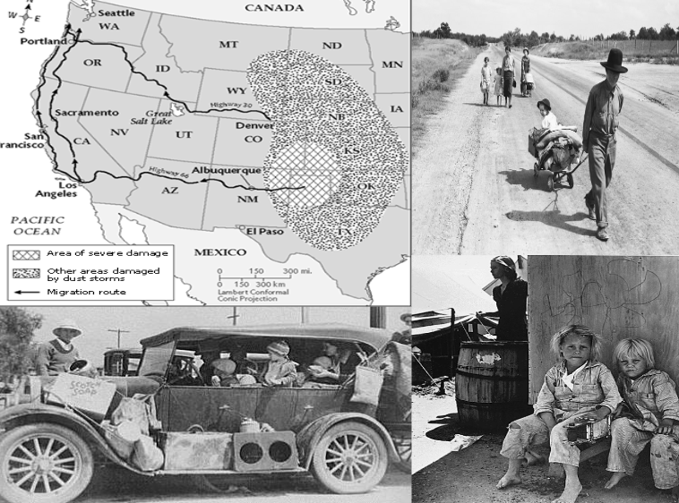
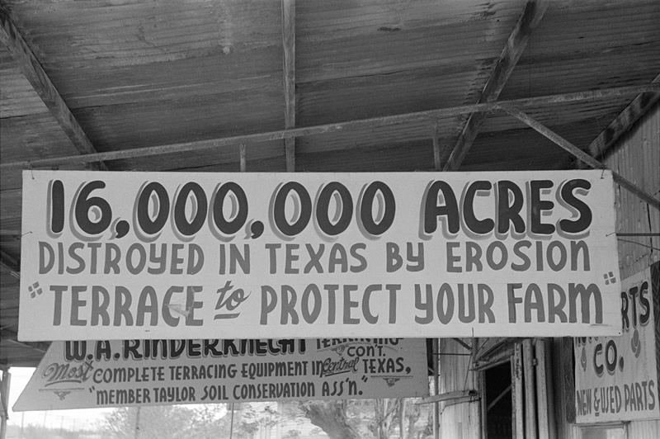

Slide 10
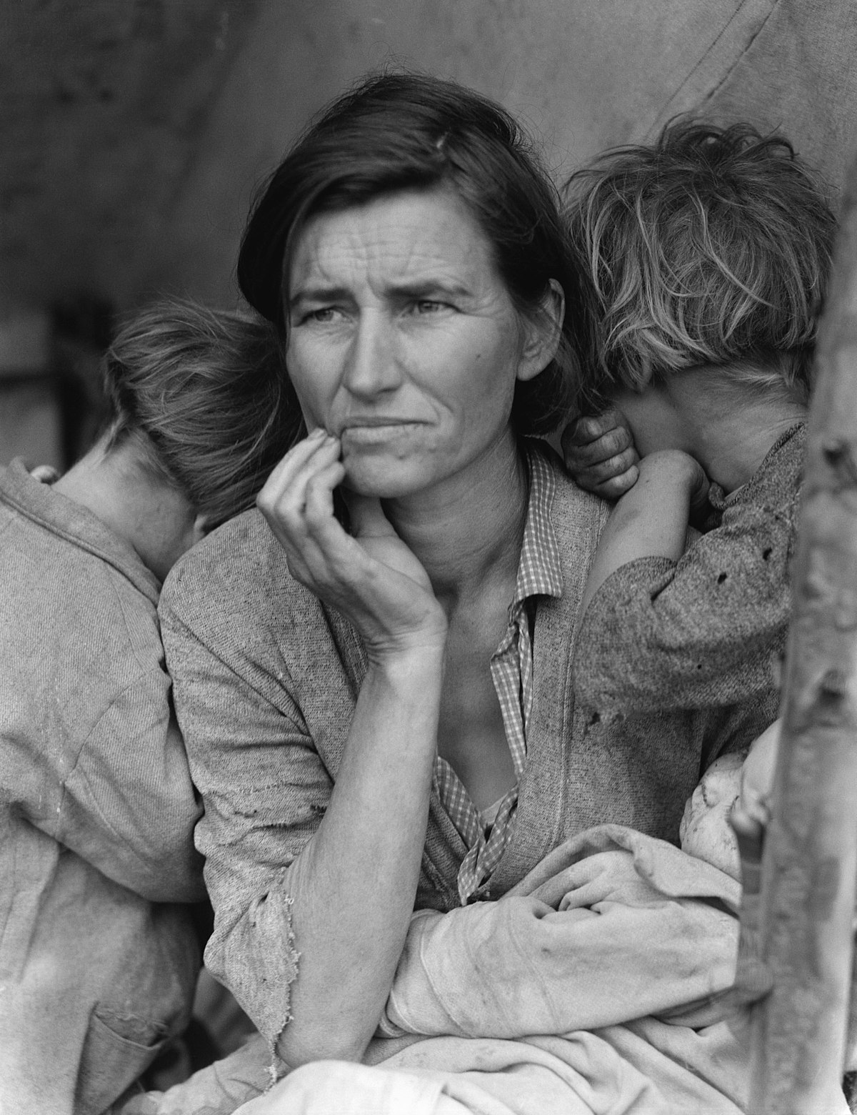
Dorothea Lange
Lange’s childhood difficulties seemed to give her a deep sense of other people’s sufferings
Traveled through Dust Bowl states
Hired by the government to photograph the effects of the Great Depression
“Migrant Mother” = extremely famous image of the 1930s & Great Depression

Slide 11
Critical Thinking:
How old do you think she is?
How many children do you think she has?
What is she thinking?

Slide 12
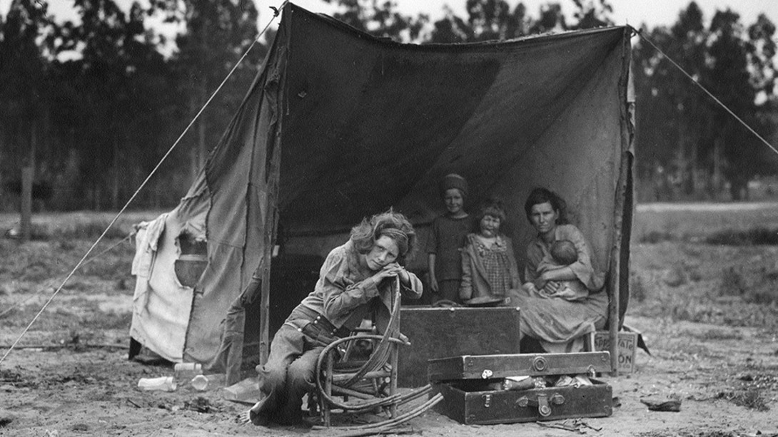

Slide 13
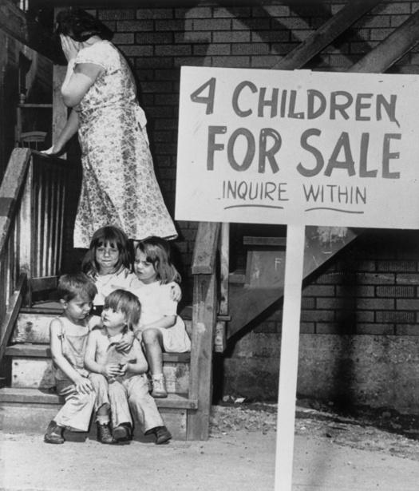
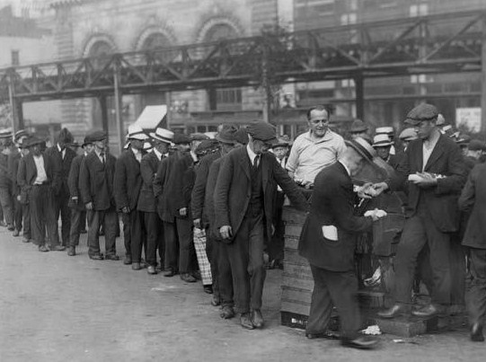
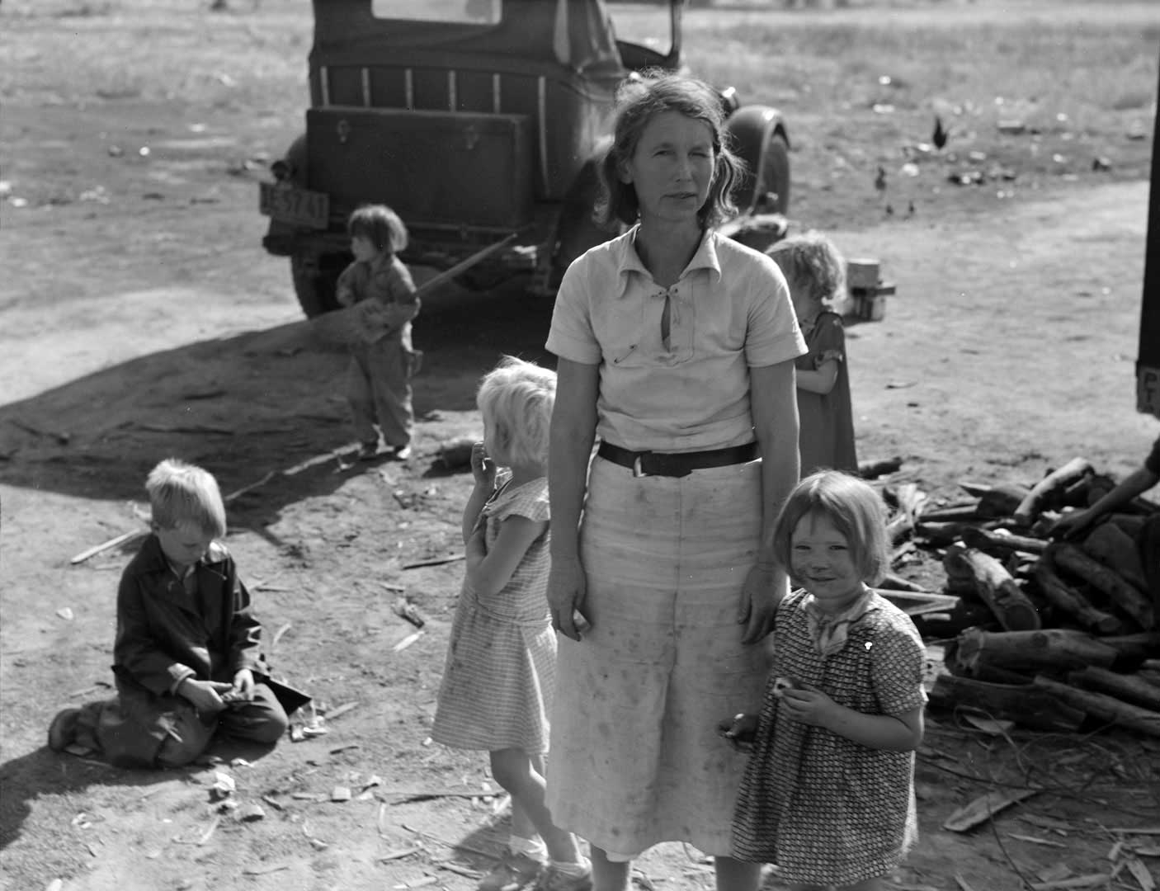
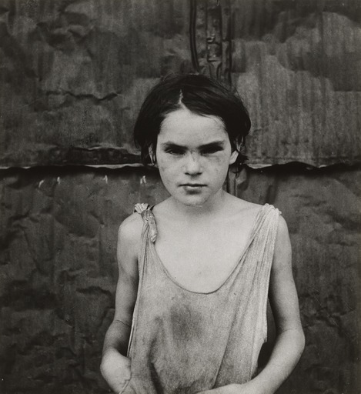

Slide 14
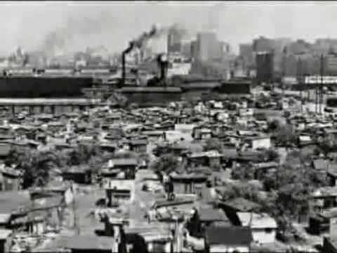

Slide 15
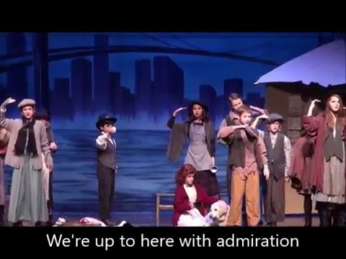

Slide 16
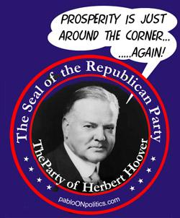
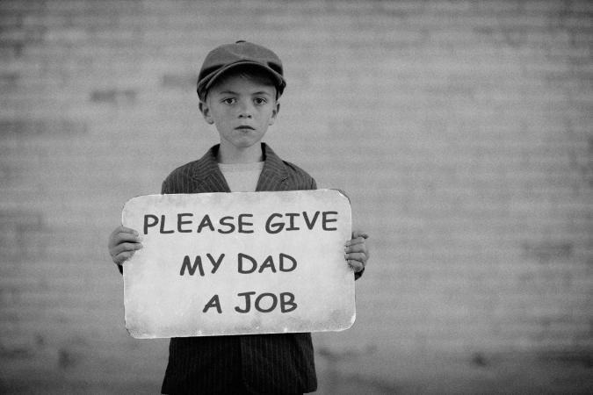
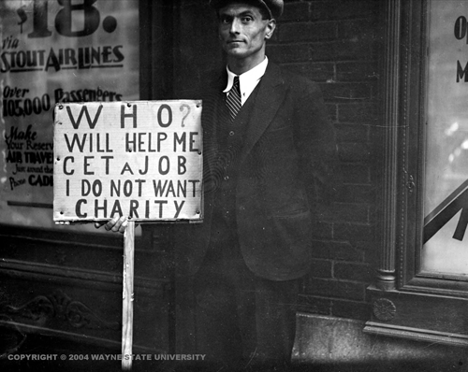
Hoover’s Response
Believed in laissez-faire capitalism
Rejected the idea that the government should get involved to help the economy
Problem: did not create enough jobs to offset high unemployment rates
Believed that a “government that governs the best is that which governs the least…”

Slide 17
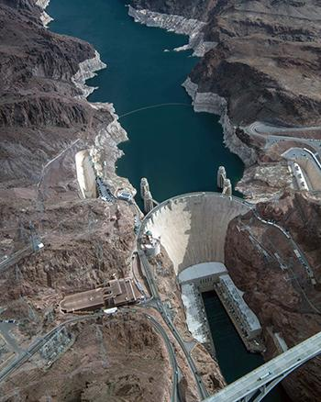
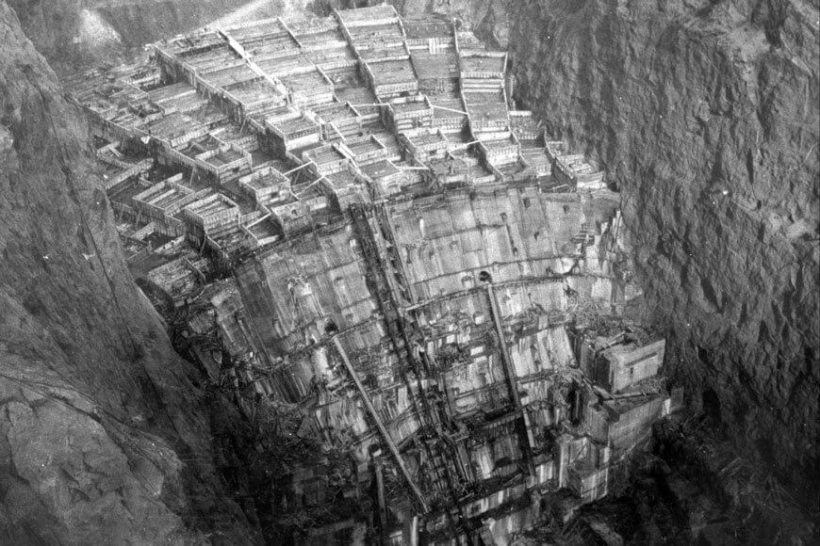
Hoover Dam
Begins public work programs like: (to create jobs)
Constructing roads
Bridges
Dams
Launches programs to raise food prices to help farmers
Constructs the Hoover Dam which created:
Jobs
Electricity
Flood control
Provided water for the West

Slide 18
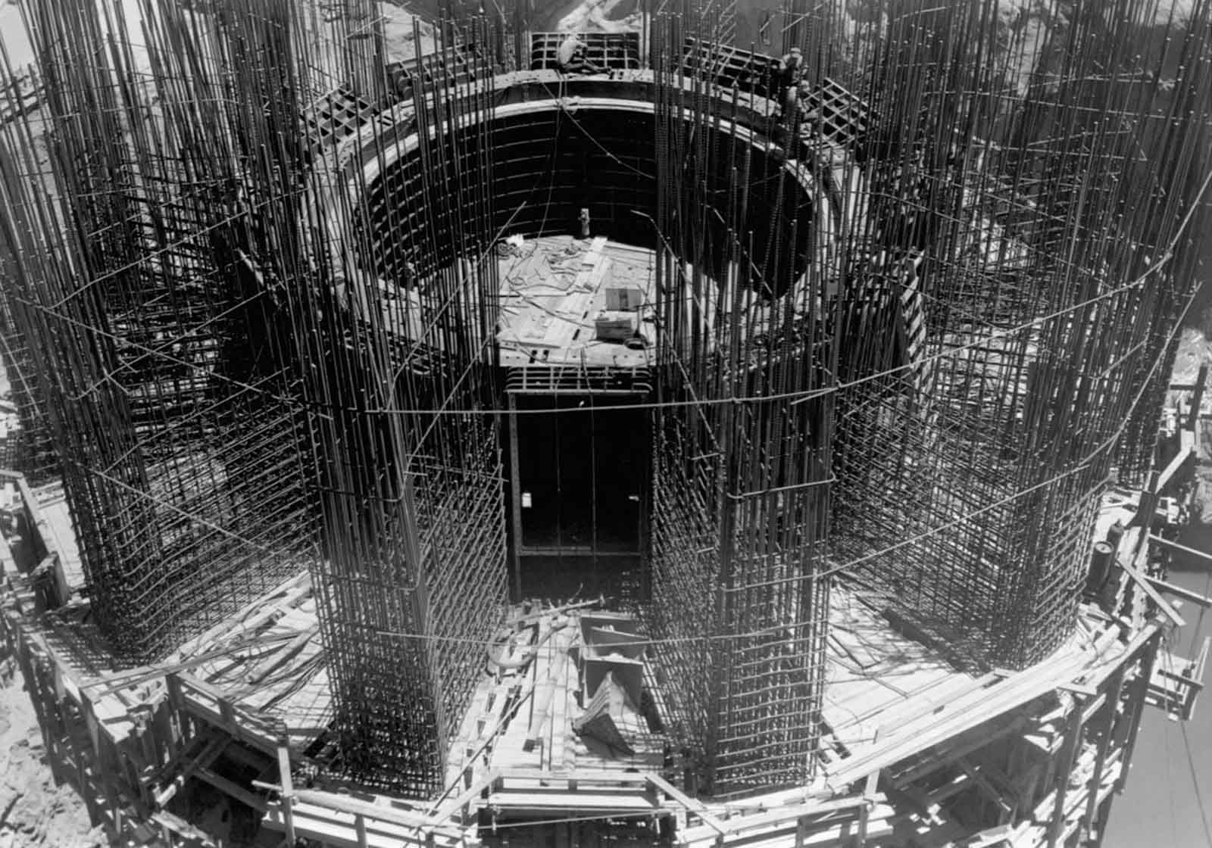
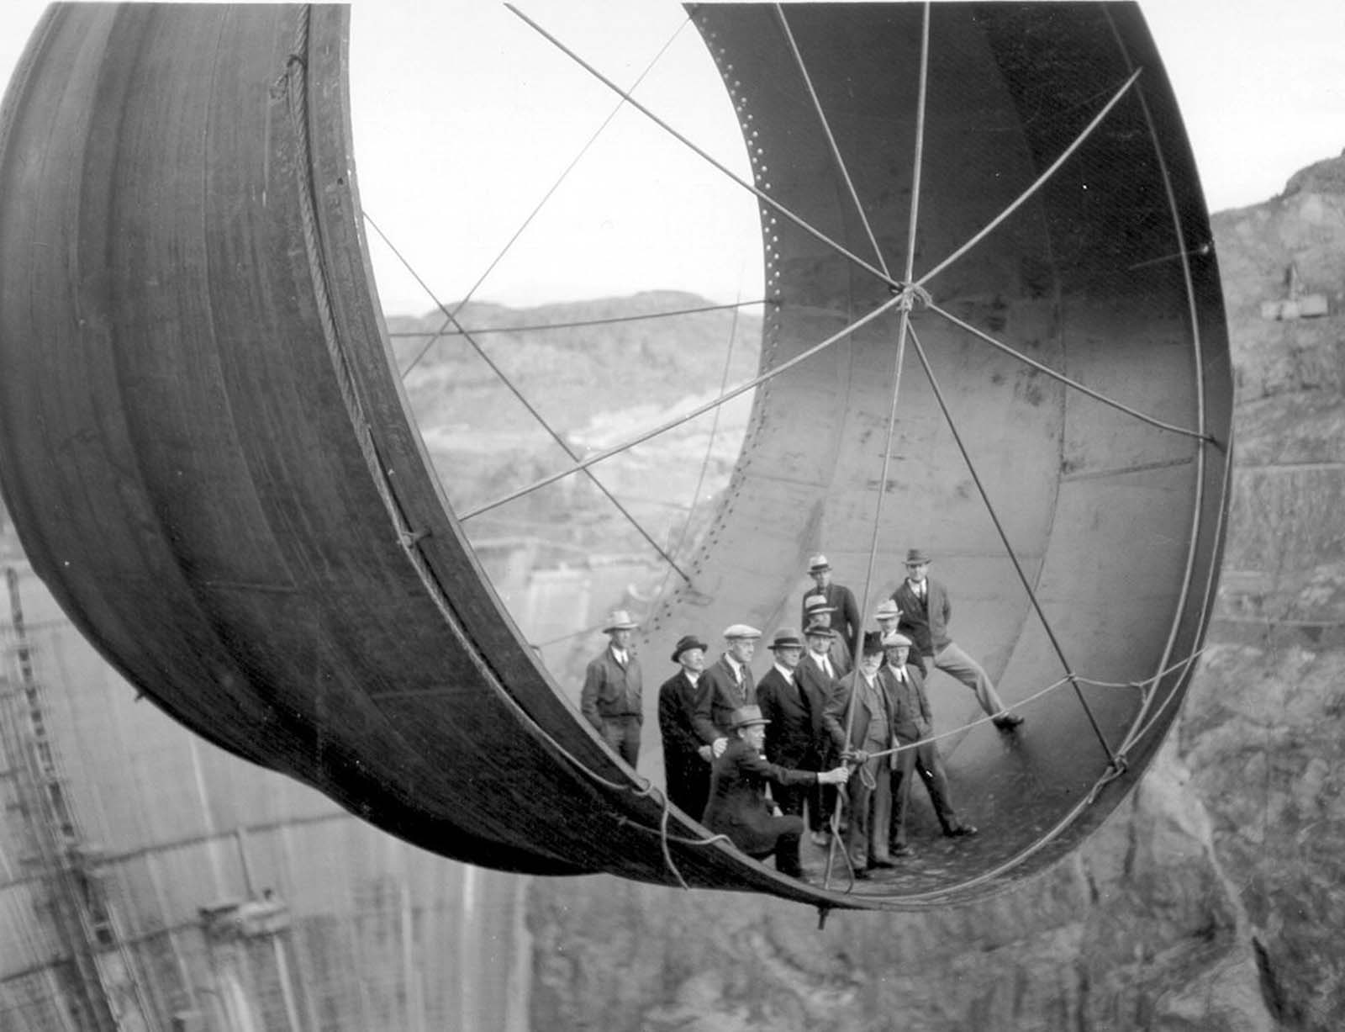

Slide 19
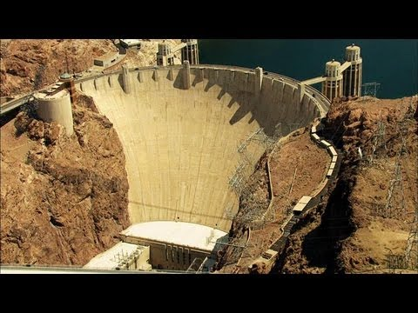

Slide 20
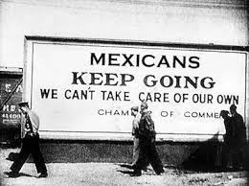
Mexican Repatriation Act
Unemployed whites wanted jobs held by Mexican-Americans
Law authorized the deportation of Mexicans out of the United States
Split up many families

Slide 21
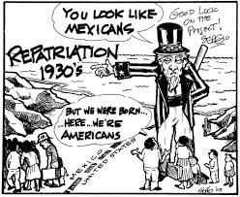

Slide 22
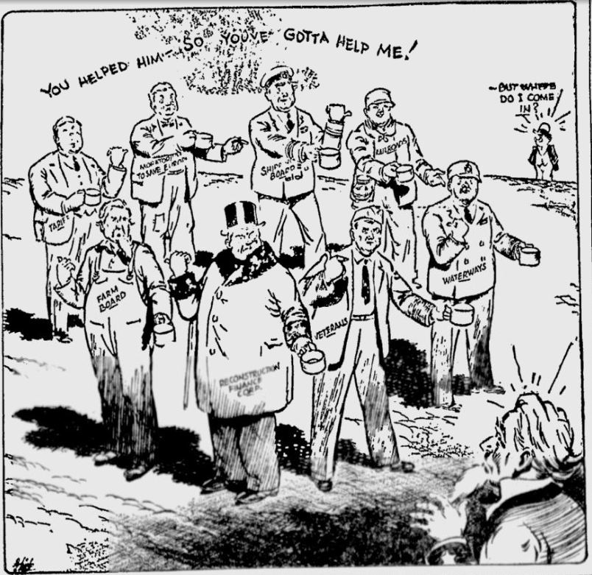
Reconstruction Finance Corporation
Hoover gave emergency loans to banks, believing that money would spur (encourage) economic growth, but it was a little too late

Slide 23
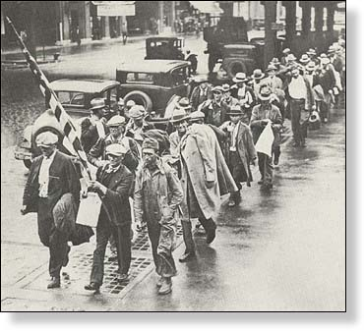
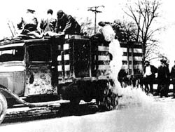
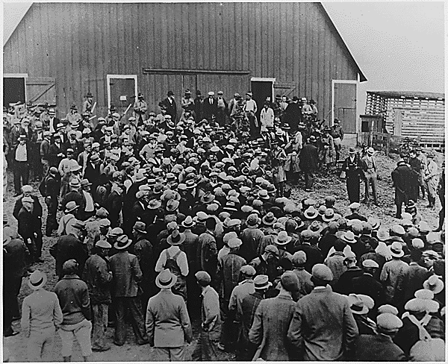
The People’s Responses
Hunger Marches (1932):
1,200 hunger marchers assembled at the nation’s capital & chanted “Feed the hungry, tax the rich!”
Denied food, water, & medical treatment
Penny Auctions (Farmers):
Neighboring farmers would bid tiny amounts for the farm & then give the land back to the original owner
Farmers destroy product:
Overproduction; farmers destroyed their crops to raise prices, reducing the supply

Slide 24
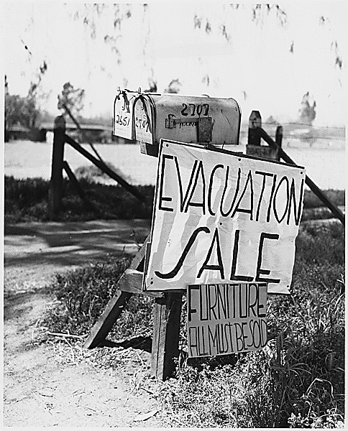
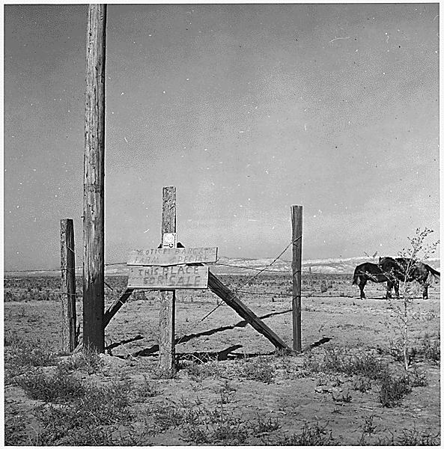

Slide 25
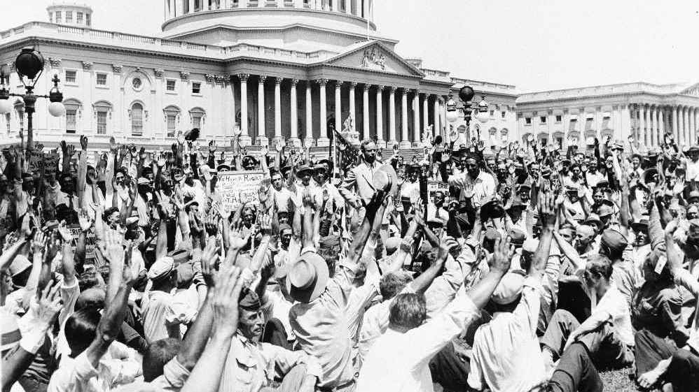
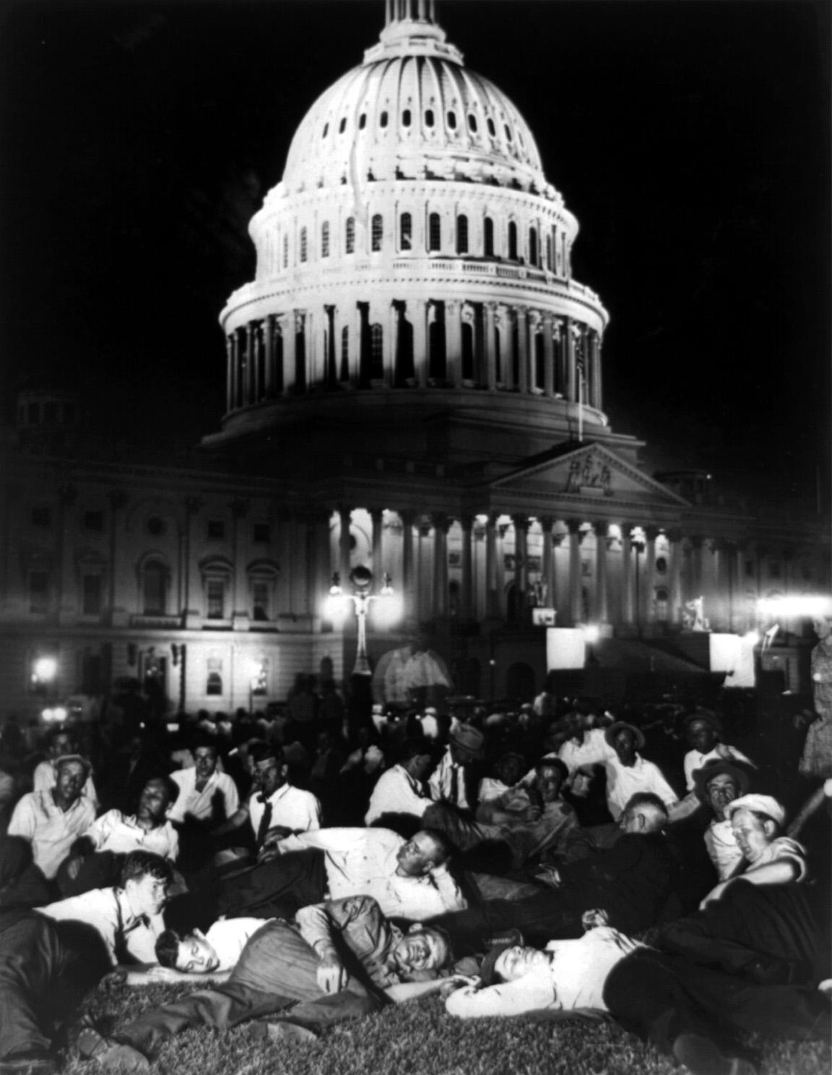
1932 Bonus Army March
World War I veterans were promised a $1,000 bonus to be distributed in 1945
20,000 veterans “Bonus Army” marched to Washington, to demand economic relief by receiving their pension early

Slide 26
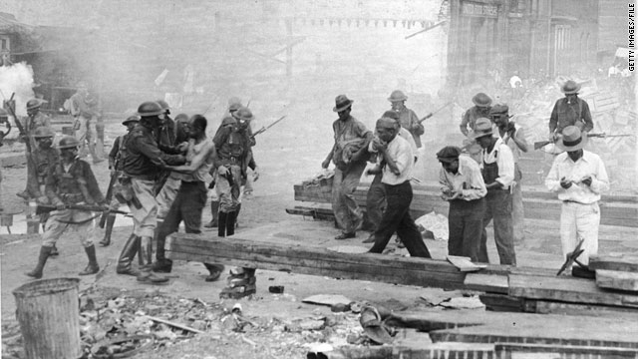
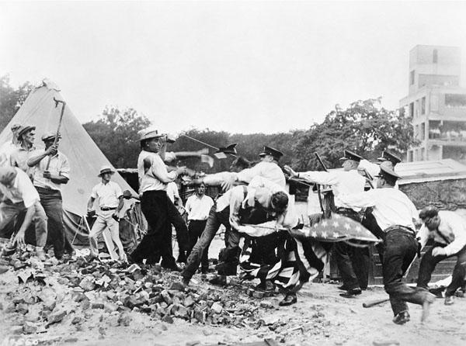
Hoover’s Response to Bonus Army
President Hoover demanded the area cleared
Ordered army to remove them peacefully
General MacArthur disobeyed orders and attacked the camps
Believed Communists were behind it
Hundreds of people were arrested

Slide 27
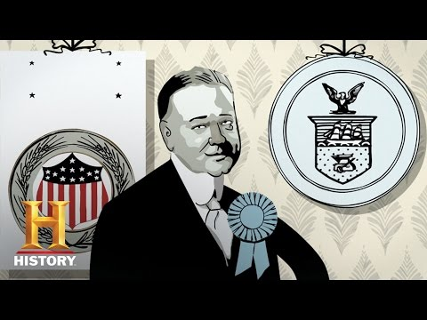

Slide 28
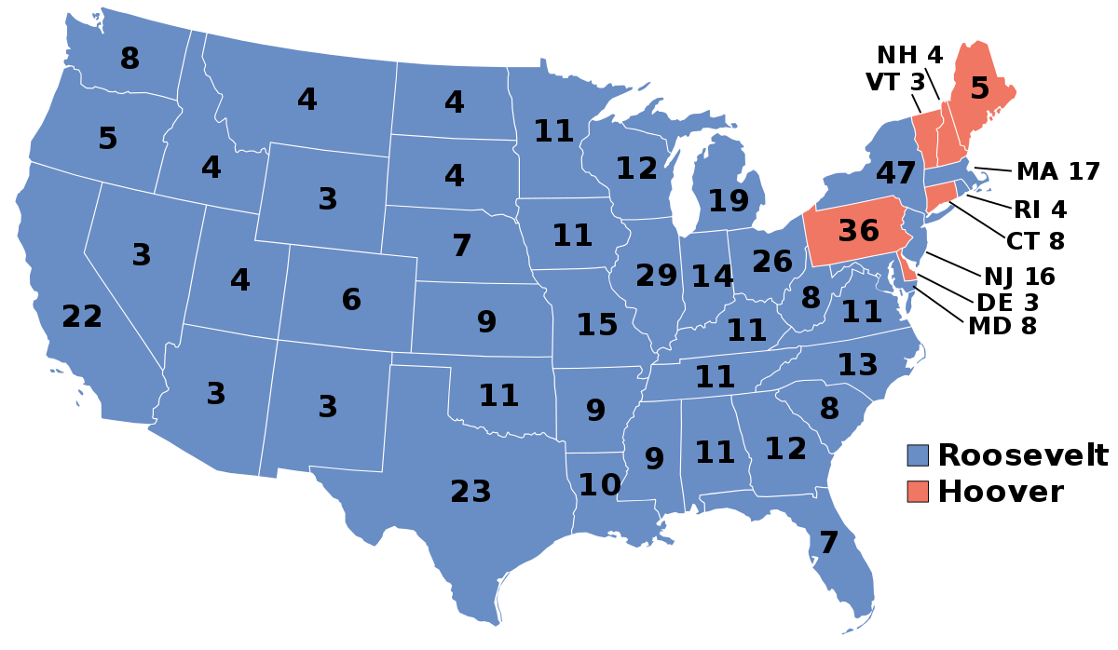
1932 Election
Hoover becomes even less popular going into the 1932 election
Who is going to win the election?

