Slide 1
Free Trade and Trade Barriers

Slide 2
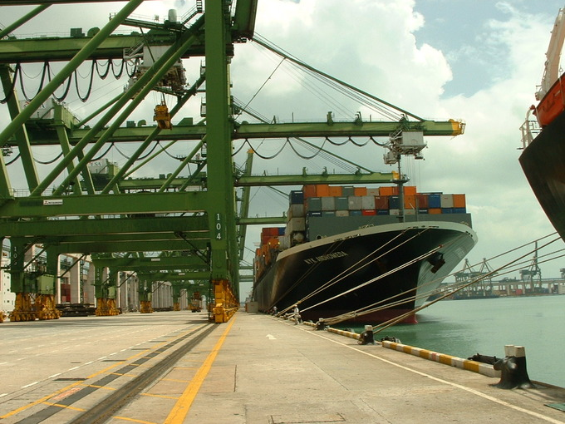
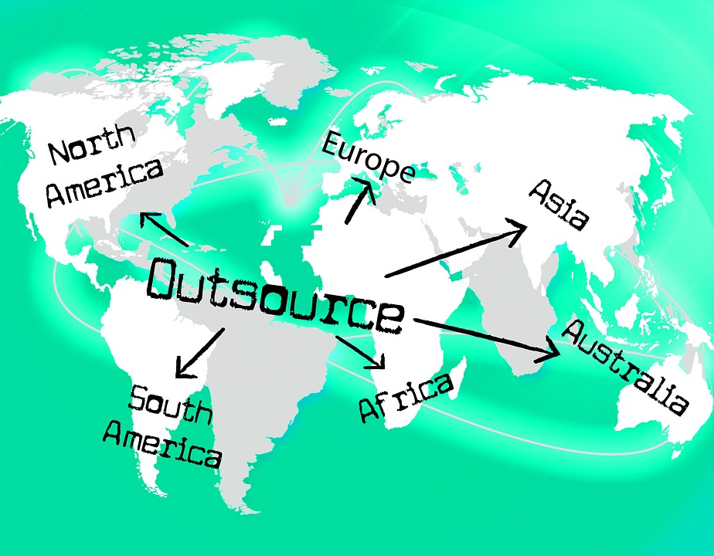
Trade Barriers
Protectionism: When a country has laws or other rules that make it easier for their own products and brands to sell by making goods from foreign countries more expensive or harder to get.
Many nations set up trade barriers in order to provide protectionism.
Trade Barriers: Anything that prevents the free flow of goods and services coming into a country
Arguments in favor of trade barriers:
Protecting infant industries
Outsourcing
National Security
Protecting domestic jobs
Notes:
Mercantilism was a type of protectionism in Europe during the 16th-18th century. The idea was that these European countries that had monarchies would have a trade balance between exports and imports. They tended to have tons of tariffs, so they could export more and a lot of that money would help fund the monarchy’s army, government officials, and their lifestyle. They would hold tons of reserves for gold, which financed the government. Adam Smith was very against mercantilism.
The idea is to stop imports. For example, if farmers from Argentina are selling wheat at a lower price than French farmers are, French people would buy more wheat from Argentine farmers than from French farmers, and French farmers would not get so much money. The benefits to protectionism is that some people in a country would make more money because they would be able to sell things at higher prices, but on the other hand, other people would lose money because they wouldn't be able to buy the things from other countries that sell them cheaper.
Regarding trade barriers:
Protecting newer technologies that isn’t fully developed, such as artificial intelligence, solar panels, etc. It’s just getting developed. So government would subsidize it;
The concern is that it’s putting Americans out of work, but it’s beneficial for companies because it’s cheaper labor for them. When I talk to someone over the phone on Spectrum or Amazon, I’m talking to someone in either India or the Philippines.
Should we charge tariffs on imported steel and oil? Well, we use oil and steel for a lot of national defense items such as artillery, airplanes, tanks, etc. We don’t want to rely in other countries for key components of our national defense.
Think about the auto industry. We would impose a lot of tariffs on foreign cars so we’re able to protect the American autoworkers. Put a tariff on competing products to protect American businesses. The argument against it is because we can get cheaper goods elsewhere and that if a few people would lose their jobs, maybe it’s because it was bound to happen. Or would you rather have people keep their jobs and pay more money. The argument is everyone benefits, but some lose out. Would you rather pay 30k for a new car or 37k?

Slide 3
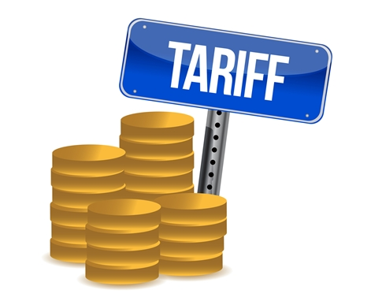
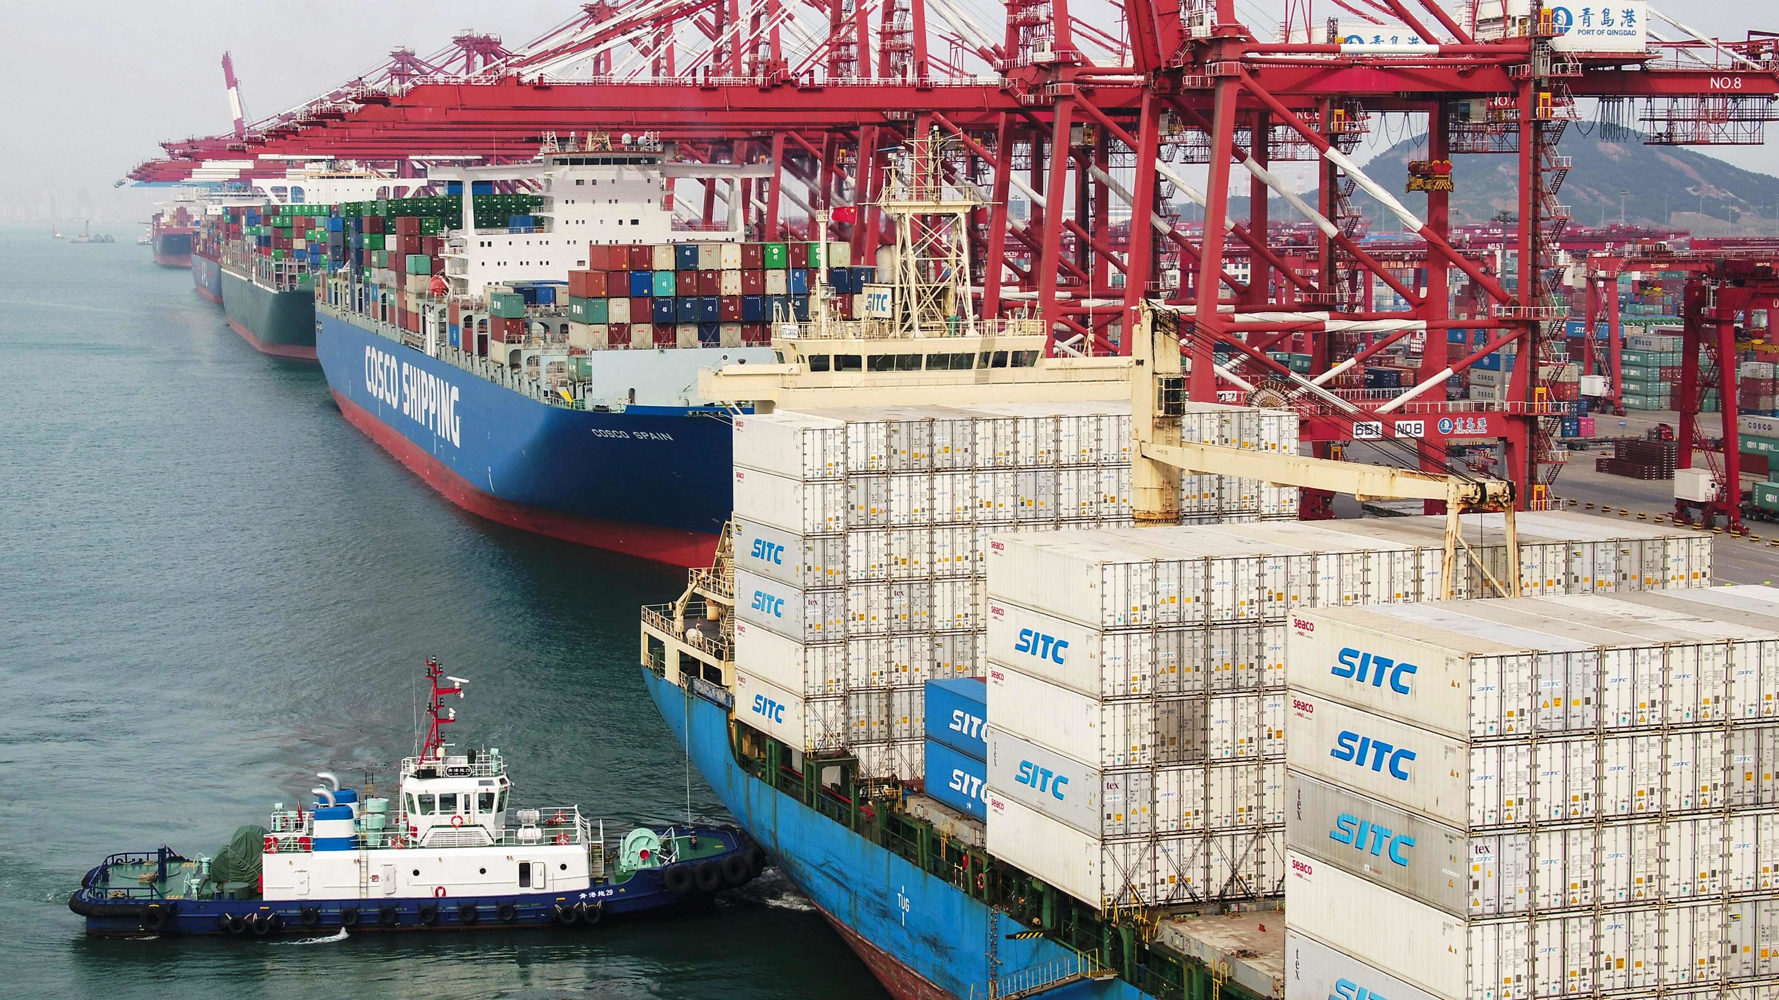
Trade Barriers
Quotas: A limit on how much is produced, exported, or imported.
Voluntary Export Restraints: A self-imposed trade restriction where the government of a country limits the amount of a certain good or category of goods that are allowed to be exported to a different country.
Tariffs: A tax on imported goods.
Used to encourage purchasing of domestic goods.
Embargo: When a government refuses to trade with a country or a certain part of a country.
Notes:
For those who bring in items from a certain country, you can bring in a certain amount of items in and if you exceeded the quota you pay a tax. Reason could be domestic competition. Quota comes from a Latin language word meaning "How many?“
At times it’s also when there’s something that’s not being exported. For example, would you export nuclear weapons? Or high tech surveillance? Or aerospace technology? Usually things with national security.
Most countries have tariffs on some products. Most economists are for free trade with no tariffs, because it benefits other countries. For example, countries such as Singapore and Hong Kong after they declared independence had no tariffs, with free trade and they expanded rapidly to one of the hottest national economies in the world. The US was very dependent on tariffs as revenue in the 18th and 19th century.
We have embargoes with a few countries, particularly with Cuba, Iran, and North Korea. They are for political reasons.

Slide 4
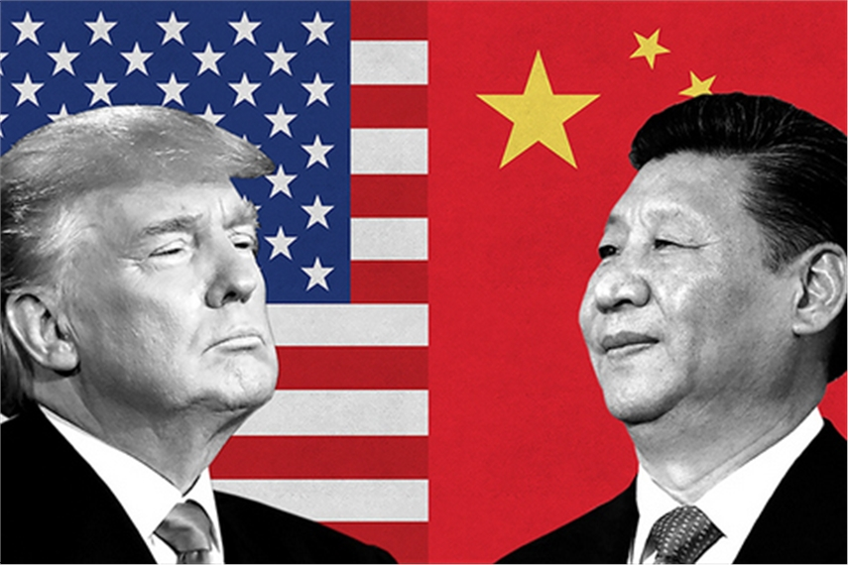
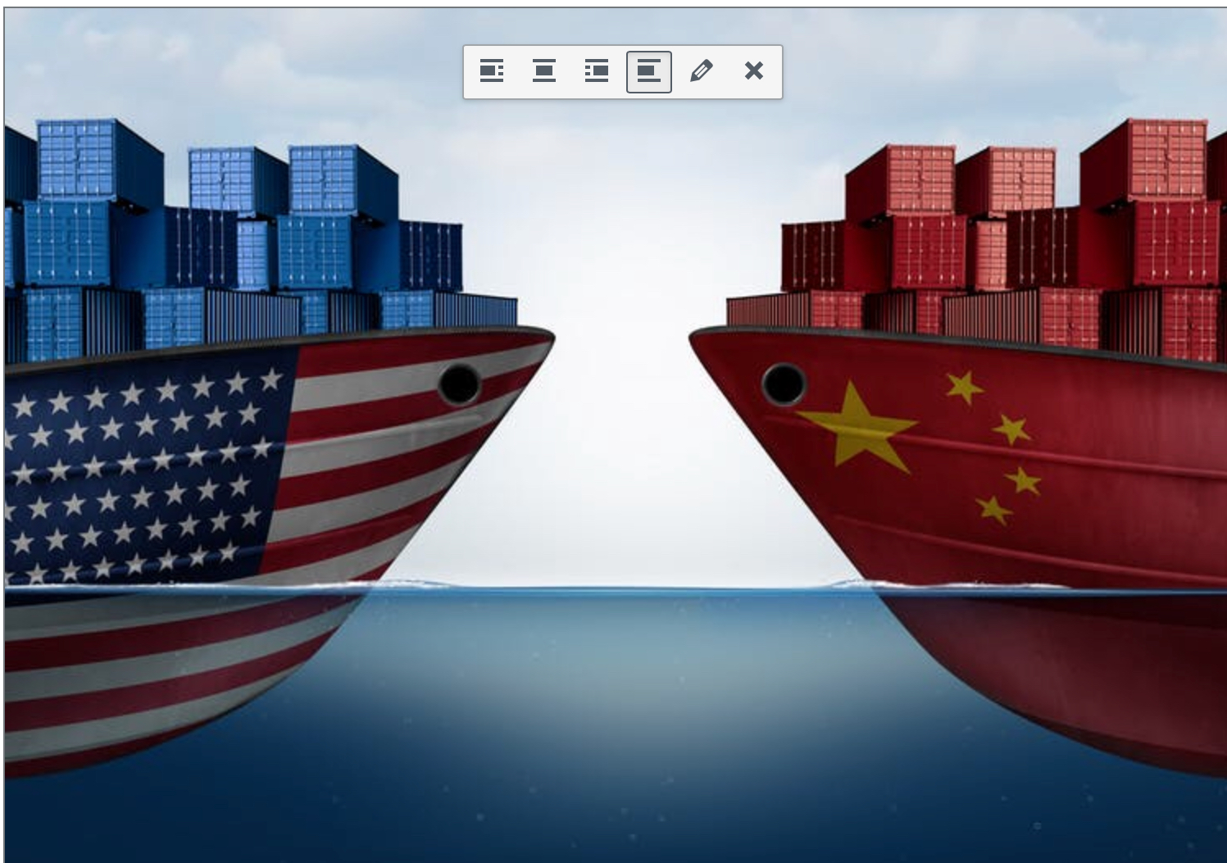
Trade Barriers
Trade War: When a country retaliates against another country by raising tariffs or placing other restrictions on the other country's imports.
Ex: Hawley-Smoot Tariff raised tariffs very high on Europe. In response, Europe raised its tariffs on the United States, which resulted in a trade war.
The United States is currently entangled in a trade war with China.
Notes:
President Hoover signed the Hawley-Smoot Tariff act and many economists and historians believe that the tariffs made the Great Depression worse. Farmers and industries needed some materials from Europe and the cost was too high for them. Hoover originally did not want to sign the bill.
Reasons for the trade war is that Trump believed China was stealing intellectual property and didn’t want to play by certain rules for fair trade. China also has a TON of rules when it comes to trading e.g., for the board of directors you need to hire one of the members of the CCP.
We were involved in a trade war with Japan back in 1987. Part of it was similar to China and wanted to set a TON of rules for their business.

Slide 5
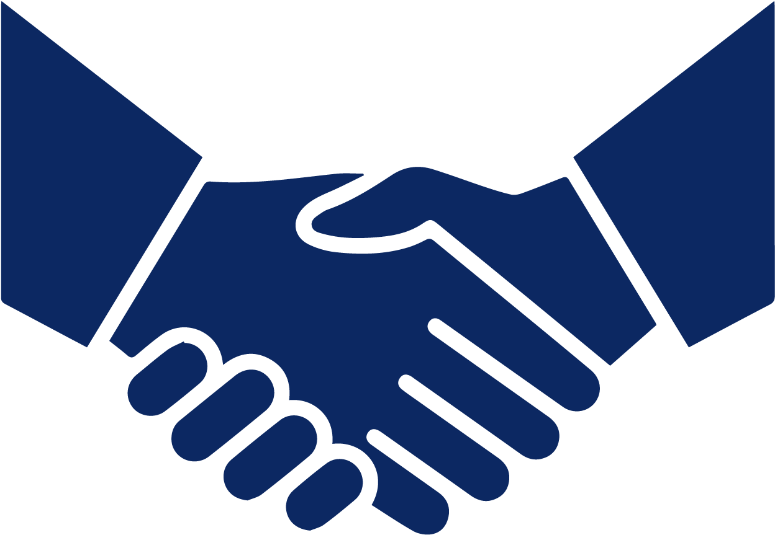
Trade Agreements
Free Trade: The free flow of goods and services between countries without any barriers or restrictions.
Arguments in favor of Free Trade:
Raises living standards
Increases the amount of goods and services available to domestic consumers
Cheaper prices
Economic efficiency
International Free Trade Agreements: Cooperation of two or more countries to reduce trade barriers.
Notes:
Free trade also helps promote good relations with countries and reduces the likelihood of war.
It raises living standards for people that are in impoverished countries. They’re able to be productive and not on the streets being trafficked or in gangs.
There’s more options for you to have and there’s just so many great things to buy that you can’t really get here in America. Think about if we didn’t have free trade and what we wouldn’t have? No Toyotas, Hondas, Sony, etc.
It also restrains the power of the government and lets the private sector do things.
Economic efficiency means that each country focuses on its comparative advantage, lowering the price of goods and making everyone better off. If the United States is really good at making cars and China is good at making televisions, free trade rules should mean that each country plays to its strengths instead of wasting time and effort doing less efficient tasks.
There’s also less corruption. Barriers to trade create lots of opportunities for political corruption, according to some advocates of free trade. Powerful interest groups can convince governments to give them special protections like tariffs or subsidies, while less powerful groups have to go it alone.

Slide 6
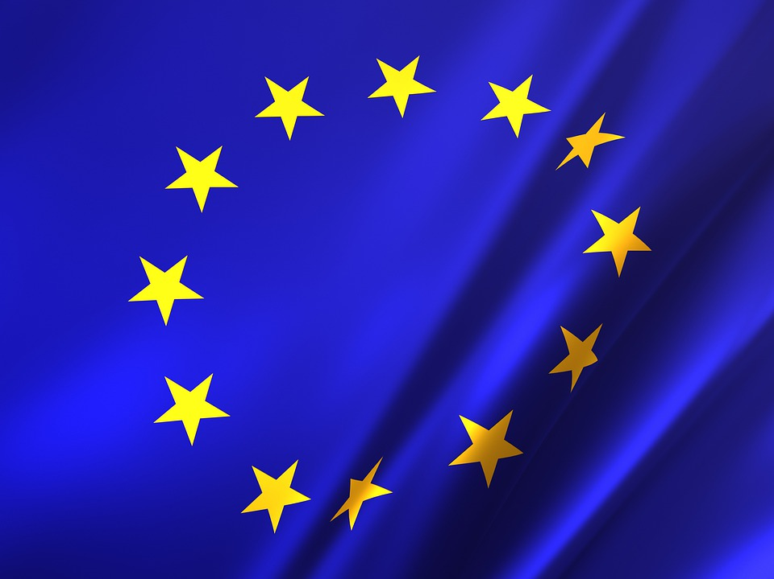
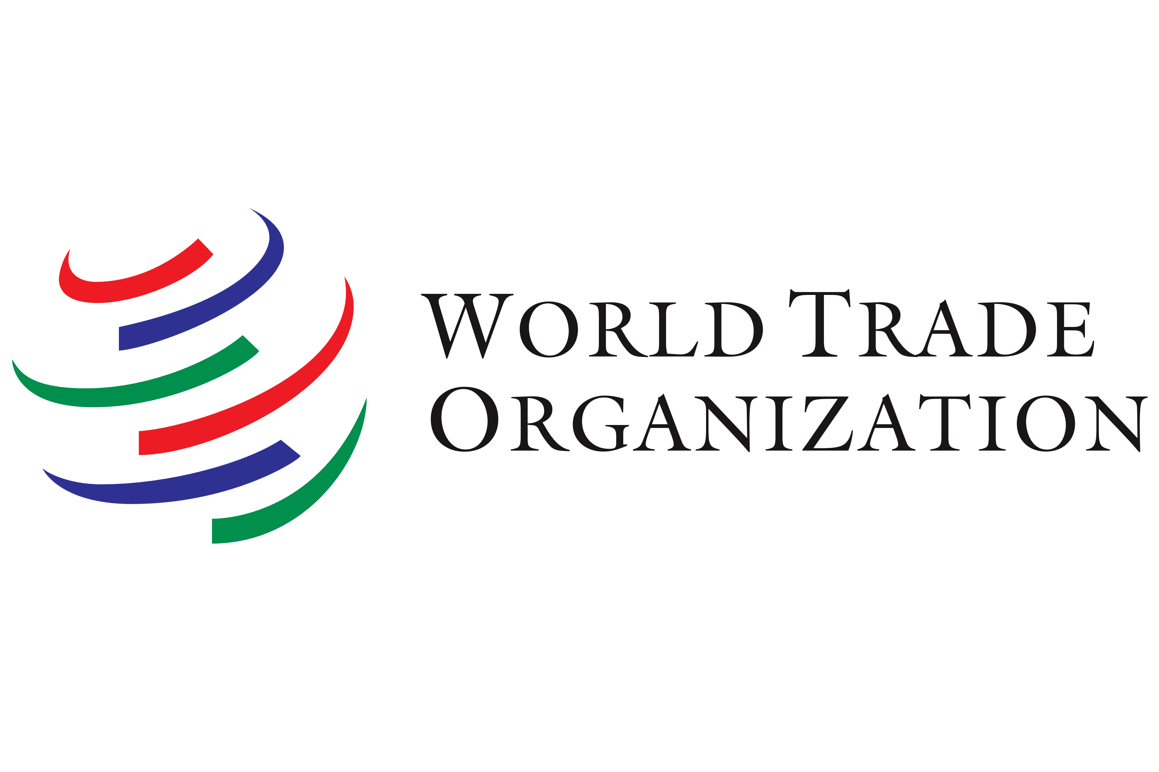
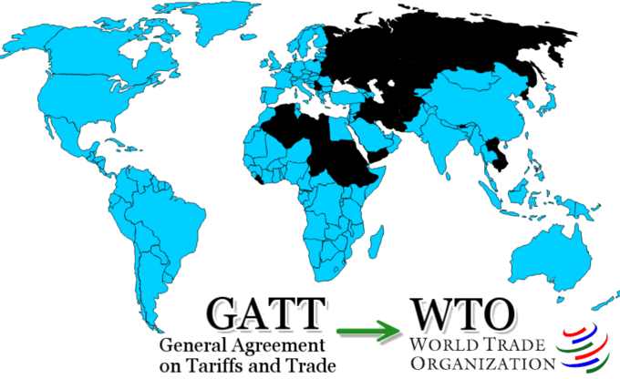
Trade Agreements
General Agreement on Tariffs and Trade (GATT): A legal agreement between many countries, whose overall purpose was to promote international trade by reducing or eliminating trade barriers such as tariffs or quotas.
World Trade Organization (WTO): A large international organization to regulate trade and replaced GATT in 1995.
European Union (EU): A confederation of 27 member countries in Europe that allows citizens of those countries to move and trade in other EU countries almost the same as they do on their own.
Notes:
GATT was established in 1948 and was signed by 23 nations in Geneva, Switzerland
As of 2018, there are 164 members and 23 observer nations. In the WTO, agreements are made on trade between countries. WTO also is there to solve trade disputes between other countries.
Before the EU, it was known as the European Economic Community (EEC). The EU was established in 1992-1993 and they all use the same currency, which is the Euro (est. 2001).
Great Britain was part of the EU, but they officially left in 2020 via Brexit. Countries that are part of the EU include Belgium (they all meet in Brussels), Luxembourg, Italy, Netherlands, France, Germany, Croatia, Romania, Bulgaria, Greece, and many more. Switzerland IS NOT part of the EU.
The objective of the EU is to bring its member states closer together with respect of human rights and democracy. It does this with common rules about fair trading with each other, common agreements about law enforcement, a common style of passport, and other agreements.
For example, you can work without a visa in Spain, if you’re French. Some countries don’t want to be a member, because of sovereignty and don’t like having their laws decided in Brussels.

Slide 7
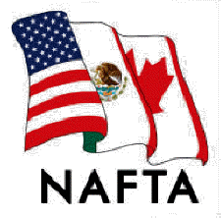
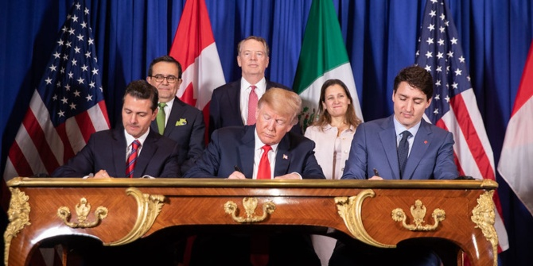
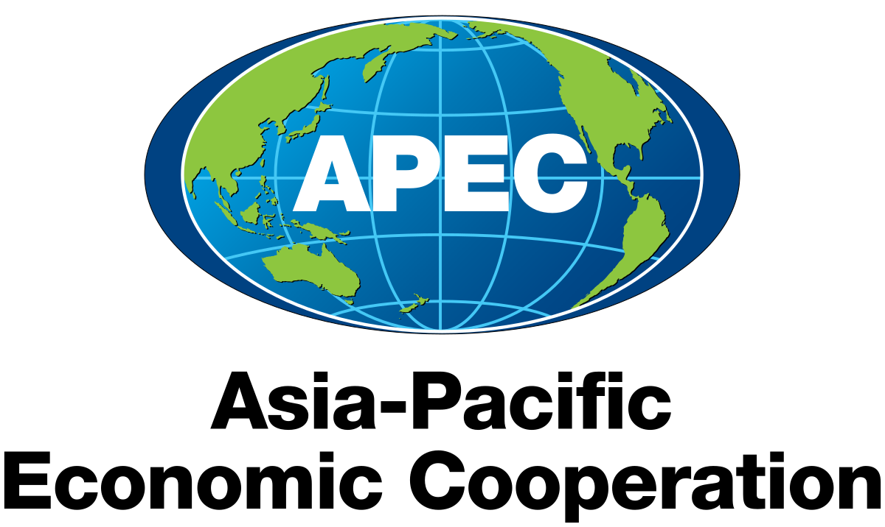
Trade Agreements
North American Free Trade Agreement (NAFTA): Was a trade agreement between Mexico, the United States, and Canada that removed taxes on products traded between those countries. It was then replaced by the United States-Canada-Mexico Agreement (USMCA)
Asia Pacific Economic Corporation (APEC): 21 member economies/countries in the Pacific Rim that promote free trade throughout Asia-Pacific region.
Notes:
NAFTA took effect on January 1, 1994 and was signed in 1992 by then US President George Bush, along with the Canadian PM Brian Mulroney, and whomever the Mexican President was at the time. Trump was very critical of NAFTA due to job losses (Bernie Sanders was as well) and higher illegal immigration, because the intent was that it would get people in Mexico more productive and having them want to stay in their country.
Compared to NAFTA, the USCMA gives the U.S. more access to Canada's $19 billion dairy market, more domestic production of cars and trucks, increases environmental and labor regulations, and introduces updated intellectual property protections. It was signed in 2018 by Trump, Trudeau, and Obrador.
The US, Peru, Australia, New Zealand, Mexico, and Canada are included in APEC. It was established in 1989.

Slide 8
Questions to think About
Does trade move a nation’s production possibilities curve outward or inward?
What does trade increase?
Notes:
Outward, because you have more goods and services (draw on board)
Trade increases competition and lower world prices.

Slide 9
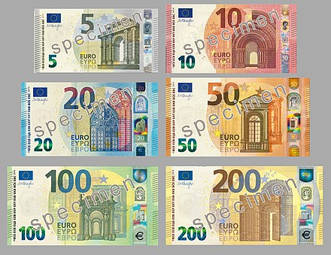
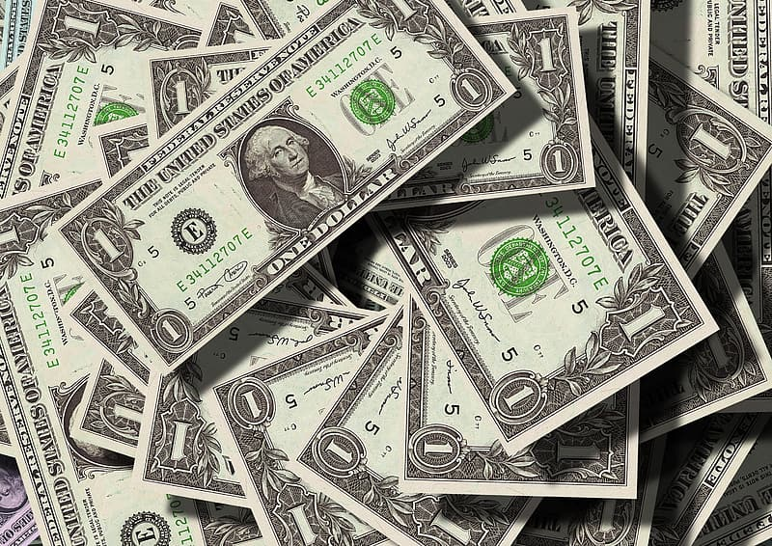
Exchange Rates

Slide 10
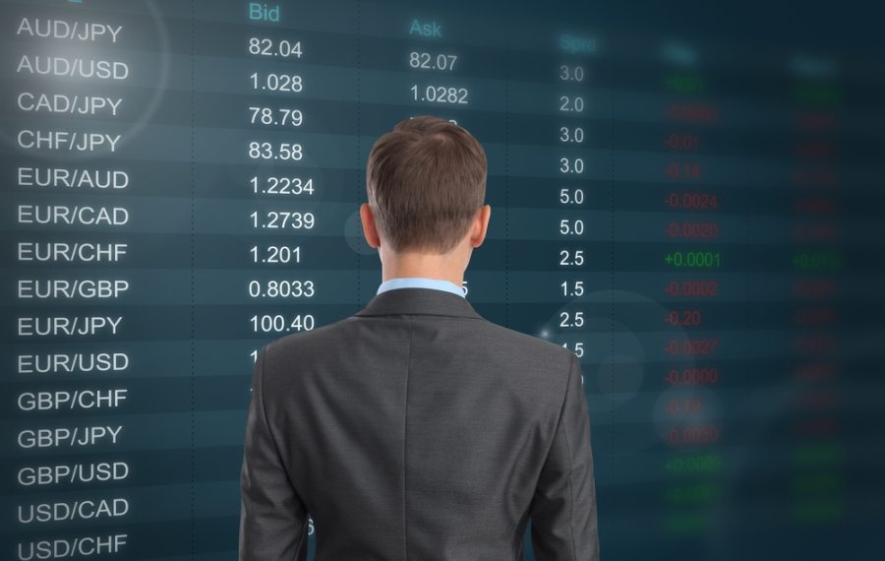
Exchange Rates
Foreign Exchange Market: A market made up of the many traders of one currency for another.
Exchange Rate: The value of one currency for the purpose of conversion to another.
Factors that influence exchange rates:
Inflation
Interest Rates
Geopolitical Stability
Speculation
Public Debt
Notes:
A country with a lower inflation rate than another's will see an appreciation in the value of its currency. If inflation is low in the US, it’ll be strong compared to those with a higher rate. In Venezuela the Bolivar is essentially useless due to hyperinflation. Twenty dollars will get you far in Venezuela.
Central banks can influence both inflation and exchange rates by manipulating interest rates. Higher interest rates offer lenders a higher return compared to other countries. For example, if interest rates are high you might attract Japanese investors to take their money to buy dollars, where they might get a 5% interest, instead of the 2% interest in Japan.
If it’s seen as a country with high corruption, you’re not going to invest into that country. Would you want to invest in Russia right now?
What’s your expectation within the next year or so compared to another country? Will the dollar appreciate more compared to the Yen or Euro within the next year?
Do you have more confidence in a country with extremely high debt and high inflation OR will they invest in a country’s exchange with low or no debt?

Slide 11
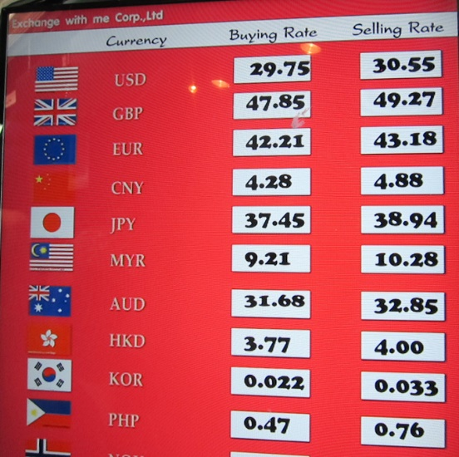
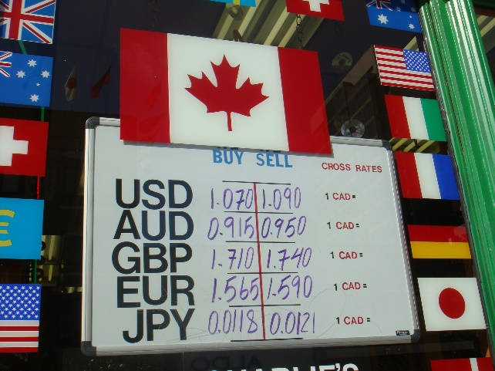
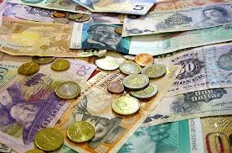
Influencing Foreign Exchange Rates
Fixed Exchange Rates: The exchange rate between two currencies is kept the same over time.
Also known as a currency peg.
Floating Exchange Rates: The market equilibrium of exchange rates, which fluctuates. Determined by supply and demand.
Managed Floating Exchange Rates: Same as floating exchange rate, except the country’s central bank will intervene.
Notes:
This is RARE and was common throughout the 1950s-1960s. At one point the British Pound was worth $2.98 for a while. Sometimes a country would have to value or devalue their currency in order to balance their payments. Right now the Thai Bot is 36 to the dollar, so they try to peg it to the dollar. Reason being they want to attract tourists and want to export more.
Most countries’ currency floats. They change every day.
So if the currency gets to high or to low, they’ll intervene in the market to sell or buy their currency at a certain level. An example, would be China intervening. So if the Yuan is appreciating more, they wouldn’t be able to export as much.

Slide 12
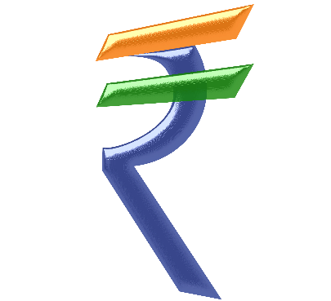
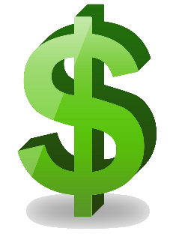
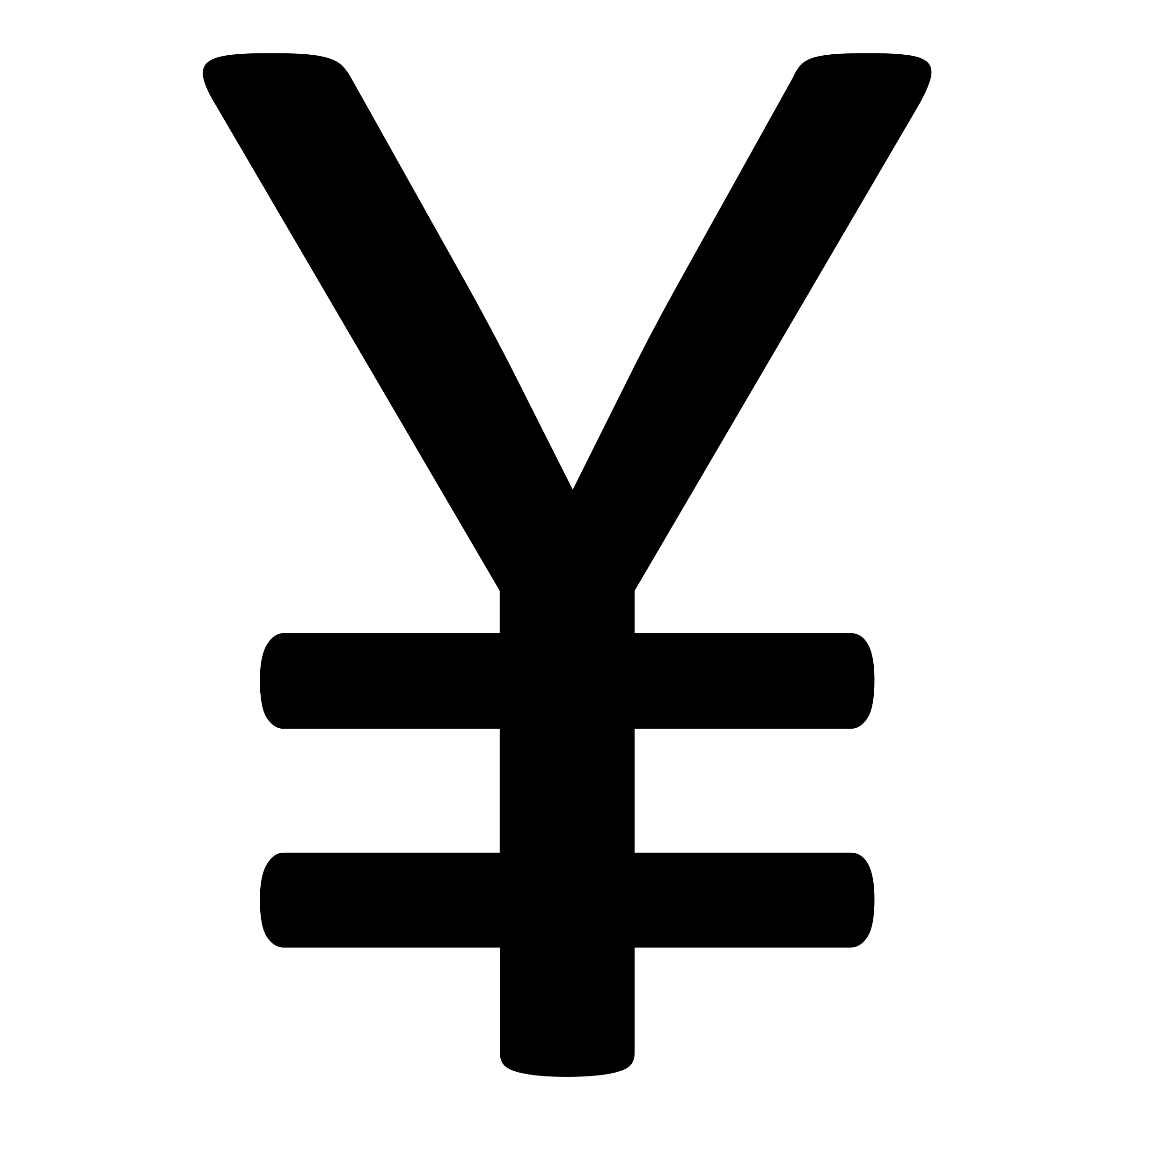
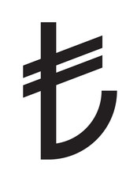
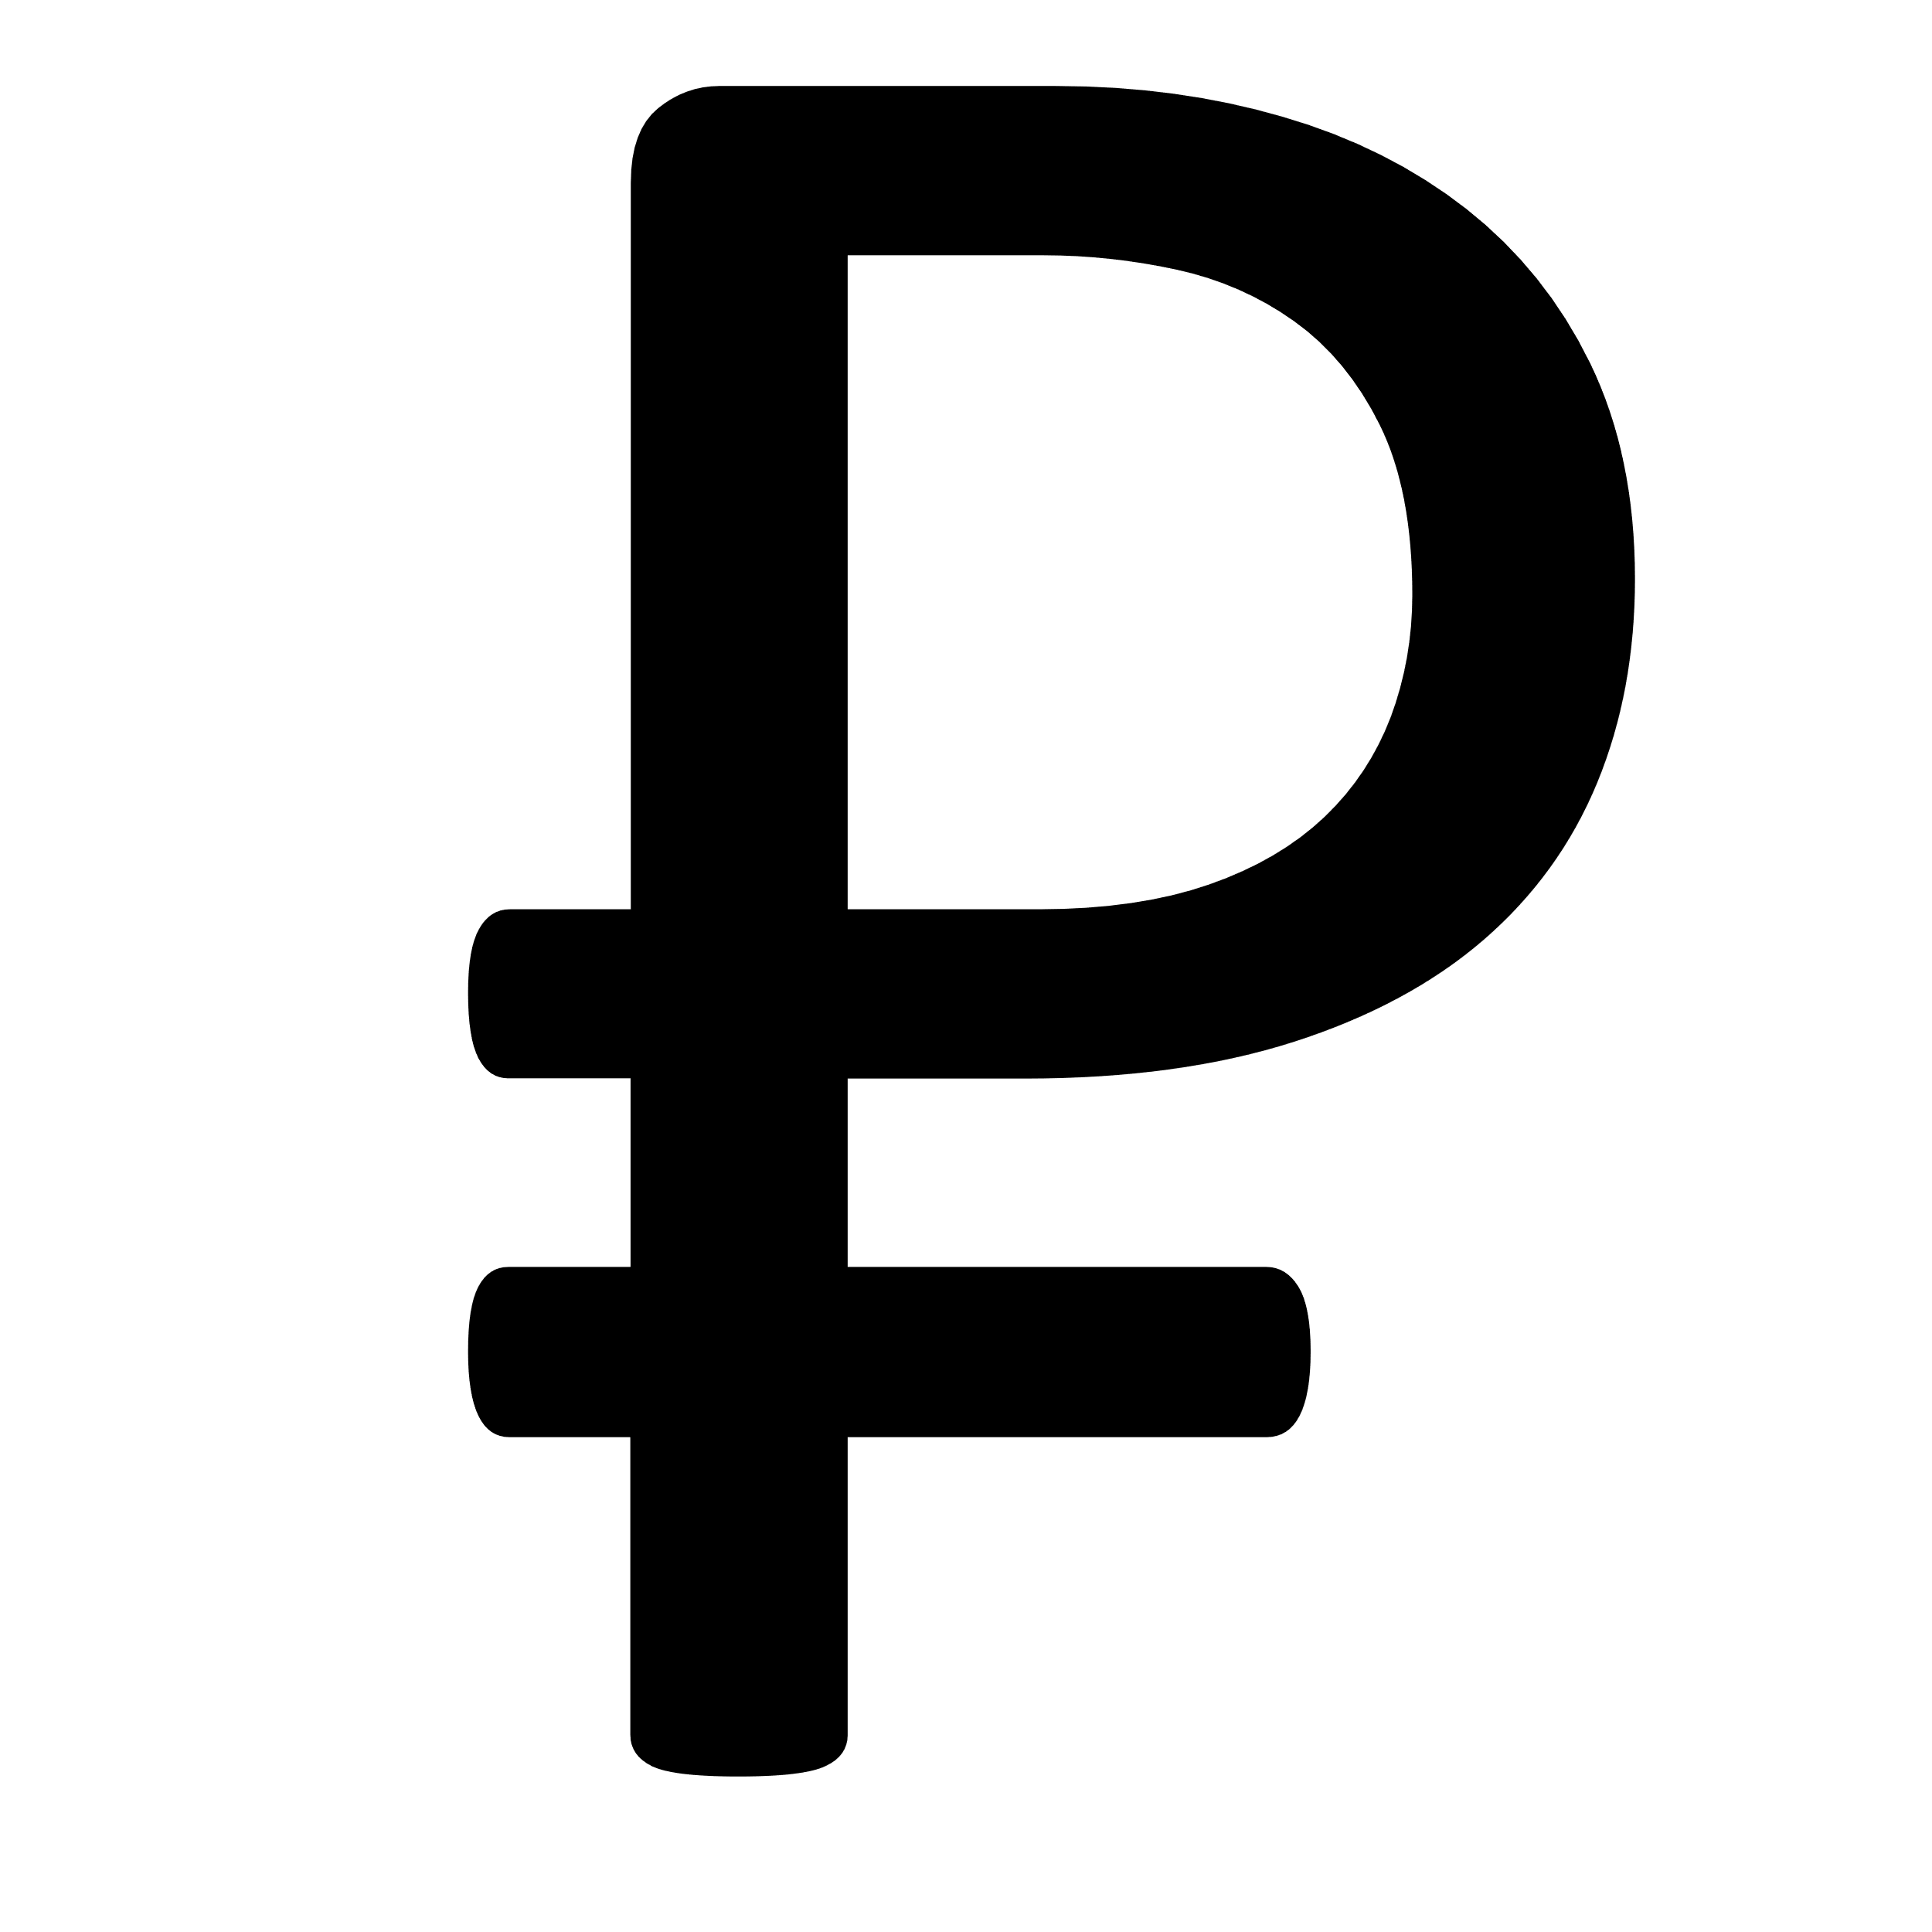
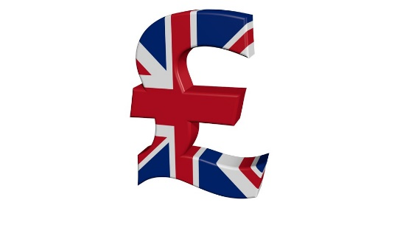
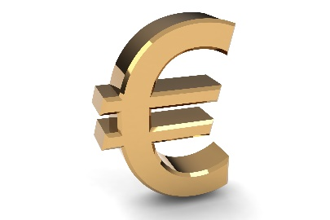
Trade (with Exchange Rates)
Imports: Foreign goods bought by citizens.
Exports: Goods sold to another country.
The more valuable our US currency is, the less we export, and the more we import.
If $150 = ¥200 (Japanese Yen) then we would export less and import more because our money is worth more than the yen so we could buy things cheaper.
The less valuable our US currency is elsewhere, the more we export and the less we import.
If $100 = €50 (Euro), we would export more and import less because our money is not worth as much as the Euro.
This Photo by Unknown Author is licensed under CC BY-NC
Notes:
1. With a strong dollar you can import more and spend a lot less money. Imagine going to Thailand, South America, Mexico, etc. where your money goes a long way. However, if it’s strong and you export it’s difficult, because their currency is weaker. With a weak dollar isn’t good if you’re importing (buying stuff) or vacationing to Europe, Japan, etc.

