Slide 1
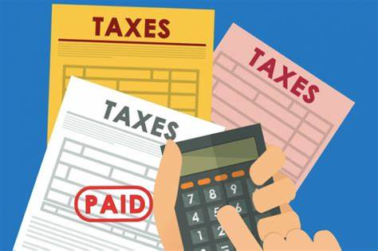
Taxes
a required payment to a local, state or national government

Slide 2
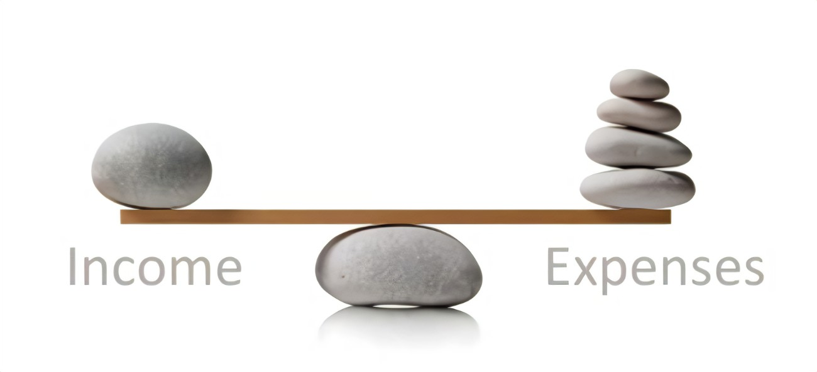
Balanced Budget
when revenues are equal to or greater than total expenses

Slide 3
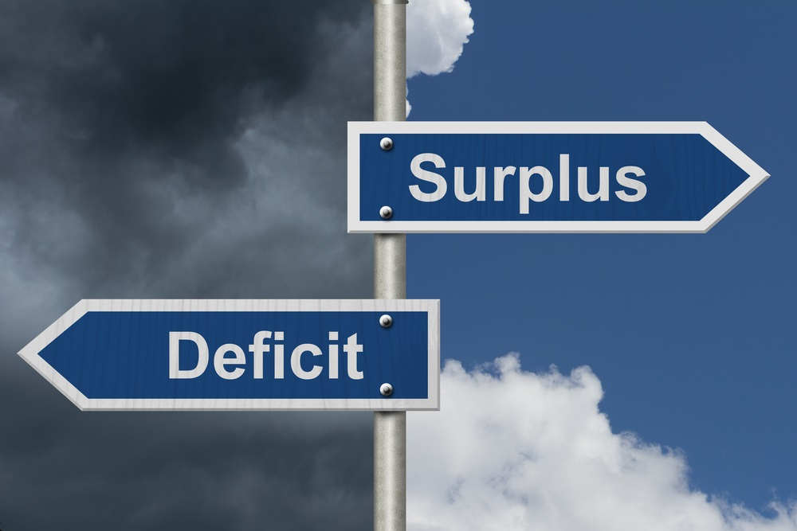
Budget Surplus
when income exceeds expenditures

Slide 4
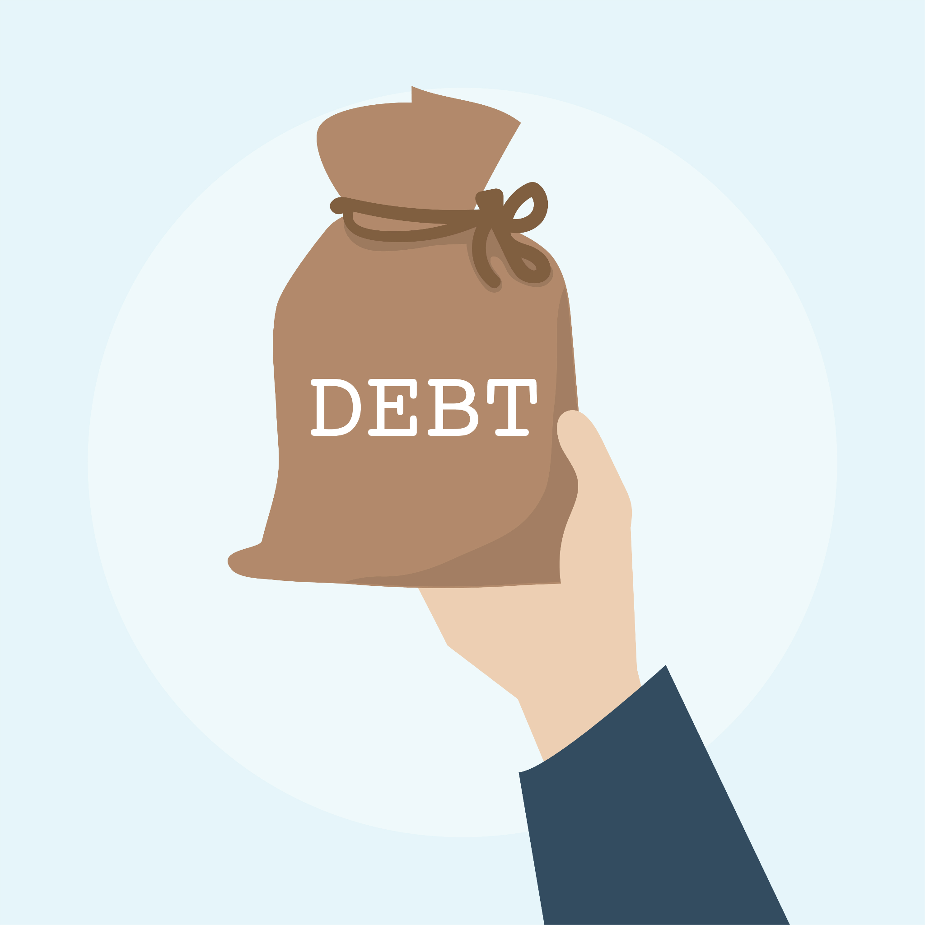
Budget Deficit
when spending exceeds income

Slide 5
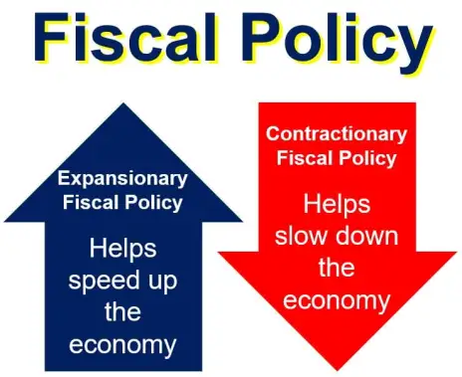
Fiscal Policy
the use of government spending and tax policies to influence economic conditions

Slide 6
Discretionary Spending
a type of government spending that is optional and implemented through an appropriations bill

Slide 7
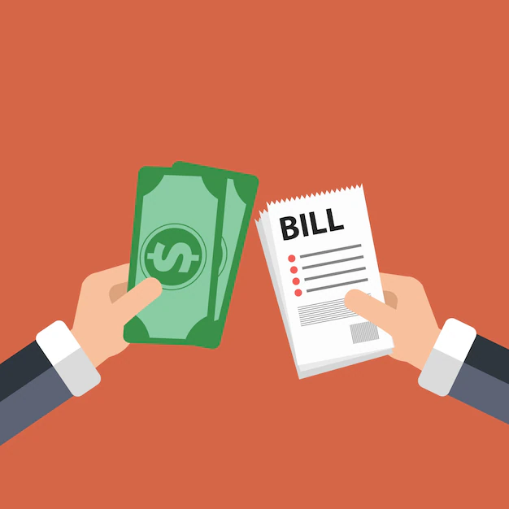
Mandatory Spending
government spending on certain programs that are required by law

Slide 8
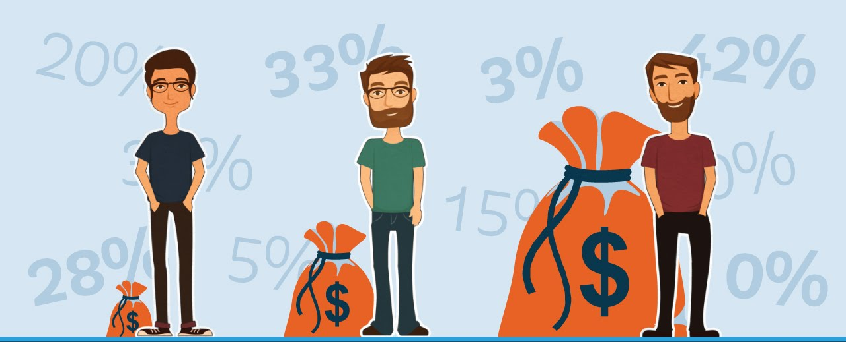
Progressive Taxes
A tax that takes a larger portion of income from higher incomes than from lower incomes, such as federal income tax.

Slide 9
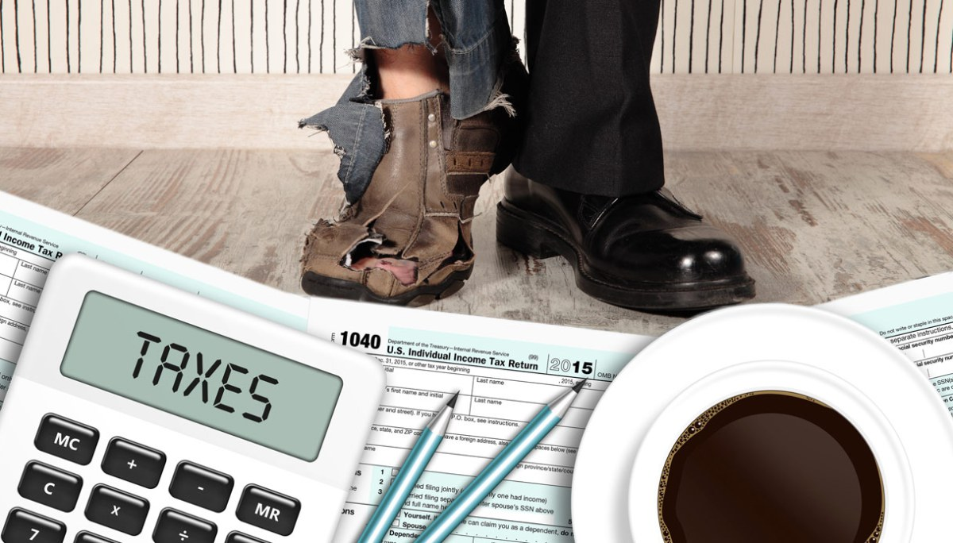
Proportional Taxes
All taxpayers pay the same percentage of income, such as flat tax.

Slide 10
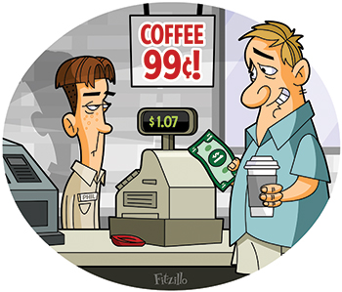
Regressive Taxes
A tax that collects a greater portion of income from low-income earners, such as sales tax.

Slide 11
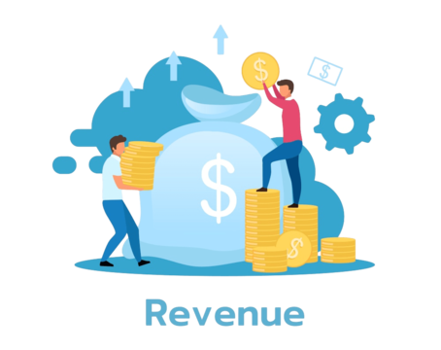
Revenue
The income of a firm. Determined by multiplying the quantity of goods sold by the price at which they were sold.

Slide 12
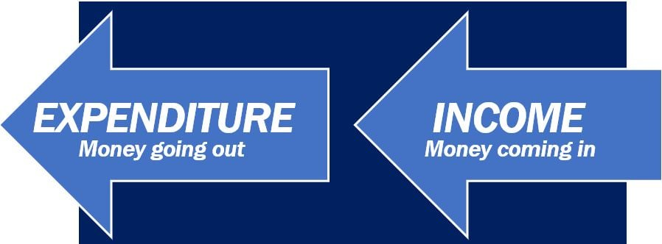
Expenditures
the monetary amounts an organization spends to purchase an asset or service

