Slide 1
FDR & The New Deal
Unit 7: The Great Depression #3

Slide 2
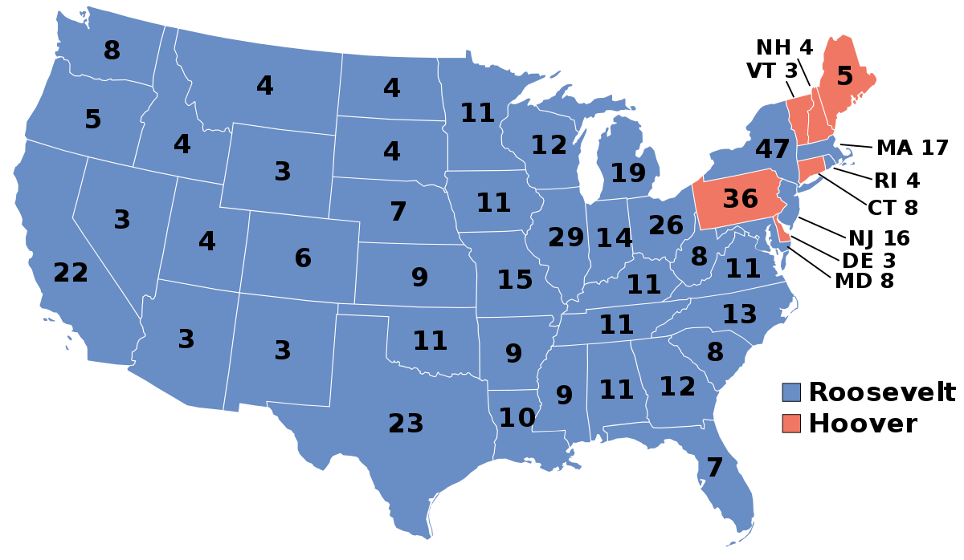
1932

Slide 3
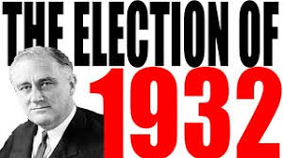
The 1932 Election
Democrat Franklin Delano Roosevelt wins presidency in 1932
The Democrats win control of both the Senate and House of Representatives
This means that the Democrats would have control over what the government did for at least 2 years

Slide 4
Cause & Effect
Cause:
The current midterm elections have just ended. As a result of those elections the Republicans control the House of Representatives and the Democrats control the Senate. What would be one possible effect of having a different political party over the House and a different political party over the Senate?
Effect:
One effect of having two different political parties in control of the House and Senate would be…

Slide 5
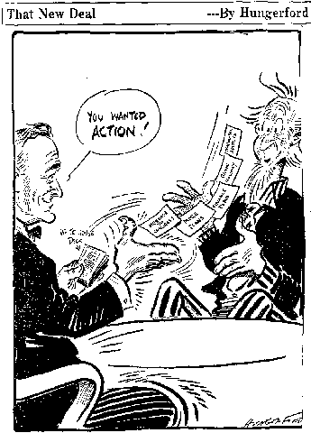
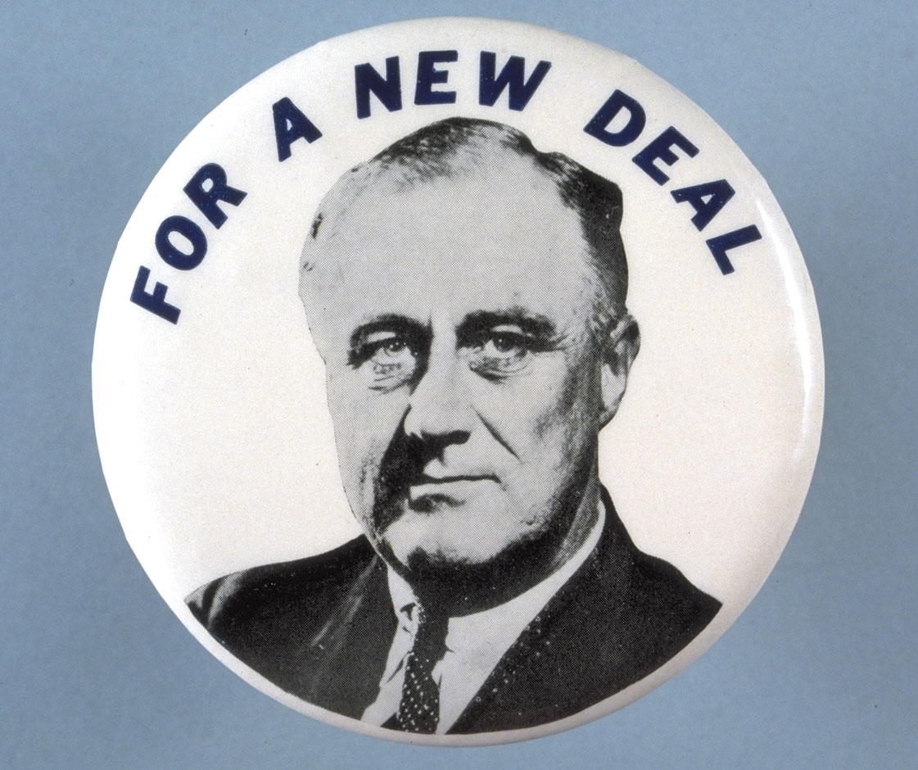
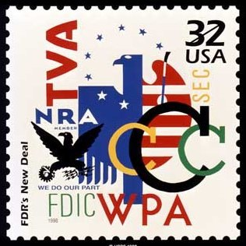
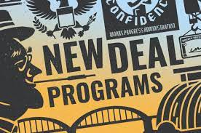
FDR & The New Deal
FDR puts together a plan to fix the Great Depression and calls it “The New Deal.”
After his inauguration, Roosevelt launched a period of intense activity known as the Hundred Days lasting from March 9 - June 16, 1933
Since then every president is judged by the media on how much he is able to get done in his first 100 days
The actions FDR took in his first 100 days significantly expanded the federal government’s role in the nation’s economy

Slide 6
Roosevelt vs. Hoover
Roosevelt was more willing to use federal government intervention to solve economic issues
Hoover was more of a “laissez-faire” type thinker when it came to government involvement in economic issues

Slide 7
Big Question:
Is the government responsible for the economic well-being of its citizens?
Sentence Starter: I believe that the government is/is not (pick one) responsible for the economic well-being of its citizens because…

Slide 8
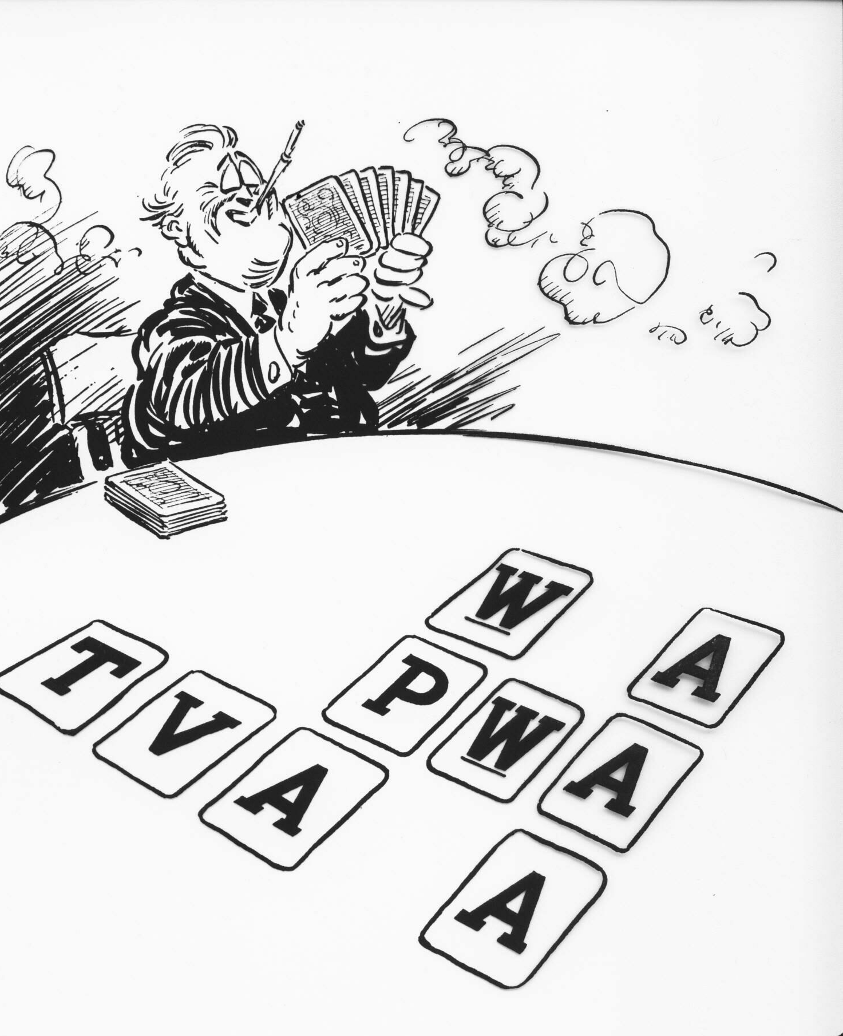
The New Deal: “Alphabet Soup”
Agencies/Legislative changes that increased the power of the federal government to provide aid and welfare to the people (input in their everyday lives)

Slide 9
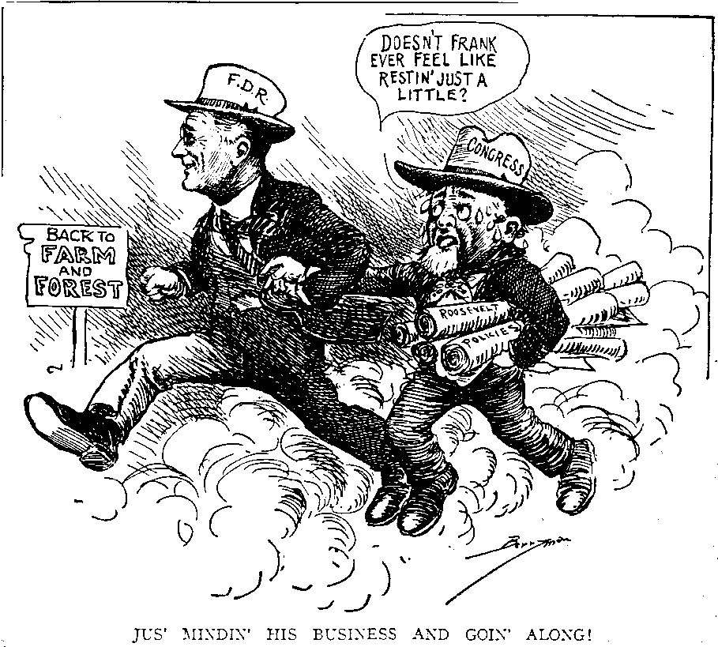
New Deal Policies
Relief: Programs to help the poor, either with direct relief or through job programs (IMMEDIATE)
Recovery: fixing the economy with programs to help businesses recover (LONG TERM)
Reforms: financial fixes to the lack of banking rules; created new regulations on banking and the stock market (PERMANENT)

Slide 10
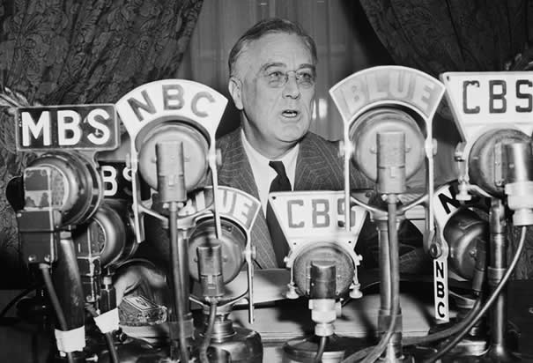
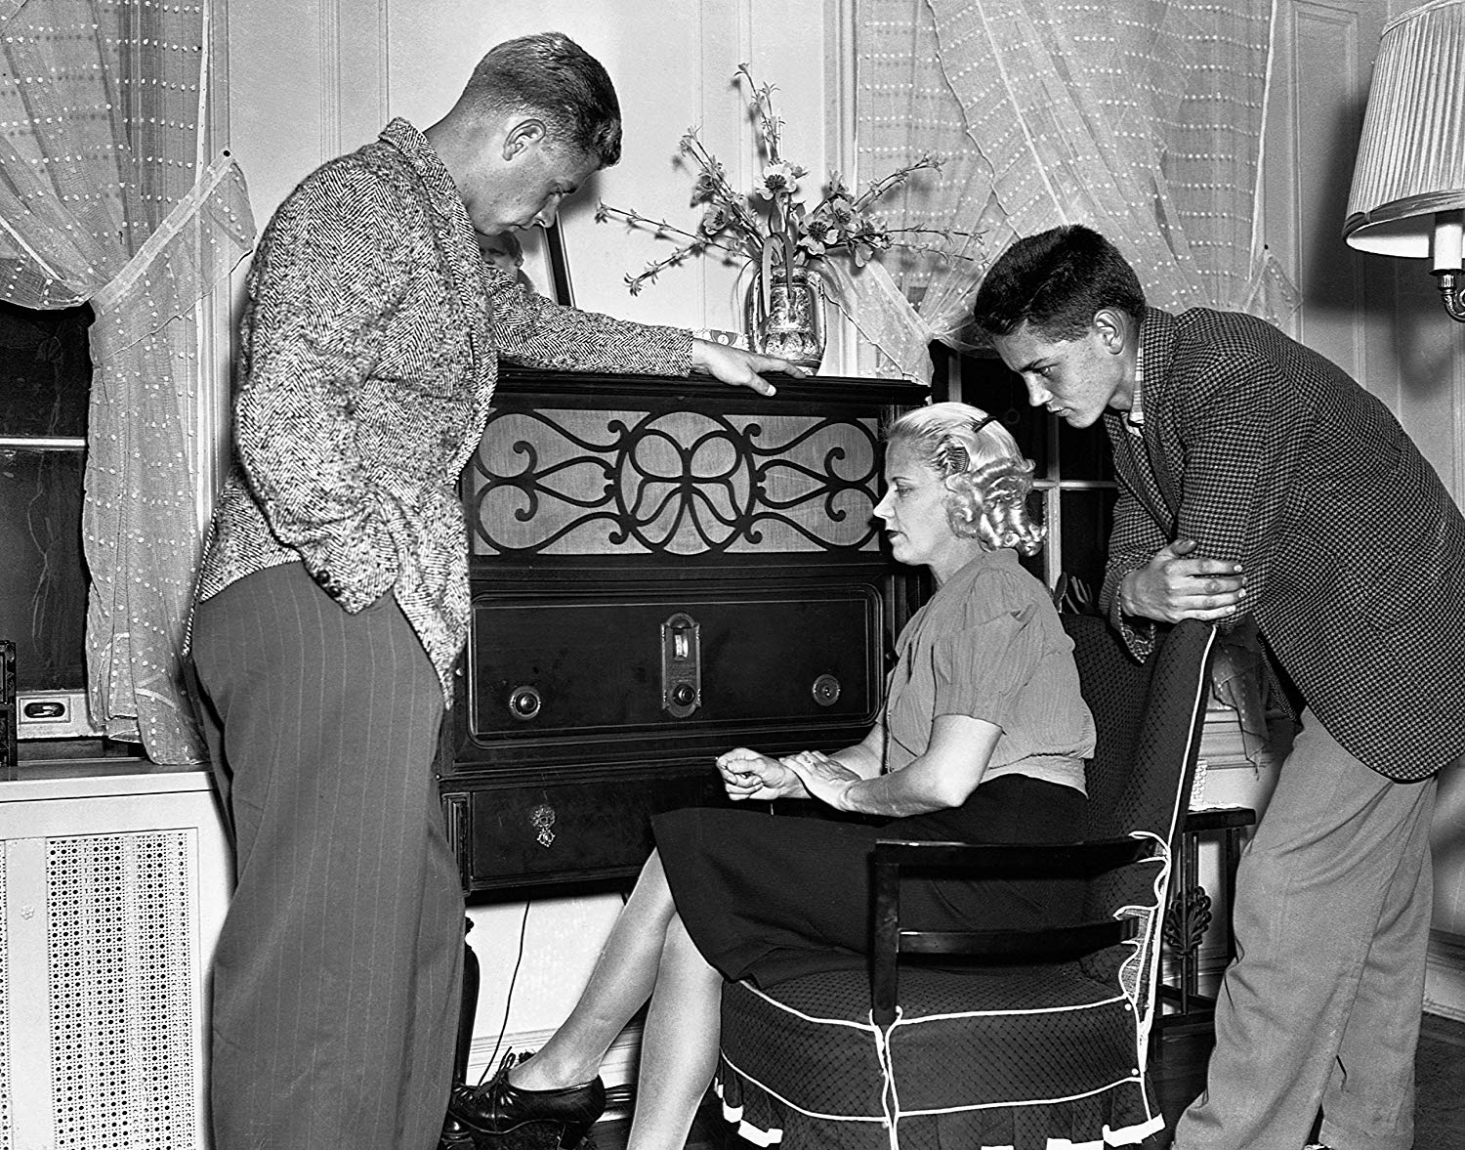
Fireside Chats
One thing that helped FDR get his programs passed were his “Fireside Chats”
These radio speeches were about current issues and proposed New Deal policies
People felt the President cared and understood - helped gain support

Slide 11
Vocab Review: Match the vocab word with its definition
Relief ______
Recovery ______
Fireside Chats ______
New Deal ______
Reform ______
Proposed speeches about current issues and proposed New Deal policies
Programs to help the poor
FDR’s plan to fix the Great Depression
Fixing the economy with programs to help businesses recover
Financial fixes to help with the lack of banking rules
B.
D.
A.
C.
E.

Slide 13
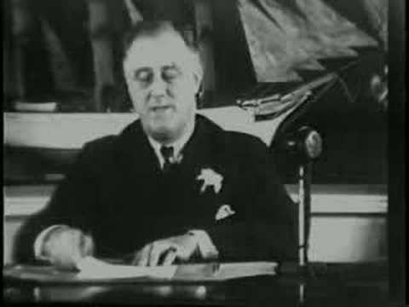

Slide 14
Bank Reforms
FDIC (1933 - Present):
Federal Deposit Insurance Corporation
Protects citizens from potential bank failures
Ensures savings
SEC (1934 - Present):
Securities Exchange Commission
Regulates the stock market
The “stock cops”
Emergency Banking Relief Act (1935):
Immediately put all banks on a “holiday;” US Treasury Department could inspect each bank to make sure it was ok

Slide 15
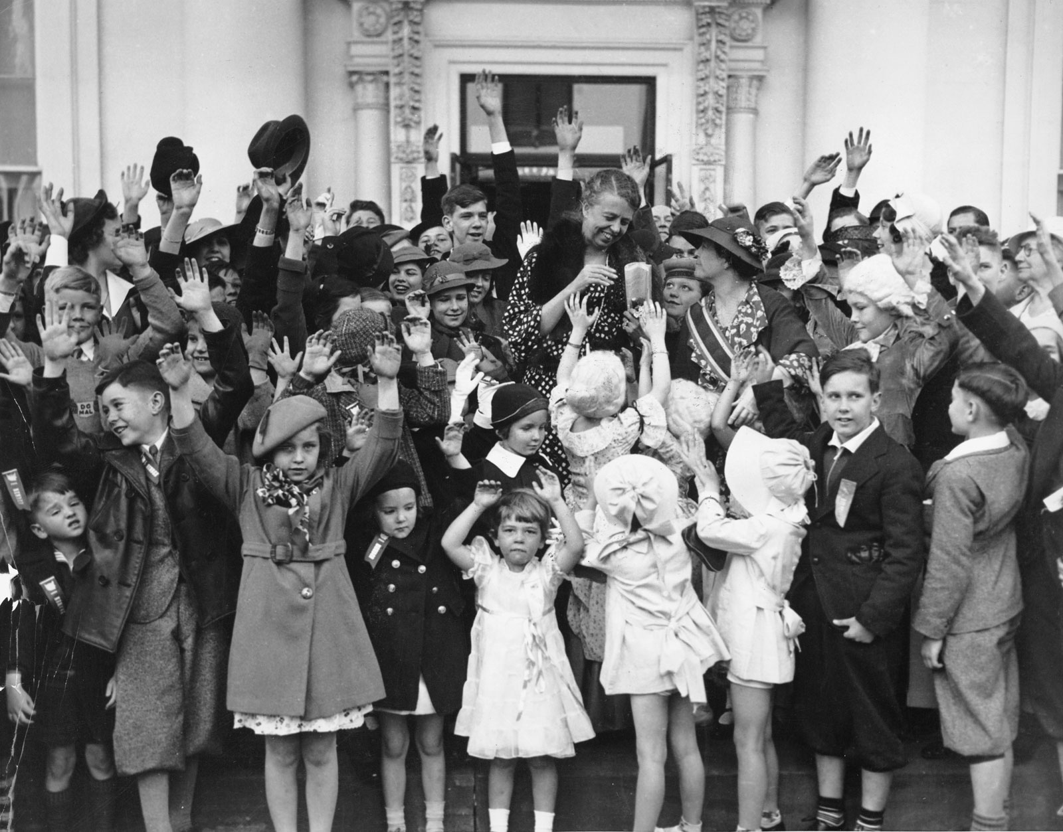
The Second Hundred Days
Eleanor Roosevelt, FDR’s wife, is considered by most historians to be the most-loved first lady in presidential history
She had a deep concern for the poor and was outspoken in her support for African-Americans
Promoted freedom & equality
In 1934, she convinced FDR to get Congress to provide more extensive relief for farmers and workers

Slide 16
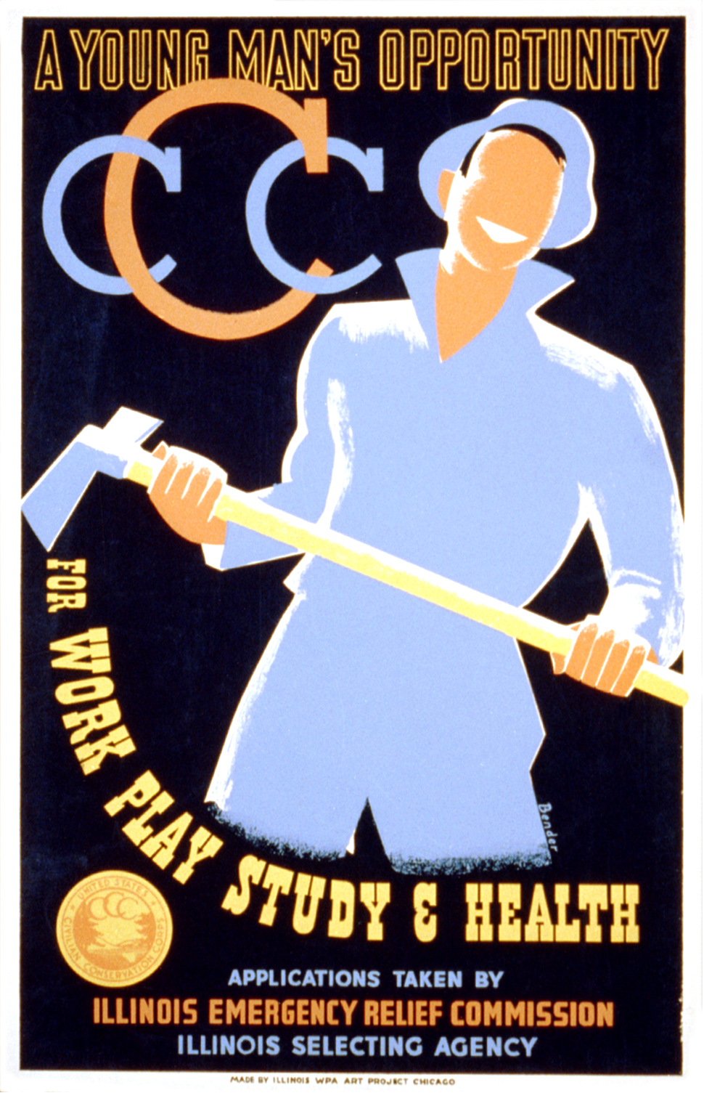
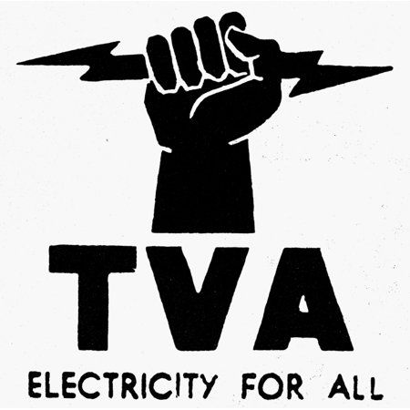
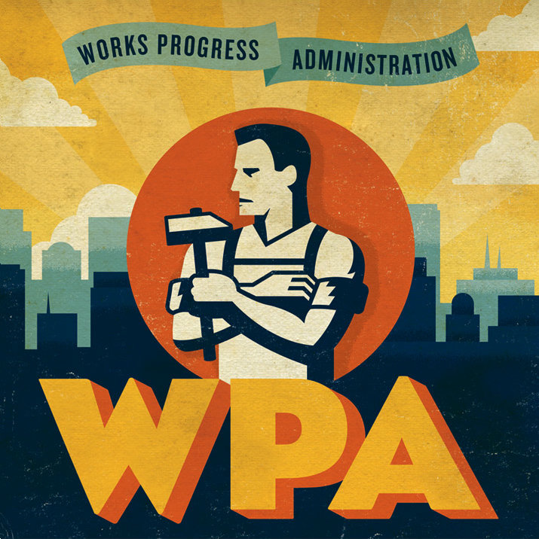
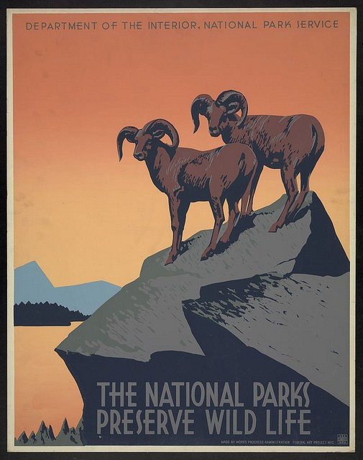
Alphabet Agencies
Over the course of the New Deal and the Second New Deal, FDR initiated many programs with acronyms. These have come to be commonly called Alphabet Agencies (relief organizations)
Tennessee Valley Authority (TVA)
1933 - Present
Provided jobs to build dams for flood control and electricity
Civilian Conservation Corps (CCC)
1933 - 1942
Provided jobs for young men
Reforestation & conservation
Public Works Administration (PWA)
1933 - 1939
The government provided jobs to adult men to build schools, bridges, libraries, courthouses, etc.
National Youth Administration (NYA)
1935 - 1945
Originally part of the WPA, the NYA paid high school students a small monthly wage to do various part time work that included job training
Works Progress Administration (WPA)
Employed 8.5 million workers
Projects in art, theater, and culture, etc.

Slide 17
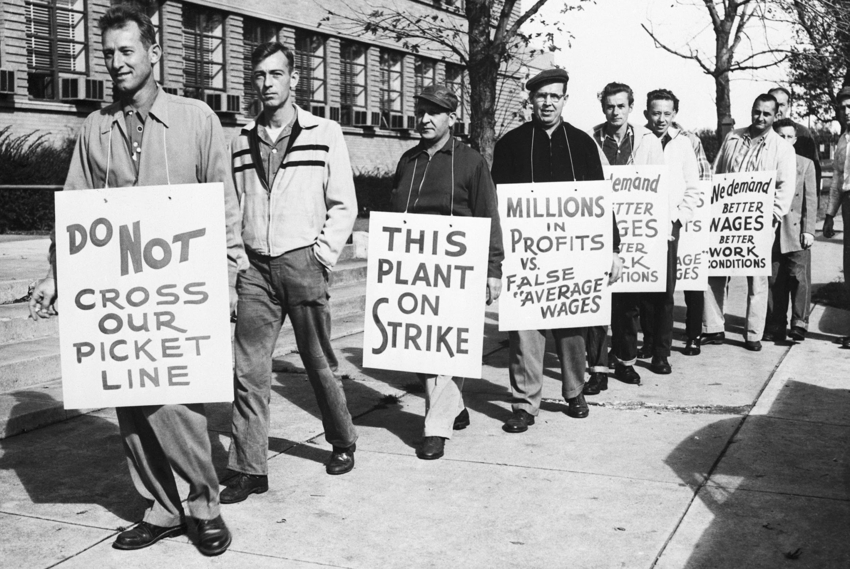
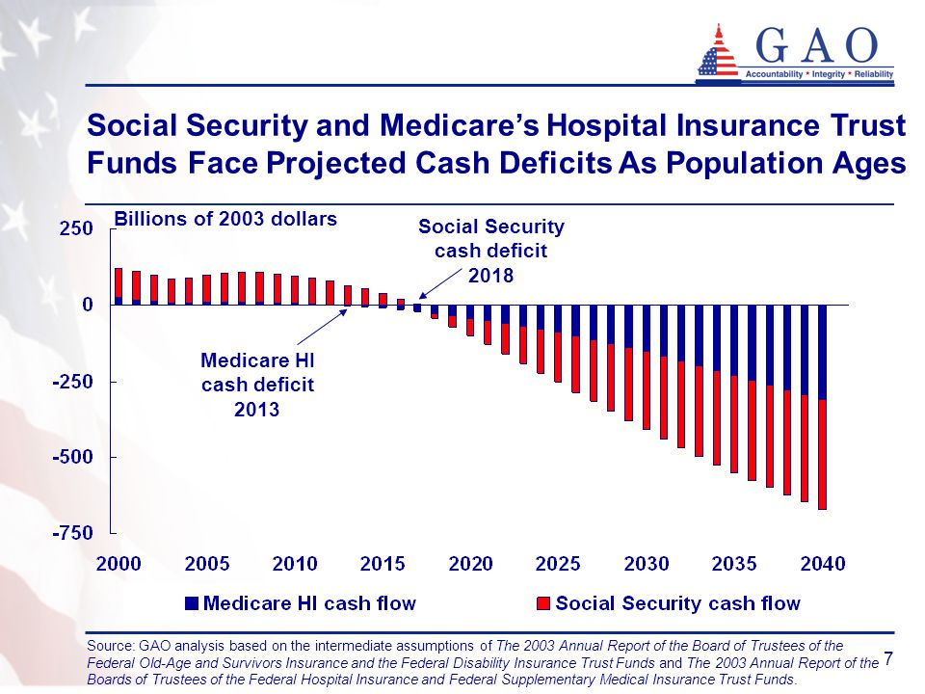
Aftermath of the New Deal
Most of the programs for the New Deal expired after the Great Depression
Two important New Deal programs, however, still exist and affect Americans today:
The Wagner Act (National Labors Relations Act): protects the rights of the workers to join unions and to collectively bargain (negotiate) with their employers; it also created the National Labor Relations Board to oversee all of this
The Social Security Act: created many different programs, but main programs provide retirement money (benefits) to the elderly and the permanently disabled. It was created by the Labor Secretary Francis Perkins, the first woman named to a presidential cabinet in U.S. history

Slide 18
Determine if each act is a relief, recovery, or reform
FDIC (1933 - Present): _______________________
Federal Deposit Insurance Corporation; protects citizens from potential bank failures; ensures savings
TVA (1933 - Present): _______________________
Tennessee Valley Authority; provided jobs to build dams for flood control and electricity
The Social Security Act: _______________________
Created many different programs, but main programs provides retirement money (benefits) to the elderly and the permanently disabled
SEC (1934 - Present): _______________________
Securities Exchange Commission; regulates the stock market, the “stock cops”
CCC (1932 - 1942): _______________________
Civilian Conservation Corps; provided jobs for young men; reforestation & conservation
REFORM
RELIEF
RELIEF
REFORM
RELIEF

Slide 19
Guiding Question:
How does President Roosevelt’s New Deal concepts of relief, recovery, and reform provide stability for the U.S?
Sentence Starter: FDR’s New Deal concepts provided stability because…

Slide 20
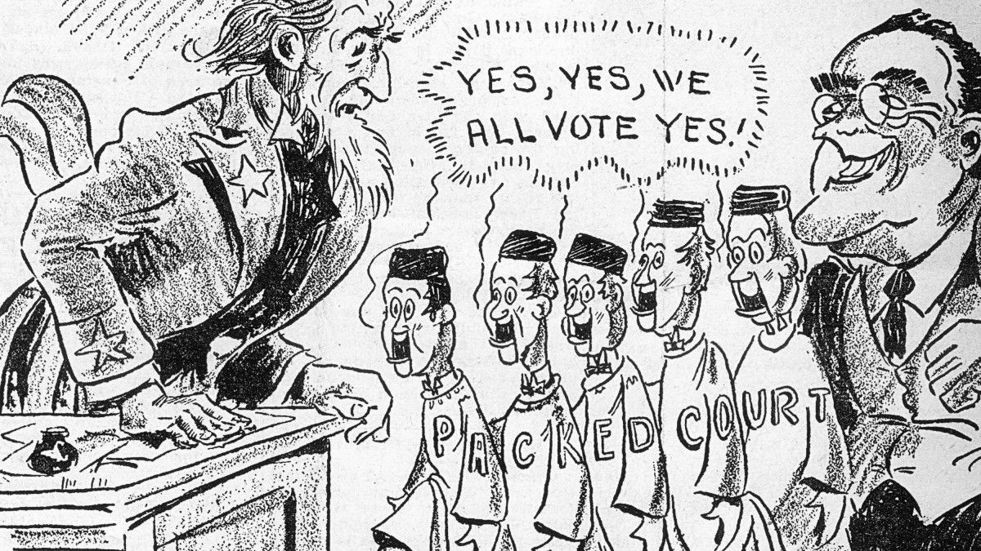
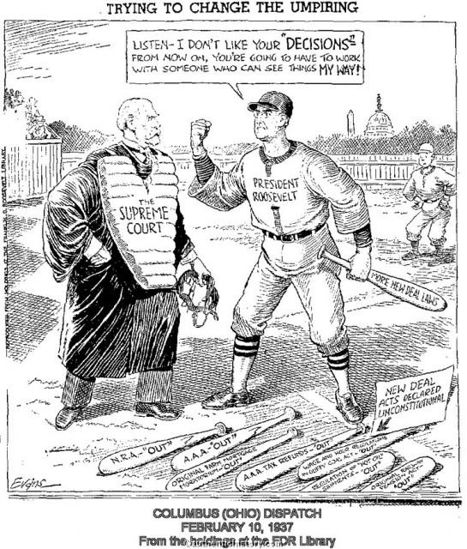
FDR’s Court-Packing
There was just one thing holding back FDR’s New Deal - the Supreme Court
FDR attempted to fix this by proposing a change in how judges were appointed and replaced that would allow him to “pack” the court with judges that he liked
This worried many Americans, especially Congress, who worried that it would violate the principle of Separation of Powers (abusing power)
In the end, Roosevelt didn’t get his way and his reputation was hurt, but the more conservative judges retired and were replaced with judges friendlier to the New Deal anyway

Slide 21
Guiding Question:
How did FDR’s court-packing plan conflict with the Constitutional principles of Separation of Powers and checks & balances?
Sentence Starter: FDR’s court-packing plan conflicted with separation of powers and checks & balances because…

Slide 22
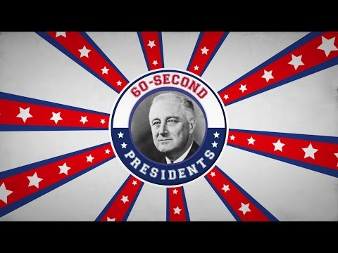

Slide 23
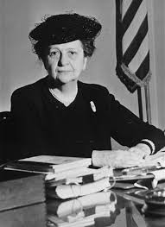
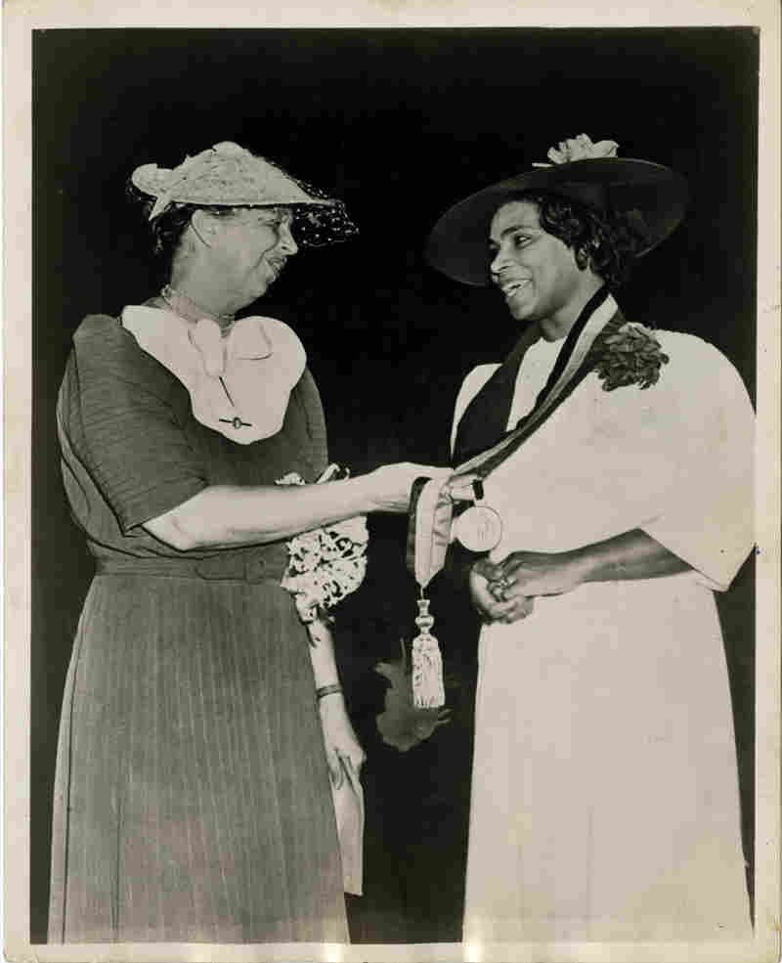
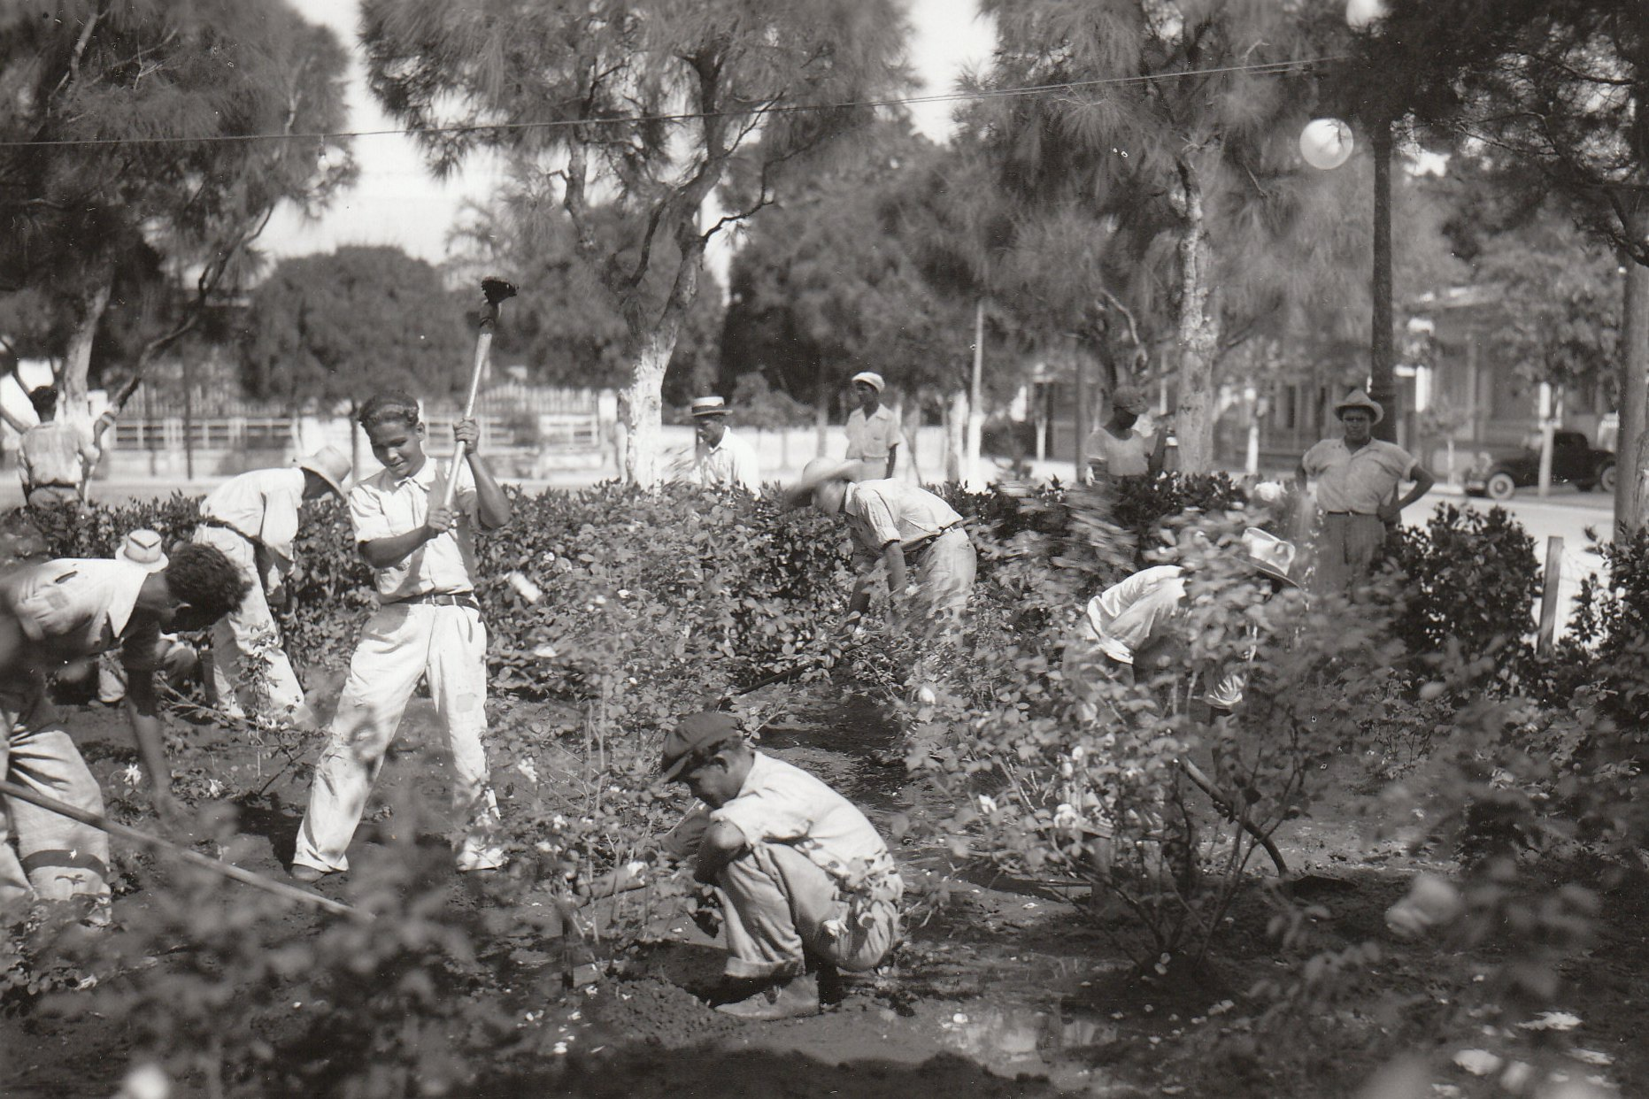
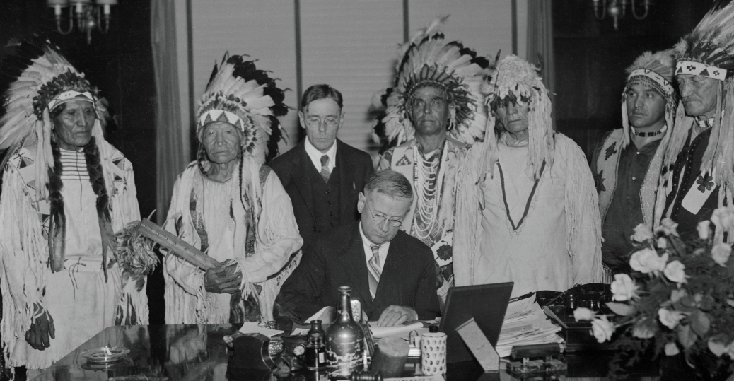
Who did the New Deal affect?
Women: appointed to gov’t positions, more women in the workplace
African Americans: played key roles in gov’t, but FDR failed to support civil rights
Mexican Americans: mainly worked in the farming industry, which wasn’t well protected. Also, large numbers of them were deported to open up jobs for whites
Native Americans: Got some of their land back; were previously granted citizenship in 1924
Eleanor Roosevelt and Marian Anderson
Frances Perkins
Mexican-American labor
Native Americans

Slide 24
Big Question:
What ended the Great Depression?
Sentence Starter: I think that ____ brought an end to the Great Depression.

Slide 25
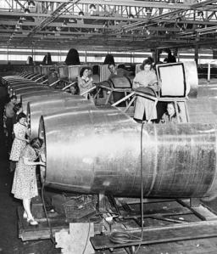
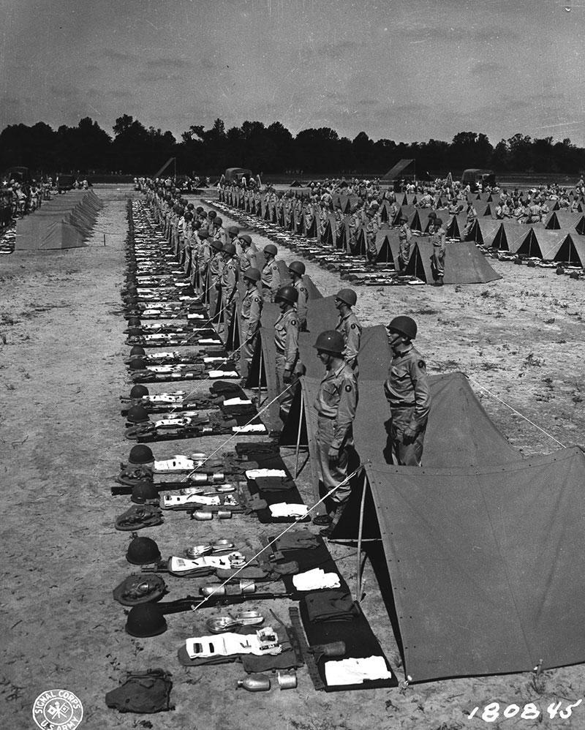
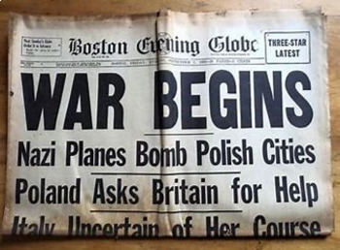
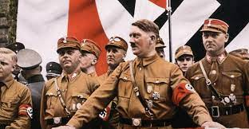
What DID end the Great Depression?
Historians agree that while the New Deal helped a lot with the Great Depression, it didn’t do enough to actually end it. So, how did the Great Depression end?
It was a massive military spending in preparation for and during World War II that actually helped pull the American economy out of the Great Depression

