Slide 1
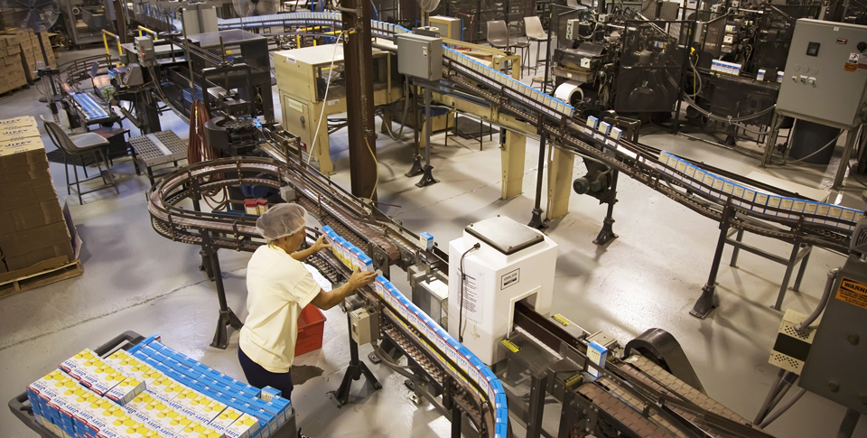
The Characteristics of Corporations
A large corporation has the capital to build factories and hire many workers. As a result, it can produce and sell goods on a large scale.

Slide 2
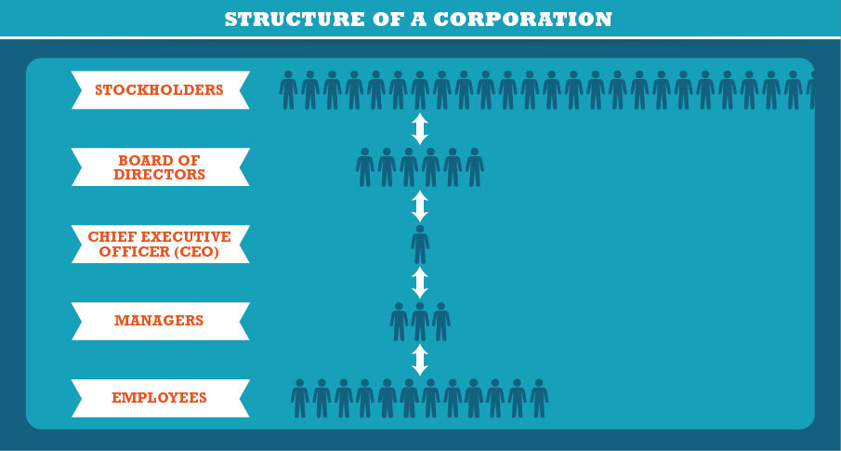
The Characteristics of Corporations
Owned by the stockholders treated as an individual by law.

Slide 3
Unique Characteristics
Publicly owned
Earns greatest % of total sales in the US

Slide 4
Advantages of Incorporation
Incorporation (forming a corporation), offers advantages to both stockholders and the corporation itself.
These advantages include:
Profit to shareholders (dividends capital gains) limited liability
Ability to attract capital
long life

Slide 5
Advantages of Incorporation
Infer Before the introduction of modern technology, stocks were traded in person. What effect do you think Internet trading has had on the stock market?

Slide 6
Disadvantages of Incorporation
Difficulty and Expense of Start-Up
Double Taxation
Loss of Control
More Regulation
Slow decision making

Slide 7
Corporate Mergers
Corporations can grow very large. One way to grow is to raise money by selling stocks or bonds.
Corporations may also grow by merging, or combining, with another corporation. The three kinds of mergers are horizontal mergers, vertical mergers, and conglomerates.

Slide 8
Corporate Mergers
Draw Conclusions How do you think that Office Depot’s three horizontal mergers over 23 years may have benefited the company?

Slide 9
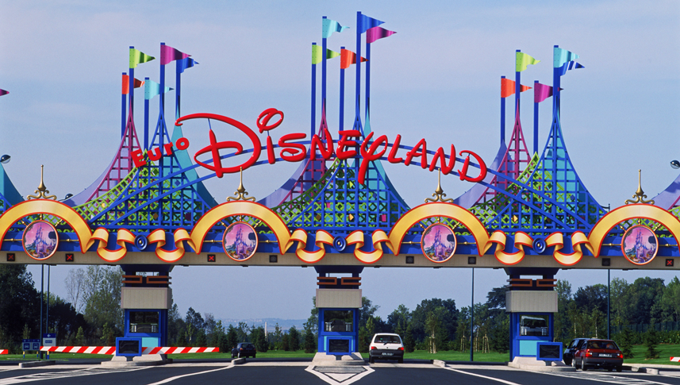
Multinational Corporations
Disney is a multinational corporation with stores and theme parks all over the world. This photo shows the entrance to Disneyland in Paris, France.

Slide 10
Quiz: The Characteristics of Corporations
A publicly held corporation has
A. no legal identity beyond that of its owners.
B. many shareholders who can buy or sell its stock.
C. a few stockholders who are often family members.
D. stockholders who rarely trade their shares of stock.

Slide 11
Quiz: Advantages of Incorporation
How do corporations raise capital?
A. by transferring funds from the owners to the investors
B. through grants from the board of directors
C. by taking out loans against the owners’ assets
D. by selling stocks and bonds

Slide 12
Quiz: Disadvantages of Incorporation
In order to do business, what is one regulation that corporations have to follow?
A. They have to form limited liability corporations.
B. They have to have an advisory board that makes financial decisions.
C. They have to sell stocks and bonds on the stock exchange.
D. They have to file quarterly and annual reports with the SEC.

