Slide 1
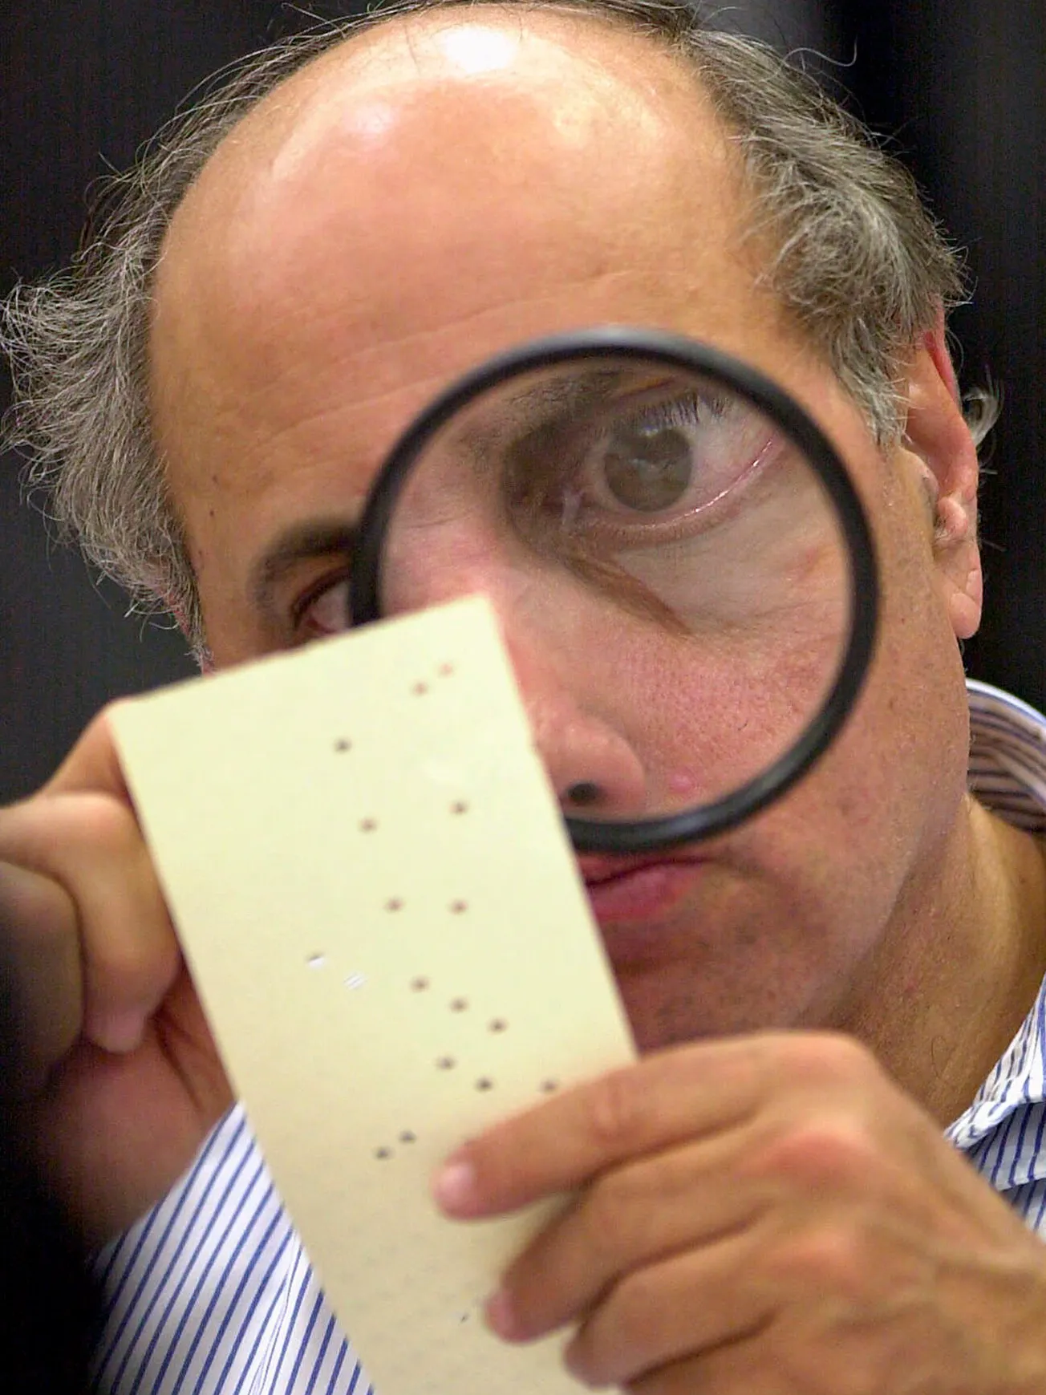
Bush v. Gore
Background of the Case
The outcome of the 2000 presidential election hinged on Florida’s 25 electoral votes. When the polls closed on November 7, the vote in Florida was so close that it triggered an automatic recount. Bush led by only 1,784 votes. When ballots were again run through machines, Bush’s lead shrank to fewer than 200 votes. Gore requested hand recounts of ballots in four predominantly Democratic counties where thousands of punch card ballots had recorded no vote for president. Bush asked the U.S. District Court to block any further recounts.
While the manual recount was still in progress, the Florida secretary of state certified Bush as the winner. Gore appealed this, and the Florida Supreme Court authorized manual recounts of disputed ballots to begin immediately. Bush appealed the ruling to the U.S. Supreme Court, which ordered the recount to stop.
How the Court Ruled
The Florida Supreme Court ordered any recounts to use a general standard set forth in Florida law to discern the “clear intent of the voter.” In a 7-2 ruling, the U.S. Supreme Court declared that because different vote counters used different standards, the recount did not treat all voters equally. The Court ruled 5-4 that there was not enough time left to conduct a manual recount that would pass constitutional standards.
Notes:
*Constitutional issues

Slide 2
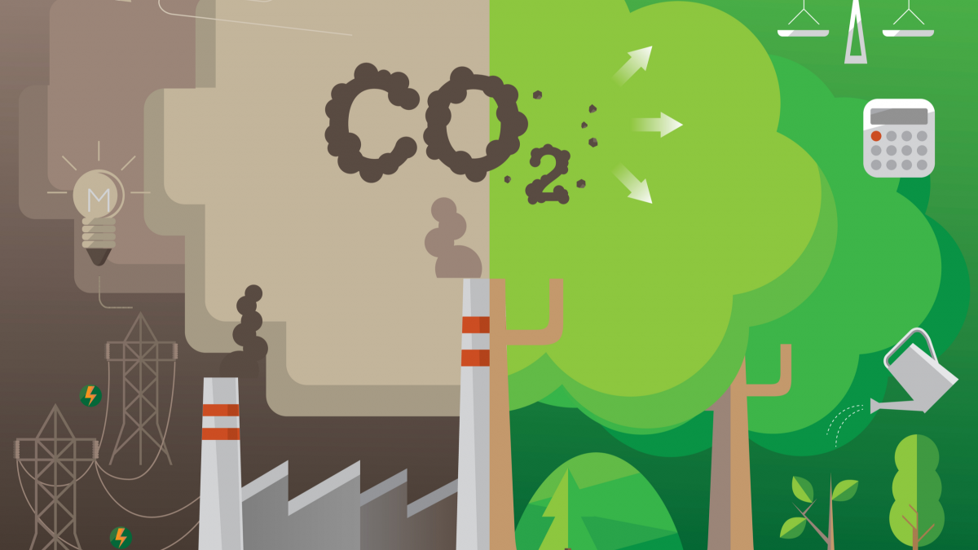
Kyoto Protocol Treaty
The Kyoto Protocol was adopted in December 1997 by many countries within the United Nations. The Kyoto Protocol commits industrialized countries and economies to limit and reduce their greenhouse gas emissions in accordance with agreed upon targets. In March 2001, the Bush Administration announced that it would not implement the Kyoto Protocol and instead introduced an alternative 10-year plan for reducing greenhouse gas emissions in February 2002.
Since the Kyoto Protocol’s adoption in 1997, the United States has not agreed to sign the treaty or join in the commitment.
Notes:
*How are we now trying to address this issue?

Slide 3
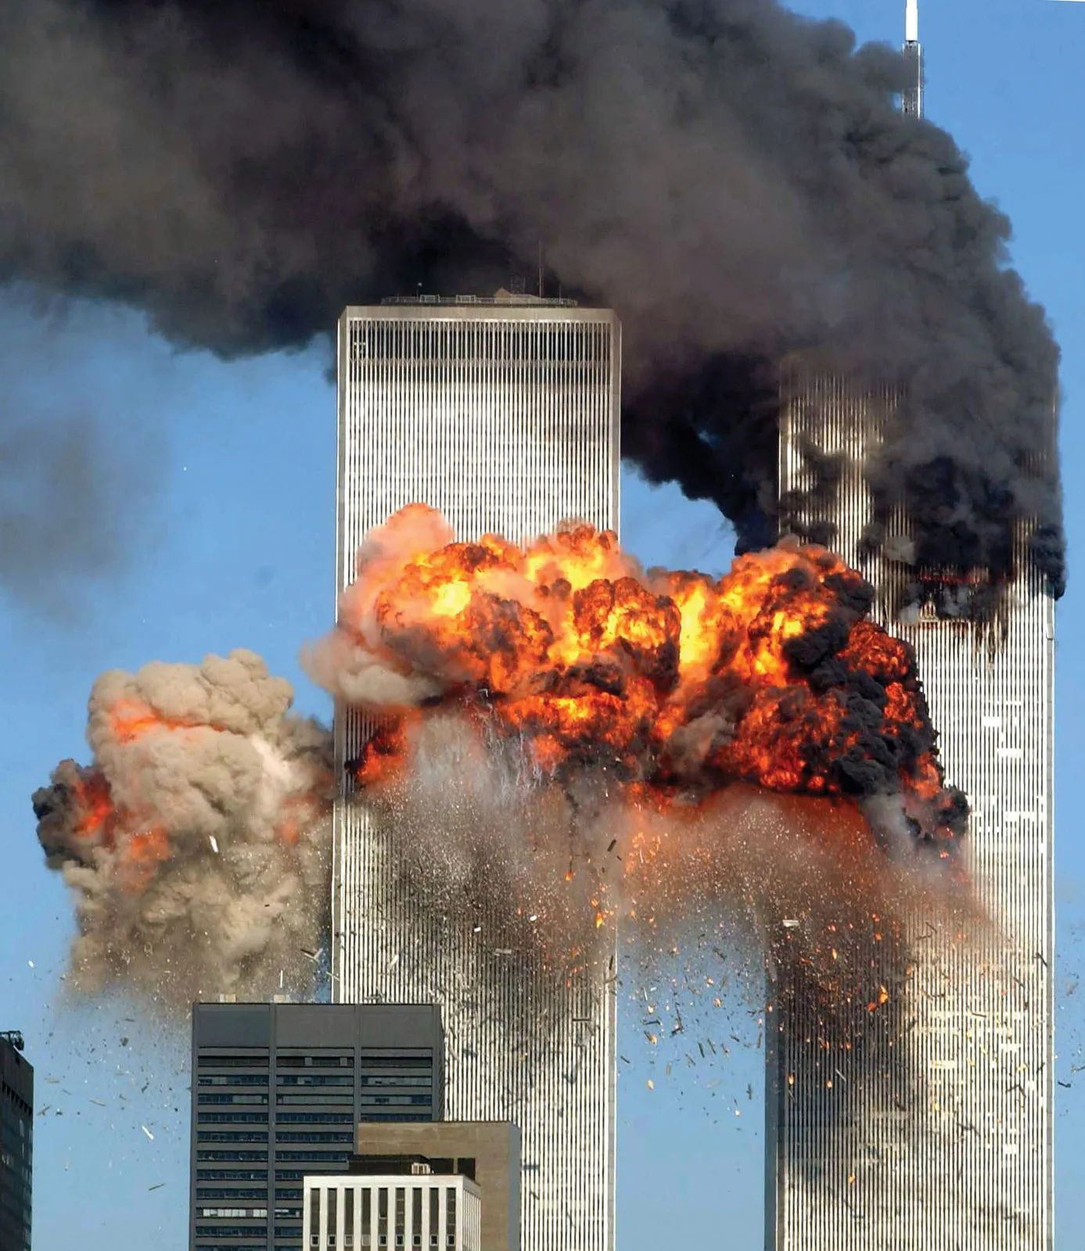
September 11th, 2001
On September 11, 2001, two passenger jets slammed into the two towers of the World Trade Center in New York City. Soon afterward, a third plane crashed into the Pentagon in Washington, D.C. Within about two hours, the World Trade Center collapsed in a billow of dust and debris, killing nearly 3,000 people. The airplanes did not crash accidentally. Hijackers deliberately flew them into the buildings. Hijackers had also seized a fourth airplane. Passengers on that flight had cell phones and had learned of the earlier attacks. Four passengers decided to fight the hijackers, and the plane crashed in a field in Pennsylvania.
The attacks shocked Americans. Citizens donated food, money, supplies, and their own time toward the recovery effort. They rallied together to show their unity and resolve. On September 14, President Bush declared a national emergency. Congress authorized the use of force to fight whoever had attacked the nation. Osama bin Laden and his organization, al-Qaeda, were soon identified as the plotters behind the attacks.
Notes:
*Effects including War on Terror

Slide 4
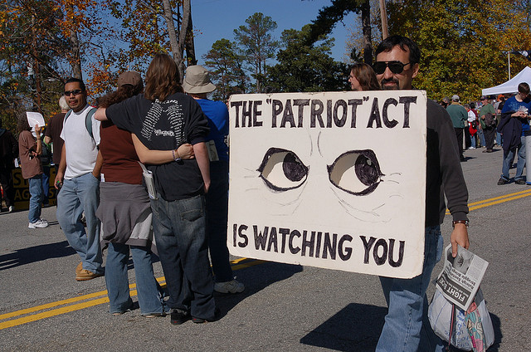
USA PATRIOT Act
After the September 11th terrorist attacks, the nation was on high alert. To protect against further attacks, President Bush created the Office of Homeland Security and asked Congress to pass legislation to help law enforcement agencies locate terrorist suspects.
Congress had to balance Fourth Amendment protections against unreasonable search and seizure with the need to increase security, but in October 2001, Bush signed into law the anti-terrorist bill called the USA PATRIOT Act.
The law made it easier to wiretap suspects, track Internet communications, and seize voicemail. Authorities were permitted to conduct secret searches and were allowed to obtain a nationwide search warrant usable in any jurisdiction. In June 2002, Bush asked Congress to combine the agencies responsible for public safety into a new cabinet department, the Department of Homeland Security. This agency worked to coordinate efforts to fight terrorism.
Notes:
*Possible issues regarding individual rights and freedoms **DISCUSS

Slide 5
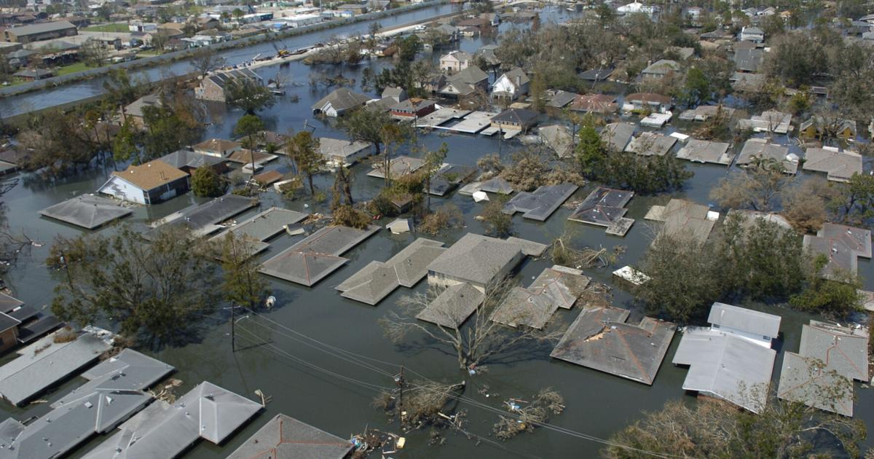
Hurricane Katrina
On August 29, 2005, Hurricane Katrina smashed into the Gulf Coast of the United States, spreading devastation from Florida to Louisiana. The fierce winds, rain, high tides, and storm surges destroyed buildings, roads, and electrical lines, left thousands of people homeless, and cost at least 1,200 lives. After the hurricane had passed, rising waters breached levees protecting New Orleans and flooded the low-lying city, causing thousands to flee to rooftops and for shelter in the convention center and at the Superdome. Waiting for days with little food, clean water, or information from authorities, survivors were shown on television news in deplorable conditions.
Reporters asked why the government was not responding more quickly. The mayor of New Orleans was faulted for not issuing a mandatory evacuation until the storm was less than a day away and for having failed to provide public transportation. The Federal Emergency Management Agency (FEMA) seemed unprepared in its response. With polls showing a sharp drop in confidence in his administration, President Bush fired the head of FEMA and traveled to New Orleans to pledge federal funds for rebuilding the city.
Notes:
*Levees and below sea level

Slide 6
2008 Election
In October 2008, President Bush and Congress passed a $700 billion bailout for the nation’s financial institutions, intended to help the worsening crisis. Americans opposed it. With the approval ratings of the president and Congress at all-time lows, McCain and Obama both promised change.
Obama made good use of the Internet and formed a strong grassroots network of young supporters. On Election Day, Obama won 53 percent of the popular vote and 365 electoral votes. It was the biggest victory for a Democratic candidate since 1964.On January 20, 2009, Barack Obama was inaugurated as the 44th President of the United States. He was the first African American President in U.S. history.

Slide 7
Affordable Care Act
Obama’s health care reform plan aimed to:
lower health care costs
introduce better procedures for delivering care, and;
insure all Americans.
Obama wanted to pay for the plan through higher taxes on the wealthy and by reducing wasteful spending. Yet some Americans opposed what they saw as another expensive government intrusion. Months of heated debate took place within Congress. No Republican voted for the final bill that passed in March 2010, and many vowed to overturn it.
The bill extended coverage to about 32 million more Americans who could not previously afford it. It prevented insurers from denying insurance to people who had preexisting medical conditions. It also gave tax credits to small businesses that provide health care to their employees. According to the White House, it would lower costs, strengthen the Medicare program, and expand the Medicaid program.
Notes:
*Increased access to healthcare (provided at a lower cost)

