Slide 2
Supply and demand:
Households supply.
Firms demand.

Slide 3
Supply and demand:
Households demand.
Firms supply.

Slide 5
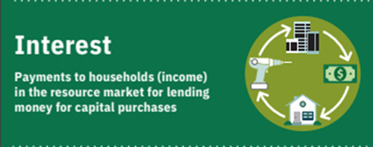

Slide 6
