Slide 1
Chapter 8 The Byzantine Empire and Emerging Europe
LESSON 1 – The First Christians
LESSON 2 – THE DECLINE OF ROME
LESSON 3 – THE EARLY CHRISTIAN CHURCH
LESSON 4 – THE AGE OF CHARLEMAGNE
LESSON 5 – THE BYZANTINE EMPIRE

Slide 2
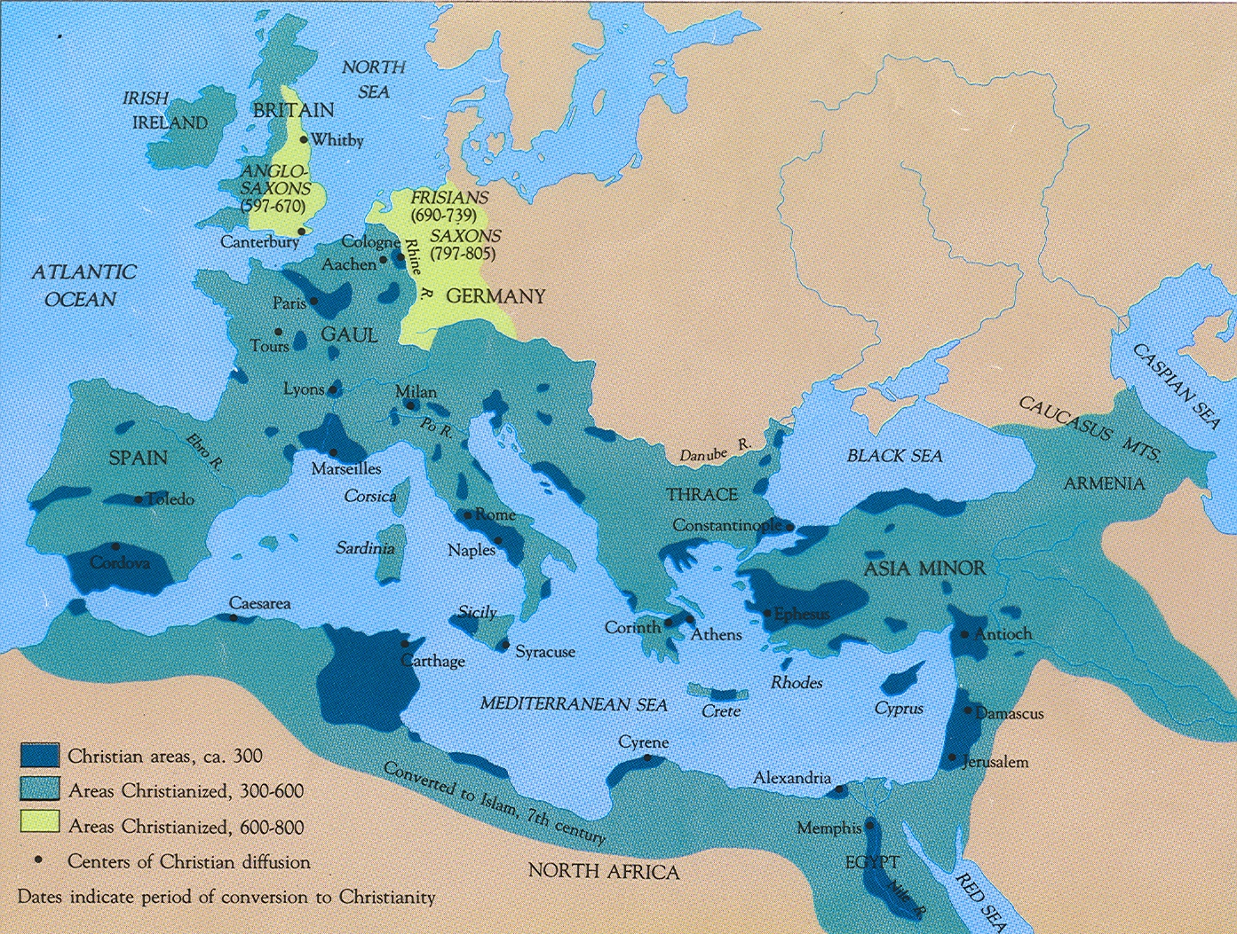
Progression of Christianity in the Roman Empire
50CE - the Christian faith was noticeable in the Roman province of Judea
1st-2nd Centuries - Christians were persecuted off and on depending on the emperor

Slide 3
Progression of Christianity in the Roman Empire
313CE - Edict of Milan made Christianity legal and proclaimed
official tolerance
391CE - Christianity became the official state religion in the
Roman Empire

Slide 4
Christianity was spread by missionaries throughout the empire and beyond
The church developed a governing structure based on the authority and the leadership of bishops and eventually of the Pope in Rome

Slide 5
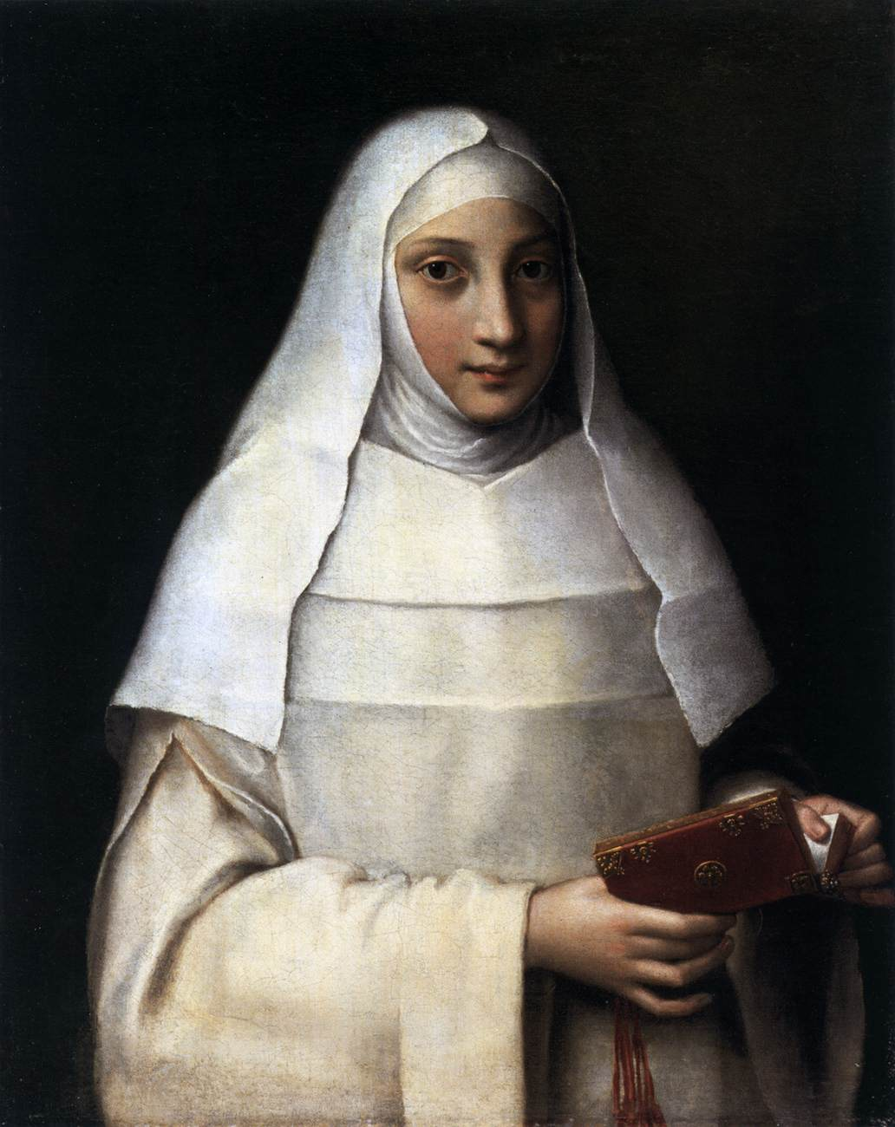
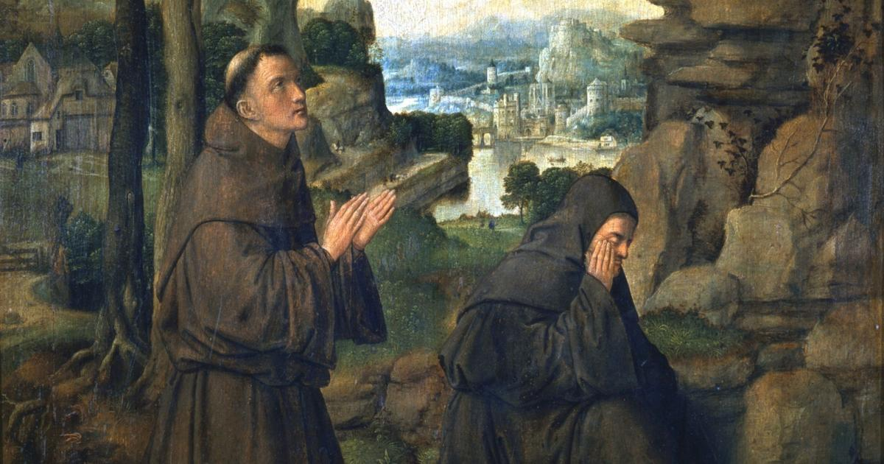
Monasteries were communities where monks and nuns devoted themselves to the faith
Notes:
*1* How is the Pax Romana responsible for Mary and Joseph finding themselves in a manger?
What was a pregnant woman doing wandering around ready to give birth?

Slide 6
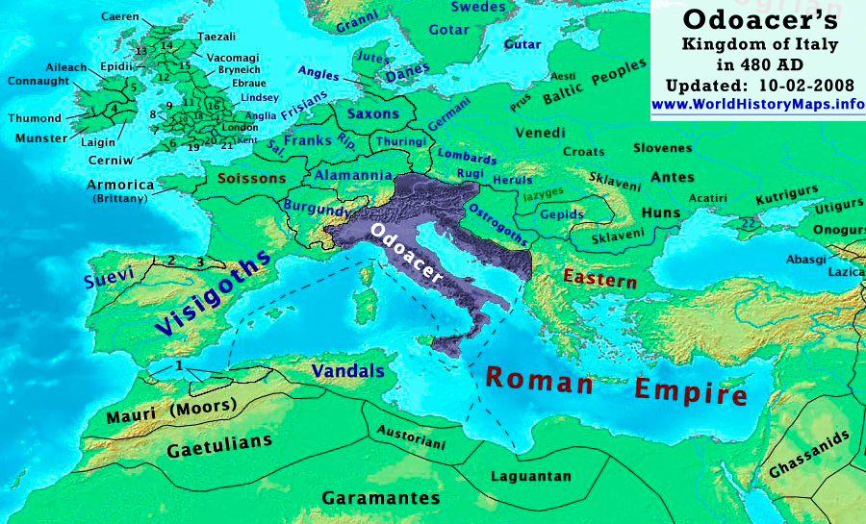
Notes:
Odoacer - soldier who in 476 became the first King of Italy (476–493). His reign is commonly seen as marking the end of the Western Roman Empire.^{[3]} Though the real power in Italy was in his hands, he represented himself as the client of the Emperor in Constantinople. Odoacer generally used the Roman honorific patrician, granted by the Emperor Zeno, but is referred to as a king

Slide 7
The First Christians
After the fall of the western part of the Roman Empire,
a new civilization formed in Western Europe
It blended three major influences:
Germanic people moved into the area before the fall of the empire
2) Roman traditions
The Christian Church later known as the Roman Catholic Church

Slide 8
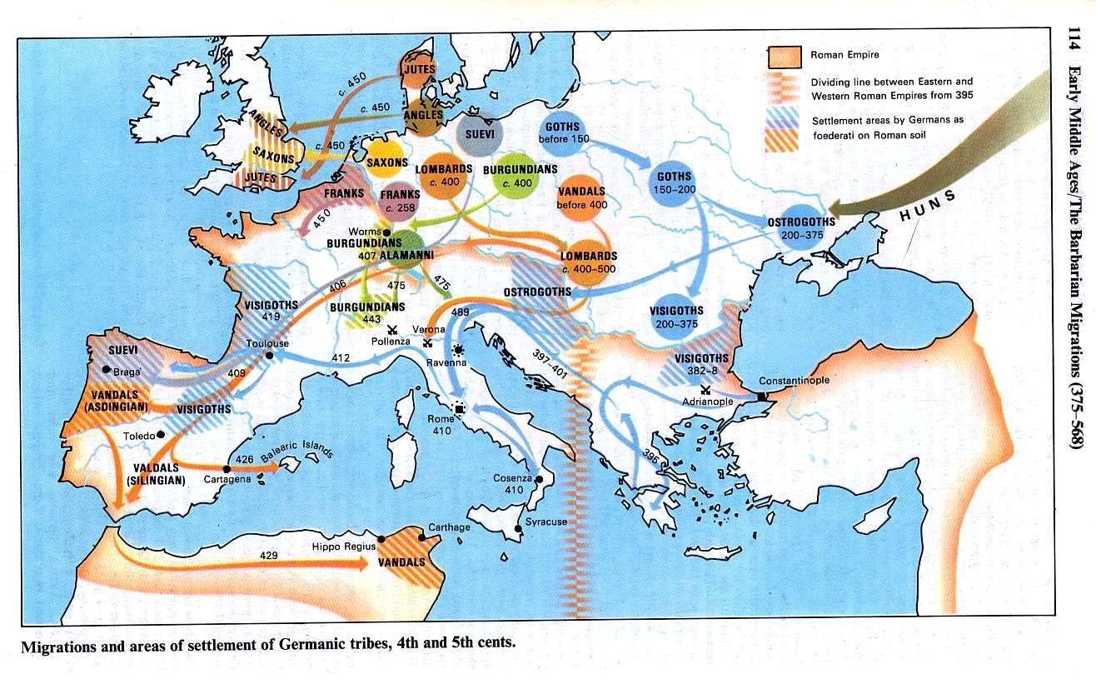
The First Christians

Slide 9
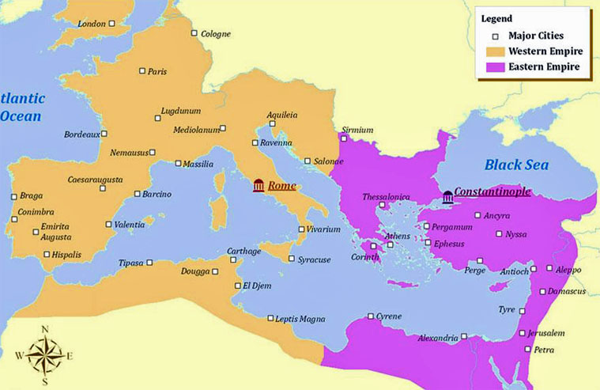
The First Christians
Judaism in the Roman Empire
The Jewish area of JUDEA was far from the city of Rome in the far eastern part of the empire
Notes:
Map - Roman Empire East and West
Map - Judea

Slide 10
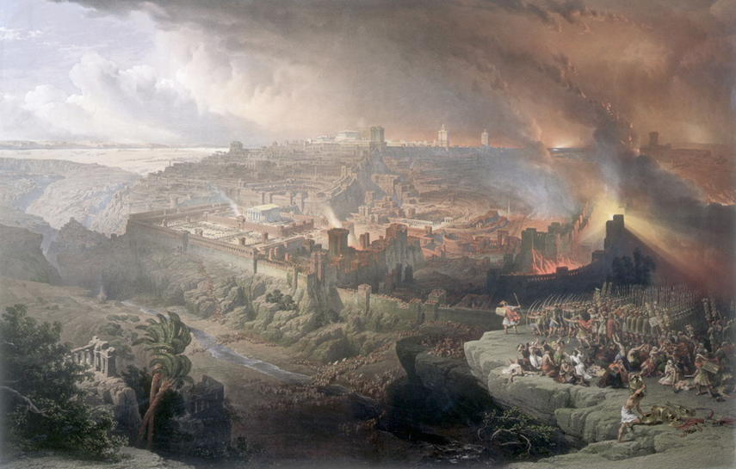
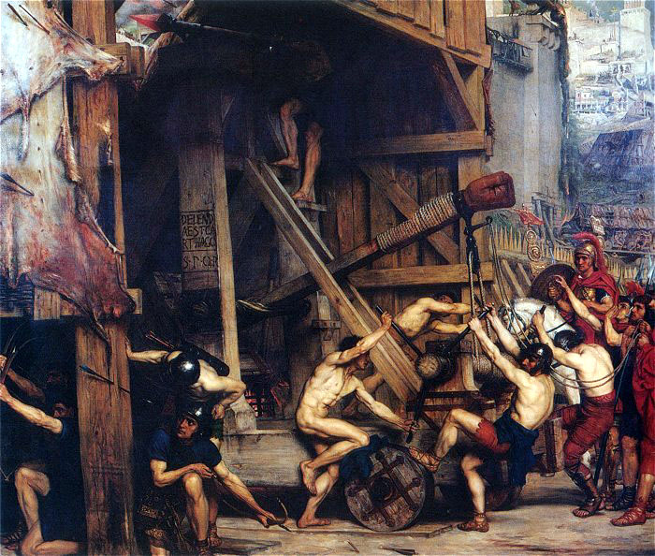
The First Christians
Judaism in the Roman Empire
Some Jewish people tried to get along with the Romans, others withdrew from society, and some (the Zealots) called for the violent overthrow of Roman rule
Jewish revolt began in 66CE
Notes:
The Siege of Jerusalem in the year 70 was the decisive event of the First Jewish–Roman War
The Roman army, led by the future Emperor Titus, with Tiberius Julius Alexander as his second-in-command, besieged and conquered the city of Jerusalem, which had been controlled by Judean rebel factions since 66
The siege ended on August 30 with the sacking of the city and the destruction of its Second Temple
The destruction of both the first and second temples is still mourned annually as the Jewish fast Tisha B'Av
The Arch of Titus, celebrating the Roman sack of Jerusalem and the Temple, still stands in Rome
Sadducees – favored cooperation w/Rome
Pharisees – Close observance of religious law would
protect them from Roman influence
Zealots – called for violent overthrow of Roman rule (*Sicarii)

Slide 11
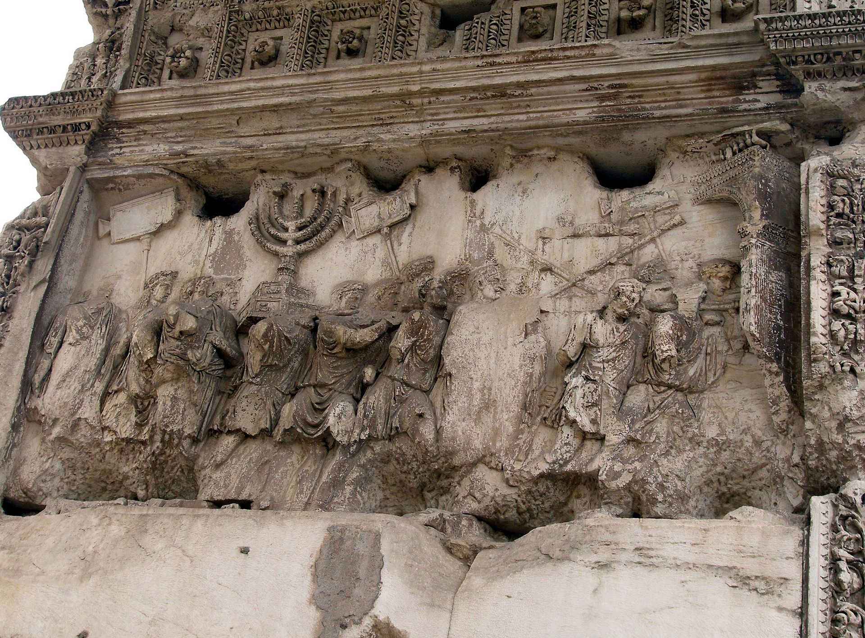
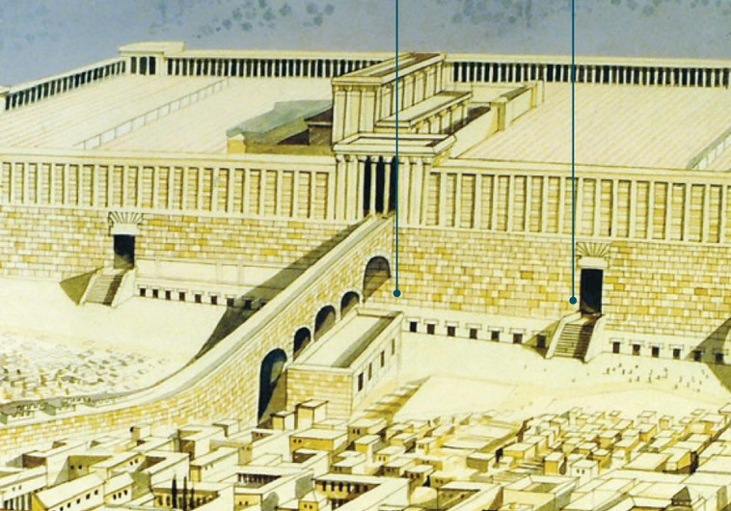
The First Christians
Judaism in the Roman Empire
By 70CE The revolt was put down and the second Temple was destroyed*
Notes:
*How is this Jewish uprising – destruction of the Jewish Temple connected to the coliseum?
Coliseum
100,000 tons marble
188m155m
Wooden floor
1,000 sailors to hoist the awning
Night before – free meal

Slide 12
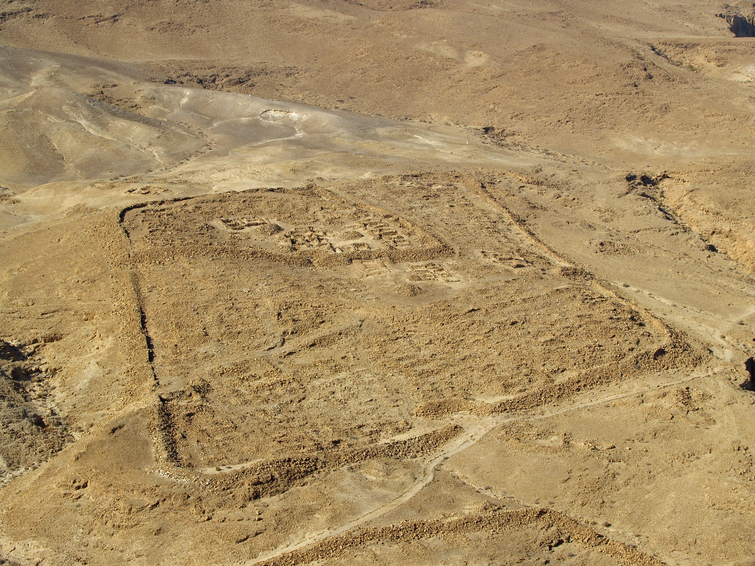
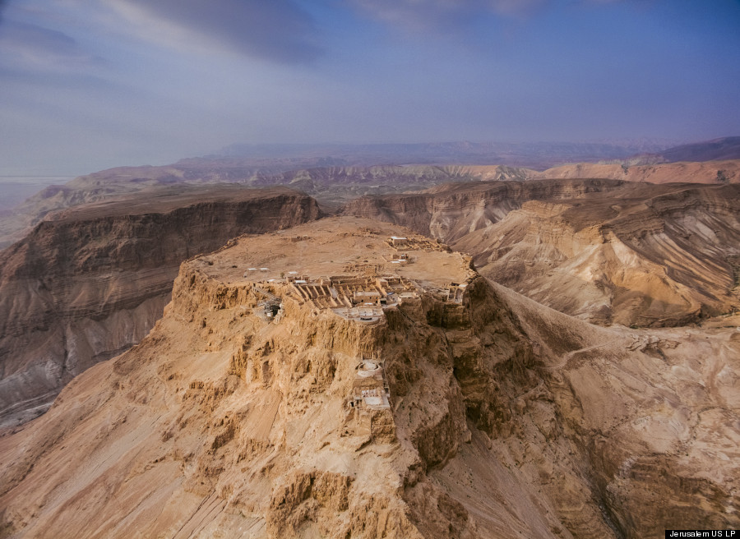
The First Christians
Judaism in the Roman Empire
Siege of Masada 70-73CE
Notes:
ancient fortification in the Southern District of Israel situated on top of an isolated rock plateau, akin to a mesa
It is located on the eastern edge of the Judaean Desert, overlooking the Dead Sea 20 km (12 mi) east of Arad
Herod the Great built palaces for himself on the mountain and fortified Masada between 37 and 31 BCE. According to Josephus, the siege of Masada by troops of the Roman Empire at the end of the First Jewish–Roman War ended in the mass suicide of 960 people, the Sicarii rebels and their families hiding there

Slide 13
The First Christians
A few decades before this, a Jewish baby named JESUS was born
When he grew up Made claims that caused great controversy within the Roman Empire
Followers spread the new monotheistic views known as Christianity
Notes:
Why was it controversial

Slide 14
The First Christians
The Teachings of Jesus
Many years before Jesus was born, the Jewish scriptures, now recorded in the Old Testament of the Bible told of a promise that their God made to the Jews: He would send a Messiah to "deliver them“
The Jews had waited and longed for this Savior for hundreds of years. When Jesus claimed to be this Messiah, it angered many people
The Jews had always thought that they would be delivered from the Romans, but Jesus offered another kind of deliverance: a personal deliverance from their sins and salvation (eternal life) after death for those who believed in Jesus He called his followers to show humility, charity and love to others

Slide 15
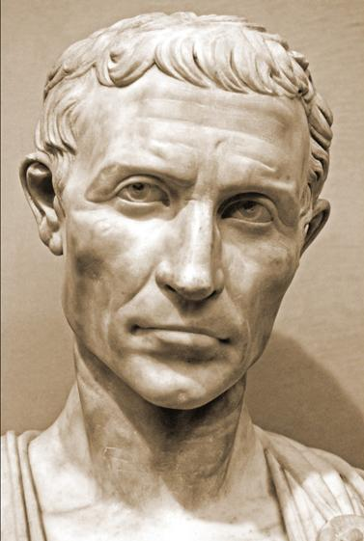
The First Christians
The Jews who wanted a military victory over the Romans did not believe Jesus' claims and were furious with his message
He was turned over to the prefect (local ruler) of Judea - Pontius Pilate
Pilate ordered Jesus to be crucified

Slide 16
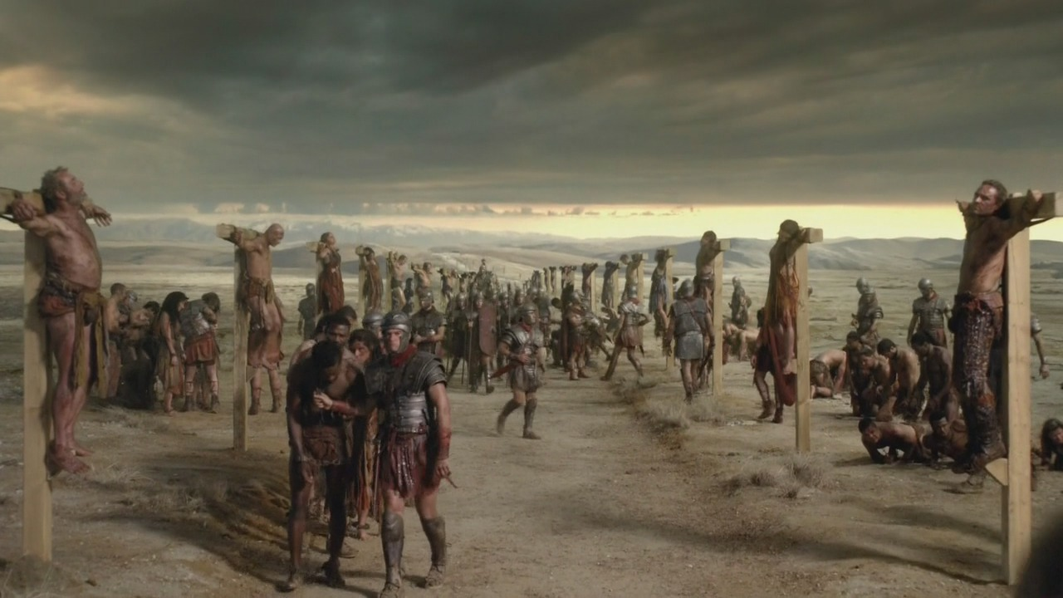
The First Christians
This was a Roman method of execution by being
nailed to a wooden cross

Slide 17
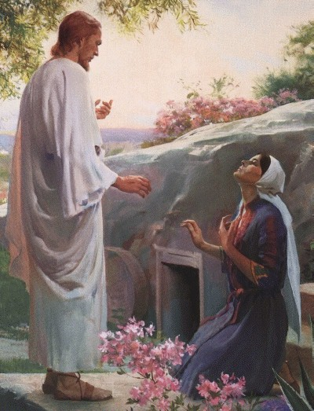
The First Christians
Three days after His public execution, his followers saw Jesus and said He had risen from the dead
They believed that this proved that He was the Messiah and that he was the Son of God

Slide 18
The First Christians
Christianity Spreads Through the Empire
Many of Jesus' followers spread the word about His life, teachings, death and resurrection
They taught that Jesus's death paid for the sins of humanity
By accepting Jesus as Savior, people could have eternal life and by saved from their sins and reconciled to God
The followers called this message the Gospel or "Good News" about Jesus

Slide 19
The First Christians
The Apostle Paul was the main person who spread this "gospel"
These early followers of Jesus recorded his life and teachings in what later became known as the New Testament
The Bible is the most published book in history
By 100CE, there were many Christian missionaries: people who are sent with a religious message, hoping to convert others
Christianity eventually spread from the Eastern Roman Empire which spoke Greek - to the Western Roman Empire - Latin

Slide 20
The First Christians
Christianity Spreads Through the Empire

Slide 21
The First Christians
Roman Persecution of Christians
The Romans were usually tolerant of other religions,
But…Christians refused to worship the Roman gods and emperor
The Roman government began to persecute the Christians
- caused suffering and deaths by execution
Notes:
Tolerant towards all religion but they are expected to be open to Roman ways and beliefs.

Slide 22
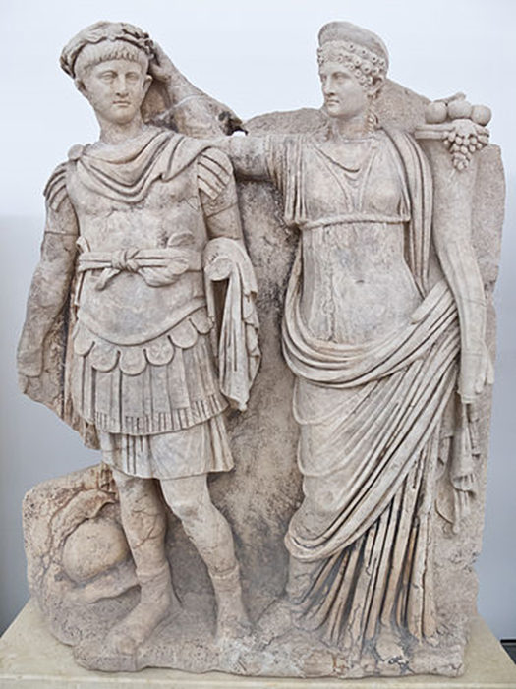
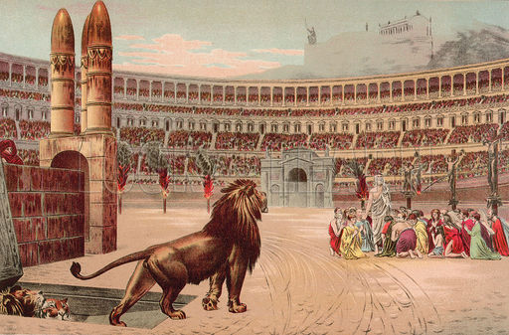
The First Christians
Roman Persecution of Christians
The persecution would lessen or grow, depending of the
current emperor
Nero- Blamed Christians for the fire that destroyed much of Rome
(Nero fiddled while Rome burned)
Christianity continued to grow and spread throughout the empire and beyond
Notes:
Nero and Agrippina
The Romans were usually tolerant of other religions, but they began to change their attitude against the Christians because they refused to worship the Roman gods and emperor. The Roman government began to persecute the Christians; this caused them much suffering and even deaths by execution. As time went on, the persecution would lessen or grow, depending of the current emperor. Despite this, Christianity continued to grow and spread throughout the empire and beyond.

Slide 23
SGPT
How does a religion attract followers?

Slide 24
Christianity strengthened in the 2nd and 3rd centuries because the church structure
became more organized
Bishops began to exercise control over church communities (localized areas)
Church leaders (clergy) had distinct jobs

Slide 25
The First Christians
The Roman Empire Adopts Christianity
Why was Christianity able to grow and spread despite heavy persecution?
Christianity was personal and offered eternal life to people
2) People could relate to Jesus, sacrificed himself to save them
Did not require expensive or painful initiation
- Christian initiation was by water baptism

Slide 26
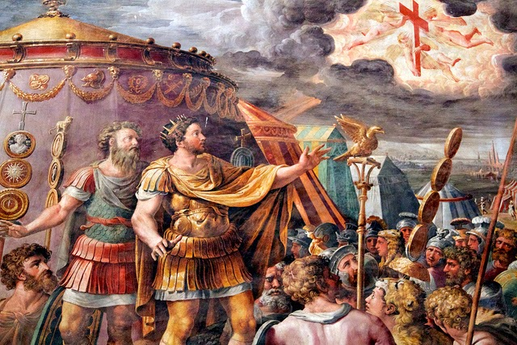
The First Christians
The Roman Empire Adopts Christianity
4) Fulfilled the human need to belong
People helped each other and Christianity was open to anyone
Appealed to: rich, poor, men, women, and free slaves
5) 313CE: The Edict of Milan was passed by the emperor Constantine the Great, who had seen a vision of a cross before a battle
This Edict of Milan proclaimed official tolerance of Christianity and made it legal within the empire
Notes:
Constantine would become the first Christian emperor

Slide 27
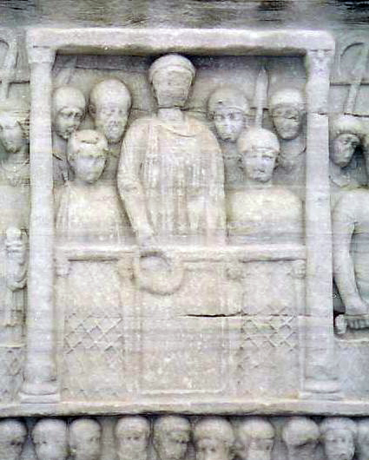
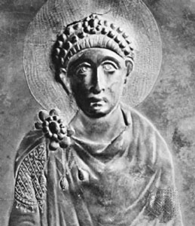
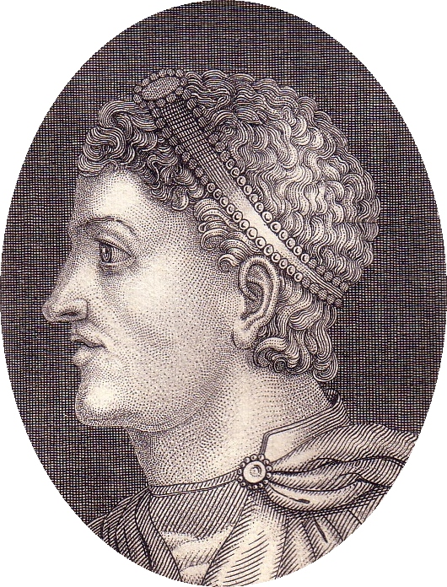
The First Christians
The Roman Empire Adopts Christianity
6) 380CE: the emperor Theodosius made Christianity the Official State Religion of the Roman Empire
Notes:
Theodosius the Great, was Roman Emperor from AD 379 to AD 395. Theodosius was the last emperor to rule over both the eastern and the western halves of the Roman Empire
On accepting his elevation, he campaigned against Goths and other barbarians who had invaded the empire. He failed to kill, expel, or entirely subjugate them, and after the Gothic War, they established a homeland south of the Danube, in Illyricum, within the empire's borders
He fought two destructive civil wars, in which he defeated the usurpers Magnus Maximus and Eugenius at great cost to the power of the empire
Issued decrees that effectively made Orthodox Nicene Christianity the official state church of the Roman Empire

Slide 28
SGPT
Why make Christianity the official religion of the Roman Empire?

