Slide 1
WORLD WAR I: CAUSES OF WWI & REASONS FOR U.S. ENTRY
UNIT 5: WWI #1

Slide 2
Causes of World War I
In the years leading up to WWI there were four underlying issues that were building up and moving Europe toward war
Because of those underlying causes, it only took one significant event to light the fire and plunge the world into war
Four factors contributed to the outbreak of World War I in Europe

Slide 3
Causes of World War I
M → Militarism:
Nations develop strong armed forces to back up their empire
Built up weapons and troops to intimidate other nations
A → Alliances:
A series of treaties that grouped the nations of Europe into two armed camps
Pre-war: Triple Alliance, Franco-Russian, Triple Entente
Wartime: Allies & Central Powers
I → Imperialism:
Rivalries increased as nations fought for power around the world
Countries gathered up land for profit, trade, & influence
N → Nationalism:
Intense pride in one’s country
Tensions grew as nations pursued only their own interests

Slide 5
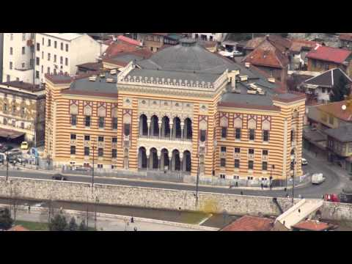
The Spark…

Slide 6
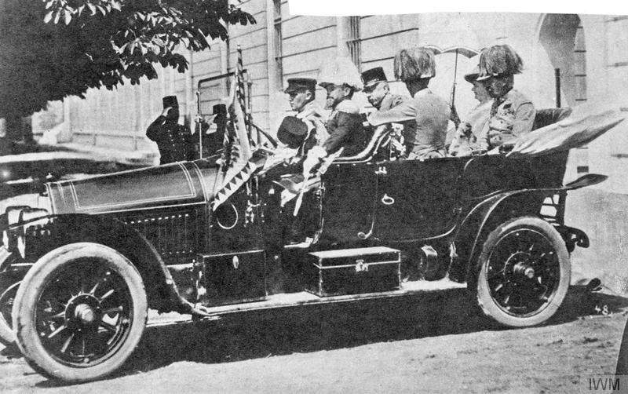
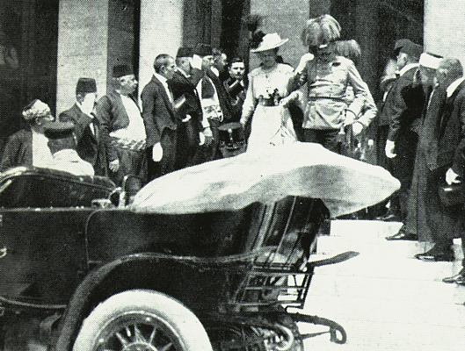
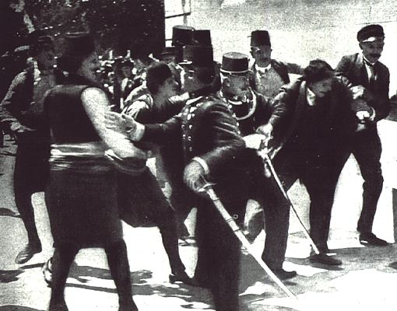
An Assassination Leads to War

Slide 7
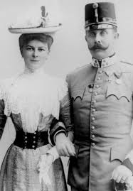
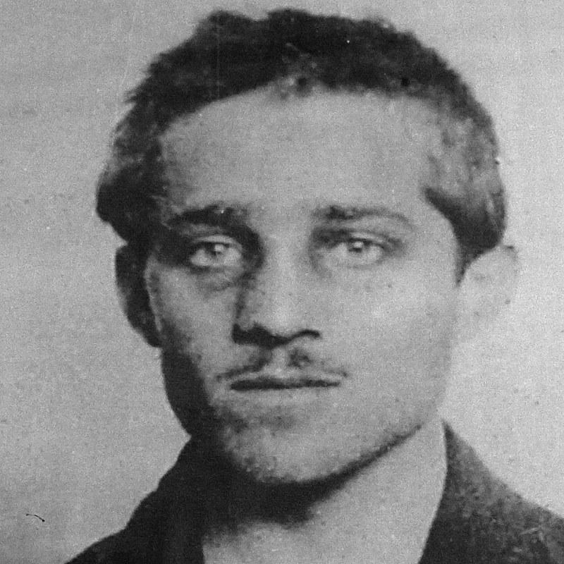
The Assassination
Archduke Franz Ferdinand of Austria and his wife Sophie are shot to death by a Bosnian Serb nationalist Gavrilo Princip (from a terrorist group called the Black Hand)
Austria had invaded Serbia in 1908 and the group wanted to free Serbia from Austria
The assassination took place during an official visit to the Bosnian capital of Sarajevo on June 28, 1914
As heir to the Austrian throne he was there as a representative of his country, Austria
The killings sparked a chain of events that led to the outbreak of World War I

Slide 8
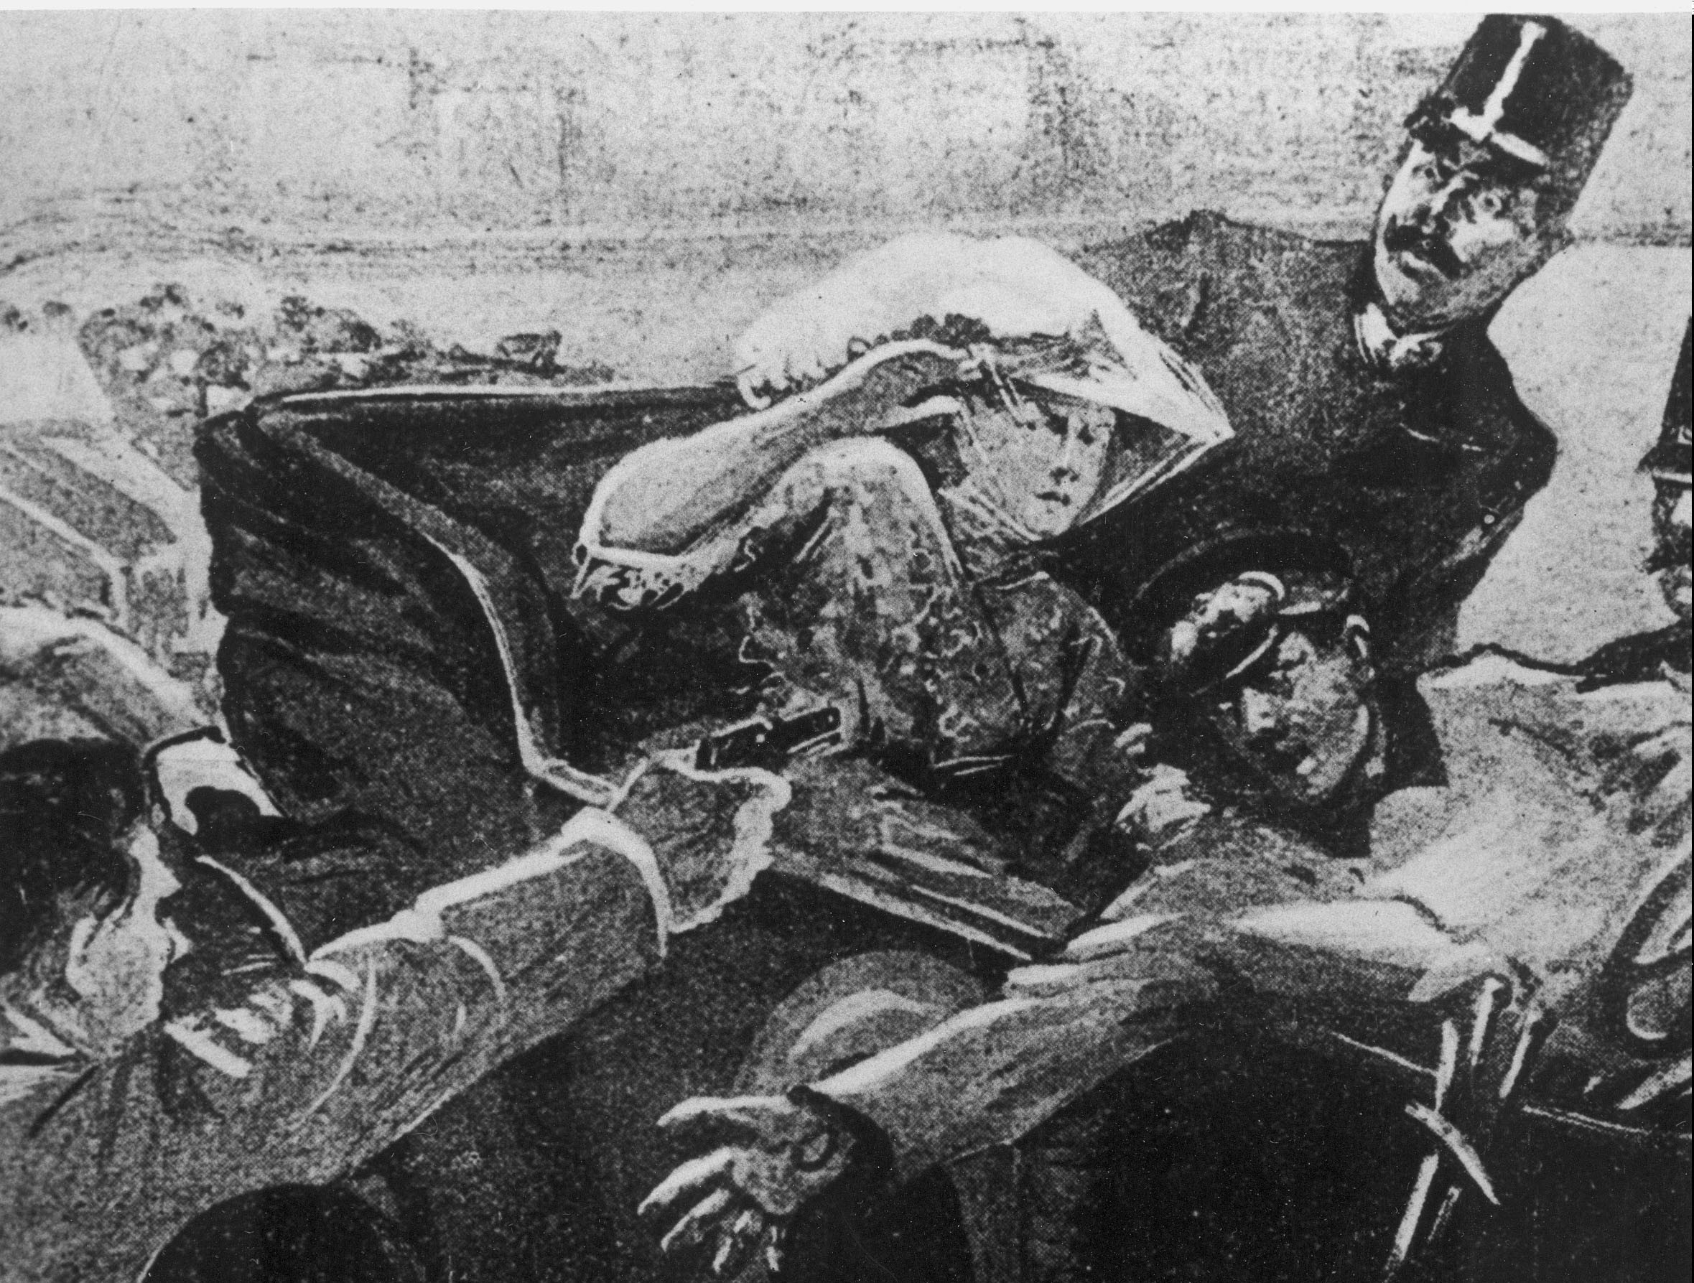
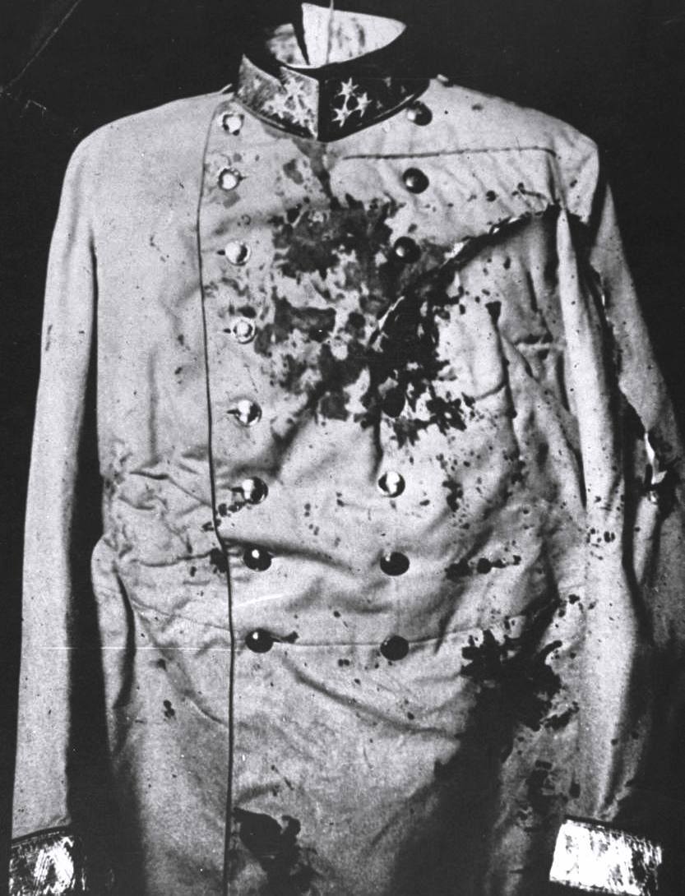
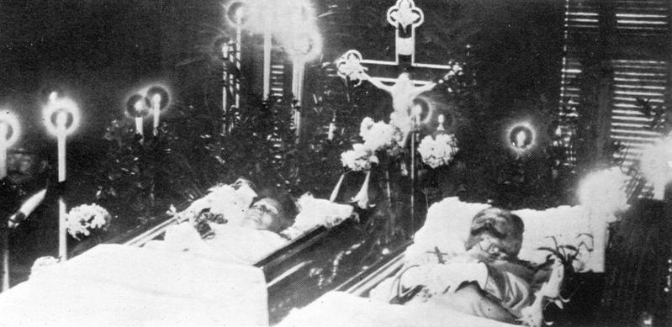
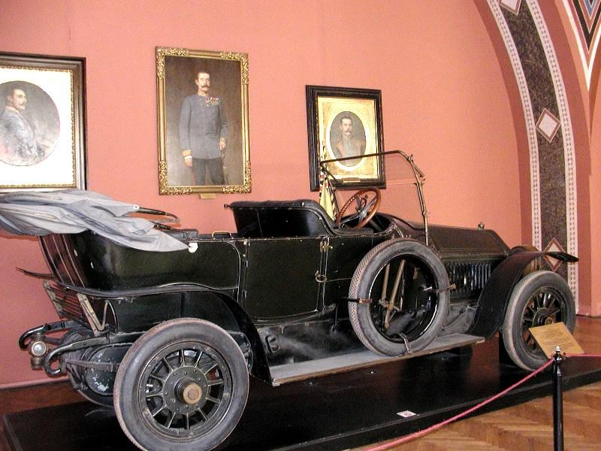

Slide 9
Mastery Check
Development of armed forces and their use as a tool of diplomacy
Countries joined together in a common activity
Devotion to one’s country
The murder of Archduke Franz Ferdinand and the spark that activated the alliance system and set off the war
Extending economic and political control over other nations
Match the cause to its definition:
Nationalism ______
Imperialism ______
Militarism ______
Alliances ______
Assassination ______
C.
E.
A.
B.
D.
Notes:
C
E
A
B
D

Slide 10
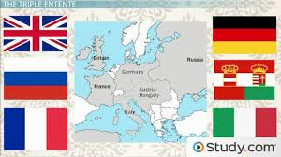
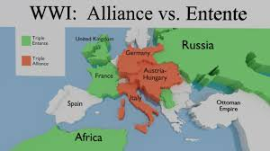
A Diplomatic Crisis
The assassinations kicked off a diplomatic crisis:
On July 28th, Austria-Hungary declared what it expected to be a short war against Serbia
Germany obligated by treaty to support Austria-Hungary, declared war on Russia
Germany declared war on Russia’s ally France
After Germany invaded Belgium, Britain declared war on Germany and Austria-Hungary

Slide 11
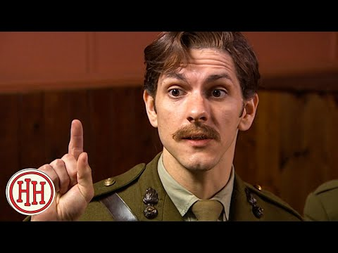
The Alliances Begin… Central Powers vs. Allies

Slide 12
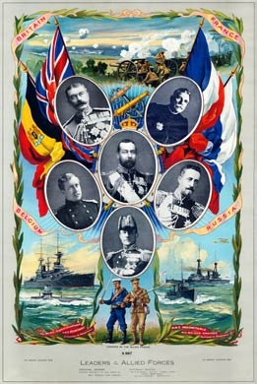
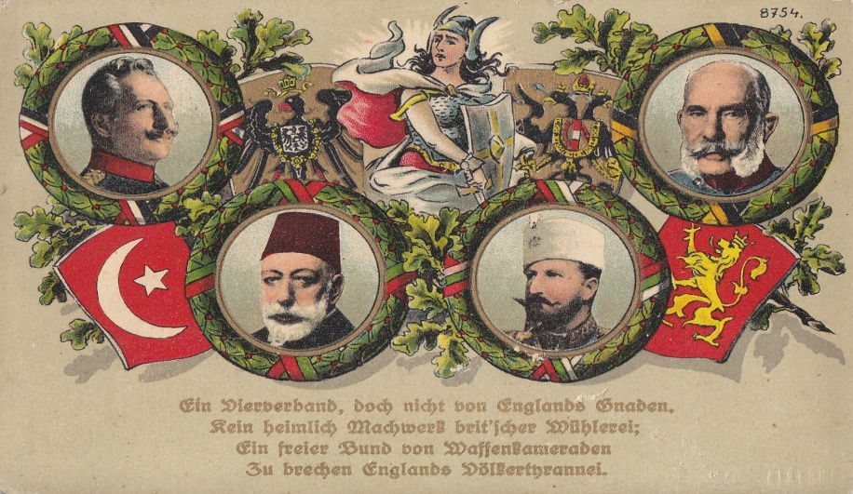
The Alliances:
The Central Powers:
Germany
Austria-Hungary
Ottoman Empire
The Allied Powers:
France
Britain
Russia

Slide 13
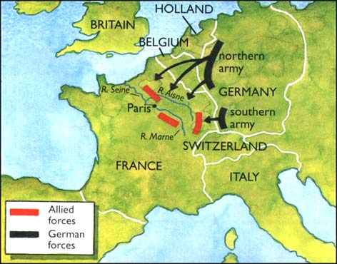
The Great War Begins…
Germany invades Belgium on August 4, 1914
Their plan was to hold back Russia, quickly drive through Belgium to Paris
After France fell, the two German armies would defeat Russia

Slide 14
REASONS FOR U.S. ENTRY INTO WWI

Slide 15
R.U.N.
R → Russia exits the war:
Russia leaves war, now a fight for democracy
March 1917: riots break out in Russia over the government’s handling of war and scarcity of food & fuel (Russian Revolution)
November 1917: Vladimir Lenin leader of Bolshevik Party overthrows government and established a Communist government
U → Unrestricted submarine warfare:
6 American ships sunk
German u-boats deployed to get around British blockade (threatened to sink any merchant ship)
Sunk Lusitania & Sussex
Sussex Pledge: Germany would not sink any merchant ships without warning
N → Zimmerman Telegraph/Note:
January 1917: Germany proposed that Mexico ally with them and wage war on the U.S.
Germany promises Mexico would win “lost territory” in Texas, New Mexico, and Arizona if they allied with Germany

Slide 16
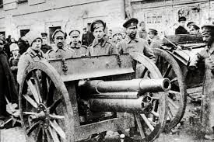
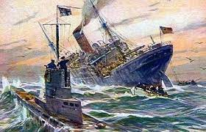
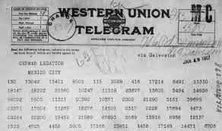
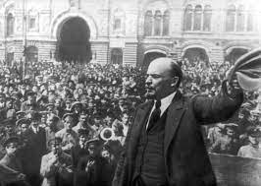

Slide 17
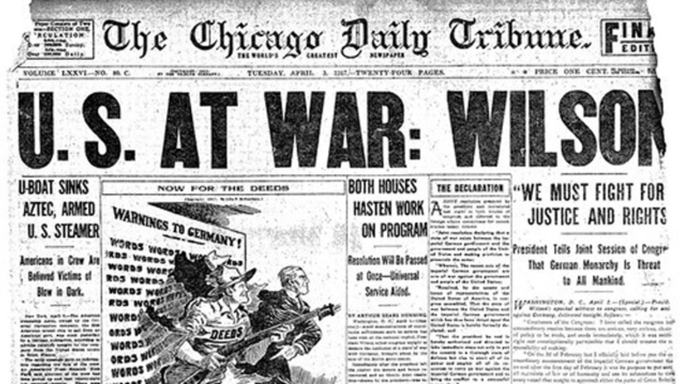
President Wilson Declares War
Due to these issues, U.S. declared war in April 1917
President Woodrow Wilson asked Congress to declare war - told Congress that war was necessary to “make the world safe for democracy”

Slide 18
Impact of War on U.S.
Inflation
War kept the economy booming, war supplies and materials produced and sold
After the war, supplies and materials weren’t needed
Strikes
Women’s suffrage
Workers’ strikes - working conditions and pay
End of Progressives
The ideas & beliefs of Progressives were lost because of the anti-Communist hysteria and racially motivated violence
Race riots
Dramatic growth of black communities in northern industrial cities - expanded so quickly & would move next to white communities → often met with violence
Red Scare
The fear of the spread of communism
Return to Isolationism
U.S. disillusioned with world affairs; war gains came at a terrible cost; decide to stay out of European affairs

Slide 19
