Slide 1
CAUSES OF THE GREAT DEPRESSION
UNIT 6: THE GREAT DEPRESSION #1

Slide 2
Knowledge Check
Place the following historical eras in the correct chronological order on your notes:
The Gilded Age
World War II
The Great Depression
The Roaring 20s
World War I
Answer:
The Gilded Age
World War I
The Roaring 20s
The Great Depression
World War II

Slide 3
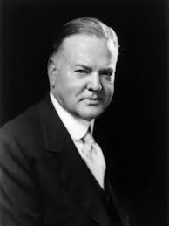
Herbert Hoover
Becomes President in 1929
“I have no fears for the future of our country. It is bright with hope…”

Slide 4
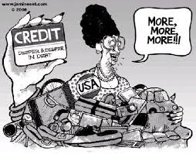
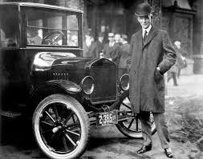
Roaring 20s Recap
New consumer goods
MATERIALISTIC
Buying on credit = debt
BAD IDEA
Makes stocks seem more valuable than they actually are

Slide 5
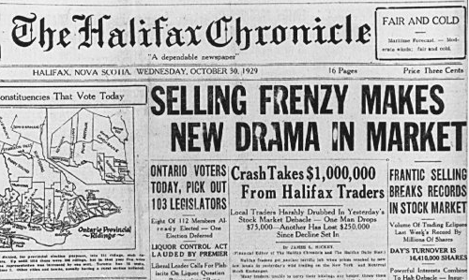
The Stock Market Crash
On Thursday, October 24th, the stock market began to decline
Bankers tried to stop the decline by buying stocks, but they were able to only delay the drop
Effect on the Depression:
Five days later on October 29, 1929, Black Tuesday, the stock market crashed
As stock prices dropped, people sold their stock - some lost everything

Slide 6
Stock Market Speculation

Slide 7
Speculation
Speculation: risky investments (purchasing stocks) with the hopes of getting rich quick
In the 1920s, many people bought stocks hoping to “get rich quick”
Drove stock prices even higher
Buying on margin: borrowing money
In the 1920s, stocks could be purchased for a 10% down-payment, called margin
Rest of the price was financed by a loan from a stock broker → similar to making a purchase on installment plan
The purchaser was responsible for the rest of the price whether stock market prices dropped or rose
SPY into the future HOPING it will be good

Slide 8
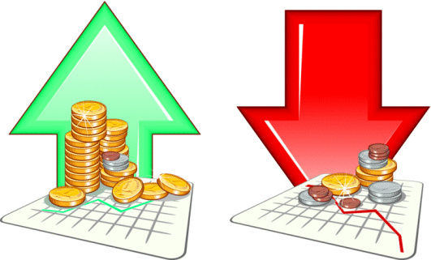
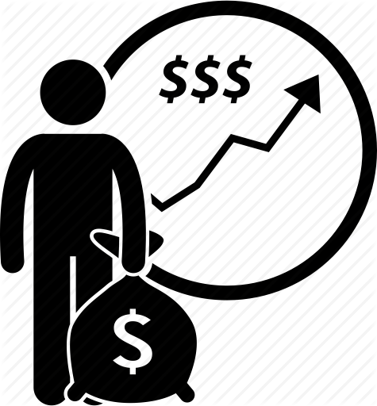
The Stock Market
You can buy a part (or stock) in a company
When company does GOOD, stock price goes UP
Sell your stocks to make money

Slide 9
2. Tariffs & Trade

Slide 10
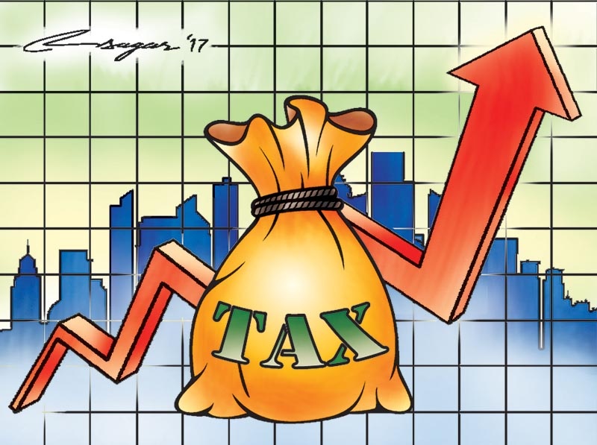
High Tariffs
Tariff: a tax on imported goods (from another country)
HIGH tariffs RAISE the price of foreign goods, LESS trade
Example: Smoot-Hawley Tariff
We stop buying other countries’ products, then they stop buying ours
Decline in trade leads to loss of money
The shrinking of world trade contributed to the Great Depression

Slide 11
3. Overproduction

Slide 12
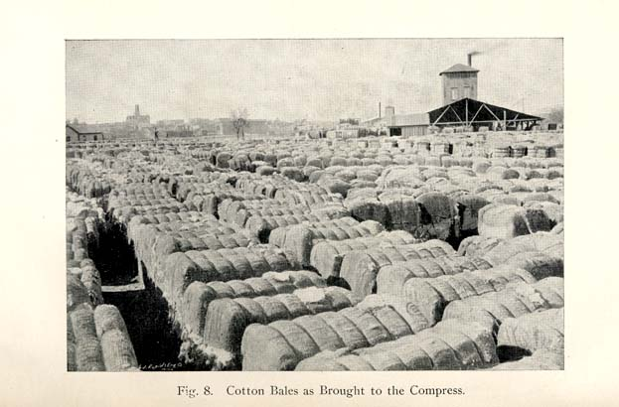
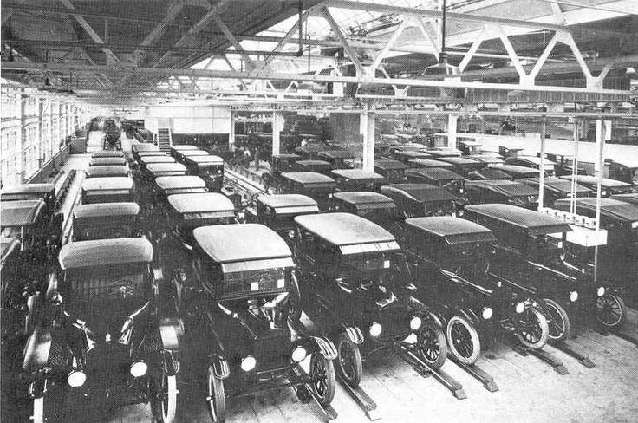
Overproduction of Goods
Economic Boom of 20s → consumerism & buying on credit
Businesses produce more goods than they can sell
Farmers didn’t benefit from the Roaring 20s (they kept farming as they did in WWI)

Slide 13
4. Policy (Monetary $$)

Slide 14
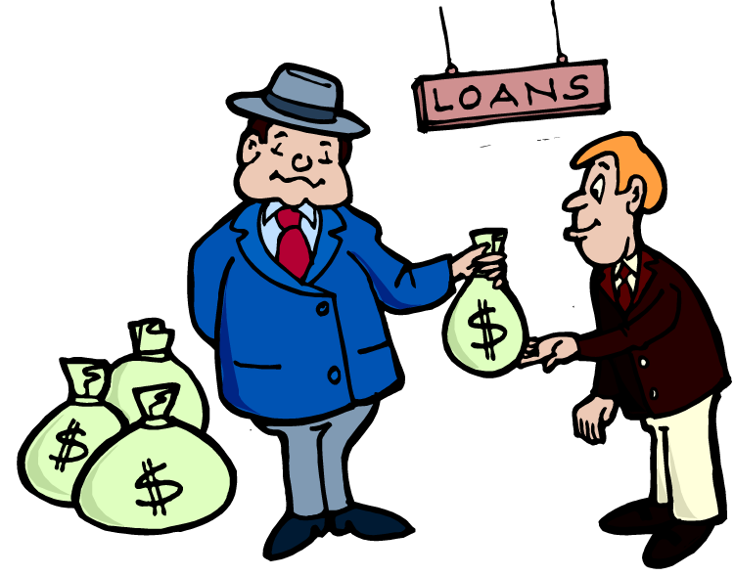
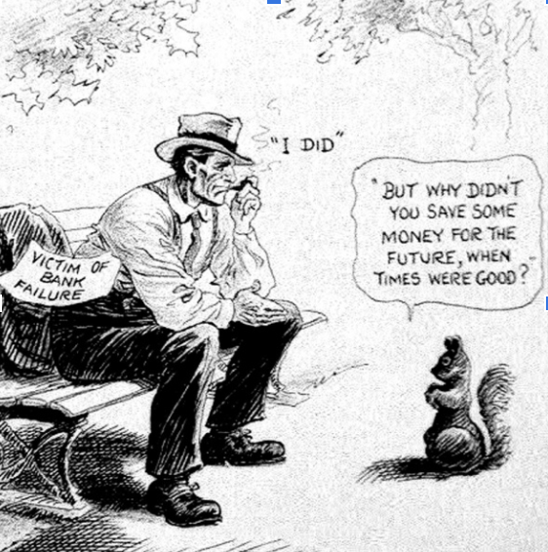
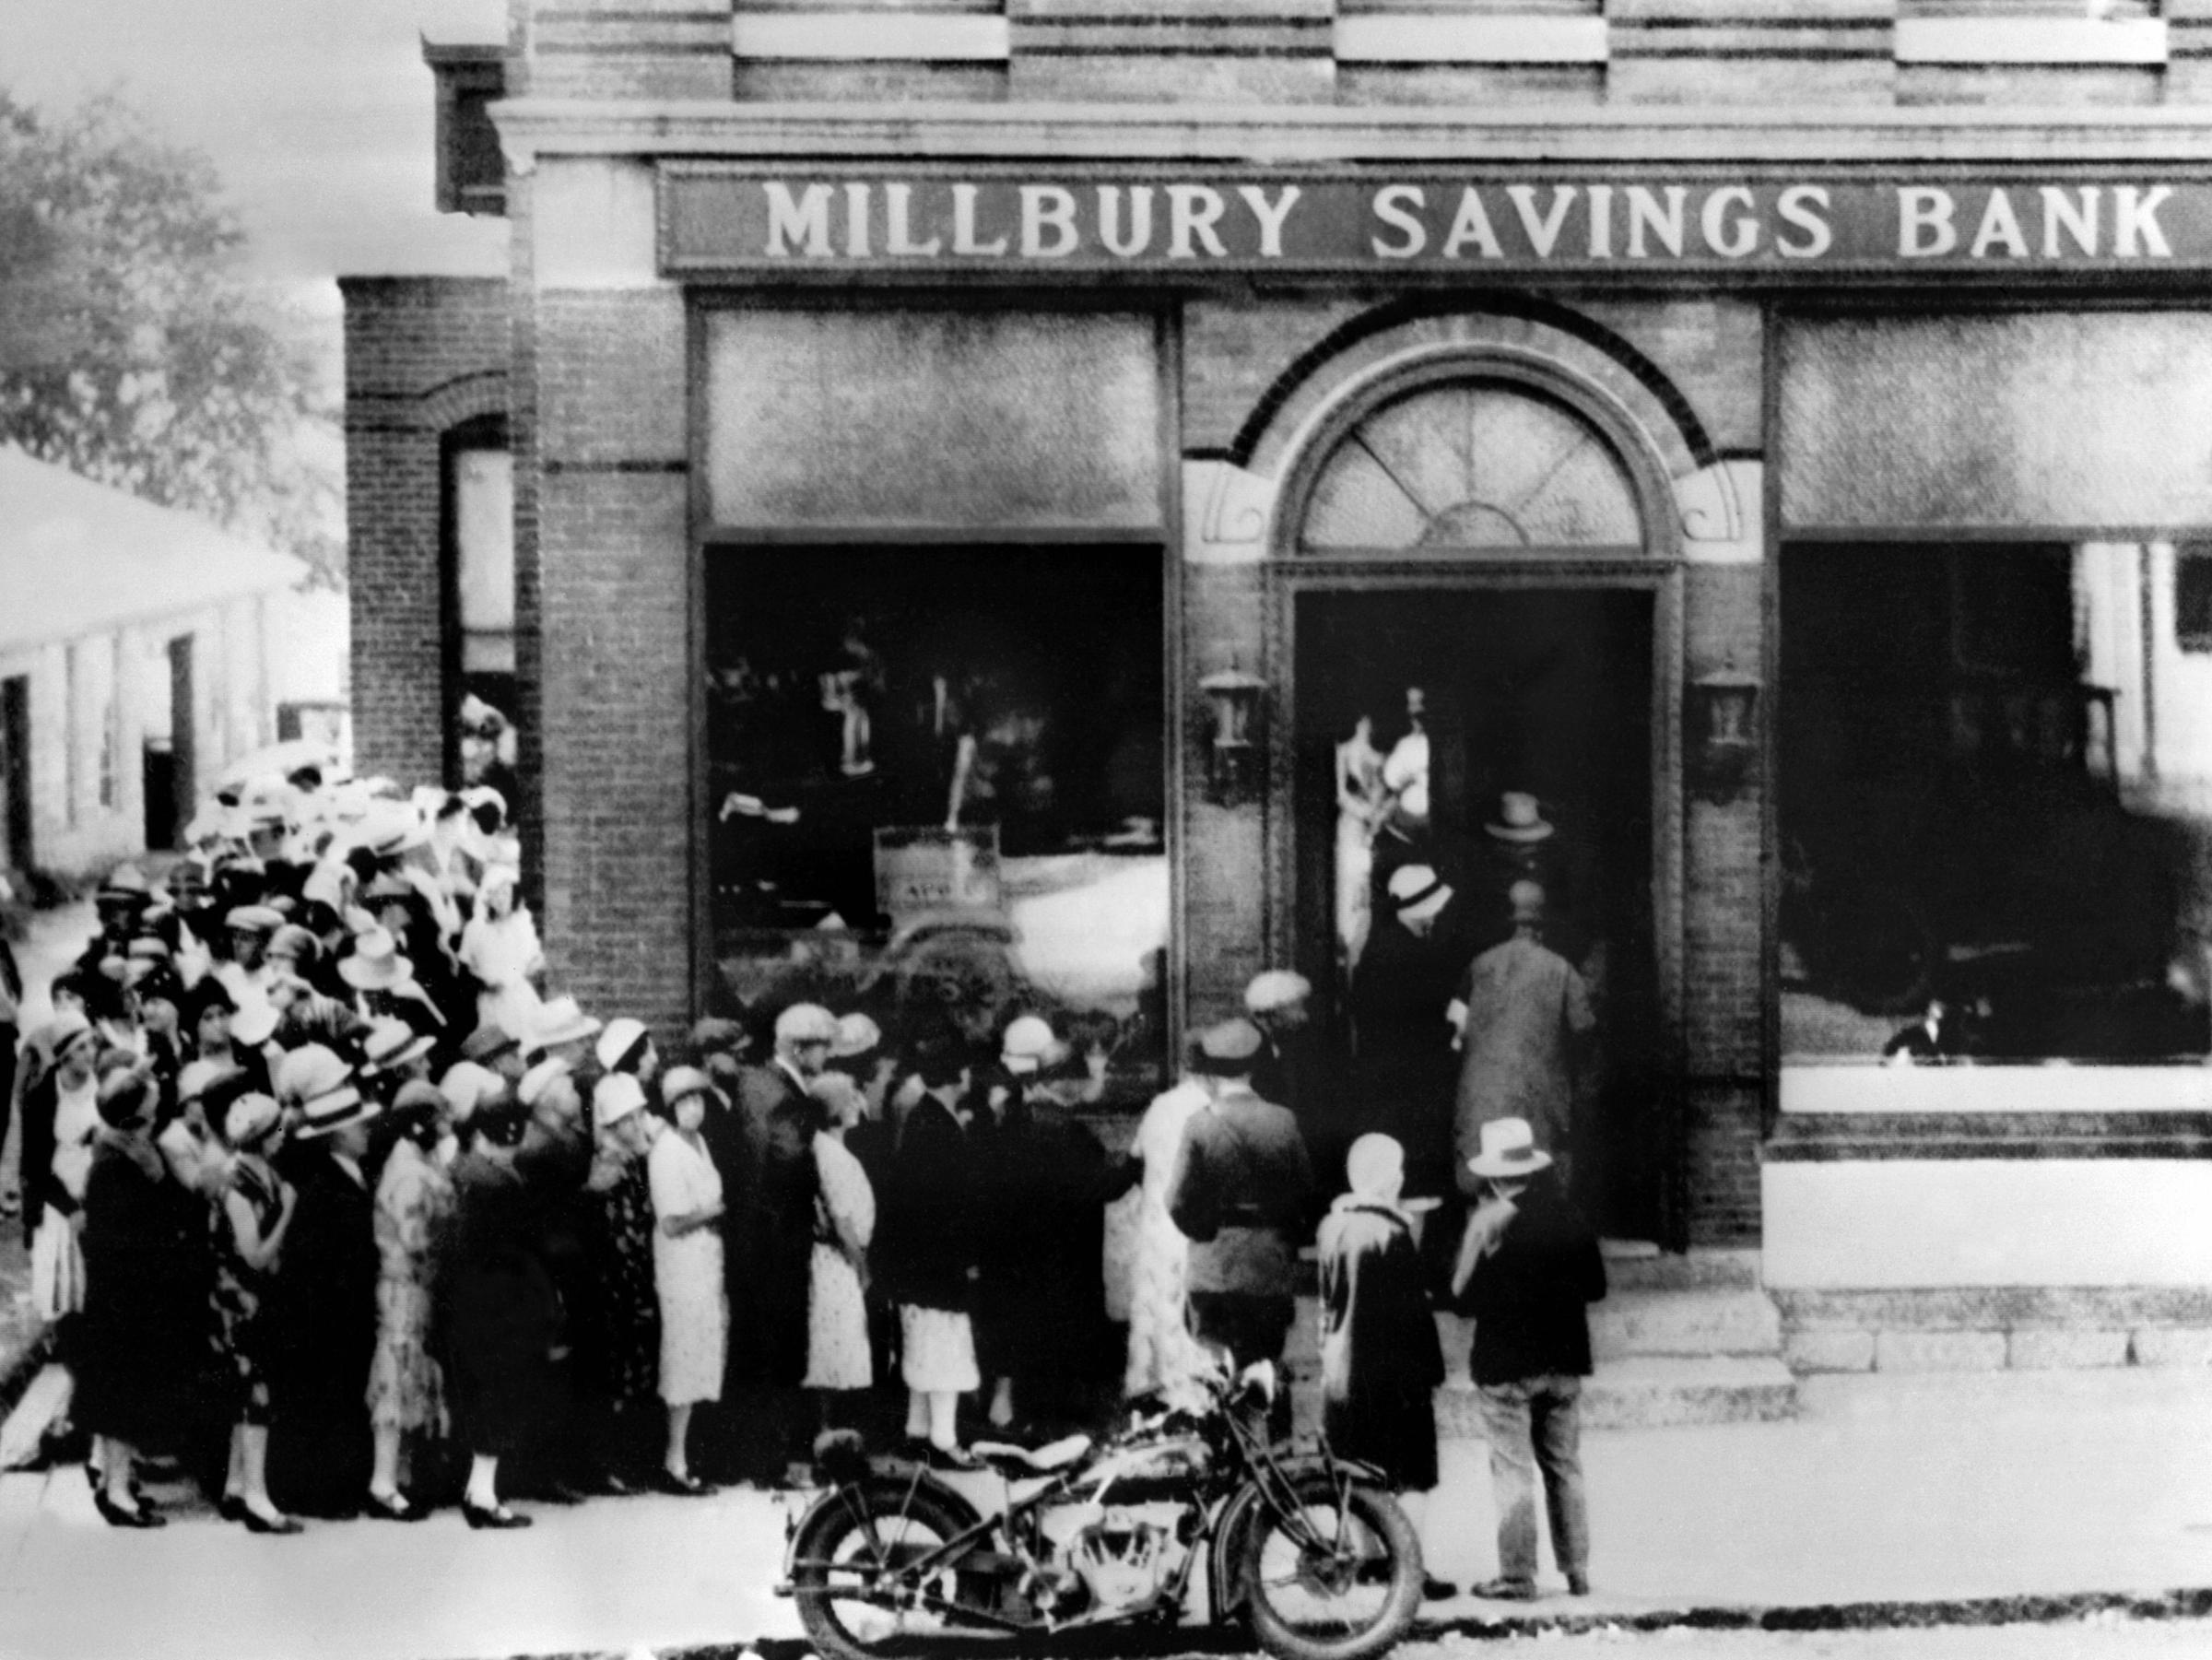
Monetary ($$) Policy
The Federal Reserve reduced the amount of money available
Banks generally collect money from depositors and then invest these funds in businesses
This enables them to earn money to pay interest on deposits
Harder to receive loans → bank failures
Banks use YOUR money to give other people loans
When everyone tries to take their money out, the bank does NOT have enough
Banks shut down and people lost money that was saved in the banks

Slide 15
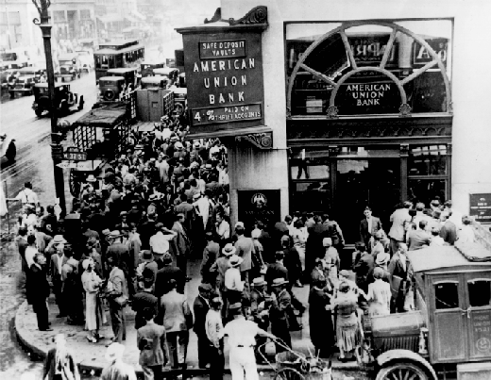
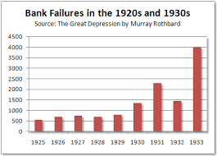
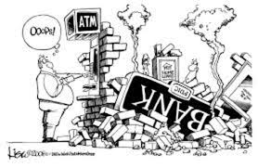
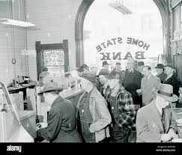

Slide 16
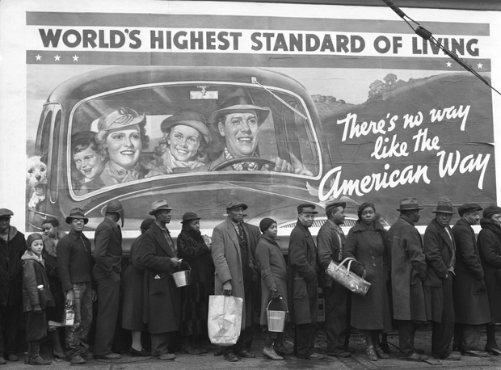
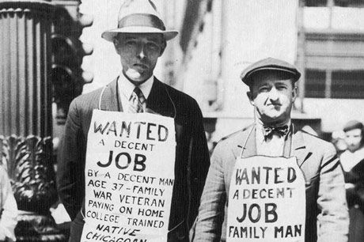
HIGH UNEMPLOYMENT
Businesses start going under (closing) → causes a snowball effect

