Slide 1
Why and how Capitalism has lifted humans out of poverty!

Slide 2
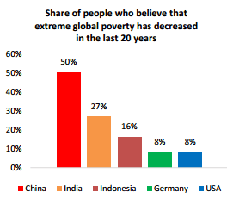

Slide 3
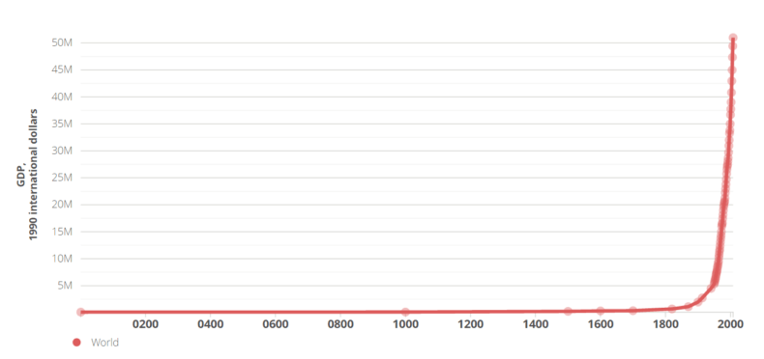
The Enlightenment and Industrial Revolution caused income to skyrocket!

Slide 4
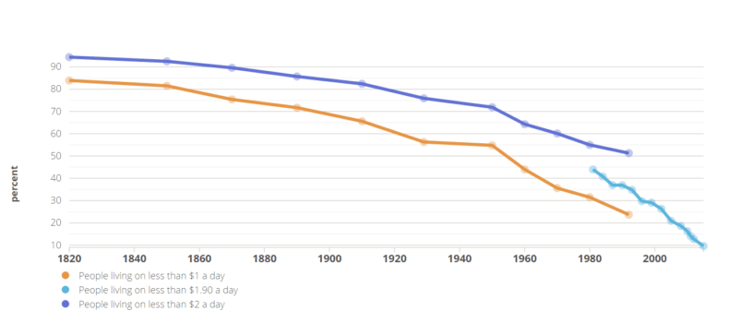
Using the definition of poverty, the % has dramatically fallen

Slide 5
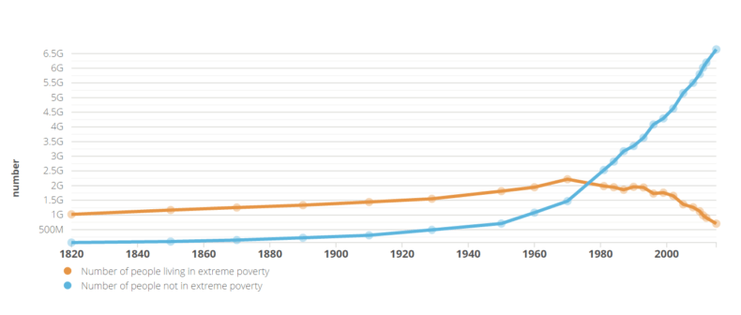
Even with the population increase from 700 mil to 6.6 billion the number has dramatically fallen!

Slide 6
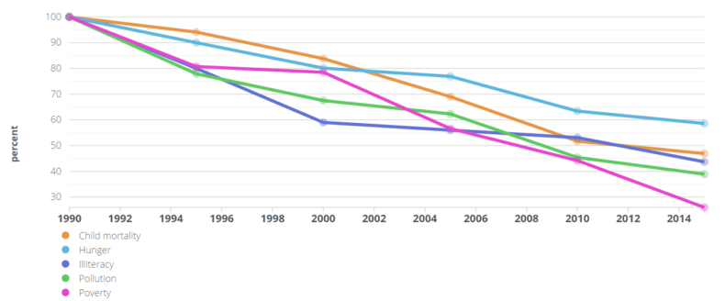
Increased prosperity has led to progress in other areas

Slide 7
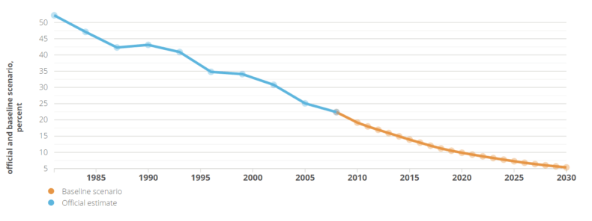
Predicted Global Poverty by 2030 – 1.4%

