Slide 1
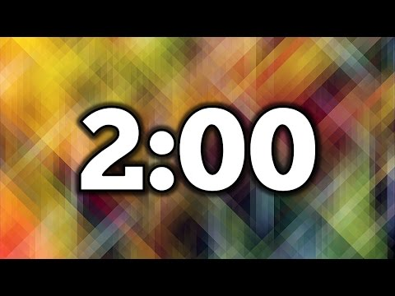
Bracelet Factory
Left Side
Supplies: Free
$2.00 for 6 bracelets
Bracelets must be 1 inch thick and fit over my hand
Right Side
Supplies:
2 Pieces of paper: $1.00
1 Pair of scissors: $1.00
1 Ruler: $1.00
1 Stapler: $2.00
$1.00 for every 4 bracelets
Creative License on bracelets, but must fit and be well-made.

