Slide 1
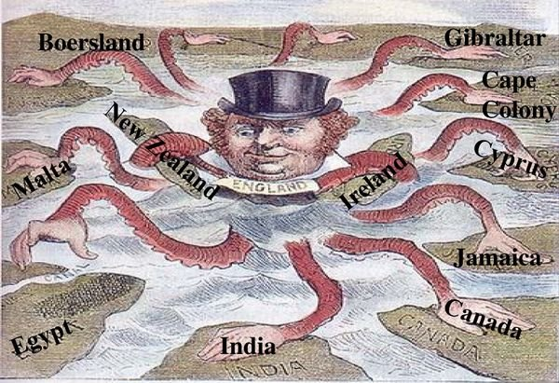
Imperialism
Policy extending a country’s power and influence through diplomacy or military force

Slide 2
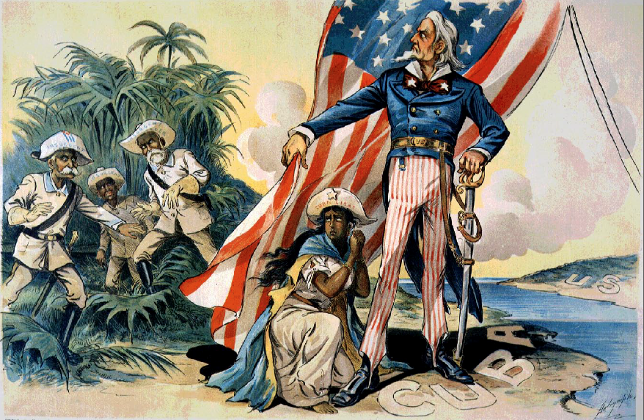
Spanish American War (1898)
America fought Spain on behalf of Cuba; involved the Philippines

Slide 3
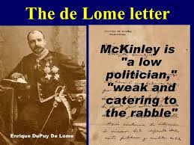
De Lome Letter
Derogatory (negative) remarks about the American President McKinley written by the Spanish ambassador; one cause of the Spanish American War

Slide 4
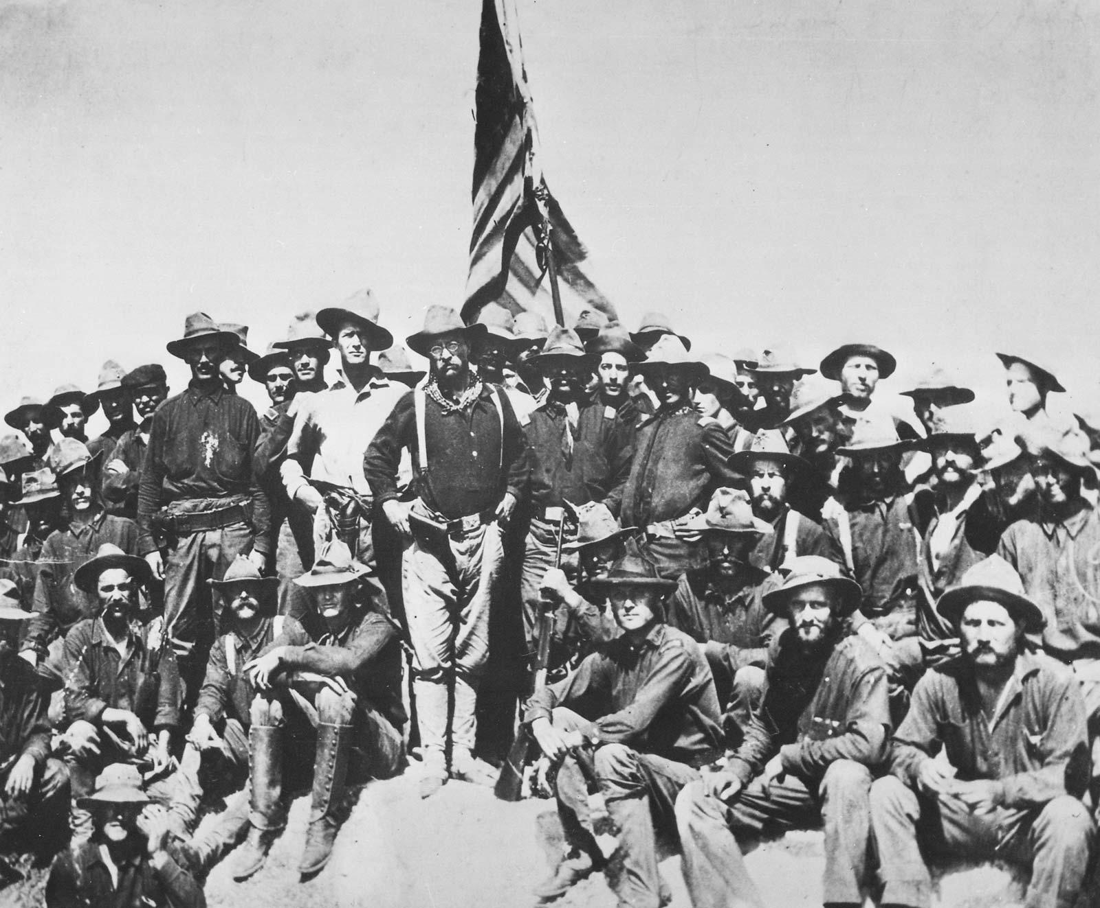
Rough Riders
Cavalry led by Teddy Roosevelt; fought the Spanish in Cuba

Slide 5
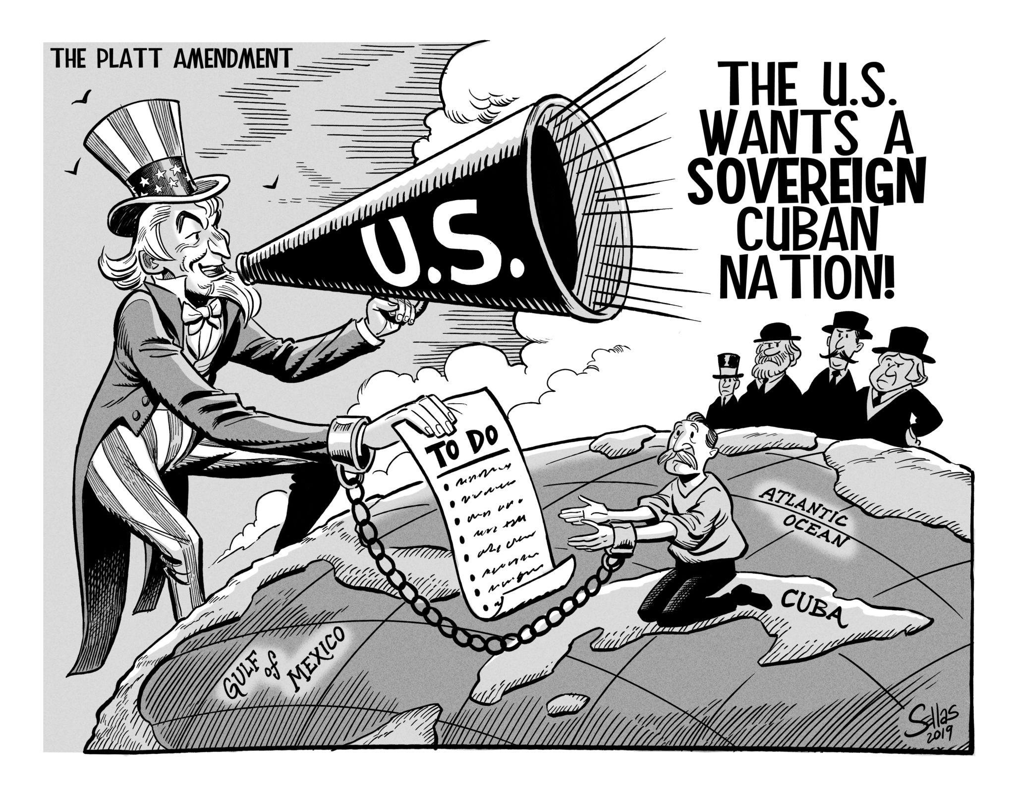
Platt Amendment
U.S. required Cuba to add this to their constitution; gave U.S. power in Cuba

Slide 6
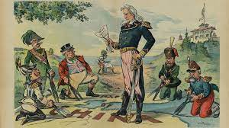
Open Door Policy
Every major industrial country should be able to trade freely with China

Slide 7
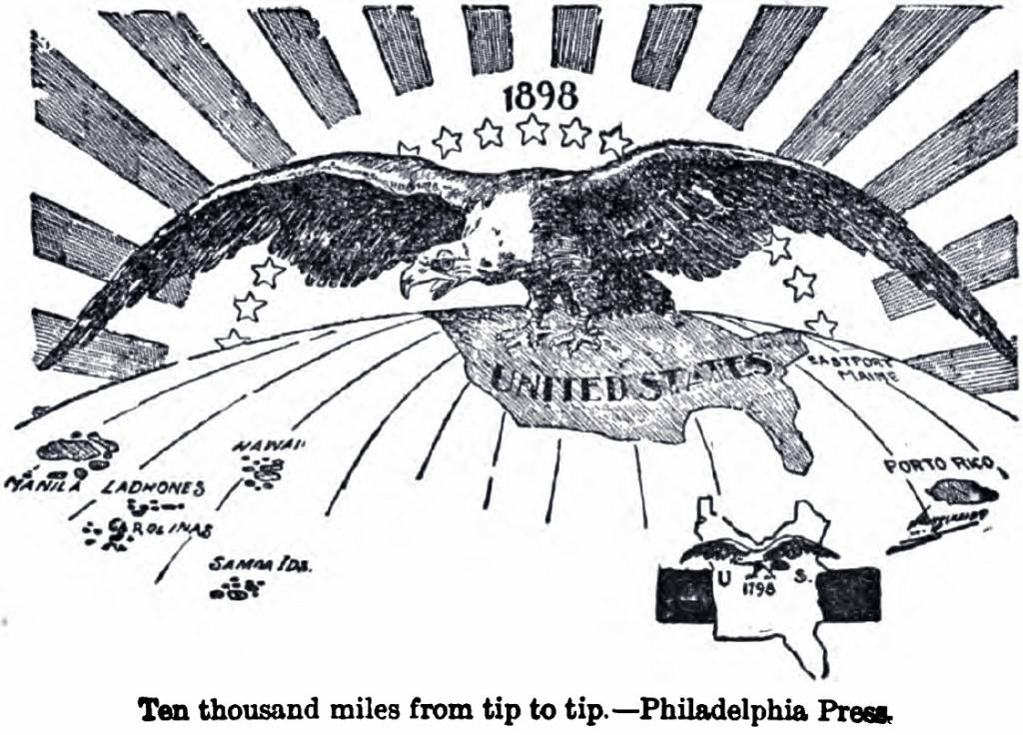
Expansionism
Increasing a country’s size by adding territory

Slide 8
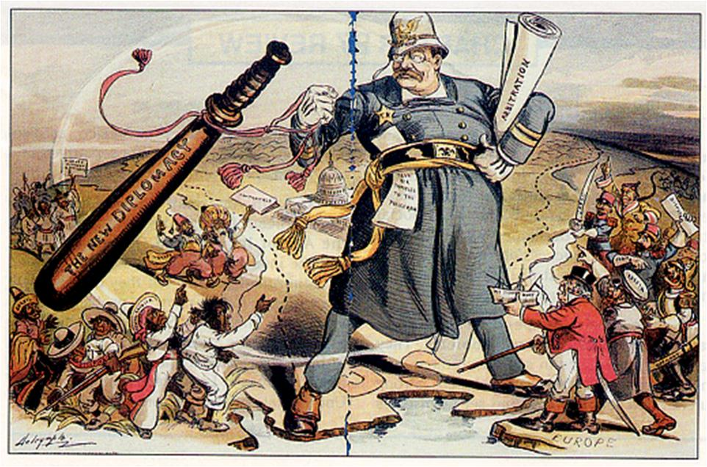
Roosevelt Corollary
U.S. would use force to protect its interests in Latin America (if necessary)

Slide 9
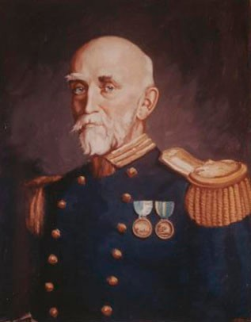
Alfred Thayer Mahan
Naval Admiral who wrote The Influence of Sea Power on History; said in order to be a world power nation must have a strong navy

Slide 10
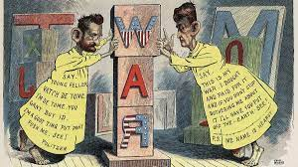
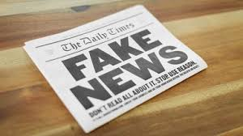
Yellow Journalism
Exaggerated and fake stories written in newspapers to encourage public response

Slide 11
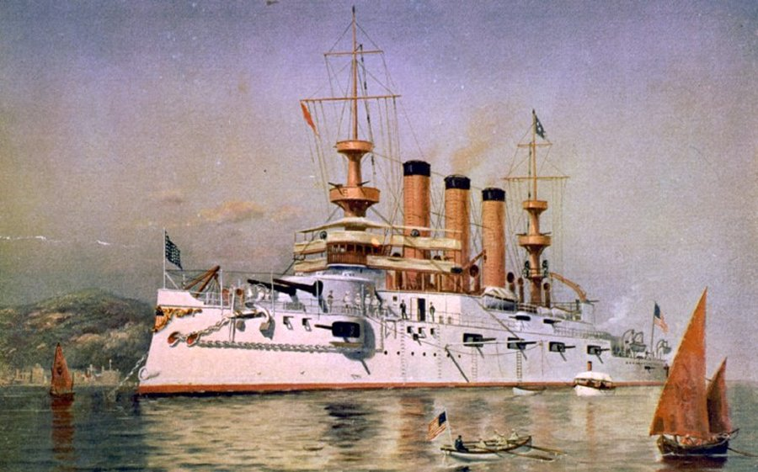
U.S.S. Maine
American naval ship that blew up in Cuba; Spain was blamed; was another reason for America to go to war with Spain

Slide 12
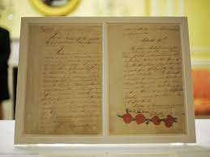
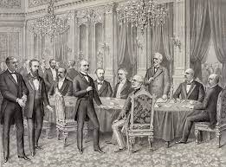
Treaty of Paris (1898)
Ends Spanish American War; gave Cuba independence; gave U.S. the Philippines, Guam, and Puerto Rico

Slide 13
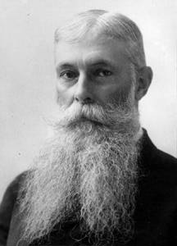
Sanford B. Dole
Convinced U.S. to annex Hawaii; 1st governor of Hawaii

Slide 14
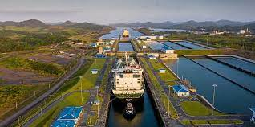
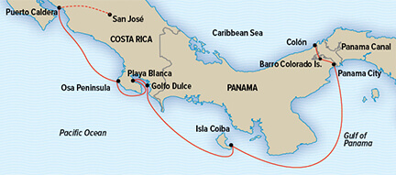
Panama Canal
Waterway passage between North and South America; reduced travel time; Teddy Roosevelt’s legacy

Slide 15
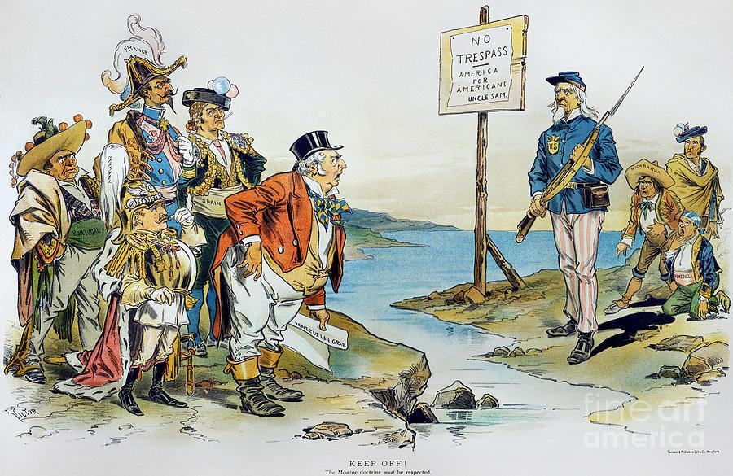
Monroe Doctrine
U.S. demanded European countries to stay out of Latin American affairs

Slide 16
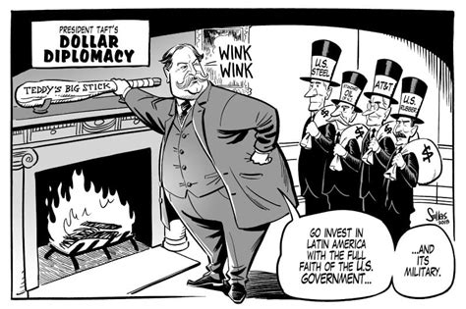
Dollar Diplomacy
U.S. government guaranteed loans made to foreign countries by American business people

Slide 17
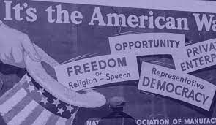
Domestic Policy
How a country deals with issues at home

Slide 18
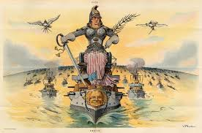
Militarism
A country builds up its military for strength

Slide 19
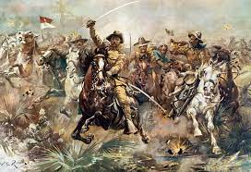
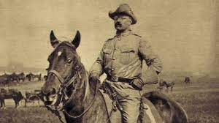
Teddy Roosevelt
Leader of Rough Riders; gains recognition and later becomes President

Slide 20
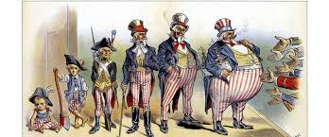
Foreign Policy
How a country deals with other countries

Slide 21
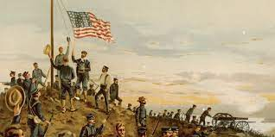
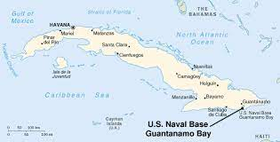
Guantanamo Bay
U.S. Naval Base in Cuba as a result of the Platt Amendment after the Spanish- American War

Slide 22
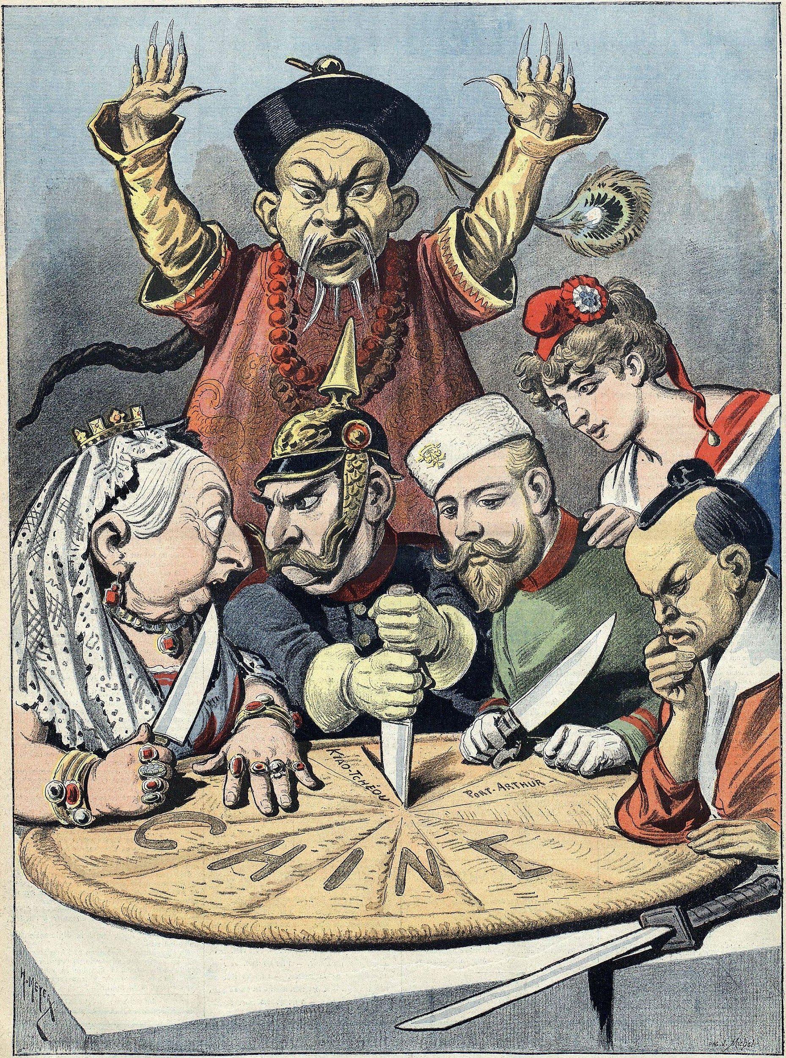
Spheres of Influence
Imperialist countries control different regions of a less powerful country

Slide 23
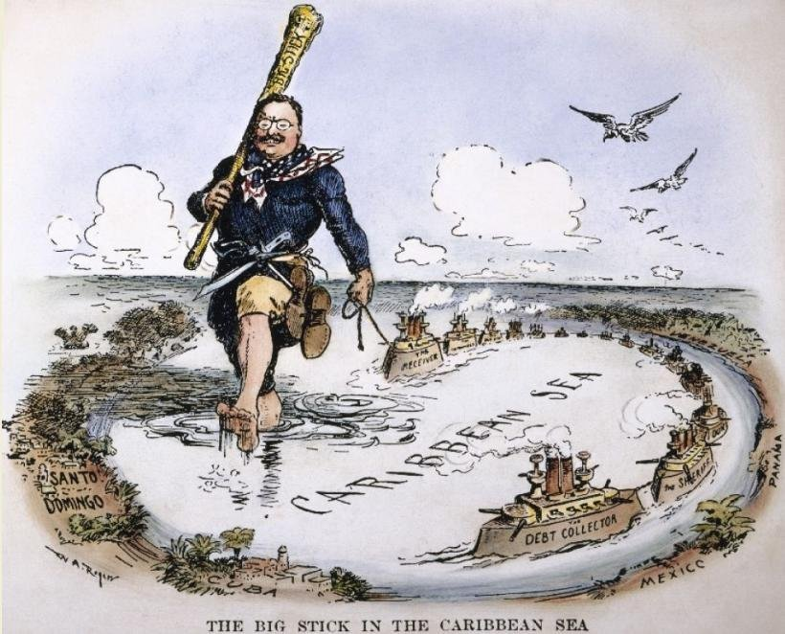
Big Stick Policy
Teddy Roosevelt’s policy of international negotiations being backed by the threat of force

Slide 24
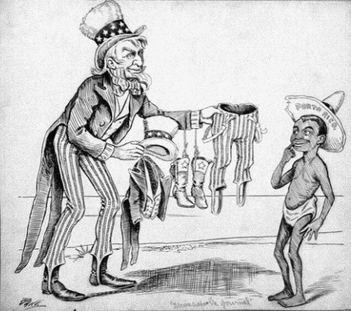
Foraker Act
U.S. law that established civilian government appointed by U.S. president on island of Puerto Rico after we acquired it during the Spanish American War

Slide 25
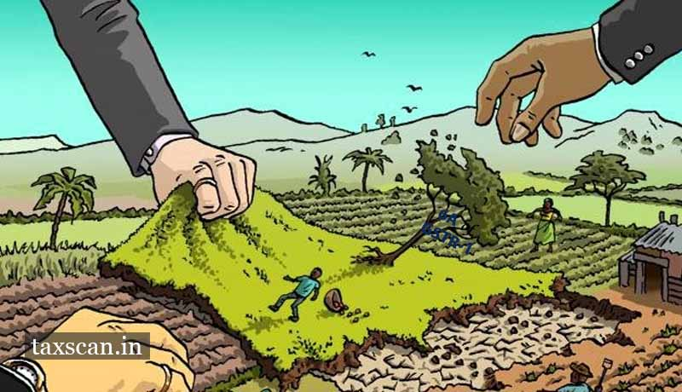
Acquisition
An asset (land) or object bought or obtained

Slide 26
Moral Diplomacy
Used by President Woodrow Wilson; system in which support is given only to countries whose beliefs are analogous (similar in practice) to that of the nation

Slide 27
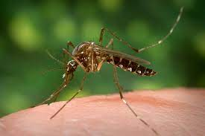
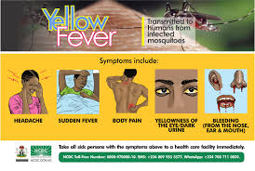
Yellow Fever
In Cuba, Dr. Gorgas learned this was transmitted through mosquitoes; his discovery allowed the canal to be built as mosquitoes were fumigated and eradicated

Slide 28
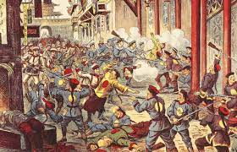
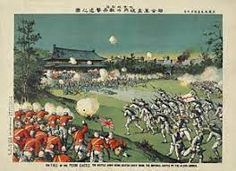
The Boxer Rebellion
Chinese secret society who wanted to purge China of all foreigners and Christians, the rebellion was put down

