Slide 1
African American Civil Rights Movements
Unit 10: Civil Rights #3

Slide 2
Wars have been fought for it. Treaties and pacts have been formed to ensure it. Men and women have sacrificed everything for the chance to experience it. That “it” is freedom.-MLK
“Freedom is never given voluntarily by the oppressor; it must be demanded by the oppressed.” You must demand it, for it will not be given freely. MLK

Slide 3
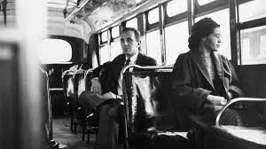
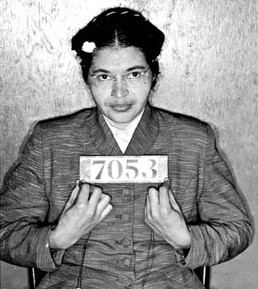
Montgomery Bus Boycott
Rosa Parks: refused to give up her seat on the bus and was arrested
This led to MLK Jr. becoming the main leader for African-American civil rights
King and others began the Montgomery Bus Boycott (nonviolent)
This lasted for 381 days until the segregation laws were changed in the federal court

Slide 4
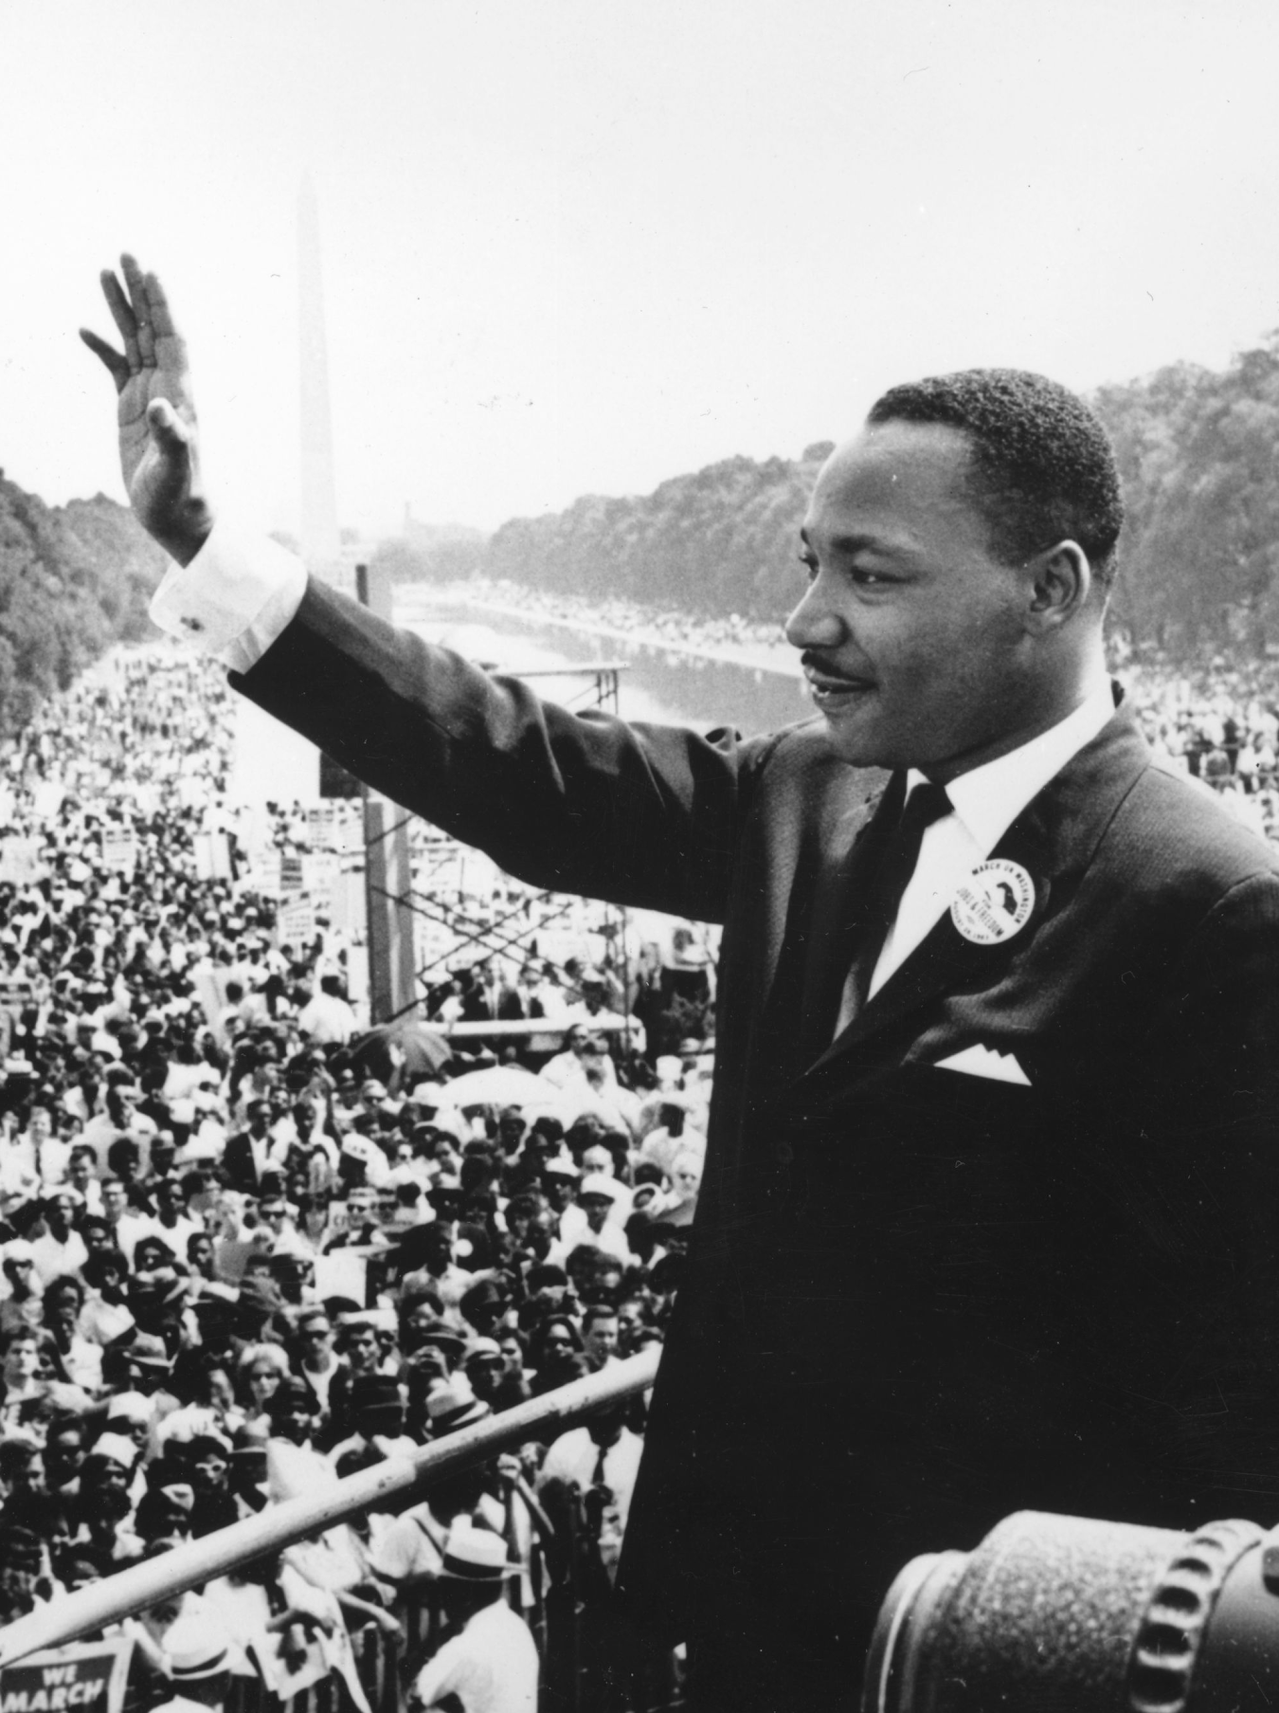
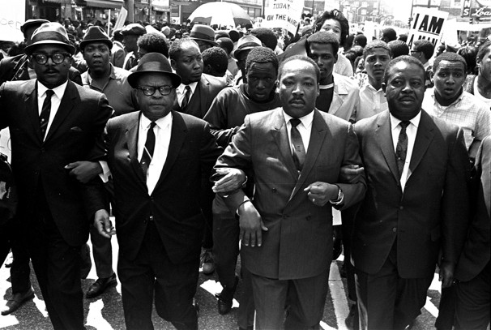
Martin Luther King, Jr. & SCLC
Promoted ending racial discrimination through non-violent protest (civil disobedience)
Focuses on Birmingham, Alabama
SCLC:
One of the first SCLC’s actions was a boycott of businesses and a series of sit-ins and marches in Birmingham, Alabama in protest of segregation
Nonviolent action strategies

Slide 5
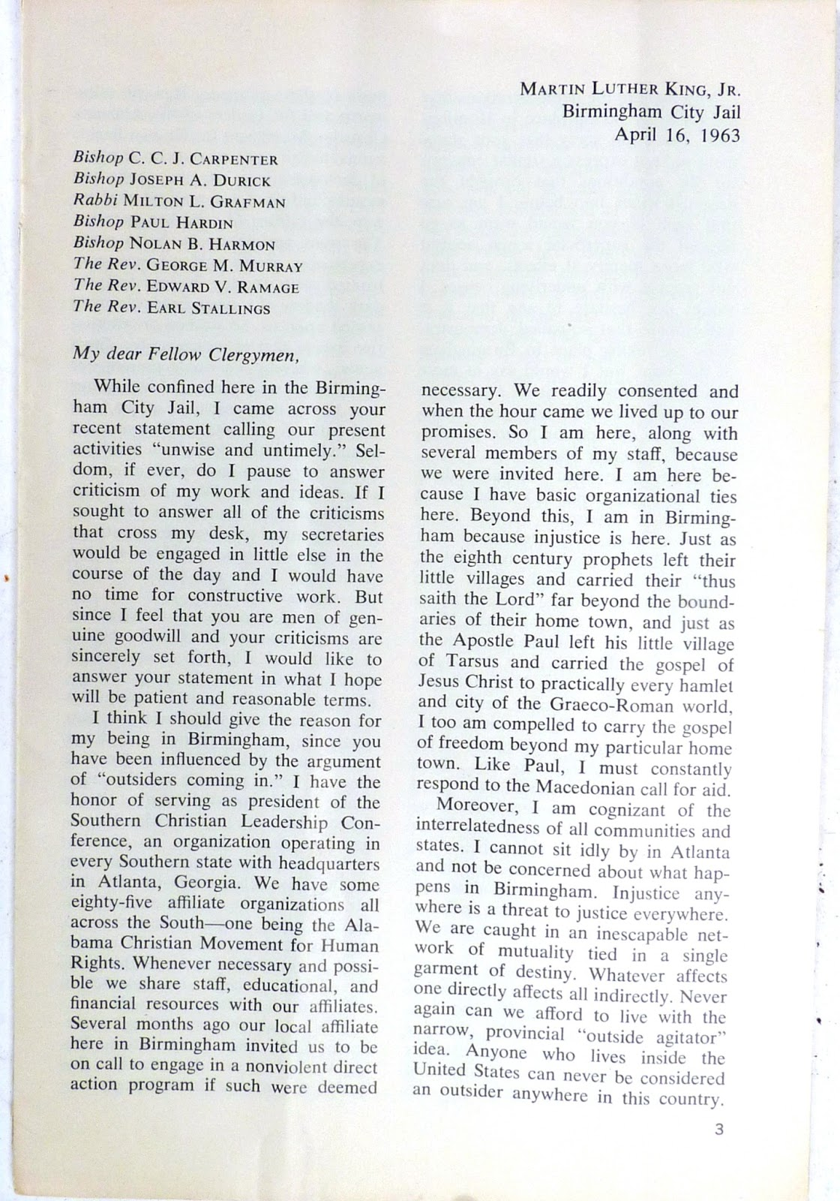
Notes:
Letter from a Birmingham Jail
MLK was arrested while in Birmingham during the peaceful protests.
While in jail he wrote the famous "letter from a Birmingham jail", in which he called other religious leaders to action.
Letter from a Birmingham Jail” (1963) discussed mistreatment of African Americans and convinced young people to join the movement

Slide 6
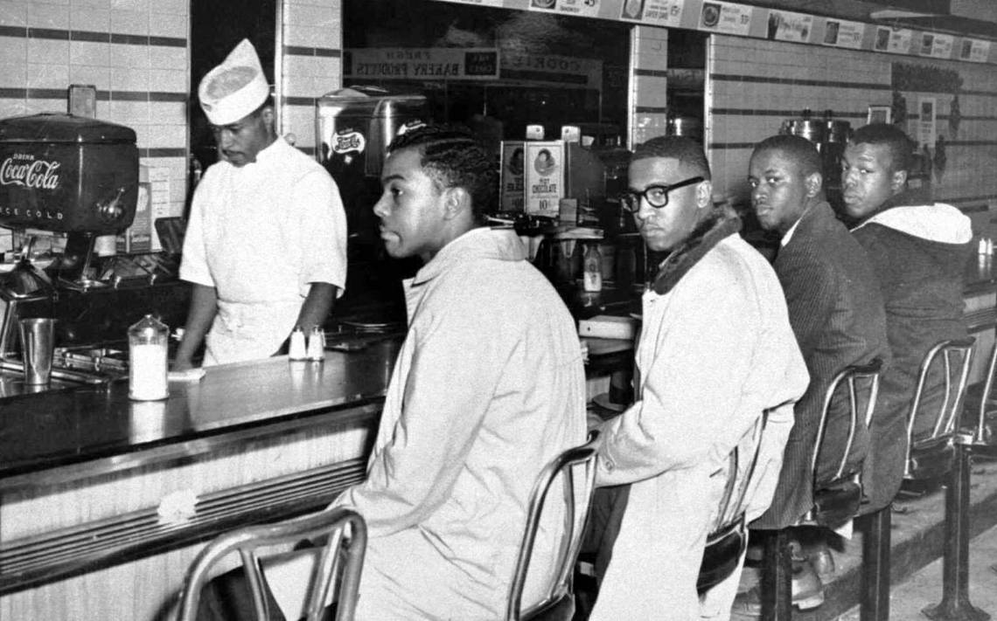
Sit Ins & Freedom Rides

Slide 7
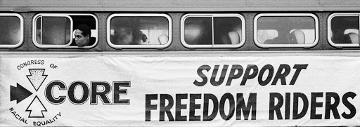

Slide 8
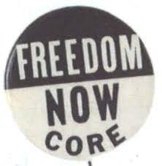
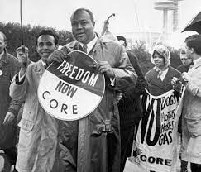
CORE
Another civil rights group at this time was the Congress on Racial Equality (CORE)
Pioneered (began) the use of nonviolent direct action in America’s civil rights struggle
During the Montgomery Bus Boycott, CORE publicized King’s work in its pamphlets

Slide 9
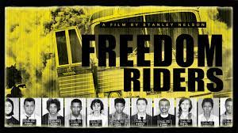
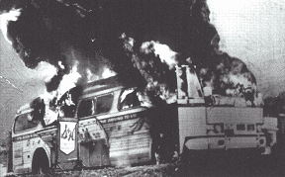
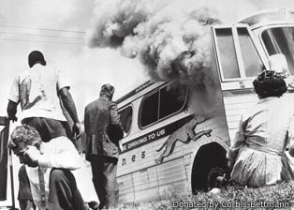
Freedom Rides
Organized in the spring of 1961, with a mission to test Supreme Court rulings of desegregation
In 1963, they organized the Freedom Rides, in which white and black civil rights workers rode buses from the North into the segregated South in defiance of Jim Crow laws

Slide 10
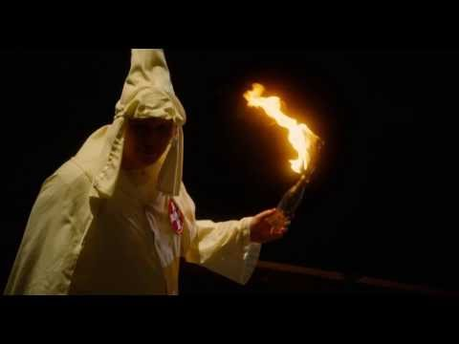

Slide 11
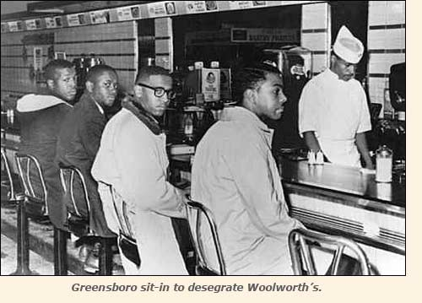
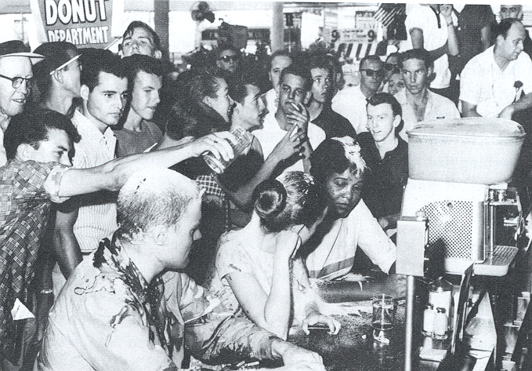
SNCC & The Sit-Ins
The Student Nonviolent Organizing Committee (SNCC - pronounced “snick”) was a civil rights group made of mostly black and white college students
They were best known for sit-ins
They would sit down in white-only areas of restaurants often being assaulted

Slide 13
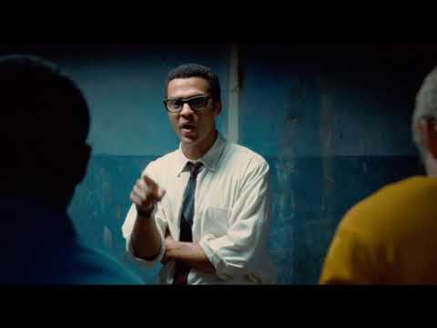

Slide 14
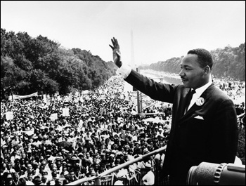
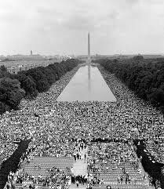
March on Washington
1963: Martin Luther King called on the leaders of other civil rights groups to help him organize a March on Washington
They demanded an end to segregation in the South
It was at this event that MLK gave his famous “I Have A Dream” speech

Slide 15
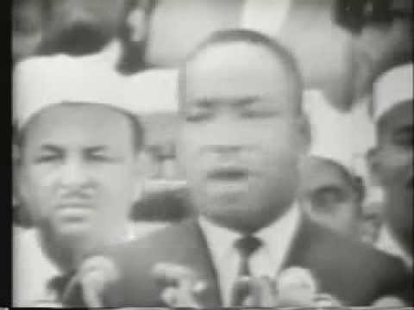

Slide 16
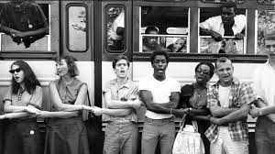
Freedom Summer

Slide 17
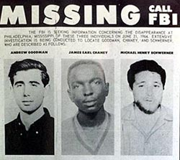
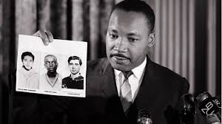
Freedom Summer
In 1964, SNCC, the SCLC, & the NAACP helped organize Freedom Summer, where civil rights workers went to Mississippi to register African Americans to vote
There was a very violent reaction to this, three civil rights workers were murdered and at least 4 African American locals were killed as well
At least 1000 assaults

Slide 18
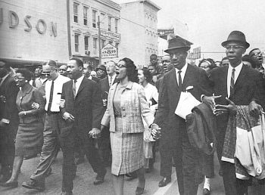
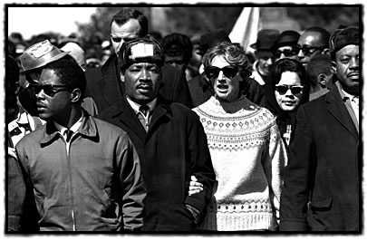
Selma March (1965)
Protest march after police arrest those trying to vote

Slide 19
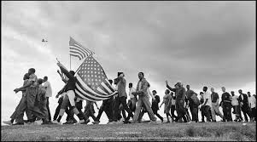
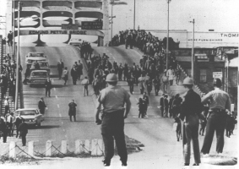

Slide 21
The 1960s: Reactions & Backlash to the Civil Rights Movement

Slide 22
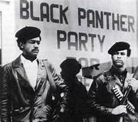
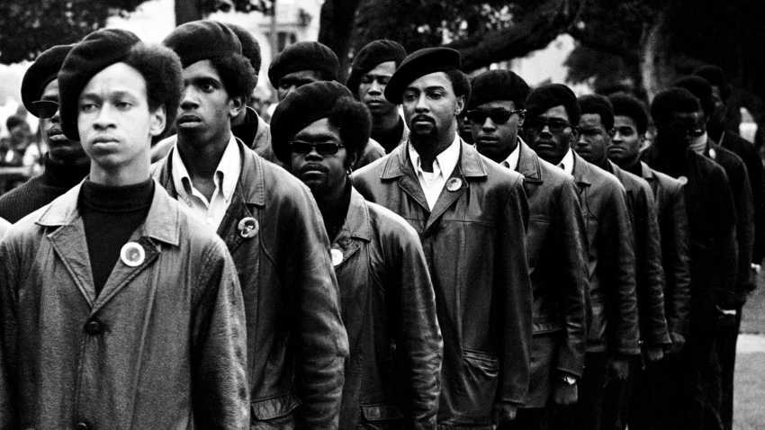
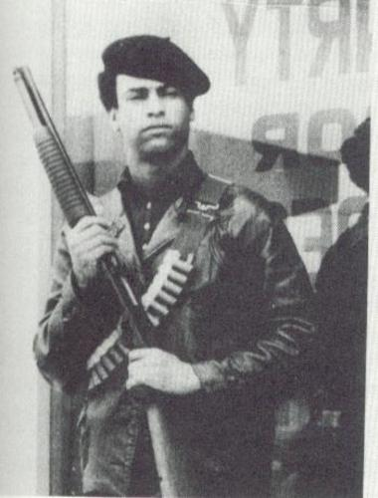
The Black Panthers
Militant (aggressive) political party that advocated for equal opportunities
Violence was acceptable if necessary
Founded by Huey P. Newton

Slide 23
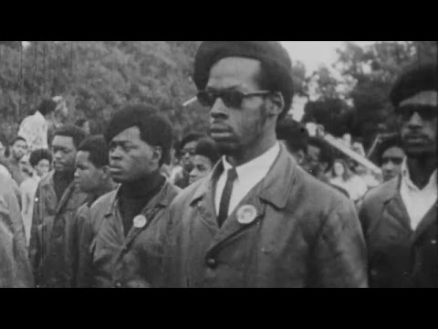

Slide 24
Black Panther Solutions
At first, the Black Panthers were black nationalists (believed in blacks being separate from and superior to whites)
Eventually, they changed and supported blacks and whites working together
Some solutions they tried:
Setting up free private schools
Day cares
Free breakfast programs for kids
Drug & alcohol rehab

Slide 25
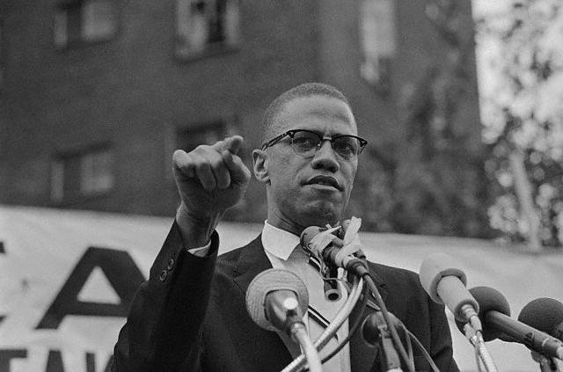
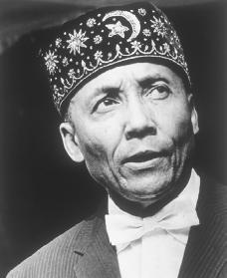
Malcolm X
Disagreed with nonviolent protests
More radical than MLK Jr.
Joined the Nation of Islam
Nation of Islam is a sect of the Muslim religion specifically for African Americans (led by Elijah Muhammed)
Unlike King and most other civil rights groups, they were opposed to integration of blacks and whites
They also advocated violence and were critical of King’s nonviolent approach

Slide 26
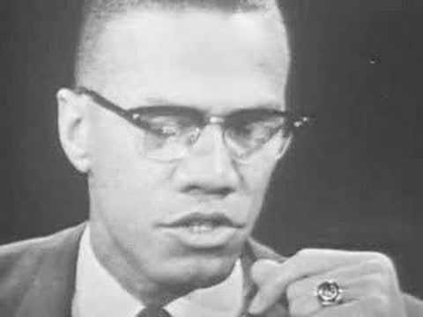

Slide 27
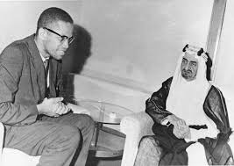
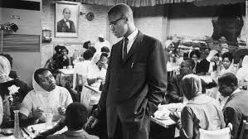
A Change of Heart
In 1964, Malcolm X left the Nation of Islam and went on a Hajj (pilgrimage) through Africa to Mecca, Saudi Arabia
While there, he met Muslims of various ethnicities working together peacefully; he converted to Sunni Islam and changed his message to African Americans
He expressed a willingness to work with other civil rights groups and to act peacefully
He also claimed to have been a brainwashed “zombie” of the Nation of Islam

Slide 29
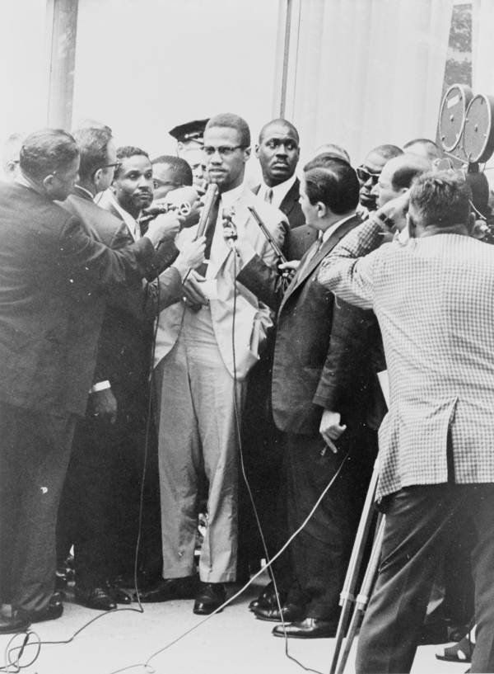
Assassination of Malcolm X
February 21, 1965, New York City, Malcolm X was assassinated while addressing his organization of Afro-American Unity at the Audubon Ballroom in Washington Heights
At least one of the shooters was a member of the Nation of Islam - controversy surrounds the case, as many believe that the Nation of Islam ordered the assassination; he was 39 years old

Slide 30
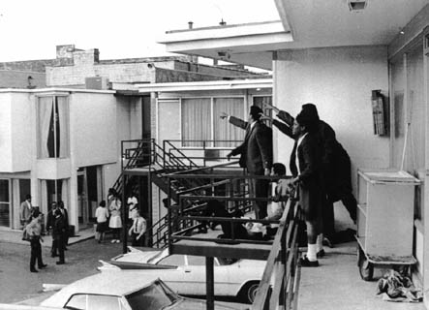
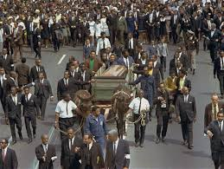
Assassination of MLK Jr.
On April 4, 1968, Martin Luther King was shot and killed while standing on a hotel balcony in Memphis
While his killer was eventually caught, controversy surrounds his death as well
The news of King’s death led to deadly, violent race riots across the nation

Slide 31
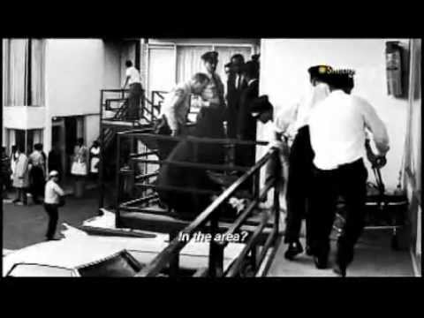

Slide 32
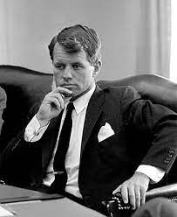
Robert F. Kennedy
“We must recognize that this short life can either be ennobled or enriched by hatred or revenge. Our lives on this planet are too short and the work to be done too great to let this spirit flourish any longer in our land.”
Advocated for civil rights and a better America
Was assassinated 2 months after MLK

Slide 33
