Slide 1
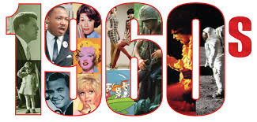
1960s & Vietnam

Slide 2
Leadership is essential to how a country responds to foreign and domestic issues.

Slide 3
John F. Kennedy

Slide 4
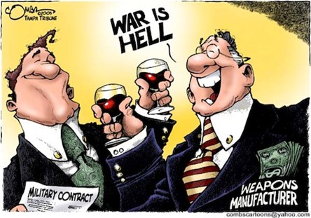
Military-Industrial Complex
As President Eisenhower left office, he warned Americans not to allow too much power to fall into the hands of what he called the "Military-Industrial Complex,"
which meant the relationship between the government and the arms industry.

Slide 5
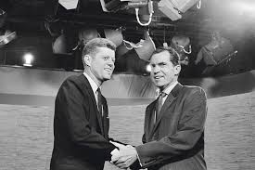
Election of 1960
Peopled liked Vice President Richard Nixon because of his tough stance on the Cold War and Communism.
People liked Senator John F. Kennedy because of his youth, charisma, and dedication to African-American Civil Rights.
Kennedy vs. Nixon

Slide 6
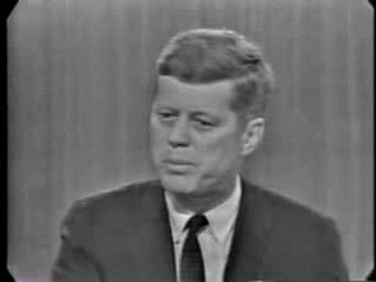

Slide 7
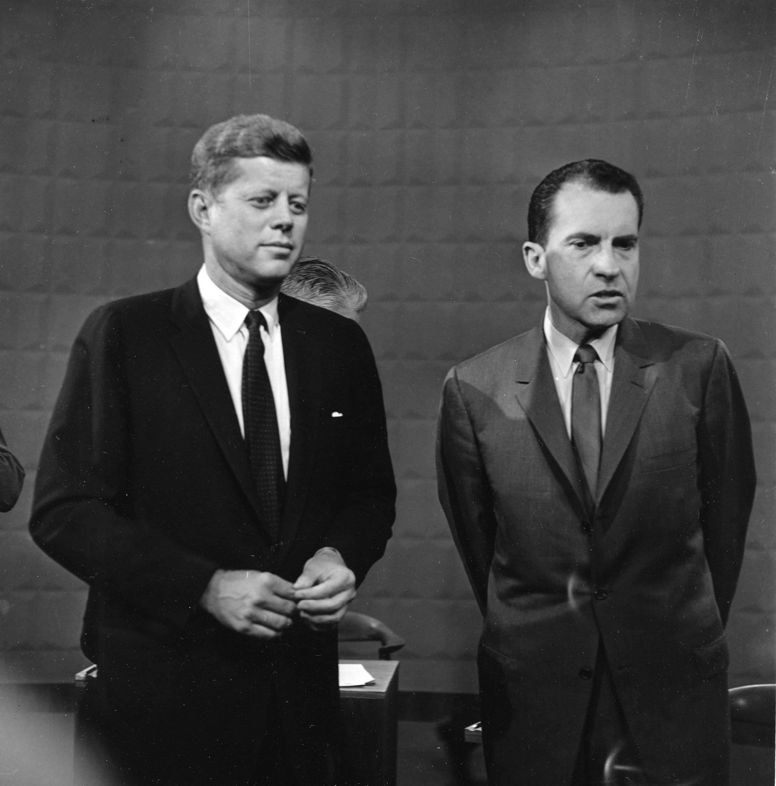
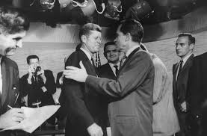

Slide 8
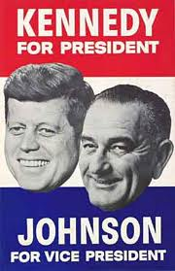
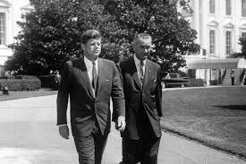
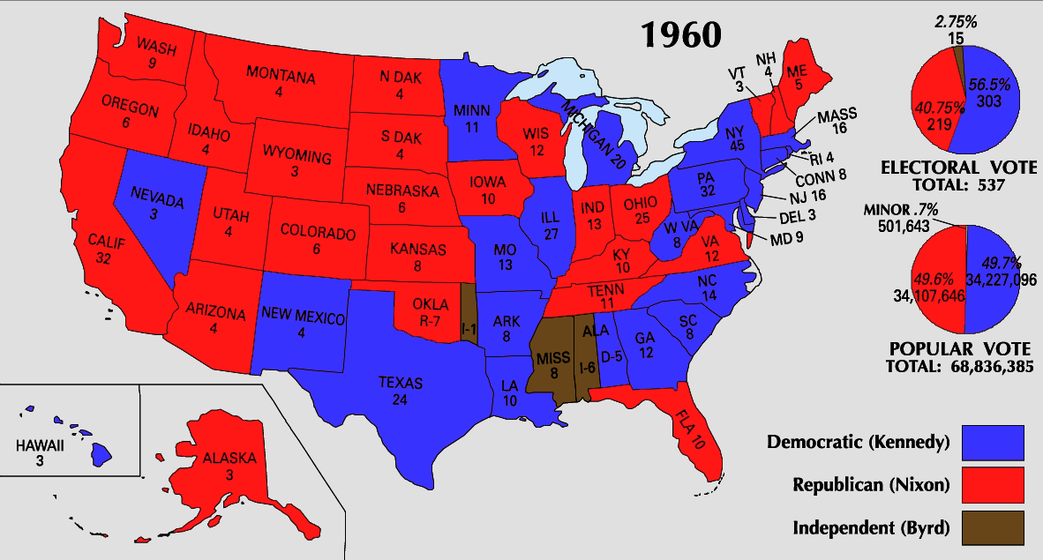
Election of 1960:
With help from his running mate: Senate Majority Leader Lyndon Johnson becomes Vice-President
JFK defeats Nixon and became President of the United States. (35th President)

Slide 9
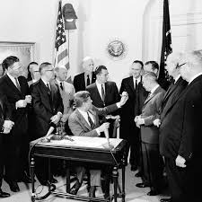
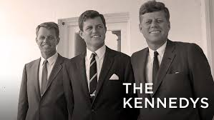
“Brain Trust”
President Kennedy gathered a group of highly educated experts for his cabinet
His brother Robert Kennedy was his Chief Advisor and the US Attorney General
The press will refer to them as the “Brain Trust”

Slide 10
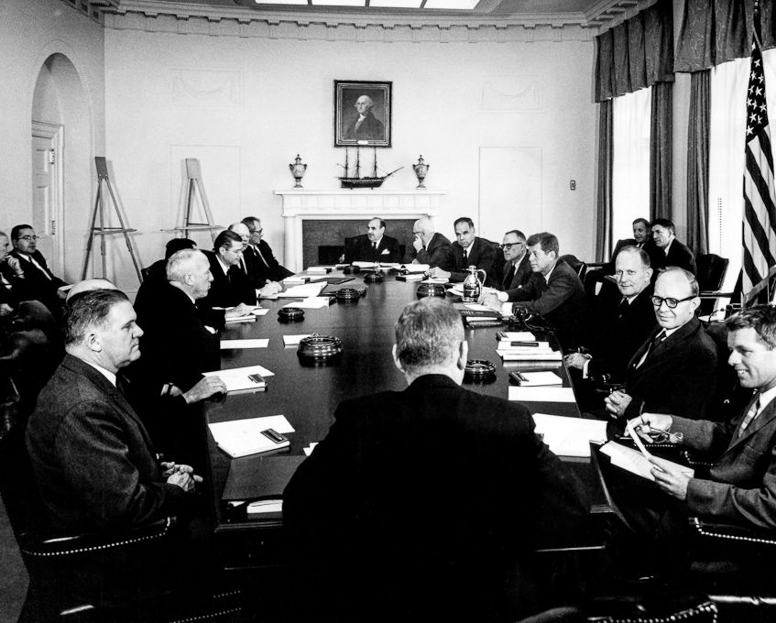
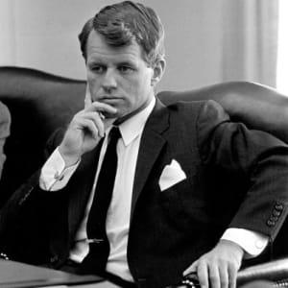

Slide 11
Kennedy and the Cold War

Slide 12
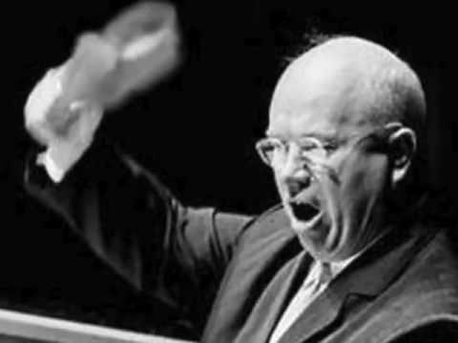
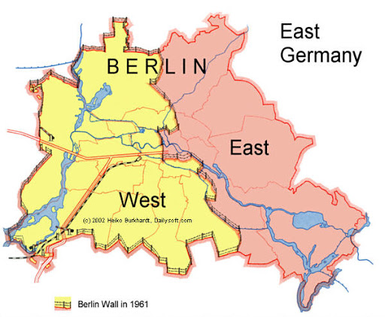
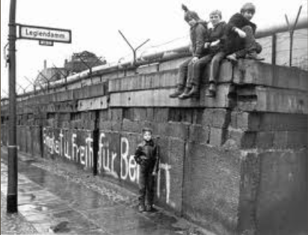
The Berlin Wall
Soviet Premier(president) Nikita Khrushchev threatened to block all access to West Berlin again.
When Kennedy refused to negotiate with him on the issue, the Soviets built the Berlin Wall around West Berlin.
This was to stop Eastern Europeans from escaping to the democratic West

Slide 13
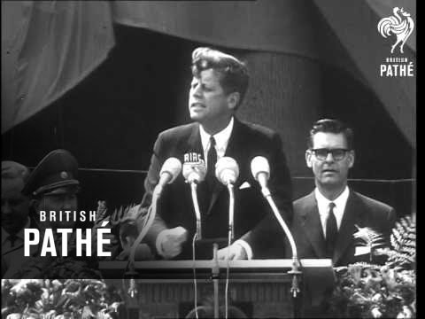

Slide 14
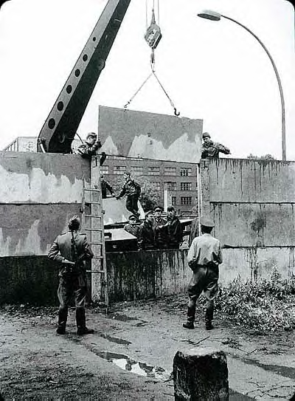
Berlin Wall Construction

Slide 15
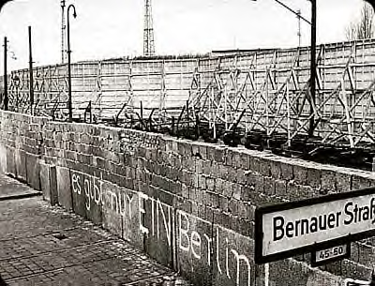
Berlin Wall

Slide 16
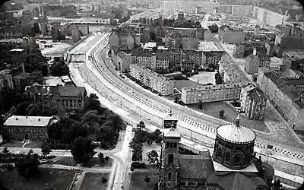
Berlin – a city divided…

Slide 17
Communism in Cuba

Slide 18
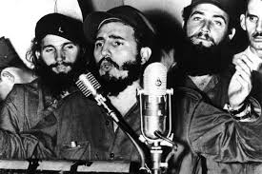
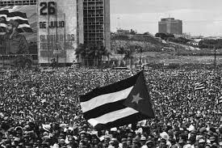
Communism Expands
Widespread poverty will make Latin America ideal for the spread of communism
The Cold War and heavy American influence will also contribute to the Cuban Revolution in the 1950’s
This will make the problem of communism much closer for the United States

Slide 19
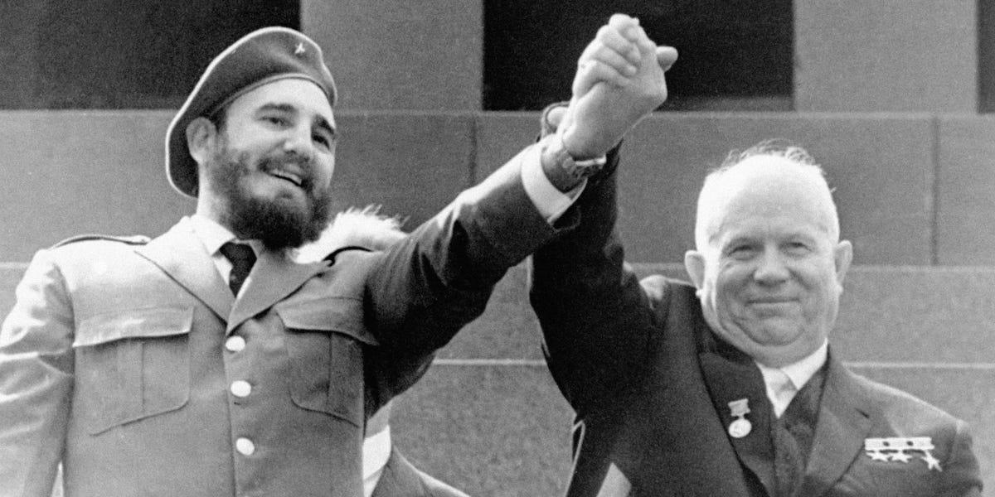
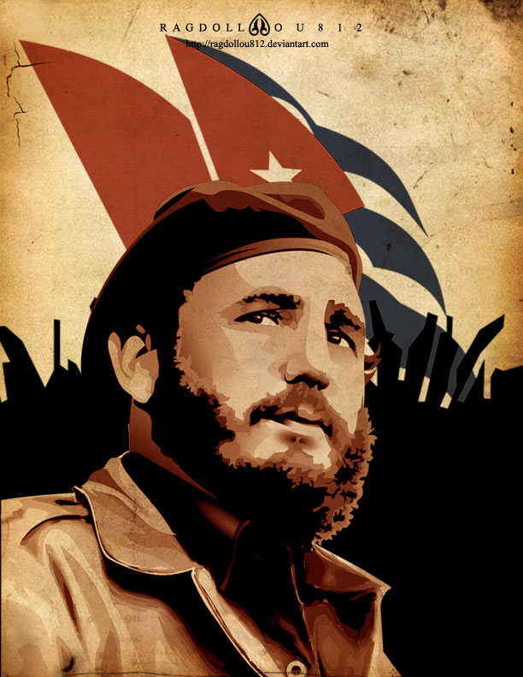
Communist Cuba
Nikita Khrushchev-Soviet Union
In 1959: Cuba became a Communist dictatorship after a revolution led by Fidel Castro.
The new Communist Cuba quickly became allies with the Soviet Union, causing much fear in the U.S.

Slide 20
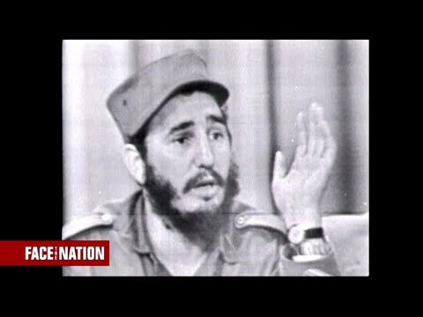
Face the Nation

Slide 21
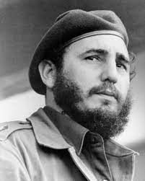
Fidel Castro
Promised democracy to Cubans but once in power he nationalized businesses and executed opponents
He does help many Cubans by increasing the standard of living
This led to America breaking off trade in Cuba
**This is why Cuban cigars are more desired**
Which will lead Castro to seek support from the Soviet Union

Slide 22
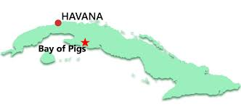
BAY OF PIGS:

Slide 23
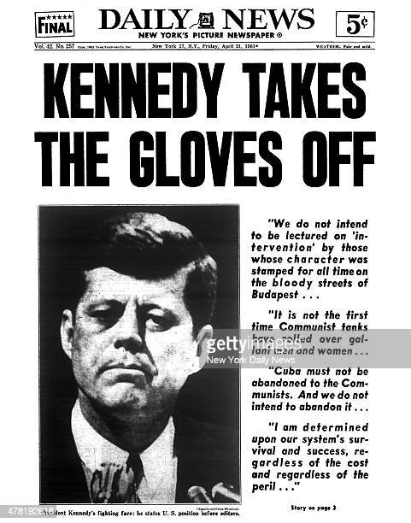
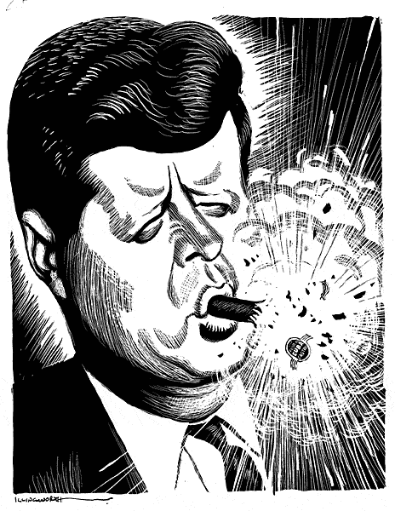
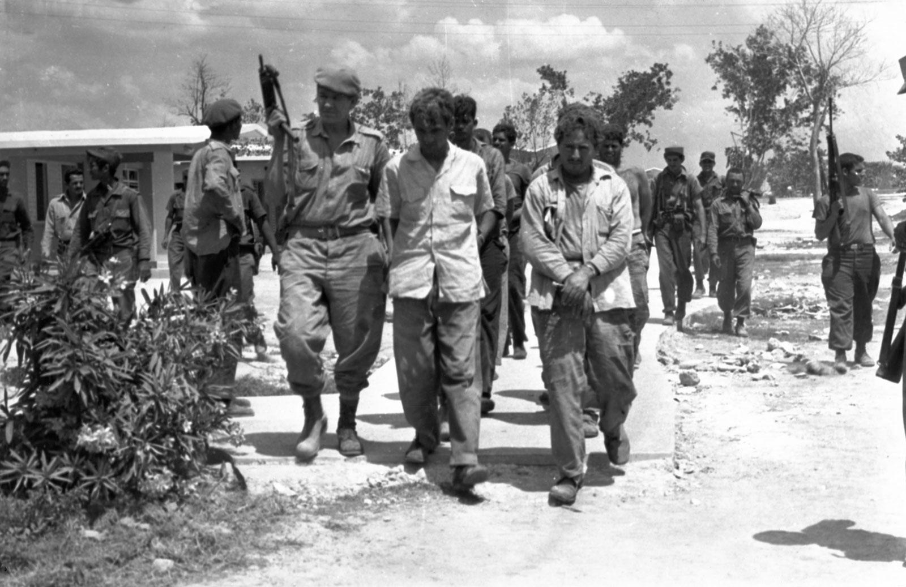
Bay of Pigs
In 196: Cuban exiles trained by the CIA invade Cuba at the Bay of Pigs
The goal was to start an uprising against Fidel Castro
To remove him from power
To remove Communism
Notes:
On April 17, the Cuban exile brigade began its invasion at an isolated spot on the island’s southern shore known as the Bay of Pigs. Almost immediately, the invasion was a disaster. The CIA had wanted to keep it a secret for as long as possible, but a radio station on the beach (which the agency’s reconnaissance team had failed to spot) broadcast every detail of the operation to listeners across Cuba. Unexpected coral reefs sank some of the exiles’ ships as they pulled into shore. Backup paratroopers landed in the wrong place. Before long, Castro’s troops had pinned the invaders on the beach, and the exiles surrendered after less than a day of fighting; 114 were killed and over 1,100 were taken prisoner.

Slide 24
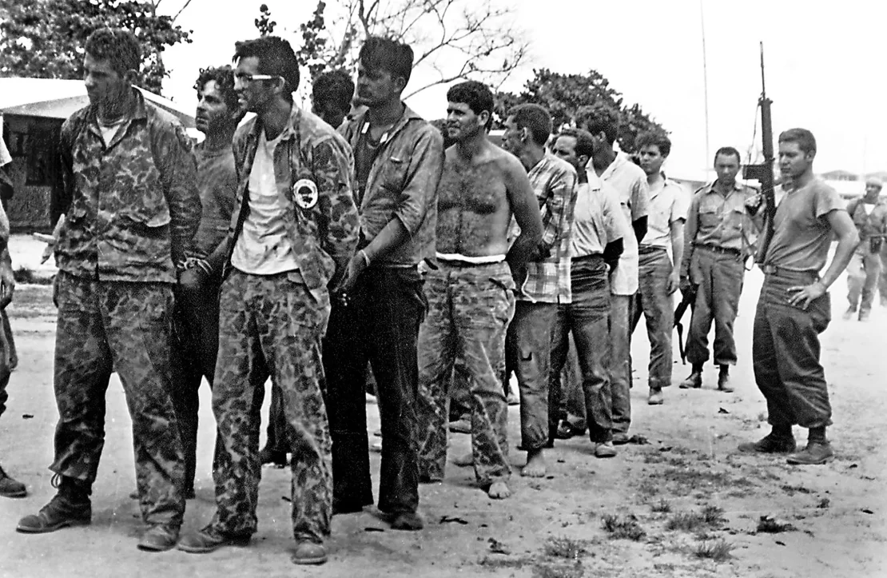
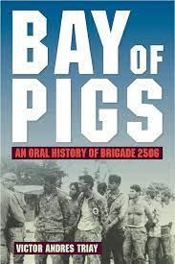
President Kennedy refused to supply the rebels with air support to help carry out the attack.
The invasion fails!!!!!

Slide 25
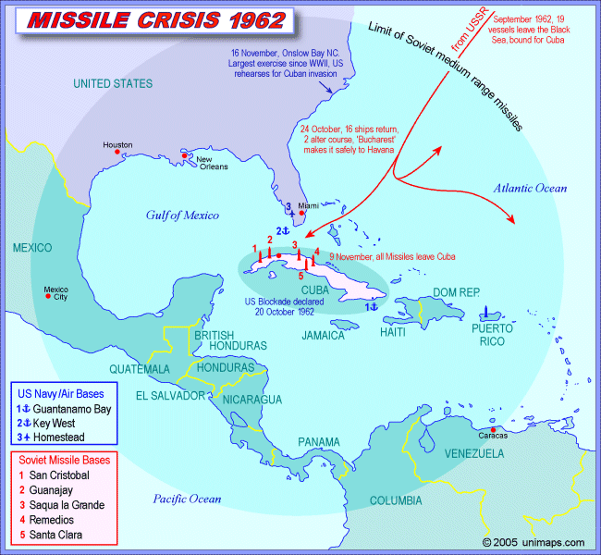
Cuban Missile Crisis
In response to the Bay of Pigs (and other attempts by the U.S. to overthrow Castro) the Soviet Union built nuclear launch bases in Cuba(secretly)
This would put the U.S. under a very real threat of a nuclear attack.
Roughly 100 miles of the coast of Florida

Slide 26
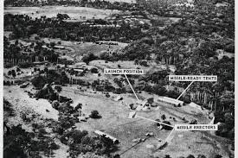

Slide 27
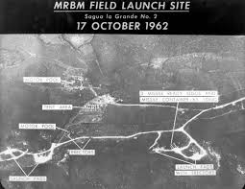
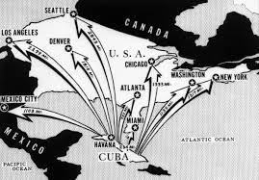

Slide 28
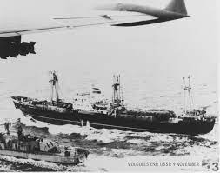
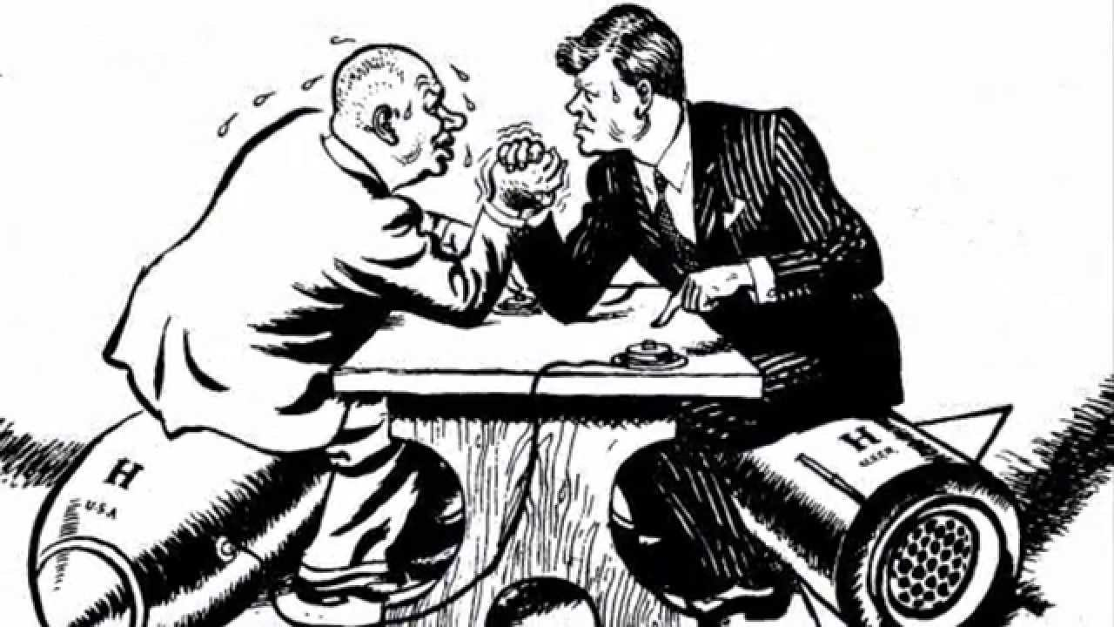
Cuban Missile Crisis
The Kennedy administration responded with a naval blockade of Cuba
Threatened to invade if the missiles were not withdrawn.
The next 13 days were tense as it will be the closest to the US & USSR ever came to nuclear war.
Khrushchev eventually backs down

Slide 29
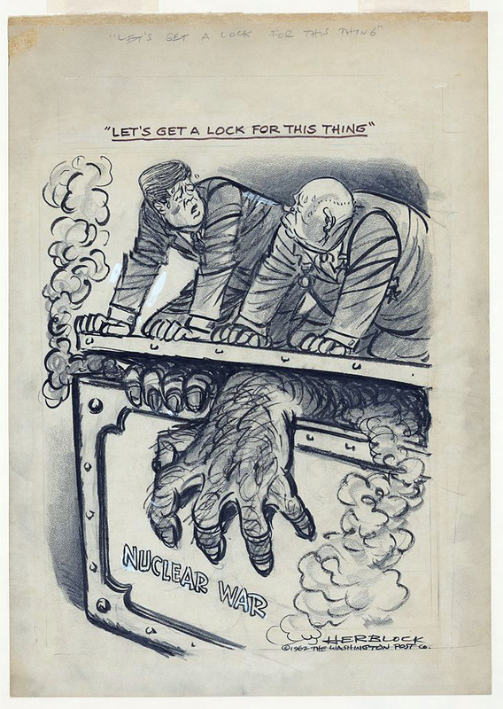
The other part of the story….
The Soviets had installed missiles in Cuba because the US had installed the same type of missile in Turkey and Italy
Both agreed to dismantle their missile sites
Notes:
Khrushchev and Kennedy secretly agreed that

Slide 30
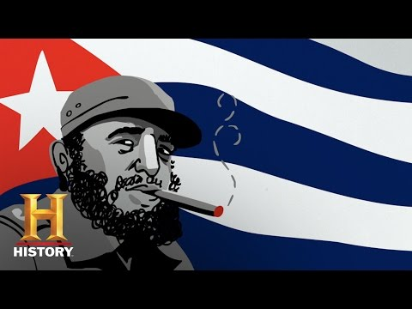

Slide 32
Kennedy and the New Frontier

Slide 33
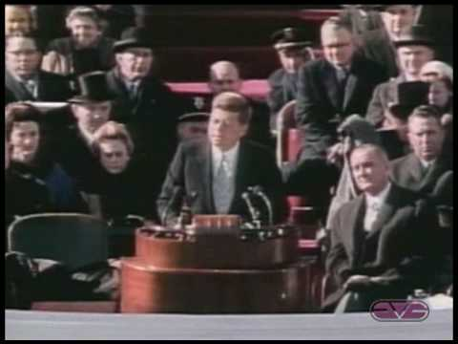

Slide 34
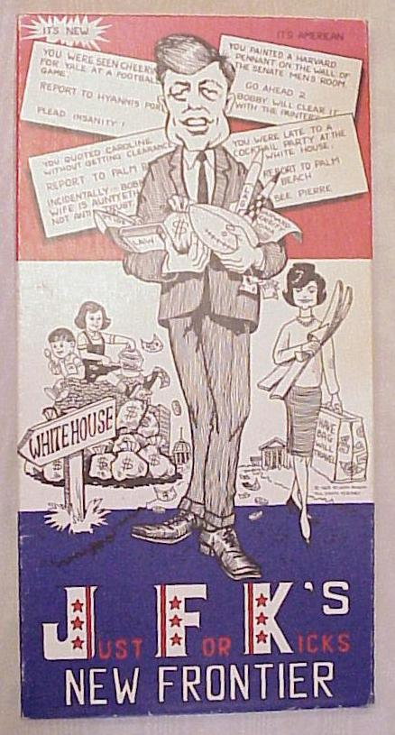
Kennedy & The New Frontier
Kennedy called his domestic program the New Frontier
It mostly focused on helping the poor
Republicans and Southern Democrats blocked most of these programs
but he was able to get some things accomplished in spite of the opposition

Slide 35
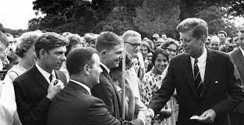
The Peace Corps
One of Kennedy’s most praised programs
An organization that sends Americans to developing countries to help and provide various services
This program was created to help provide good will for the US and abroad and to instill a service ethic in America’s young adults

Slide 36
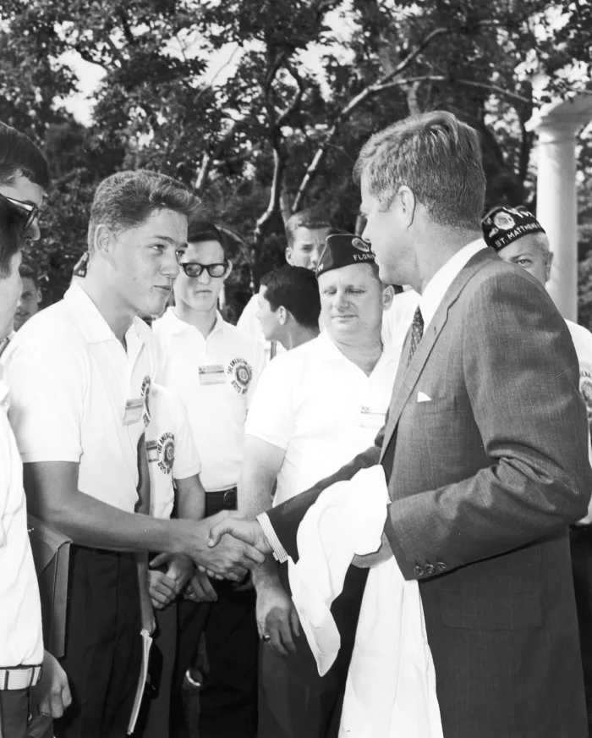

Slide 37
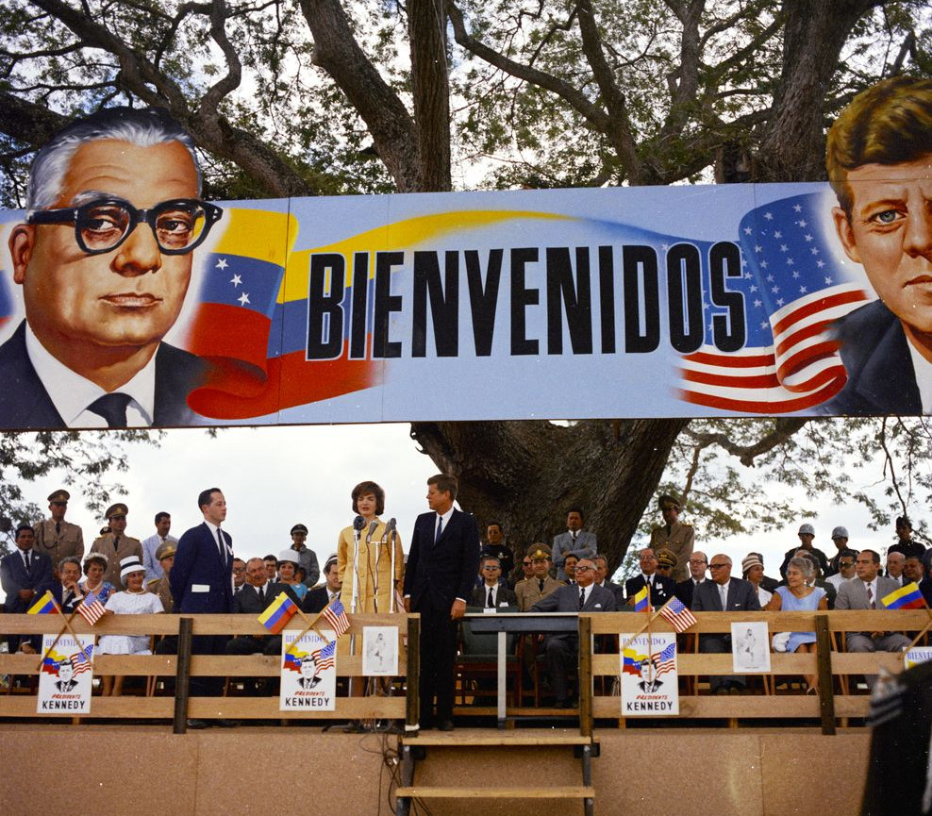
Alliance for Progress
Helped developing Latin American countries economically
Main purpose was to prevent the spread of Communism in Latin America
Notes:
Picture was from Venezuela 1961

Slide 38
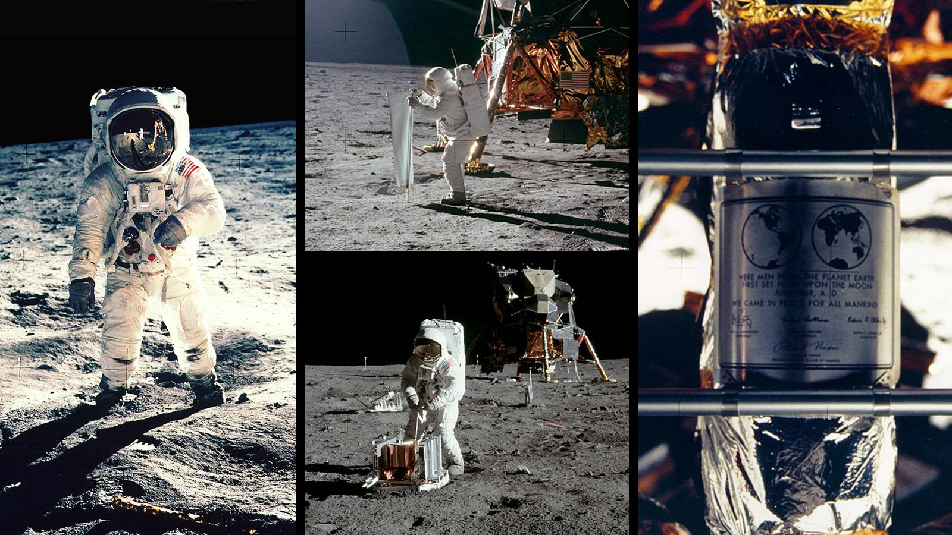
The Apollo Program
Kennedy’s most well known program was to put a man on the Moon
1962: Kennedy challenged America to put a man on the moon by the end of the 1960s
In 1969, NASA’s Apollo program was successful

Slide 39
Quotable Quotes
“We choose to go to the moon in this decade and do other things, not because they are easy but because they are hard.”
-President John F. Kennedy (1962)
Respond the this quote. How does this make you feel? What things do you want to do? Why do you want to do them? Do you think America is living up to President Kennedy’s challenge today? Why/Why not?

Slide 40
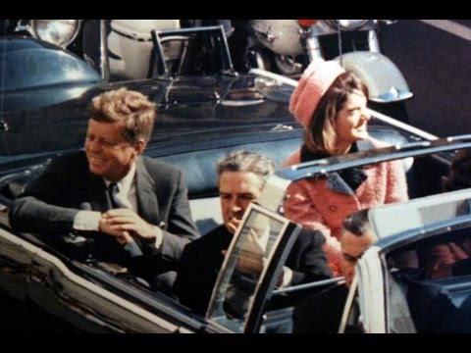

Slide 41
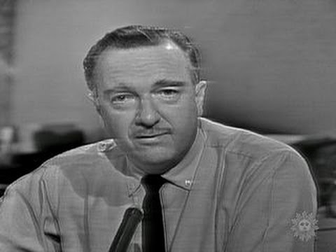

Slide 42
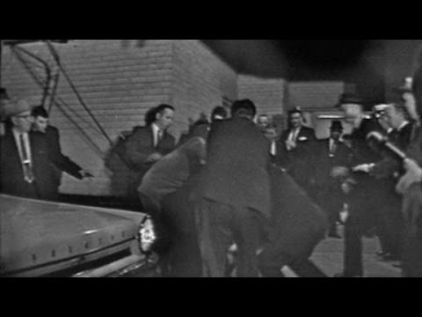

Slide 43
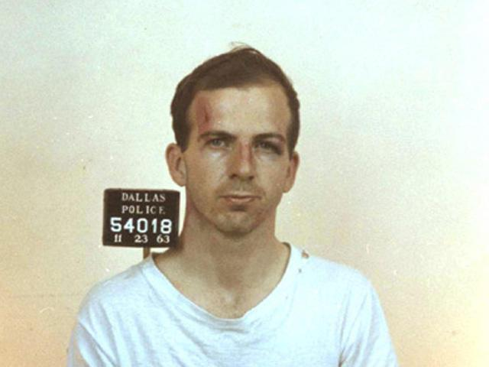
The Assassination
Lee Harvey Oswald, a US Marine veteran was charged with the assassination of President Kennedy
Shortly after his arrest he was killed by Jack Ruby, a Dallas nightclub owner
After the assassination, Vice President Lyndon B Johnson will be sworn in as President

Slide 45
Warren Commission
Created by President Lyndon B Johnson
Headed by Supreme Court Chief Justice Earl Warren
They investigated JFK’s assassination and ruled that Oswald was the lone killer in spite of numerous conspiracy theories

Slide 46
President Lyndon Baines Johnson
Many fellow Southern Democrats will not support Johnson’s stance on Civil Rights.
He will be dedicated to African American Civil Rights
With the help from sadness of JFK’s death, LBJ will gain the passage of 2 Civil Rights Acts
1964 Civil Rights Act which will outlawed public segregation
1965 Voting Rights Act which outlawed voting discrimination

Slide 47
GREAT SOCIETY
LBJ saw himself as a domestic policy president.
He wanted to make America a better-more fair place.
He called this agenda “The Great Society”

Slide 48
Attempts at Universal Healthcare
A big part of the Great Society was the war on poverty
Healthcare accounted for much of low-income people’s spending
LBJ pushed two programs through Congress:
Medicare (healthcare for the elderly and disabled)
Medicaid (healthcare for the poor and disabled).
Notes:
ESTABLISHED MEDICAID AND MEDICARE
MEDICAID = EXTENDED HEALTH INSURANCE TO WELFARE RECIPIENTS
MEDICARE = LOW COST MEDICAL INSURANCE FOR ELDERLY

Slide 49
Other programs included:
affordable housing laws
childcare programs
food stamp
public educational programming
Notes:
Silent Spring: book by Rachel Carson’s that exposed the dangers of pesticides and other harmful environmental threats
•Silent Spring led to the Water Quality Act of 1965— required states to clean up their rivers and lakes
•LBJ also ordered the government to search out and clean up corporate polluters of the environment

Slide 50
Vietnam Troubles
In spite of Johnson’s domestic achievements, LBJ did a poor job managing America’s war in Vietnam.
America’s youth portested in big numbers chanting “Hey, Hey, LBJ, how many kids will you kill today?”
When it came time for reelection in 1968, he chose not to run.

