Slide 1
Chapter 23 Industrialization and Nationalism
Lesson 4 - Nation Building in Latin America

Slide 2
By the end of the 18th century, the new political ideals that supported the American Revolution began to take hold in Latin America, and many countries followed their lead
Peninsulares
Spanish & Portuguese officials who came to Latin America temporarily to represent their country’s interests

Slide 3
Creoles
Descendants of Europeans who had settled permanently in Latin America
They had land & businesses & they supported liberal goals
1. Equality of people in the eyes of the law
Free trade
Free speech & press
Did not like being controlled by Spain/Portugal
Written constitutions

Slide 4
Mestizos
People of mixed European & Native American descent
They also wanted freedom from European rule
Between 1791 & 1825 a series of revolts enabled most of Latin America to become independent

Slide 5
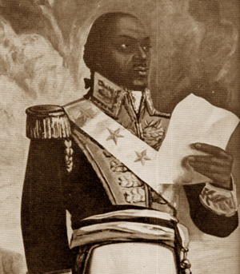
Haiti (1791)
A French colony based on sugar production
Toussaint Louverture led more than 100,000 slaves in a revolt

Slide 6
Haiti (1791-1804)
The revolt was successful fought the French & others (many of these died of yellow fever)
1804 – Haiti granted independence – 1st in Latin America
Notes:
Why the Louisiana Purchase was offered for sale by Napoleon. After Haiti he concluded colonies could not be defended

Slide 7
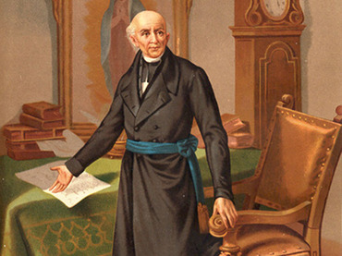
Mexico (1810-23)
Miguel Hidalgo: a parish priest who
encouraged revolution among the Native
Americans & Mestizos - It began Sept 16, 1810
(Sept 16 is Mexico’s Independence Day)
Hidalgo was captured by the Spanish & was
executed

Slide 8
Mexico – (1810-23)
Creoles & Peninsulares were vastly outnumbered & eventually joined with the others to overthrow the Spanish
1821 – Mexico won its independence
& became a Republic in 1823

Slide 9
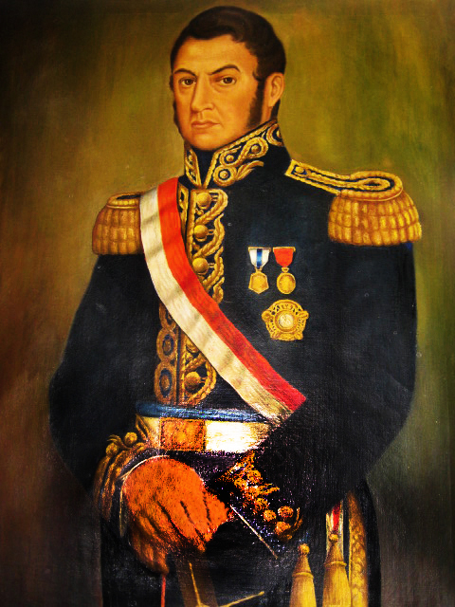
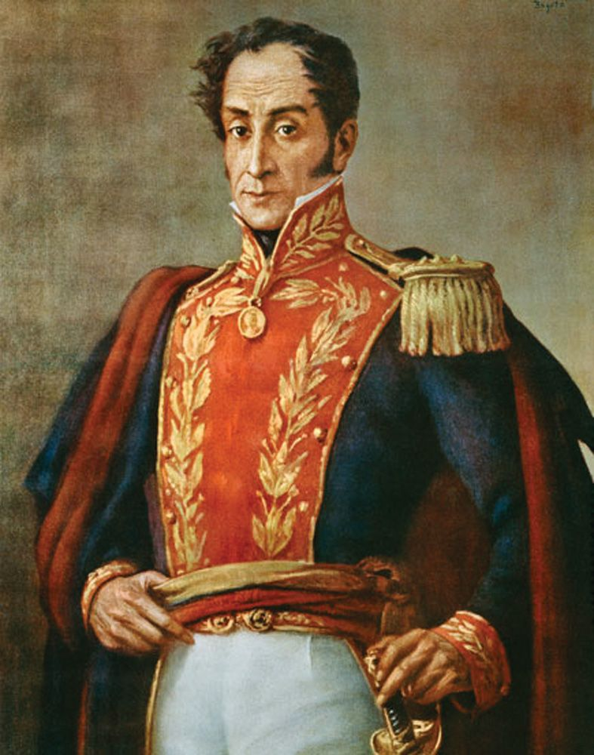
Liberators of South America
Jose de San Martin – gathered forces
to liberate Argentina in 1810 & Chile in 1818
Simon Bolivar – led forces to free Venezuela, Colombia & Ecuador by 1919 – they joined together to form Gran Colombia

Slide 10
Liberators of South America
San Martin & Bolivar joined forces to
defeat the last Spanish Army & free Peru in Dec. 1824
Many other countries followed suit,
including Brazil & countries in Central
America

Slide 11
Independence did not come easily or without serious problems:
Countries lost large amounts of people, property & livestock in the fights for independence
2. No experience with self-rule

Slide 12
Sometimes military rulers took power, or
civil wars broke out
4. Economic problems because wealthy
landowners grew cash crops for profits (mainly coffee) rather than growing food & many experienced poverty

