Slide 1
CHAPTER 23 industrialization Nationalism
Lesson 2 – Nationalism & Political Revolutions

Slide 2
After the Napoleonic wars in the early 19th century, European rulers had sought to stabilize the countries by restoring monarchs to their thrones
But the Enlightenment ideas did not die down & new forces began to push for change again

Slide 3
Liberalism
the idea that people should be as free as possible from any type of government restraint & that the civil liberties of people should be protected

Slide 4
Nationalism
unique cultural identity & pride of a people based on common language, religion & goals

Slide 5
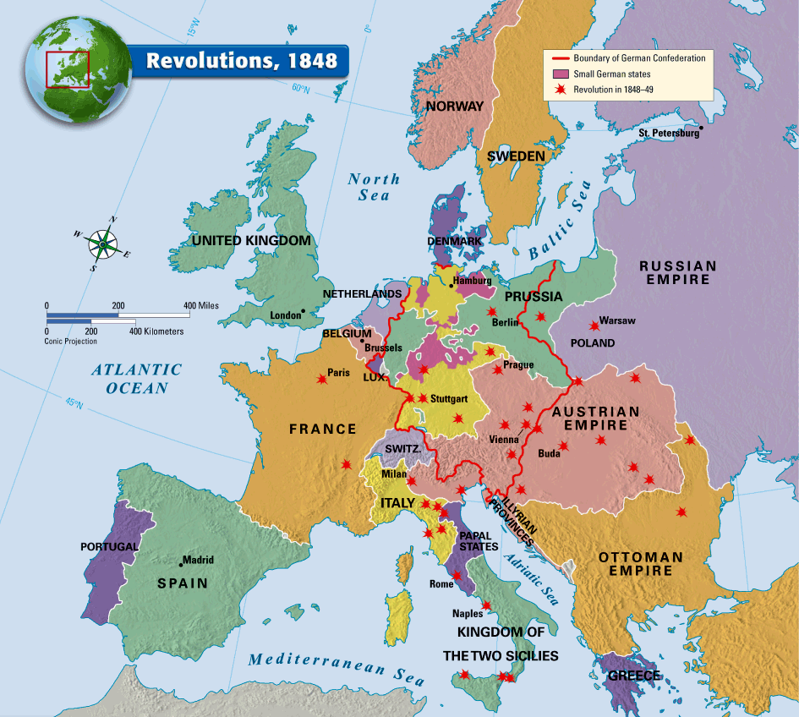
These ideas sparked numerous revolutions in Europe, with varying degrees of success

Slide 6
Though others failed, the French finally succeeded in the Revolution of 1848
1) Overthrew the monarchy
2) Drafted a new constitution

Slide 7
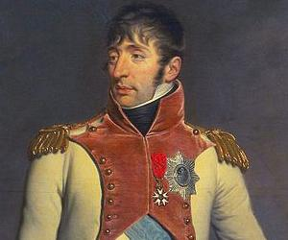
Instituted universal male suffrage: the right of all adult men to vote
Elected Charles Louis Napoleon
Bonaparte (Louis-Napoleon) as president for 4 years

