Slide 1
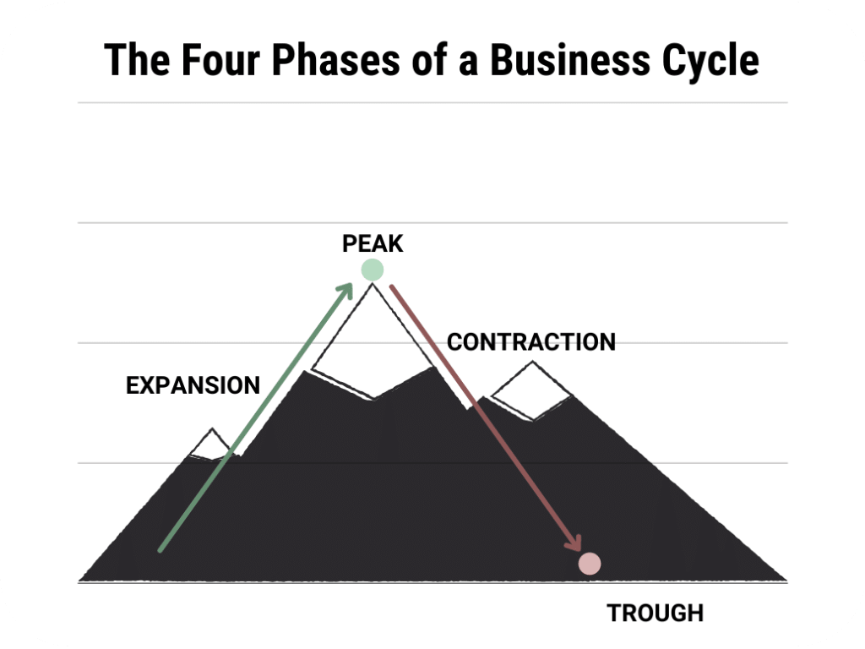
Business Cycle
Period of macroeconomic expansion (growth) followed by one of contraction (decline)

Slide 2
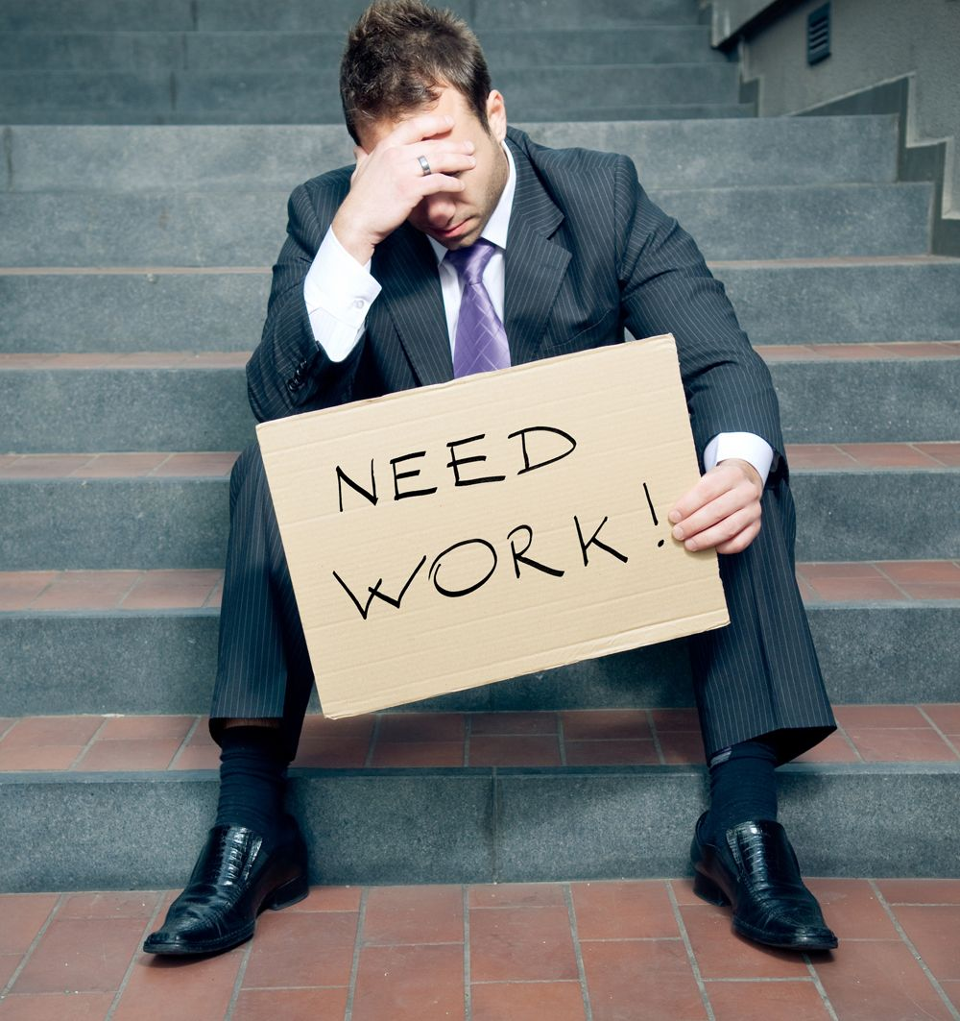
Unemployment
a worker without a job
WHY:
worker take time to find a job
workers lack the necessary skills
layoffs due to economic downturns
industrites slow or shut down for a season

Slide 3
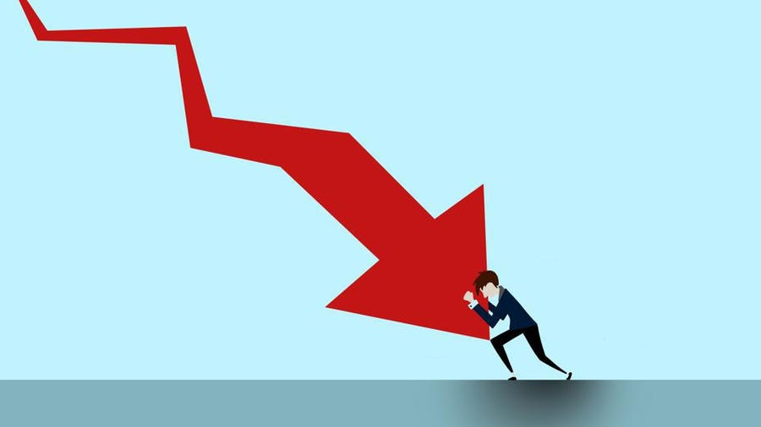
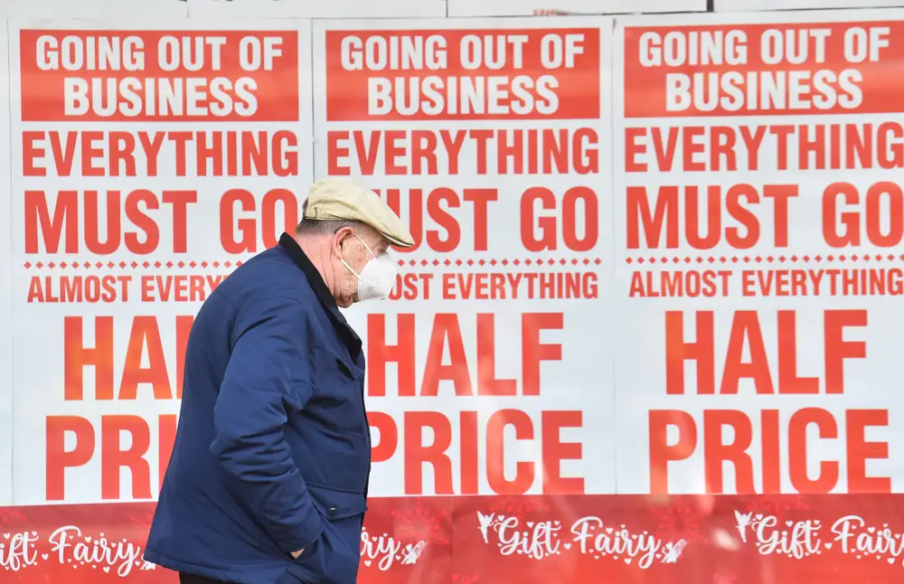
Recession / Contractionary
Prolonged downturn in economic activity

Slide 4
Gross Domestic Product
(GDP)
the market value of all goods and services newly produced in a country in one year

Slide 5
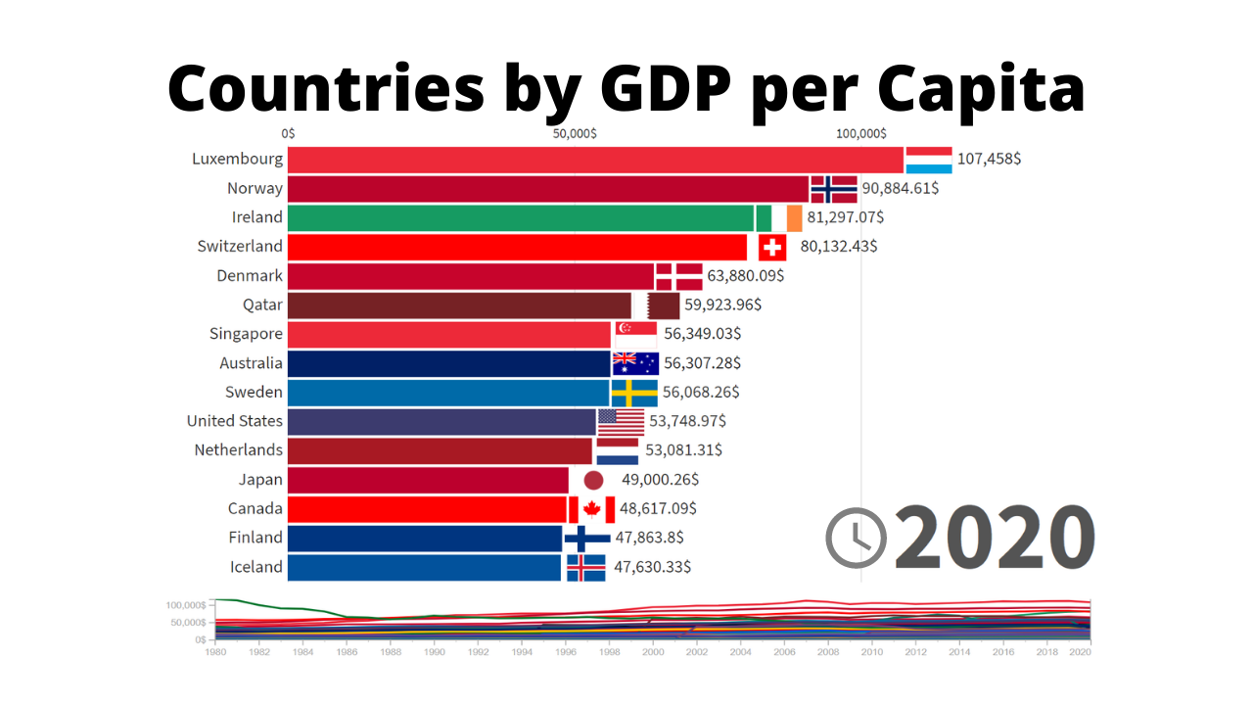
Gross Domestic Product Per Capita
(GDP per capita)
GDP of the country divided by its population

Slide 6
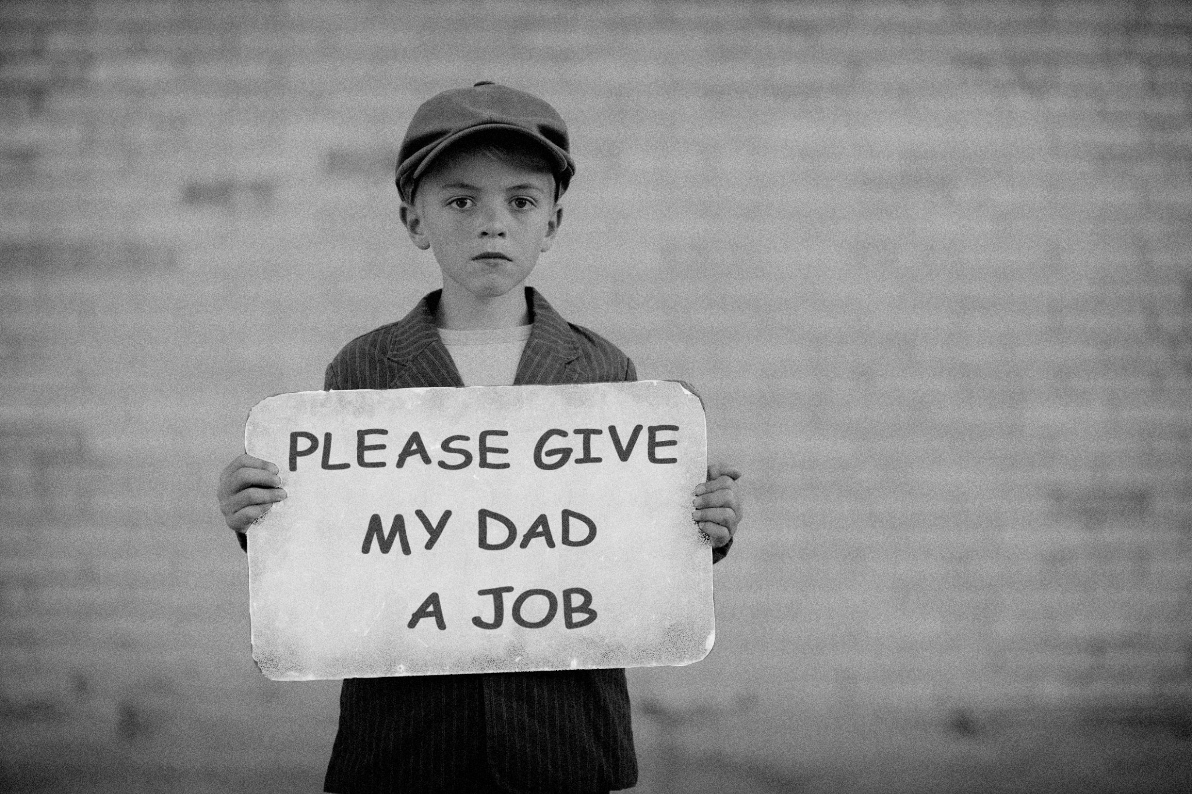
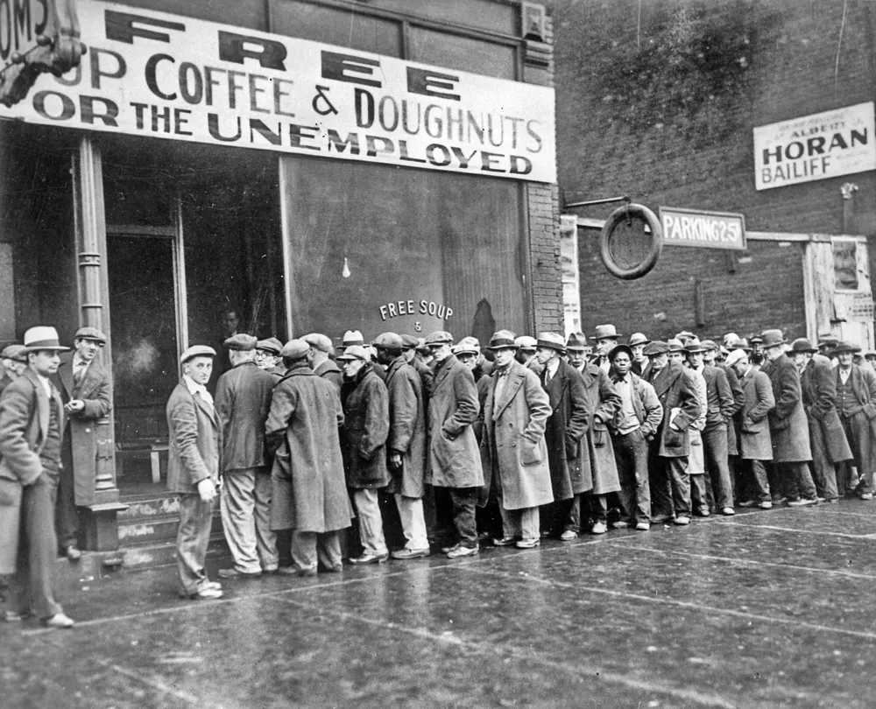
Depression
A recession that is especially long and severe

Slide 7
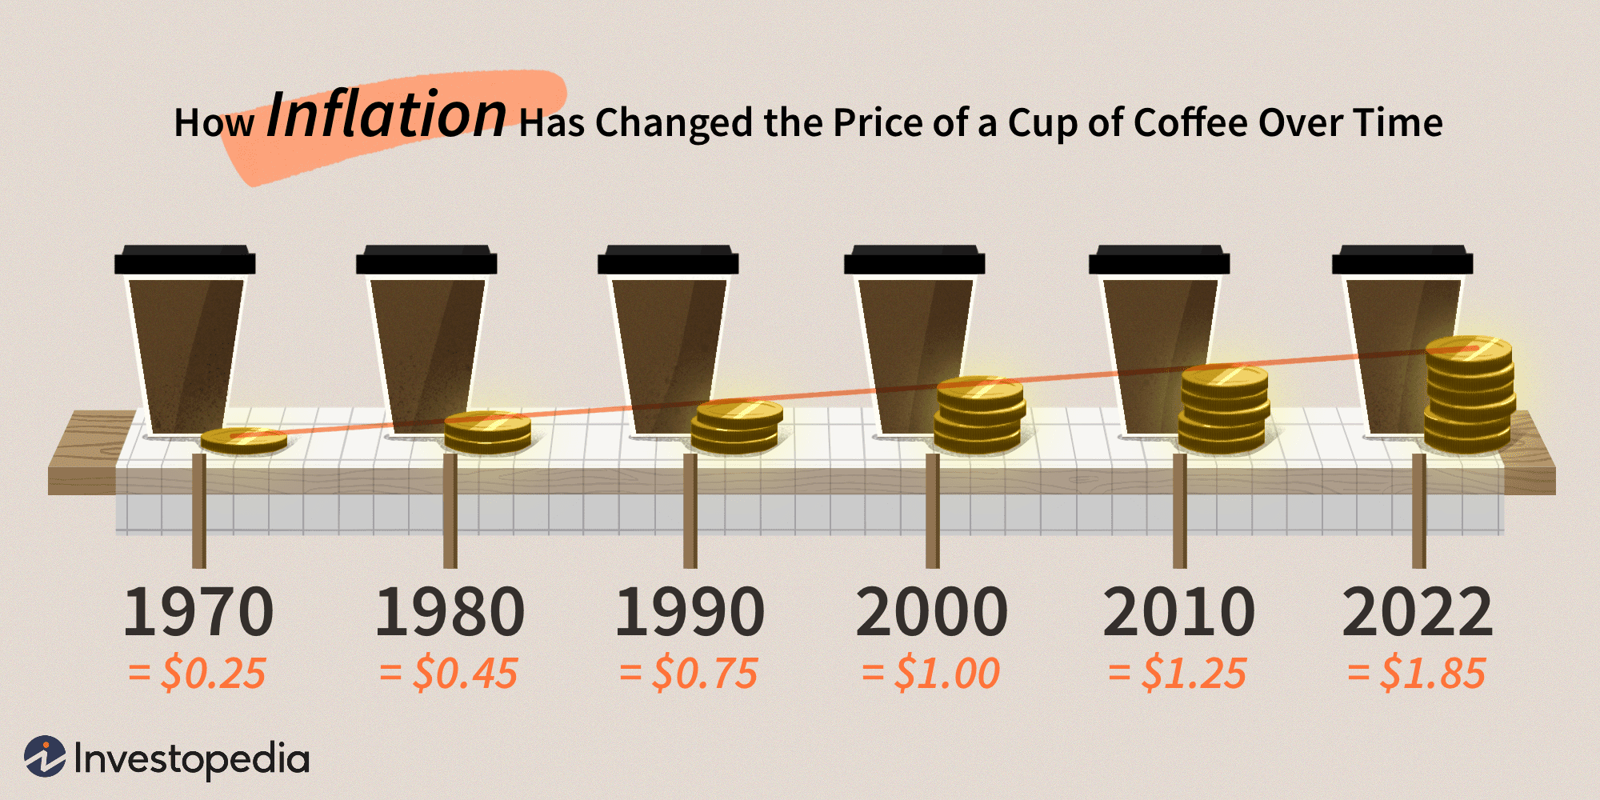
Inflation
Increase in prices across an economy

Slide 8
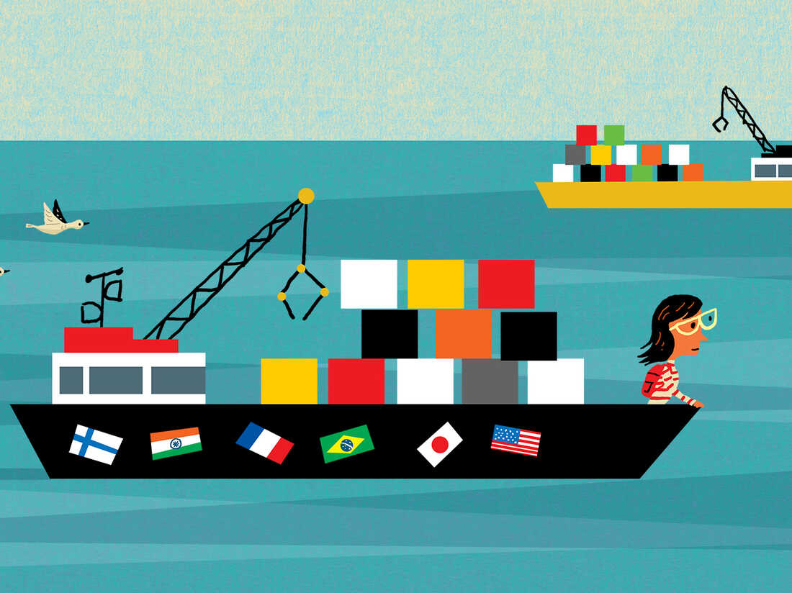
Factors of Economic Growth
Productivity
Technology
Trade

Slide 9
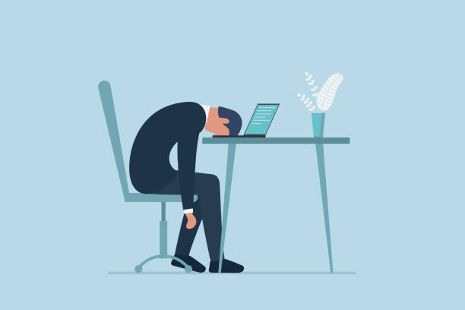
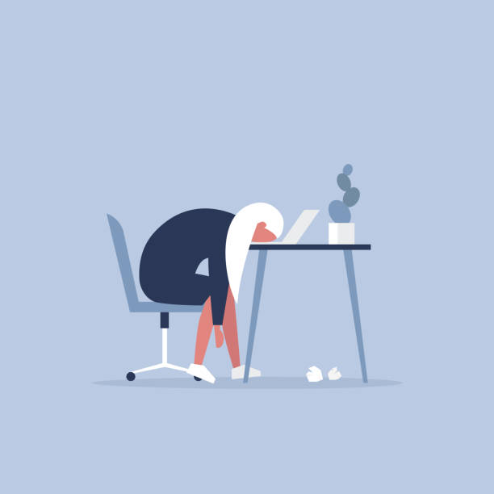
Discouraged Workers
They want a job but are not actively searching because they believe there are no jobs available for them

Slide 10
Embargo
official ban on trade or other commercial activity with a particular country

Slide 11
Quota
government imposed trade restriction on the number or value of goods a nation imports or exports

Slide 12
Recovery / Expansionary
a period of economic growth that follows a recession

