Slide 1
CHAPTER 23 Industrialization and Nationalism
Lesson 1 – The Industrial Revolution Begins
Notes:
Since 12,000 BCE we have been an agrarian society
Agricultural based
What part of the Industrial Revolution are we in?
Beginning Middle or end?
Most misrepresented topic in economic history
Capitalism vs Socialism
Rewriting history to show Capitalism began on the backs of the poor.
What indicators show prosperity in a country: Population growth
Economic downturn or recession population decline.
Initial industrialization period was 1750–1900
Drew on the Scientific Revolution
Transformed European society
Pushed Europe into a position of global dominance
More fundamental than any breakthrough since the Agricultural Revolution

Slide 2
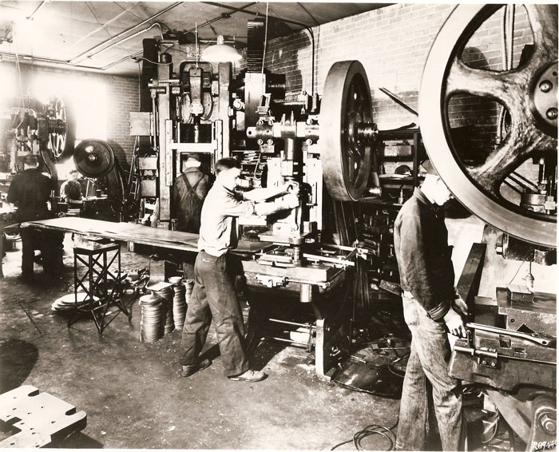
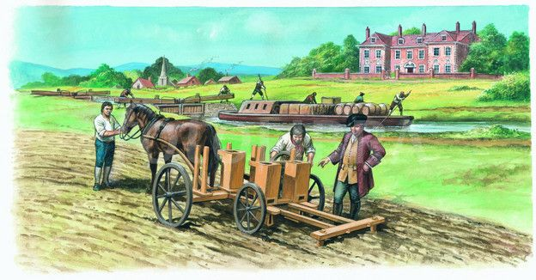
The Industrial Revolution Begins
During the late 18th century, the Industrial Revolution began in Great Britain
Resulted in a shift in economy – from being based on farming & hand-made goods, to machine manufacturing
Notes:
Segmented sleep, also known as divided sleep, bimodal sleep pattern, bifurcated sleep, or interrupted sleep, is a primarily biphasic sleep pattern where two periods of nighttime sleep are punctuated by a period of wakefulness. Along with a nap (siesta) in the day, it has been argued that this is the natural pattern of human sleep. A case has been made that maintaining such a sleep pattern may be important in regulating stress
Historian A. Roger Ekirch has argued that before the Industrial Revolution, segmented sleep was dominant in Western civilization. He draws evidence from documents from the ancient, medieval, and modern world. Other historians, such as Craig Koslofsky, have endorsed Ekirch's analysis
As a historical norm
According to Ekirch's argument, adults typically slept in two distinct phases, bridged by an intervening period of wakefulness of approximately one hour. This time was used to pray and reflect, and to interpret dreams, which were more vivid at that hour than upon waking in the morning. This was also a favorite time for scholars and poets to write uninterrupted, whereas still others visited neighbors, engaged in sex, or committed petty crime

Slide 3
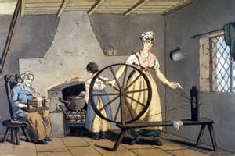
Earlier in the 18th century, Britain led the world in the production of inexpensive textiles (cotton cloth)
A process where women spun the cotton into thread & others wove the thread into cloth
Did this in their homes, (cottages), known as a Cottage Industry

Slide 4
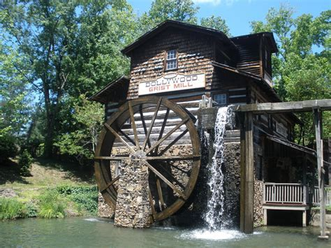
Several advances in the spinning & weaving processes made it more efficient for the women to gather in one large place to work
Factories were located by water since it was the source of power until 1782

Slide 5
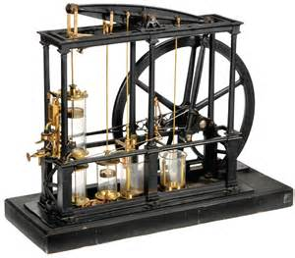
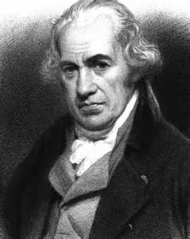
A Scottish engineer, James Watt made great improvements to the steam engine

Slide 6
Before long, cotton mills, with steam powered machines were all over Britain
Other products began to be produced using similar technology

Slide 7
The Factory System
the use of machines powered by water, steam, or (later) electricity to manufacture goods
Featured:
1. Use of unskilled labor
2. Centralized machinery under one roof
3. Standardization of parts used in the
machines

Slide 8
The Industrial Revolution began in Great Britain in the 1780’s
Didn’t spread to other nations till later what made Britain the ideal starting place?
Notes:
1840 Great Britain was producing more iron and utilizing more steam power than the rest of Europe combined
1789 the global productivity of Great Britain and France was about even
French Huguenot's escaped to Great Britain and brought with them skills that added to Great Britain's advantage od industrialization

Slide 9
Agricultural improvements – more food was being produced with less labor
2. Population growth – due to increased food, the population grew & able to purchase manufactured products
3. Natural resources: coal & iron ore were plentiful

Slide 10
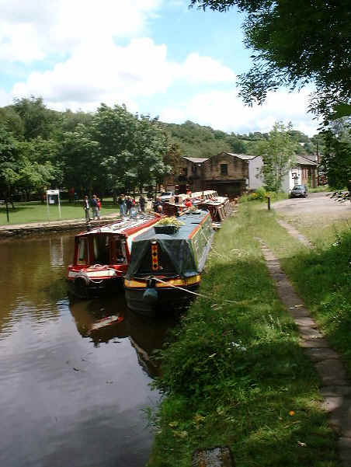
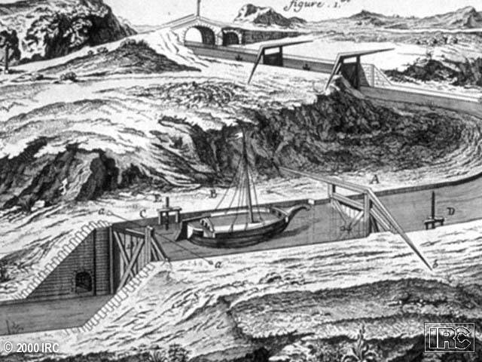
Many rivers made it easier to transport goods

Slide 11
Wealthy investors: Britain had many entrepreneurs willing to invest in new factories & machines for huge profits (or sometimes, losses)
Overseas Markets: w/Britain’s vast colonial empire, goods shipped & sold all over the world
6. Domestic markets increased as more people wanted goods
Free Enterprise System: Government placed few
restrictions & regulations on the producers & sellers
Allowed great expansion of the economy & encouraged more investment

Slide 12
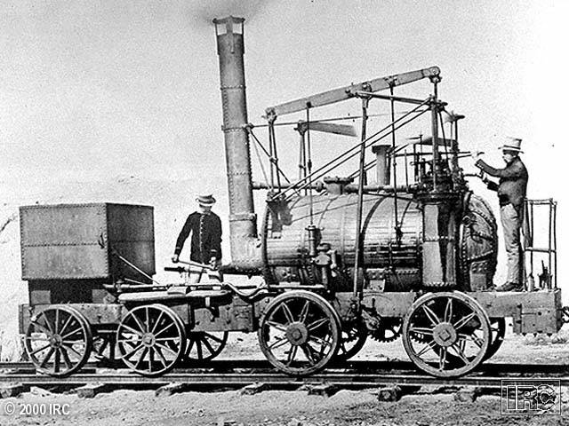
Railroads were a critical advancement in the early 1800’s because:
Transport of goods – great amounts raw materials & finished goods moved at once & also moved over land
2. Efficiency: as railroads improved, goods could be moved quickly & with less cost

Slide 13
3. Products improved: manufactured goods were
a) Standardized
b) Made more quickly
c) More available
d) Lower priced
4. Provided employment: many jobs created for workers to build railroads, work in factories & sell products

Slide 14
The Spread of Industrialization
Great Britain was the first nation to industrialize
It also made it the wealthiest nation in the world
Later, Belgium, France & Germany industrialized as well
But the 2nd country to benefit from industrialization was the United States
Notes:
Uproots the traditional class system
Middleclass more important
Aristocrats less important
Each country was a small market and many contain Tariffs and government restrictions
Because of the military implication of industrialization all the powers of Europe and the world had to deal with industrialization
i.e. Russia was defeated in 1856 by Great Britain and France because Russia had not industrialized but Great Britain and France had
This began Russia’s start of industrialization
In 1905 Russia was defeated by the Japanese who had industrialized and this forced Russia to make it a priority to do it right

Slide 15
The Spread of Industrialization
By the mid-19th century, (by 1860) the U.S. had:
Grown from 5 million people (in 1800) to 30 million
2) Eight cities had populations of over 100,000
3) 50% of Americans were farmers
4) 30,000 miles of railroad tracks

Slide 16
Social Impact of Industrialization
Society was greatly changed by industrialization:
1. 2 new classes:
1) Emerged the industrial middle class
2) The industrial working class
2. Huge population growth (decline in death rates) a) less wars
b) Less major epidemics
c) better food supply

Slide 17
Social Impact of Industrialization
3. Mass migrations: many Europeans moved to
the U.S.
4. Urbanization: millions moved to cities to work in the factories-led to horrible living conditions:
a) Crowded tenements (apartments) often held 2-3 families in small area

Slide 18
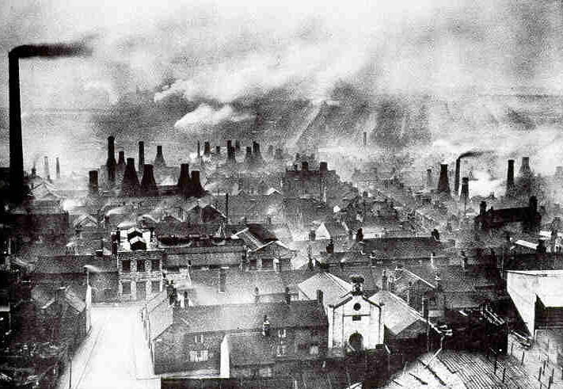
Social Impact of Industrialization
b) Pollution from the factories
c) Sanitation was very poor because of a lack
of sewage & adequate water systems

Slide 19
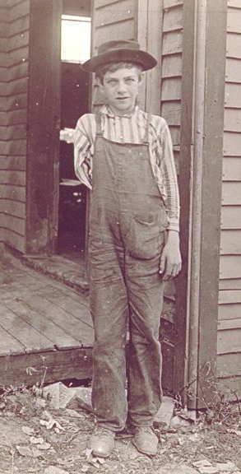
Social Impact of Industrialization
Working Conditions:
1. Long hours: sometimes 12-16 hours with rare days off
2. Extreme danger: mines with
cave-ins, explosions & deadly fumes
Factories had dangerous machines could amputate fingers, hands & arms

Slide 20
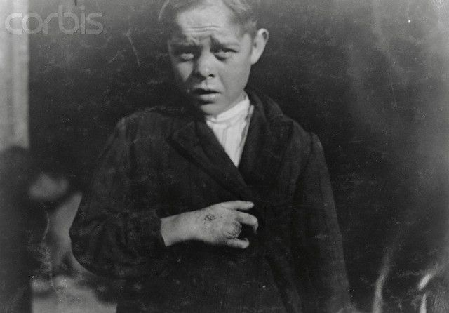
Social Impact of Industrialization
3. No employment security –
workers could be fired at will
beaten or punished
No insurance if they were injured or killed

Slide 21
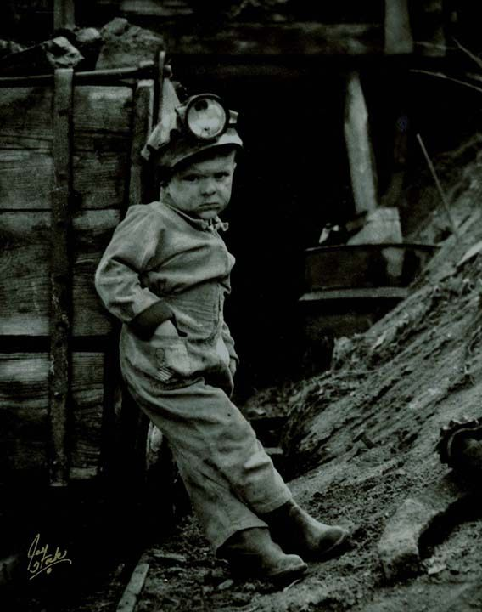
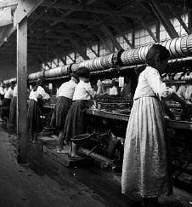
Social Impact of Industrialization
4. Women & children: as young as 6-7 worked long hours in the textile mills
Neither received the same wages as men
Notes:
Did they do the same work?
Did they produce the same amount?

Slide 22
Social Impact of Industrialization
The conditions eventually resulted in many social movements to end the abuses & to protect workers
Industrial Capitalism: an economic system based on industrial production – came to be viewed by some as unfair
Why?

Slide 23
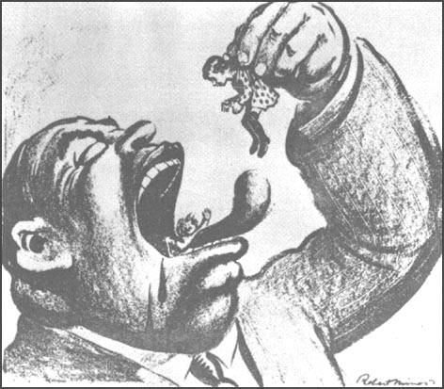
Social Impact of Industrialization
Because some made huge profits while the workers made low wages

Slide 24
Social Impact of Industrialization
The abuses of the Industrial Revolution gave rise to a new movement & economic system - Socialism
which adhered to:
1) Government ownership – all means of
production - factories, utilities & businesses
2) Government control all parts of the economy
including profits, wages, prices, production & jobs
3) Class-less society – Everyone shares equally
in what is produced & would share equally in the
profits

