Slide 1
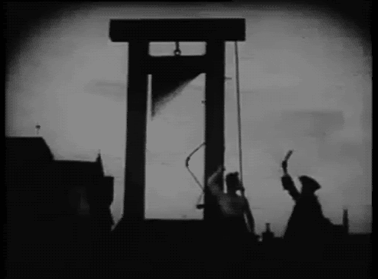
Chapter 22 The French revolution and napoleon
Lesson 2 – radical revolution and reaction

Slide 2
Radical Revolution and Reaction
Even though many people in France wanted changes, they did not agree on
what changes to bring about
how to bring about the changes
Many groups or factions were formed to pursue their differing agendas
A group of radicals promoted putting King Louis XVI (16th) to death
Queen Marie Antoinette faced the same fate months later

Slide 3
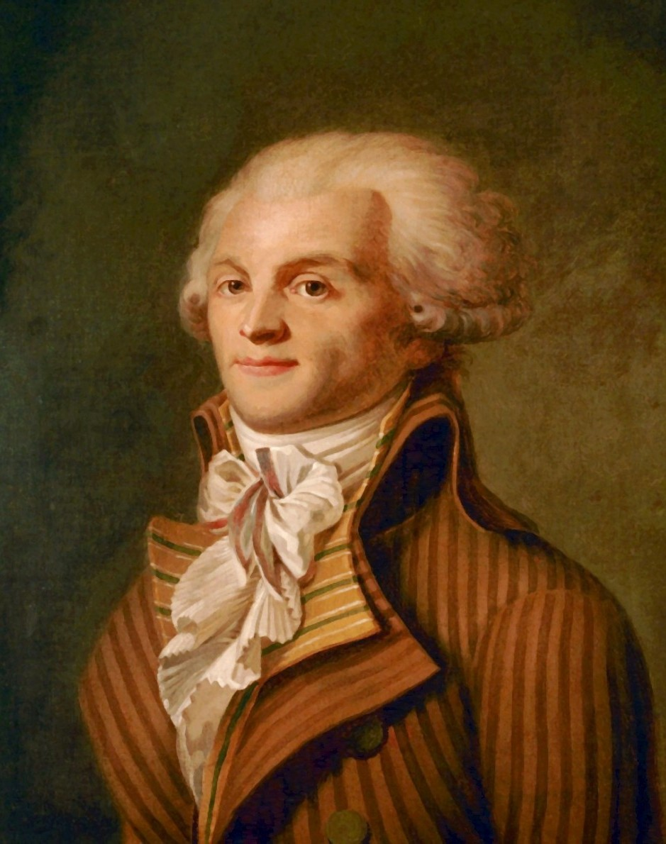
Radical Revolution and Reaction
One group was very significant:
The Committee of Public Safety – which was led by a man named Maximilien Robespierre
Notes:
Put in charge until a constitution could be written

Slide 4
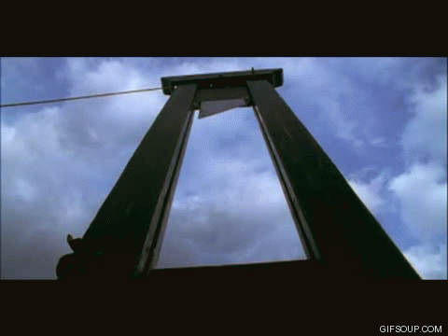
Radical Revolution and Reaction
They were supposed to help keep the peace, but soon they were initiating what became known as:
The Reign of Terror – during this time (1793-94) anyone who did not agree with the Committee & Robespierre were persecuted

Slide 5
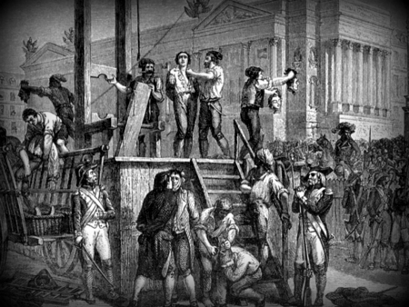
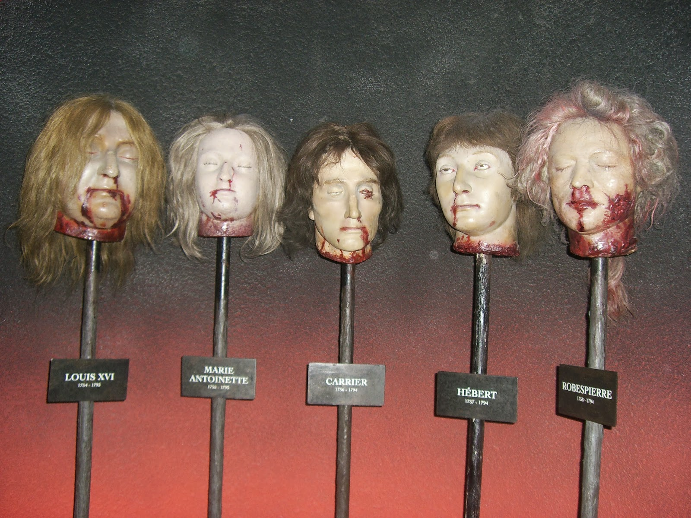
Radical Revolution and Reaction
Some were arrested
but over 40,000 were executed
Most were beheaded using the guillotine

Slide 6
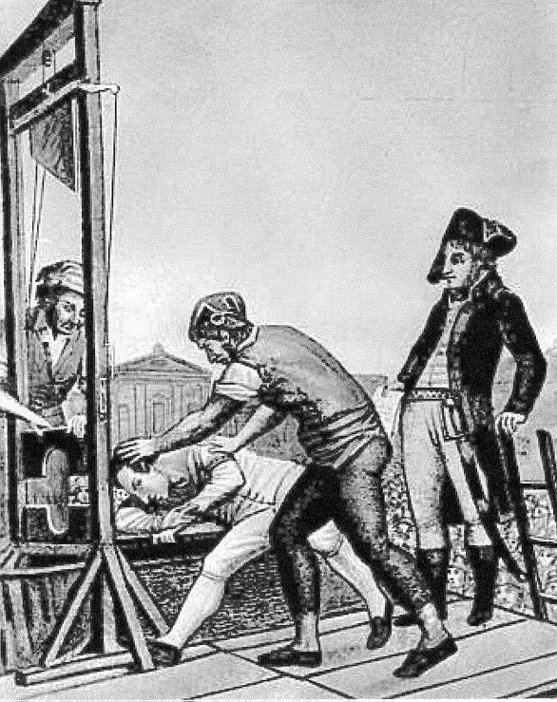
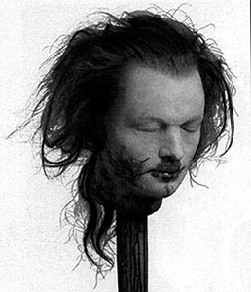
Radical Revolution and Reaction
This lasted until July / 1794 when Robespierre himself was executed

Slide 7
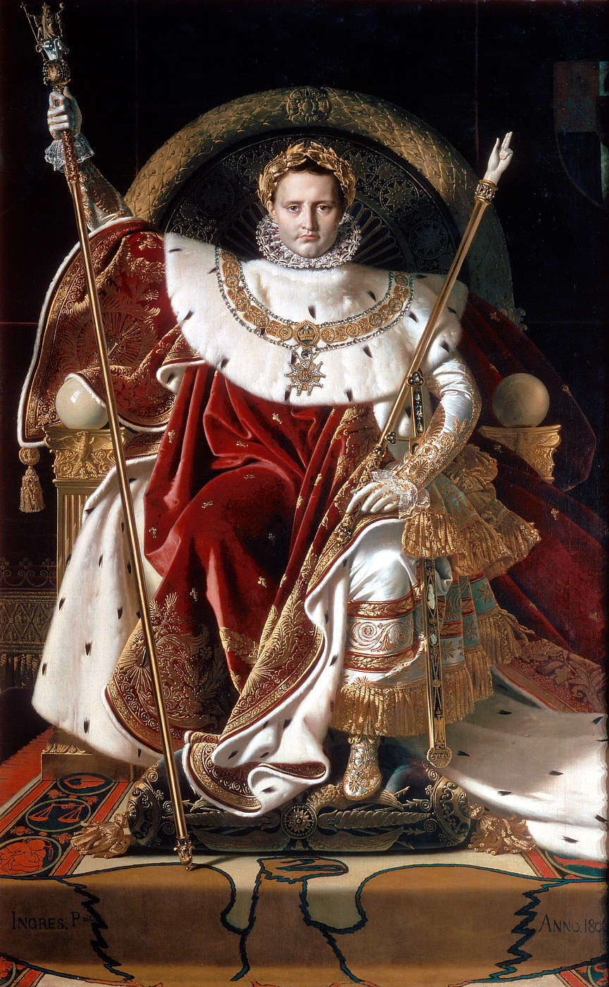
Radical Revolution and Reaction
An army was raised to confront outside invaders and yet another government, known as The Directory took power with the army’s support
Many were dissatisfied with the Directory as well
A very popular general in the army staged an overthrow (coup d'état) and seized power
His name was Napoleon Bonaparte

