Slide 1
1970s: Nixon

Slide 2
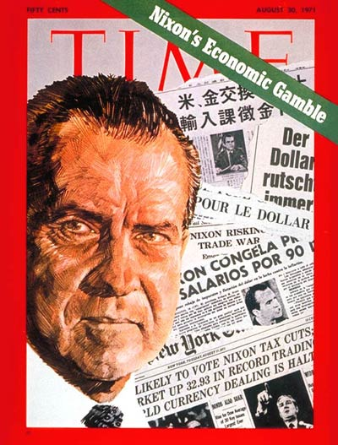
Nixon’s Domestic Policy
Nixon's Domestic Policy: the New Federalism
Based on saving taxpayer money by cutting funding for Great Society programs
(Medicare and Job Corps).
Notes:
Remind students what Domestic Policy means

Slide 3
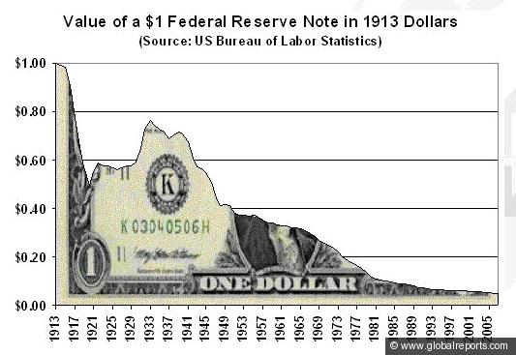
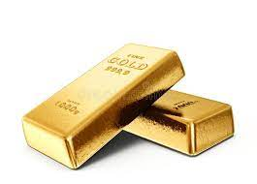
Leaving the Gold Standard
One of Nixon's most infamous moves was taking the U.S. off of the gold standard.
He enacted price freezes that were incredibly unpopular.
resulted in farmers destroying product rather than sell it at a loss.
Nixon said the dollar would retain its value. It's now worth only 19 cents in 1971 dollars.
Notes:
President Richard Nixon closed the gold window in 1971 in order to address the country's inflation problem and to discourage foreign governments from redeeming more and more dollars for gold.
On August 15, 1971, President Richard M. Nixon announced his New Economic Policy, a program “to create a new prosperity without war.” Known colloquially as the “Nixon shock,” the initiative marked the beginning of the end for the Bretton Woods system of fixed exchange rates established at the end of World War II.

Slide 4
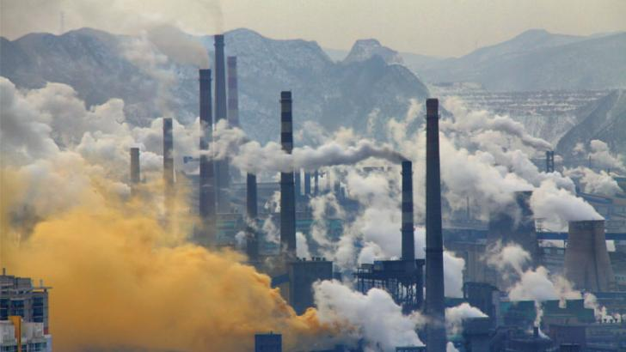
Environmental Legislation
The Environmental Protection Agency (EPA):
Created in 1970 by the Nixon Agency due to an increased national concern for the environment.
Set standards to reduce pollution.
Notes:
protecting natural areas and their resources for the public good

Slide 5
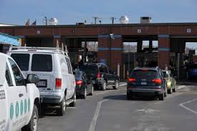
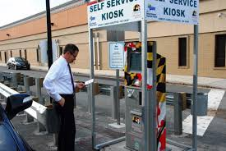
The Clean Air Act of 1972: Established emission standards for factories and cars
Restricted dumping pollutants into rivers and lakes
Notes:
In Maryland I had to take my car to get Emission test in addition to registration & Inspection

Slide 6
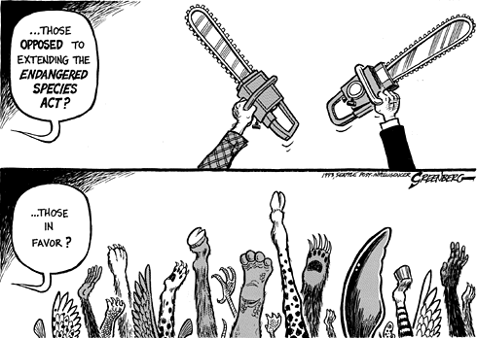
Endangered Species Act of 1973: Created plans to save threatened animal and plant species.
Notes:
protecting natural areas and their resources for the public good

Slide 7
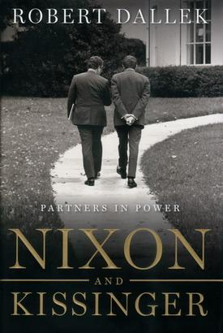
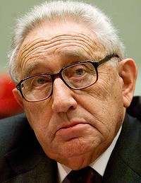
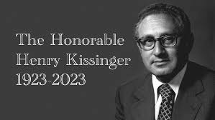
Henry Kissinger
Henry Kissinger was Nixon's National Security Adviser and eventually Secretary of State
He is best known as Nixon's partner in the presidency.
Nixon and Kissinger took over almost the entirety of U.S. foreign policy (and more) during Nixon's time as President.
Kissinger had his hands in almost every event of Nixon's presidency.
Notes:
He developed a policy of warmer U.S. relations with the Soviet Union, détente, which led to the Strategic Arms Limitation Talks (SALT) in 1969. He established the pro-Pakistan policy in the India-Pakistan war of late 1971, helped negotiate the SALT I arms agreement with the Soviet Union (signed 1972), and developed a rapprochement between the United States and the People’s Republic of China (1972), the first official U.S. contact with that nation since the Chinese Communists had come to power.
Kissinger was the recipient of numerous awards, including the Presidential Medal of Freedom (1977), the United States’ highest civilian honour, and the Medal of Liberty (1986), which was given to 10 of America’s most important foreign-born leaders.
**Died Nov. 29th, 2023

Slide 8
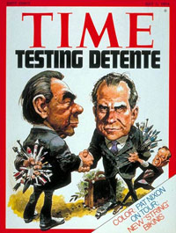
Nixon’s Foreign Policy
Nixon's policy of dealing with the Cold War is called "détente."--French for "relaxation,"
Designed to relax tensions with the Soviet Union
reduce nuclear arsenals
limit military commitments.

Slide 9
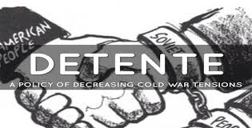
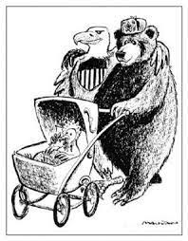

Slide 10
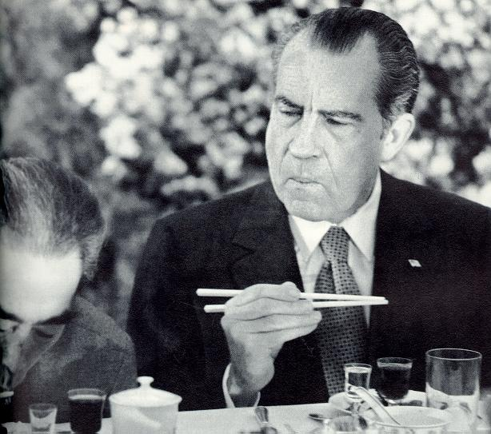
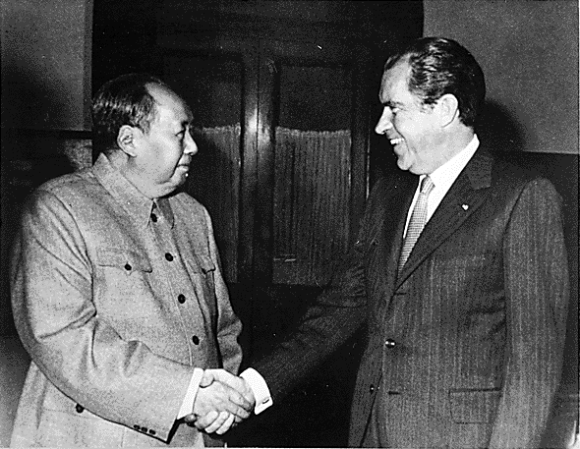
How to Détente
Even though they were both Communists, China and the Soviet Union were big rivals and each feared the other.
Nixon played on this by improving relations between the U.S. and China.
In 1972, he became the first U.S. President to visit China.
*His main goal was to make the Soviet Union jealous and get them to open negotiations with U.S.

Slide 11
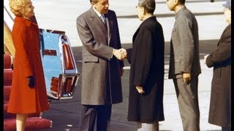

Slide 12
How do you think the Soviet Union will respond?

Slide 13
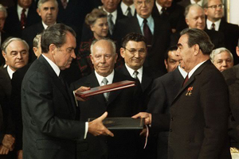
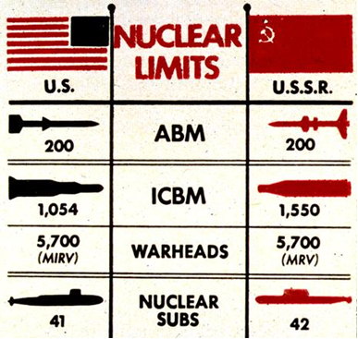
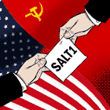
S.A.L.T 1
The same year Nixon Visited China (1972), He was invited to meet with the Soviet Union - can you say jealous?!
He and the Soviet leaders signed
Strategic Arms Limitation Treaty, which limited production of nuclear weapons in the U.S. and Soviet Union.
**This was a MAJOR step in the direction of Detente.

Slide 14
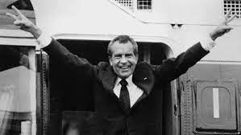

Slide 15
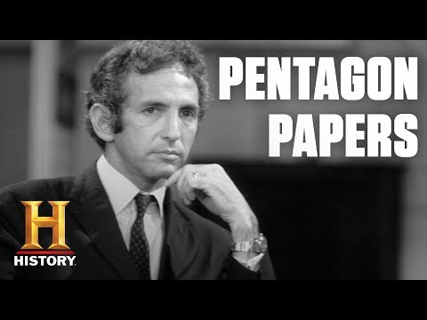

Slide 16
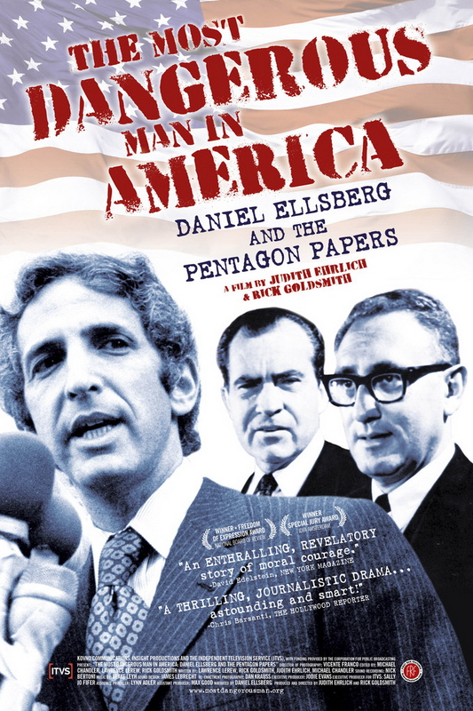
The Pentagon Papers and the Plumbers
Pentagon Papers: Documents leaked by Daniel Ellsberg.
Showed the government had been dishonest about its intentions in Vietnam.
Effect: This made Nixon paranoid of info leaks.

Slide 17
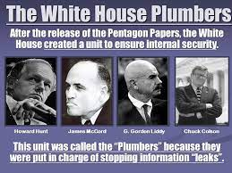
Nixon formed the "White House Plumbers:
" a secret investigation group to prevent any other information leaks.
Nixon also ordered a recording system to be installed in the White House to record all conversations in certain places

Slide 18
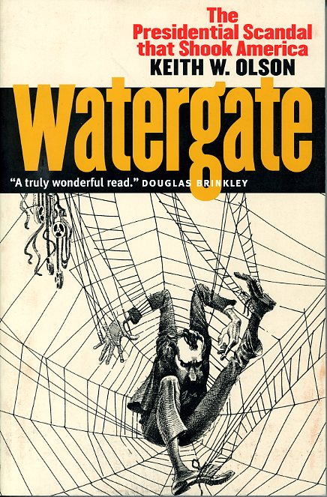
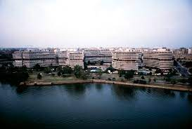
Watergate
Some of the Plumbers were part of Nixon's re-election committee.
In the summer of 1972, Watergate-Nixon's re-election committee (CREEP) was caught breaking into the headquarters and wiretapping the phones of Nixon's opponent in the election.
But the Question remained, was Nixon involved?

Slide 19
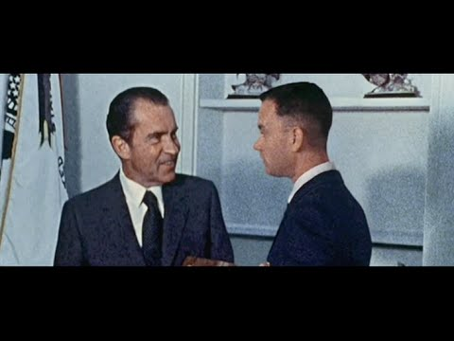

Slide 20
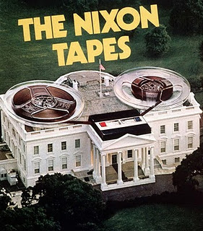
The Watergate Tapes
The Justice Department ordered Nixon to hand over the tapes, but Nixon refused to turn them over
tried to fire the investigators and others.
Nixon had to give them the tapes and some of them revealed that Nixon had given his approval to a plan to cover up the Watergate break-ins.
This is OBSTRUCTION OF JUSTICE!!!
Nixon was almost guaranteed to be impeached
Notes:
Unfortunately for Nixon, he had previously had a recording system installed in the White House that automatically recorded any audio in several locations
including the Oval Office and Nixon's private office.

Slide 21
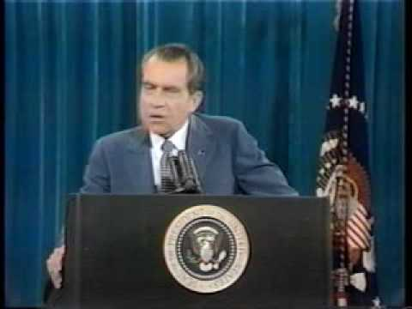

Slide 22
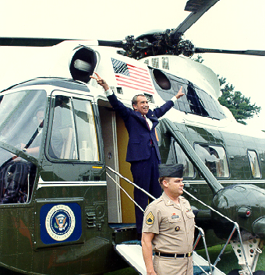
Nixon Resigns
Nixon decided to resign before he could be impeached.
This made him the only president in U.S. history to ever resign the presidency.
He could still face criminal charges as a civilian, though.

Slide 23
