Slide 2
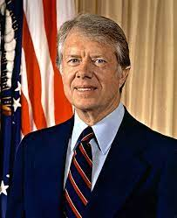
39th President Jimmy Carter (1977-1981)
Baptist Sunday School teacher
Governor of Georgia and peanut farmer
Pro-African-American Civil Rights
Supported gay rights
Anti-abortion, but upheld Roe v. Wade
Attempted to make abortion less necessary
Easier to adopt
Improved conditions for mothers (WIC)
Anti-death penalty
Pardoned draft dodgers

Slide 3
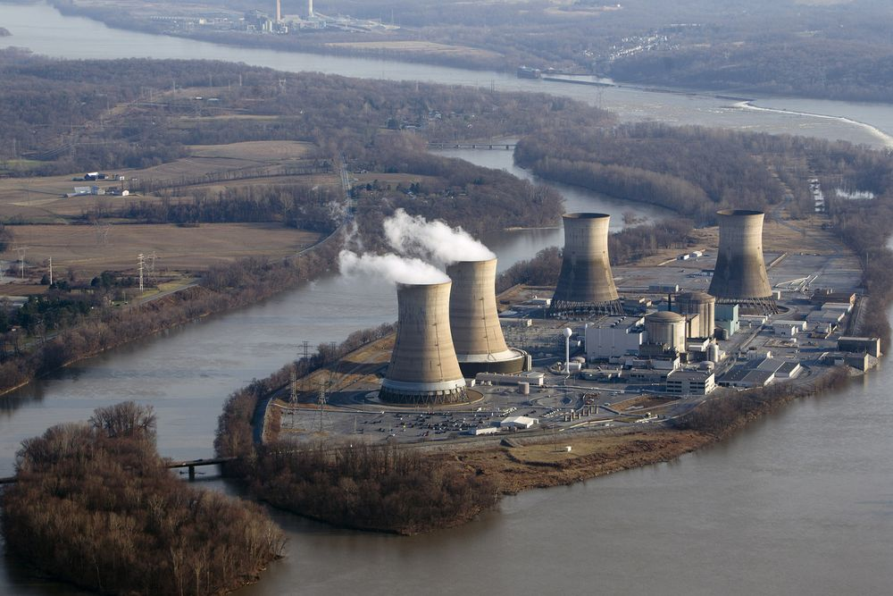
Carter’s Administration
Appoints more women & minorities than any other president
Tries to find alternative fuel/energy sources (nuclear power)

Slide 4
Community Reinvestment Act
Encouraged banks to give loans to help low-income neighborhoods

Slide 5
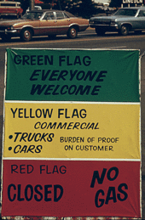
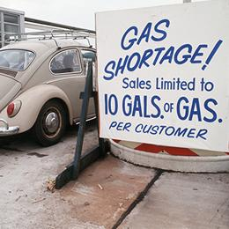
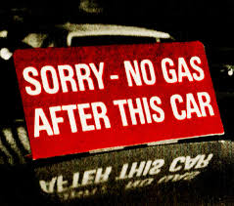
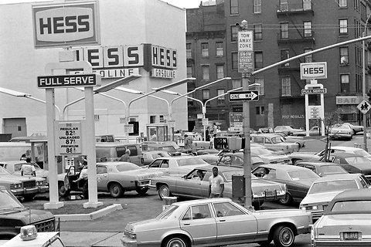
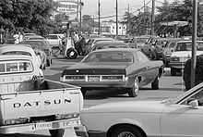
Economic Problems of the 70s
Energy Crises of 73 & 79
The Oil Embargo of 73 from OPEC
issues with Iran in 79 caused extreme gas shortages
Notes:
The Organization of Petroleum Exporting Countries (OPEC) was formed in 1960 (in order for oil producing countries to maintain control over their resources and control oil prices)
In 1973, the Yom Kippur War broke out between Israel and several Arab nations, including members of OPEC.
The United States helped the Israeli military
In response, OPEC initiated an oil embargo.

Slide 7
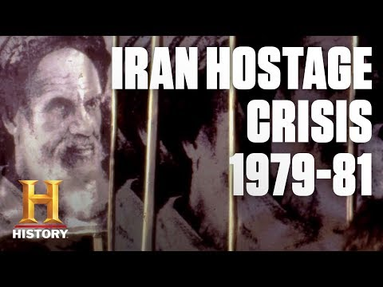

Slide 8
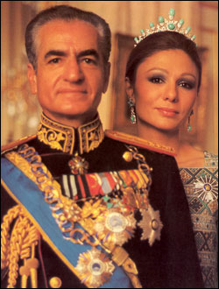
Iran Hostage Crisis (CAUSE:)
The US allowed the Shah of Iran in(the United States) after he was forced into exile after the Islamic Revolution
Iran was a source of oil and pro-Western
Shah Mohammad Reza
Notes:
Prior to 1953, Iran had been ruled by a constitutional monarchy.
1953 the United States and Great Britain orchestrated a coup to help the Shah (king) go from being a figurehead to a dictator.
In 1979, this came back to bite the U.S.
A popular revolution overthrew the American-friendly Shah in favor of the anti-American Ayatollah Khomeini.
After the Shah had been kicked out of Iran, he was diagnosed with terminal cancer.
The U.S. allowed him to enter the country for treatment in 1979, enraging Iranians.

Slide 9
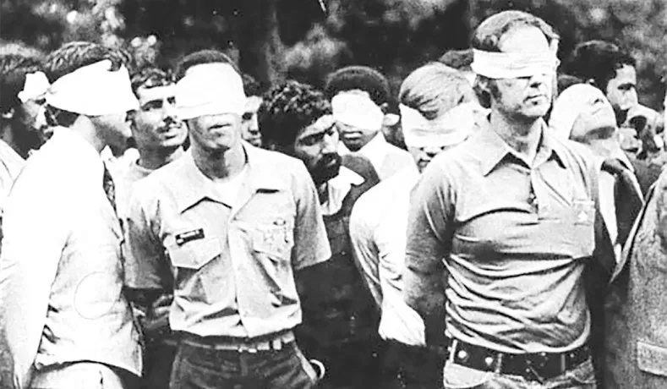
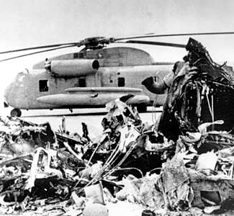
Iran Hostage Crisis (EFFECT)
Iranian Revolutionaries kidnapped US citizens who were held hostage for 444 days in the Iran Embassy
Notes:
On November 4th, 1979, Iranian students took over the U.S. embassy in Tehran, taking the American diplomats there hostage.
In April 1980, Carter authorized a rescue mission, Operation Eagle Claw.
Extremely over-complicated, the operation was an embarrassing failure in which 8 U.S. servicemen died and two aircraft crashed. Carter still tried to get the Iranians to release the hostages, eventually agreeing to unfreeze several billion dollars of Iranian money sitting in American banks.

Slide 10
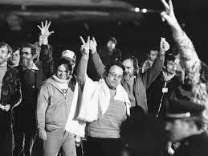
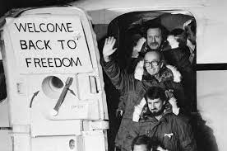
The hostages were released the moment Reagan finished his inauguration speech - 444 days after they were captured.
Notes:
The group of six would remain guests of the Canadian diplomats for almost three months. On January 28, 1980 they were rescued in a CIA extraction operation, led by operative Tony Mendez, in which the group posed as a Canadian film production team scouting locations in Tehran.
Mr. Mendez was promoted to chief of the agency’s authentication branch in December 1979, his efforts shifted to rescuing the six Canadian “houseguests,” as the American diplomats were euphemistically called. Their very existence was kept hidden from the public in an effort to protect them from the Iranians.
With a Canadian passport in hand, Mr. Mendez flew to Tehran on Jan. 25, under the name Kevin Costa Harkins. (He chose an Irish identity, he later said, because the Irish are “nonthreatening” and “ubiquitous around the world.”) Supported by a second CIA agent known as Julio, he spent a few days coaching the six diplomats, teaching them their new identities — including as a cameraman and set designer — and preparing them for potential interrogations at the airport.
Before dawn on Jan. 28, they headed to Tehran Mehrabad International Airport for an early Swissair flight to Zurich. After being delayed for an hour because of a mechanical problem, the flight took off and cleared Iranian airspace, leading Mr. Mendez to celebrate by ordering a bloody mary and delivering a toast: “We’re home free.”
AD
The diplomats returned to a heroes’ welcome in the United States, where Canadian flags were flown from town halls, and billboards reading “Thank you, Canada” cropped up around the country. Mr. Mendez met with Carter in the Oval Office and received the Intelligence Star, one of the CIA’s highest honors. But his and the CIA’s role in the rescue operation was concealed until 1997, when Mr. Mendez was honored as one of 50 “trailblazers” who shaped the agency’s first 50 years.

Slide 11
Notes:
Disguising himself as an Irish filmmaker, Mr. Mendez successfully smuggled six State Department employees out of Tehran during the 1979-1981 Iran hostage crisis, passing them off as a Canadian movie crew in a daring mission that formed the basis of the Oscar-winning movie “Argo” (2012).
*ARGO TRAILER…

Slide 12
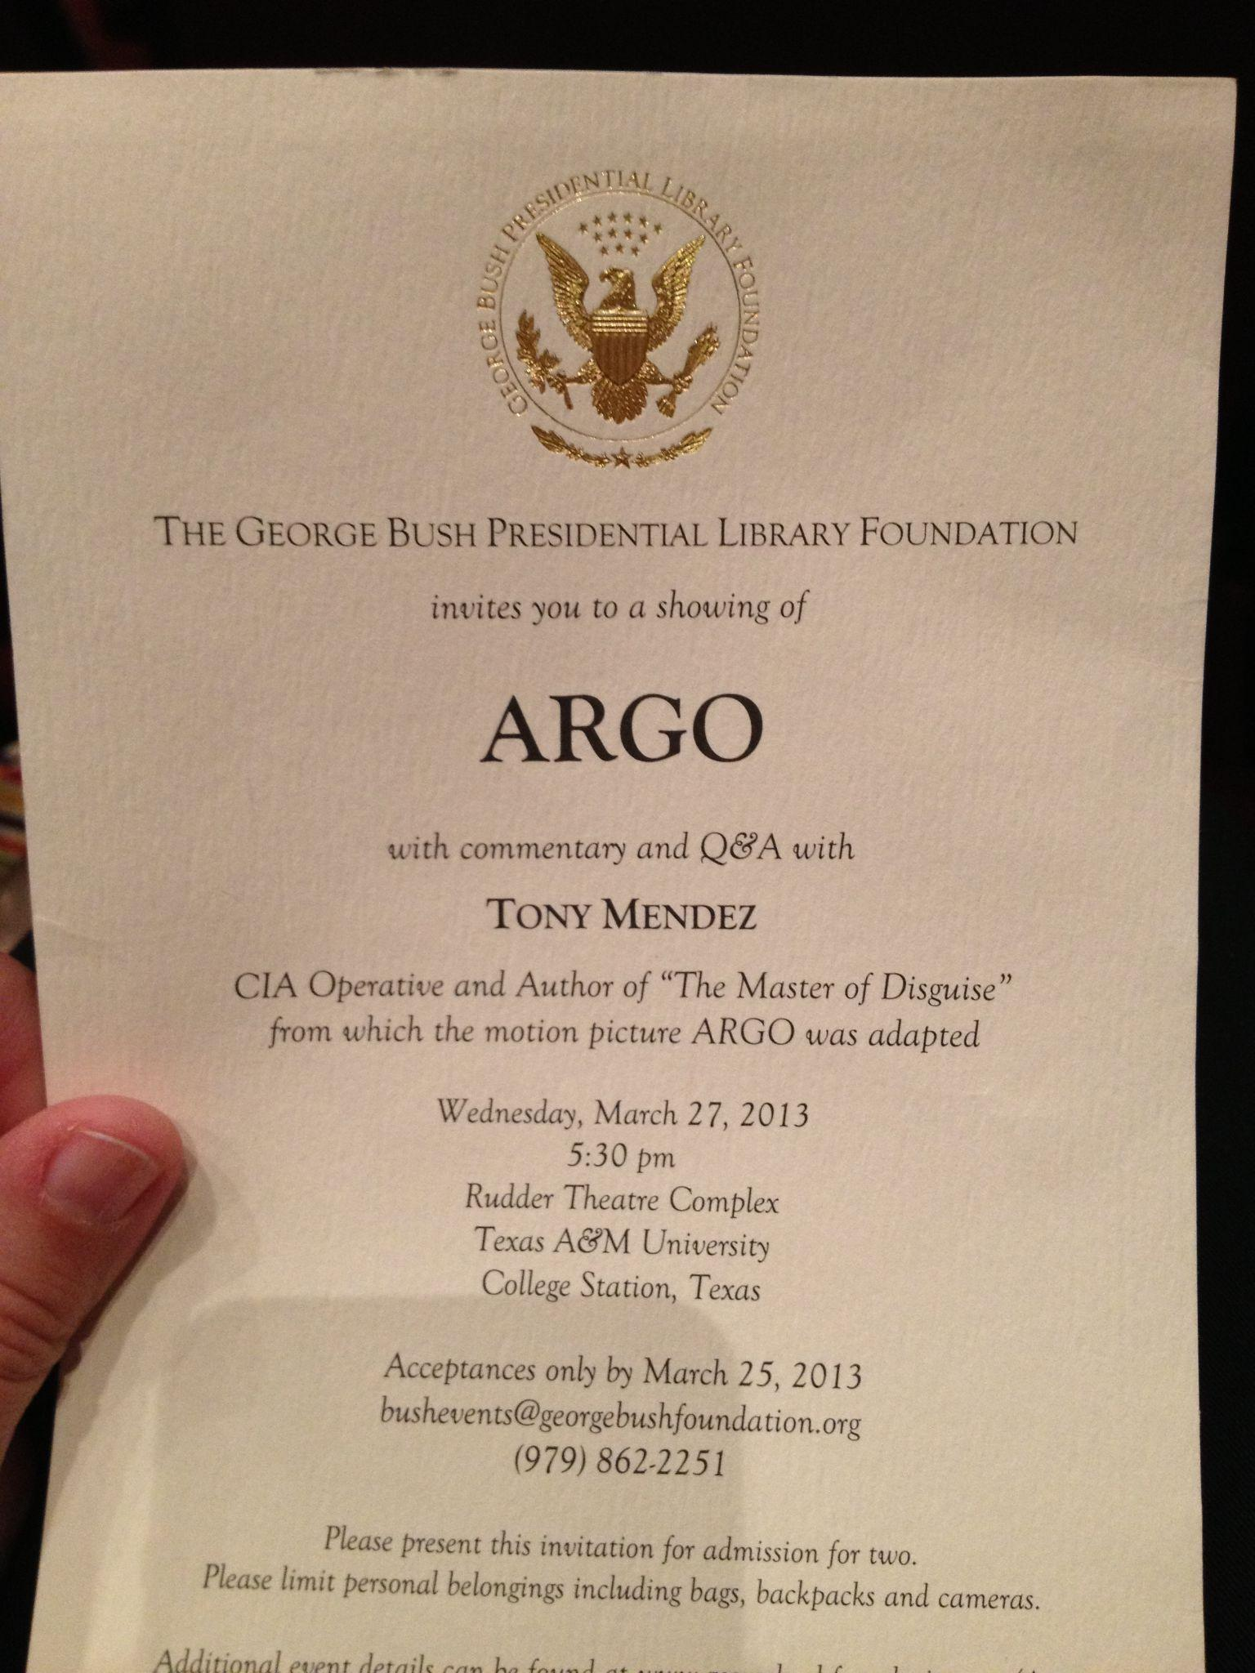
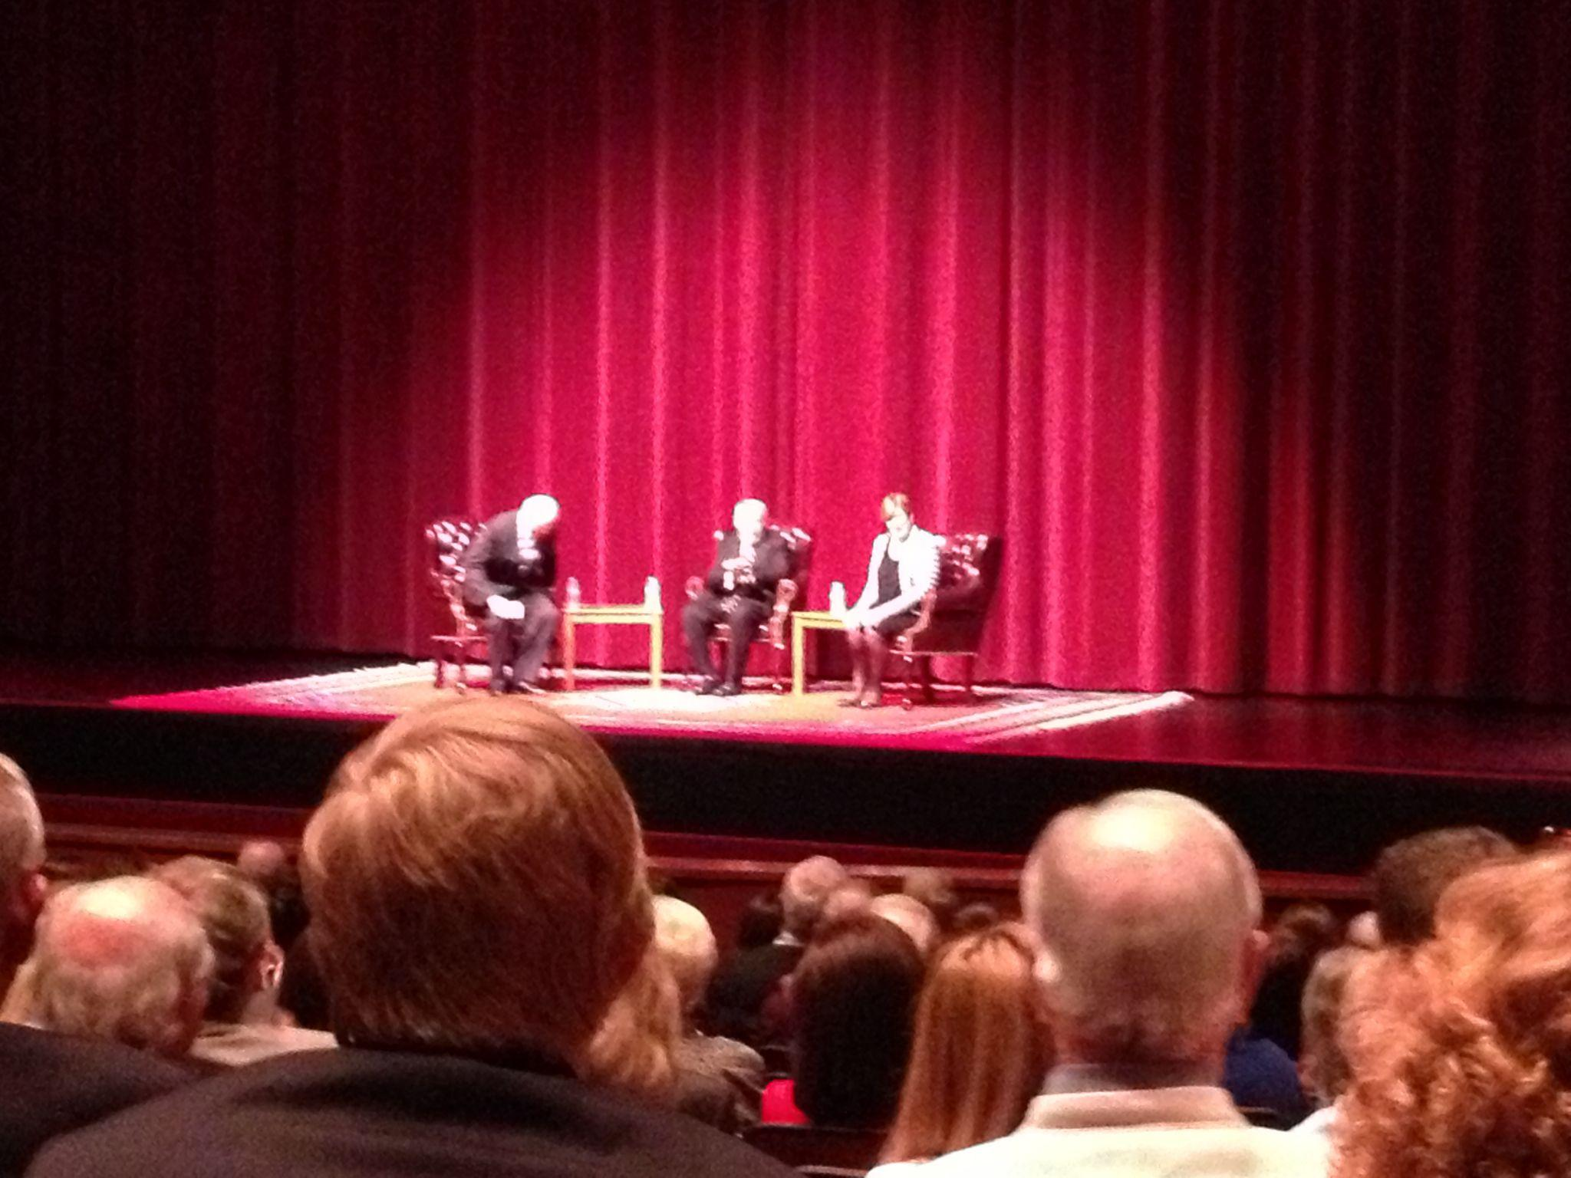
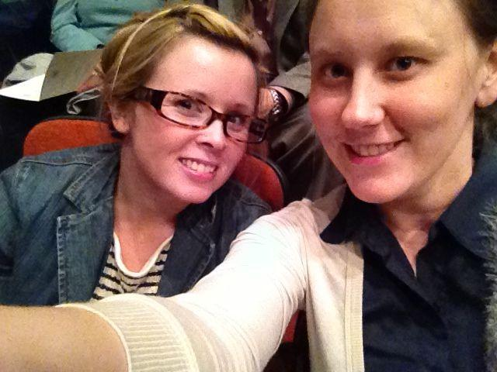

Slide 13
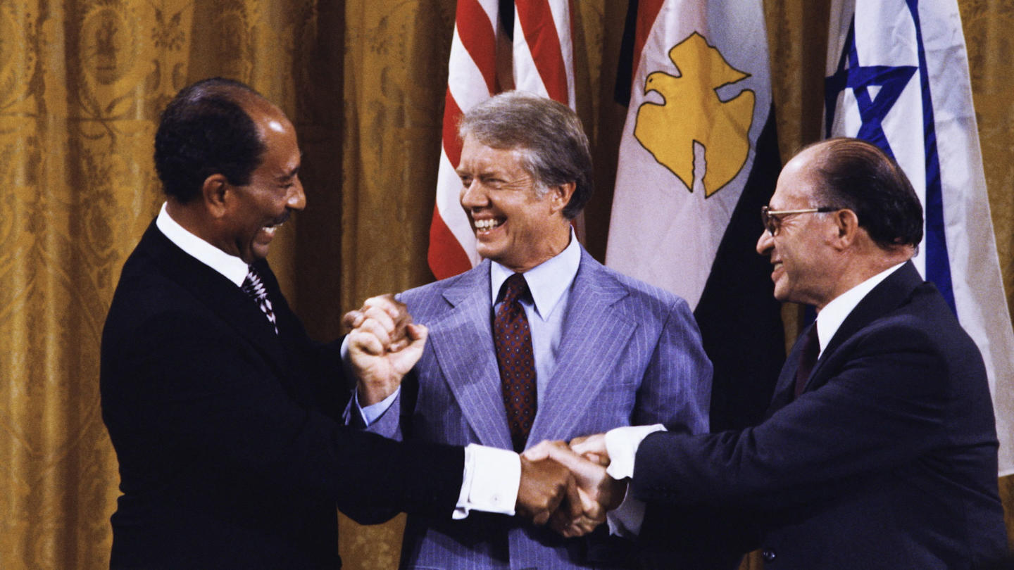
The Camp David Accords
President Carter was the peacemaker who helped negotiate between Egypt & Israel
Created peaceful relations between Israel and Egypt.
Notes:
Jimmy Carter's greatest accomplishment were undoubtedly the Camp David Accords.
The result of thirteen days of secret talks between Israeli Prime Minister Menachem Begin, and Egyptian President Anwar El Sadat, the Camp David Accords created peaceful relations between Israel and Egypt.
At the time, Egypt was considered to be the most powerful military in the Arab world and very influential in the region.
Why did they happen???? The ultimate goal of the Camp David Accords was to establish a framework for peace in the Middle East by formalizing Arab recognition of Israel's right to exist, developing a procedure for the withdrawal of Israeli forces and citizens from the so-called “Occupied Territories” of the West Bank (which would enable the

Slide 14
