Slide 1
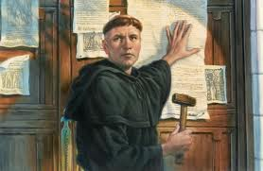
16-1 The Protestant Reformation 16-2 The Spread of Protestantism
Chapter 16
THE REFORMATION IN Europe
Notes:
Why could the reformation only have happened at this time in the Holy Roman Empire?
How is the age of exploration and the lack of exploration
by the HRE connected to the Reformation?
-The Monarchs needed money and new avenues of income/tax
-HRE was poor thus could a weakened Monarchy and stronger local lords

Slide 2
Martin Luther: “Lord, teach us to think about death so that we may learn how to live.”
1. If you were to die tonight, what would be:
A. two good things people would say about you at your funeral
B. something about yourself that people
might say that would be negative
Fast-forward to your death in 60-70 years…
What are two things you HOPE people will say?

Slide 3
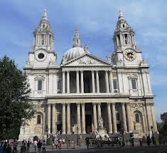
The Catholic Church
Most Powerful Institution and focal point for Europeans.
by 1500 the Church’s power was in decline
Struggle w/Secular Rulers
Vocal Critics:
Leaders
Practices
Doctrine (beliefs, teachings)

Slide 4
Problems with the Catholic Church
Materialism
many of the church leaders lived lives of luxury, using tithes & offerings of the people – many of whom were poor & gave sacrificially
Notes:
Materialism: many of the church leaders lived lives of luxury, using tithes & offerings of the people – many of whom were poor & gave sacrificially.
Favoritism: the church often granted leadership positions to people who would pay large sums of money for them. They also practiced nepotism: granting positions to people based on family or friendship ties.
Immortality: despite the clergy’s vows of celibacy (they would not marry or have sexual relations) – still of these leaders engaged in illicit relationships. Some of these even resulted in illegitimate children.

Slide 5
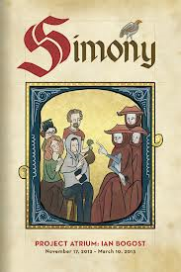
Problems with the Catholic Church
Favoritism
the church often granted leadership positions to people who would pay large sums of money for them
They also practiced nepotism:
granting positions to people based on family or friendship ties
Notes:
Materialism: many of the church leaders lived lives of luxury, using tithes & offerings of the people – many of whom were poor & gave sacrificially.
Favoritism: the church often granted leadership positions to people who would pay large sums of money for them. They also practiced nepotism: granting positions to people based on family or friendship ties.
Immortality: despite the clergy’s vows of celibacy (they would not marry or have sexual relations) – still of these leaders engaged in illicit relationships. Some of these even resulted in illegitimate children.

Slide 6
Problems with the Catholic Church
Immorality
despite the clergy’s vows of celibacy (they would not marry or have sexual relations) – still of these leaders engaged in illicit relationships
Some of these even resulted in illegitimate children
Notes:
Materialism: many of the church leaders lived lives of luxury, using tithes & offerings of the people – many of whom were poor & gave sacrificially.
Favoritism: the church often granted leadership positions to people who would pay large sums of money for them. They also practiced nepotism: granting positions to people based on family or friendship ties.
Immortality: despite the clergy’s vows of celibacy (they would not marry or have sexual relations) – still of these leaders engaged in illicit relationships. Some of these even resulted in illegitimate children.

Slide 7
INDULGENCES
by far the most distasteful practice was the selling of indulgences
These started out as having people give money for sins they confessed to the priests Over time, it escalated to where the Church told people that if they paid money, their dead relatives would go to Heaven
If they did not, or if they didn’t pay “enough,” it would not go well for them
Notes:
Indulgences: by far the most distasteful practice was the selling of indulgences. These started out as having people give money for sins they confessed to the priests. Over time, it escalated to where the Church told people that if they paid money, their dead relatives would go to Heaven. If they did not, or if they didn’t pay “enough,” it would not go well for them
John Tetzel was famous for the saying (ppt) & being the heaviest promoter of indulgences
Purgatory – 13th Century idea that not all sins were equal but were sins and time spent in Purgatory for lessor sins before entering Heaven

Slide 8
INDULGENCES
“If you pay enough money, your sins are forgiven, my child…”
“As soon as a coin in the coffer
rings, another soul from Purgatory springs!”
Johann Tetzel
Notes:
Indulgences: by far the most distasteful practice was the selling of indulgences. These started out as having people give money for sins they confessed to the priests. Over time, it escalated to where the Church told people that if they paid money, their dead relatives would go to Heaven. If they did not, or if they didn’t pay “enough,” it would not go well for them
John Tetzel was famous for the saying (ppt) & being the heaviest promoter of indulgences
Purgatory – 13th Century idea that not all sins were equal but were sins and time spent in Purgatory for lessor sins before entering Heaven

Slide 9
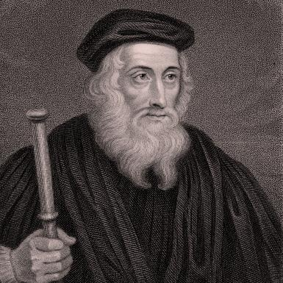
Church Critics
John Wycliffe 14th c
Questioned Papal Authority
believed the Bible taught that all men were sinners
The pope was no better than others and could sin or be wrong about issues
Notes:
Two men were vocal critics of certain church practices & teachings in the 14th & early 15th centuries
John Wycliff: questioned Papal Authority – he believed the Bible taught that all men were sinners, and the pope was no better than other and could sin or be wrong about issues
Jan Hus: believed the Bible taught that people did not need the Catholic Church to go to God for them or help them confess their sins. Instead, he said people who had believed in Jesus as the Savior could go to God on their own at any time. Why would this bother Church? It decreased people’s need for the Church. Jan Hus was burned at the stake for promoting this belief.

Slide 10
Church Critics
believed the Bible taught that people did not need the Catholic Church to go to God for them or help them confess their sins
He said people who had believed in Jesus as the Savior could go to God on their own at any time.
Jan Hus 1369-1415
Priesthood
of Believers
Notes:
Two men were vocal critics of certain church practices & teachings in the 14th & early 15th centuries
John Wycliff: questioned Papal Authority – he believed the Bible taught that all men were sinners, and the pope was no better than other and could sin or be wrong about issues
Jan Hus: believed the Bible taught that people did not need the Catholic Church to go to God for them or help them confess their sins. Instead, he said people who had believed in Jesus as the Savior could go to God on their own at any time. Why would this bother Church? It decreased people’s need for the Church. Jan Hus was burned at the stake for promoting this belief.

Slide 11
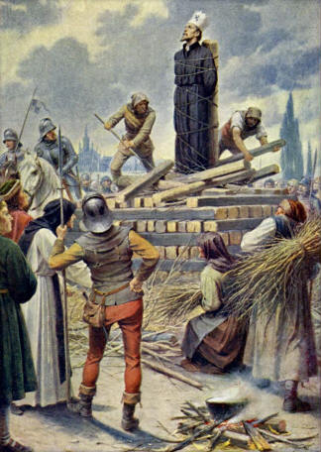
Church Critics
Why would this bother the Church?
Jan Hus 1369-1415
It decreased people’s need for the Church
He was burned at the stake for promoting this belief
Priesthood
of Believers
Notes:
Two men were vocal critics of certain church practices & teachings in the 14th & early 15th centuries
John Wycliff: questioned Papal Authority – he believed the Bible taught that all men were sinners, and the pope was no better than other and could sin or be wrong about issues
Jan Hus: believed the Bible taught that people did not need the Catholic Church to go to God for them or help them confess their sins. Instead, he said people who had believed in Jesus as the Savior could go to God on their own at any time. Why would this bother Church? It decreased people’s need for the Church. Jan Hus was burned at the stake for promoting this belief.

Slide 12
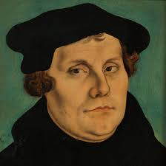
Martin Luther (1483-1546)
German law student, one night, he was caught in a violent thunderstorm & promised God that if he was delivered safely, he would devote himself to God
After this he:
Notes:
Martin Luther: at first was a German law student, one night, he was caught in a violent thunderstorm & promised God that if he was delivered safely, he would devote himself to God. After this he:
Became a student of theology & began to study the Bible relentlessly.
Took vows & became a Catholic monk where he continued his study.
Began to see many problems with the Catholic Church & he wrote them down.

Slide 13
Martin Luther (1483-1546)
Became a student of theology & began to study the Bible relentlessly
Took vows & became a Catholic monk where he continued his study
Began to see many problems with the Catholic Church & he wrote them down
No d
Notes:
Martin Luther: at first was a German law student, one night, he was caught in a violent thunderstorm & promised God that if he was delivered safely, he would devote himself to God. After this he:
Became a student of theology & began to study the Bible relentlessly.
Took vows & became a Catholic monk where he continued his study.
Began to see many problems with the Catholic Church & he wrote them down.

Slide 14
95 Theses
Notes:
95 Theses: on October 31, 1517, he nailed a copy of his disagreements to the door of the church at Wittenberg. His ideas spread quickly through Europe and many joined the protest

Slide 15
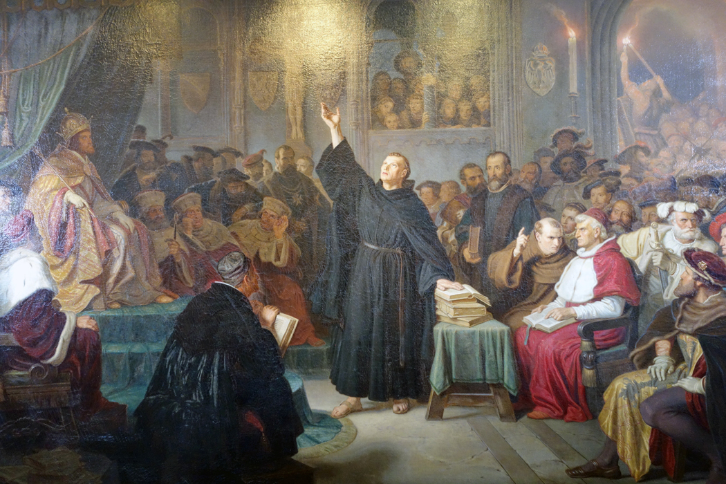
Diet of Worms
“RECANT!”
Diet = Council
Worms = City in Germany
Luther was summoned before church council to face charges as a heretic (one who goes against teachings of the church)
Notes:
Diet of Worms: Diet = Council – Worms = City in Germany
Luther was summoned before church council to face charges as a heretic (one who goes against teachings of the church). He was told to recant (take back) his viewpoint, but he refused & said, “I am captive to the word of God.” He was condemned & he feared for his life, so he went into hiding for more than a year at a friend’s castle.

Slide 16
Diet of Worms
He was told to recant (take back) his viewpoint, but he refused & said
“I am captive to the word of God…”
He was condemned & he feared for his life, so he went into hiding for more than a year at a friend’s castle
Notes:
Diet of Worms: Diet = Council – Worms = City in Germany
Luther was summoned before church council to face charges as a heretic (one who goes against teachings of the church). He was told to recant (take back) his viewpoint, but he refused & said, “I am captive to the word of God.” He was condemned & he feared for his life, so he went into hiding for more than a year at a friend’s castle.

Slide 17
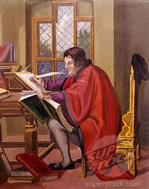
Castle at Wartburg
Translated the bible from Latin to
German…

Slide 18
He also solidified his Theology (what he believed about God & the Bible). He promoted these beliefs:
Salvation: was by faith in Jesus as Savior, not by any works or actions.
Priesthood of Believers: believers in Jesus could go to God on their own & did not need a priest.
The Bible: was the final authority on what was right & wrong, not what the church or pope said.

Slide 19
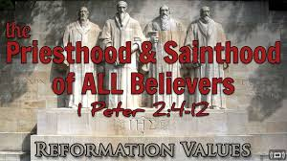
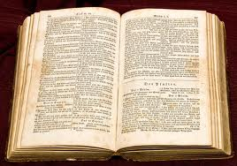
Luther’s Theology…
Notes:
He also solidified his Theology (what he believed about God & the Bible). He promoted these beliefs:
Salvation: was by faith in Jesus as Savior, not by any works or actions.
Priesthood of Believers: believers in Jesus could go to God on their own & did not need a priest.
The Bible: was the final authority on what was right & wrong, not what the church or pope said.

Slide 20
Changes
Many churches began conducting their services
in German, rather than in Latin so people could understand
Even clergy men & women left the Church
He renounced his vows as a monk and he
married a former nun (many others did, also)
Notes:
Changes: many people broke away and some churches began conducting their services in German,
rather than in Latin. Benefit: people could understand. Even clergy men & women left the Church. Luther renounced his vows as a monk & married a former nun

Slide 21
Effects of the Reformation…
Protestant – comes from the word PROTEST because of all the church problems
Reformation – Re – form – big changes came about when many left the Church & began following Luther & others
Notes:
Protestant – comes from the word PROTEST because of all the church problems
Reformation – Re – form – big changes came about when many left the Church & began following Luther & others
One effect was that many religious wars broke out between Catholics & Protestants

Slide 22
Effects of the Reformation…
One effect was that many religious wars broke out between Catholics & Protestants
Religious Wars

Slide 23
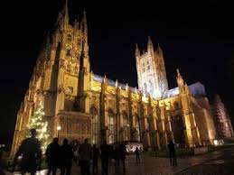
Effects cont… Church Power Weakened
Henry VIII of
England
Est. Church of England
Notes:
Another effect: Church Power weakened further because many broke away. In England, King Henry VIII wanted to divorce his wife because she did not give him a son. The Pope would not allow it, so he kicked the Catholic Church out of England & began his own Church known as the Church of England or Anglican Church

Slide 24
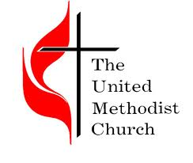
PROTESTant Sects Emerged
Notes:
as people left the Catholic Church, they formed different sects (denominations) because they disagreed with each other about certain issues such as baptism

Slide 25
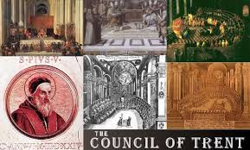
Notes:
Pope Paul III named a commission in 1545 to determine how to address problems in the Cahtolic Church. They met for 18 years and upheld many of the Church’s doctrines including:
-celibacy for clergy
-the supreme leader was the Pope
One change was that the selling of indulgences was forbidden

Slide 26
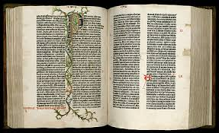
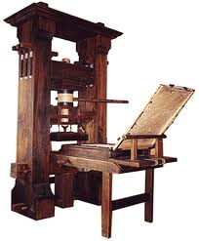
One critical note…
Notes:
What year did Gutenberg make his changes to the printing press? 1450
What happened in Europe by 1500? More books were available, increased literacy
This “reformation” & protest happened in 1517… What was different about the
response to Martin Luther as opposed to John Wycliffe & Jan Hus?
Much more widely accepted
Why was this? Greater literacy & access to information

