Slide 1
Ways of the World: A Brief Global History First Edition
Robert W. Strayer
CHAPTER XVII
Atlantic Revolutions and Their Echoes
1750–1914

Slide 2
Comparing Atlantic Revolutions
In 1989, celebration of the bicentennial of the French Revolution coincided with the Chinese government’s crackdown on demonstrators in Tiananmen Square.
1. The French Revolution was the centerpiece of a revolutionary process all around the Atlantic world between 1775 and 1875

Slide 3
Comparing Atlantic Revolutions
2. Atlantic revolutions had an impact far beyond the
Atlantic world
a. French invasions of Egypt, Poland, and Russia
b. Inspired efforts to abolish slavery, give women greater rights, and extend the franchise in many countries
c. Nationalism was shaped by revolutions
d. Principles of equality eventually gave birth to
socialism and communism

Slide 5
A. The revolutions of North America, Europe, Haiti, and Latin America influenced each other. 1. They also shared a set of common ideas 2. Grew out of the European Enlightenment a. b. Traditional ways of thinking were no longer sacrosanct
Comparing Atlantic Revolutions
Notes:
a. Notion that it is possible to engineer, and improve, political and social life b. Traditional ways of thinking were no longer sacrosanct - (regarded as too important or valuable to be interfered with)

Slide 6
3. The core political idea was “popular sovereignty” that the authority to govern comes from the people, not from God or tradition 4. Except in Haiti, the main beneficiaries of the Atlantic revolutions were middle-class white males a. b. 5. Considerable differences between the Atlantic revolutions
Comparing Atlantic Revolutions
Notes:
a. but in the long term, the revolutions gave ammunition to groups without political rights b. their goal was to extend political rights further than ever before, thus they can be called “democratic revolutions”

Slide 7
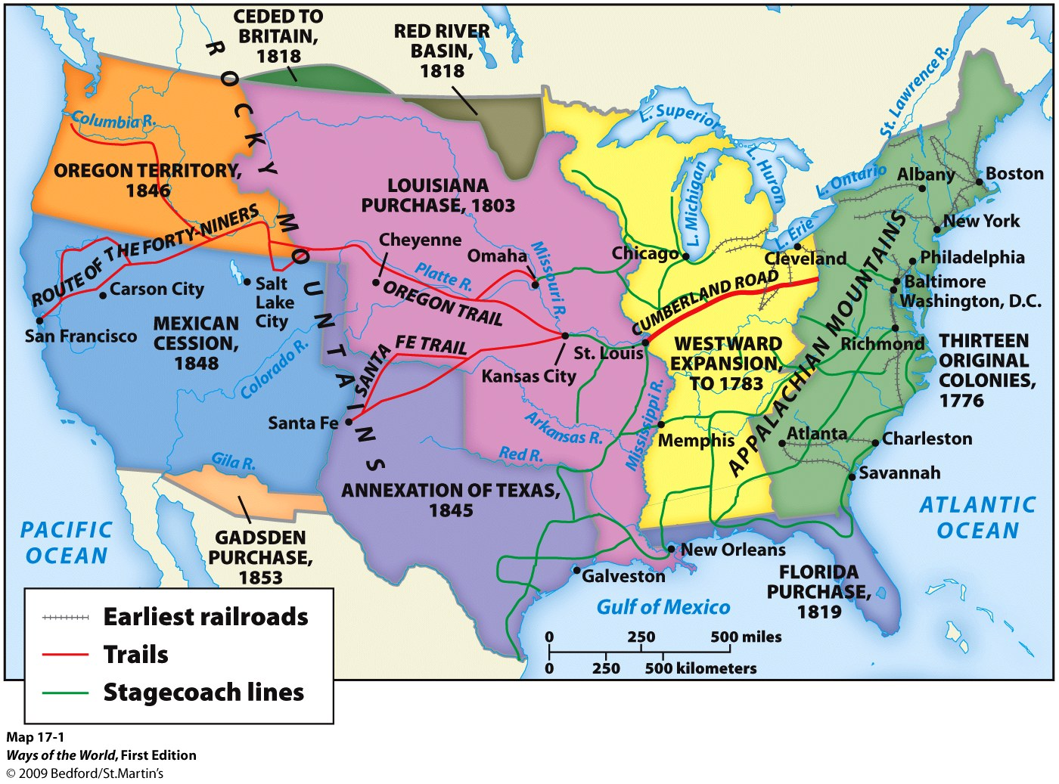

Slide 8
All of the Atlantic Revolutions
Connection
Were sparked by similar tensions within society.
b. Shared a similar broadly “democratic” political vocabulary.
c. Were accomplished with little resort to violence.
d. Resulted in the immediate institution of legal equality for everyone.

Slide 10
The North American Revolution, 1775–1787
1. Basic facts of the American Revolution are well known
2. A bigger question is what it changed
3. American Revolution was a conservative political
movement
a.
b.
c.
d.
Notes:
3. American Revolution was a conservative political movement
a. aimed to preserve colonial liberties, rather than gain new ones
b. for most of seventeenth and eighteenth centuries, the British North American colonies had much local autonomy
c. colonists regarded autonomy as their birthright
d. few thought of breaking away from Britain before 1750

Slide 11
The North American Revolution, 1775–1787
4. Colonial society
a. Was far more egalitarian than in Europe
b. In manners, they were republican well before the
revolution
Notes:
4. Colonial society
a. Was far more egalitarian than in Europe
b. In manners, they were republican well before the revolution
believing in the principle that all people are equal and deserve equal rights and opportunities

Slide 12
The North American Revolution, 1775–1787
5. Britain made a new drive to control the colonies/get more
revenue from them in the 1760s
a. Britain needed money for its global war with France
b. Imposed a number of new taxes and tariffs on the colonies
c. Colonists were not represented in the British parliament
d. Appeared to deny the colonists’ identity as true Englishmen
e. Challenged colonial economic interests
f. Attacked established traditions of local autonomy
Notes:
5. Britain made a new drive to control the colonies and get more revenue from them in the 1760s
a. Britain needed money for its global war with France
B. Imposed a number of new taxes and tariffs on the colonies
c. Colonists were not represented in the British parliament
d. Appeared to deny the colonists’ identity as true Englishmen
e. Challenged colonial economic interests
f. Attacked established traditions of local autonomy
believing in the principle that all people are equal and deserve equal rights and opportunities

Slide 13
The North American Revolution, 1775–1787
6. British North America was revolutionary for the society
that had already emerged, not for the revolution itself
a. No significant social transformation came with
independence from Britain
b. Accelerated democratic tendencies that were already
established
c. Political power remained in the hands of existing elites
Notes:
6. British North America was revolutionary for the society that had already emerged, not for the revolution itself
a. no significant social transformation came with independence from Britain
b. accelerated democratic tendencies that were already established
c. political power remained in the hands of existing elites

Slide 14
The North American Revolution, 1775–1787
7. Many Americans thought they were creating a new world order
a. Overseas supporters acclaimed the United States as “the
hope and model of the human race”
b. Declaration of the “right to revolution” inspired other
colonies around the world
c. The U.S. Constitution was one of the first lasting efforts
to put Enlightenment political ideas into practice
Notes:
7. Many Americans thought they were creating a new world order
a. overseas supporters acclaimed the United States as “the hope and model of the human race”
b. declaration of the “right to revolution” inspired other colonies around the world
c. the U.S. Constitution was one of the first lasting efforts to put Enlightenment political ideas into practice

Slide 16
The French Revolution, 1789–1815
1. Thousands of French soldiers had fought for the American
revolutionaries
2. French government was facing bankruptcy
a. Had long attempted to modernize the tax system and
make it fairer, but was opposed by the privileged classes
b. King Louis XVI called the Estates General into session
in a new effort to raise taxes
c. First two estates (clergy and nobility) were about 2
percent of population; third estate everybody else
Notes:
1. Thousands of French soldiers had fought for the American revolutionaries
2. French government was facing bankruptcy
a. had long attempted to modernize the tax system and make it fairer, but was opposed by the privileged classes
b. King Louis XVI called the Estates General into session in a new effort to raise taxes
c. First two estates (clergy and nobility) were about 2 percent of population; third estate included everybody else

Slide 17
The French Revolution, 1789–1815
3. When the Estates General convened in 1789, third
estate representatives broke loose and declared
themselves the National Assembly
a. Drew up the Declaration of the Rights of Man
and Citizen
b. Launched the French Revolution
Notes:
3. when the Estates General convened in 1789, third estate representatives broke loose and declared themselves the National Assembly
a. Drew up the Declaration of the Rights of Man and Citizen
b. launched the French Revolution
the rights of man are held to be universal: valid at all times and in every place, pertaining to human nature itself. It became the basis for a nation of free individuals protected equally by law. It is included in the preamble of the constitutions of both the Fourth French Republic (1946) and Fifth Republic (1958) and is still current. Inspired in part by the American Revolution, and also by the Enlightenment philosophers, the Declaration was a core statement of the values of the French Revolution and had a major impact on the development of freedom and democracy in Europe and worldwide.[

Slide 18
The French Revolution, 1789–1815
4. Unlike the American Revolution, the French rising was
driven by pronounced social conflicts
a. Titled nobility resisted monarchic efforts to tax them
b. Middle class resented aristocratic privileges
c. Urban poor suffered from inflation and unemployment
d. The peasants were oppressed
5. Enlightenment ideas gave people a language to articulate
grievances
Notes:
4. unlike the American Revolution, the French rising was driven by pronounced social conflicts
a. titled nobility resisted monarchic efforts to tax them
b. middle class resented aristocratic privileges
c. urban poor suffered from inflation and unemployment
d. the peasants were oppressed
5. Enlightenment ideas gave people a language to articulate grievances

Slide 19
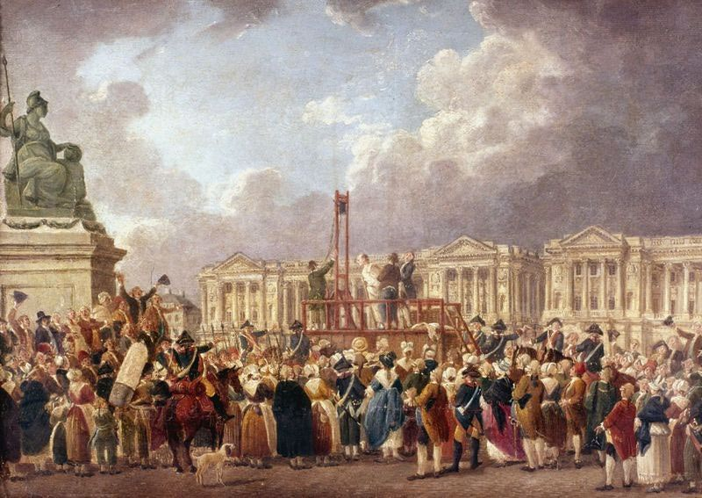
The French Revolution, 1789–1815
6. French Revolution was more
violent, far-reaching, and radical
than American Revolution
a. Ended hereditary privilege
b. Even abolished slavery
(for a time)
c. The Church was subjected to
government authority
d. king and queen were executed (1793)
e. The Terror (1793–1794) killed tens of
thousands of people regarded as enemies
of the revolution
Notes:
6. French Revolution was more violent, far-reaching, and radical than American Revolution
a. ended hereditary privilege
b. even abolished slavery (for a time)
c. the Church was subjected to government authority
d. king and queen were executed (1793)
e. the Terror (1793–1794) killed tens of thousands of people regarded as enemies of the revolution

Slide 20
The French Revolution, 1789–1815
7. Effort to create a wholly new society
a. 1792 became Year I of a new calendar
b. Briefly passed a law for universal male suffrage
c. France was divided into 83 territorial departments
d. Created a massive army (some 800,000 men) to fight
threatening neighbors
e. Spurt of nationalism, with revolutionary state at the center
f. Radicals especially pushed the idea of new beginnings
Notes:
7. effort to create a wholly new society
a. 1792 became Year I of a new calendar
b. briefly passed a law for universal male suffrage
c. France was divided into 83 territorial departments
d. created a massive army (some 800,000 men) to fight threatening neighbors
e. spurt of nationalism, with revolutionary state at the center
f. radicals especially pushed the idea of new beginnings

Slide 21
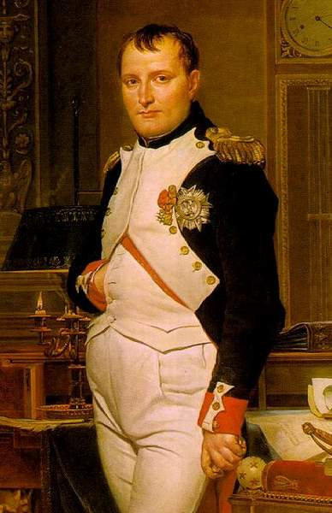
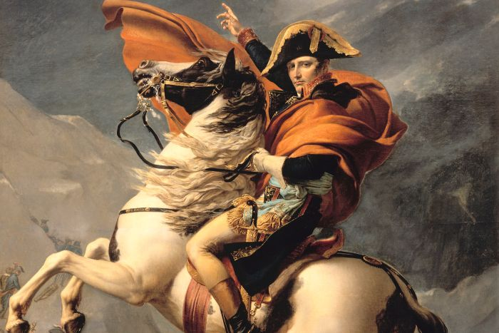
The French Revolution, 1789–1815
8. Influence of French Revolution spread through conquest
a. Napoleon Bonaparte (r. 1799–1814) seized power in 1799
Notes:
8. Influence of French Revolution spread through conquest
a. Napoleon Bonaparte (r. 1799–1814) seized power in 1799
b. preserved many moderate elements of the revolution
c. kept social equality, but got rid of liberty
d. subdued most of Europe
e. imposed revolutionary practices on conquered regions
f. resentment of French domination stimulated national consciousness throughout Europe

Slide 22
The French Revolution, 1789–1815
b. Preserved many moderate elements of the revolution
c. Kept social equality, but got rid of liberty
d. Subdued most of Europe
e. Imposed revolutionary practices on conquered regions
f. Resentment of French domination stimulated national
consciousness throughout Europe
Notes:
8. Influence of French Revolution spread through conquest
a. Napoleon Bonaparte (r. 1799–1814) seized power in 1799
b. preserved many moderate elements of the revolution
c. kept social equality, but got rid of liberty
d. subdued most of Europe
e. imposed revolutionary practices on conquered regions
f. resentment of French domination stimulated national consciousness throughout Europe

Slide 23
