Slide 1
Ways of the World: A Brief Global History First Edition
Robert W. Strayer
CHAPTER XIV
Empires and Encounters
1450–1750
Russia

Slide 2
The Steppes and Siberia: The Making of a Russian Empire

Slide 3
Chinese conquests, together with the expansion of the Russian Empire, transformed Central Asia.
Eurasia Before | After under Russian or Chinese Rule
Notes:
Handout- Student

Slide 5
Russians and Empire
A small Russian state centered on Moscow began to emerge ca. 1500
Moscow began to conquer neighboring cities
Three centuries grew into a massive empire
Early expansion into the grasslands to south and east was for security against nomads
Expansion into Siberia was a matter of opportunity (furs) not threat

Slide 6
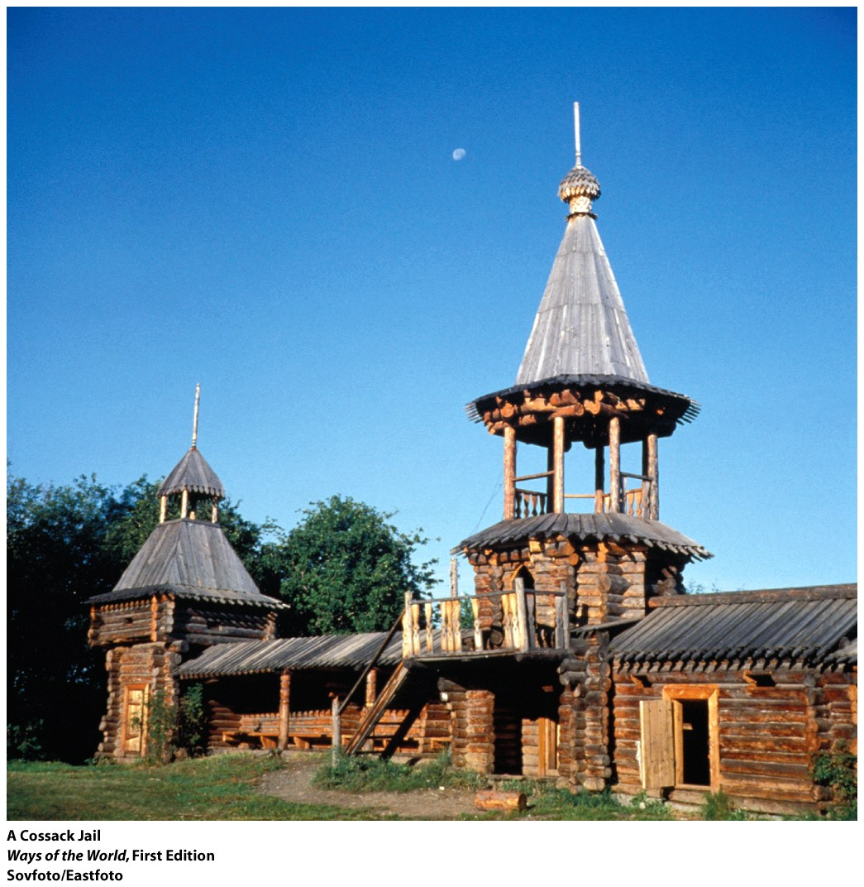
Cossacks were bands of fiercely independent warriors consisting of peasants who had escaped serfdom as well as criminals and other adventurers. They helped to expand Russia into Siberia.

Slide 7
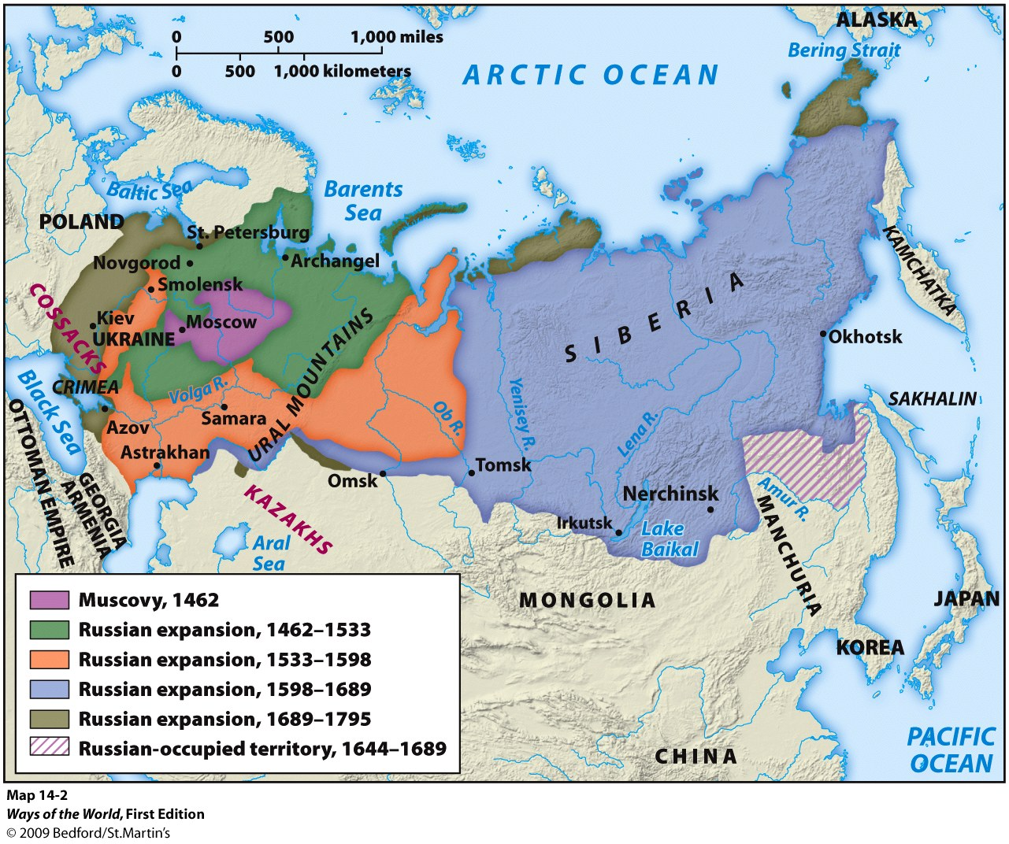
Experiencing the Russian Empire
Conquered people had to take an oath of loyalty to the Russian ruler.
Notes:
payment of tribute
intermittent pressure to convert to Christianity
devastating epidemics killed large populations
the influx of Russian settlers
loss of hunting grounds and pasturelands (for the nomads) to Russian agricultural settlers, which disrupted the local economy and left local populations dependent on Russian markets

Slide 8
Russians and Empire
With imperial expansion, Russians became a smaller proportion of the overall population.
Russian Identity
Colonization experience was different from Americas
Notes:
Rich agriculture lands, furs, and minerals helped make Russia a great power by the eighteen century.
Became an Asian power as well
Russian Identity
Expansion made Russia a very military state
Reinforced autocracy
Colonization experience was different from Americas
Conquest of territories with which Russia had long interacted
Conquest took place at the same time as development of Russian State
The Russian empire remained intact until 1991.

